Slide 1
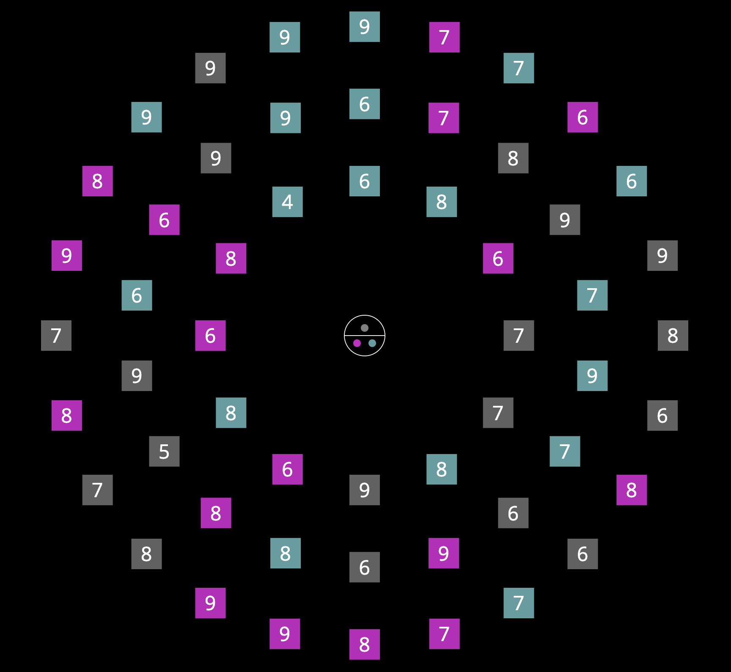
In this experiment, you will be searching for a target square.
TWO targets will appear on every trial, both having a digit between 2 and 5 on them.
Press SPACE to continue

Slide 2
In this experiment, you will be searching for a target square.
TWO targets will appear on every trial, both having a digit between 2 and 5 on them.
Potential targets:
2
3
4
5
2
3
4
5
2
3
4
5
Press SPACE to continue

Slide 3
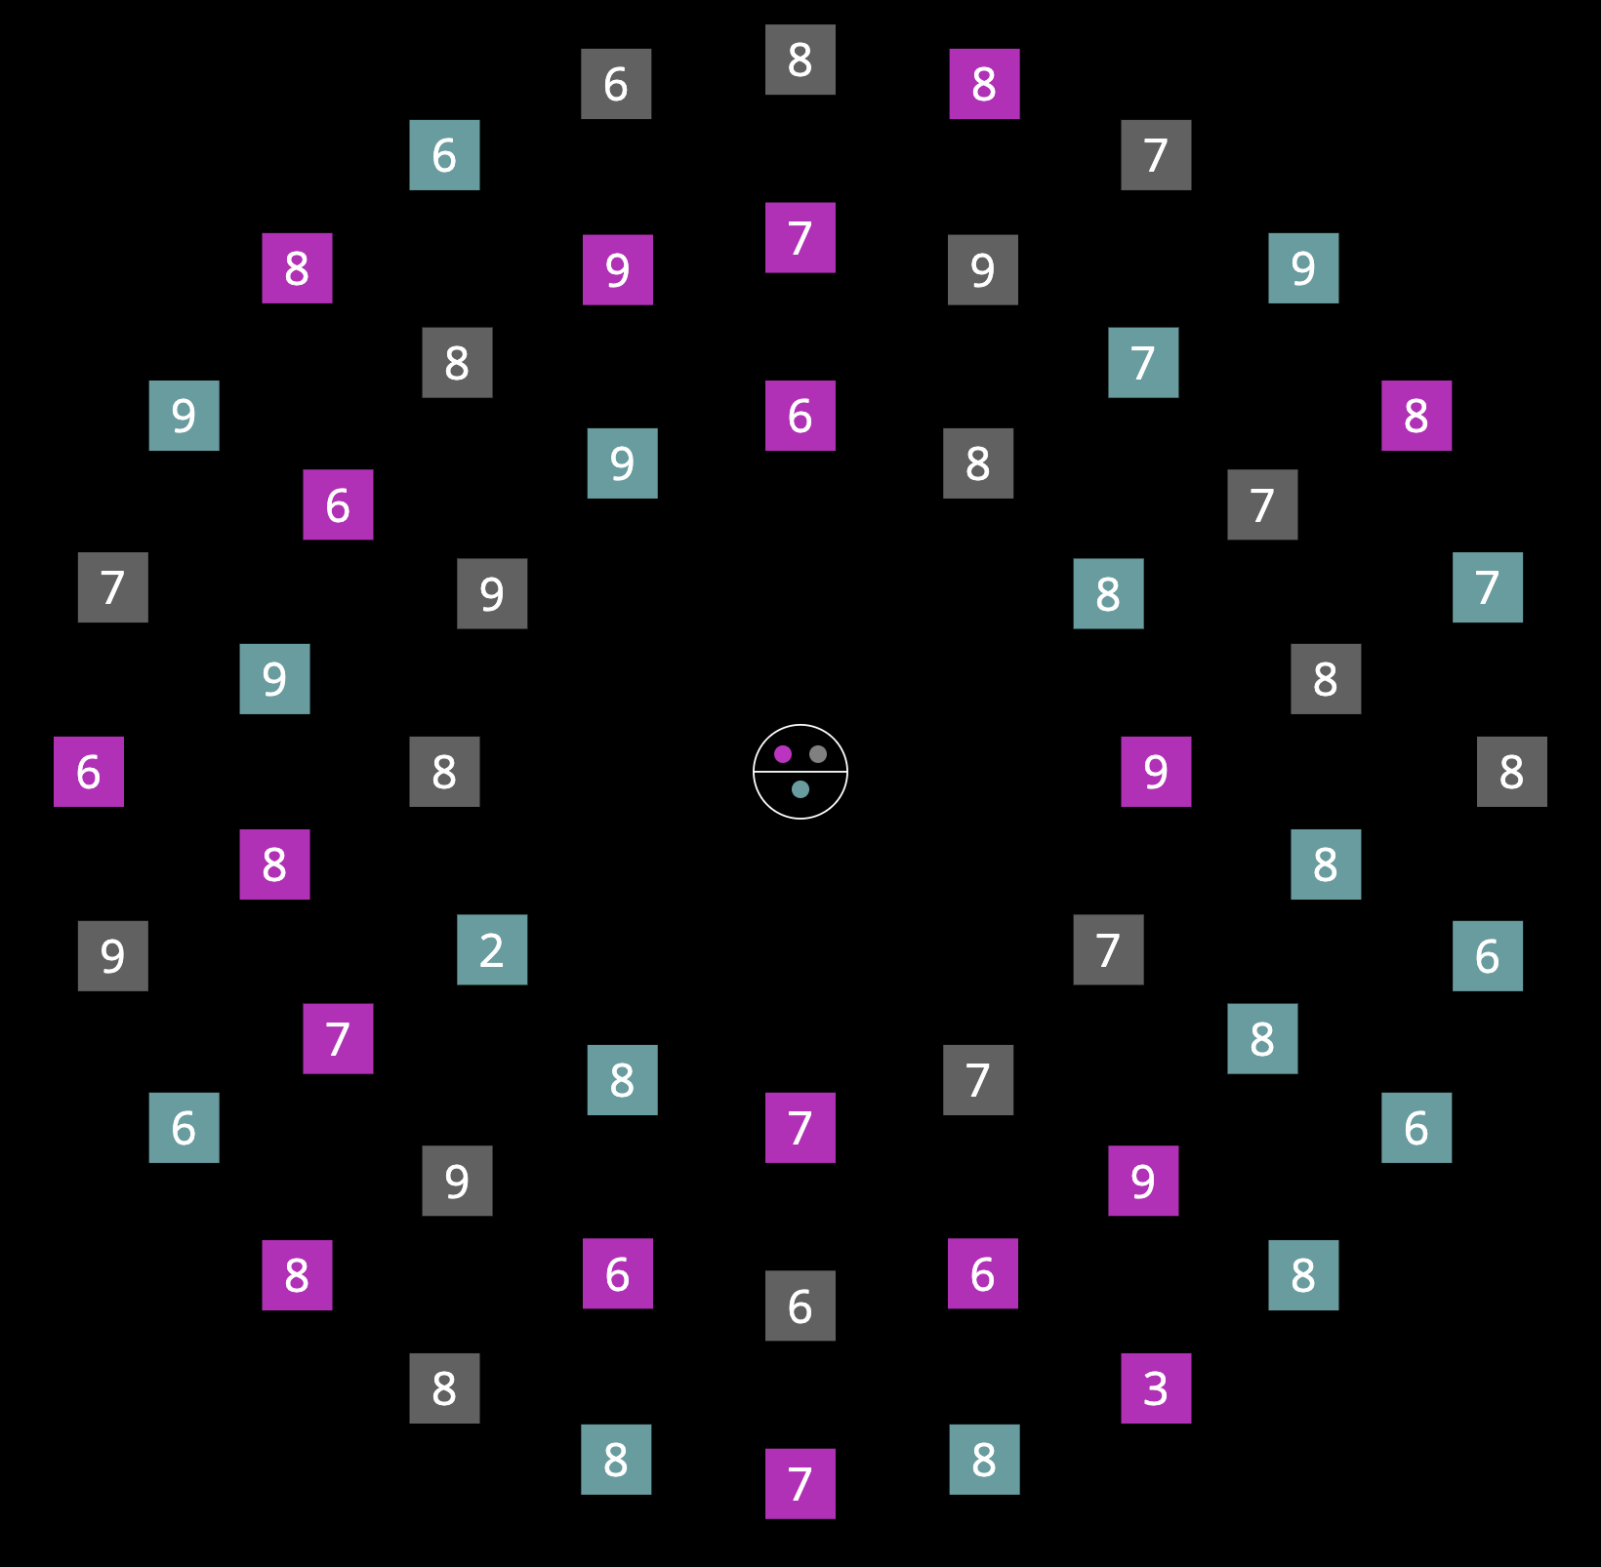
You will also see a cue at the center of the display.
Press SPACE to continue

Slide 4
You will also see a cue at the center of the display.
The cue will tell you some information about the colors of both targets.
Press SPACE to continue

Slide 5

You will also see a cue at the center of the display.
The cue will tell you some information about the colors of both targets.
For example this cue
tells you that ONE of the targets will be ,
and the other ONE will be either or .
Press SPACE to continue

Slide 6
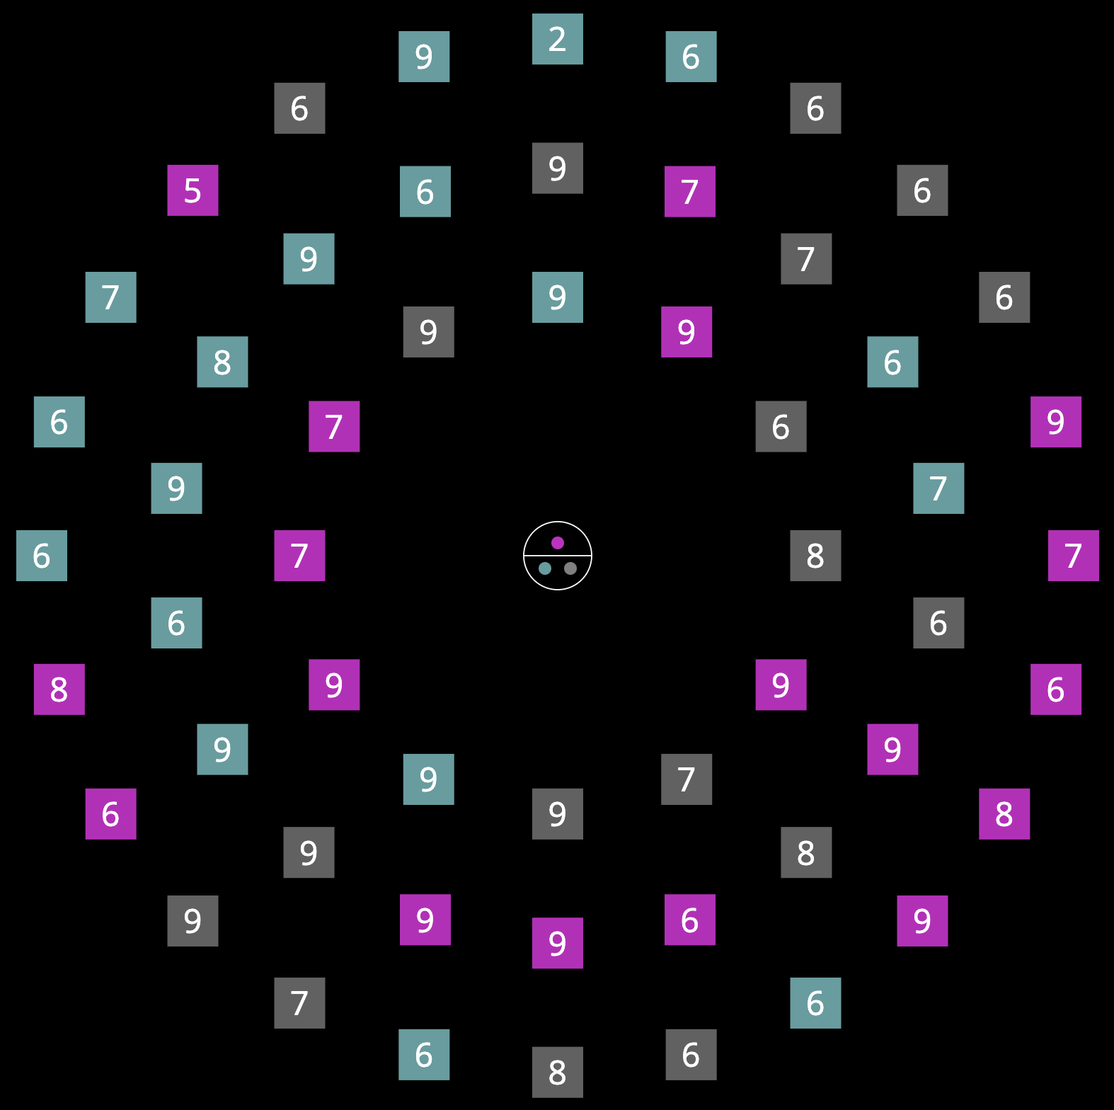
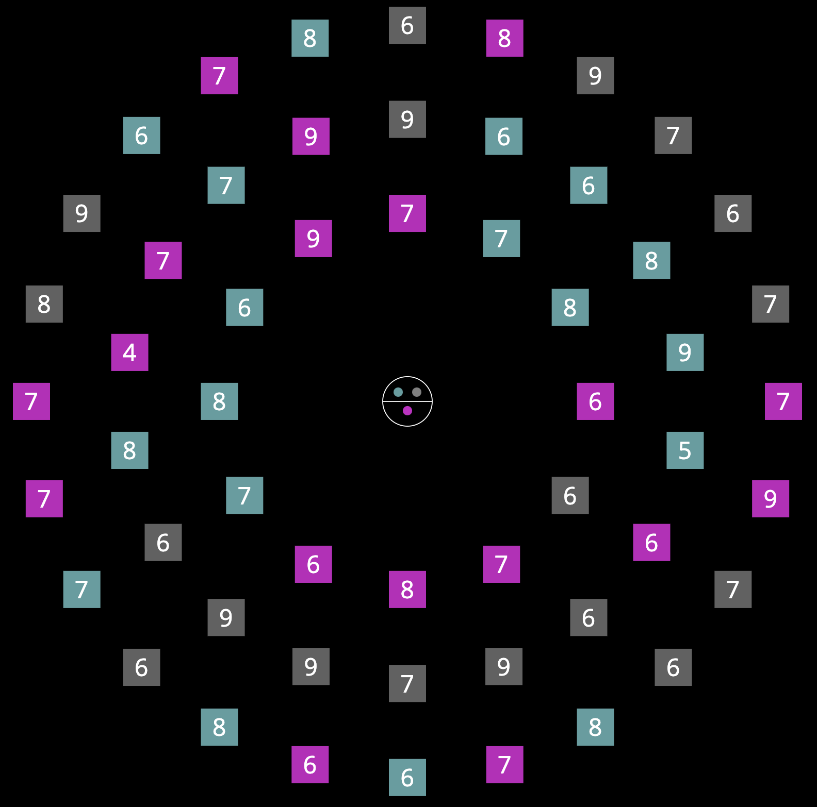
You might see different cues in the experiment. The following are examples of these cues.
All of them will correctly target color information.
Press SPACE to continue

Slide 7
There will ALWAYS be two targets, in different colors.
Press SPACE to continue

Slide 8
There will ALWAYS be two targets, in different colors.
However, you may choose to search for whichever target you like on each trial. Either one will ALWAYS be correct.
Press SPACE to continue

Slide 9
When you find the target you choose to search for, please press the key that corresponds to the number on that target:
2: press V
3: press B
4: press N
5: press M
You can use either one hand or two hands to respond, as long as you use a DIFFERENT finger on each key.
V
B
Press SPACE to continue

Slide 10
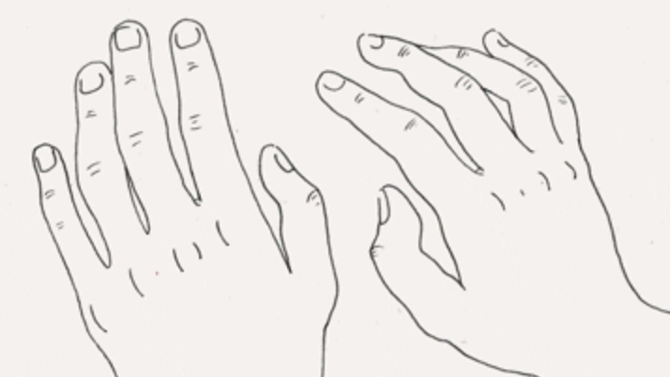
When you find the target you choose to search for, please press the key that corresponds to the number on that target:
2: press V
3: press B
4: press N
5: press M
You can use either one hand or two hands to respond, as long as you use a DIFFERENT finger on each key.
B
N
M
V
B
N
M
V
V
B
M
N
Press SPACE to continue

Slide 11
Please try to respond as accurately as you can!
If you make a mistake, you will hear a ‘beep’.
First we will start with some practice trials.
Press SPACE to begin

