Slide 1
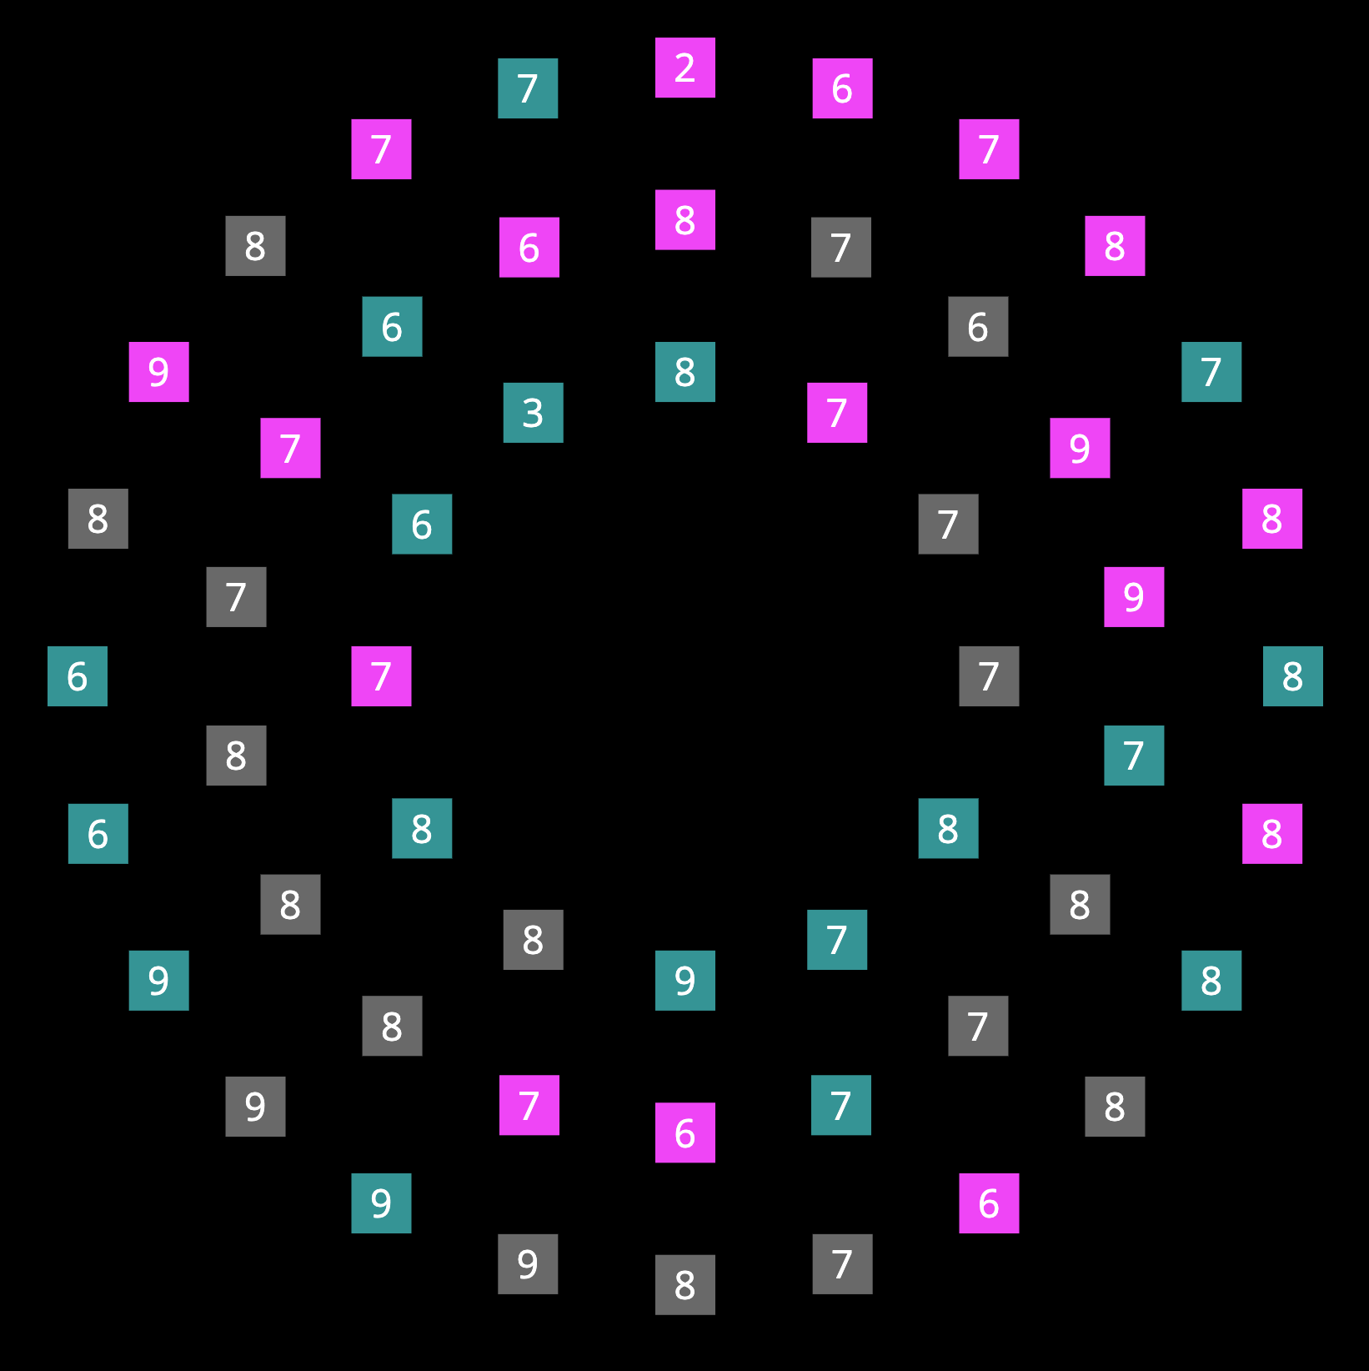
In this experiment, you will be searching for a target square.
TWO targets will appear on every trial, both having a digit between 2 and 5 on them.
Press SPACE to continue

Slide 2
In this experiment, you will be searching for a target square.
TWO targets will appear on every trial, both having a digit between 2 and 5 on them.
In other words, potential targets are 2, 3, 4, 5.
Press SPACE to continue

Slide 3

Before each display appears, you will also see a cue at the center of the screen.
This cue separates the squares into two groups, based on their colors.
Press SPACE to continue

Slide 4
For example the cue
tells you that one group of squares are colored and , while the other groups of squares are colored .
Exactly ONE target will be in each group.
Press SPACE to continue

Slide 5
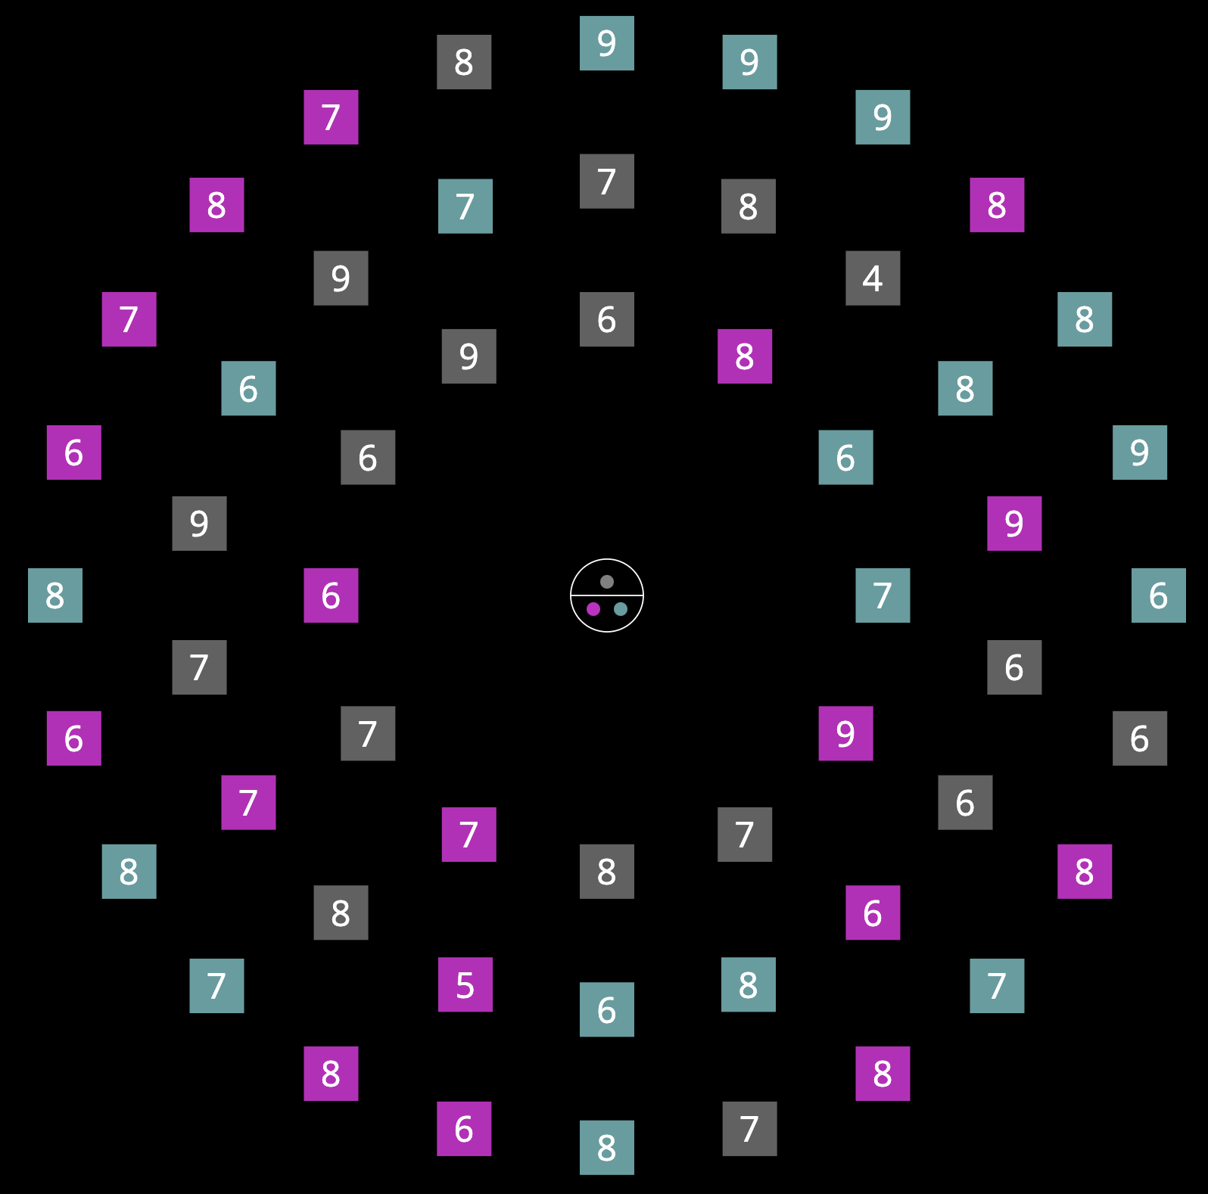
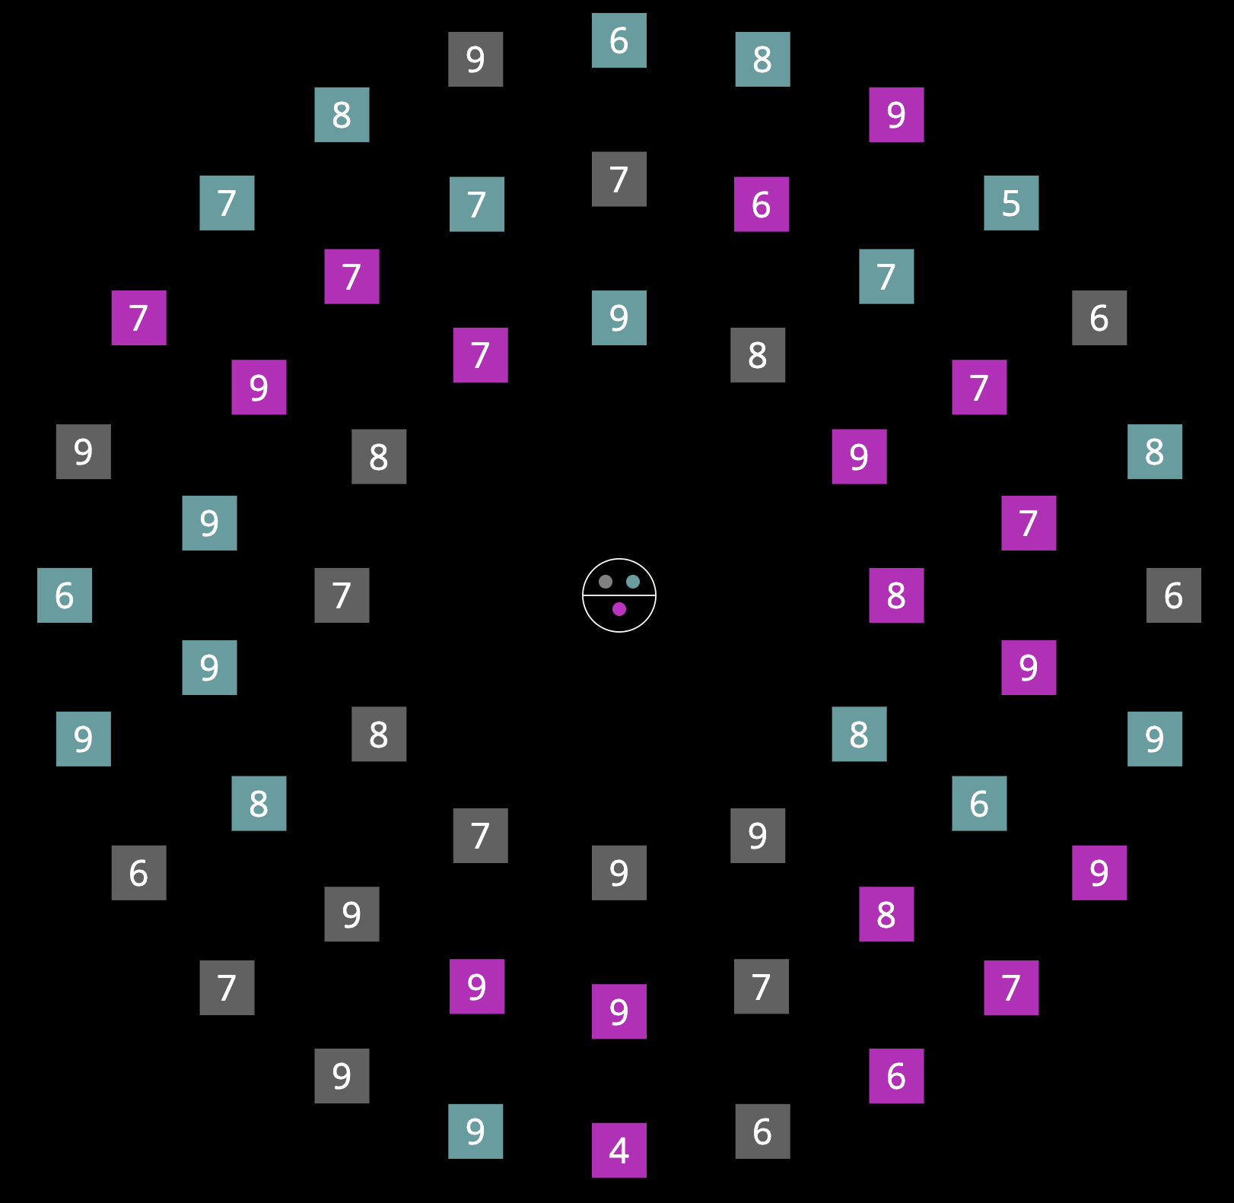


You might see different cues in the experiment. The following are examples of these cues.
All of them tells you the color information of the two groups.
Press SPACE to continue

Slide 6
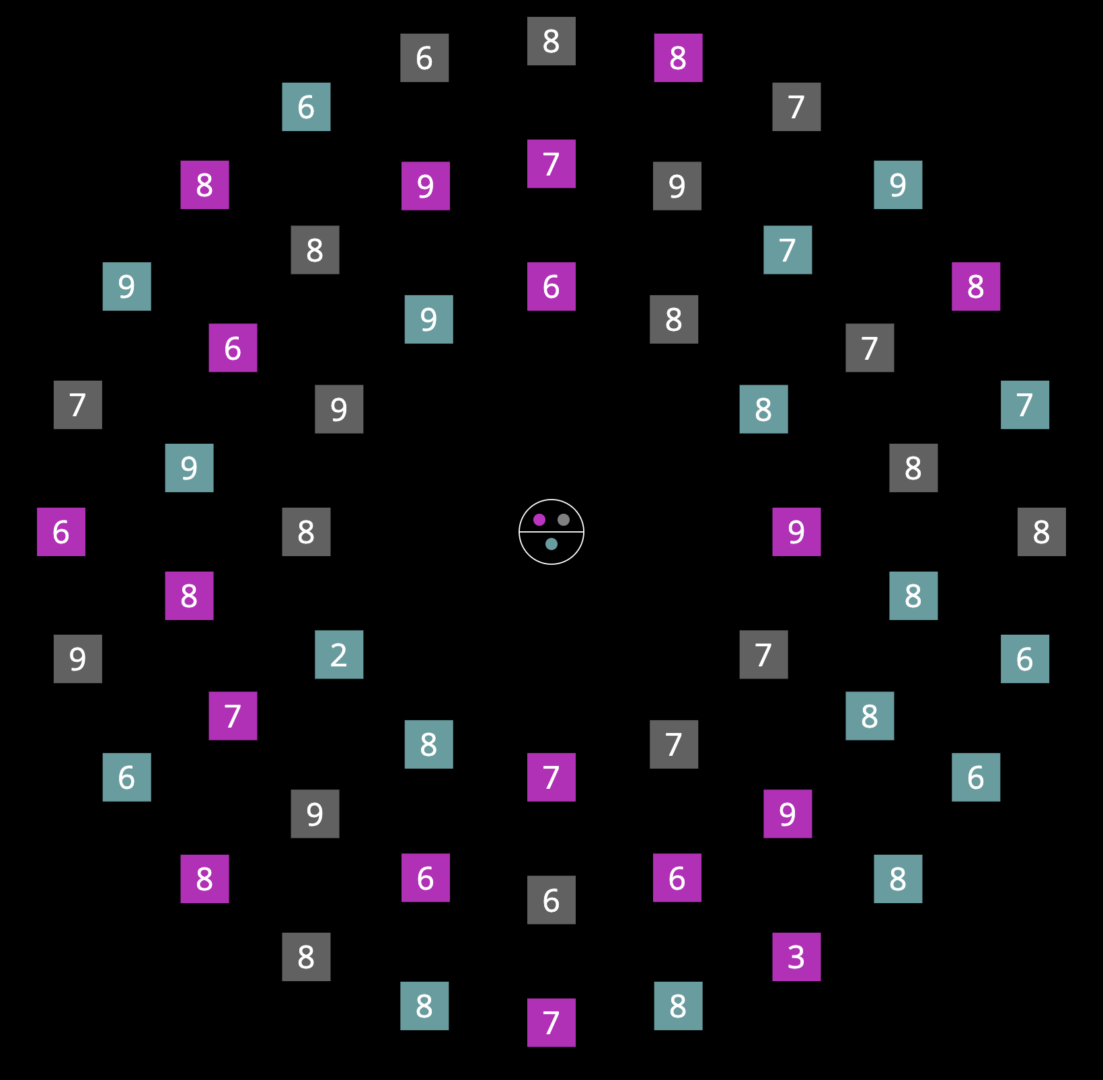
There will ALWAYS be two targets, one in each group.
Press SPACE to continue

Slide 7
There will ALWAYS be two targets, one in each group.
However, you may choose to search for whichever target you like on each trial. Either one will ALWAYS be correct.
Press SPACE to continue

Slide 8
When you find the target you choose to search for, please press the key that corresponds to the number on that target:
2: press V
3: press B
4: press N
5: press M
You can use either one hand or two hands to respond, as long as you use a DIFFERENT finger on each key.
V
B
Press SPACE to continue

Slide 9
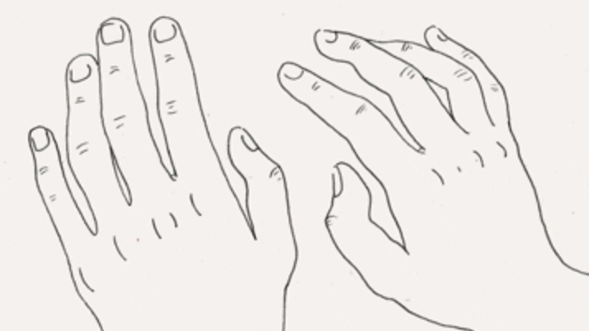
When you find the target you choose to search for, please press the key that corresponds to the number on that target:
2: press V
3: press B
4: press N
5: press M
You can use either one hand or two hands to respond, as long as you use a DIFFERENT finger on each key.
B
N
M
V
B
N
M
V
V
B
M
N
Press SPACE to continue

Slide 10
Please try to respond as accurately as you can!
If you make a mistake, you will hear a ‘beep’.
First we will start with some practice trials.
Press SPACE to begin

