Slide 1
Branching Strategies

Slide 2
Version Control - Branching
A way to write code without affecting the rest of your team
Merge branches to integrate your changes

Slide 3
Why use branching?
So you can push unstable code
Work independently

Slide 4
Without Branching
All team member push to master
If there are many developers with different tasks on the same codebase?
Someone pushes code with errors
Code breaks, why?- can be time consuming
Who broke it?- can be time consuming
Everyone’s workflow halts and the search begins

Slide 5
Branching
New commits are only added to the current branch
Can implement experimental code without affecting others
When the life of the branch is over
Merge it into the primary codebase

Slide 6
Merging
Once the changes are complete and stable
Merge the branch back to the codebase
Typically:
Initiate a pull request
Performs code reviews
Merge the code
Conflict resolution can be time consuming
Helps to coordinate with your team and limit editing the same files

Slide 7
Branching in git
git checkout –b <newBranchName>
Creates branch off of current branch
Equivalent to:
git branch <newBranchName>
git checkout <newBranchName>

Slide 8
A Branching Model
A suggested method for branching

Slide 9
Master and Develop
The two primary branches
Master is the default branch in git
Use for stable releases
Create develop branch
Use for untested code
Primary working branch for the team
Contains the latest features

Slide 10
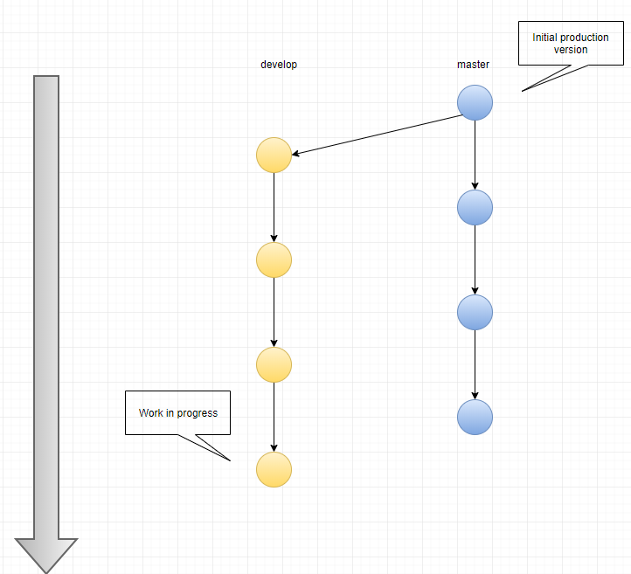

Slide 11
Develop
Master
Initial Production
Time
Work in progress

Slide 12
Feature Branch
Branch off of develop
Primary working branches for an individual(s)
When new feature is finished
Merge into develop
Code reviews
Hope it doesn’t break develop (it might)
Temporary branches
Can be many feature branches being developed in parallel
If the feature is a failure
Delete the branch without merging into develop

Slide 13
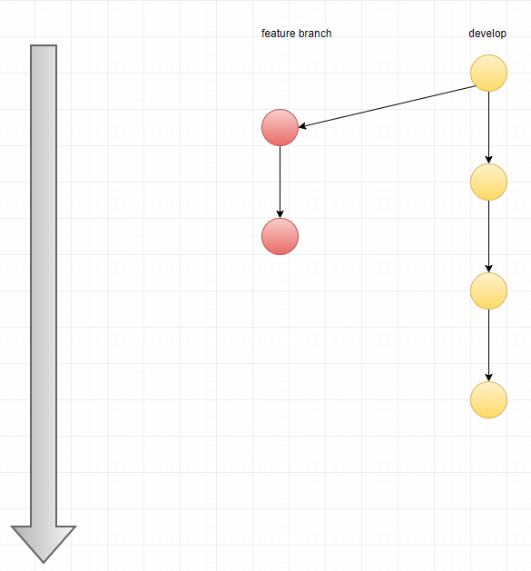

Slide 14
Feature
Feature
Develop
Time

Slide 15
Merging
To retain branch information
git merge --no-ff
no fast-forward
With fast-forward
Existence of the branch is lost
Without meaningfully tagging commit messages
looking through history is confusing
Especially with many features developed in parallel

Slide 16
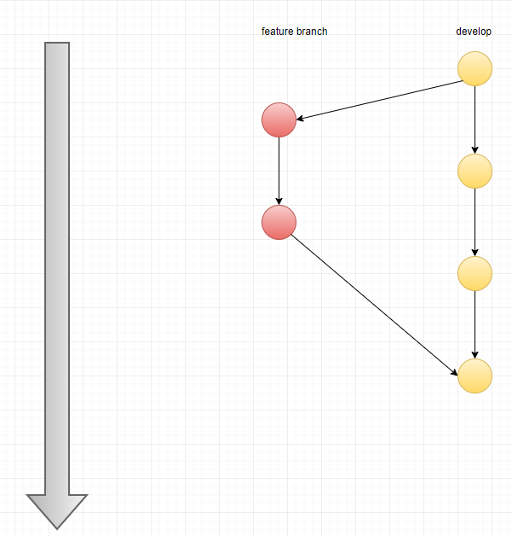

Slide 17
Feature
Feature
Develop
Time
25-Oct-18
AXP Internal
14

Slide 18
Hotfixes
Production release contains a bug
Create a hotfix branch from master
Fix the bug
merge fix into:
Next production release
Develop

Slide 19
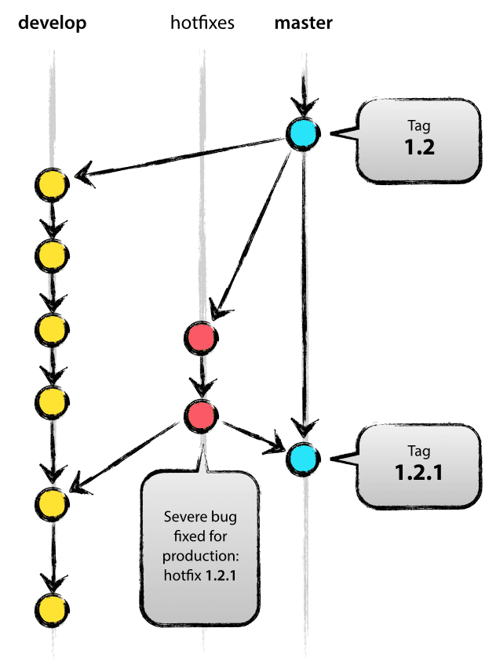

Slide 20
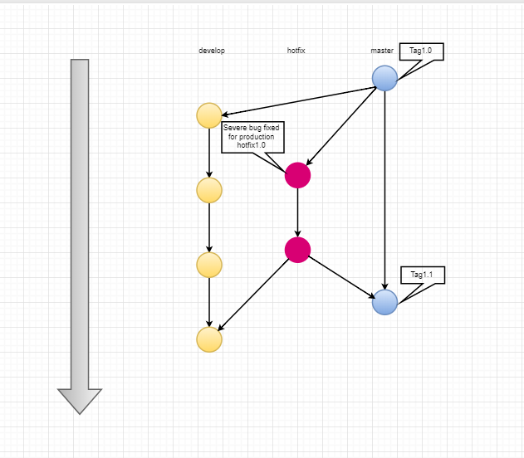

Slide 21
Release Branch
Branch off develop when approaching a release
No features added
Extensive testing and bug fixes
Merge all changes back to develop
When confidently stable
Merge into master as a release

Slide 22
Versioning
Tag the current state of the code
Can easily work with a previous version if needed
Use versioning on master

Slide 23


