Slide 1

Steam Data
Group N
Chen Tianhao
Li Yufei
Xia Liang
Notes:
Hello, everyone. We are group N. And today we will share our project about steam, a famous game platform with various games.

Slide 2





Have you ever heard these games ?
Notes:
Have you ever heard these games ? Such as PUBG, CSGO, DOTA ….
Today, we will tell you sth about games on steam.

Slide 3
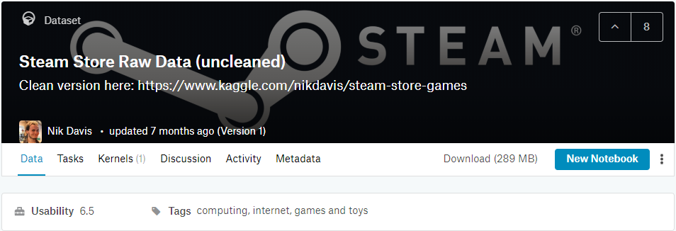
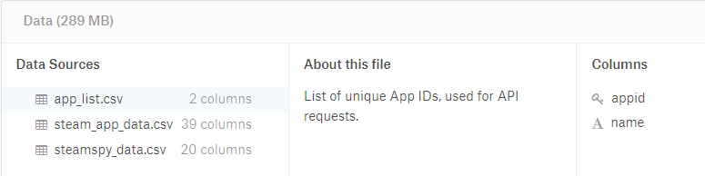
Data Source & Introduction
Kaggle
Steam and SteamSpy APIs
Three files, 289MB, 59 columns
Most data from 2006.01 to 2019.07
Notes:
In this project, we analyze game data on steam platform which is crawled by Davis and published on Kaggle.
And there are 3 files with 59 (fifty nine) columns and 289MB (two hundred and eighty nine mega byte) in total.
Most of game data is from 2006(two thousands six) to 2019 (two thousands nineteen).

Slide 4
Our Work
Know about data
Cleaning Data
Delete irrelevant columns
Extract key information from crawl results
Further Process Data
Convert the data type
Rename columns
Analyze and Visualize Data
Seaborn, WordCloud
Notes:
It’s a raw data set, so our work focus on Cleaning and Further Processing the data.
And we also do some Analysis and Visualization.
Now I will introduce our work in detail.

Slide 5
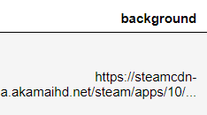
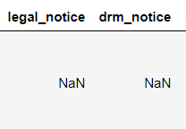
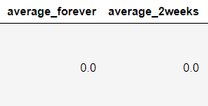
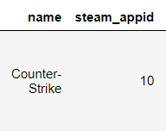
Cleaning Data
Delete columns with URLs, lots of Nan and unclear text
Merge three files
Notes:
First, we simply clean the data. After discussing whether a content to keep or drop.
We delete the columns with ……
Merge files by name and steam_id, and delete columns with same information

Slide 6
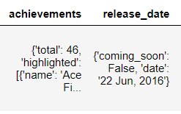
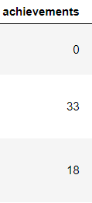
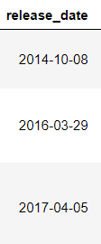
Further Processing
Extract key information from text
Notes:
We spent a lot of time in processing the data. It’s a not difficult but really complicated task.
Sometimes when we do the analysis, we find sth wrong and have to go back and re-processing.
Here are some examples. The left and right part are not one-to-one correspondent, I just want to show you how data looks like.
We only get total number of Achievement and don’t care about the details.
We care about release date and convert it to timestamp in pandas.

Slide 7

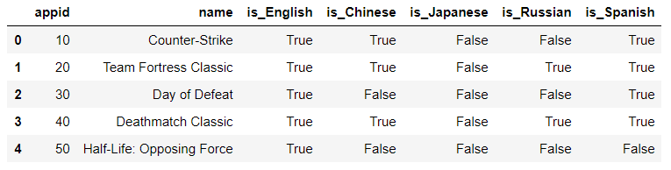
Further Processing
Generate new sub-tables and then merge with the main table
Notes:
You can see lots of text in left
And we transform them into True / False table

Slide 8
Further Processing
Convert data types
Delete unreasonable values
Fill Nan values
Rename and resort columns
Notes:
Convert data types, such as transform to int, float.

Slide 9

Analysis and Visualization

Slide 10
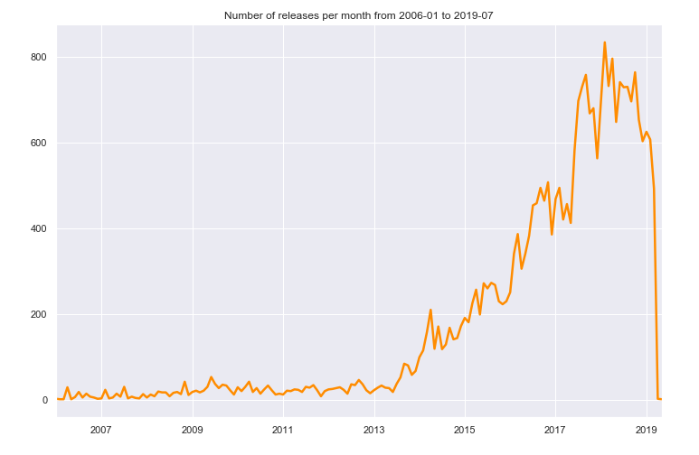
• Annual development of Steam
Notes:
This figure shows the total release game in time series.
We can see the development of steam.
Few games are released before 2013 (two thousand thirteen) and The number of games has exploded after two thousand seventeen
Because our data is to July, 2019, (two thousand nineteen) so you could see the Falling part.

Slide 11
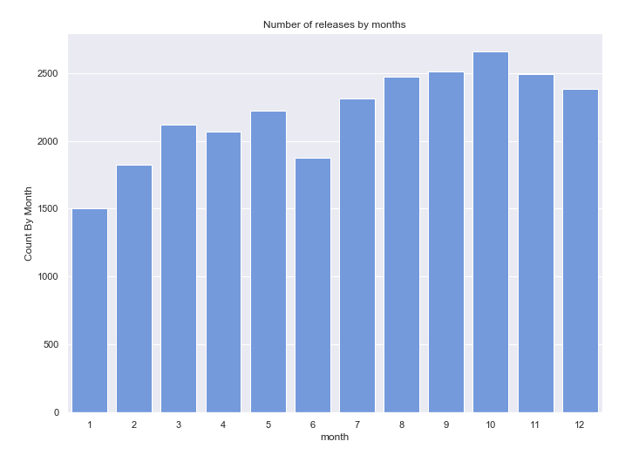
Games released in Months
Notes:
We are also interested in which month do the publishers most like to release the game.
And we can see from the figure probably the October is the “most popular” time.

Slide 12
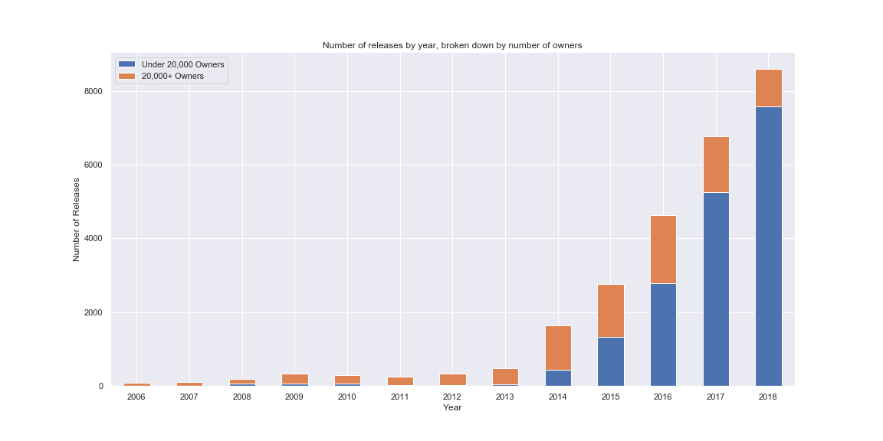
Number of popular games over the years
Notes:
Next one is ….
orange part is the number of games with above twenty thousands owners.
Maybe old games are always enduring

Slide 13
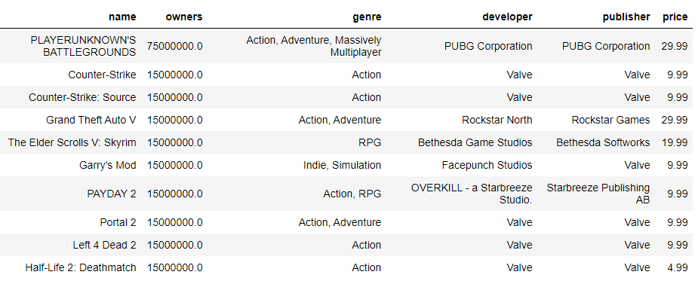
• Top 10 popular paid games

Slide 14
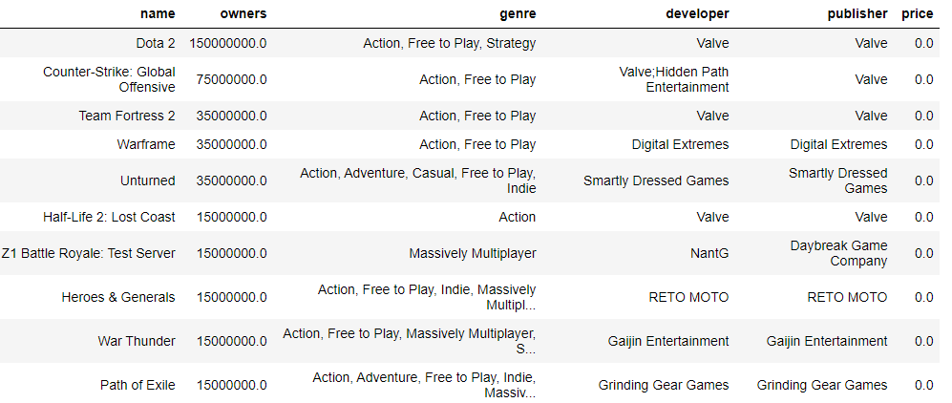
• Top 10 popular free games
Notes:
They are in top list

Slide 15
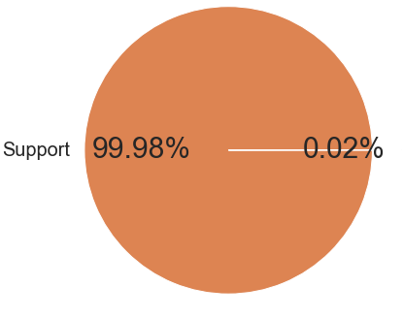
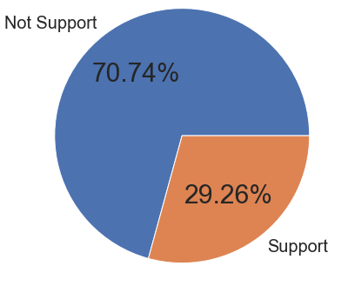
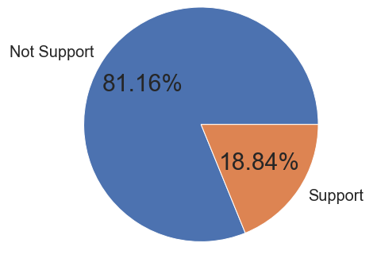



Percentage of Supporting System
Notes:
Most support,
Nearly thirty percent games support Mac
Twenty percent games support Linux

Slide 16
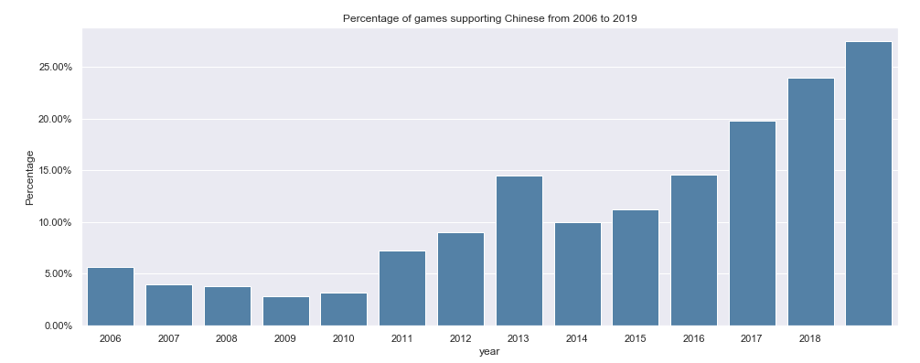
• Percentage of Chinese supporting
Notes:
We also investigated the proportion of games supporting Chinese.
Gradually rising, and finally close to a quarter

Slide 17
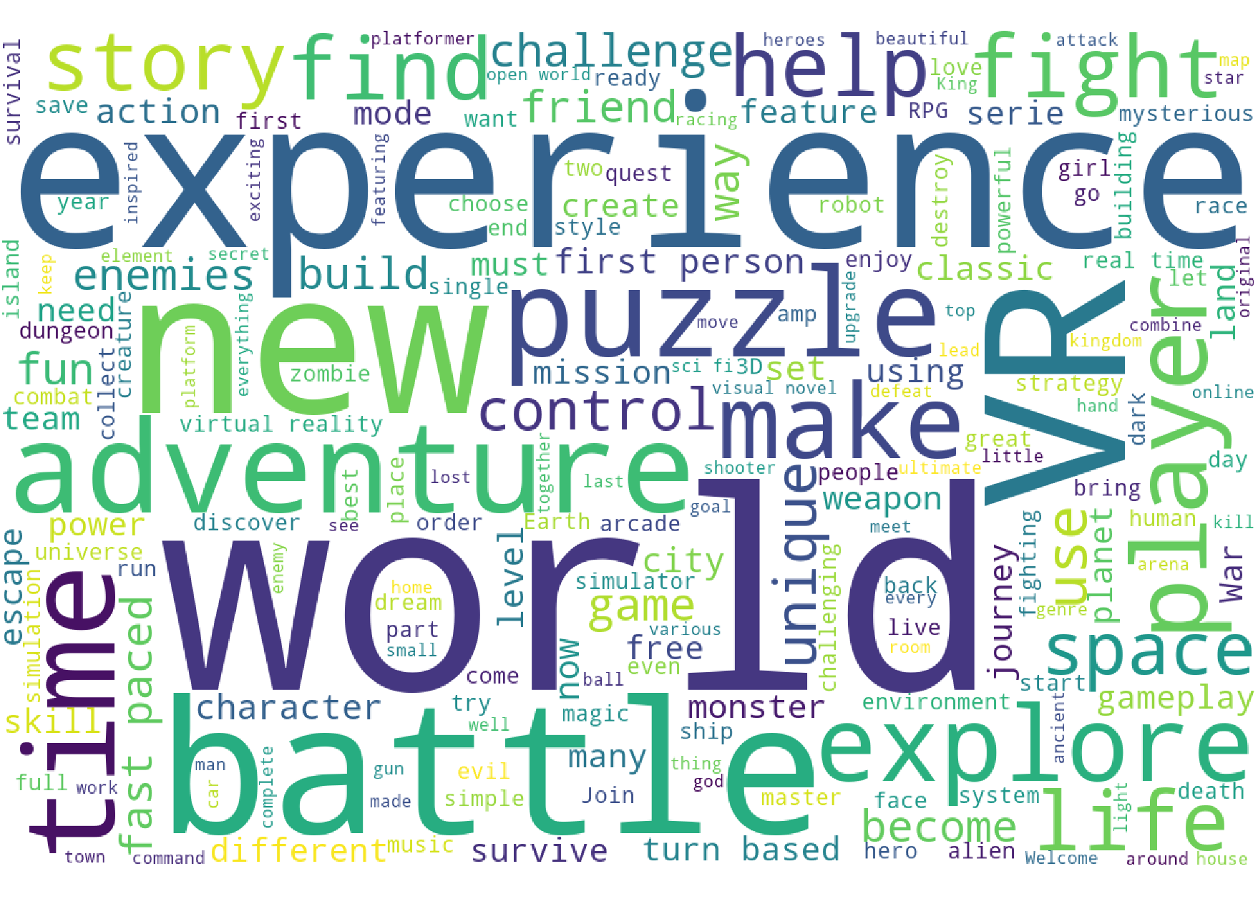
• Word Cloud about Popular Games
Notes:
At last is the world cloud about the most usual comment the players give to the popular games.
The description such as

Slide 18
Summary
Data cleaning
Data processing
Data analysis
Optimize the program
Notes:
In a summary, we did data cleaning, processing, analyzing using Pandas, Seaborn and Word Cloud library
We also do some optimization such as
Replace the for loop with more efficient function.
Time reason, we won’t go to details

Slide 19

Thanks
Group N
Chen Tianhao
Li Yufei
Xia Liang

