Slide 1
AI@T-mobile
Team Weeb Presents
the churn Preventer（仮）

Slide 2
Motivation
Churn rate is a critical metric for companies whose customers pay on a recurring basis.
This metric is especially important for T-Mobile, which pays exceptional attention to customer experience
By predicting potential churning customers, T-Mobile would be able to look into those individuals closely and see what can be done to retain them.
Potential Churn → Proper Reaction → High Retention = Low Churn
→ Service++, Satisfaction++!

Slide 3
Dataset
The Telco Customer Churn dataset is obtained from Kaggle, an online community of data scientists and machine learners under Google. [1]
The raw data contains 7043 rows, each of which represents a customer, and 21 columns that specify the features of each customer including the target feature “Churn.”
Excluding the target feature and customer ID, the remaining 19 features are all relevant for the study of customer retention programs.
Those features are rather generic but they still provide a feasible approach for T-Mobile to conduct the similar program with substitution of its own data.

Slide 4
Model Selection
Decision Tree
/To do
Support Vector Machine
/To do
Neural Network
High training time, low query time.
/To do

Slide 5
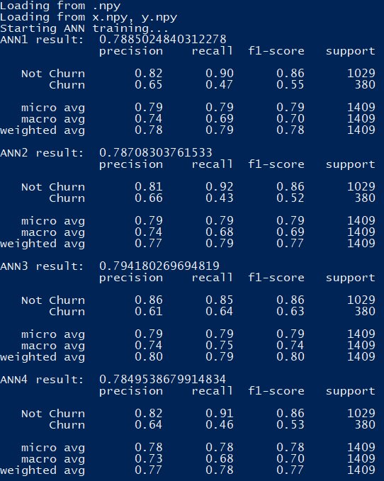
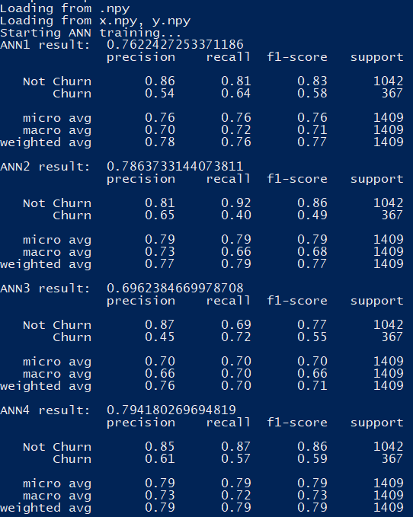
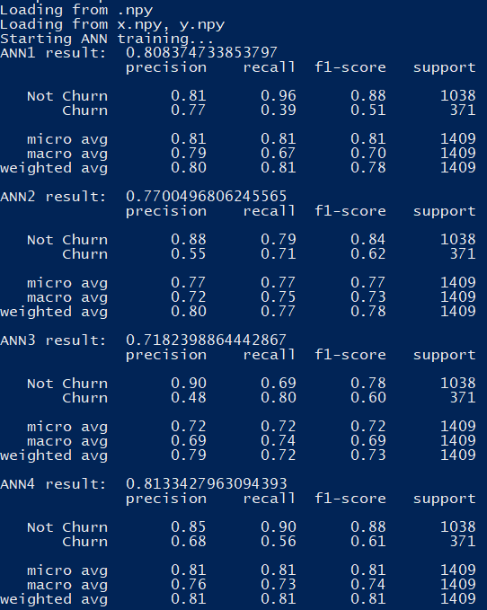
Measuring Metric: Accuracy? Recall.

Slide 6
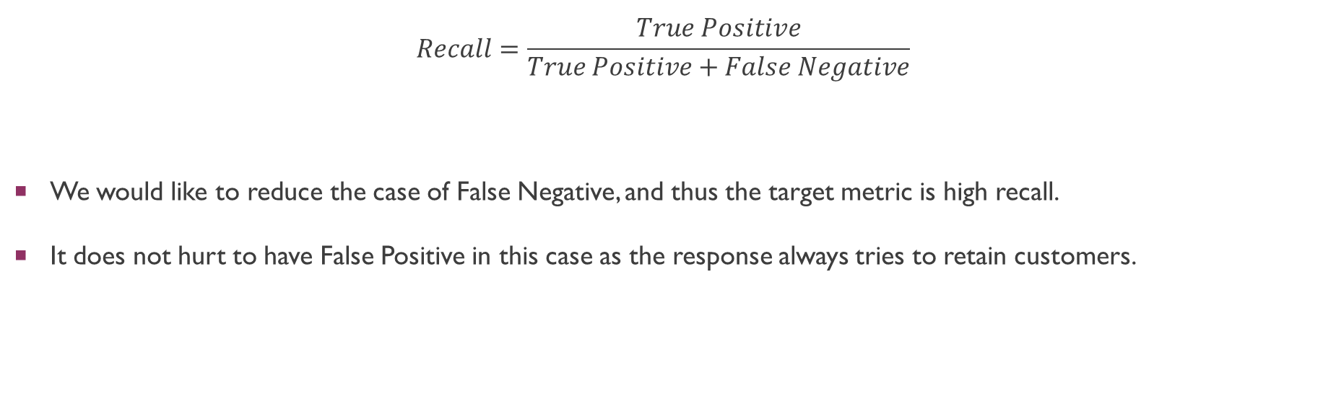
Out of all metrics, Why Recall?
$$Recall=\frac{True Positive}{True Positive+False Negative}$$
We would like to reduce the case of False Negative, and thus the target metric is high recall.
It does not hurt to have False Positive in this case as the response always tries to retain customers.

Slide 7
Demo
/To do

Slide 8
Future Development
Once feedback is obtained for new data, we can do boosting on the current model periodically to maintain/improve its accuracy.
Little worry about overfitting as old generations still serve certain weights in the new model

Slide 9
Reference
[1] Telco Customer Churn – [https://www.kaggle.com/blastchar/telco-customer-churn]

