Slide 1

BANKING BUSINESS CASE
Presented by,
Ria Liz Luke
rializluke@gmail.com
MISSION
CHRIST is a nurturing ground for an individual’s holistic development to make effective contribution to the society in a dynamic environment
VISION
Excellence and Service
CORE VALUES
Faith in God | Moral Uprightness
Love of Fellow Beings
Social Responsibility | Pursuit of Excellence

Slide 2
Agenda
Business Understanding
Project Plan
Data Understanding
Data Preprocessing
Data Analysis and Visualization
Modeling
Evaluation
Model Improvement Strategies
Conclusion

Slide 3
I. Business Understanding
Business Objectives:
To analyze customer base and Marketing campaign data.
To understand which customers are most likely to take a fixed deposit
Available Resources:
Dataset containing Customer Demographics and Dataset containing Transaction Details stored in separate Excel Sheets.
A defined set of questions to be answered using Data Analysis.
The data available is labelled, enabling use of supervised learning models.
Excellence anService

Slide 4
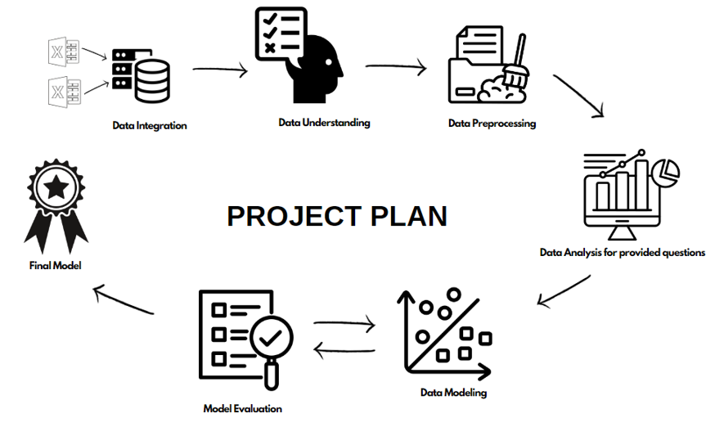
Excellence nd Service

Slide 5
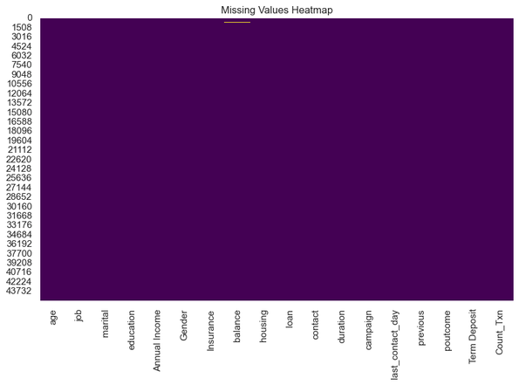
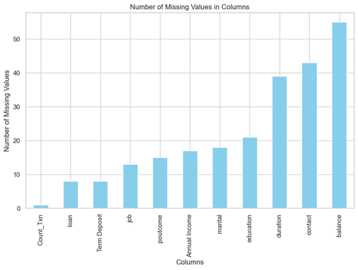
II. Data Understanding
The final merged data contains 45211 records across 18 variables.
There are 8 numerical columns and 10 categorical columns in the data.
The number of missing values when compared to the whole dataset is negligible.
Excellence and Service

Slide 6
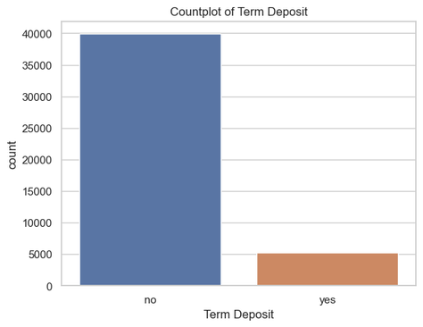
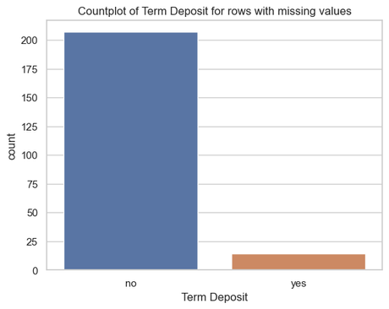
III. Data Preprocessing
1. Handling missing values
Dropping all the rows with missing values will lead to loss of rows where Term Deposit belongs to minority class.
This cannot happen since the data is already imbalanced, so dropping the missing values will not be the best way of handling null values.
Excellence and Service

Slide 7
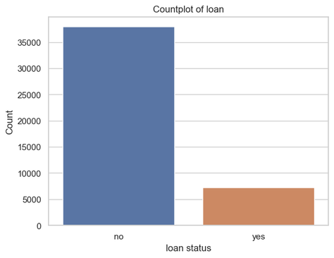
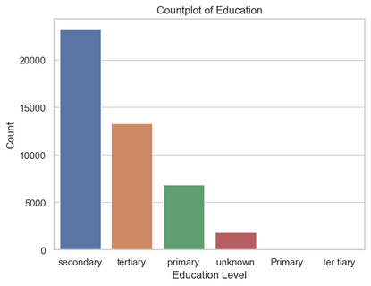
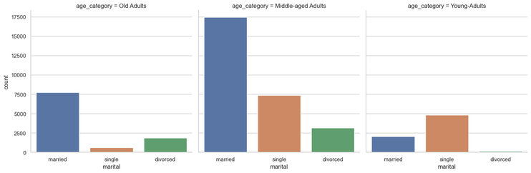
Categorical Columns
The data entry errors/ formatting errors in the columns are replaced with null values.
Since 'unknown' is a category for a few columns, null values are replaced as 'unknown' in those columns.
For marital status, null values is replaced using mode of marital within each age category.
Age Categories were created from Age and the mode in each category was used to impute the missing values.
Excellence nd Service

Slide 8
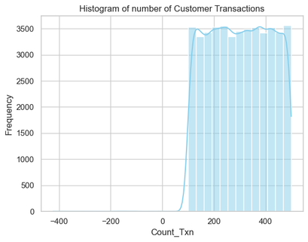
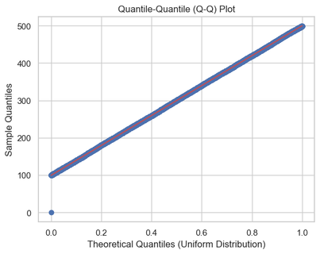
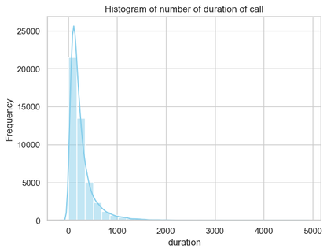
Numerical Columns
Nulls in variables that shows almost uniform distribution are replaced with mean.
Median is less sensitive to extreme values, so median imputation is performed for skewed distributions.
Excellence and Service

Slide 9
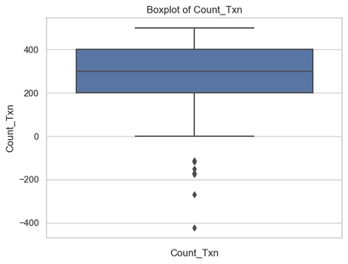
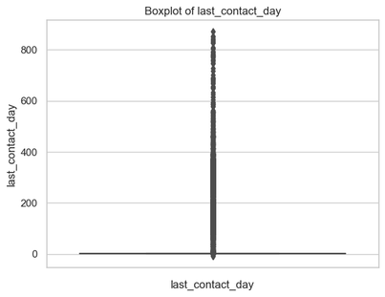
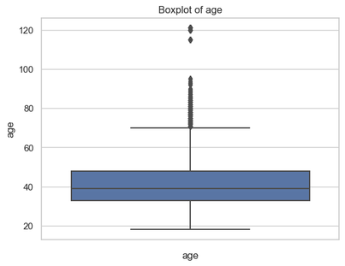
2. Handling Outliers
The boxplot of age shows that there are customers whose age is greater than 120.
This most likely indicates an error. Therefore, all the customers with age above a decided threshold is clipped to a certain value.
There are five records that has negative value for number of transactions, these rows are omitted.
For columns with too many outliers, handling them will alter the actual data, so they are left untouched.
Excellence and Service

Slide 10
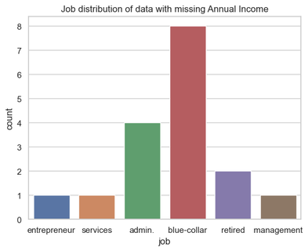
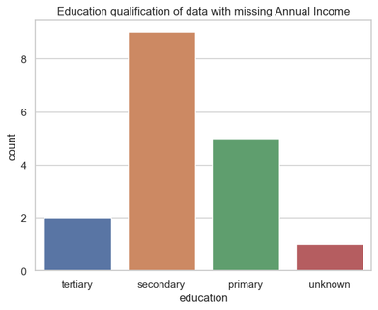
IV. Data Analysis & Visualization
1. Income Insights
Requirement : How many customers have no annual income? Plot and present the data distribution of these customers.
There are no customers with zero Annual Income in the dataset.
Possibility 1: look at the rows where the 'Annual Income' is missing.
This can be done under the assumption that the customers with zero Annual Income left the field for 'Annual Income' empty, indicating that it is null while filling out the survey for details.
Possibility 2: people belonging to ‘unemployed’ section and ‘students’ have zero annual income.
Excellence and Service

Slide 11
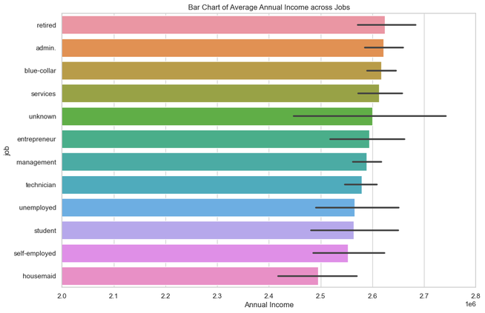
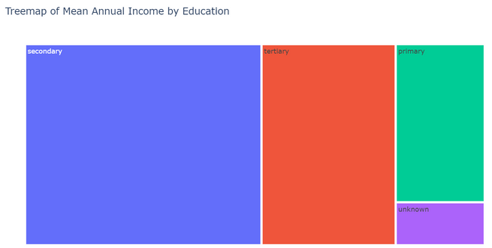
Data Distribution of Customers with low Annual Income
Housemaids fall under the lowest Income bracket, followed by self-employed and students.
Surprisingly, unemployed people have considerable Average Annual Income.
Since the missing data had people mostly from blue-collar jobs with secondary education, which is shown to have third highest and highest average income respectively, it is unlikely that missing value represents zero income.
Excellence and Service

Slide 12
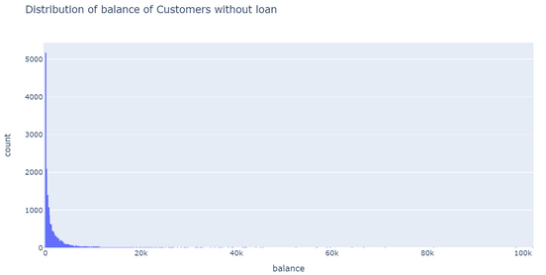
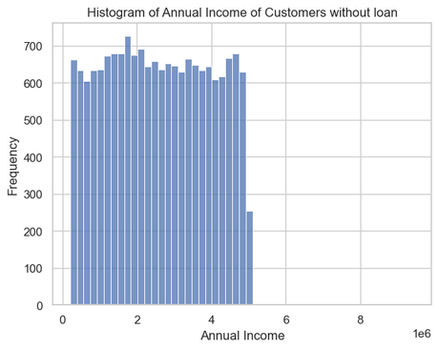
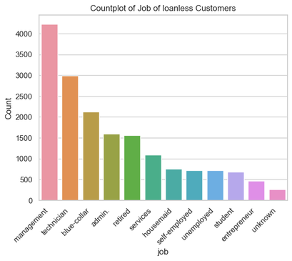
2. Loan-less Customers Profile
Filter out customers who don’t have any type of loan. Plot the distribution of their Income, balance, and profession. How do these metrics differ from those with loans?
There are two types of loan in the dataset - housing loan and loan.
If a customer has either of the loans or both, he cannot be considered Loan-less.
There are 17203 customers without any kind of loan and 27993 with at least one type of loan.
Excellence and Service

Slide 13
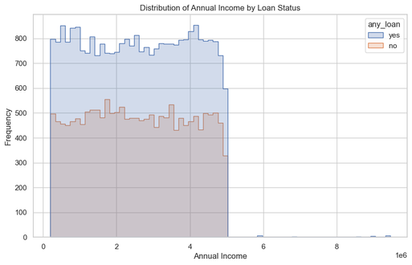
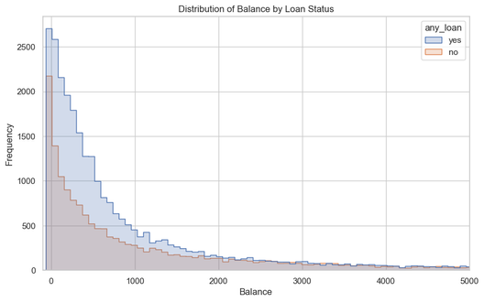
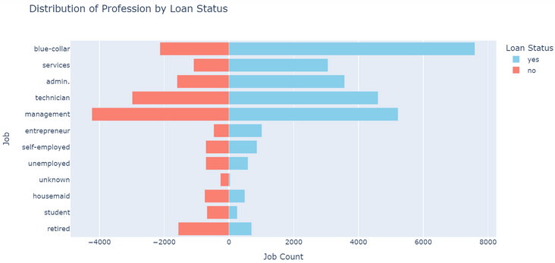
Comparison between Customers with Loan and without Loan
The Annual Income range of all the customers in the data is between 200k and 5M with few earning more than that.
In every range, number of people with Loan is greater that those without loan.
People with exceptionally high Annual Income tend to take loan.
Among people with very low balance, there is a larger number of people with loan compared to those without.
The number of people without loan gradually increases as the balance increases.
Most loan recipients work in blue-collar jobs.
Retirees, despite having the highest average income, have a lower loan proportion.
Unemployed customers show a near equal split between those with and without loans.
Lower-income occupations often have more individuals without loans than with loans.
Excellence and Service

Slide 14
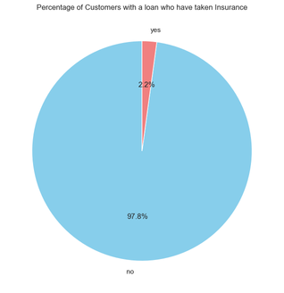
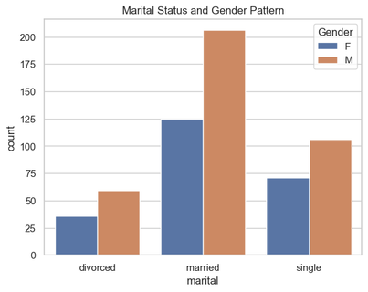
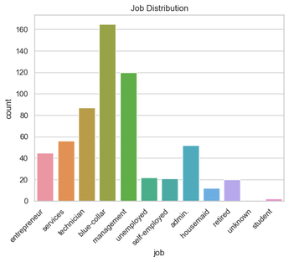
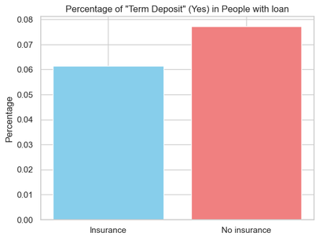
3. Loan and Insurance Analysis
Calculate the percentage of customers with a loan who have taken out insurance. Visualize this data and discuss potential implications.
2.2 % of customers with a loan have taken out insurance.
603 customers out of 27993 have taken insurance.
Those with insurance are less likely to take Term Deposit.
Married Males with loan are the highest among the people who have taken insurances.
People in Blue-collar occupations are dominating in this data.
Excellence and Service

Slide 15
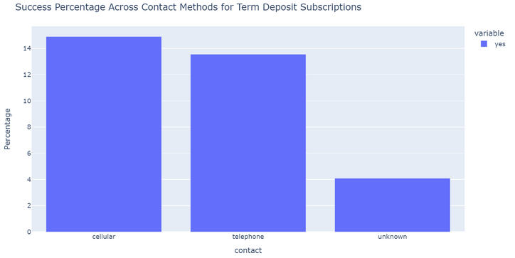
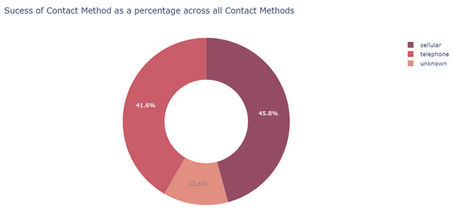
4. Communication Strategy Insights
Analyse and summarize the best Contact method (with the highest success percentage) to contact people to ascertain the status of term deposit subscriptions.
When customers were contacted by cellular mode of contact, the highest success percentage was observed.
Excellence and Service

Slide 16
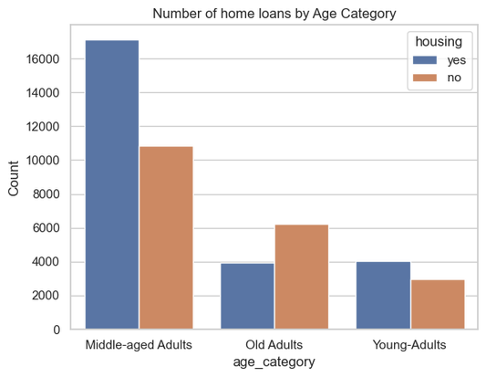
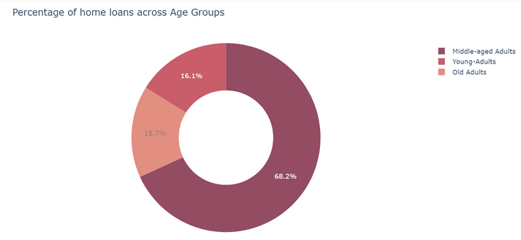
5. Age and Home Loans
Determine which age group has the highest percentage of home loans. Present this data visually and discuss possible reasons.
Middle-Aged groups have the highest percentage of home loans.
Financial Stability: Middle-aged individuals often have stable careers and higher income, increasing their eligibility and affordability for home loans.
Family Growth: The data showed a transition from single to married when the age category changed. This drives the need for housing, and in turn home loans.
Excellence and Service

Slide 17
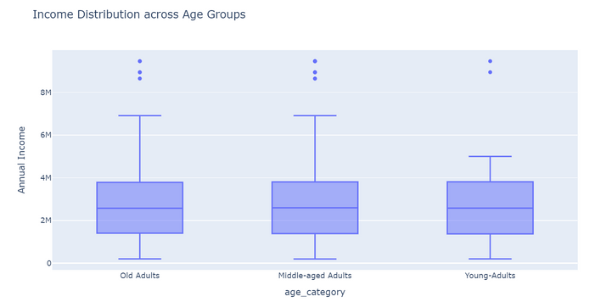
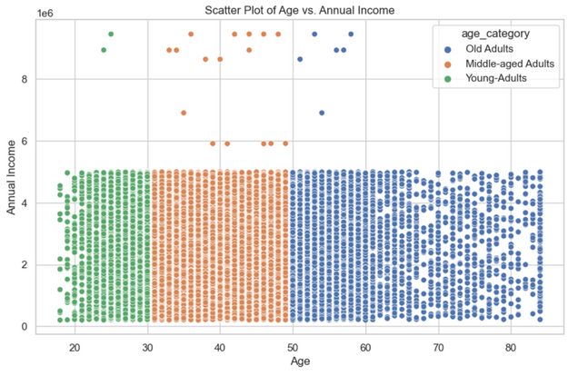
6. Income and Age Relationship
Investigate any relationships between annual income and age group. Use appropriate plots and statistics to present the findings.
Relationship between annual income and age group
Visual test: Box Plot and Scatter Plot
The median age is very similar across all age groups in the boxplot. There are few outliers after the upper fence.
The points shows no linear relationship in the scatter plot. This suggests that Income and Age are uncorrelated and may have no relationship.
From the plot, it is inferred that there may be no relationship.
Excellence and Service

Slide 18
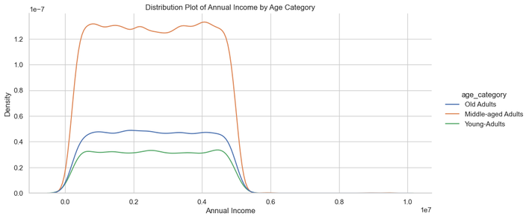
Test Used: Wilch ANOVA
H0: There is no relationship. That is, the mean Annual Income across the three age groups are equal.
H1: There is a relationship. That is, the mean Annual Income across the three age groups are not equal.
Checking if assumptions are followed:
The assumption of independence of observations is satisfied.
Considering the large sample size, the data is likely to meet the assumptions of normality.
Levene’s test is used to check for homogeneity of variance.
The test resulted in a p-value lesser than significance level.
This implies that there is difference in variance among age groups.
The homogeneity in variance assumption is violated.
Excellence and Service

Slide 19

Interpretation
The p-value is greater than the common significance level of 0.05, Therefore we do not reject the null hypothesis.
There is insufficient evidence to conclude that the means are different across groups, even when considering potential unequal variances.
Conclusion : There is no relationship between Annual Income across Age Groups.
Excellence and Service

Slide 20
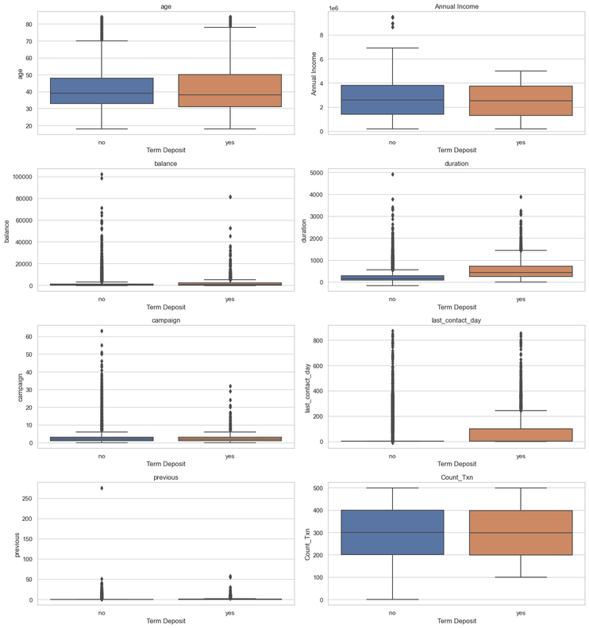
V. Modeling
1. Term Deposit and Related Variables
Identify variables strongly related to Term Deposit. Discuss your approach when the variable is categorical. Which tests or metrics will you employ?
Identifying Numerical feature variables related to Term Deposit
Boxplots can be used to identify numerical variables that is strongly related to Term Deposit.
If the median value of the numerical variable changes across each class of the target variable significantly, we can say that there is a strong relationship.
From the plot - duration and last contacted day is shown to have a relationship with the target variable.
Excellence and Service

Slide 21
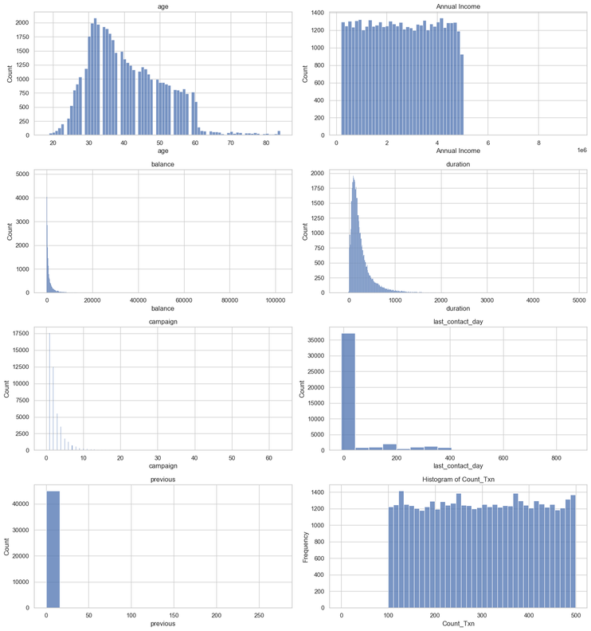
Conclusions from visual tests are subjective.
The distributions of numerical variables deviate from normality, so we cannot use t-test.
Hence, Mann-Whitney U test is used.
Excellence and Service

Slide 22
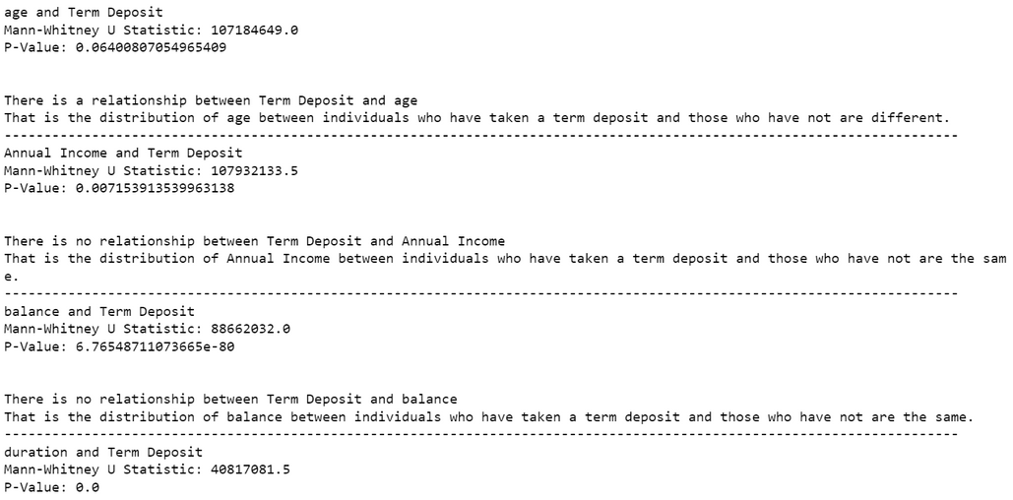
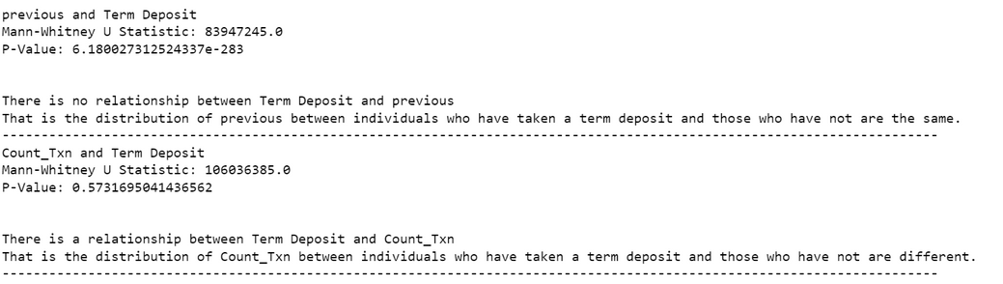
Mann-Whitney U test
H0: There is no relationship, the variable distributions across the two categories are equal.
H1: There is a relationship, the variable distributions across the two categories are not equal.
Thus, two variables - Age and Number of transactions has shown to have relationship with Term Deposit
Excellence and Service

Slide 23
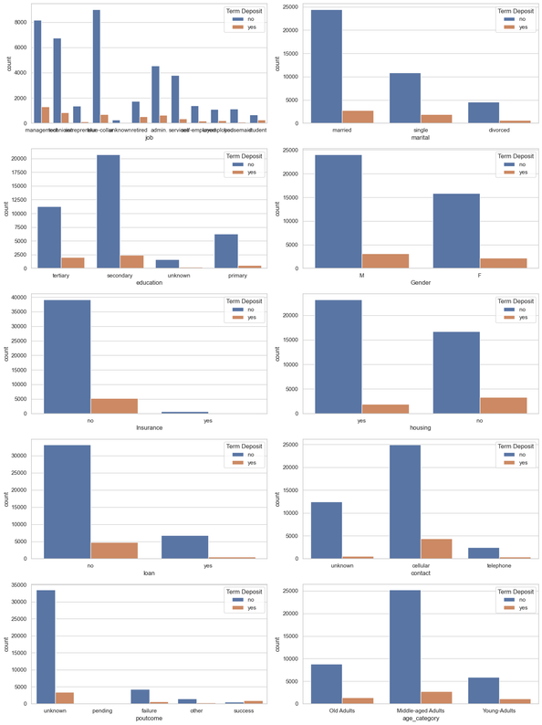
Identifying Categorical feature variables related to Term Deposit
Visual test 1: Clustered count plot
Useful for visualizing the distribution and relationship between two categorical variables.
The categorical feature is plotted on the x-axis, and the count of occurrences is represented on the y-axis.
It is evident that there is no one category where the number of customers who have taken a Term Deposit is greater compared to those who have not.
There is a notable amount of people without housing loan who have taken Term Deposit.
Excellence and Service

Slide 24
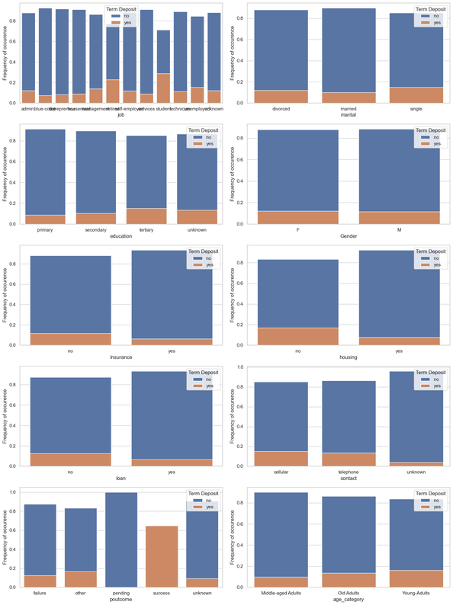
Visual test 2: Stacked Bar plot based on Normalised Counts
Allows for a direct and proportional comparison of different categories.
Each bar represents the relative contribution of a specific category to the whole.
The stacked format shows the relative distribution of categories within each bar, making it easier to identify patterns and trends.
Inspite of relatively smaller proportion in the data, the students have taken the highest number of Term-Deposits compared to the other categories.
Housing, loan, insurance, contact and previous marketing outcome is shown to have significant relationship with Term Deposit.
Gender is little to no difference in the bars.
Excellence and Service

Slide 25
Statistical Test: Chi-squared test and Cramer’s V
Null Hypothesis (H0): There is no association between the two categorical variables; they are independent.
Alternative Hypothesis (H1): There is a significant association between the variables.
Assumption : The observations are independent
Chi-Square test tells whether there is an association between the categorical variables.
Cramer’s V gives the magnitude association between the variables.
It ranges from 0 to 1.
Inference:
After running Chi-square test, it is seen that all the variables are significant.
The Cramer’s V showed that there is no variable with strong relationship with Term Deposit.
However, previous marketing outcome shows moderate relationship.
Contact, Housing loan and Job shows low association with Cramer score of 0.1.
Conclusion:
Thus Age, Number of Transactions, Previous Marketing Outcome, Housing loan, Job and Contact Method are the variables most related to Term Deposit.
Excellence and Service

Slide 26
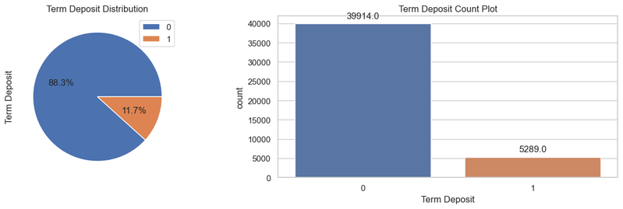
1.Model Building
I. Feature Engineering:
Serial Number and Customer Number columns were dropped.
Age Category column was extracted from the Age column.
A column was temporarily created to facilitate data visualization of people that has any type of loan.
II. Feature Scaling
Since outliers were present in the dataset, the Robust Scaler was employed for data normalization.
III. Feature Transformation
The nominal variables are encoded by creating dummies.
Label Encoding is implemented in case of Ordinal variables.
IV. Imbalance in data
The imbalanced data is dealt with in two ways: oversampling and using class weight parameter.
Excellence and Service

Slide 27
Logistic Regression
Assumptions
Linearity of independent variables and log odds
No strongly influential outliers
Absence of multicollinearity
Independence of observations
Sufficiently large sample size
Training the Model
The data is split to training and testing set in the ratio 80:20
Two models are built, one using the oversampled data and one using class weights parameter.
The class weight was set in the ratio 90:10.
Excellence and Service

Slide 28
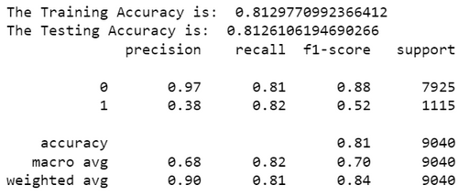
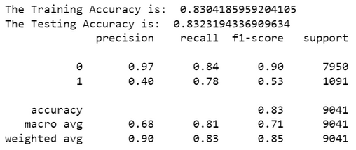
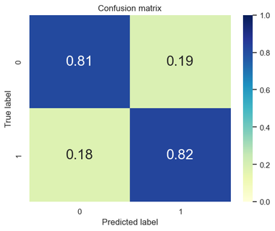
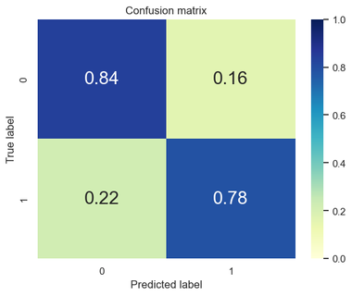
3. Model Evaluation
SMOTE
Class Weight (0.9:0.1)
Excellence and Service

Slide 29
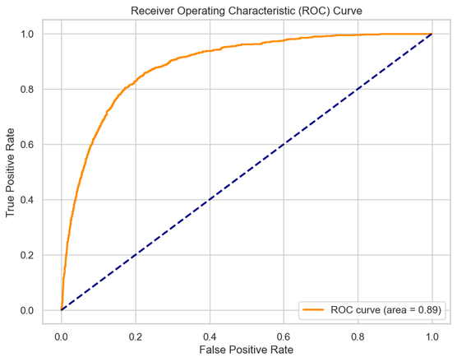
Excellence and Service

Slide 30
VI. Model Improvement Strategies:
Feature Selection techniques like Step-wise logistic Regression or Tree Based feature selection can be done.
Cross-Validation: Implement cross-validation techniques to obtain a more reliable estimate of model performance and mitigate overfitting.
Hyperparameter Tuning: Fine-tune model hyperparameters to find the optimal configuration, maximizing performance on the specific problem.
Other classification algorithms like Random Forest can be used.
Excellence and Service

Slide 31
Conclusion
The Logistic Regression Model built can be used for predicting the probability of a customer taking a Term Deposit.
The threshold can be regulated based on the requirements of the Bank or model predictions.
Targeted Marketing Strategies may result in larger number of customers taking Term Deposit.
For example, contacting Middle-Aged people towards the higher income bracket without any kind of loans.
In conclusion, although there is room for improvement the model built generalizes well to unseen data.
Excellence and Service

Slide 32
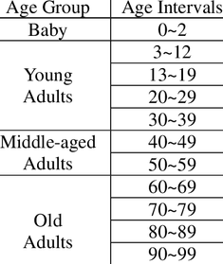
References
https://labelyourdata.com/articles/how-to-choose-a-machine-learning-algorithm
https://github.com/Pitsillides91/Python-Tutorials/blob/master/Introduction%20to%20ML%20-%20Logistic%20Regression%20Example/Introduction%20to%20Machine%20Learning%20-%20Logistic%20Regression%20Example%20(Complete).ipynb
https://github.com/sandipanpaul21/Logistic-regression-in-python/blob/main/07_LR_Assumptions.ipynb
Introduction to Data Science - Davy Cielen, Arno D. B., Meysman Mohamed Ali
Age Category : Classification of Age Groups Based on Facial Features- Weng Bing
Excellence and Service

