Slide 1
Measure Factory User Guide
Dimensional Insight 2017

Slide 2
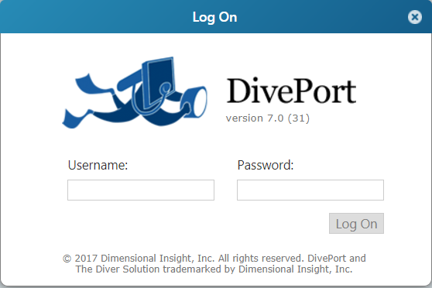
Log On
Use your single sign-on information for AD.

Slide 3
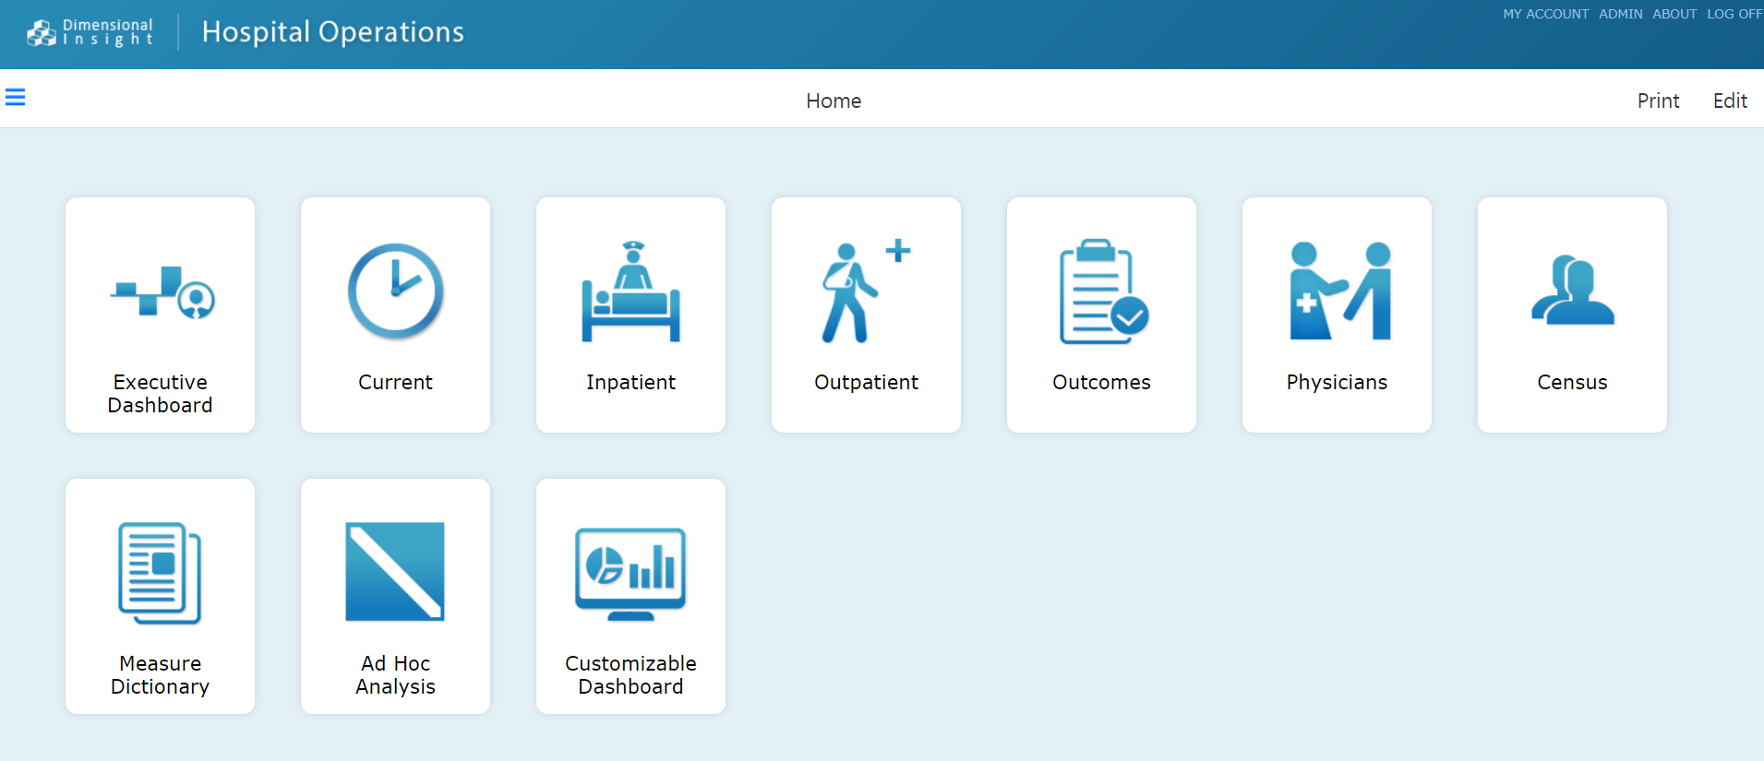
Dashboard Launch Screen
Double-click the dashboard that you want to open.
You might not have access to all dashboards shown here.

Slide 4
Dashboards
Dashboard | Description
Executive Dashboard | Current state and trending information for measures within operational, revenue, quality and efficiency
Current | An overview of current patient census volumes by facility
Inpatient | A daily snapshot of inpatient volumes, plus monthly and yearly trended information as defined by key operational volume performance measures
Outpatient | A daily snapshot of outpatient volumes, plus monthly and yearly trended information as defined by key operational volume performance measures
Outcomes | A summary of standard outcomes measures that have been specified in various regulatory, quality, improvement, and reimbursement programs

Slide 5
Dashboards (Continued)
Dashboard | Description
Physicians | An overview of physician volume and quality. Physician case volumes are reported by DRG, service, or specialty and are subsequently trended over time.
Census | An overview of current patient census volumes by facility and nursing unit, compared to the unit capacity. Graphs provide leadership with a perspective on unit by aggregating hourly census data along with unit admission, transfer, and discharge statistics. Census measures provide for both an hourly and midnight or daily timeframe along with comparison to the previous day.
Measure Dictionary | A directory of measures and their definitions. You can perform an analysis on a measure, as well as access measure data in ProDiver.
Ad Hoc Analysis | A page where Advanced users can access data models that support operational dashboard measures

Slide 6
Definitions
Measure Analysis
Default Analysis
Click the Analysis icon to dive on all data for a measure. Perform this type of analysis when you want to view progressively more detailed information about a measure.
Click a value—a number or a graphical indicator—on a page to dive on measure data for a given time period. Perform this type of analysis when you want compare measure data between time periods.

Slide 7
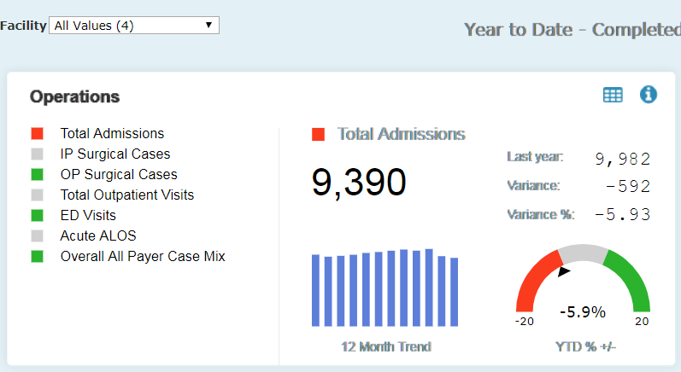
Executive Dashboard
Click Print to print the page in PDF, PowerPoint, or image format.
Click Home to return to the Home page.
Click Back to return to the previous page.
The Last Refreshed date tells you when the data was last updated.
The Year-to-Date Summary shows you beginning and ending dates for the data.
Choose a facility to view data for.
Click the Analysis icon to perform an analysis on the selected measure.
Click a measure on the left to view its data on the right.
Click the Information icon to view the definition and details for the selected measure.

Slide 8
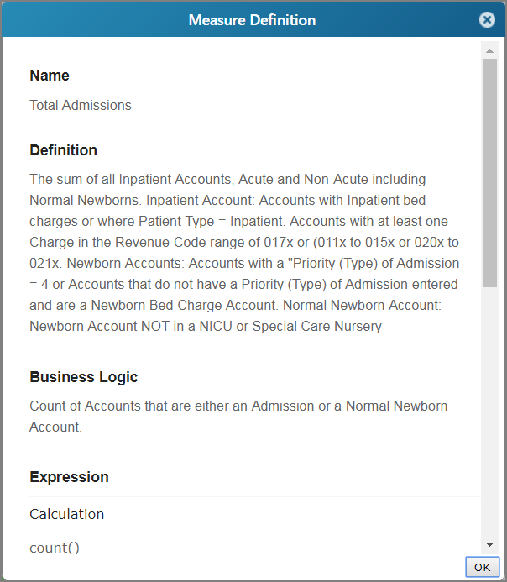
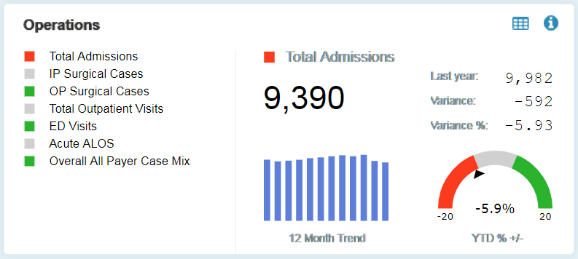
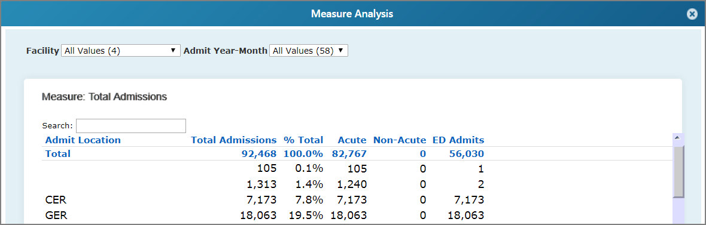
Executive Dashboard
Operations Section
Click the Information icon to review contextual information about a measure in the Measure Definition window.
Click the Analysis icon to perform an analysis of measure data in the Measure Analysis window.

Slide 9
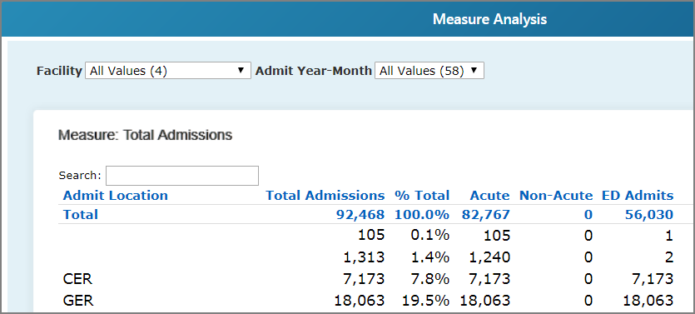
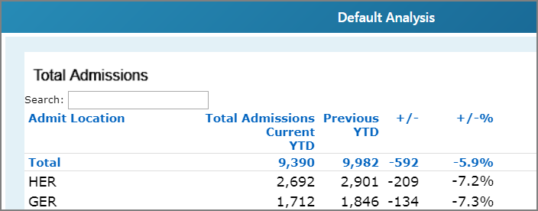
Executive Dashboard
Click a value to compare and analyze measure data from two time periods.
The Measure Analysis window allows you to analyze measure data, but doesn’t maintain a time period comparison.
A measure analysis without a time period comparison is useful when you want to include more custom summary columns.
The Default Analysis window maintains a time period comparison.

Slide 10
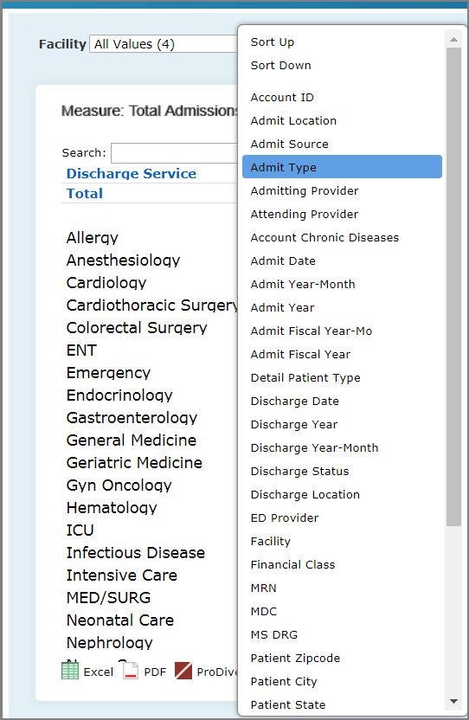
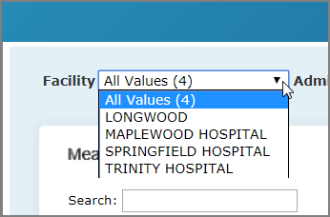
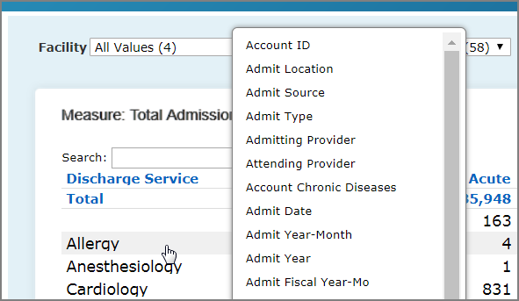
Executive Dashboard
Measure Analysis
Click the Analysis icon in the upper right of a dashboard.
Dive on the data:
Select a value from a QuickView to narrow your view of the data.
To view measure data broken down by a different dimension, click the leftmost column heading and select a new dimension.
To dive on measure data, click a row, and select a value.
Click an icon to view the data in Excel or PDF format, or to open the data in ProDiver.

Slide 11
Executive Dashboard
Measure Definition
To access the measure definition, click the Information icon in the upper right of a dashboard.

Slide 12

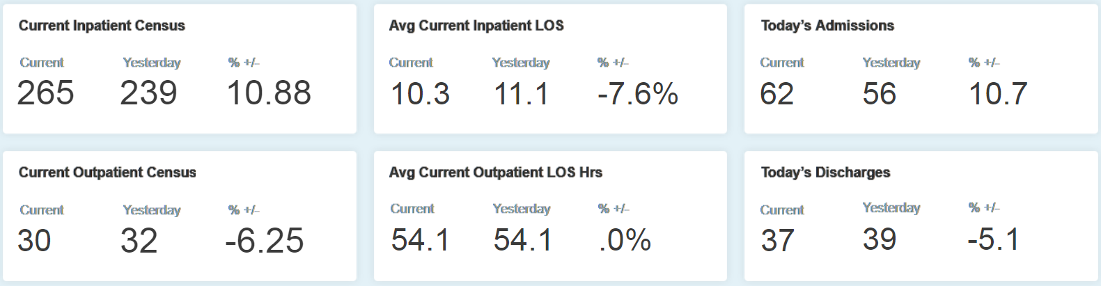
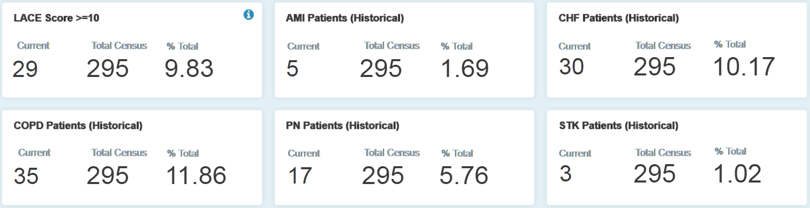
Current
Today Tab
The top two rows display an hourly summary of in-house census patient counts, LOS, as well as cumulative admit and discharge activity for the current day.
You can use the bottom two rows to identify patients at risk for readmission based on LACE scores, as well as identify patients with a history of chronic disease by using past medical history of diagnoses for HF, PN, Stroke, COPD and AMI.

Slide 13
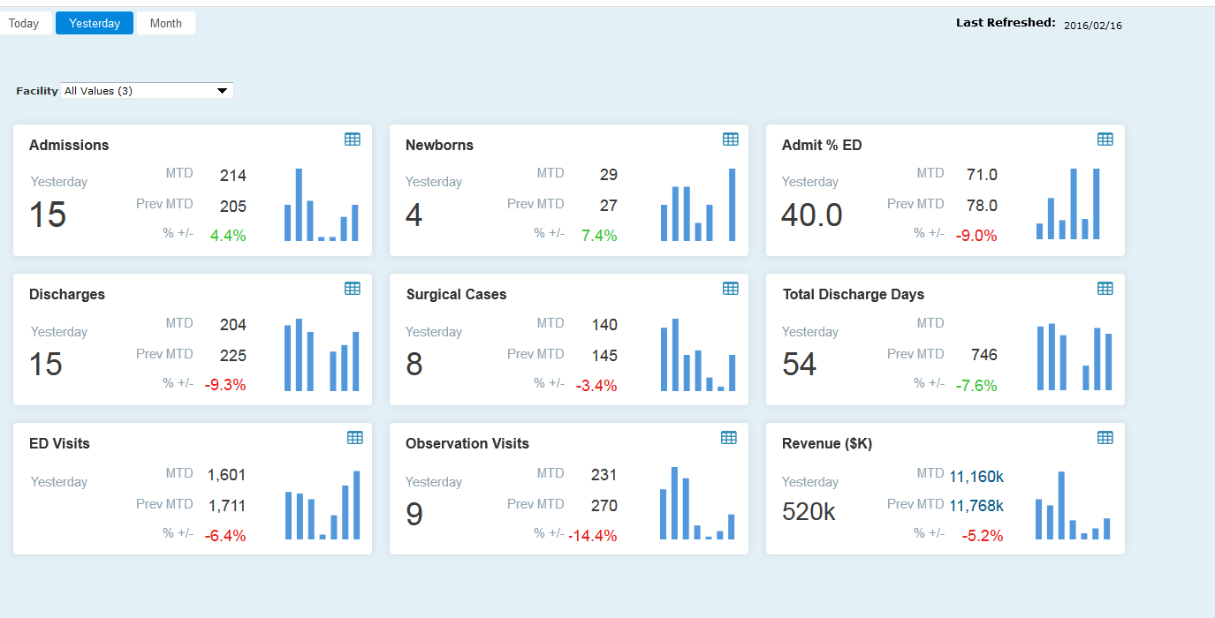
Current
Yesterday Tab
This dashboard provides a high level view of activity from the previous day, by facility.
Click a value to analyze measure data for a given time period.

Slide 14
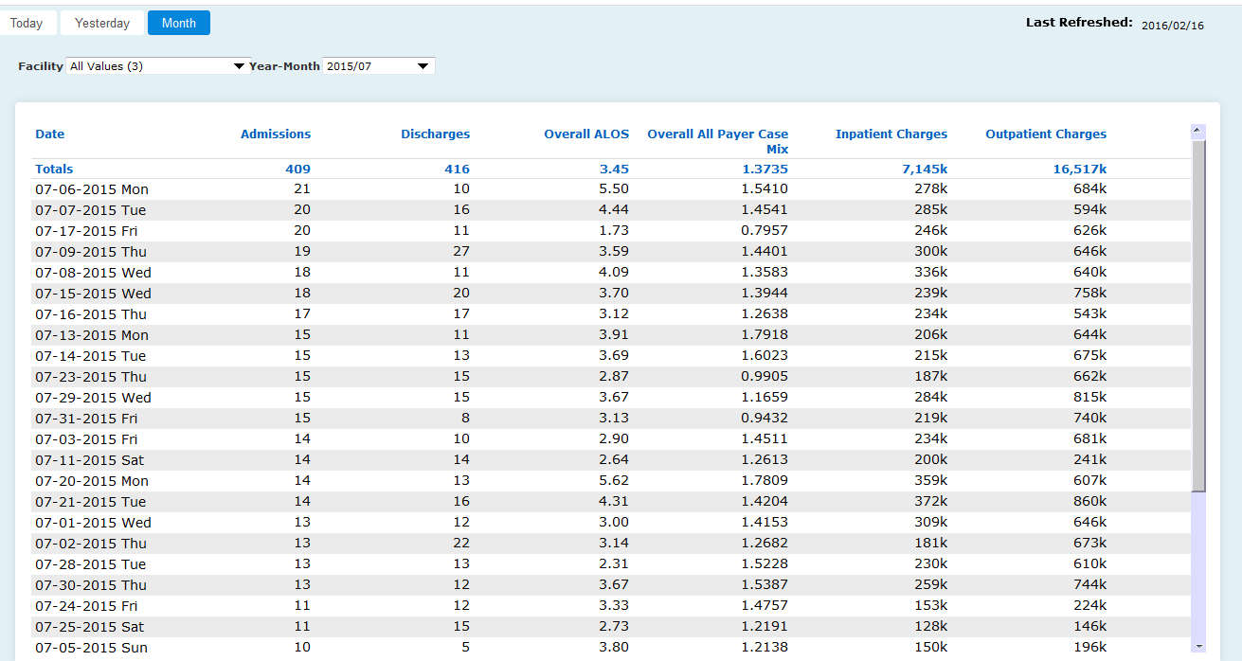
Current
Month Tab
Select the month that you want to view data for.
Click a column heading to sort the data in ascending or descending order.

Slide 15
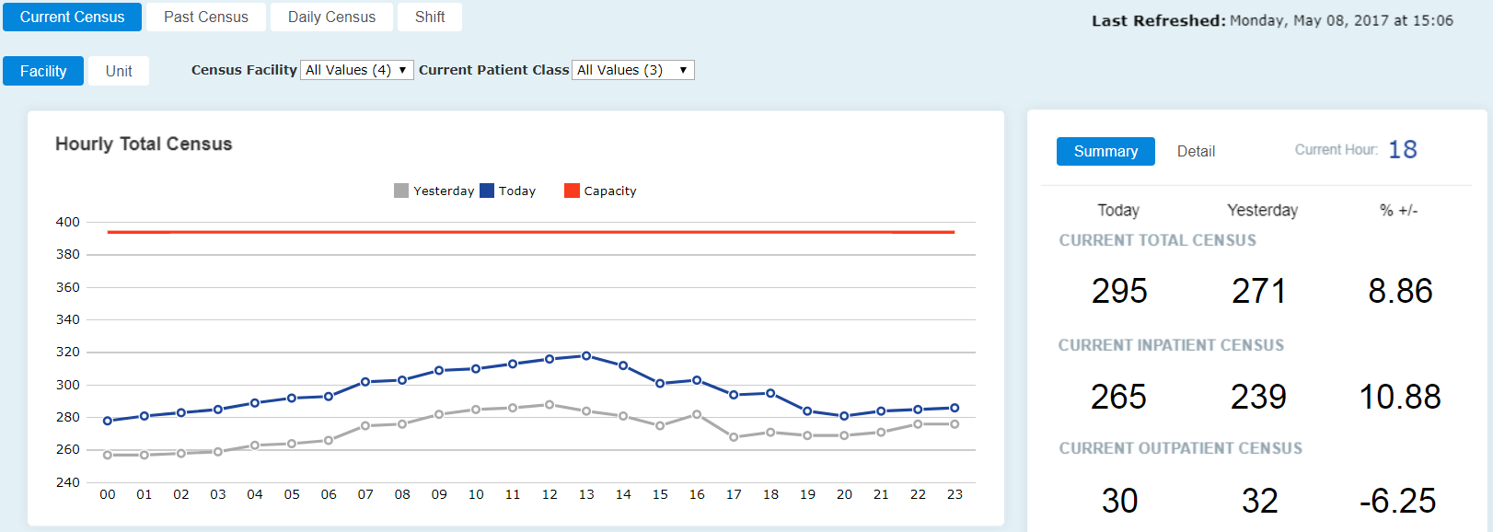
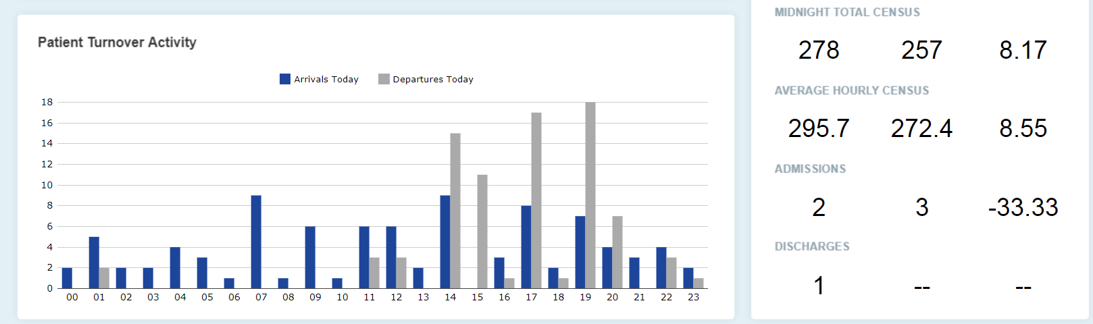
Census
Current Census Tab—System Summary
Click a value to open the Patient Detail window.

Slide 16
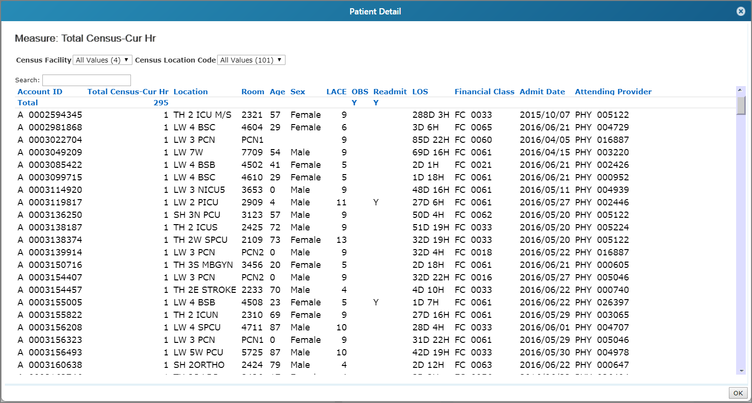
Census
Current Census Tab—Patient Detail

Slide 17
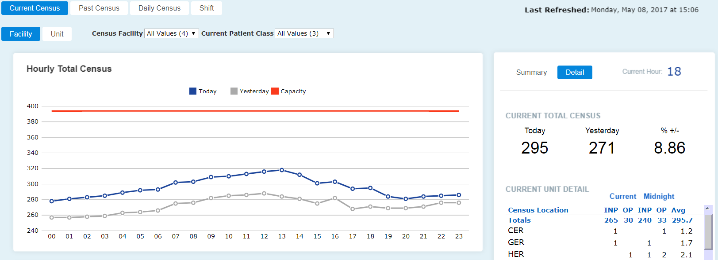
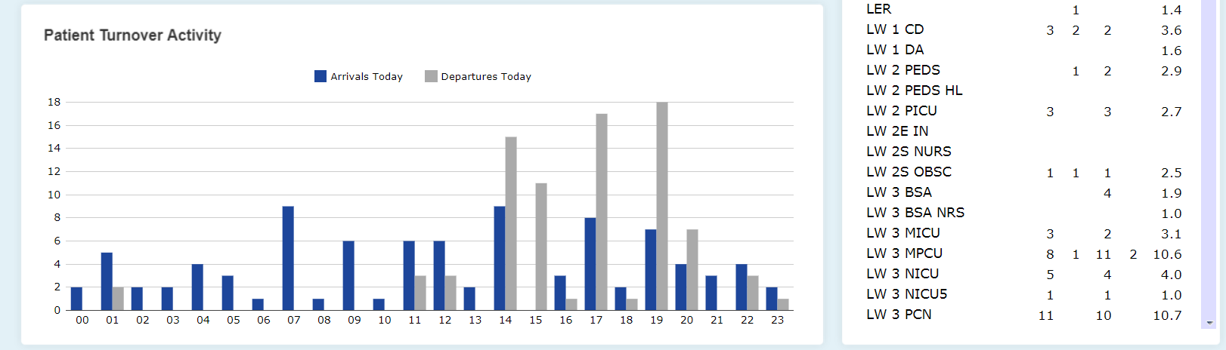
Census
Current Census Tab—Detail Page
Shows the current unit detail within a facility.

Slide 18
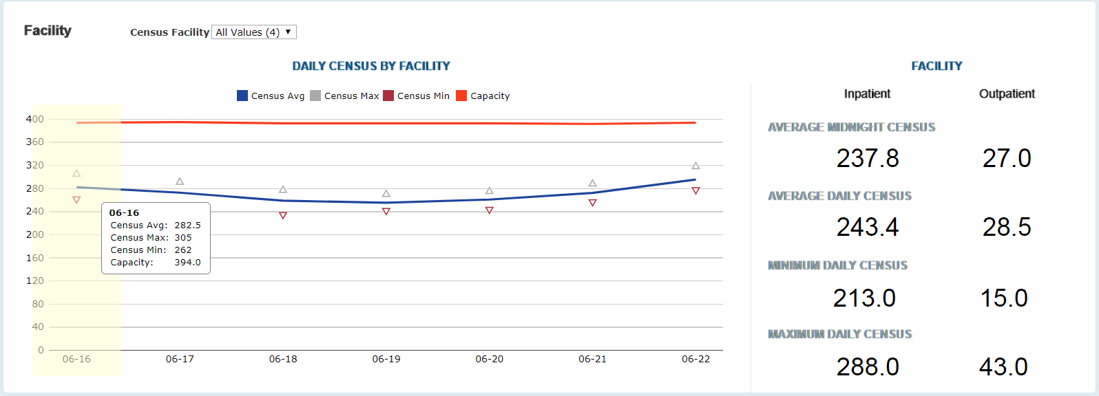
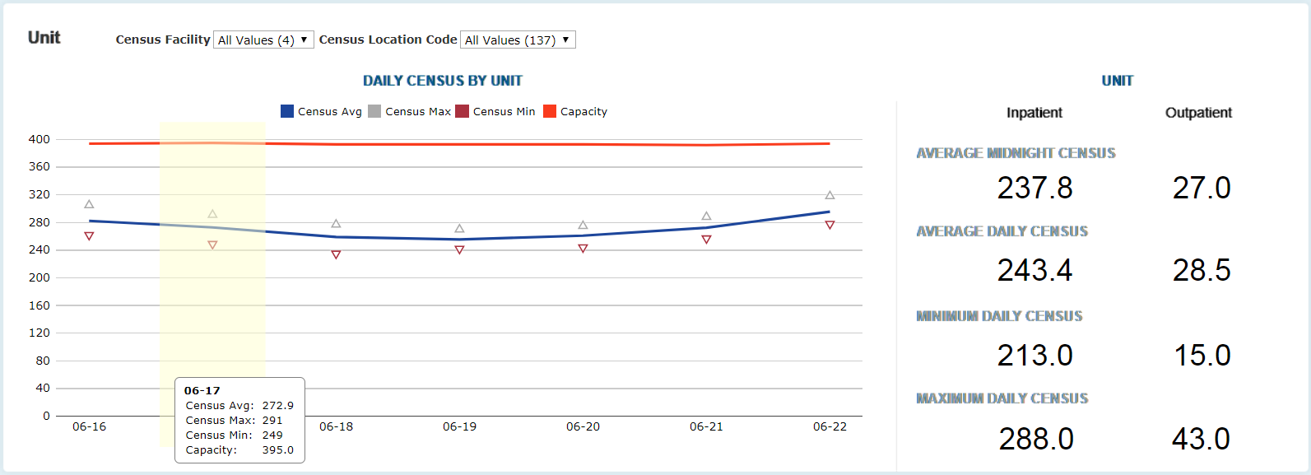
Census
Daily Census Tab
View the last 7 day trend for census.

Slide 19
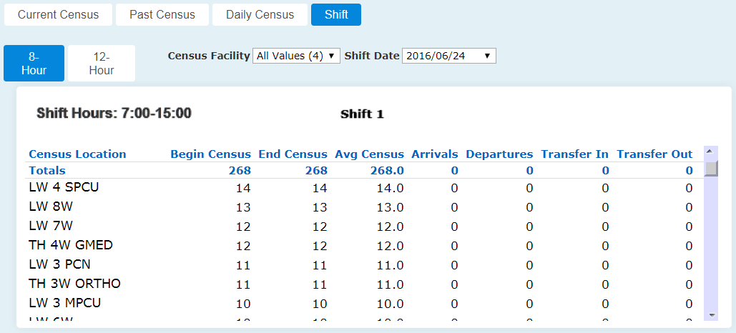
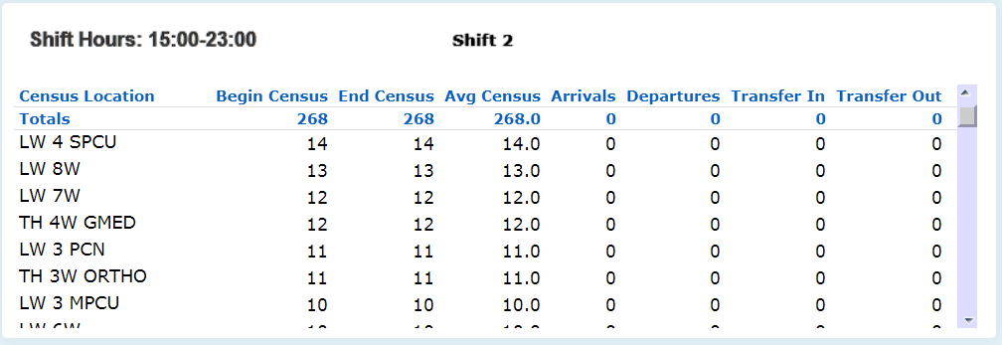
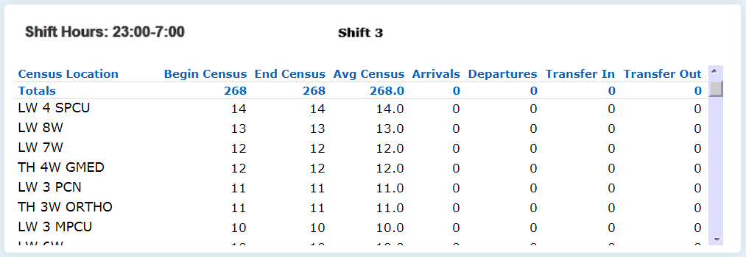
Census
Shift Tab
View census activity by date by shift.

Slide 20
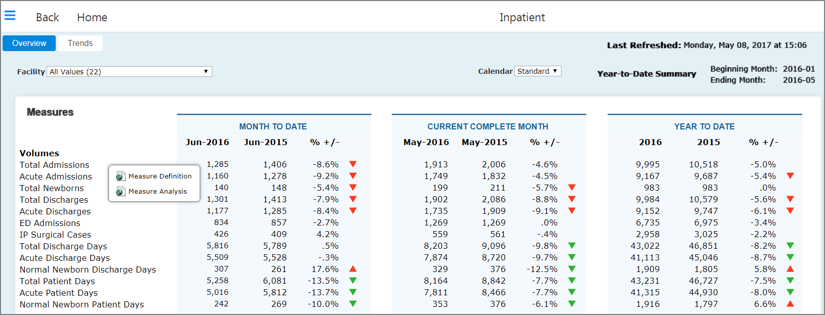
Inpatient
Overview Tab—Periods
Click a value to analyze measure data for a given time period.
Click a measure to review its definition.

Slide 21
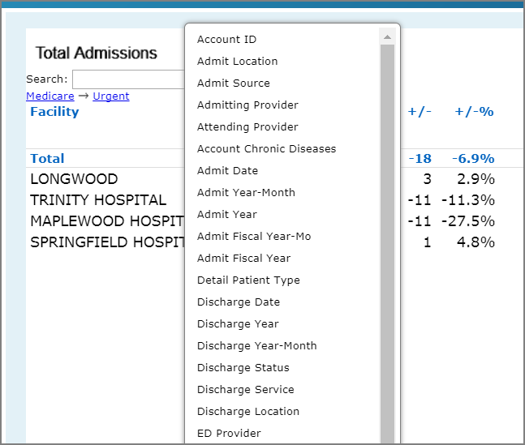
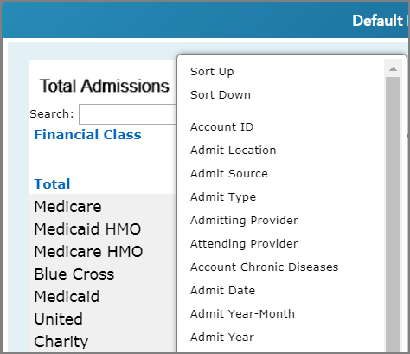
Inpatient
Overview Tab—Default Analysis
Click a value.
Dive on the data:
To view measure data broken down by a different dimension, click the leftmost column heading and select a new dimension.
To dive on measure data, click a row, and select a value.
To return to a previous view, click the name of a dimension.

Slide 22
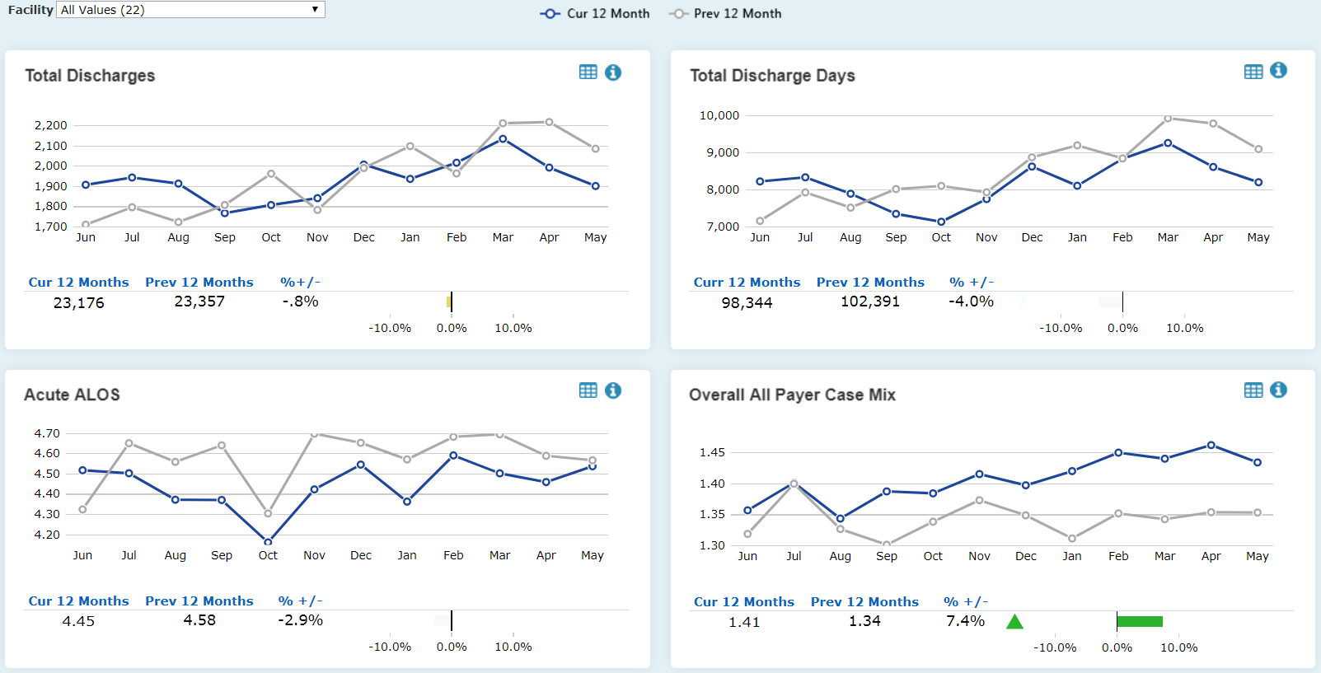
Inpatient
Trends Tab—Periods
This page displays the current 12 months compared to the previous 12 months.
Click a data point to analyze measure data for a given time period.

Slide 23
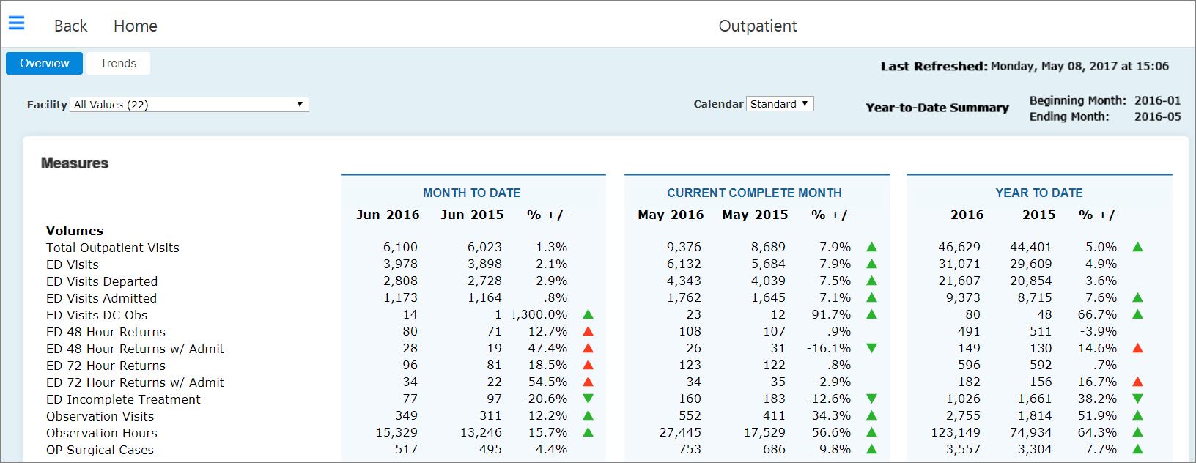
Outpatient
Overview Tab
Behaves the same as the Inpatient Overview page

Slide 24
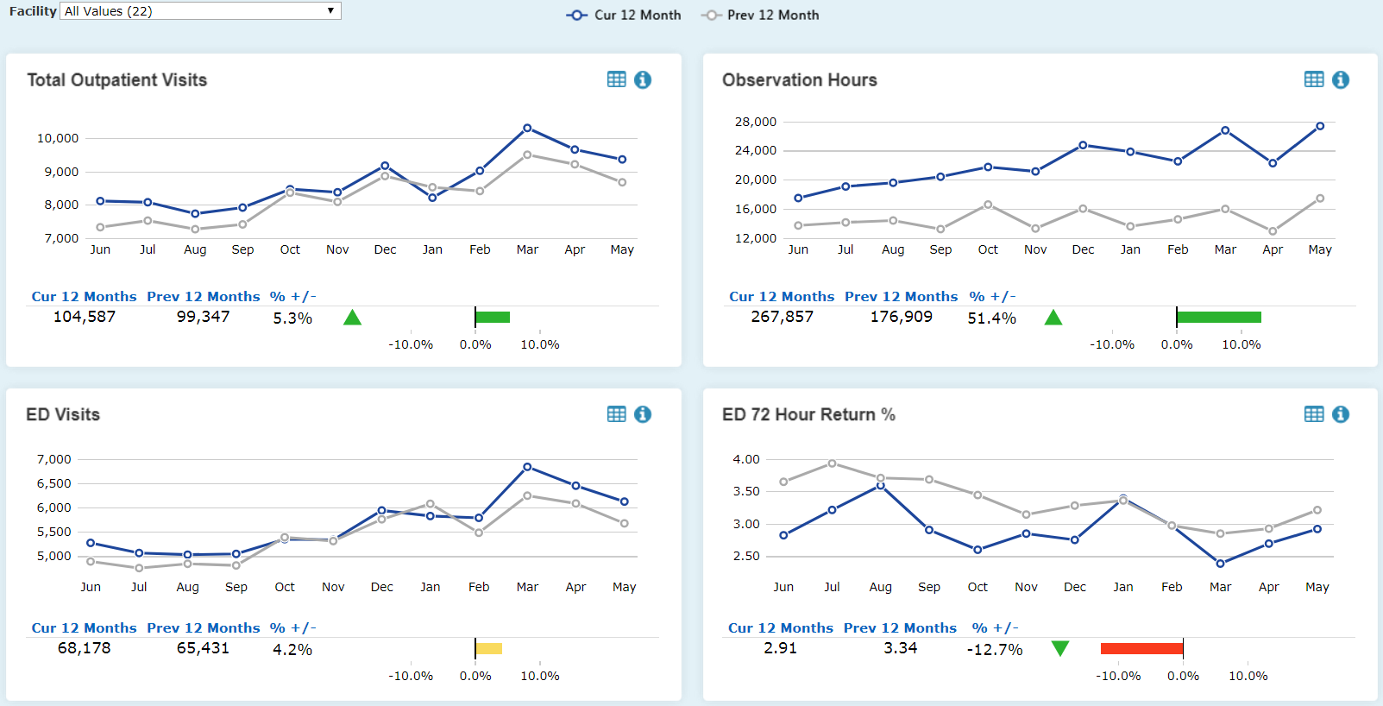
Outpatient
Trends—12 Month Periods
This page displays the current 12 months compared to the previous 12 months.
Click a data point to analyze measure data for a given time period.

Slide 25
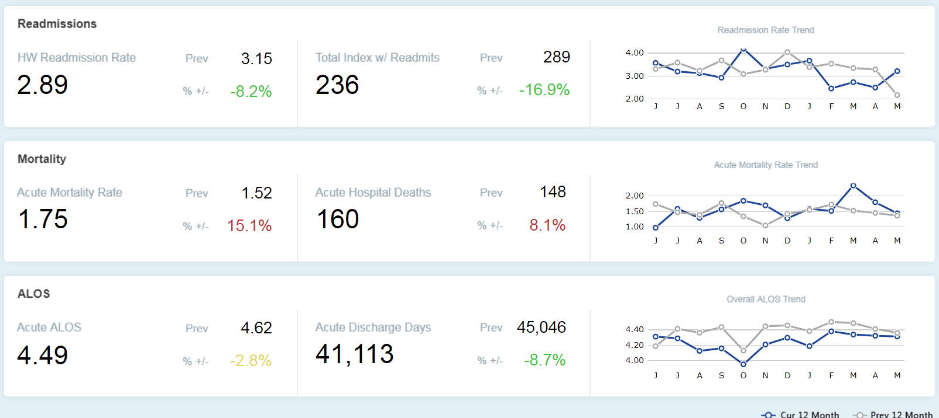
Outcomes
Overview Tab
Click to see detailed data for to each measure.
The Overview tab shows a 12 month summary of Readmissions, Mortality, and Acute ALOS.
Click a data point to analyze measure data for a given time period.

Slide 26
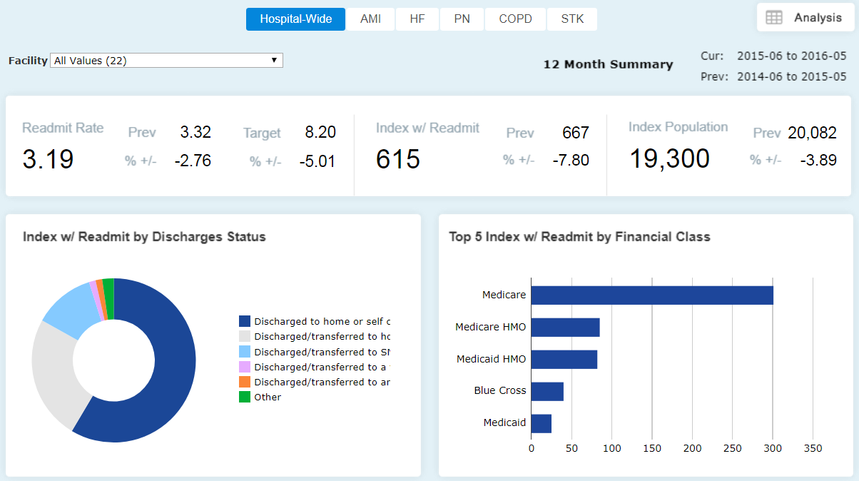
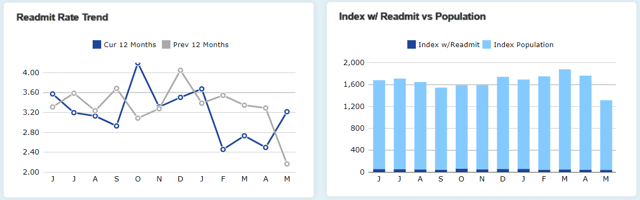
Outcomes
Readmissions Tab—Hospital Wide
Click a data point to analyze measure data for a given time period.

Slide 27
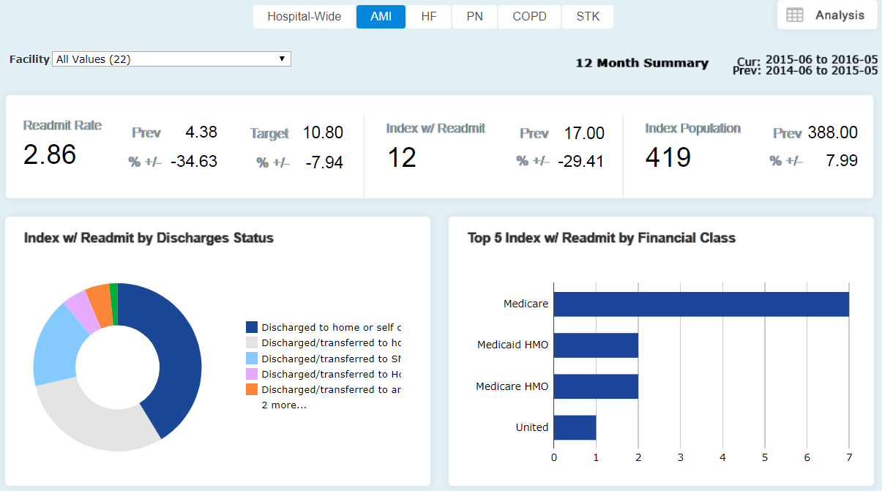
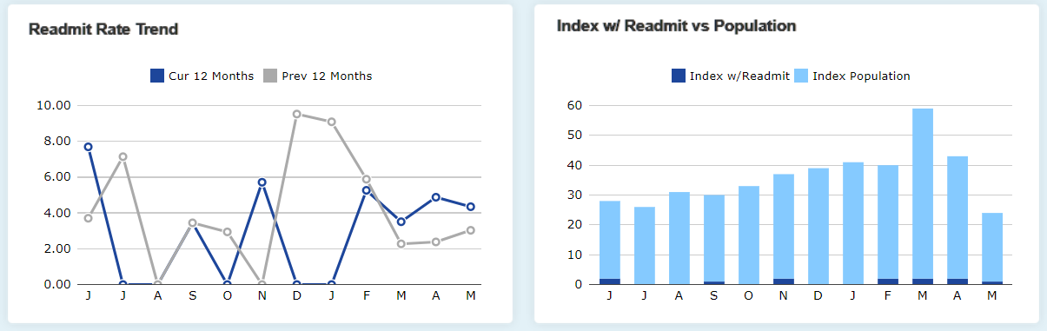
Outcomes
Readmissions Tab—Disease Specific
Click a data point to analyze measure data for a given time period.

Slide 28
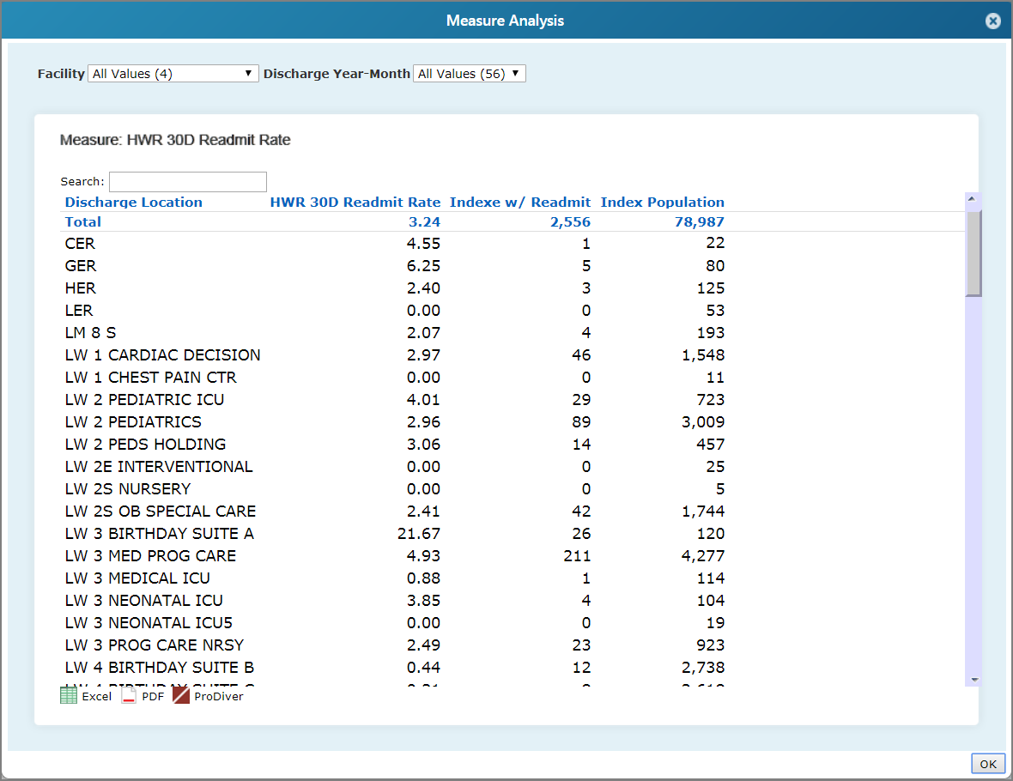
Outcomes
Readmissions Tab—Analysis Icon

Slide 29
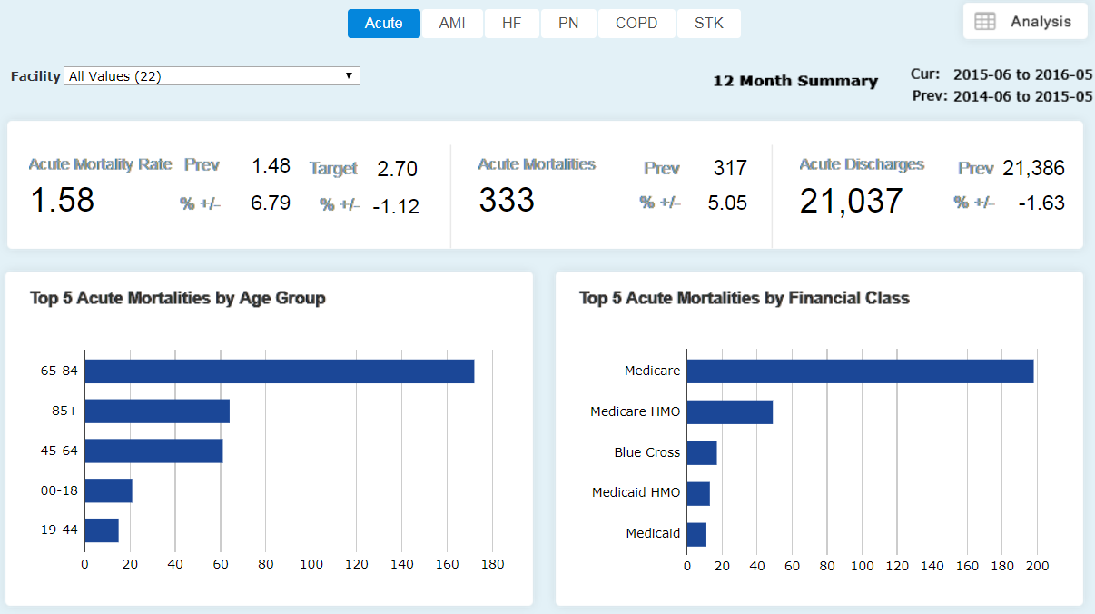
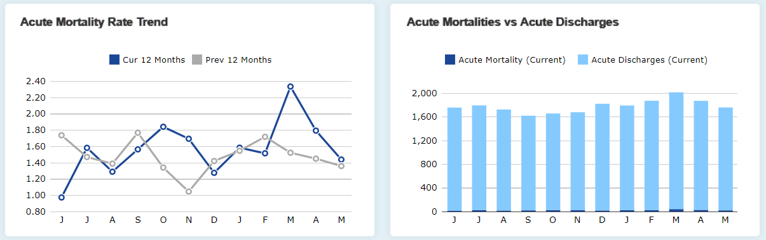
Outcomes
Mortality Tab
Click a data point to analyze measure data for a given time period.

Slide 30
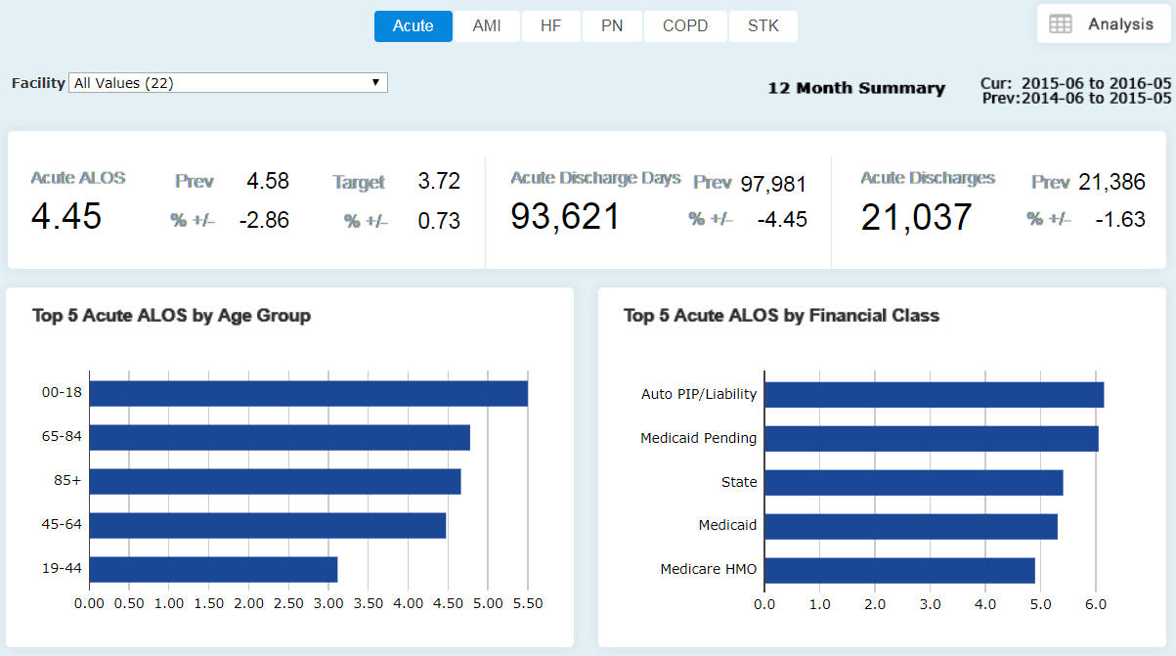
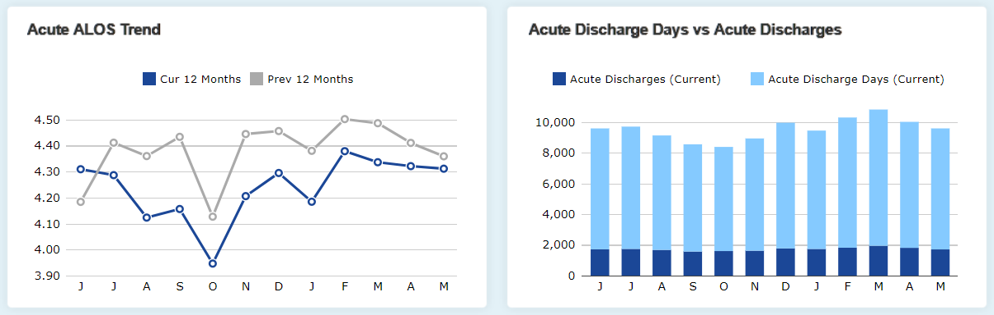
Outcomes
ALOS Tab
Click a data point to analyze measure data for a given time period.

Slide 31
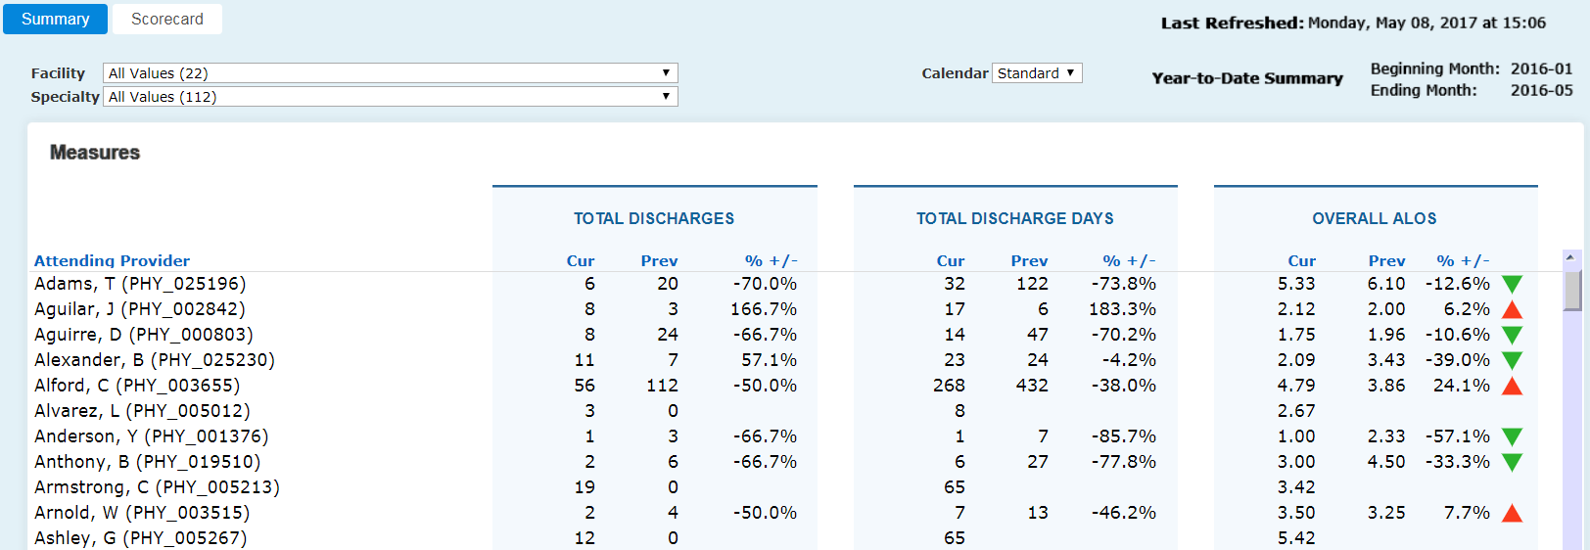
Physicians
Summary Tab
Click a row to view the scorecard for a physician.

Slide 32
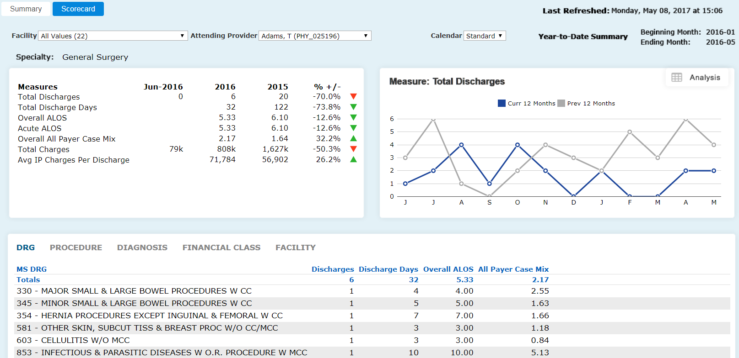
Physicians
Scorecard
The values in the filters are carried over from the previous screen.
Click a label to change your view.

Slide 33
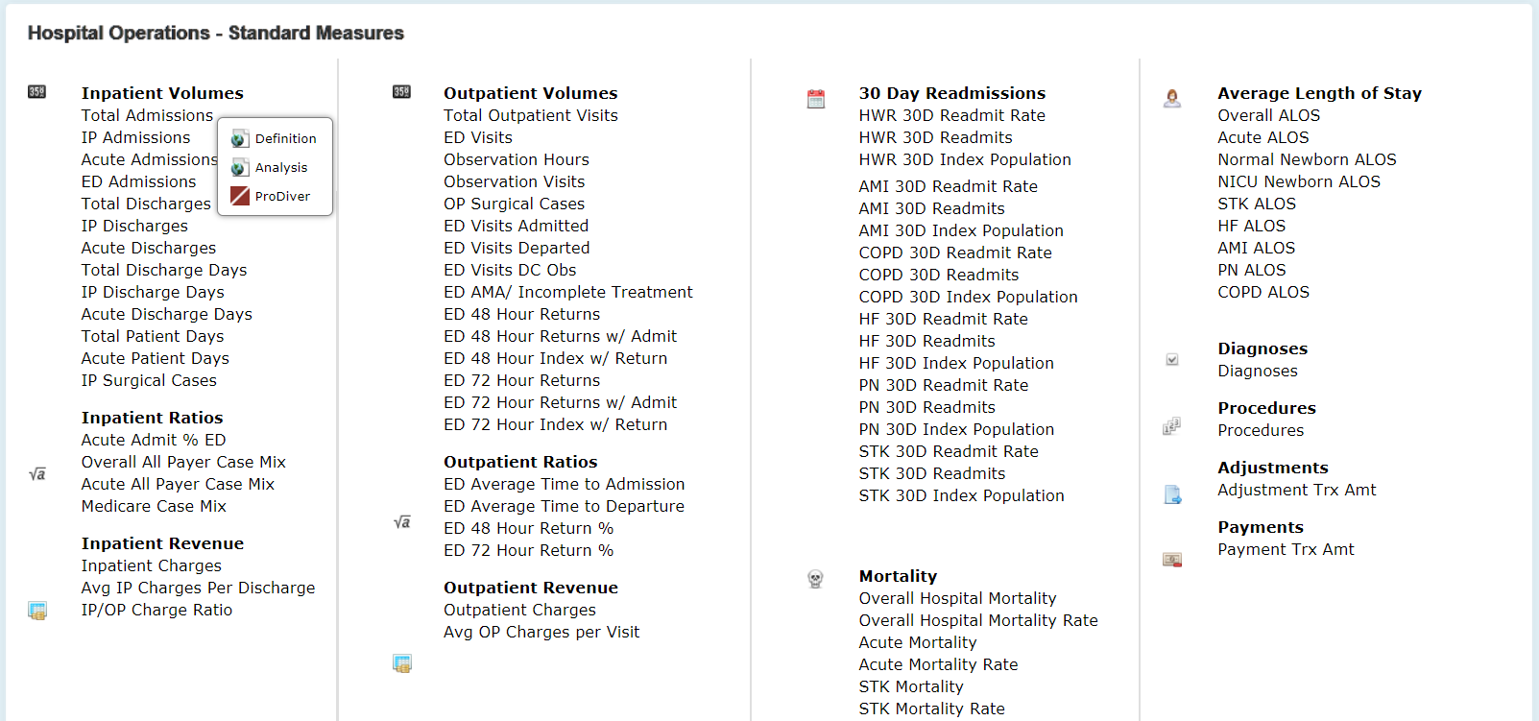
Measure Dictionary
Access all the measures from the Framework Dashboard
Click a measure to perform an analysis or to open the measure data in ProDiver.

Slide 34
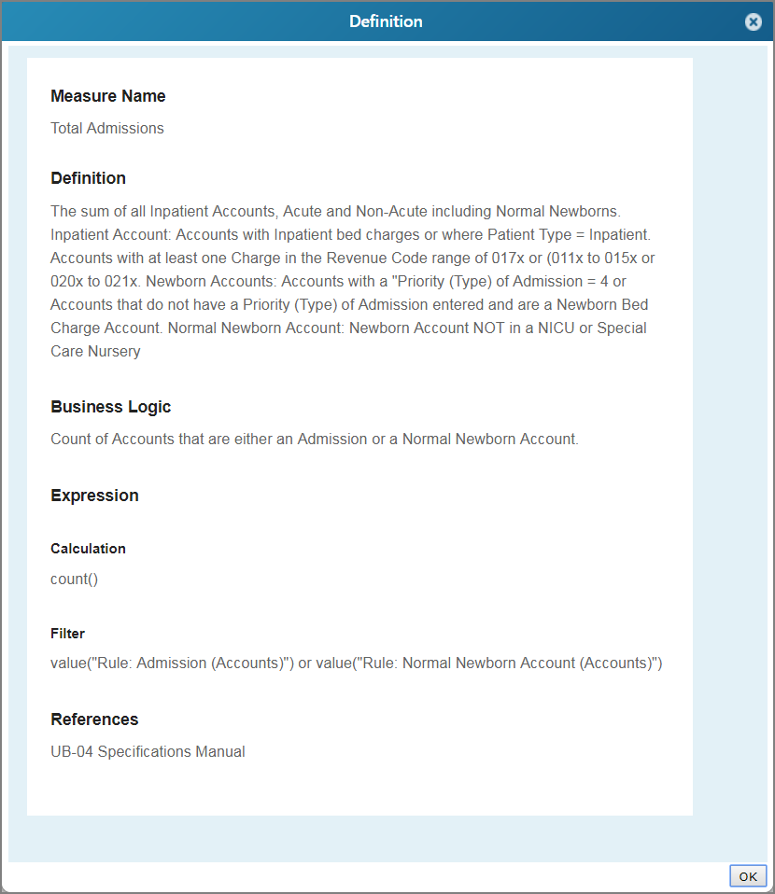
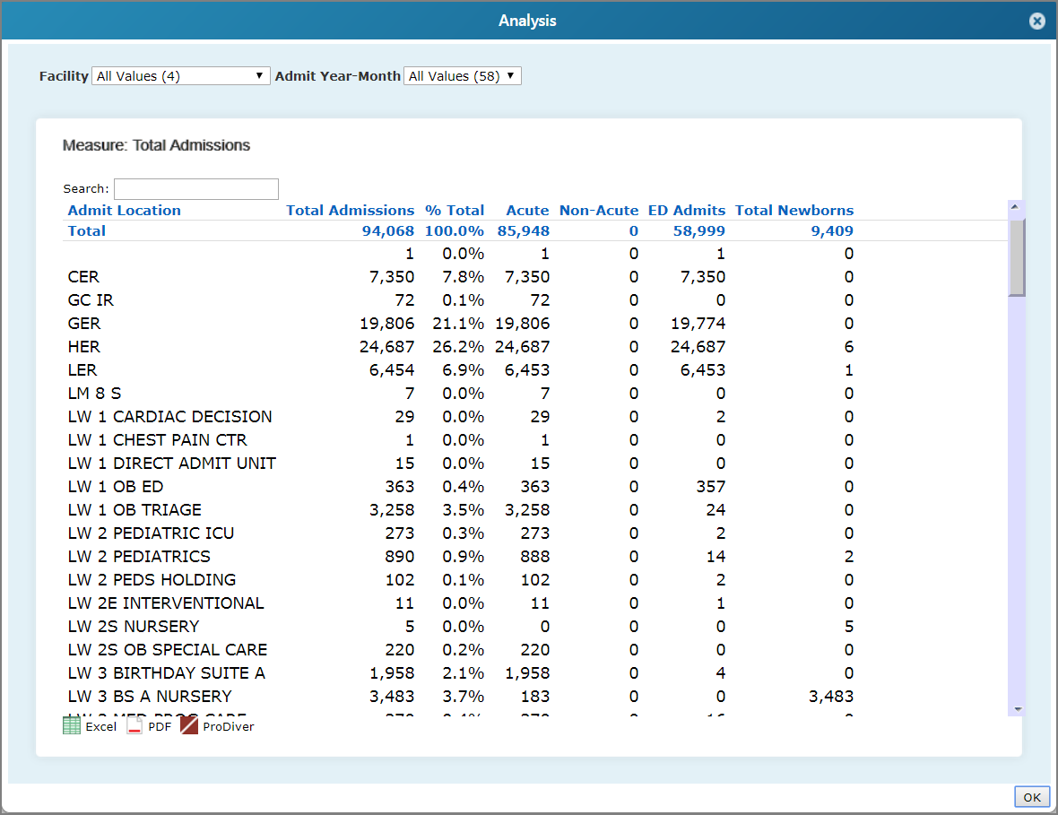
Measure Dictionary (Continued)
Select Definition to review the measure’s definition.
Select Analysis to perform an analysis on the measure.

Slide 35
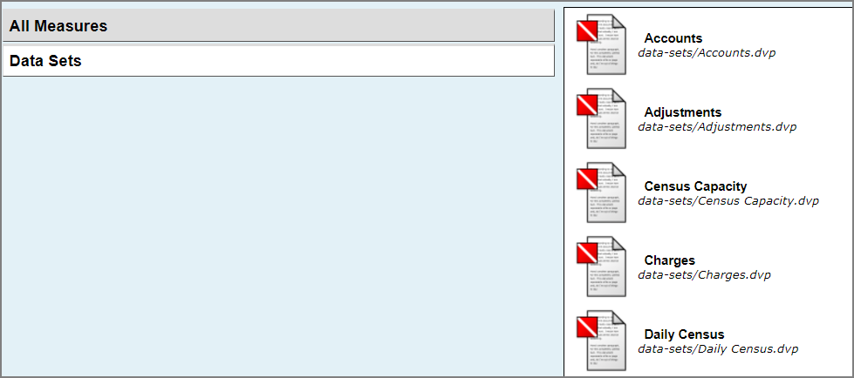
Ad Hoc Analysis
Access all Measure Factory measures and data sets in ProDiver

