Slide 1


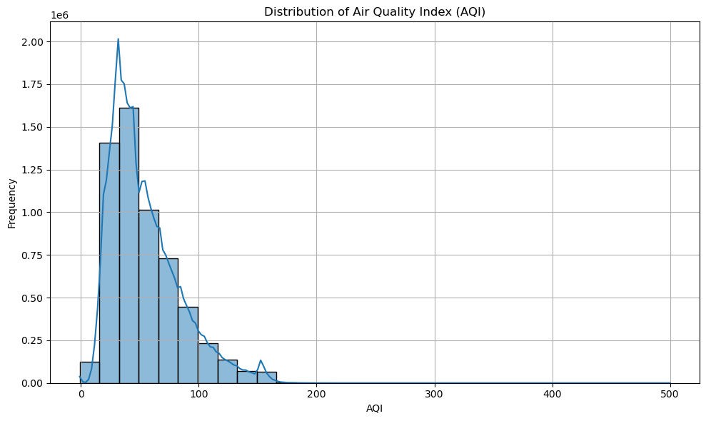
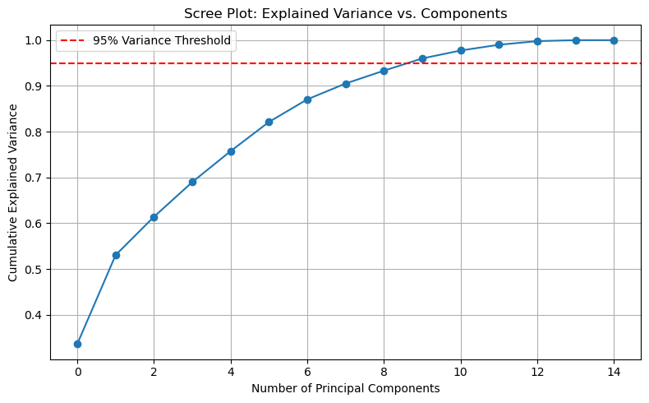
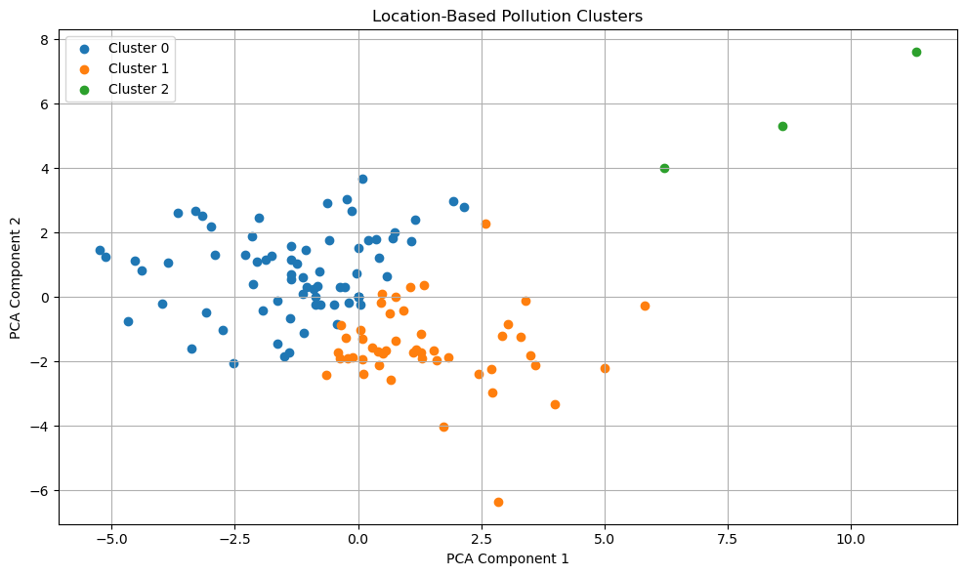
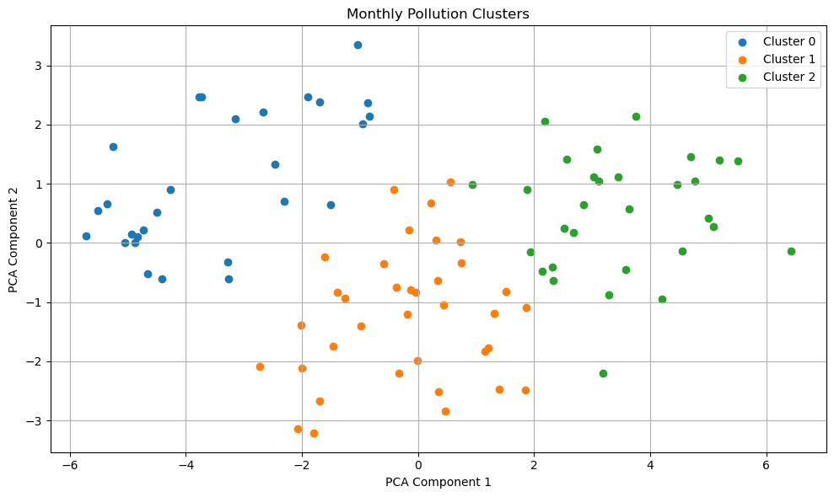
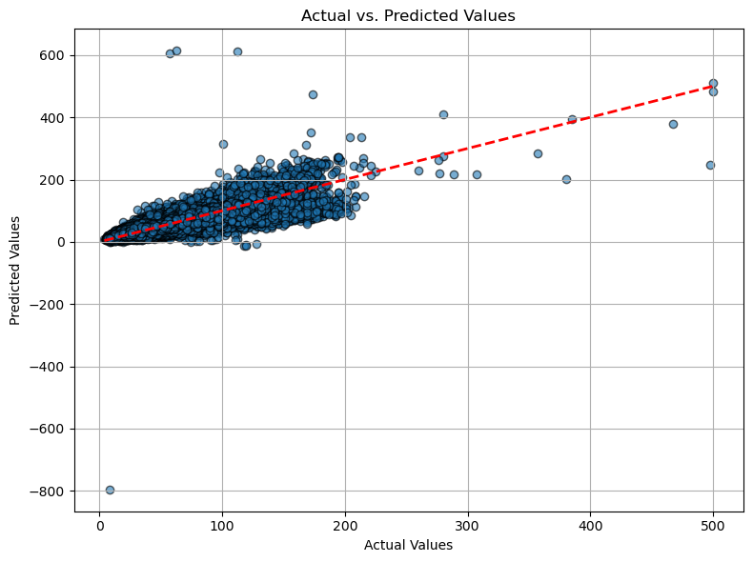

Taiwan Air Quality vs Pollutants
Liz Ragsdale, Nam Huynh, and Martina Nesbeth – May 2025
Advisor: Dr. Mehmet Aktas
INTRODUCTION
RESULTS
The dataset is from Kaggle and includes the air quality data of Taiwan from 2016 – 2024. The Air Quality Index (AQI) detects the level of pollutants in the air. In this study, the AQI is being compared to various pollutants such as PM2.5, PM10, Ozone(O3), Nitrogen dioxide (NO2), Sulfur dioxide (SO2), and Carbon monoxide (CO). The variables that the air quality is being tested against are:
Location of quality test sites
Surrounding location information (City/County)
Dates of the tests
Wind information recorded during the time of tests
The purpose of this study is to analyze how various environmental pollutants interact to influence AQI across different regions and seasons in Taiwan. The study will help to develop better air pollution strategies and protect human health not only in Taiwan but also in the United States.
The scree plot confirmed our suspicion that there is multicollinearity between variables, with the total variance explained leveling out around 10 of the 14 components
K-means cluster analysis based on location revealed 3 distinct clusters (rural, coastal, or low-density residential; densely populated, light-industrial; high density, industrial, historical urban)
Cluster analysis based on time revealed 3 distinct clusters (summer, transition season, winter)
Regression analysis using PCA components capturing 87% of variance could predict AQI values with an RMSE of about 10 units
Figure 1: Frequency distribution plot of AQI, showing a right-skewed distribution
Figure 2: Scree plot mapping the number of principle components needed to explain 95% of the total variance in the data out of the original 14 components.
DISCUSSION
Most AQI values are below 100, peaking around 40, with a long tail indicating less frequency of poor air quality.
Based on the evidence of multicollinearity from the scree plot, we can trust the PCA regression model has less noise and more accurate results from the reduced number of overall components
Cluster analysis revealed there are distinct clusters with both location and time that warrant further investigation into geospatial and temporal trends in data.
The predictive regression model overall had predictions deviate around 10 or less AQI units from the actual AQI. The model struggled with the AQI values over 200, which often corresponded to uncommon extremes within the original data.
METHODOLOGY
Figure 3: Visualization of the clusters formed from the K-means cluster analysis for location
Figure 4: Visualization of the clusters formed from the K-means cluster analysis for time
The methodologies utilized are:
Principal Component Analysis (PCA)
Multiple Linear Regression (MLR)
Cluster Analysis
The multiple linear regression is used to model the air quality Index as a function of pollutant concentrations. The Principal Component Analysis reduces dimensionality and uncovers latent pollution patterns. The cluster analysis classifies similar locations or time periods based on pollution profiles.
MULTIPLE LINEAR REGRESSION MODEL
Metric | Value | Explanation
R² (R-squared) | 0.8771 | Indicates that 87.71% of the variance in AQI is explained by the model. A higher R² means better fit.
MAE | 7.33 | The model’s predictions are, on average, off by 7 AQI units. Measures average absolute error.
MSE | 106.68 | Represents the average of the squared errors. Penalizes larger errors more heavily than MAE.
RMSE | 10.33 | The square root of MSE. On average, predictions deviate from actual AQI by about 10.33 units.
CODE & SOURCES
Dataset: https://www.kaggle.com/datasets/taweilo/taiwan-air-quality-data-20162024/data
Further Air Quality information: https://www.airnow.gov/aqi/aqi-basics/
Figure 5: Mapping of predicted values from the multiple linear regression model compared to the actual values

