Slide 1


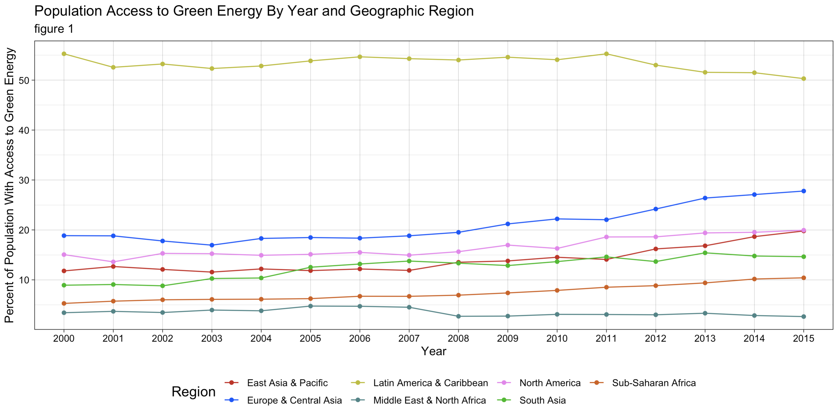
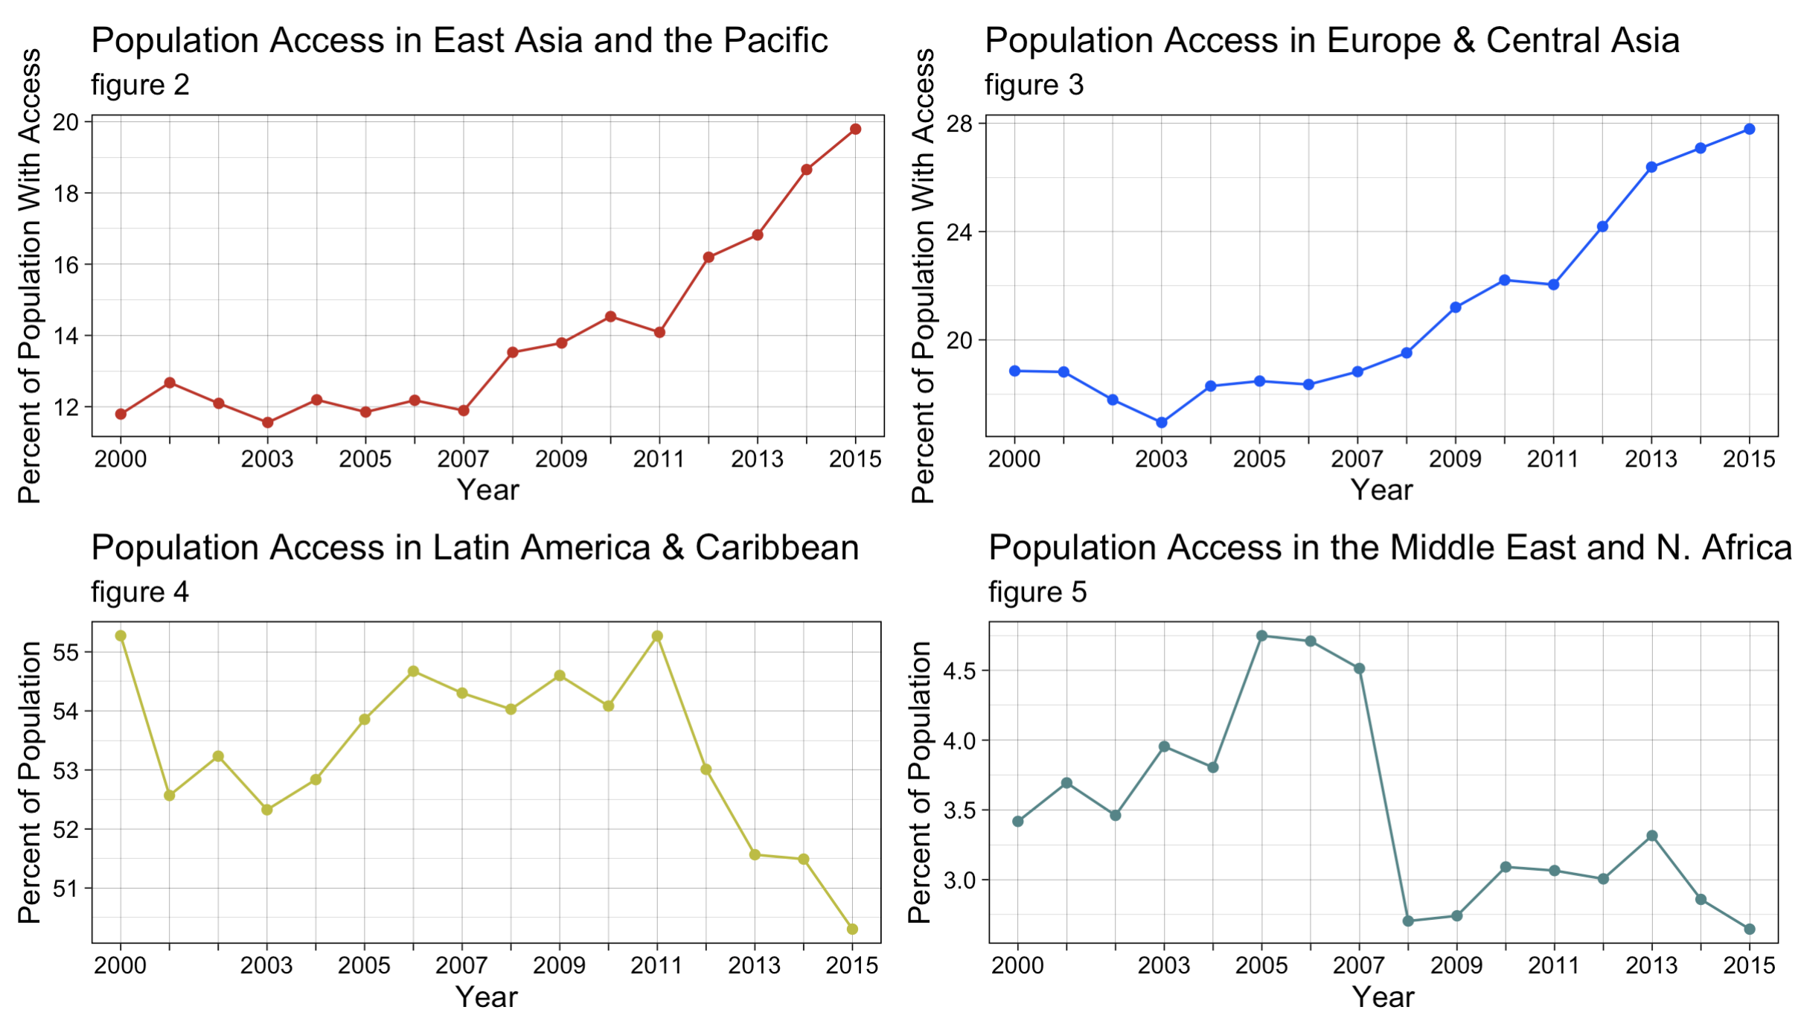
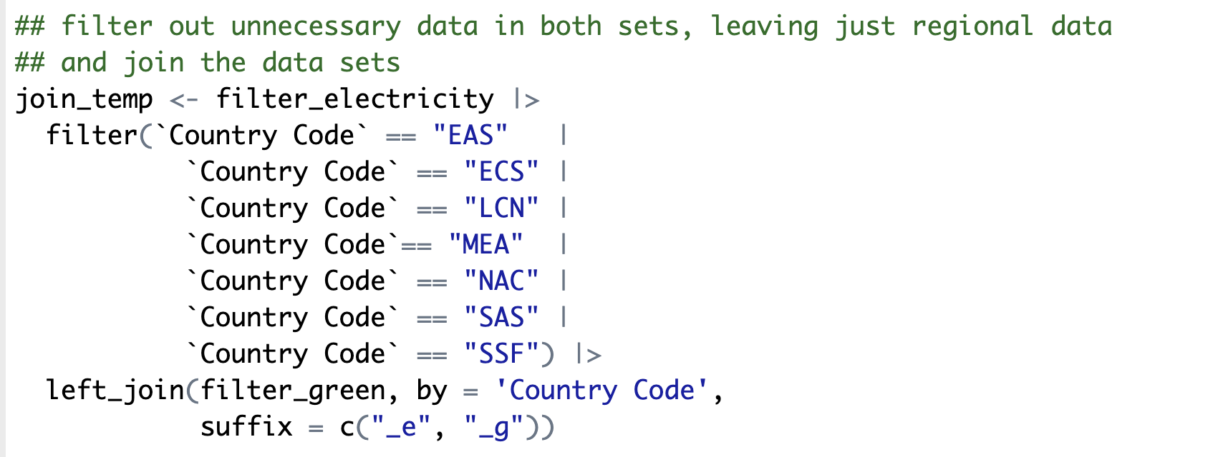
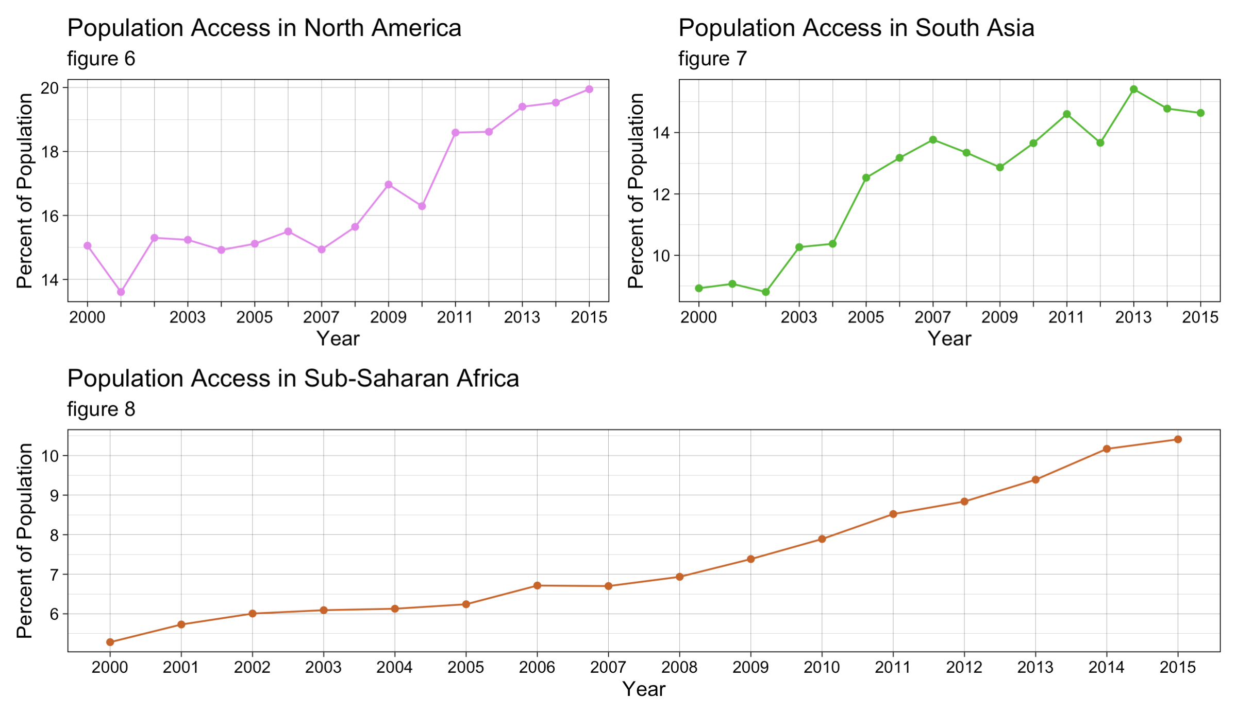

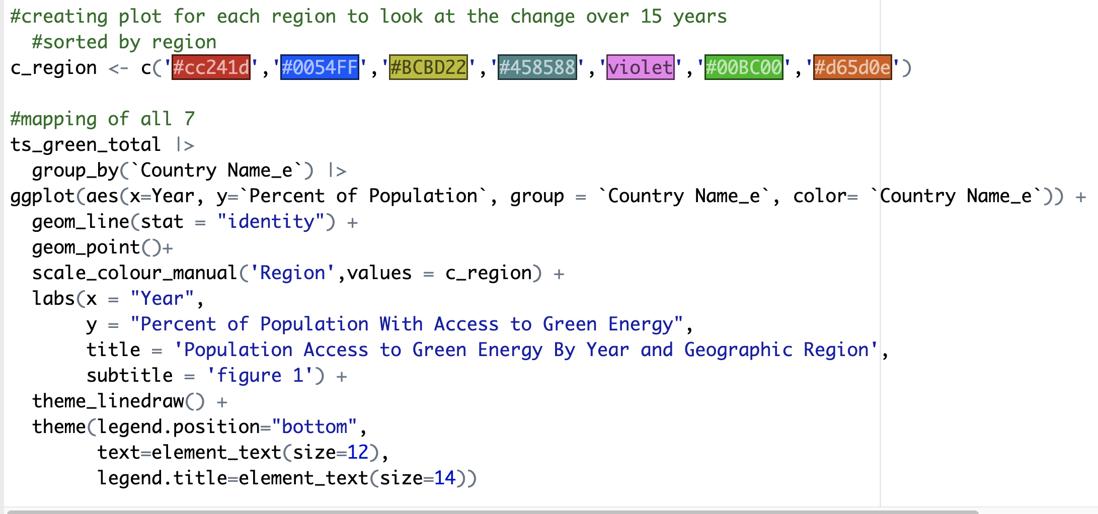
Time Series Analysis of Global Access to Renewable Energy
Liz Ragsdale – May 2025
INTRODUCTION
Dr. Austin Brown
DISCUSSION
When creating and analyzing data to compare between groups, its important to ensure the metric being used accurately represents the groups being compared. With that in mind, the goal in this analysis is to be able to compare the use of green energy between countries or groups using a more accurate metric than the percent of renewable energy output alone would be. The renewable energy output measure fails to account for what percentage of the population has access to electricity to begin with, it only accounts for the electricity generated.
Using this metric, a time series analysis of population access to renewable energy is conducted over a 15-year time frame.
While several groups saw growth of about 5-10% in 15 years, this was notably not the case for Latin America and the Middle East and South Asia regions. The Middle East’s result likely due to heavy impact of oil drilling and funding in the area, whereas South Asia and Latin America’s lack of growth are more closely tied to improvements in electricity access where implementation of renewable options has fallen behind, but additional analysis and research would be required to confirm.
A shortcoming of this analysis is the time frame is not representative of a more recent time frame. It wasn’t possible due to widespread data about renewable energy generation being unavailable past 2015. This also restricts the ability to potentially expand into a time series forecast, predicting changes in green energy availability into the future.
This analysis provided a wealth of opportunities for expansion on the topic or new directions for further research, with potential options listed below:
Different groupings of countries, like by economic income ranking
Creating large plots of individual country data to find outliers in the trends, used as a basis for a closer look into what those outliers are doing different development wise
Regression of relationship between total energy availability and green energy availability
METHODS
This analysis was conducted using two datasets acquired from the World Bank Data archive. The first being a longitudinal set regarding the percentage of a country that has access to electricity and the second being a longitudinal set detailing the percentage of a country’s electricity production generated by renewable means. Both sets were filtered to only return data by geographic region from the years 2000-2015. All data was managed within an R program.
The variable population access to green energy was determined by the equation:
Total electric access × % green energy / 100
Total access to renewable (green) energy was calculated per year and geographic region and formatted to conduct an exploratory time series analysis.
R CODE
RESULTS
The East Asia and Pacific region saw around a 7% increase in availability of renewable energy, ending near 20% availability
Europe and Central Asia saw a 10% rise, ending near 28% availability
Latin America and the Caribbean had an 8.5% decrease in availability, but still has over 50% green energy availability
The Middle East and North Africa saw a 1% decrease, ending at 2.7%
North America has a 5% increase in availability, ending at 19.5% availability
South Asia saw a 1.5% increase, ending at 16.8% availability
Sub-Saharan Africa has a growth of 5% in availability, ending at 26.6% availability.
References
IEA Statistics. (n.d.). Renewable electricity output (% of total electricity output). World Bank Open Data. https://data.worldbank.org/indicator/EG.ELC.RNEW.ZS
IEA, IRENA, UNSD, World Bank, WHO. (n.d.-a). Access to electricity (% of population). World Bank Open Data. https://data.worldbank.org/indicator/EG.ELC.ACCS.ZS

