Slide 1
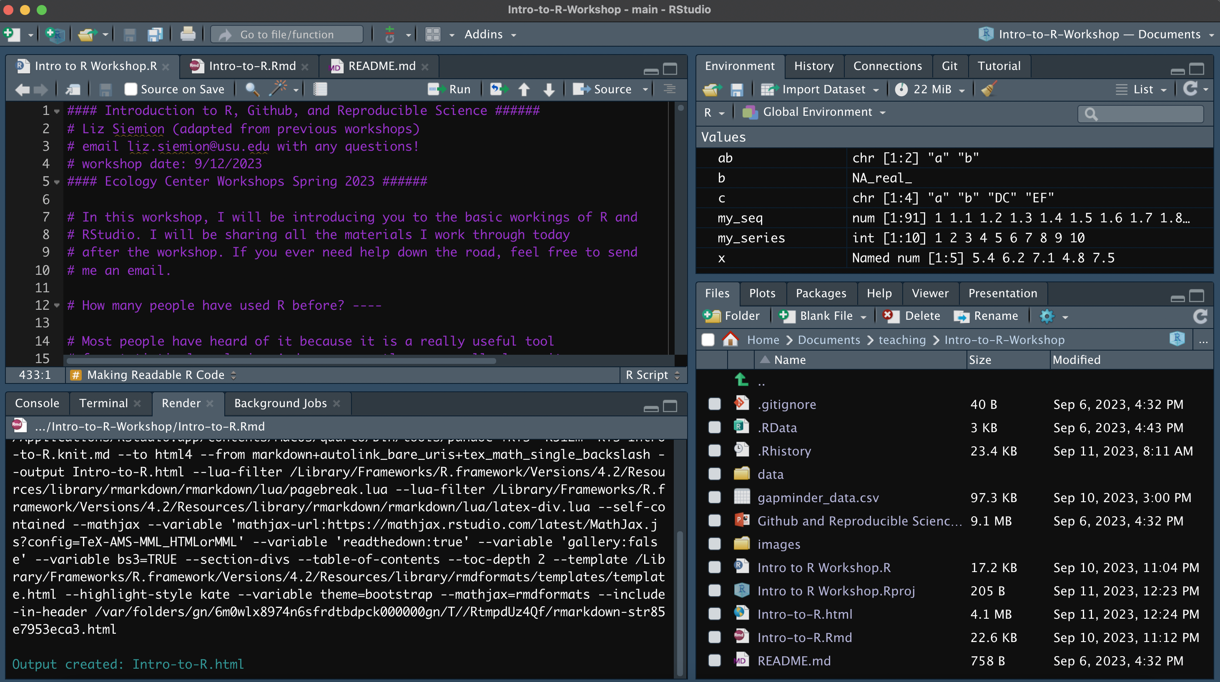
Interactive Console
Environment/History
Code Editor: R scripts written here
Files/Plots/Packages/Help/Viewer
Console: where code is executed

Slide 2
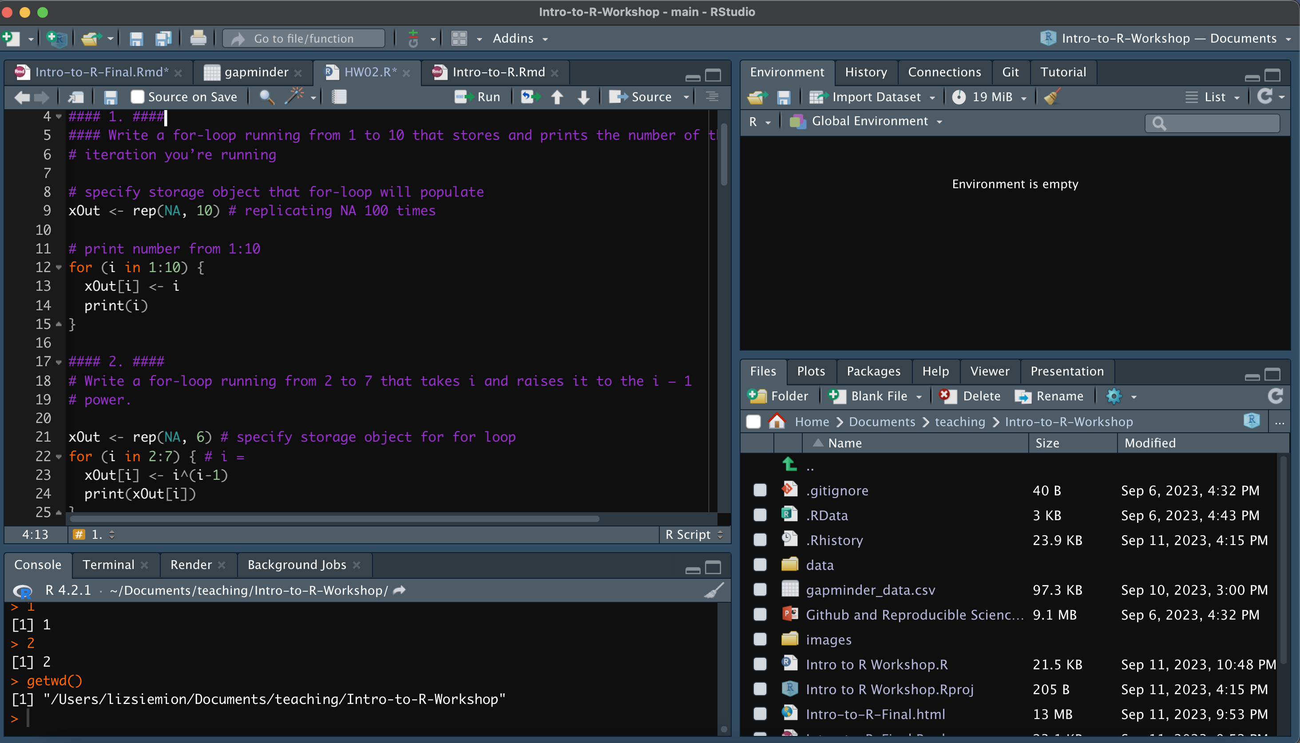
absolute file path of your
Working directory

