Slide 1

VENDORCAP
Connecting the world's best Chinese sellers to global marketplaces
Shenzhen, China

Slide 2
THE PROBLEM WE SOLVE
Marketplaces can't efficiently access China's best sellers from the outside.
Internal vetting teams process whoever applies — they don't source proactively.
The result: mixed seller quality, catalog gaps, and missed GMV.
2

Slide 3
WHO WE ARE
Shenzhen-Based
A seller acquisition company operating from the heart of China's manufacturing and e-commerce ecosystem.
Expert Leadership
Founded by a former Amazon strategic partnerships manager and McKinsey consultant.
15+ Years Experience
Deep operating experience inside China's manufacturing and cross-border e-commerce ecosystem.
3

Slide 4
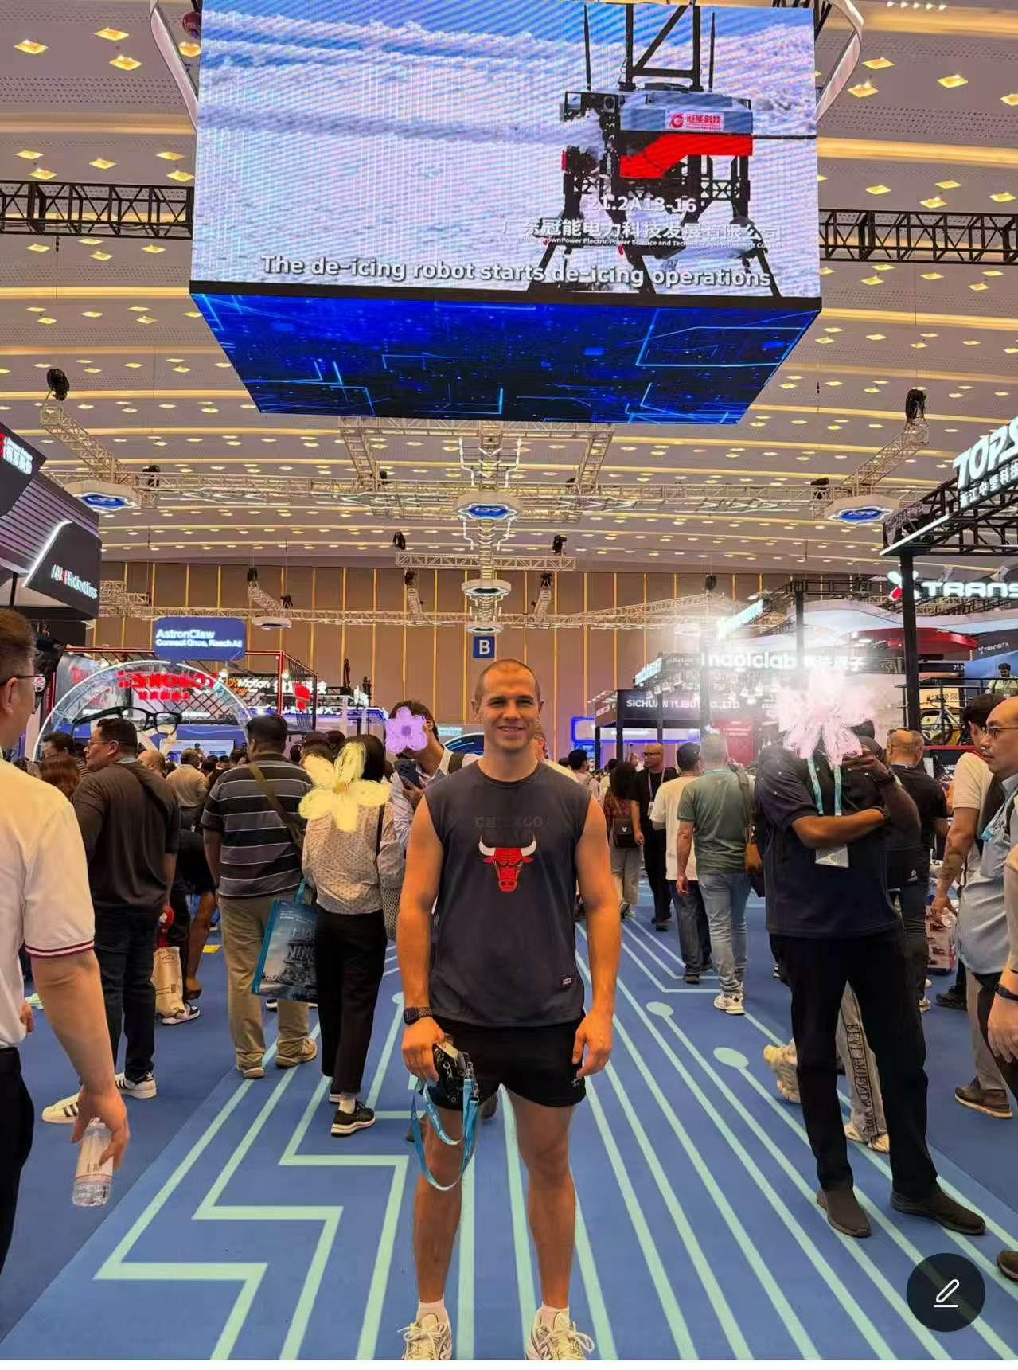
WHAT WE DO
One thing — Seller Acquisition
We identify, qualify, and deliver experienced Chinese sellers that match a marketplace's specific category needs.
We don't do account management, advertising, or logistics.
We find the right sellers and get them to the platform ready to perform.
4

Slide 5
OUR SELLER NETWORK
10,000+ sellers. Proven, capital-backed, ready.
Experienced Operators
Capital-Backed
Proven GMV history across multiple platforms and categories.
Financially solid sellers with the resources to scale.
Multi-Platform
Seasoned Professionals
Already selling on Amazon, Shopee, AliExpress, and similar marketplaces.
Not newcomers — seasoned cross-border e-commerce operators.
5

Slide 6
HOW IT WORKS
Five steps from need to live seller
1
2
3
4
5
Marketplace shares category needs
We search and match from our network
We present a qualified shortlist
Marketplace approves
Sellers onboard and go live
6

Slide 7
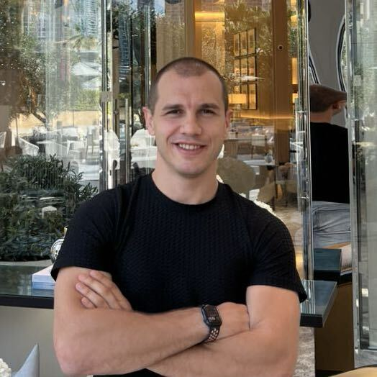
PLATFORMS WE WORK WITH
50+ platforms across 6 continents
Leroy Merlin
Cdiscount
eMAG
Takealot
and 46+ more marketplace partners worldwide
7

Slide 8
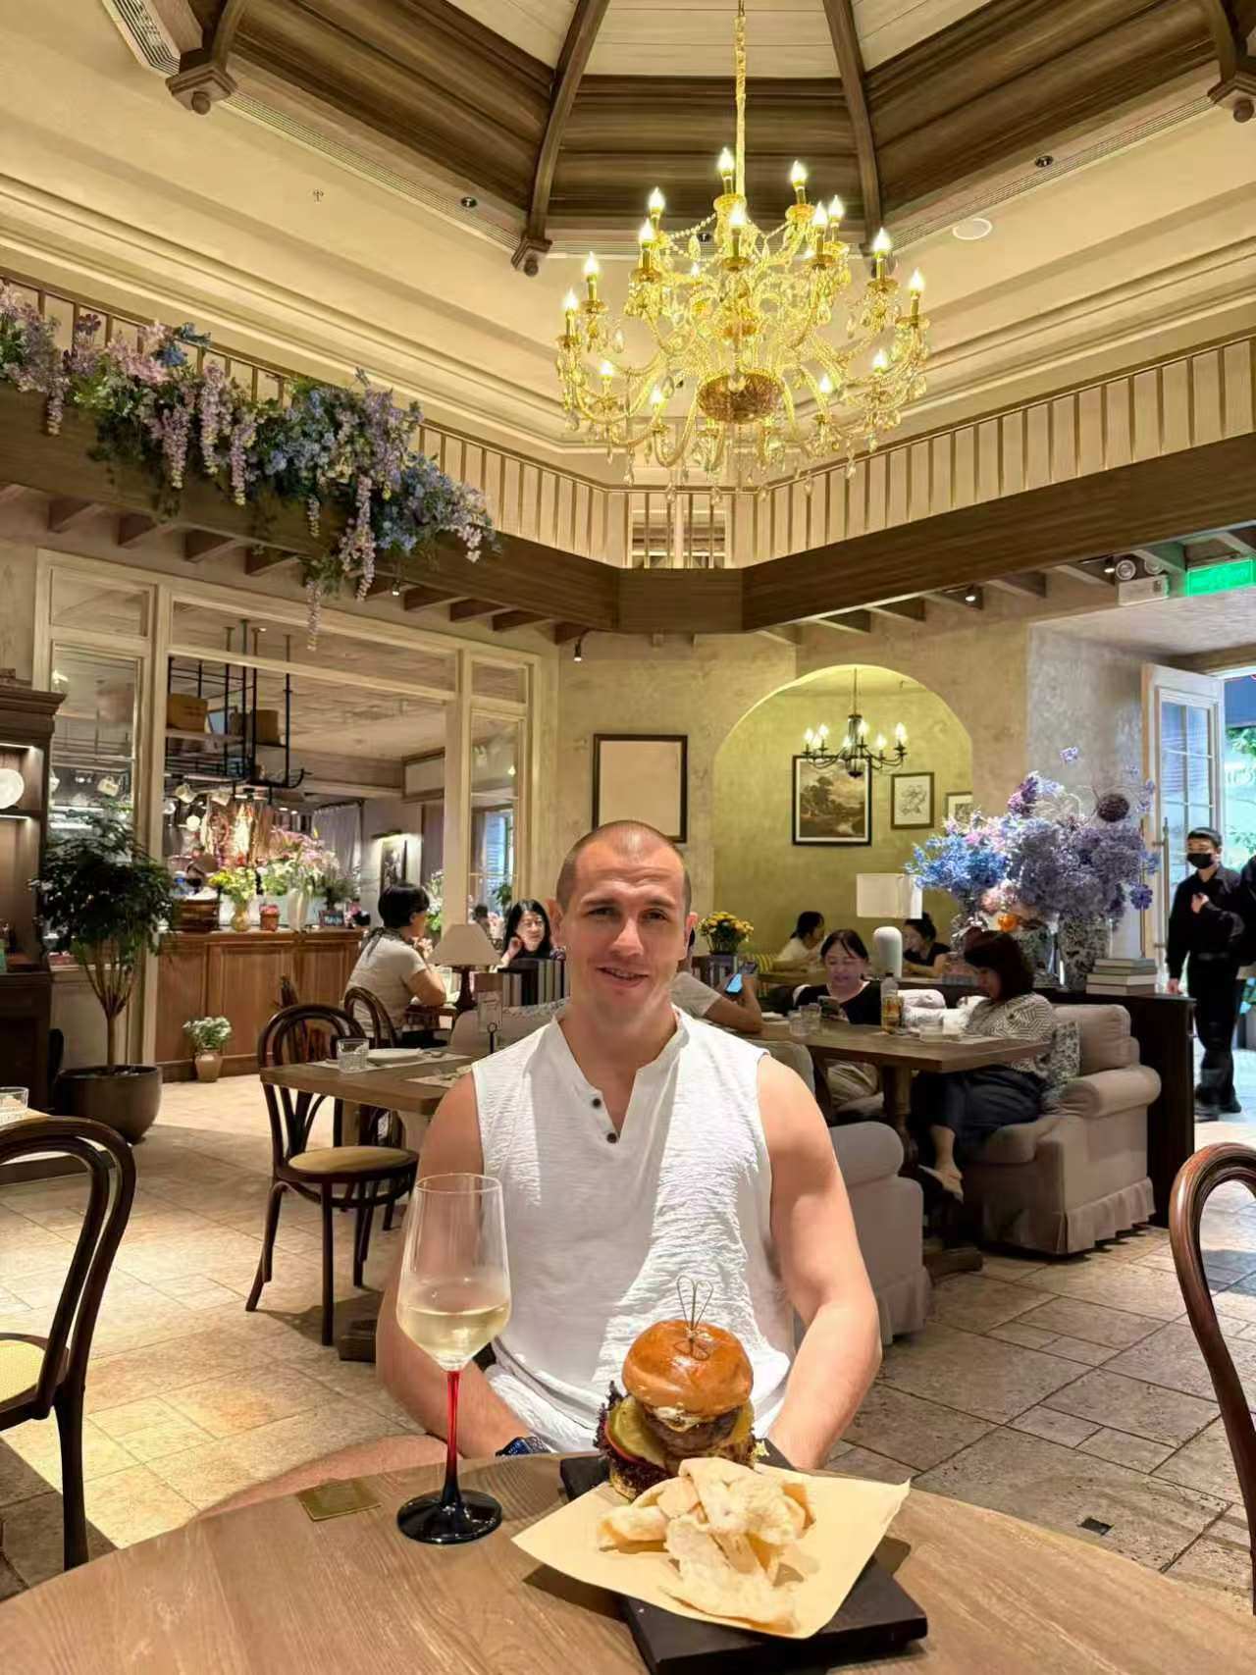
RESULTS
Sellers placed by VendorCap have generated over $2B in GMV
Across partner platforms, over the past two years:
10,000+
Verified sellers in our network
50+
Marketplace platforms served
$2B+
GMV generated by placed sellers
6
Continents covered
8

Slide 9
WHY VENDORCAP
Pre-qualified beats first-come, first-served
Open Applications
VendorCap
• Mixed seller quality
• High internal vetting cost
• Unpredictable performance
• Pre-qualified sellers
• Category-matched to your needs
• Ready to perform from day one
9

Slide 10
COMMERCIAL MODEL
1%
✓
No retainer
✓
No setup fee
commission on seller GMV
✓
No cost until sellers generate revenue
Nothing else.
✓
Fully aligned incentives
10

Slide 11
OUR REACH
Europe
Africa
Middle East
Central Asia
Southeast Asia
11

Slide 12
VENDORCAP
Let's Talk
Martin Kaufman, Founder
martin@vendorcap.global
vendorcap.global
Shenzhen, China

