Slide 1
Analysis of Height, Age and Weight of Olympic Athletes
Programming Course Project

Slide 2
Research Question
What are the maximum and minimum values for age, weight, and height among olympic athletes across all sports?
How do these values differ between men and women?

Slide 3
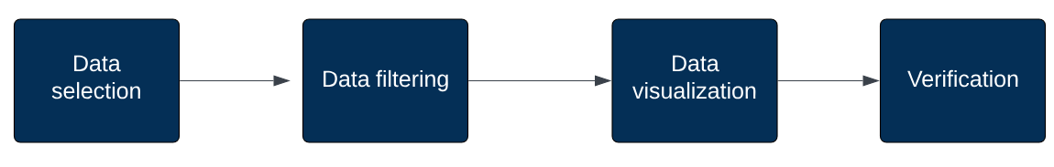
Process

Slide 4
Data Selection

Slide 5
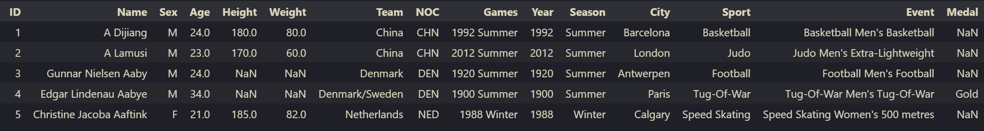
Dataset
Data about more than 130k athletes across 66 distinct sports over the span of 120 years (Athens 1896 - Rio 2016)
Columns of interest for our use case:
Age
Weight
Height
Sex
Sport

Slide 6
Data Filtering

Slide 7
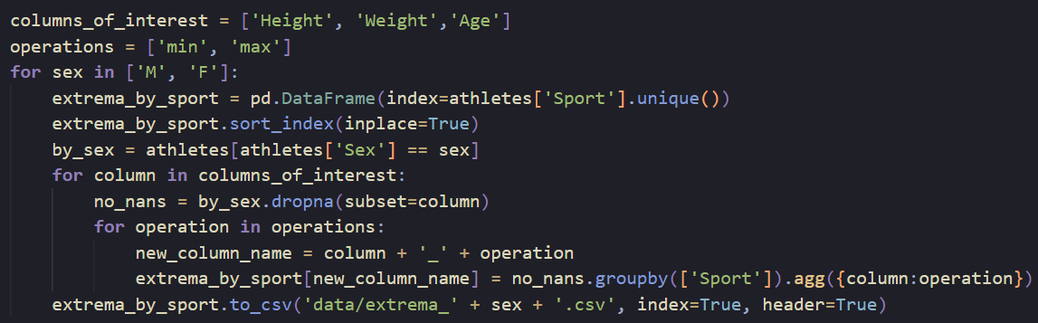
Collecting data for each sex
extrema_by_sport: data frame with the 66 unique sports as indices
Filtered by sex by using boolean indexing
Eliminated columns with NaN values only from the particular column of interest
Used min and max operations to find the extreme values
Saved data to a csv (one for male athletes and another one for female athletes)

Slide 8
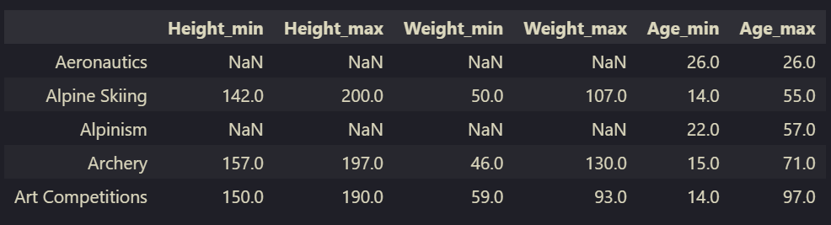
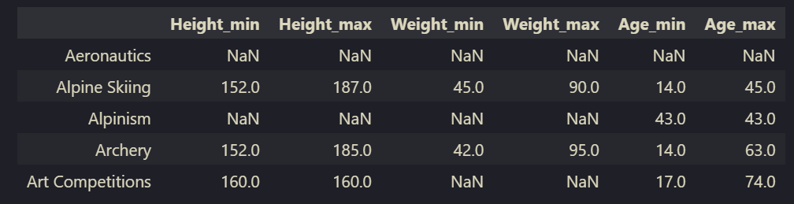
Generated dataframes
Male athletes
Female athletes

Slide 9
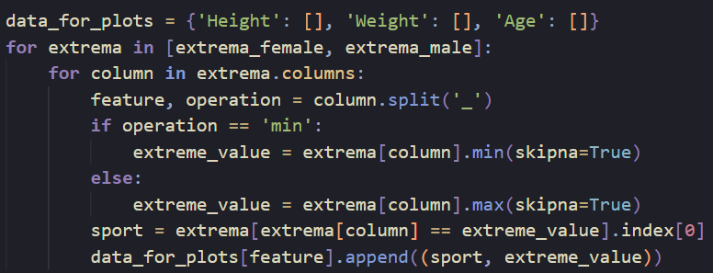
Restructuring the data
Used a dictionary to store all the data that would be needed for the plots
Minimum and maximum value of height, weight, and age for each sex
Together with the sport for each of these values

Slide 10
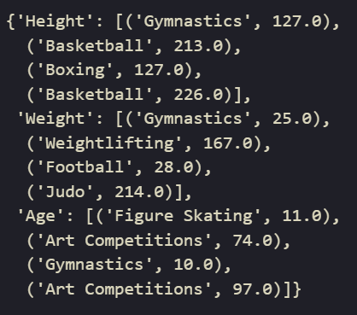
Generated dictionary
The first two values of each key correspond to the female minimum and maximum values
The last two values correspond to the male minimum and maximum values
Example (for height)

Slide 11
Data Visualization

Slide 12
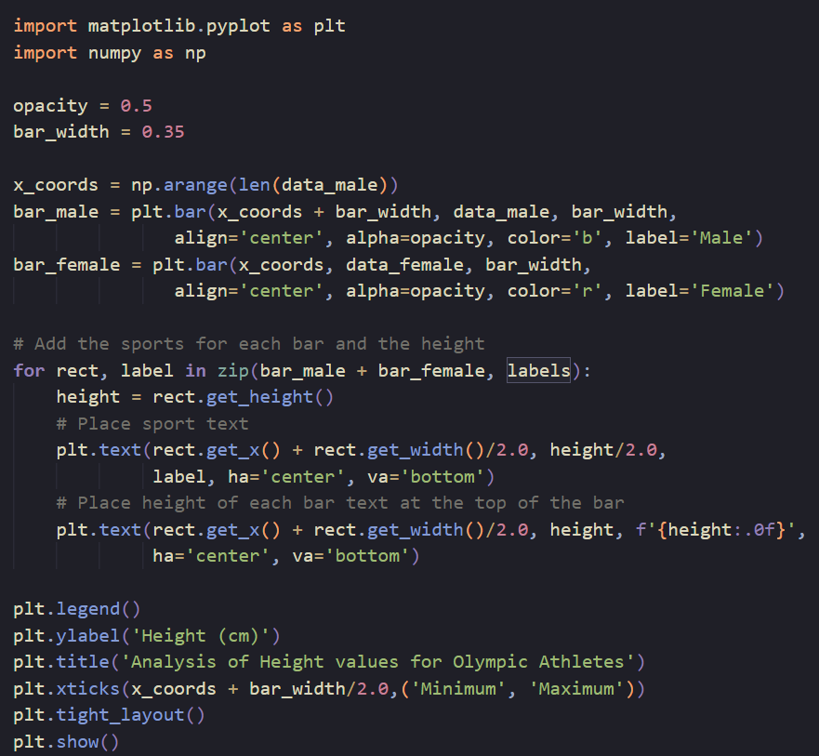
Generating plots
Plotted a grouped bar chart by manipulating the positions where the bars are plotted
Used np.arange to generate a np.array with the base x coordinates of each group
Plotted bars of male athletes first (on the right)
Plotted bars for female athletes next (on the left of the previous bar)

Slide 13
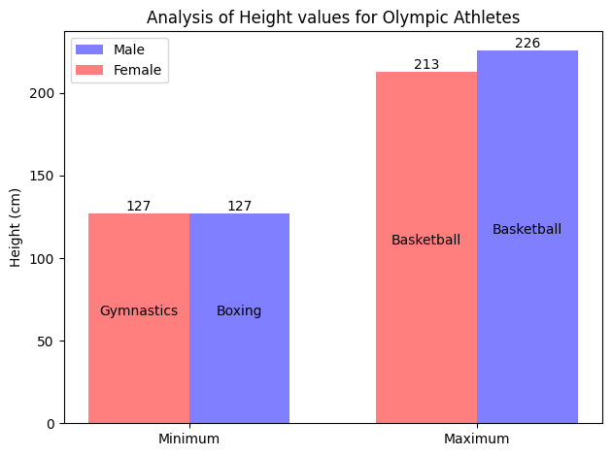
Extreme values for Height

Slide 14
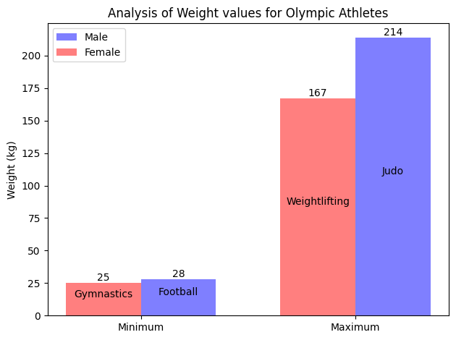
Extreme values for Weight

Slide 15
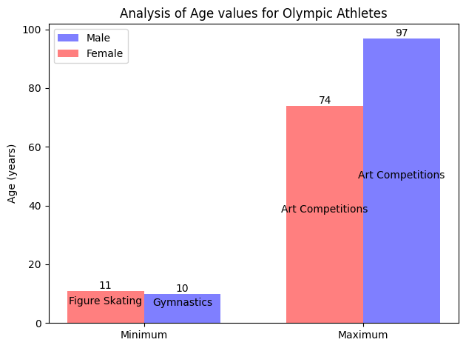
Extreme values for Age

Slide 16
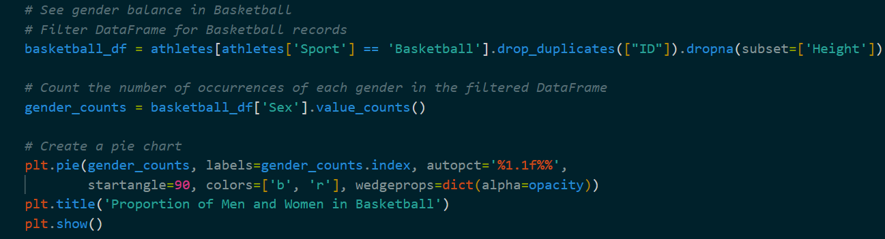
Generating plots (2)
Plotted pie charts to see gender proportion in the sports with minimum and maximum height
Each athlete should be counted only once, even if they appear in records multiple times, to not distort the total amount for athletes and gender proportion: used drop_duplicates([“ID”])

Slide 17
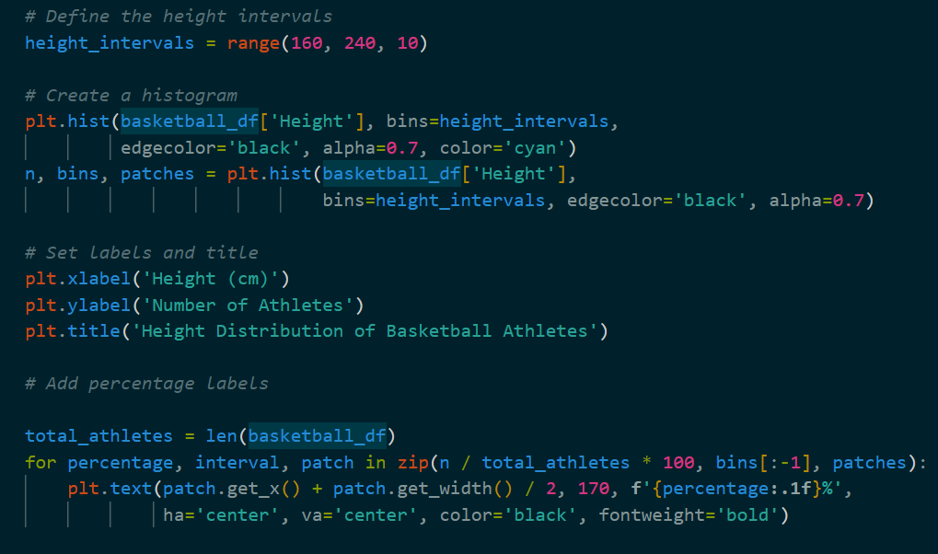
Generating plots (3)
Plotted bar chart of height distribution:
Created bins by assigning intervals of 10 cm
Added proportion of each bin in overall number of athletes in certain sport

Slide 18
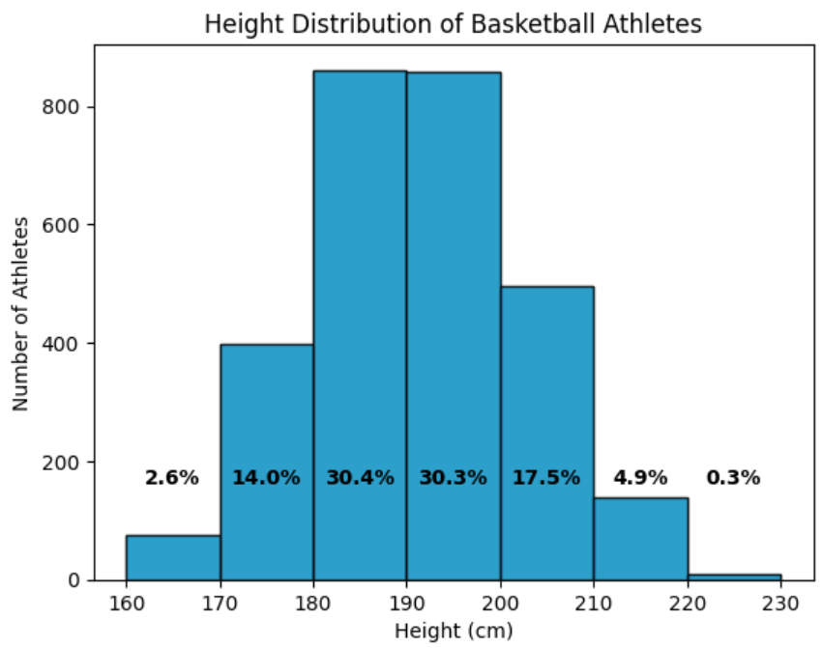
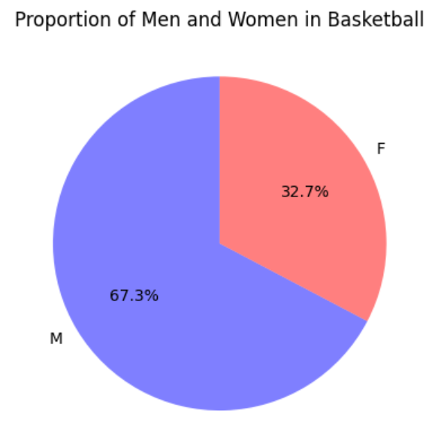
More details about height: Basketball

Slide 19
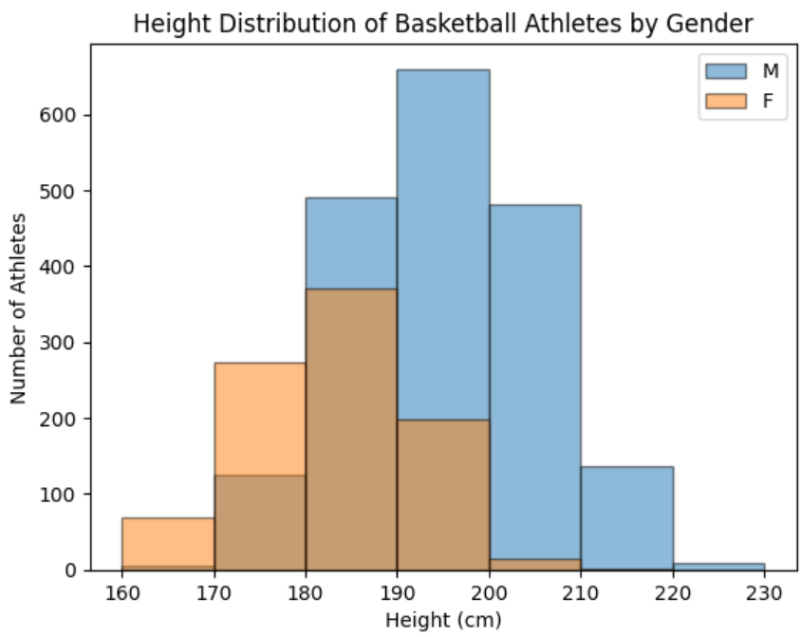
More details about height: Basketball

Slide 20
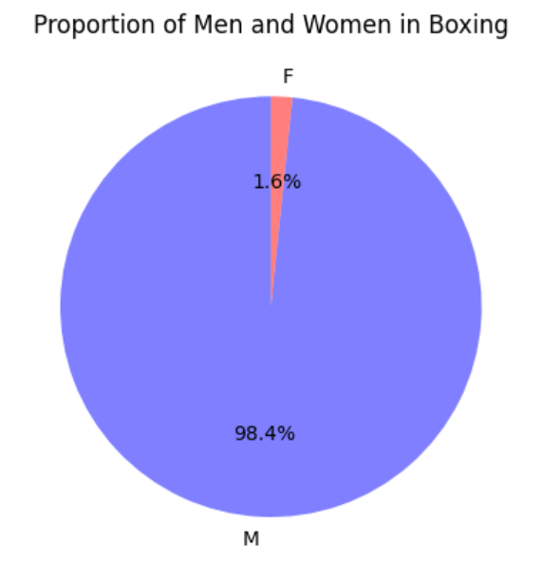
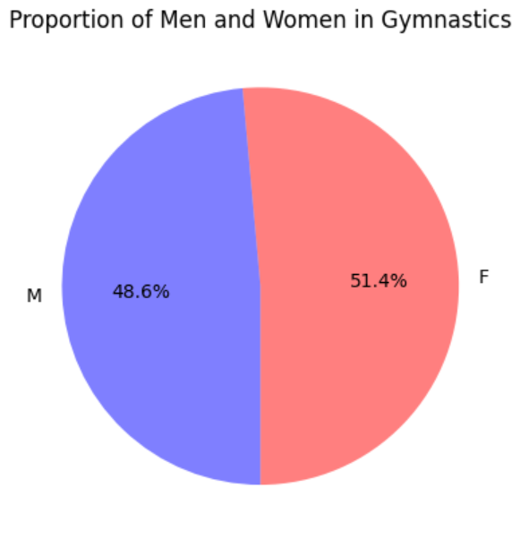
More details about height: Boxing and Gymnastics

Slide 21
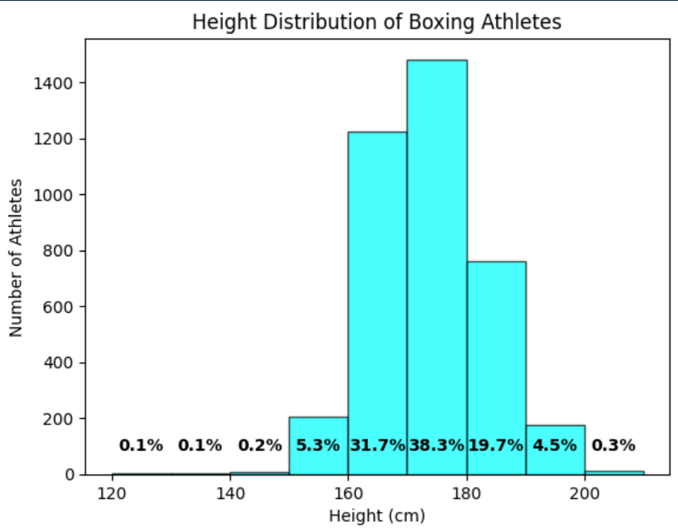
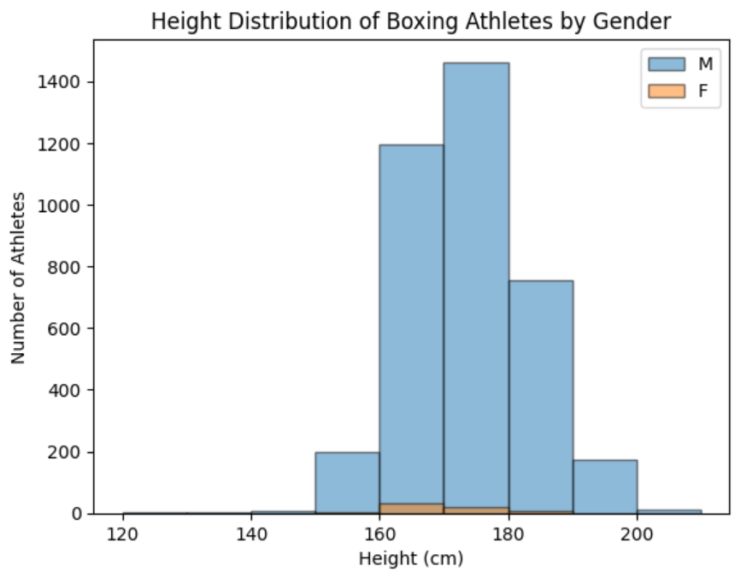

Slide 22
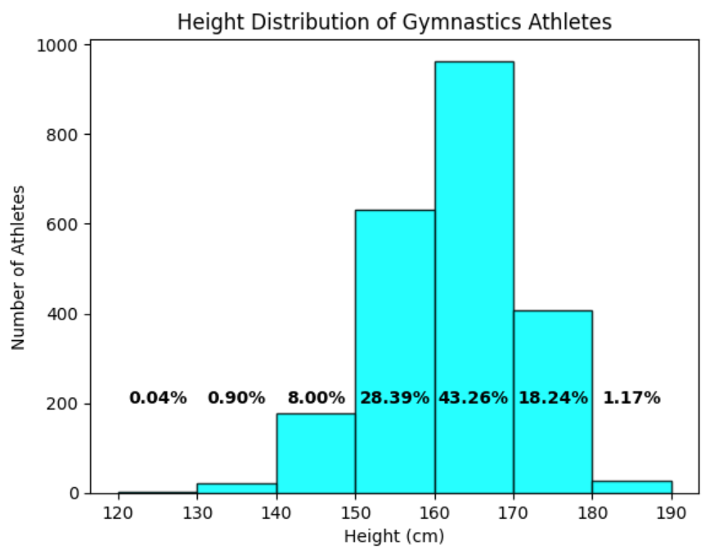
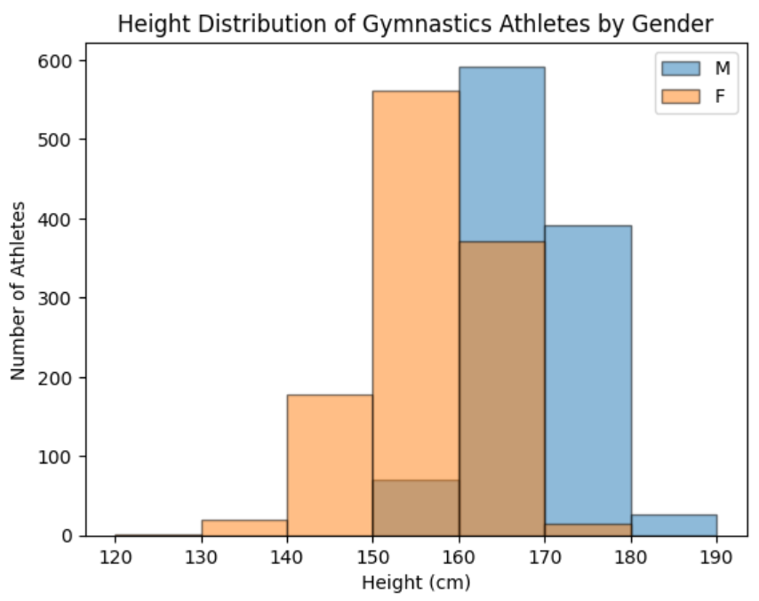

Slide 23
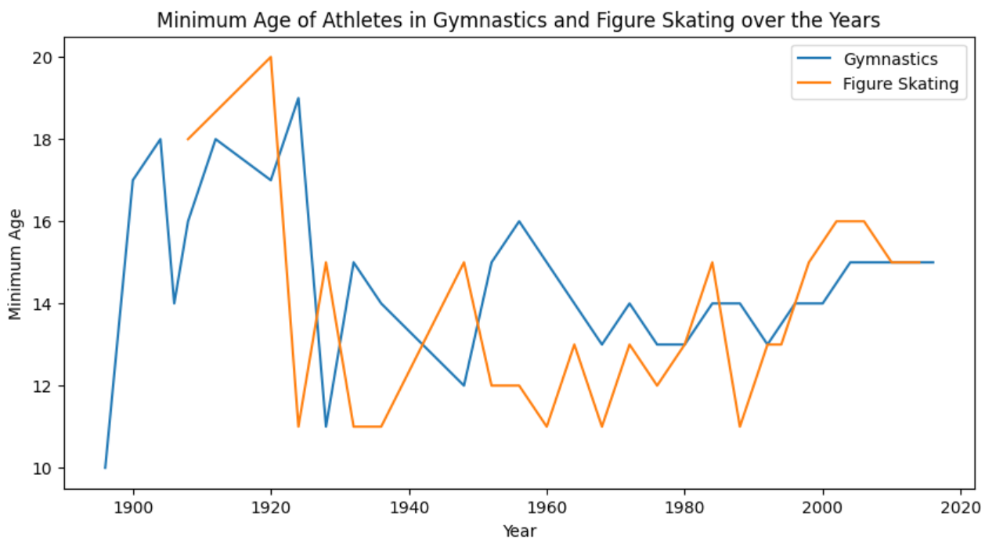
Youngest Athletes in Gymnastics and Figure Skating

Slide 24
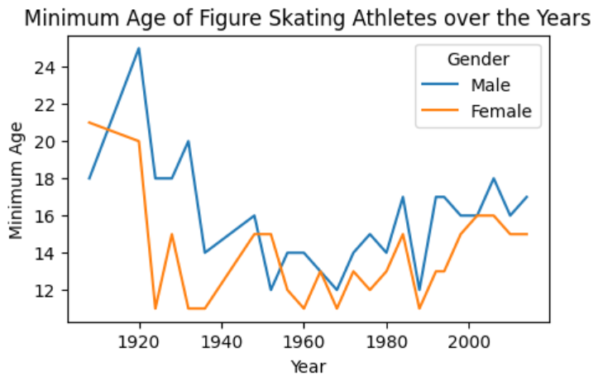
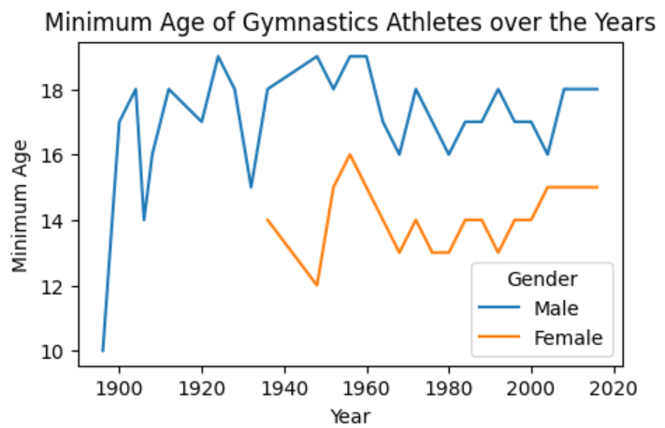

Slide 25
Verification

Slide 26
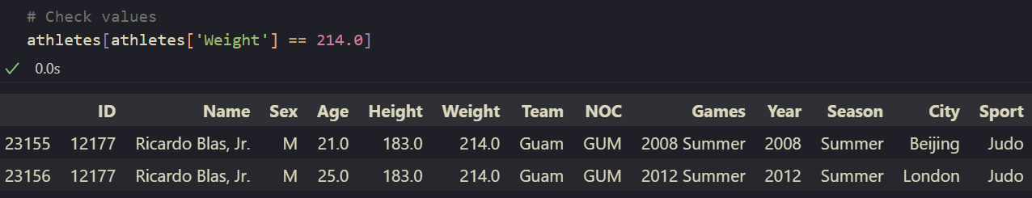

Heaviest athlete
Data obtained by us
Google search

Slide 27
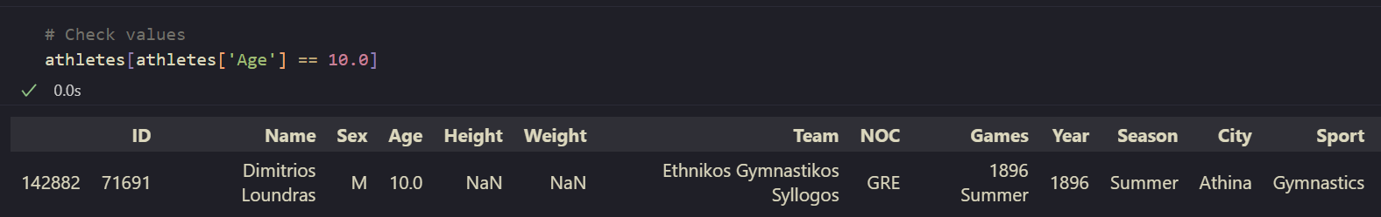
Youngest athlete
Data obtained by us
Google search

Slide 28
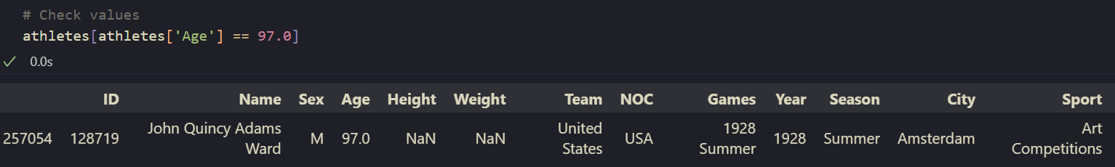
Oldest Athlete
Data obtained by us
Wikipedia entry for John Quincy Adams

Slide 29
Thank you for your attention!

