Slide 1
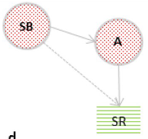
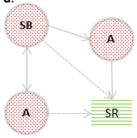
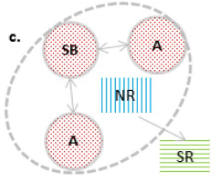
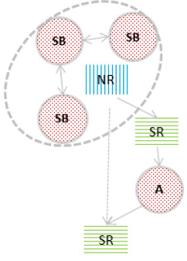
A.
B.
‘Partner mode’ structures
Open triangle
Original from Musiolik et al. 2020
‘Intermediary mode’ structures
Closed triangle

Slide 2
A.
B.
SB
SB
A
A
SR
A
SR
‘Partner mode’ structures
Closed triangle
SB
A
SB
SB
NR
NR
A
SR
SB
SR
‘Intermediary mode’ structures
A
Open triangle
SR

