Slide 1

AI, Custom Software Development
& Salesforce Capabilities
Clear. Focused. A Boutique Technology Partner

Slide 2
Where We Go Deepest
Three of our strongest practices, selected for where we add the most to your customers.
FOCUS AREA 01
FOCUS AREA 02
FOCUS AREA 03
AI & Data
Custom Software Development
Salesforce
Modern data platforms and production AI — from lakehouse architecture to enterprise AI agents.
WHERE WE HELP
Snowflake and Databricks platform builds and migrations
AI agents, RAG and document intelligence
Data governance, security and AI readiness
Senior-led engineering for the applications and integrations off-the-shelf platforms can’t cover.
WHERE WE HELP
Enterprise backends in Java, .NET, Python and Node.js
Native and cross-platform mobile apps
Integrations and APIs across enterprise platforms
Certified Salesforce delivery across core clouds, Agentforce and industry solutions.
WHERE WE HELP
Sales, Service and Experience Cloud
Agentforce and workflow automation
Health Cloud, CPQ and CRM data foundations

Slide 3
Why a Specialist Partner
We extend your bench where depth matters — not duplicate what you deliver.
ENTERPRISE AI
SALESFORCE
DELIVERY MODEL
Since 2019
90+
US + India
Enterprise AI in production
Our dedicated AI practice has shipped conversational, knowledge and agentic AI for years — not months.
Salesforce certifications
Certified talent across architecture, platform, marketing and DevOps, ready for complex programs.
Onshore leadership, scalable delivery
U.S. offices in Texas and Illinois, with delivery centers in Hyderabad.
WHAT THAT MEANS FOR YOU
Multi-LLM, secure enterprise deployment
Governance and audit logging built in
Proven: 99.6% invoice auto-reconciliation
Architect-level design authority
Core, Agentforce and industry clouds
Integration with data and custom apps
Senior, U.S.-based engagement leads
Delivers under your customer relationship
Fast mobilization for defined scopes

Slide 4
FOCUS AREA
HOW OUR DATA & AI CAPABILITIES FIT TOGETHER
01
AI & APPS
AI Agents
Domain agents, RAG and conversational AI
Document AI
OCR, NLP, search and summarization
AI & Data
Modern data platforms and production AI — from lakehouse architecture to enterprise AI agents.
PLATFORM
Modern Data Platform
Lakehouse and medallion architecture on Snowflake and Databricks
FOUNDATION
Engineering & Governance
Migrations, ELT pipelines, lineage, RBAC and PII controls
Snowflake
Databricks
AWS
YOUR DATA
ERP & CRM
SQL Databases
IoT & Time-Series
Documents
Claude
OpenAI
RAG

Slide 5
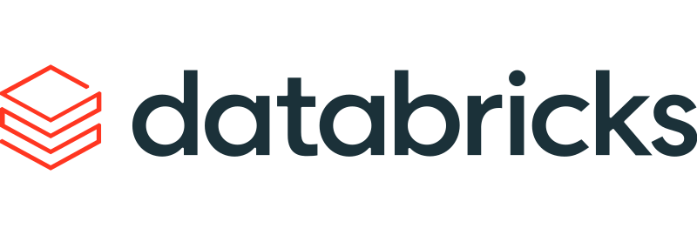

Data & AI Capabilities Framework
From lakehouse architecture to production AI agents.
Data Architecture
Lakehouse design
Medallion (Bronze/Silver/Gold) architecture
Real-time ingestion
Cross-cloud data interoperability
Data mesh & domain modeling
Data Engineering
Large-scale migrations
ELT accelerators
Observability & pipeline metrics
Pipeline orchestration & CI/CD
Cost & performance tuning
AI & Machine Learning
Domain-specific AI agents
LLM integration (Claude, OpenAI, etc.)
Vector indexing & semantic modeling
Model registry & ML-Ops
Retrieval-augmented generation (RAG) design
Governance & Security
RBAC & federated architectures
GDPR & SOC2-ready controls
Data masking & PII compliance
Enterprise data catalog & metadata models
Access auditing & lineage tracking

Slide 6
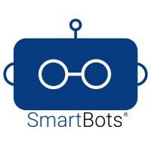
Enterprise AI Capability - Built & Delivered Since 2019
Platform Capabilities
Multi-LLM support
Secure enterprise deployment
API-first integrations
Governance & audit logging
Knowledge AI & NLP
Enterprise search
Document summarization
Context-aware responses
2019
2023
2021
2025
Conversational AI
Enterprise chatbot deployments
Workflow-driven automation
CRM / ITSM integrations
Agentic AI
Multi-step task execution
Cross-system automation
AI-driven workflow orchestration
Palni’s Enterprise AI Subsidiary

Slide 7
Modern Data Platform on Snowflake
The Challenge
What We Did
A global clean energy platform managing solar, wind, and storage data faced data fragmentation across InfluxDB, SQL Server, and analytics databases.
Historical and daily data streams were siloed, and reporting was slow, error-prone, and inconsistent across teams.
We designed a robust data pipeline and reporting layer using Snowflake.
  Migrated 35M+ records from 3 source systems in minutes
  Set up daily incremental pipelines with limitless scaling
  Eliminated data silos with a single reporting layer
  Enabled real-time access via a user-friendly, low-code interface
  Built secure, configurable metadata-driven architecture
The Transformation
Clean, consolidated energy data at scale — powering faster decisions and enterprise visibility.
  🔄 70% faster reporting times
  🧩 3 data sources unified into a single source of truth
  📊 Real-time access via low-code platform
  💵 30% cost reduction in data infrastructure

Slide 8
Real-Time Invoice Reconciliation at Scale
The Challenge
What We Did
A major auto group was drowning in mismatched invoice formats.
Finance teams were manually reconciling Excel, PDF, and CSV invoices — all structured differently across OEMs.
This created delays, manual rework, and frequent errors that impacted payment cycles and reporting.
We deployed a GenAI-powered invoice reconciliation solution using OCR, NLP, and scalable cloud infrastructure.
  Automatically processed and interpreted invoices across varied formats
  Standardized terminology across manufacturers (e.g., "Reference No." vs "Invoice ID")
  Matched invoices against multiple external reports
  Designed a low-latency, user-friendly UI with sub-2s response time
  Deployed on AWS for scale and flexibility
The Transformation
Finance teams now process thousands of invoices in real time — with unmatched speed and accuracy.
  ⚡99.6% auto-reconciliation rate across 7,970 invoices
  ⏱️600+ hours saved monthly by eliminating manual entry
  📉20% reduction in payment delays
  📈15% improvement in bookkeeping accuracy

Slide 9
FOCUS AREA
HOW OUR BUILD CAPABILITIES FIT TOGETHER
02
EXPERIENCE
Mobile Apps
Native iOS & Android, React Native, Flutter
Web & Frontend
React, Angular, PHP / Magento
Custom Software Development
Senior-led engineering for the applications and integrations off-the-shelf platforms can’t cover.
SERVICES
Enterprise Backend
Java, .NET, Python & Node.js — architecture through delivery, built to scale
INTEGRATION
Integration & APIs
APIs and middleware connecting custom apps to your enterprise platforms
Java
.NET
Python
Node.js
YOUR PLATFORMS
ServiceNow
Salesforce
Snowflake
ERP & CRM
React
Angular
Flutter

Slide 10
Custom Software Capabilities Framework
From enterprise backends to the apps and integrations around them.
Enterprise Backend
Java, .NET, Python & Node.js
Scalable, API-first architecture
Cloud deployment on AWS
Performance & security by design
Architecture through delivery
Web & Frontend
React & Angular applications
PHP / Magento commerce builds
Responsive, low-latency UI
Customer & internal portals
Front ends on existing platforms
JAVA · .NET
PYTHON · NODE.JS
REACT · FLUTTER
Mobile Applications
Native iOS & Android
React Native & Flutter cross-platform
Voice & conversational experiences
Field and customer-facing apps
Senior-led, single-team delivery
Integration & APIs
REST APIs & middleware
ServiceNow, Salesforce & Snowflake
CRM, ERP & knowledge-base connectivity
Legacy-to-modern system bridging
Secure authentication & access

Slide 11
Voice-Enabled Sales Assistant for Field Reps
The Challenge
What We Did
Sales reps at a global healthcare tech firm had difficulty accessing product and customer data.
Time was lost navigating portals or calling HQ — slowing down client engagement and reducing sales efficiency.
We built an AI-powered virtual sales assistant using Amazon Lex.
  Voice-enabled mobile app for real-time rep support
  Integrated with Salesforce CRM, ERP, and enterprise KB
  Used Amazon Lambda and RDS to drive dynamic conversations
  Delivered intuitive natural language experience with sub-second response time
  Fully integrated with legacy and modern systems
The Transformation
Sales reps now get answers on the go — faster decisions, smarter conversations, better outcomes.
  🗣️ Voice assistant integrated with all core systems
  📈 Faster rep onboarding and daily productivity gains
  🔍 No more digging — answers in seconds
  🤖 Seamless user experience powered by conversational AI

Slide 12
FOCUS AREA
HOW OUR SALESFORCE CAPABILITIES FIT TOGETHER
03
CLOUDS
Sales & Revenue
Sales Cloud, CPQ and quote-to-cash
Service & Portals
Service Cloud, omnichannel and Experience Cloud
Salesforce
Certified Salesforce delivery across core clouds, Agentforce and industry solutions.
AI & AUTOMATION
Agentforce & Automation
AI agents, next-best actions and workflow automation across Salesforce
PLATFORM
Platform & Integration
Apex / Lightning, APIs, middleware and CRM data foundations
Agentforce
Apex
Lightning
YOUR SYSTEMS
ERP
Data Platforms
ITSM
Custom Apps
Health Cloud
CPQ

Slide 13





Enterprise Salesforce Capabilities Framework
Revenue and customer experience platforms, from Sales Cloud to Agentforce.
Sales Cloud
Opportunity & pipeline management
Forecasting & reporting
Sales process automation
Experience Cloud
Customer & partner portals
Self-service experiences
Digital engagement
Service Cloud
Case management
Omnichannel routing
Knowledge & automation
Platform and Integration
Apex / Lightning
APIs & middleware
Data integrations

Slide 14




Expanded Salesforce Capabilities
From Agentforce AI to industry clouds, built for revenue teams.
Agentforce AI & Intelligent Automation
AI agents embedded into Salesforce workflows
Guides sales reps with next-best actions in real time
Automates follow-ups and reduces manual CRM updates
Accelerates case resolution with AI-assisted responses
Orchestrates workflows across Salesforce and external systems
Revenue & CPQ
End-to-end quote-to-cash execution
Accelerates deal cycles with automated quoting and approvals
Improves pricing accuracy and discount governance
Streamlines contract lifecycle from quote to revenue
Provides visibility into revenue and pipeline performance
Industry Clouds (Health, Financial Services, Manufacturing)
Industry-specific solutions tailored to complex business models
Health Cloud: unified patient view and care coordination
Financial Services Cloud: relationship-based client management
Manufacturing Cloud: aligned forecasting and demand planning
Customer Experience & Engagement
Personalized, data-driven customer journeys
Delivers targeted campaigns based on customer behavior
Improves engagement with personalized interactions
Provides unified customer insights across touchpoints
Drives retention and lifetime value

Slide 15






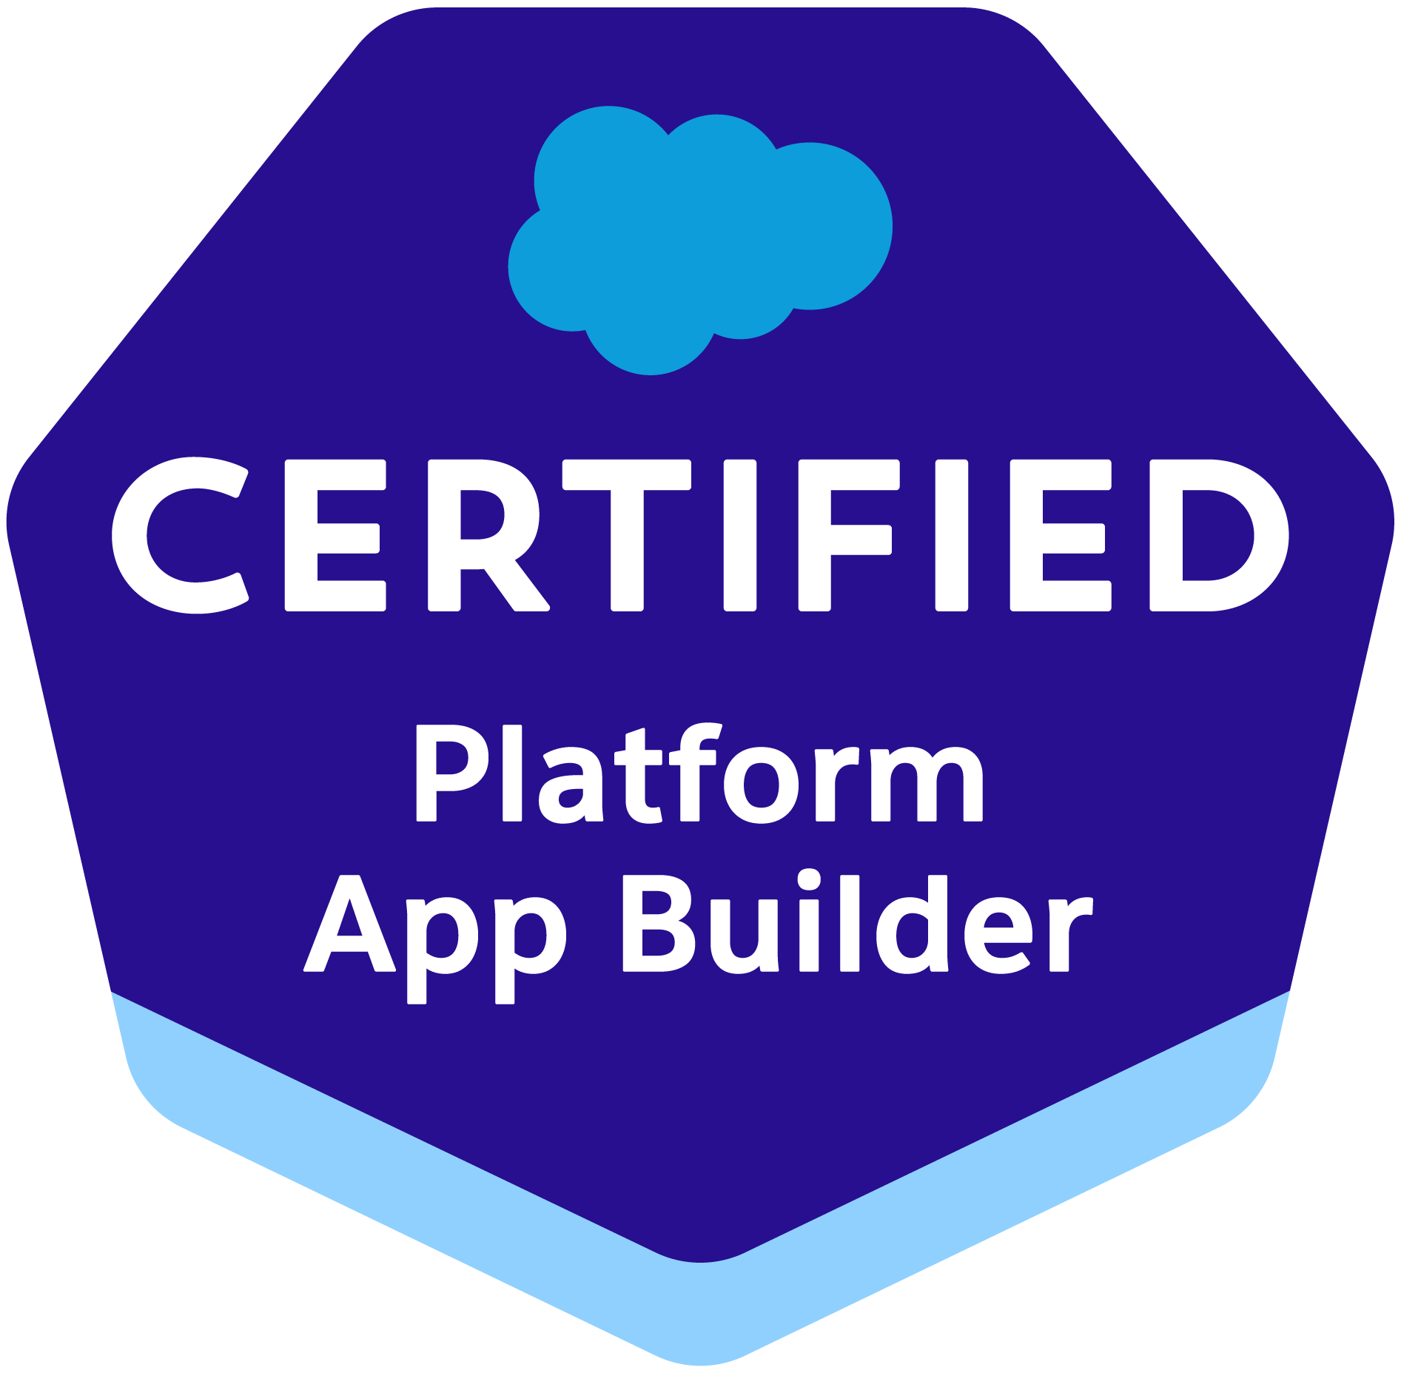
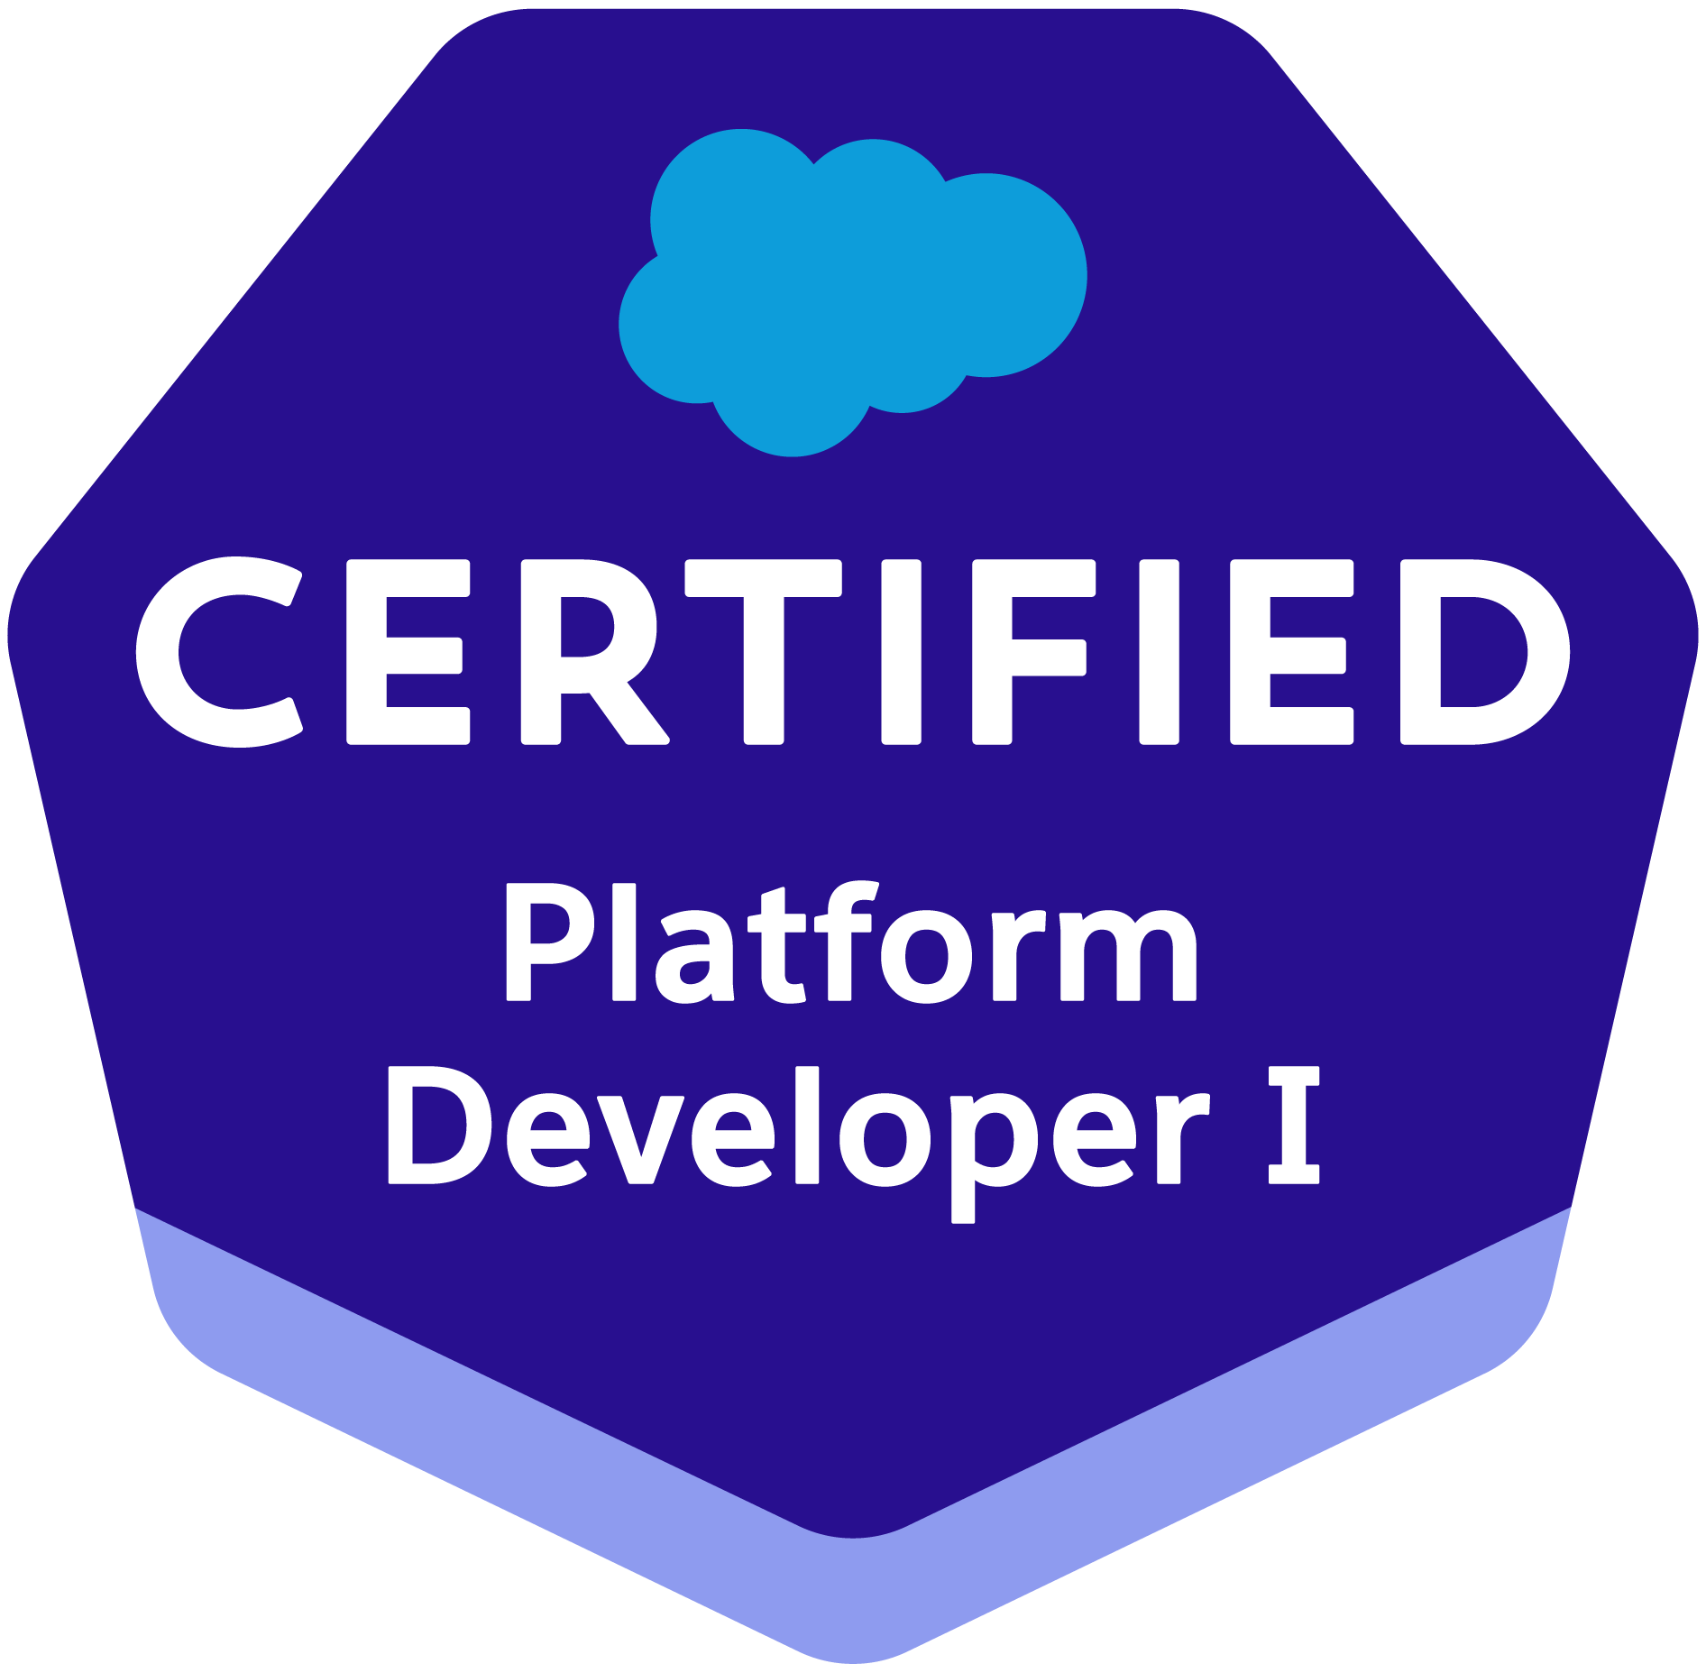

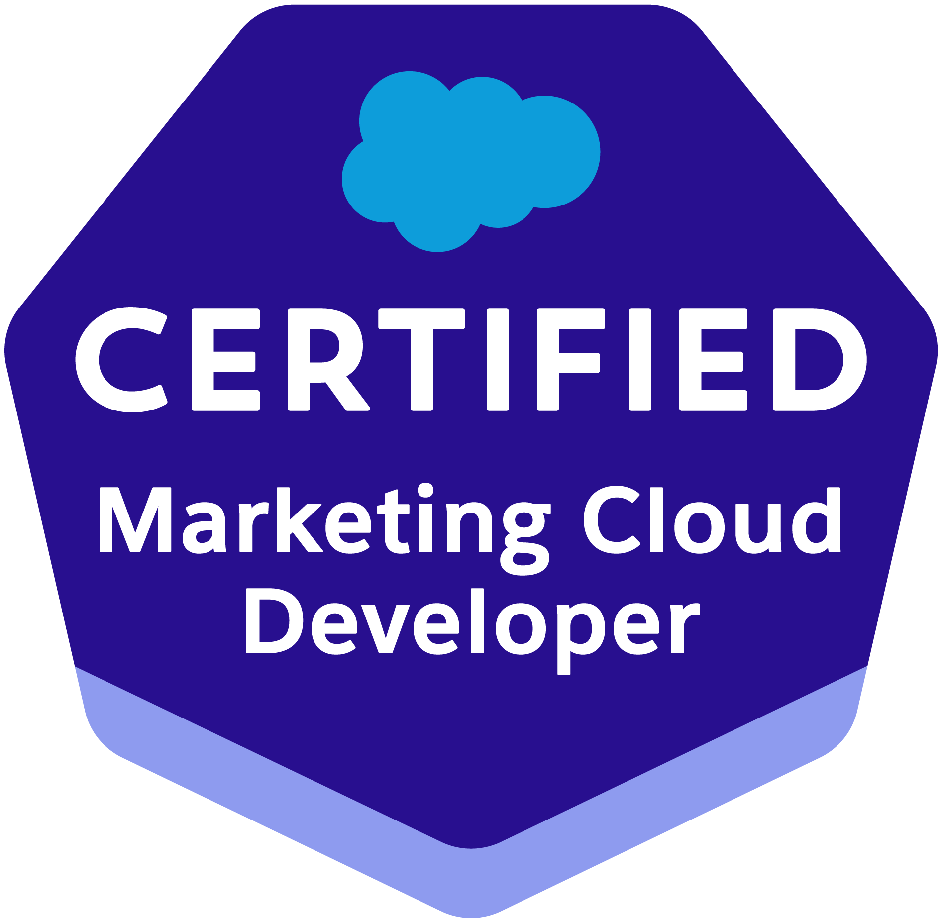
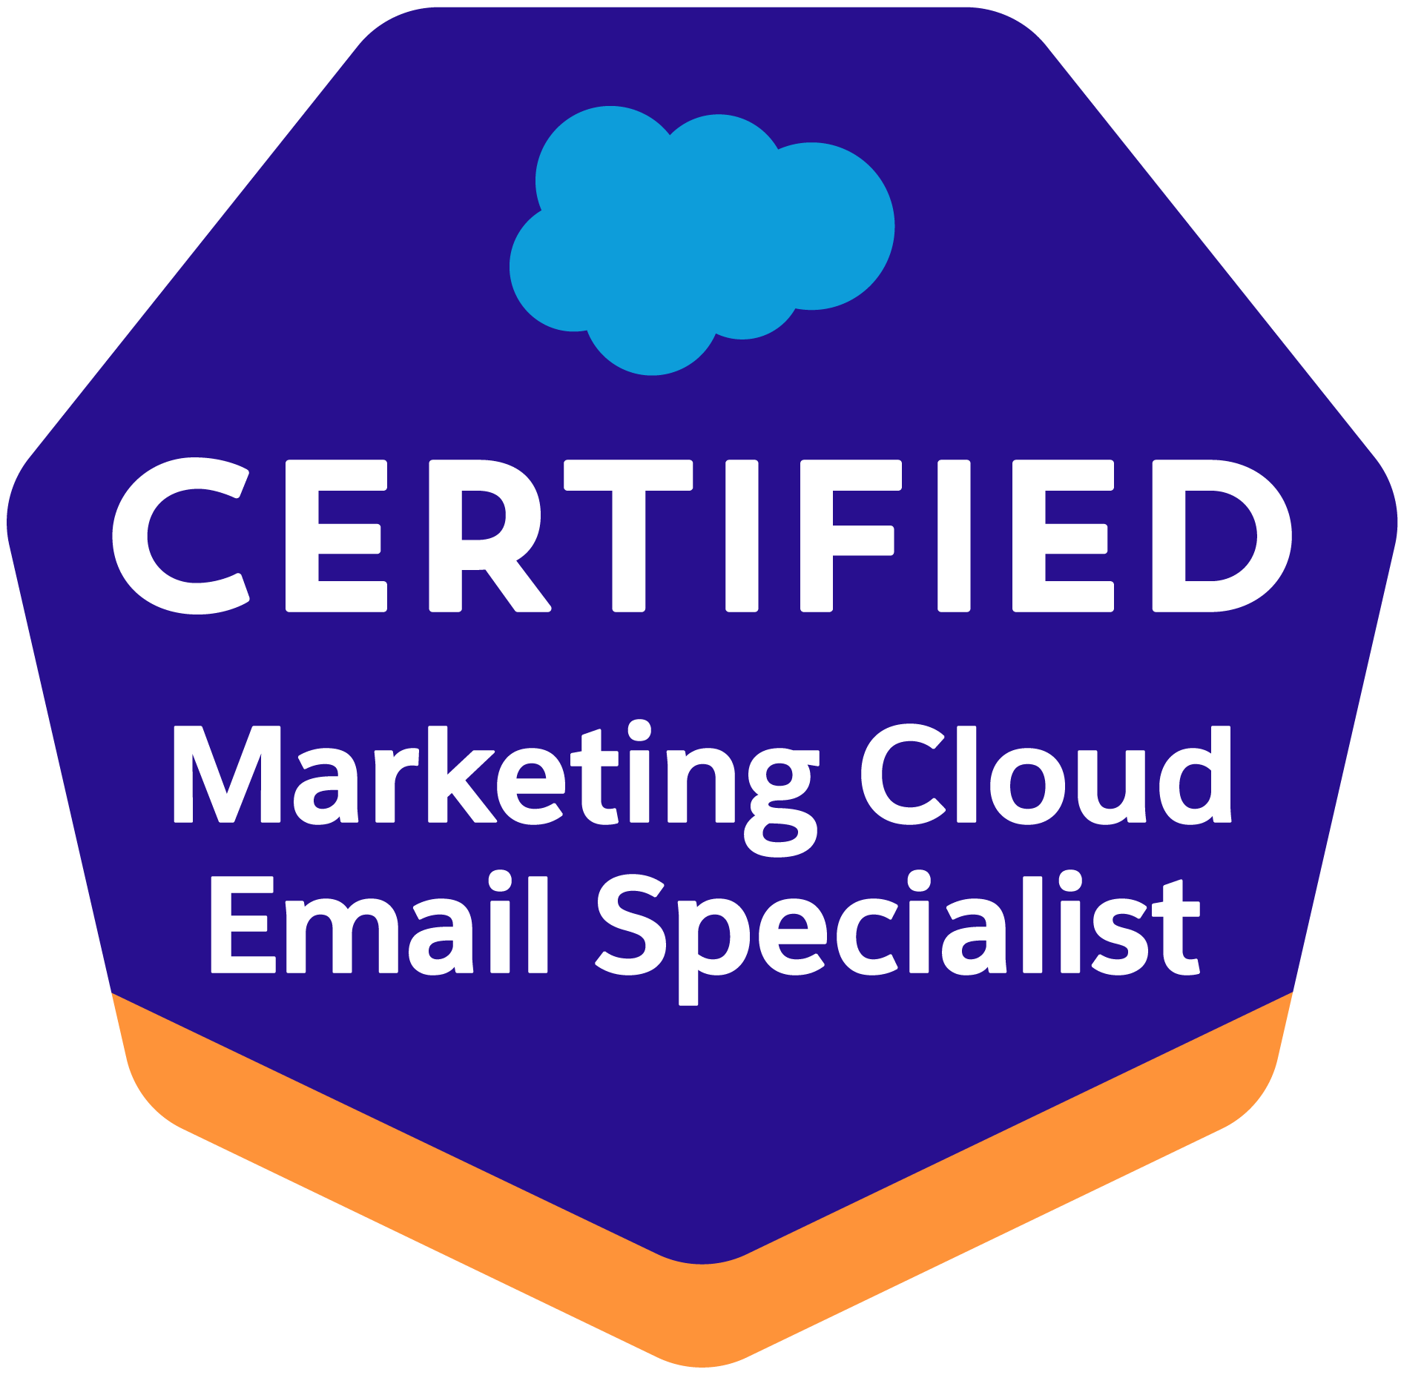
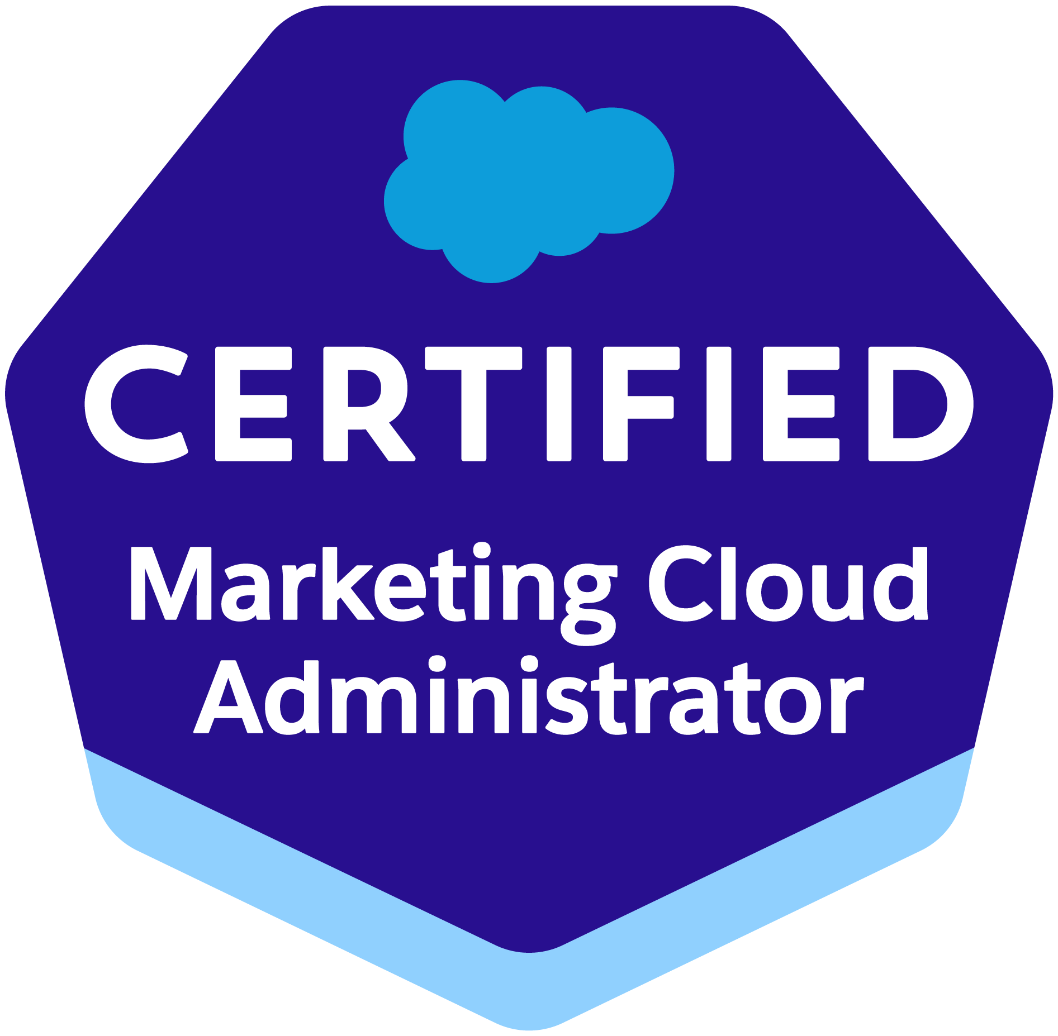
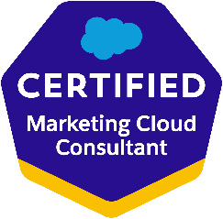
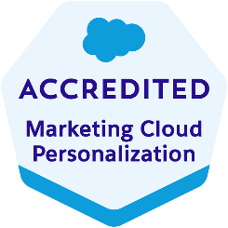
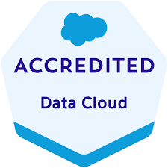
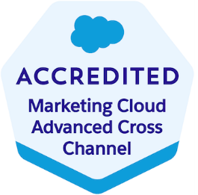
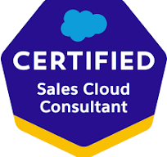
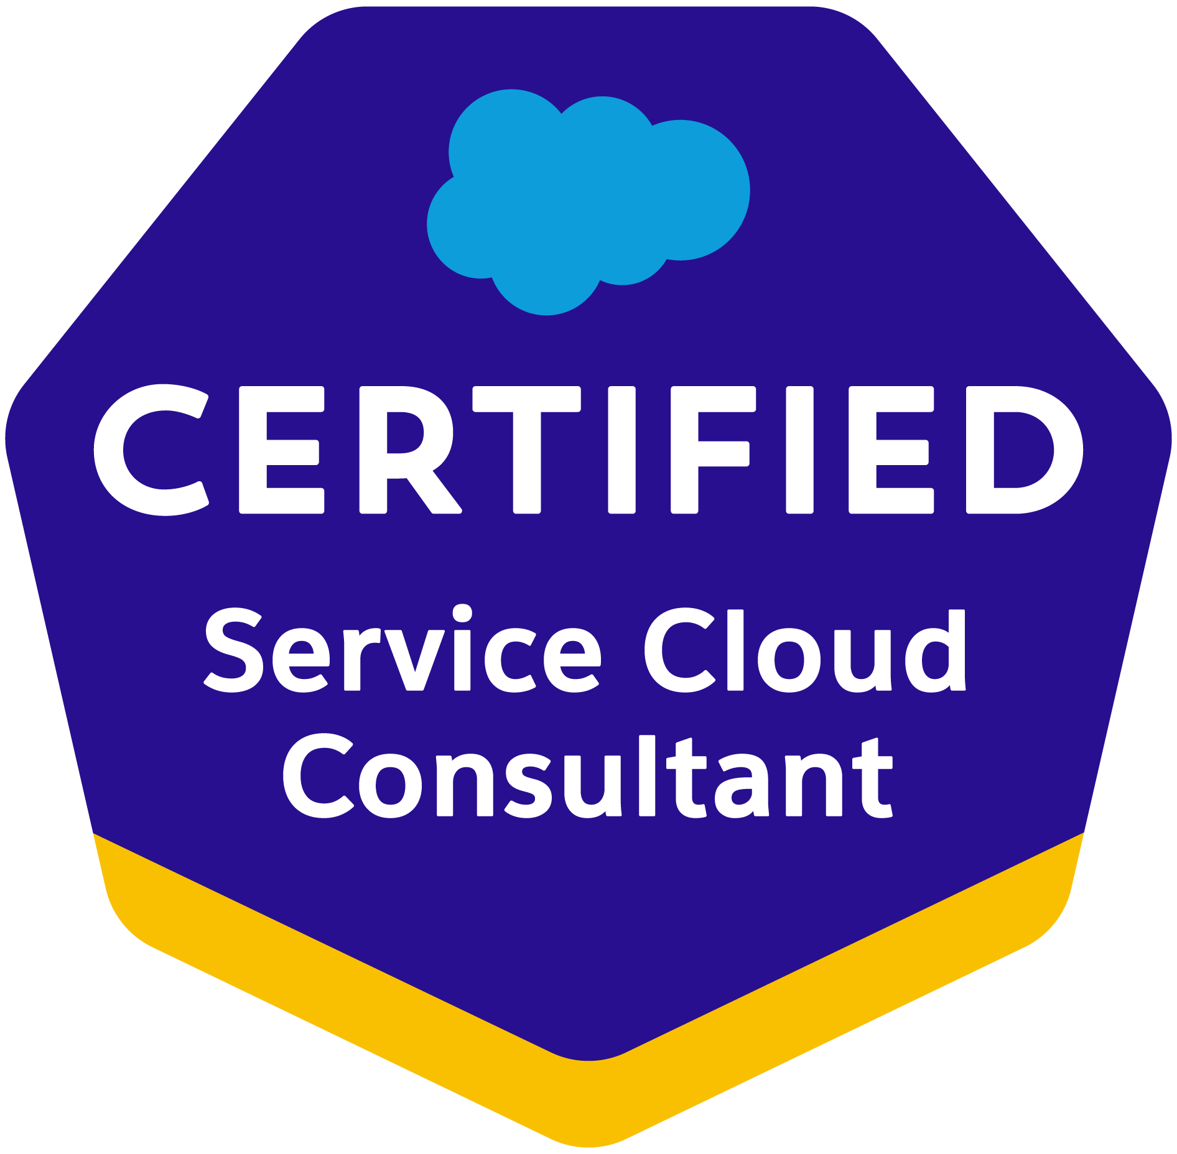
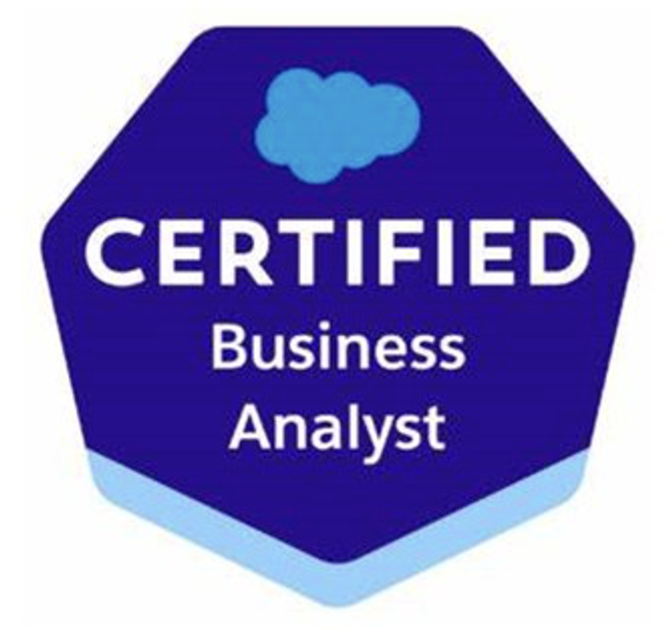


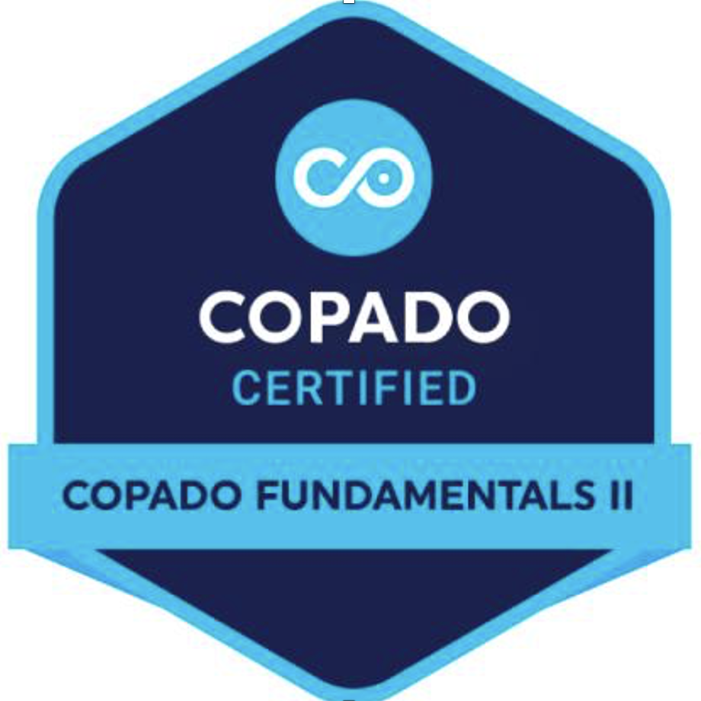
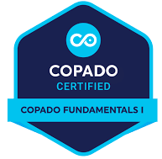
Certified Salesforce Talent at Scale
90+ Certifications Across Architecture, Platform & Cloud
Architecture (Core)
Marketing (DX)
DevOps, Domain & Others

Slide 16
Proven Partner Delivery: Healthcare JSM
JSM project consolidation for a healthcare provider, delivered as a partner.
WHAT WE DELIVERED 01
Current-state assessment, discovery, and service management process design.
Discovery & Workflow Design
WHAT WE DELIVERED 02
Security incident and request workflows, approval gates and permission schemes.
Security & Access Workflows
WHAT WE DELIVERED 03
Governed intake and audit history for healthcare security operations.
Healthcare Security Operations
WHAT WE DELIVERED 04
Consolidated projects into a governed JSM structure — and a repeatable partner delivery model for AI, software and Salesforce work.
Project Consolidation

Slide 17
Two Ways to Work Together
You own the customer relationship — choose how much delivery Palni leads.
WHO LEADS EACH STEP
PARTNER SUPPORT
Palni extends your delivery team
PARTNER LED
Palni delivers the engagement for you
Client-facing delivery
YOU
Your team stays prime and client-facing
PALNI
Palni leads, co-branded for your client
Scope & success measures
YOU
You set scope; Palni advises on approach
SHARED
Agreed jointly with you and the customer
Assessment & design
PALNI
Palni designs behind the scenes
PALNI
Palni assesses and designs the solution
Build, testing & enablement
PALNI
Palni works under your delivery lead
PALNI
Palni owns execution end-to-end
Handover & growth
SHARED
Palni documents; you run follow-on
YOU
Your team focuses on account growth
BEST FOR
Augmenting active engagements
Scaling new capability without new hires

Slide 18
Opportunities to Explore Together
Start with one opportunity, a defined scope and a joint discovery.
DATA & AI
SALESFORCE & CUSTOM DEV
Data platform modernization
Salesforce health and integration review
AI readiness and use-case assessment
Agentforce sales or service use case
Document or knowledge assistant pilot
Custom application or integration build
Production integration of an AI workflow
CRM data and automation improvements

Slide 19


THANK YOU
Corporate Office
8751 Collin McKinney Pkwy, Suite 801, McKinney, TX 75070, USA
Email: info@palni.com| Phone: +1- 469-712-4178 | Website: www.palni.com
Locations
Techno Pearl, Plot No. 6/2 & 6/3, HUDA Techno Enclave, HITEC City, Hyderabad, India 500081
3rd Floor, Building No 21, Raheja Mindspace, HITEC City, Hyderabad, India 500081
6th Floor, iLabs Building, HITEC City, Hyderabad, India 500081
109 S. Roselle Rd. Suite 201 Schaumburg, IL, 60193, USA

