Slide 1

Project 1 | Access to Healthcare services in Denver, CO
University of Oregon Data visualization bootcamp
Lisa Tschudi, Kelsy Dysart, Liz Martin-Strong

Slide 2
contents
Project Ideation
Data fetching / API Integration
Data Analysis
Summary & Future Questions

Slide 3


Project Ideation
Problem statement & scope of exploration

Slide 4
Original Question
Lisa had an interest in the broad subject of family caregivers, particularly parents of children with intellectual disability and what contributes to their wellbeing.
Data to answer questions around this was not easily publicly available.
Suspected it was an under researched question
Explored the Census data set
This has a complicated data schema and API call architecture.
We had difficulty formulating a specific question with data we could use and switched to a healthcare ‘deserts’ idea, suggested by our teacher, investigating the concentration of healthcare facilities as we also have an interest in that.

Slide 5
Refined Question
We wanted to know more about access to health care services.
Our work was modeled loosely off the Banking Desert exercise from class.
We were curious if health care services were concentrated in geographic regions due to:
Higher population numbers
Income level
Age
Selected a large metro area – Denver, Colorado

Slide 6
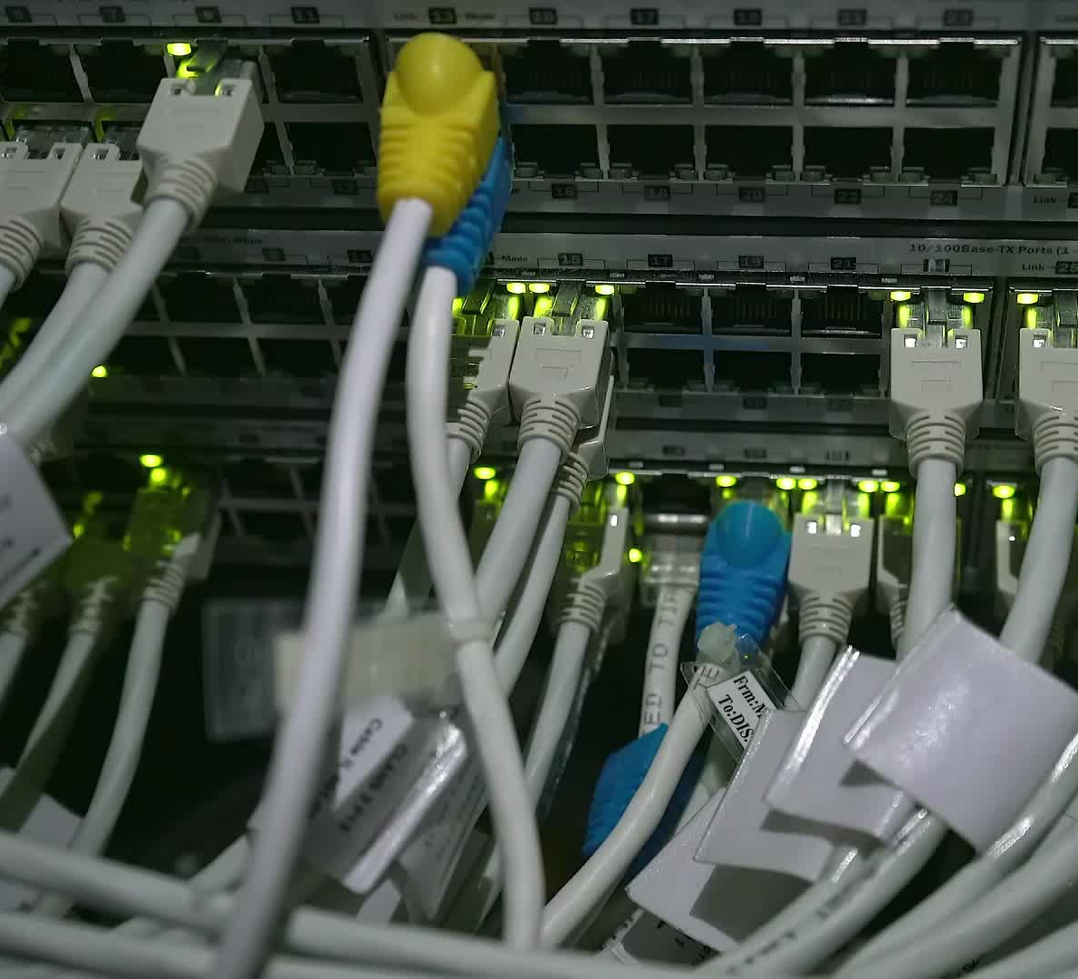
Data fetching & API integration
Sources, approach, testing, and refinement

Slide 7
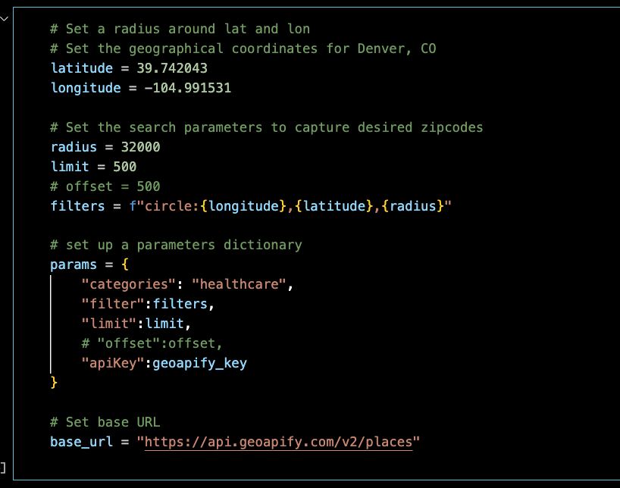
GeoApify Place API
Used to collect the name, coordinates, sub-categories, and zip codes of healthcare facilities
Original plan was to search the API by list of zip codes
Afraid we’d hit our request limit, switched to searching by radius
Experienced issues:
Radius too wide
Limited results
Timeouts

Slide 8
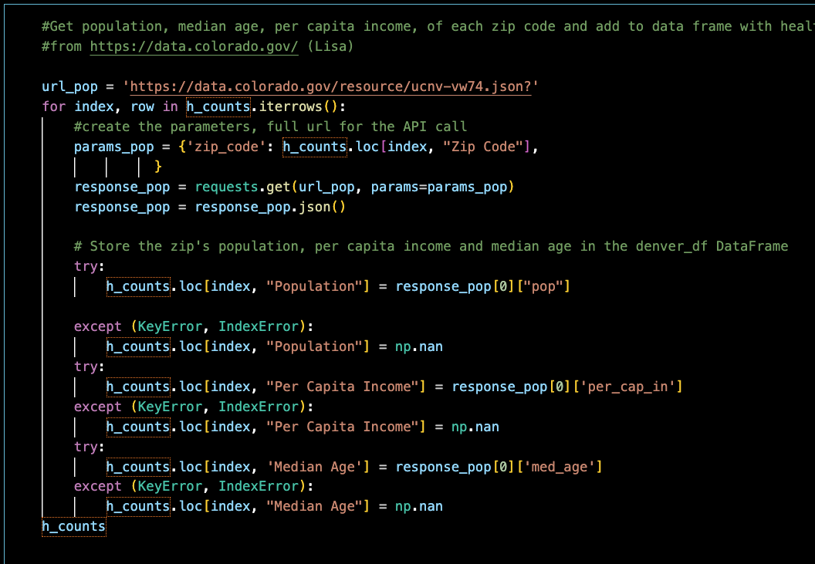
State of Colorado
When searching for a user-friendly API with population, income and age data by zip code for Denver, Lisa found 'https://data.colorado.gov/resource/ucnv-vw74.json?’
She used a for loop to call data from this source about each zip code which was returned by Kelsy’s facility search.

Slide 9

Data analysis
Exploration, questions & findings

Slide 10
Question 1: Are healthcare facilities denser where the population is dense?
In other words:
Is there a correlation between population of a zip code and number of healthcare facilities? NO
We found no statistically meaningful correlation.
By viewing the data as a scatter, and again as a double bar chart we see no visible relationship. The correlation coefficient is 0.34 and p-value is 0.0015, which indicate no correlation.

Slide 11
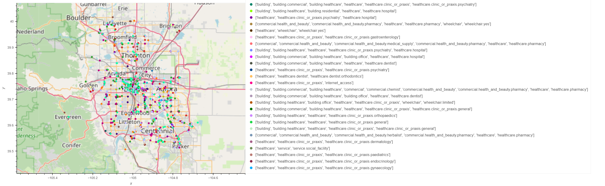
Denver Healthcare facilities: color according to category, Hoover shows name, category and zip code.

Slide 12
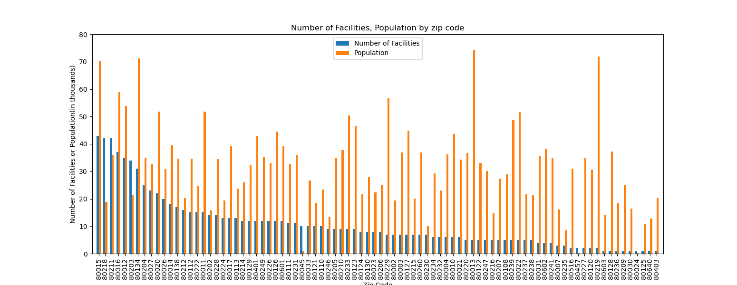
Plot 1: Healthcare facilities AND Population per zip code

Slide 13
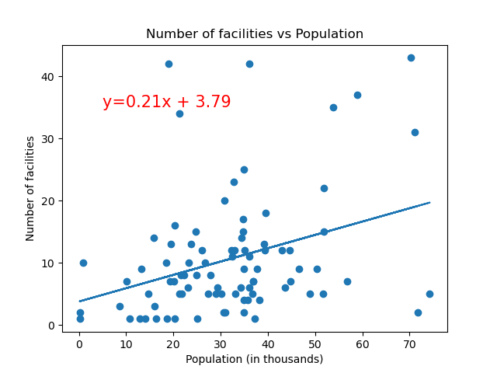
Plot 2: Facility count vs. Population

Slide 14
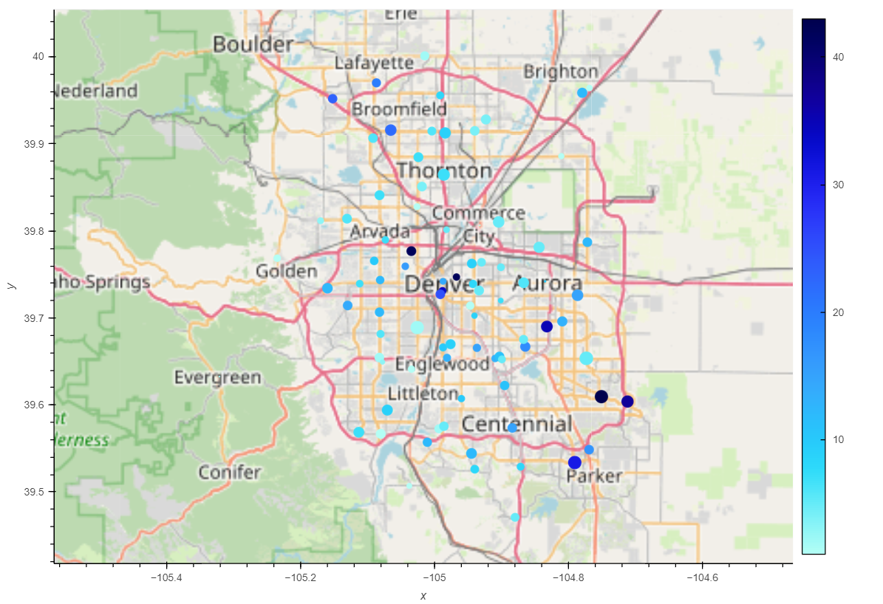
Denver zip codes: Dot size is according to population, Dot color by Number of Facilities in that Zip Code. Hoover shows facility count, population, per Capita

Slide 15
Question 2
Is there a correlation of per capita income with the number of healthcare facilities in a zip code? No, again.
We found no statistically meaningful correlation.
By viewing the data as a scatter, and again as a double bar chart we see no visible relationship. The correlation coefficient is 0.034.

Slide 16
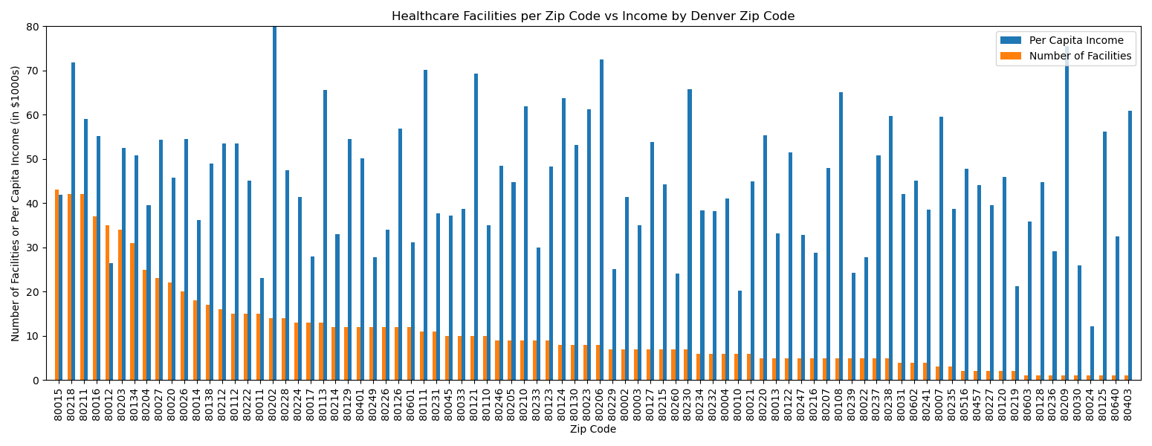
Plot 1: Healthcare facilities per zip code against per capita income

Slide 17
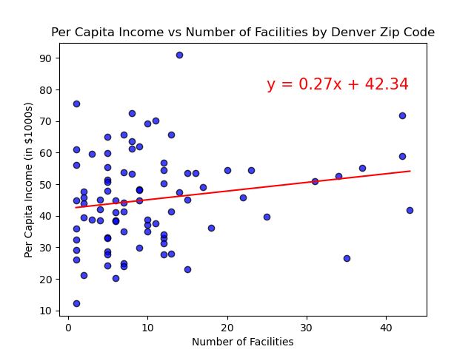
Plot 2: healthcare facilities vs per capita income
The coefficient of determination is 0.034. This is not statistically significant.
No correlation found.

Slide 18
Question 3: Is the number of healthcare facilities correspond to the median age of a population?
In other words:
Is there a correlation between median age and the number of healthcare facilities by zip code in the Denver area? NO
We found no statistically meaningful correlation.
By viewing the data as a scatter, and again as a double bar chart we see no visible relationship. The coefficient of determination is 0.018, which indicates no correlation.

Slide 19
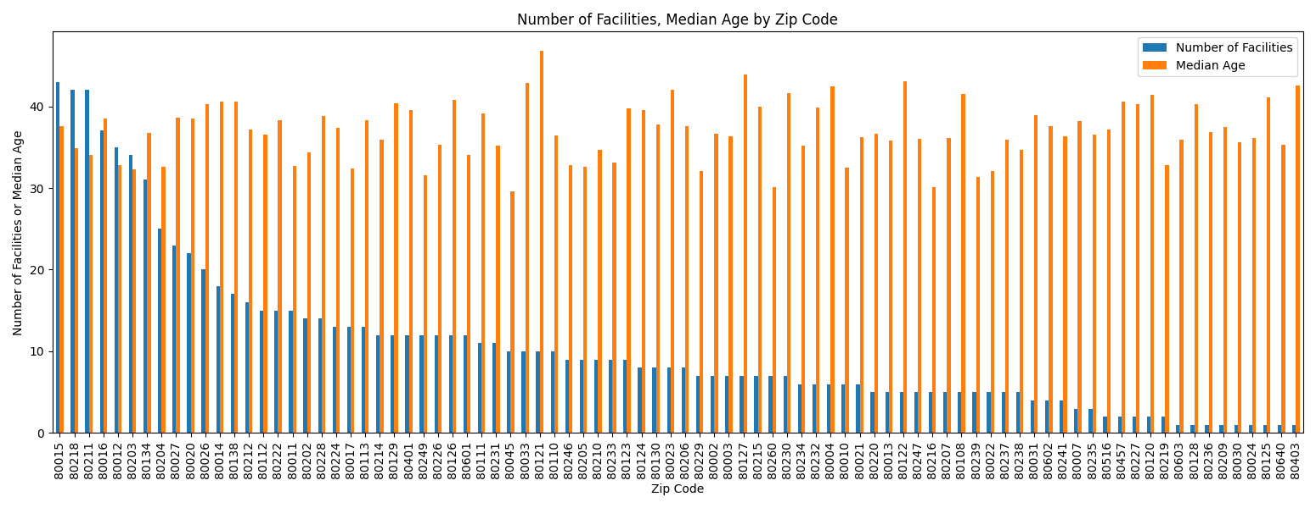
Plot 1: Healthcare facilities per zip code against Median age
Kelsy – Chart goes here

Slide 20
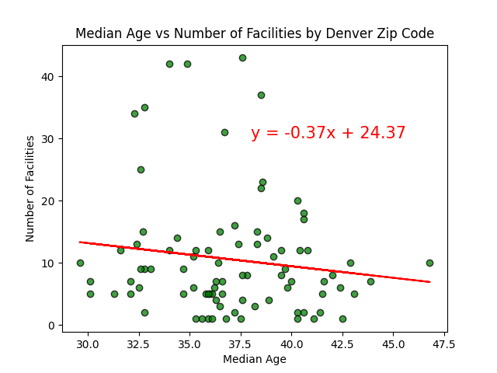
Plot 2: healthcare facilities vs Median age

Slide 21

Summary & Future Questions

Slide 22
Summary
We improved our skills on choosing our analysis questions, use of Github, coding with python pandas and matplotlib and describing our results.
We found no statistical correlation between number of healthcare facilities and population, per capita income, nor median age in each zip code.
We found data cleaning, combining and visualization relatively easy compared to formulating questions, locating appropriate data sets and version control.

Slide 23
Future Questions
Refine our coding to get complete facility results from each zip code which we include(by dropping results from zip codes we do not choose to include from the geoapify results drawn by radius). We currently have zip codes for which we have an artificially low healthcare facility count, which we realized too late to correct for this presentation.
Investigate wheelchair access to facilities in Denver, CO healthcare facilities. We were very curious about this due to two group members’ lived experiences. We noticed a data point was included from geoapify for each facility about wheelchairs.
Explore the various healthcare categories on their own. It would be interesting to see if there is any more noticeable correlation between facility count and our demographics if we only look at one category, or exclude some(for example, exclude pharmacies which often sell a lot more items than only medical prescriptions).
Widen the geographic area of this project, or perform similar analysis for other cities.

Slide 24
Thank you!
Questions or feedback?

