Slide 1

Project 1 | Access to Healthcare services in Denver, CO
University of Oregon Data visualization bootcamp
Lisa Tschudi, Kelsy Dysart, Liz Martin-Strong

Slide 2
contents
Project Ideation
Data fetching / API Integration
Data Analysis
Summary & Future Questions

Slide 3


Project Ideation
Problem statement & scope of exploration

Slide 4
Original Question
TODO: Lisa, can you please summarize your initial research idea? Was it available services for caregivers?
Narrowed question due to available data sets
Data to answer question was not easily publicly available.
Suspected it was an under researched question
Explored the Census data set
Complicated data schema and API call architecture.

Slide 5
Refined Question
Still wanted to know more about access to health care services.
Modeled loosely off the Banking Desert exercise from class.
Curious if health care services were concentrated in geographic regions due to:
Higher population numbers
Income level
Age
Selected a large metro area – Denver, Colorado

Slide 6
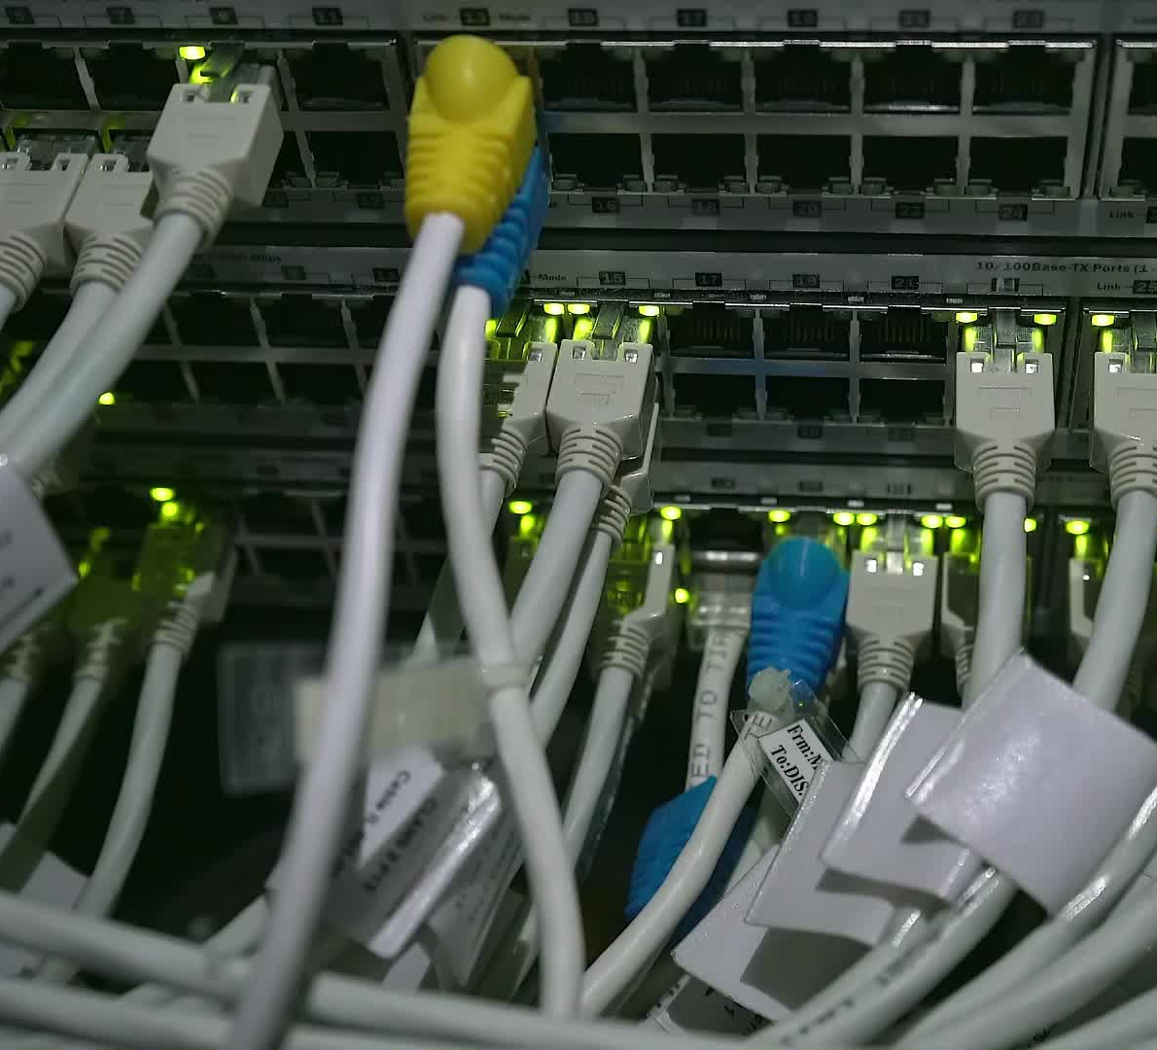
Data fetching & API integration
Sources, approach, testing, and refinement

Slide 7
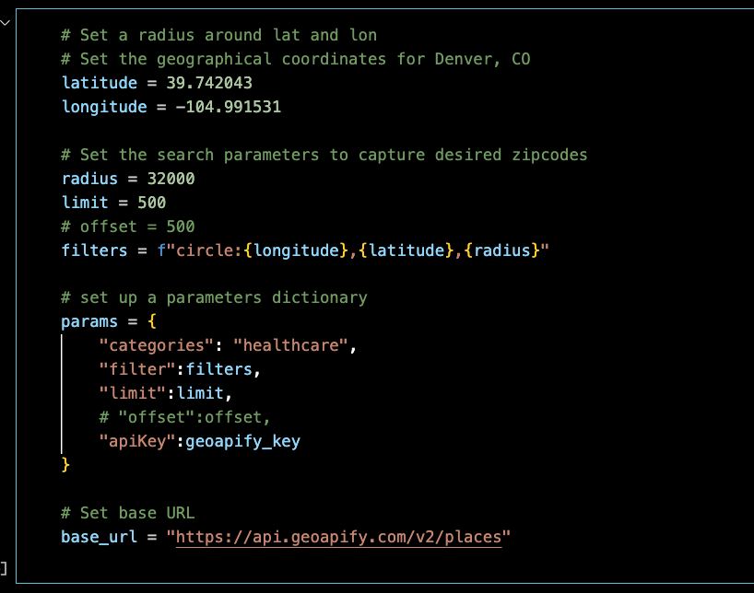
GeoApify Place API
Kelsy – include a few highlights here and process

Slide 8
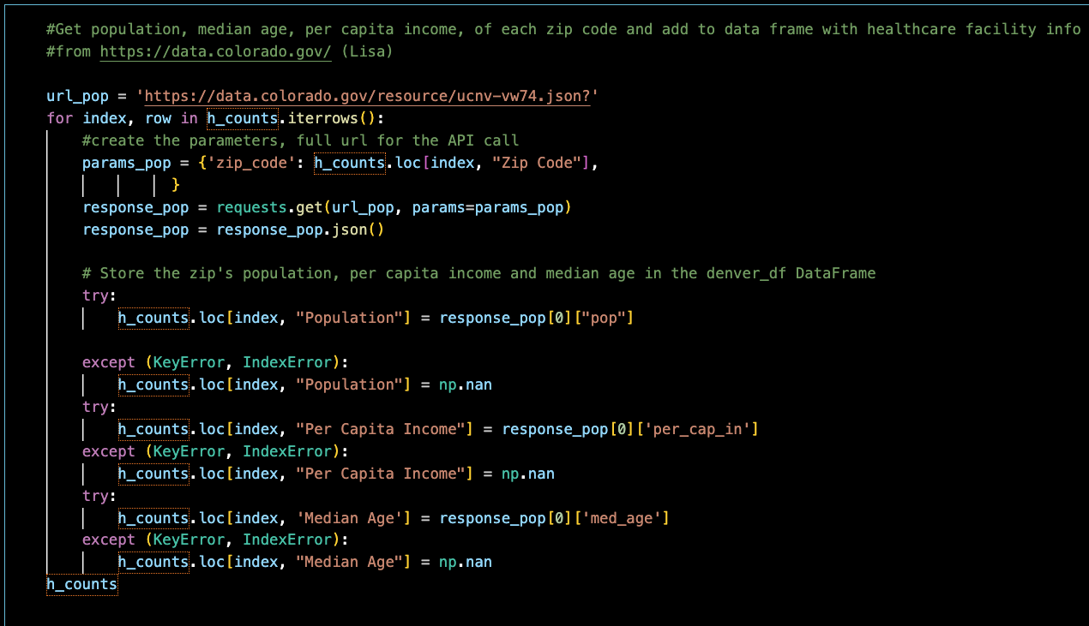
State of Colorado
Lisa – include a few highlights here and process

Slide 9

Data analysis
Exploration, questions & findings

Slide 10
Question 1
Are healthcare facilities denser where the population is dense? In other words:
Is there a correlation between population of a zip code and number of healthcare facilities?

Slide 11
Plot 1: Healthcare facilities per zip code
Lisa – Chart goes here

Slide 12
Plot 2: Facility count vs. Population
Lisa insert scatterplot & linear regression

Slide 13
Question 2
Is there a correlation of per capita income with the number of healthcare facilities in a zip code?

Slide 14
Plot 1: Healthcare facilities per zip code against per capita income
Liz – Chart goes here

Slide 15
Plot 2: healthcare facilities vs per capita income
Liz insert scatter plot and linear regression

Slide 16
Question 3
Is there a correlation of median age with # of healthcare facilities by zip code in the Denver area?

Slide 17
Plot 1: Healthcare facilities per zip code against Median age
Kelsy – Chart goes here

Slide 18
Plot 2: healthcare facilities vs Median age
Kelsy insert scatter plot and linear regression

Slide 19

Summary & Future Questions

Slide 20
Summary

Slide 21
Future Questions
Wheelchair access to facilities in Denver, CO healthcare facilities.

Slide 22
Thank you!
Questions or feedback?

