Slide 1

Project 1 | Access to Healthcare services in Denver, CO
University of Oregon Data visualization bootcamp
Lisa Tschudi, Kelsy Dysart, Liz Martin-Strong

Slide 2
contents
Project Ideation
Data fetching / API Integration
Data Analysis
Summary & Future Questions

Slide 3


Project Ideation
Problem statement & scope of exploration

Slide 4
Original Question
TODO: Lisa, can you please summarize your initial research idea? Was it available services for caregivers?
Narrowed question due to available data sets
Data to answer question was not easily publicly available.
Suspected it was an under researched question
Explored the Census data set
Complicated data schema and API call architecture.

Slide 5
Refined Question
Still wanted to know more about access to health care services.
Modeled loosely off the Banking Desert exercise from class.
Curious if health care services were concentrated in geographic regions due to:
Higher population numbers
Income level
Age
Selected a large metro area – Denver, Colorado

Slide 6

Data fetching & API integration
Sources, approach, testing, and refinement

Slide 7
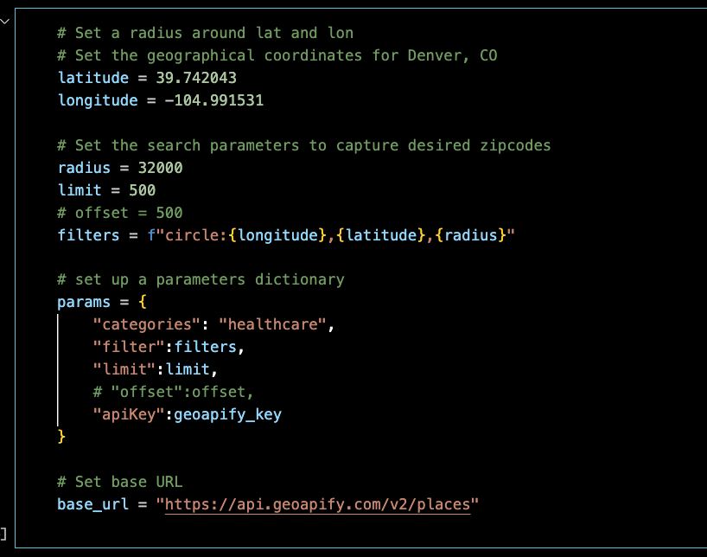
GeoApify Place API
Used to collect the name, coordinates, sub-categories, and zip codes of healthcare facilities
Original plan was to search the API by list of zip codes
Afraid we’d hit our request limit, switched to searching by radius
Experienced issues:
Radius too wide
Limited results
Timeouts

Slide 8
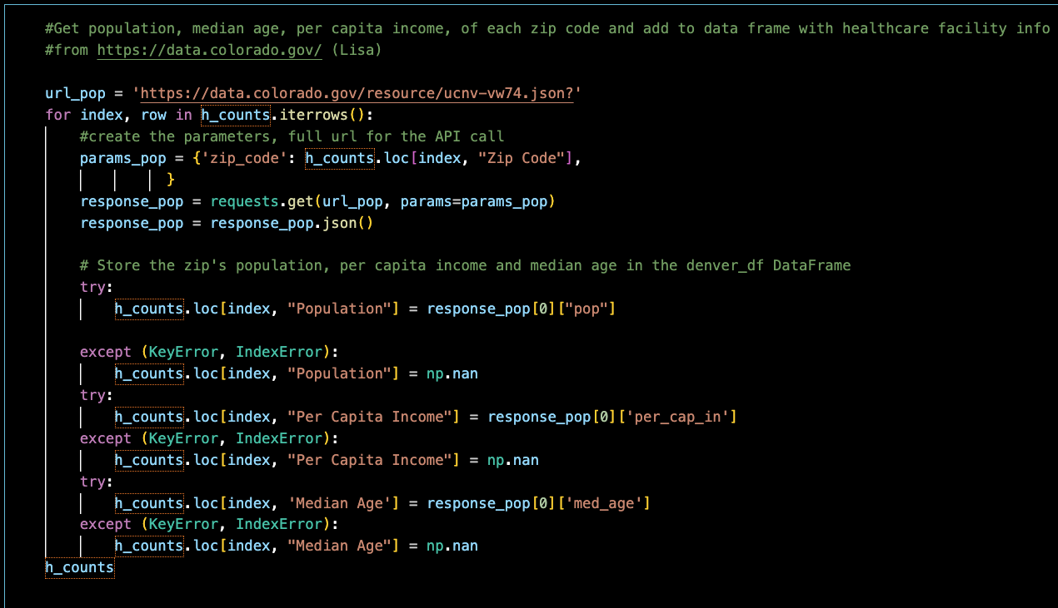
State of Colorado
Lisa – include a few highlights here and process

Slide 9

Data analysis
Exploration, questions & findings

Slide 10
Question 1
Are healthcare facilities denser where the population is dense? In other words:
Is there a correlation between population of a zip code and number of healthcare facilities?

Slide 11
Plot 1: Healthcare facilities per zip code
Lisa – Chart goes here

Slide 12
Plot 2: Facility count vs. Population
Lisa insert scatterplot & linear regression

Slide 13
Question 2
Is there a correlation of per capita income with the number of healthcare facilities in a zip code?

Slide 14
Plot 1: Healthcare facilities per zip code against per capita income
Liz – Chart goes here

Slide 15
Plot 2: healthcare facilities vs per capita income
Liz insert scatter plot and linear regression

Slide 16
Question 3: Is the number of healthcare facilities correspond to the median age of a population?
In other words:
Is there a correlation between median age and the number of healthcare facilities by zip code in the Denver area? NO
We found no statistically meaningful correlation.
By viewing the data as a scatter, and again as a double bar chart we see no visible relationship. The coefficient of determination is 0.018, which indicates no correlation.

Slide 17
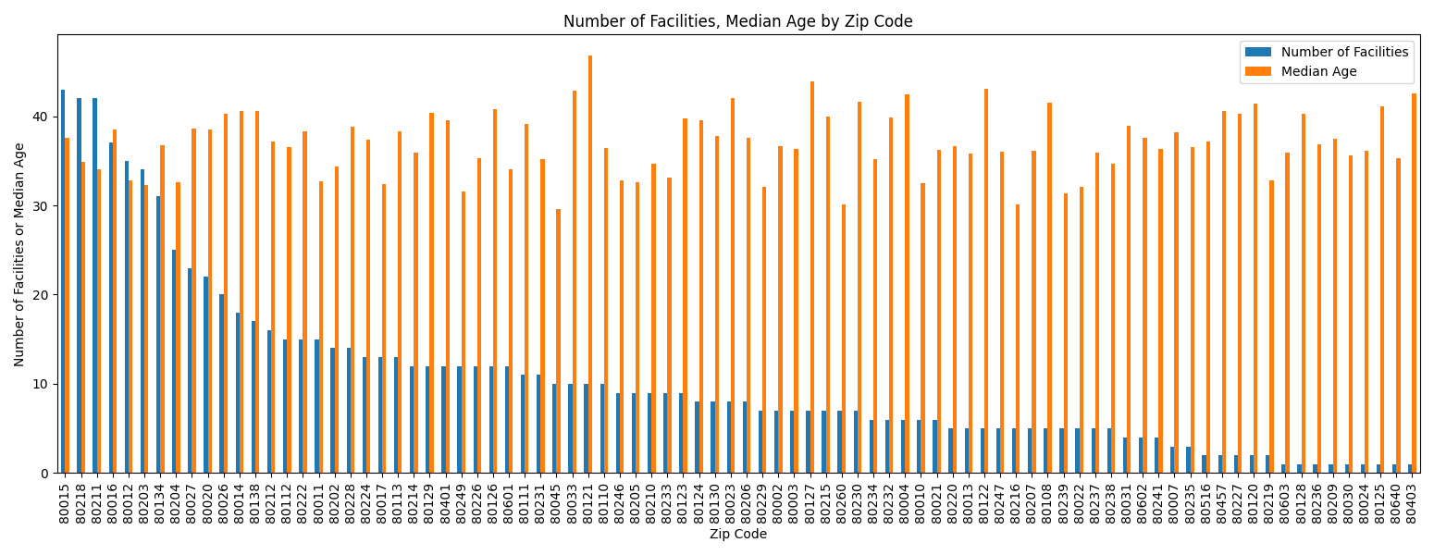
Plot 1: Healthcare facilities per zip code against Median age
Kelsy – Chart goes here

Slide 18
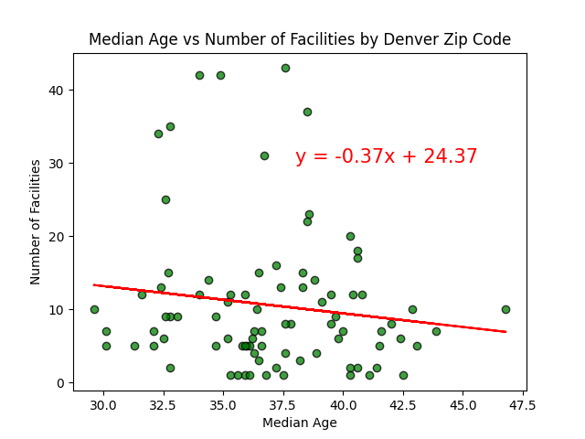
Plot 2: healthcare facilities vs Median age

Slide 19

Summary & Future Questions

Slide 20
Summary

Slide 21
Future Questions
Wheelchair access to facilities in Denver, CO healthcare facilities.
Compare the types of facilities or narrow down the ‘healthcare’ category.
**Lisa’s copy has a good expansion for the summary.**

Slide 22
Thank you!
Questions or feedback?

