Slide 1

Project 1 | Access to Healthcare services in Denver, CO
University of Oregon Data visualization bootcamp
Lisa Tschudi, Kelsy Dysart, Liz Martin-Strong

Slide 2
contents
Project Ideation
Data fetching / API Integration
Data Analysis
Summary & Future Questions

Slide 3


Project Ideation
Problem statement & scope of exploration

Slide 4
Original Question
Started with a broad area of interest: Which public policies and supports lead to the best outcomes for family caregivers?
Switched focus due to available data sets
Data in area of interest was not readily available. We suspected it is an under researched area or the data is inaccessible (not digital).
Explored the Census data set
Complicated data schema and API call architecture.

Slide 5
Refined Question
Still wanted to know more about access to health care services.
Modeled loosely off the Banking Desert exercise from class.
Curious if health care services were concentrated in geographic regions due to:
Higher population numbers
Income level
Age
Selected a large metro area – Denver, Colorado

Slide 6
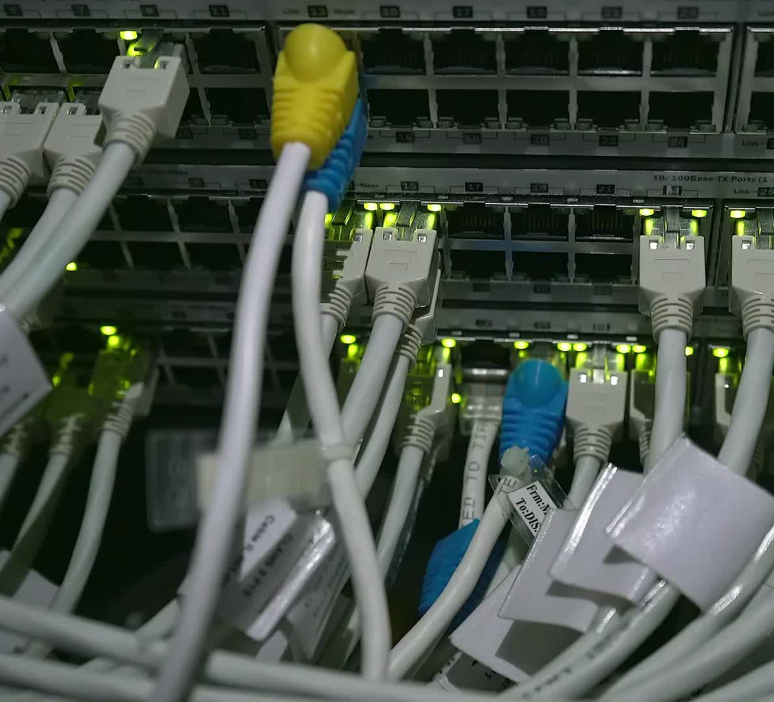
Data fetching & API integration
Sources, approach, testing, and refinement

Slide 7
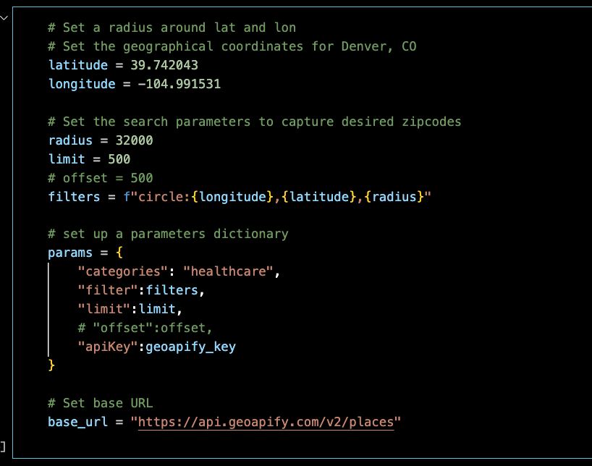
GeoApify Place API
Kelsy – include a few highlights here and process

Slide 8
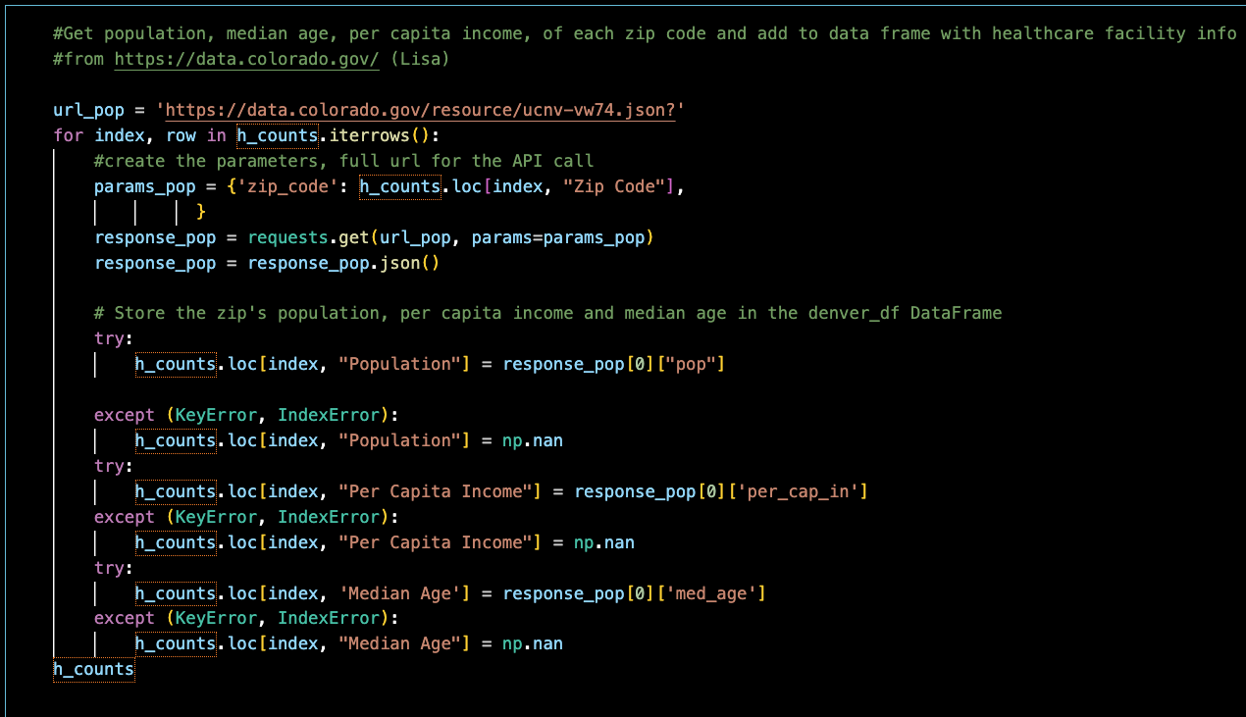
State of Colorado
Lisa – include a few highlights here and process

Slide 9

Data analysis
Exploration, questions & findings

Slide 10
Question 1
Are healthcare facilities denser where the population is dense? In other words:
Is there a correlation between population of a zip code and number of healthcare facilities?

Slide 11
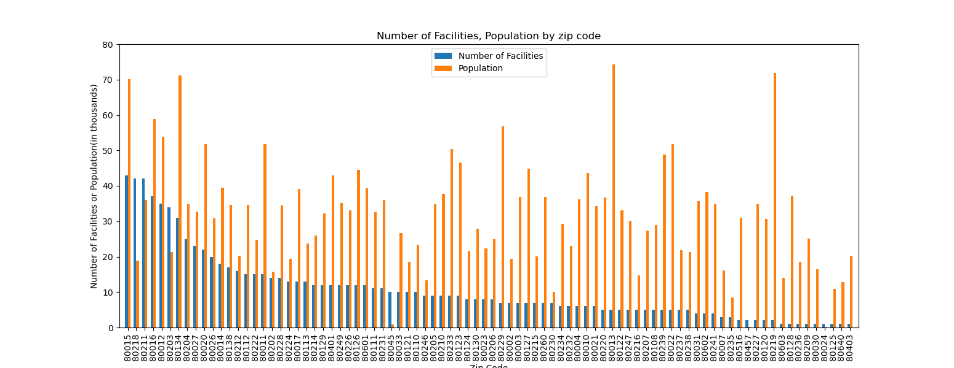
Plot 1: Healthcare facilities per zip code

Slide 12
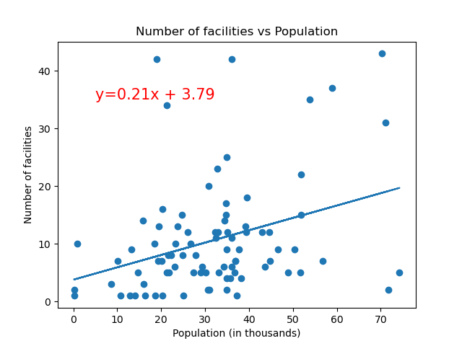
Plot 2: Facility count vs. Population
Any content to add?

Slide 13
Question 2
Is there a correlation of per capita income with the number of healthcare facilities in a zip code?

Slide 14
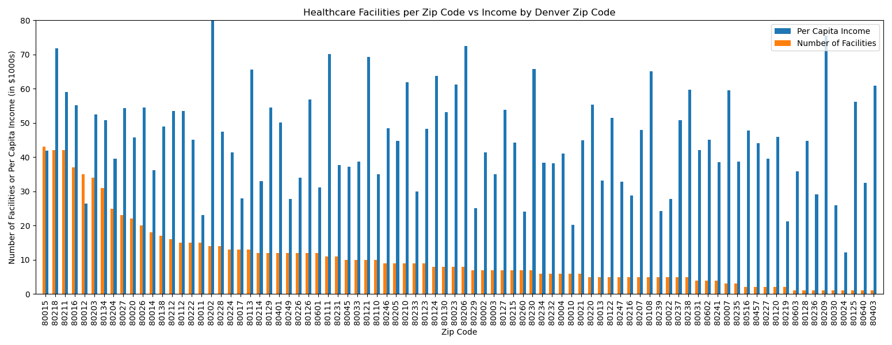
Plot 1: Healthcare facilities per zip code against per capita income

Slide 15
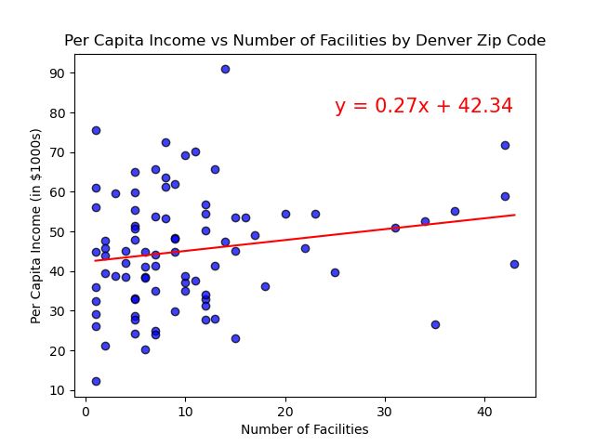
Plot 2: healthcare facilities vs per capita income

Slide 16
Question 3
Is there a correlation of median age with # of healthcare facilities by zip code in the Denver area?

Slide 17
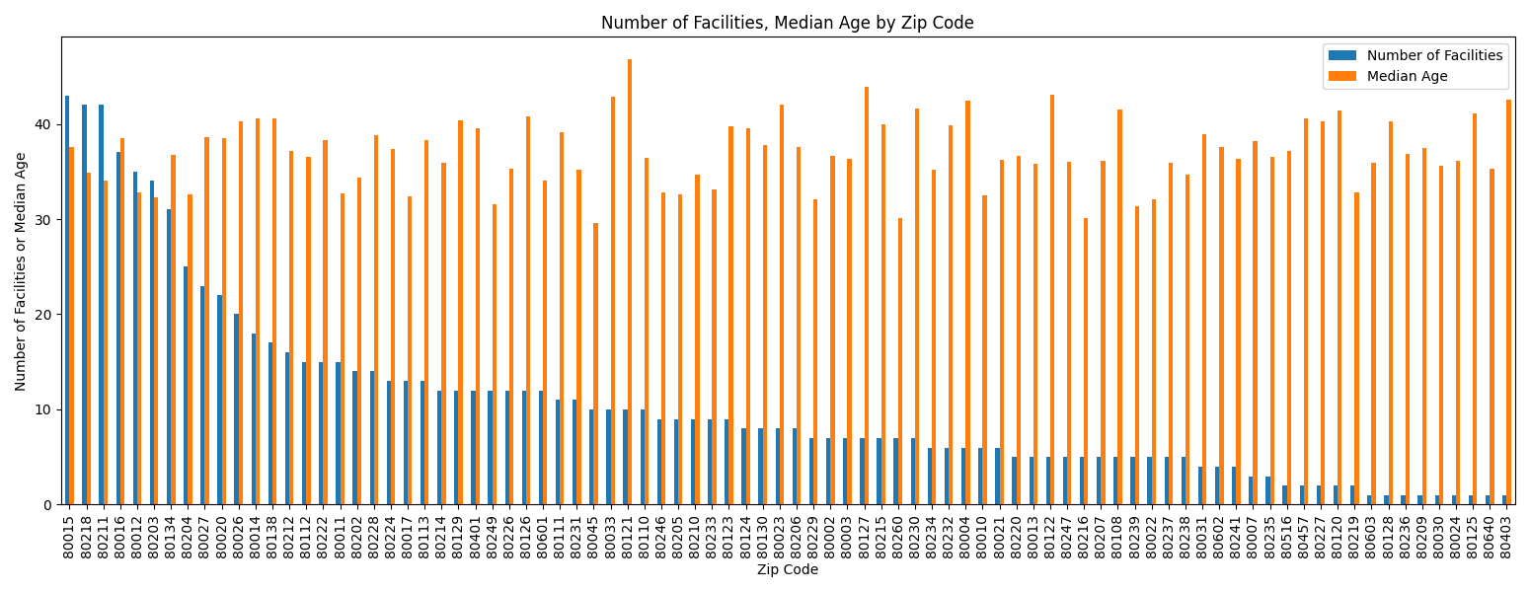
Plot 1: Healthcare facilities per zip code against Median age

Slide 18
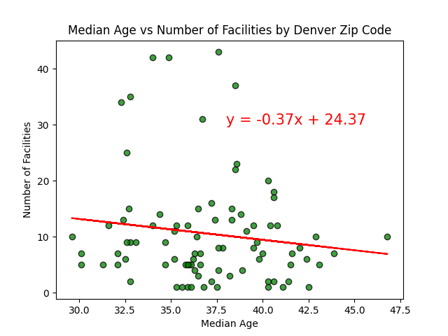
Plot 2: healthcare facilities vs Median age

Slide 19

Summary & Future Questions

Slide 20
Summary

Slide 21
Future Questions
Wheelchair access to facilities in Denver, CO healthcare facilities.

Slide 22
Thank you!
Questions or feedback?

