Slide 1
Stacks

Slide 2
Introduction
Data structures: A data structure is a way of organizing data that considers not only the items stored, but also their relationship to each other
Linear data structure: A linear data structure traverses the data elements sequentially, in which only one data element can directly be reached.

Slide 3
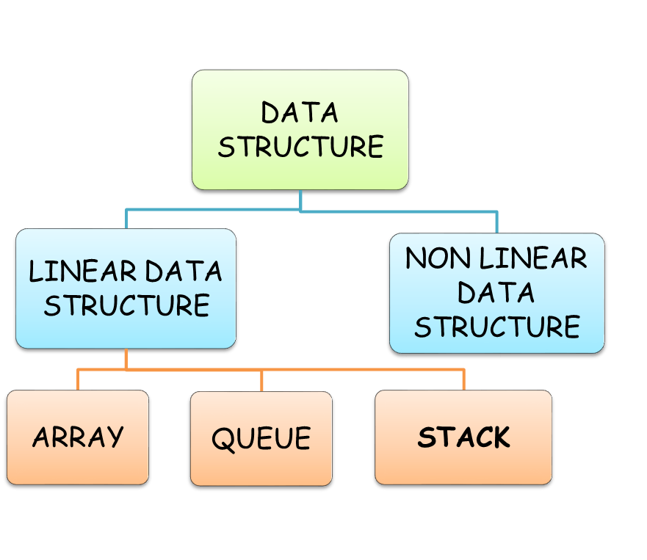
Stack : Linear data structure

Slide 4
Stacks
Stack: what is it?
ADT
Applications
Implementation(s)

Slide 5
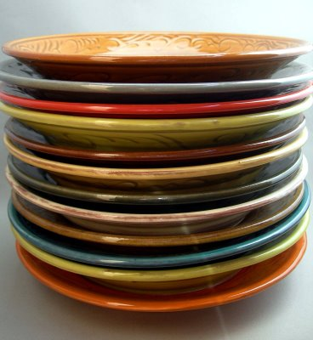


What is a stack?
Stores a set of elements in a particular order
Stack principle: LAST IN FIRST OUT = LIFO
It means: the last element inserted is the first one to be removed
Access is allowed only at one point of the structure, normally termed the top of the stack
  access to the most recently added item only

Slide 6

Operations?
Operations are limited:
  push (add item to stack)
  pop (remove top item from stack)
  top (get top item without removing it)
  clear
  isEmpty
  isFull
  size?

Slide 7
Last In First Out
A
B
A
C
B
A
D
C
B
A
E
D
C
B
A
top
D
C
B
A
top
top
top
top

Slide 8
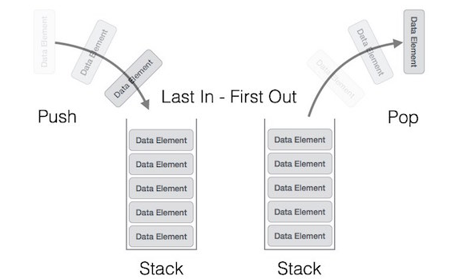
Last In First Out

Slide 9

Stack Applications
Real life
  Pile of books
  Plate trays
More applications related to computer science
  Program execution stack (read more from your text)
  Evaluating expressions

Slide 10
Operations on stack
Push: Adds the element to the top of the stack
Pop: Removes the element from the top of the stack
Peek: Returns the top element of the stack
IsEmpty: Returns True if Stack is empty
IsFull: Returns True if Stack is full

Slide 11
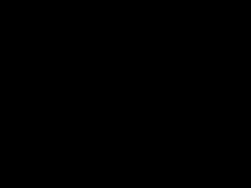
How it Works? - Animation

Slide 12
A LIFO Stack
Push
Pop
Stack Pointer
Top
Bottom

Slide 13
Push Operation
Function: Adds new-Item to the top of the stack.
Preconditions: Stack has been initialized and is not full.
Postconditions: new-Item is at the top of the stack.

Slide 14
Algorithms of Push operation on stack
Push(stack, Top, MAXSTK, X)
Step1: [stack already filled? ]
If Top = =MAXSTK - 1 then: Print “overflow” and return
Step 2: set Top = Top + 1 [increase top by 1]
Step 3: set Stack[Top] = x [insert X in new Top position]
Step 4: Return
Here, MAXSTK is max size of stack[] array
X = element to be inserted in stack
Top: contains the location of topmost element in stack

Slide 15
Push Operations
Push (10)
Stack is full, so
“Overflow occurs”
Push (20)
50
4
40
Push (30)
3
30
2
Push (40)
20
1
Push (50)
10
0
Top
-1
Push (60)

Slide 16
Overflow in stack
Overflow: when stack is full, no more elements are to be added, the status of stack is called overflowed
For ex→ MAXSTK: contains the maximum number of elements held by stack
If (top = = MAXSTK - 1)
then print “overflow”

Slide 17
POP ()
Function: Removes top-Item from stack
Preconditions: Stack has been initialized and is not empty.
Postconditions: Top element has been removed from stack

Slide 18
Algorithms of Pop operation on stack
Pop(stack, Top, X)
Step1: [stack has an element to be removed? ]
If Top==-1 then: Print “underflow” and return
Step 2: set x = Stack[Top] [Assign Top element to x]
Step 2: set Top = Top - 1 [decrease top by 1]
Step 4: Return

Slide 19
POP OPERATIONS
Pop ()
Top
Pop ()
50
4
40
Pop ()
3
30
Pop ()
2
20
1
Pop ()
10
0
Pop ()
Stack is empty, so
“underflow occurs”
-1

Slide 20
Insertion Procedure
(PUSH)
Procedure Insertion(a,top,item,max)
If top=max-1 then
print ‘STACK OVERFLOW’
exit
else
top=top+1
end if
a[top]=item
Exit

Slide 21
Deletion Procedure
(POP)
Procedure Deletion(a,top,item)
If top=-1 then
print ‘STACK UNDERFLOW’
exit
else
item=a[top]
end if
top=top-1
Exit

Slide 22
Read Stack
(Read)
Procedure Display(top,i,a[i])
If top=-1 then
Print ‘STACK EMPTY’
Exit
Else
For i=top to 0
Print a[i] End for
exit

Slide 23
Applications of Stack
Reverse String or List
Polish Notation
Reverse Polish Notation
Recursion
Tower of Hanoi
Parsing (matching parentheses or tags)
Browsers and editors

Slide 24
Reverse String or List
We can accomplish this task by pushing each character or member from the string/list in the order it appears
When the line is finished, characters are then proposed off the stack
  “They come off in a reverse order”

Slide 25











Reverse string – Name=“Angel”
L E G N A
P U S H
E G N A
G N A
NA
A
E
G
N
A
Name : “L”
P O P
G
N
A
Name : “LE”
N
A
Name :
“LEG”
A
Name : “LEGN”
Name : “LEGNA”

Slide 26
Checking for balanced braces
For ex: ([]({()}[()])) is balanced; ([]({()}[())]) is not
Simple counting is not enough to check balance
You can do it with a stack: going left to right,
    Step1: If you see a ”opening bracket” ( i.e. (, [, or { ), push it on the stack
    Step2: If you see a ”closing bracket” ( i.e. ), ], or } ), pop the stack and check whether you got the corresponding (, [, or {
    Step3: When you reach the end, check the status of stack

Slide 27
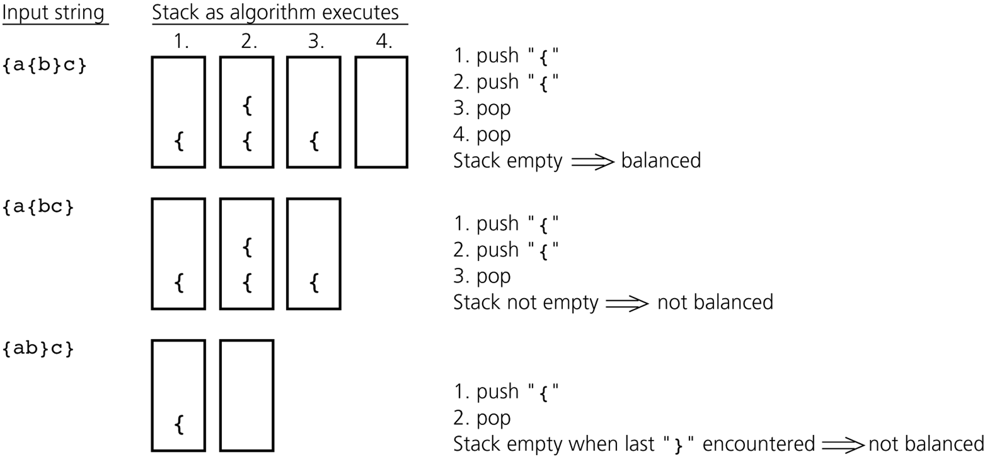
Checking for balanced braces

Slide 28
X = a / b - c + d * e - a * c a = 4, b = c = 2, d = e = 3
Interpretation 1:
((4/2)-2)+(3*3)-(4*2)=0 + 8+9=1
Interpretation 2:
(4/(2-2+3))*(3-4)*2=(4/3)*(-1)*2=-2.66666…
How to generate the machine instructions corresponding to a given expression? precedence rule + associative rule
Evaluation of Expressions

Slide 29
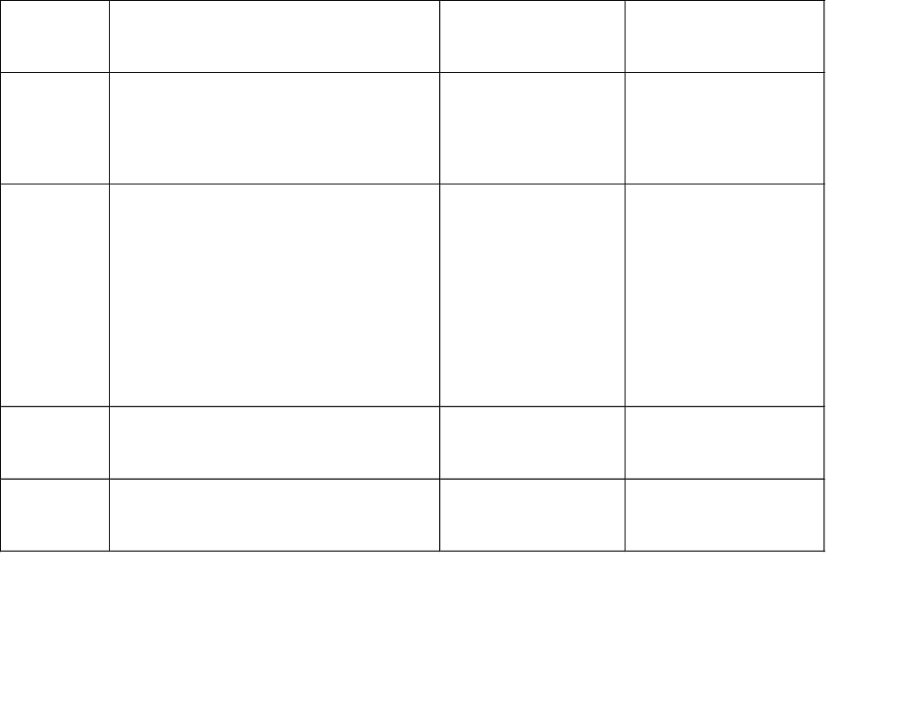

Slide 30
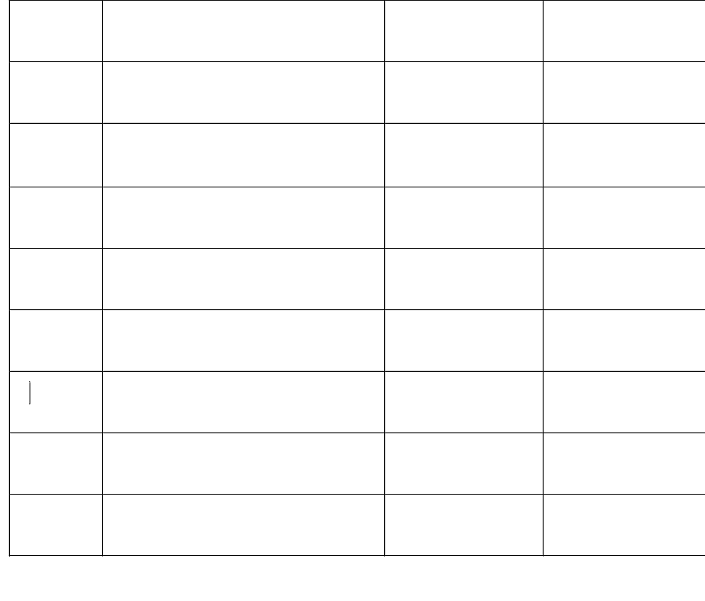

Slide 31
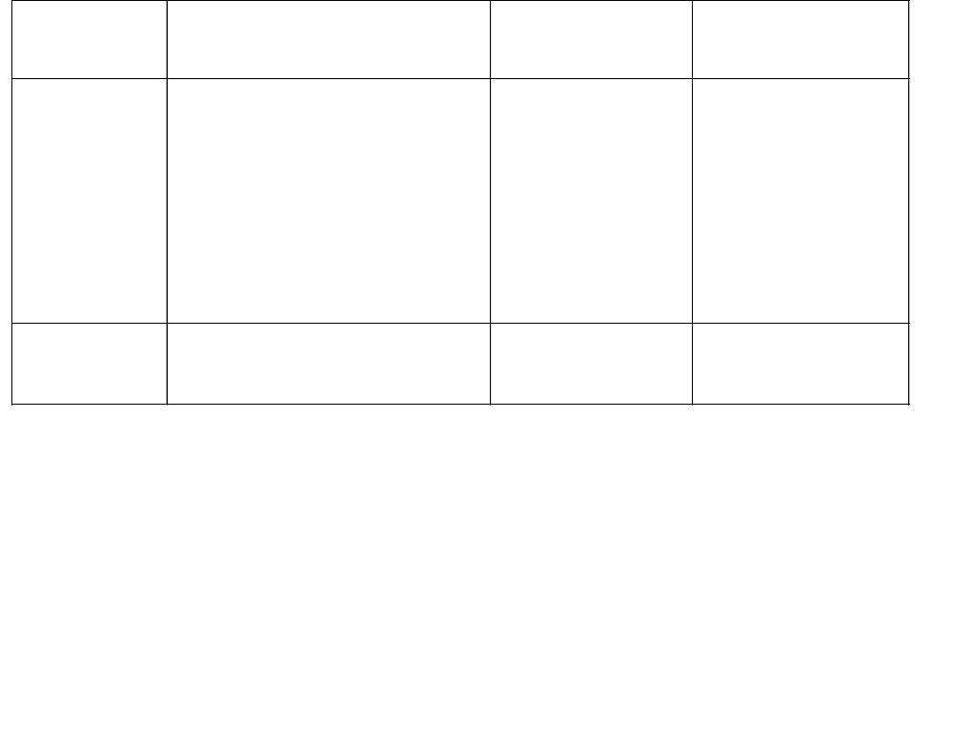

Slide 32
Polish Notation
The way to write arithmetic expression is known as a notation.
An arithmetic expression can be written in three different but equivalent notations, i.e., without changing the essence or output of an expression.

Slide 33
Polish Notation
The process of writing the operators of expression either before their operands or after them is called “Polish Notation”
The main property of Polish Notation is that the order in which operations are to be performed is ascertained by the position of the operators and operands in the expression

Slide 34
Polish Notation
These notations are
  Infix Notation
  Prefix (Polish) Notation
  Postfix (Reverse-Polish) Notation
These notations are named as how they use operator in expression.

Slide 35
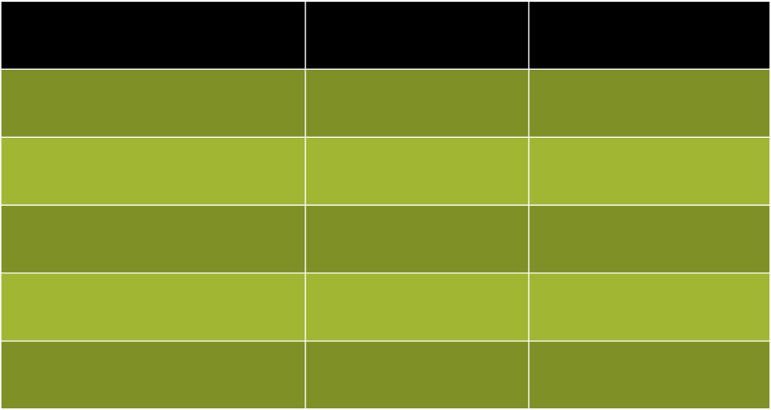
Notation
Infix Notation
Prefix Notation
Postfix Notation
A + B
+ AB
AB +
(A - C) + B
+ - ACB
AC – B +
A + ( B * C )
+ A * BC
ABC *+
(A+B)/(C-D)
/+ AB – CD
AB + CD -/
(A + (B * C))/(C – (D * B))
/+ A * BC – C * DB
ABC * + CDB * - /

Slide 36
WHY
Why to use these weird looking PREFIX and POSTFIX notations when we have simple INFIX notation?
To our surprise INFIX notations are not as simple as they seem specially while evaluating them.
To evaluate an infix expression we need to consider Operators’ Priority and Associative property
  For example expression 3+5*4 evaluate to 32 i.e. (3+5)*4 or to 23 i.e. 3+(5*4).
To solve this problem Precedence or Priority of the operators were defined. Operator precedence governs evaluation order. An operator with higher precedence is applied before an operator with lower precedence.

Slide 37
WHY
To solve this problem Precedence or Priority of the operators were defined.
Operator precedence governs evaluation order.
An operator with higher precedence is applied before an operator with lower precedence.

Slide 38
Infix Expression Is Hard To Parse
Need operator priorities,
This makes computer evaluation more difficult than is necessary.
Postfix and prefix expression forms do not rely on operator priorities.
So it is easier to evaluate expressions that are in these forms.

Slide 39
Conversion from Infix to Postfix Algorithm
Step1
Scan the Infix expression from left to right for tokens (Operators, Operands & Parentheses) and perform the steps 2 to 5 for each token in the Expression
Step2
If token is operand, Append it in postfix expression
Step3
If token is a left parentheses “(“, push it in stack.

Slide 40
Algorithm
Step4
If token is an operator,
Pop all the operators which are of higher or equal precedence then the incoming token and append them (in the same order) to the output Expression.
After popping out all such operators, push the new token on stack.

Slide 41
Algorithm
Step5
If “)” right parentheses is found,
Pop all the operators from the Stack and append them to Output String, till you encounter the Opening Parenthesis “(“.
Pop the left parenthesis but don’t append it to the output string (Postfix notation does not have brackets).

Slide 42
Algorithm
Step6
When all tokens of Infix expression have been scanned. Pop all the elements from the stack and append them to the Output String.
The Output string is the Corresponding Postfix Notation.

Slide 43
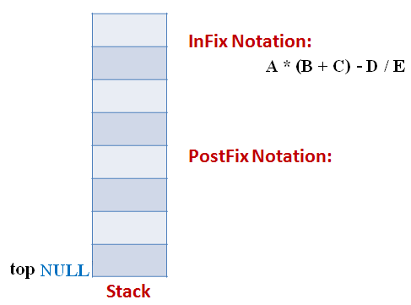
Example
Let the incoming the Infix expression be:
A * (B + C) – D / E
Stage 1: Stack is empty and we only have the Infix Expression.

Slide 44
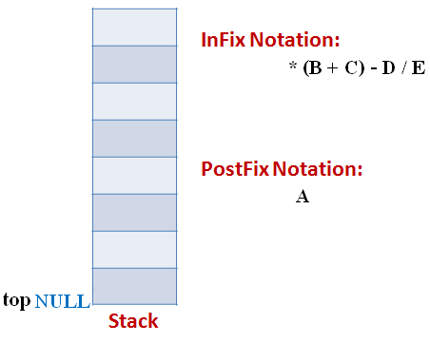
Example
Stage 2
The first token is Operand A Operands are Appended to the Output as it is.

Slide 45
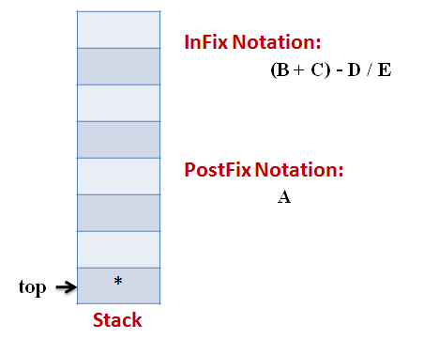
Example
Stage 3
Next token is * Since Stack is empty (top==NULL) it is pushed into the Stack

Slide 46
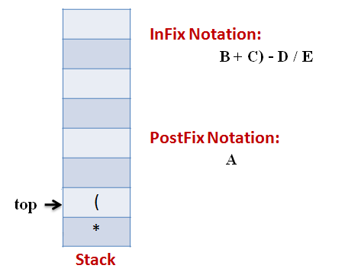
Example
Stage 4
Next token is ( the precedence of open-parenthesis, when it is to go inside, is maximum.
But when another operator is to come on the top of ‘(‘ then its precedence is least.

Slide 47
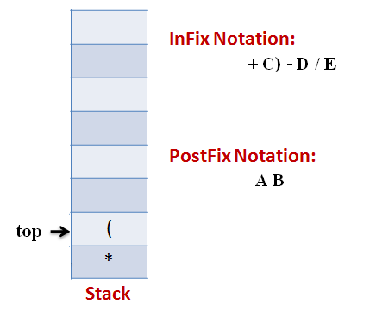
Example
Stage 5
Next token, B is an operand which will go to the Output expression as it is

Slide 48
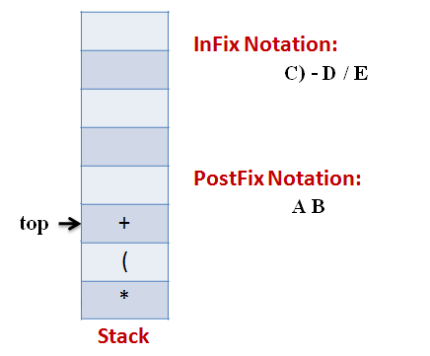
Example
Stage 6
Next token, + is operator, We consider the precedence of top element in the Stack, ‘(‘. The outgoing precedence of open parenthesis is the least (refer point 4. Above). So + gets pushed into the Stack

Slide 49
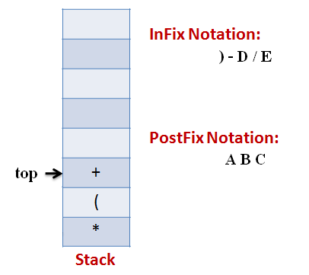
Example
Stage 7
Next token, C, is appended to the output

Slide 50
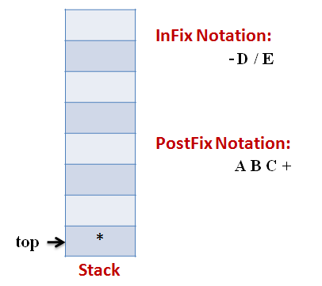
Example
Stage 8
Next token ), means that pop all the elements from Stack and append them to the output expression till we read an opening parenthesis.

Slide 51
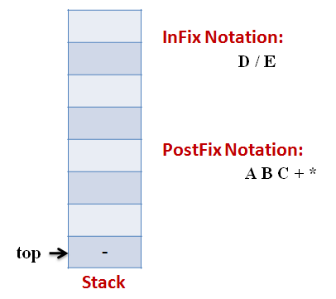
Example
Stage 9
Next token, -, is an operator. The precedence of operator on the top of Stack ‘*‘ is more than that of Minus. So we pop multiply and append it to output expression. Then push minus in the Stack.

Slide 52
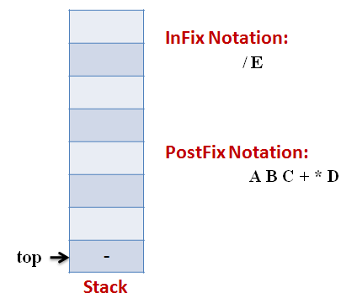
Example
Stage 10
Next, Operand ‘D‘ gets appended to the output.

Slide 53
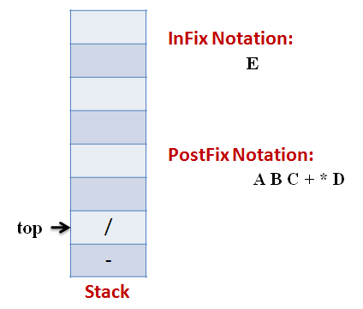
Example
Stage 11
Next, we will insert the division operator into the Stack because its precedence is more than that of minus.

Slide 54
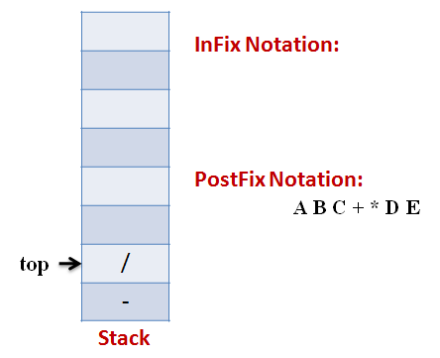
Example
Stage 12
The last token, E, is an operand, so we insert it to the output Expression as it is.

Slide 55
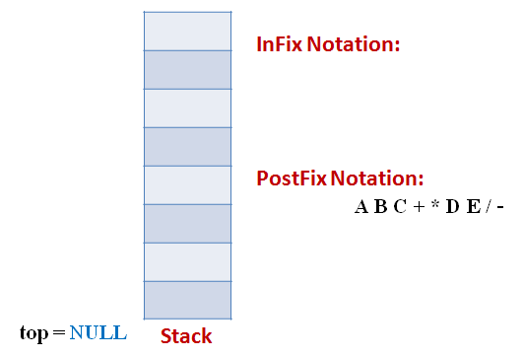
Example
Stage 13
The input Expression is complete now. So we pop the Stack and Append it to the Output Expression as we pop it.

Slide 56
Suppose we want to convert 2*3/(2-1)+5*3 into Postfix form,
Expression | Stack | Output
2 | Empty | 2
* | * | 2
3 | * | 23
/ | / | 23*
( | /( | 23*
2 | /( | 23*2
- | /(- | 23*2
1 | /(- | 23*21
) | / | 23*21-
+ | + | 23*21-/
5 | + | 23*21-/5
* | +* | 23*21-/53
3 | +* | 23*21-/53
 | Empty | 23*21-/53*+
So, the Postfix Expression is 23*21-/53*+

Slide 57
Evaluation of postfix expression
Step-1 Read the postfix expression from left to right
Step-2 If element is “operand” than
i. Push the element in the stack
Step-3 If element is “operator” then
i. Pop two operands from the stack
ii. Evaluate the expression formed by the two operands and the
operator
iii. Push the results of the expression in the stack end.
Step-4 If “no more elements” then
POP the result
else goto step1

Slide 58
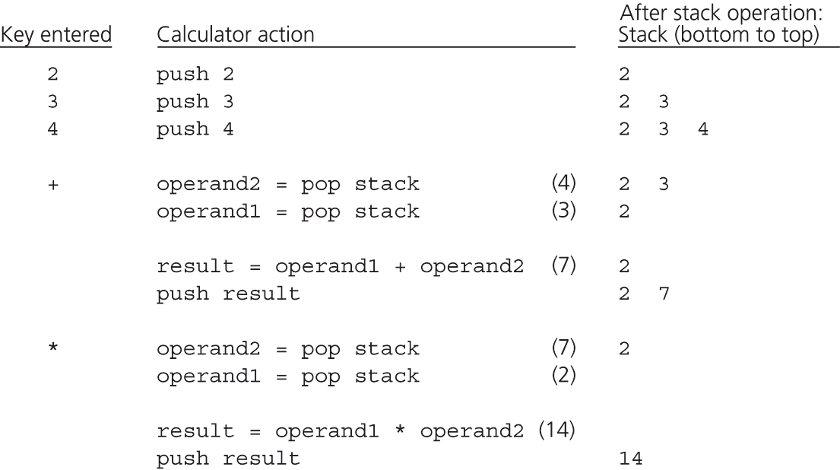
The action of a postfix when evaluating
Postfix Notation: 2 3 4 + *

Slide 59
Infix expression to Prefix expression
A – Arithmetic Expression B – Prefix Expression
Step 1. Push “)” onto STACK, and add “(“ to end of the A
Step 2. Scan A from right to left and repeat step 3 to 6 for each element of A until the STACK is empty
Step 3. If an operand is encountered add it to B
Step 4. If a right parenthesis is encountered push it onto STACK
Step 5. If an operator is encountered then:
Repeatedly pop from STACK and add to B each operator (on the top of STACK) which has same or higher precedence than the operator.
Add operator to STACK
Step 6. If left parenthesis is encontered then
Repeatedly pop from the STACK and add to B (each operator on top of stack until a left parenthesis is encounterd)
Remove the left parenthesis
Step 7. Exit

Slide 60
Infix expression to Prefix expression
Expression = (A+B^C)*D+E^5
Step 1. Reverse the infix expression.
5^E+D*)C^B+A(
Step 2. Make Every '(' as ')' and every ')' as '('
5^E+D*(C^B+A)
Step 3. Convert expression to postfix form.
Next Slide
Reverse the expression
+*+A^BCD^E5

Slide 61
Infix expression to Prefix expression
Expression | Stack | Output | Comment
5^E+D*(C^B+A) | Empty | - | Initial
^E+D*(C^B+A) | Empty | 5 | Print
E+D*(C^B+A) | ^ | 5 | Push
+D*(C^B+A) | ^ | 5E | Push
D*(C^B+A) | + | 5E^ | Pop And Push
*(C^B+A) | + | 5E^D | Print
(C^B+A) | +* | 5E^D | Push
C^B+A) | +*( | 5E^D | Push
^B+A) | +*( | 5E^DC | Print
B+A) | +*(^ | 5E^DC | Push
+A) | +*(^ | 5E^DCB | Print
A) | +*(+ | 5E^DCB^ | Pop And Push
) | +*(+ | 5E^DCB^A | Print
End | +* | 5E^DCB^A+ | Pop Until '('
End | Empty | 5E^DCB^A+*+ | Pop Every element

Slide 62
Evaluation of Prefix Expression
/* Reading the expression take place from right to left /*
Step 1. Read the next element
Step 2. If element is operand then
i. Push the element in the stack
Step 3. If element is operator then
Pop two operands from the stack
Evaluate the expression formed by two operands and the operator
Push the results of the expression in the stack end
Step 4. if no more elements then
i. Pop the result else
goto step 1
Step 5. Exit

Slide 63
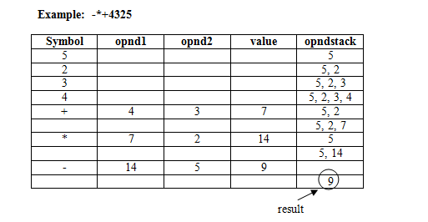
The action of a postfix when evaluating
prefix Notation:-*+4325

Slide 64
A Legend
The Towers of Hanoi
In the great temple of Brahma in Benares, on a brass plate under the dome that marks the center of the world, there are 64 disks of pure gold that the priests carry one at a time between these diamond needles according to Brahma's immutable law: No disk may be placed on a smaller disk. In the begging of the world all 64 disks formed the Tower of Brahma on one needle. Now, however, the process of transfer of the tower from one needle to another is in mid course. When the last disk is finally in place, once again forming the Tower of Brahma but on a different needle, then will come the end of the world and all will turn to dust.

Slide 65
The Towers of Hanoi
A Stack-based Application
  GIVEN: three poles
  a set of discs on the first pole, discs of different sizes, the smallest discs at the top
  GOAL: move all the discs from the left pole to the right one.
  CONDITIONS: only one disc may be moved at a time.
  A disc can be placed either on an empty pole or on top of a larger disc.

Slide 66

Towers of Hanoi

Slide 67
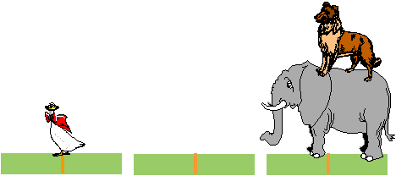
Towers of Hanoi

Slide 68

Towers of Hanoi

Slide 69

Towers of Hanoi

Slide 70

Towers of Hanoi

Slide 71

Towers of Hanoi

Slide 72
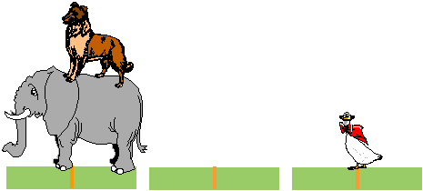
Towers of Hanoi

Slide 73
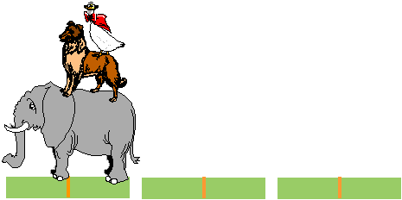
Towers of Hanoi

Slide 74
Tower of Hanoi (FOR N=3 DISKS)
A
B
C
INPUT
A
B
C
OUTPUT

Slide 75
SOLUTION TO THE PROBLEM OF TOWER OF HANOI
Formula for finding the minimum number of moves to transfer ‘n’ disks from A to C is 2^{n} – 1
No of disks | No. of moves
1 | 1
2 | 3
3 | 7
4 | 15
5 | 31

Slide 76
Recursive Algorithm for tower of Hanoi
Tower(N, Beg, Aux, End)
Step 1: if N=1 then
Write: Beg → End
Return
Step 2: [move N-1 disks from tower Beg to tower Aux]
Call Tower(N-1, Beg, End, Aux)
Step 3: Write Beg → End
Step 4: [move N-1 disks from tower Aux to tower End]
Call Tower(N-1, Aux, Beg, End)
Step 5: Return

Slide 77
Tower of Hanoi
Move top disk from tower A to C
A
B
C
A
B
C
Input
Move top disk from tower A to B
Move top disk from tower C to B
A
B
C
A
B
C

Slide 78
Tower of Hanoi
Move top disk from tower A to C
Move top disk from tower B to A
A
B
C
A
B
C
Move top disk from tower B to C
Move top disk from tower A to C
A
B
C
A
B
C

Slide 79
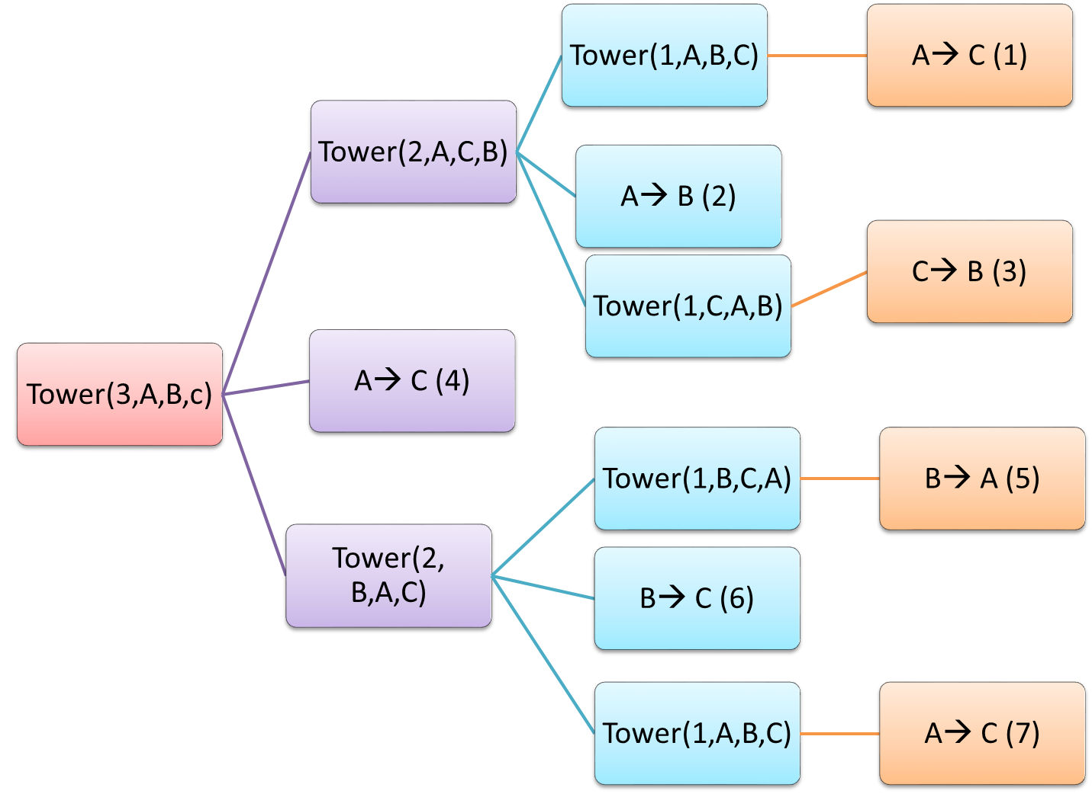

Slide 80
Recursion
Recursion is a programming Technique in which a function contains a function call to itself
Recursion and iteration are different processes.
Recursion is a process in which the function contains a function to call itself.
Iteration is a process where the group of statement is executed repeatedly.

Slide 81
Eg:- Factorial Function
factorial(int x)
{
int f;
if(x==1)
return(1);
else
f=x*factorial(x-1);
return (f);
}

Slide 82
Continued…
The number entered through scanf() is 5, means x=5,
since x truns out to be 5 the condition (x==1) fails and the statement f=x*factorial(x-1) comes in execution
Where factorial(x-1) will be recursion(recursive call)

Slide 83
Types Of Recursion
Direct Recursion
Indirect Recursion

Slide 84
Direct Recursion
Eg:-
factorial(int x)
{
factorial(int x-1);
}

Slide 85
Indirect Recursion
Eg:-
int a()
{
b();
}
int b()
{
a();
}

Slide 86
Simple C program…
Void main()
{
int a,b,c;
float d;
char e;
printf(“enter the values for three int numbers);
scanf(“%d %d %d”,&a,&b,&c);
…..
…..
}
Data
Instruction

Slide 87
Memory Organization
Heap
Stack
Activation Records
Static Variable
Code

Slide 88
Memory Organization - Example
Void main
{
int x = 10;
printf(“%d”,x);
}
Activation records
Heap
X = 10
Static Variable
Void main
{
int x = 10;
printf(“%d”,x);
}

Slide 89
Memory Organization - Example
Void ex1(int a)
{
printf(“%d”,a);
}
Void main()
{
int x =10;
X++;
ex1(x);
}
Heap
Activation records
X = 10
Static Variable
Void main()
{
int x =10;
X++;
ex1(x);}
Void ex1(int a)
{
printf(“%d”,a);
}

Slide 90
Memory Organization - Example
Void ex1(int a)
{
printf(“%d”,a);
}
Void main()
{
int x =10;
X++;
ex1(x);
}
Heap
Activation records
a = 11
X = 11
Static Variable
Void main()
{
int x =10;
X++;
ex1(x);}
Void ex1(int a)
{
printf(“%d”,a);
}

Slide 91
Memory Organization - Example
Void ex1(int a)
{
if(a>0)
{
printf(“%d”,a);
ex1(a-1);
}
}
Void main()
{
int x =2;
X++;
ex1(x);
}
Heap
Activation records
X = 2
Static Variable
Void ex1(int a)
{
if(a>0)
{ printf(“%d”,a);
ex1(a-1);}}
Void main()
{
int x =2;
X++;
ex1(x);}

Slide 92
Memory Organization - Example
Void ex1(int a)
{
if(a>0)
{
printf(“%d”,a);
ex1(a-1);
}
}
Void main()
{
int x =2;
X++;
ex1(x);
}
Heap
a = 0
a = 1
Activation records
a = 2
a = 3
X = 3
Static Variable
Void ex1(int a)
{
if(a>0)
{ printf(“%d”,a);
ex1(a-1);}}
Void main()
{
int x =2;
X++;
ex1(x);}

Slide 93
Analysis of Stack Operations
Below mentioned are the time complexities for various operations that can be performed on the Stack data structure.
Push Operation : O(1)
Pop Operation : O(1)
Top Operation : O(1)
Search Operation : O(n)
The time complexities for push() and pop() functions are O(1) because we always have to insert or remove the data from the top of the stack, which is a one step process.

