Slide 1
A view from Space
April 22, 2012
International Space Apps Challenge Tokyo
Isana Kashiwai, Hal Seki, Hiroshi Saito, Tamon Yanai, Takayuki Narabu,
Rie Nakajima, Tsugito Nagano

Slide 2
Summary
“A View from Space” is a web-based application to share a
view between the world and ISS.
The functions are as follows;
Users can track the ISS from satellite-eyes-view.
The app provides various satellite images as the base map for the earth. (MODIS Sea Surface Temperature, Wild Fire etc…)
Users can update their information via Twitter. And it will be displayed *only when* ISS pass through the region nearby.
Users can read the articles related with the earth environment issues written by researchers *only where* ISS is passing through.

Slide 3
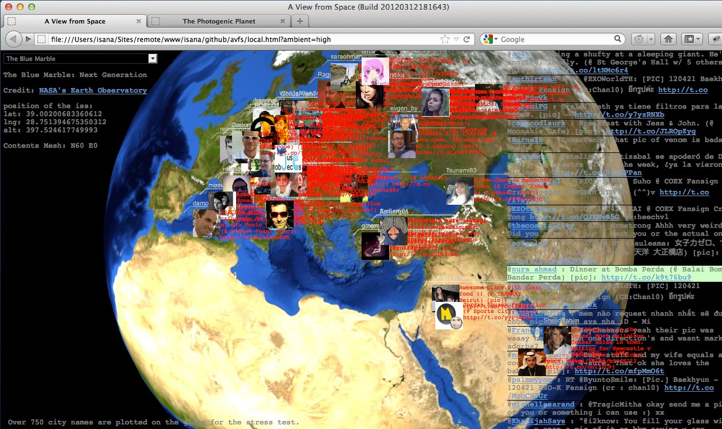
Demo Site
(works for Apple Safari or Google Chrome) http://www.lizard-tail.com/isana/avfs/
<Social area>
By using of Twitter (#avfs), users can communicate with on this app. Geo-location information will be added automatically when the user tweets from this page and will be displayed automatically when ISS passes through nearby
<Article area>
Users can see various contents along with the orbit of ISS. Some EO researchers shares their knowledge about the earth.
<Plot area>
Information is plotted based on the geo location information. Refer to FOV from ISS.

Slide 4
Why unique?
“A View from Space” is a unique because it restricts the information stream based on the orbit of ISS intentionally. The purpose of this restriction is to encourage users to share a common viewpoint which is organized by borderless rule - the orbit of ISS – it is equally fair for the people living on the earth. We believe sharing this unique view around the world will be a platform to enhance the common understanding among the people on the earth.

Slide 5
Our goal
We believe sharing this unique view around the world will be a platform to enhance the common understanding among the people on the earth.
It is our great pleasure if this app will provide the experience to the users like an astronaut felt;
‎"The first day or so we all pointed to our countries. The third or fourth day we were pointing to our continents. By the fifth day, we were aware of only one Earth."
- Sultan bin Salman Al-Saud / Astronaut

Slide 6
Special Thanks To:
Special Thanks to
Naguyen Kim Anh from Vietnam Academy of Science and Technology
Takeo Tadono from JAXA/EORC
Koji Nakau from Hokkaido Univ.
Taro Nakai from International Arctic Research Center
for their cooperation.
asianews.it cbsnews.com citslinc.com
fire.uni-freiburg.de fractalfoundation.org
guardian.co.uk iisd.ca jodrellbank.manchester.ac.uk
nasa.gov telegraph.co.uk thespacereview.com
transitionsabroad.com zedgraffiti.wordpress.com
for their images.

