Slide 1
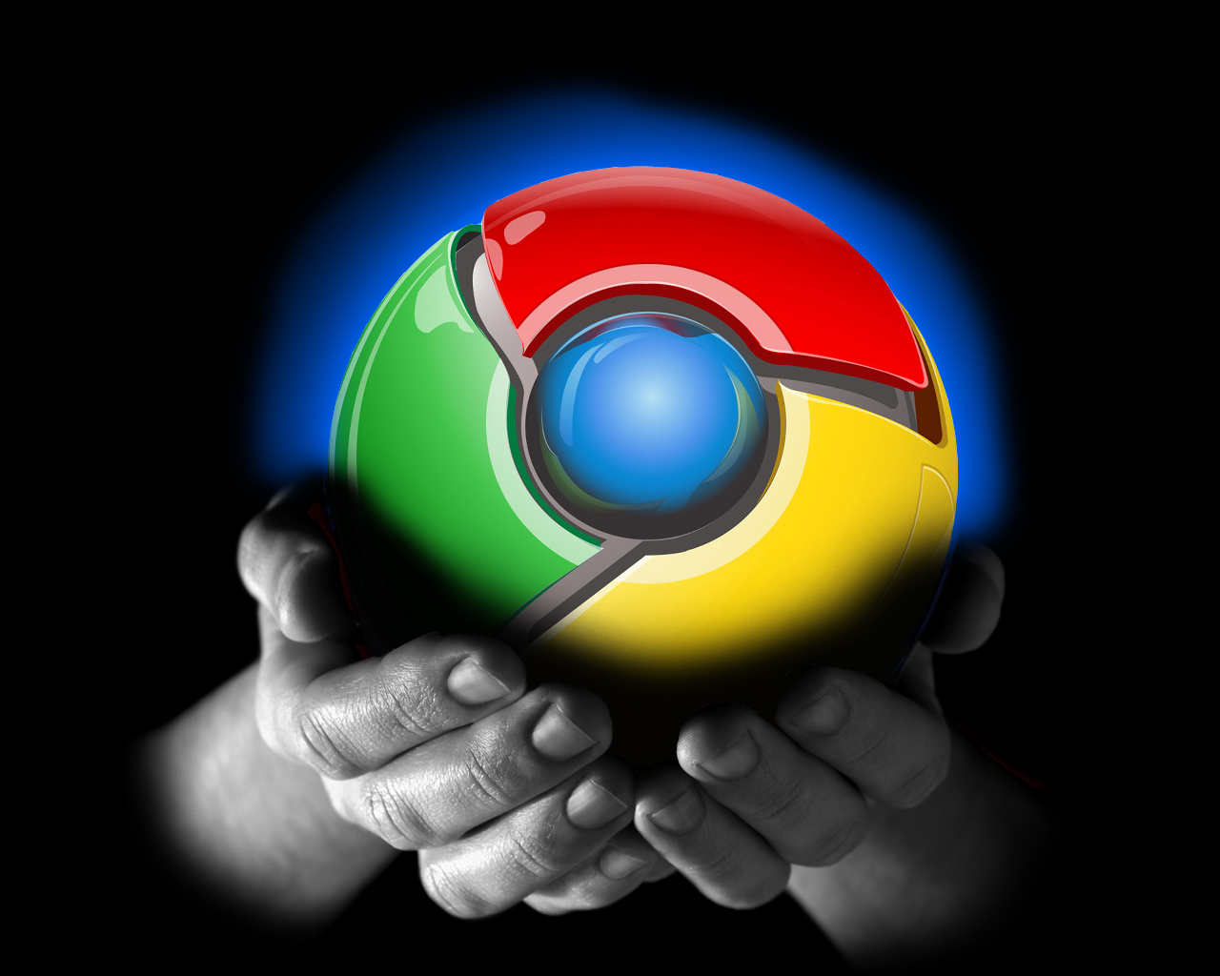
Chrome Developer Tools
Novice to Dangerous
in 20 minutes

Slide 2

What's DevTools?
Chrome Developer Tools (DevTools for short) are a set of web authoring and debugging tools built into Google Chrome.
The DevTools provide web developers deep access into the internals of the browser and their web application.
Use the DevTools to efficiently track down layout issues, set JavaScript breakpoints, and get insights for code optimization
https://developer.chrome.com/devtools

Slide 3
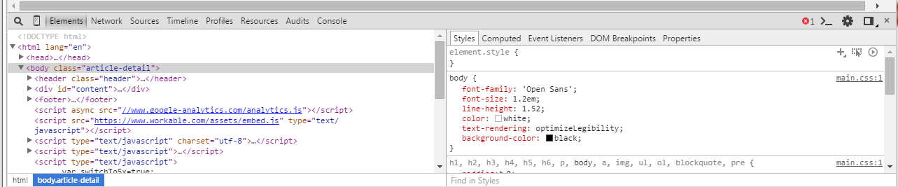
Accessing DevTools
To access the DevTools, open a web page or web app in Google Chrome. Either:
Select the Chrome menu at the top-right of your browser window, then select Tools > Developer Tools.
Right-click on any page element and select Inspect Element

Slide 4

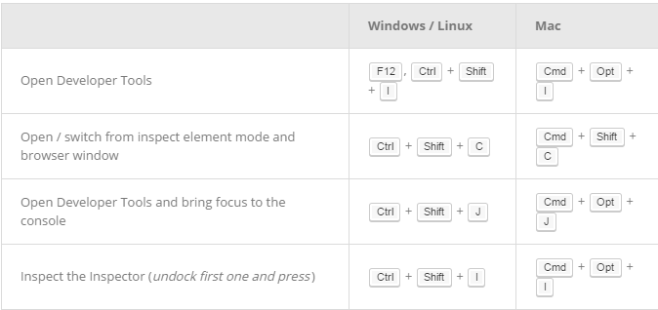
Open Shortcuts
There are several useful shortcuts for opening the DevTools:

Slide 5
DevTools Panels
There are eight main groups of tools:
Elements
Sources
Console
Resources
Network
Audits
Timeline
Profiles

Slide 6

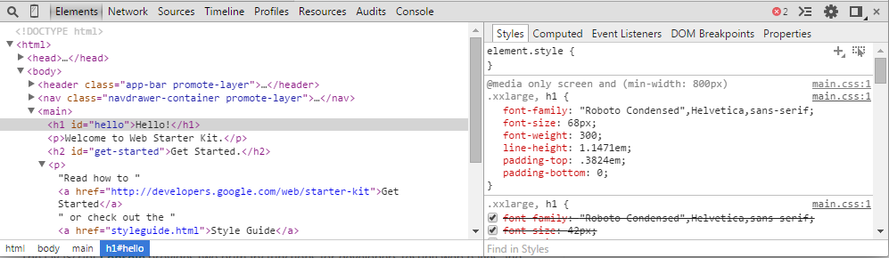
Elements
The Elements panel lets you see everything in one DOM tree and allows inspection and on-the-fly editing of DOM elements.
You will often visit the Elements tabs when you need to identify the HTML snippet for some aspect of the page.
https://developer.chrome.com/devtools/docs/dom-and-styles

Slide 7
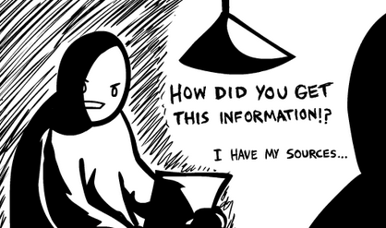
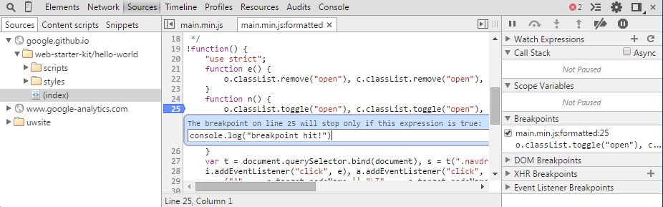
Sources
The Sources panel lets you debug your JavaScript code. It provides a graphical interface to the V8 debugger
https://developer.chrome.com/devtools/docs/javascript-debugging

Slide 8
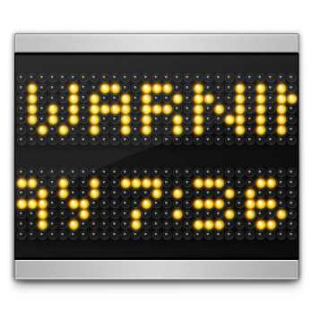
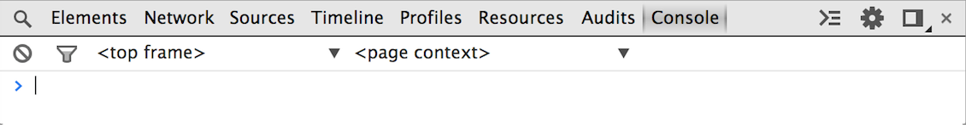
Console
The JavaScript Console provides two primary functions for developers testing web pages and applications. It is a place to:
Log diagnostic information in the development process.
A shell prompt which can be used to interact with the document and DevTools
https://developer.chrome.com/devtools/docs/console

Slide 9

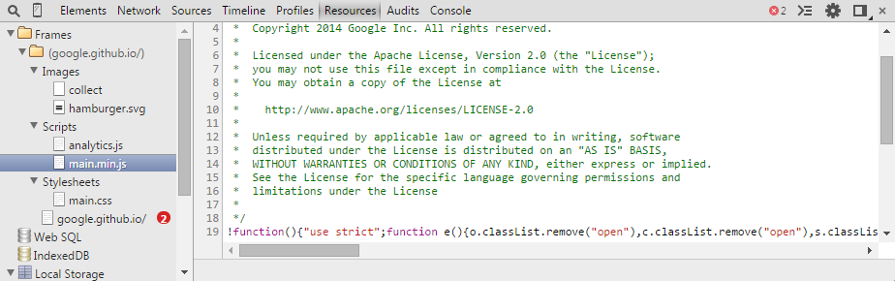
Resources
The Resources panel lets you inspect resources that are loaded in the inspected page. It lets you interact with HTML5 Database, Local Storage, Cookies, AppCache, etc
https://developer.chrome.com/devtools/docs/resource-panel

Slide 10

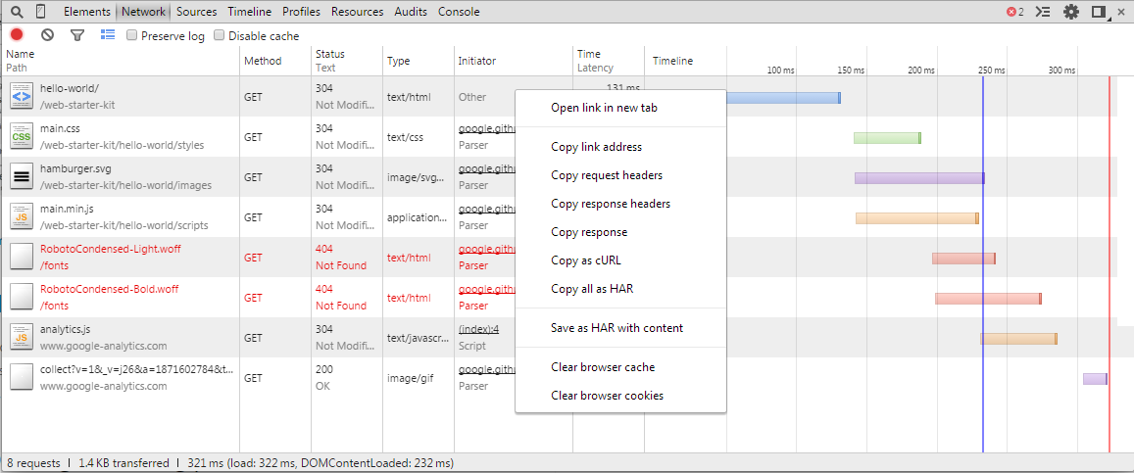
Network
The Network panel records information about each network operation in your application, including detailed timing data, HTTP request and response headers, cookies, WebSocket data, and more.
https://developer.chrome.com/devtools/docs/network

Slide 11

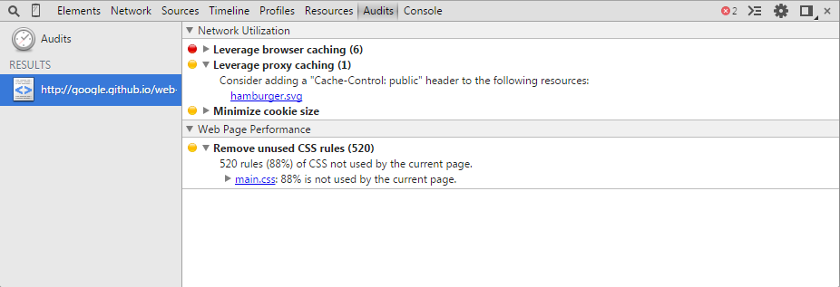
Audits
The Audit panel can analyze a page as it loads. Then provides suggestions and optimizations for decreasing page load time and increase perceived (and real) responsiveness
https://developers.google.com/speed/pagespeed/insights/

Slide 12
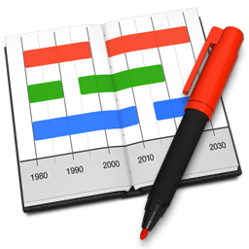
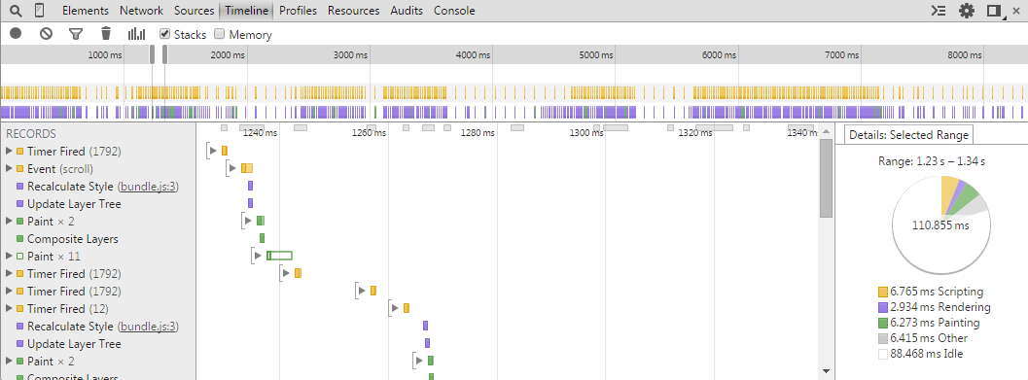
Timeline
The Timeline panel gives you a complete overview of where time is spent when loading and using your web app or page. All events, from loading resources to parsing JavaScript, calculating styles, and repainting are plotted on a timeline
https://developer.chrome.com/devtools/docs/timeline

Slide 13

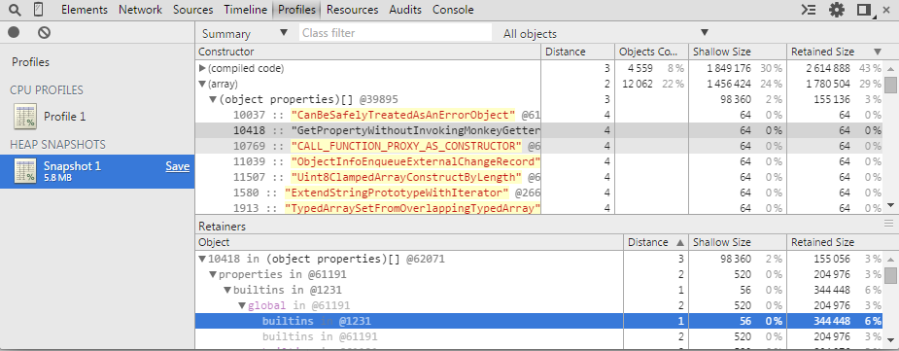
Profiles
The Profiles panel lets you profile the execution time and memory usage of a web app or page. These help you to understand where resources are being spent, and so help you to optimize your code
https://developer.chrome.com/devtools/docs/profiles

Slide 14

Devices
You can use device mode to:
Test your responsive designs by emulating different screen sizes and resolutions, including Retina displays.
Evaluate your site's performance using the network emulator, without affecting traffic to other tabs.
Visualize and inspect CSS media queries.
Accurately simulate device input for touch events, geolocation, and device orientation.
https://developer.chrome.com/devtools/docs/device-mode

Slide 15

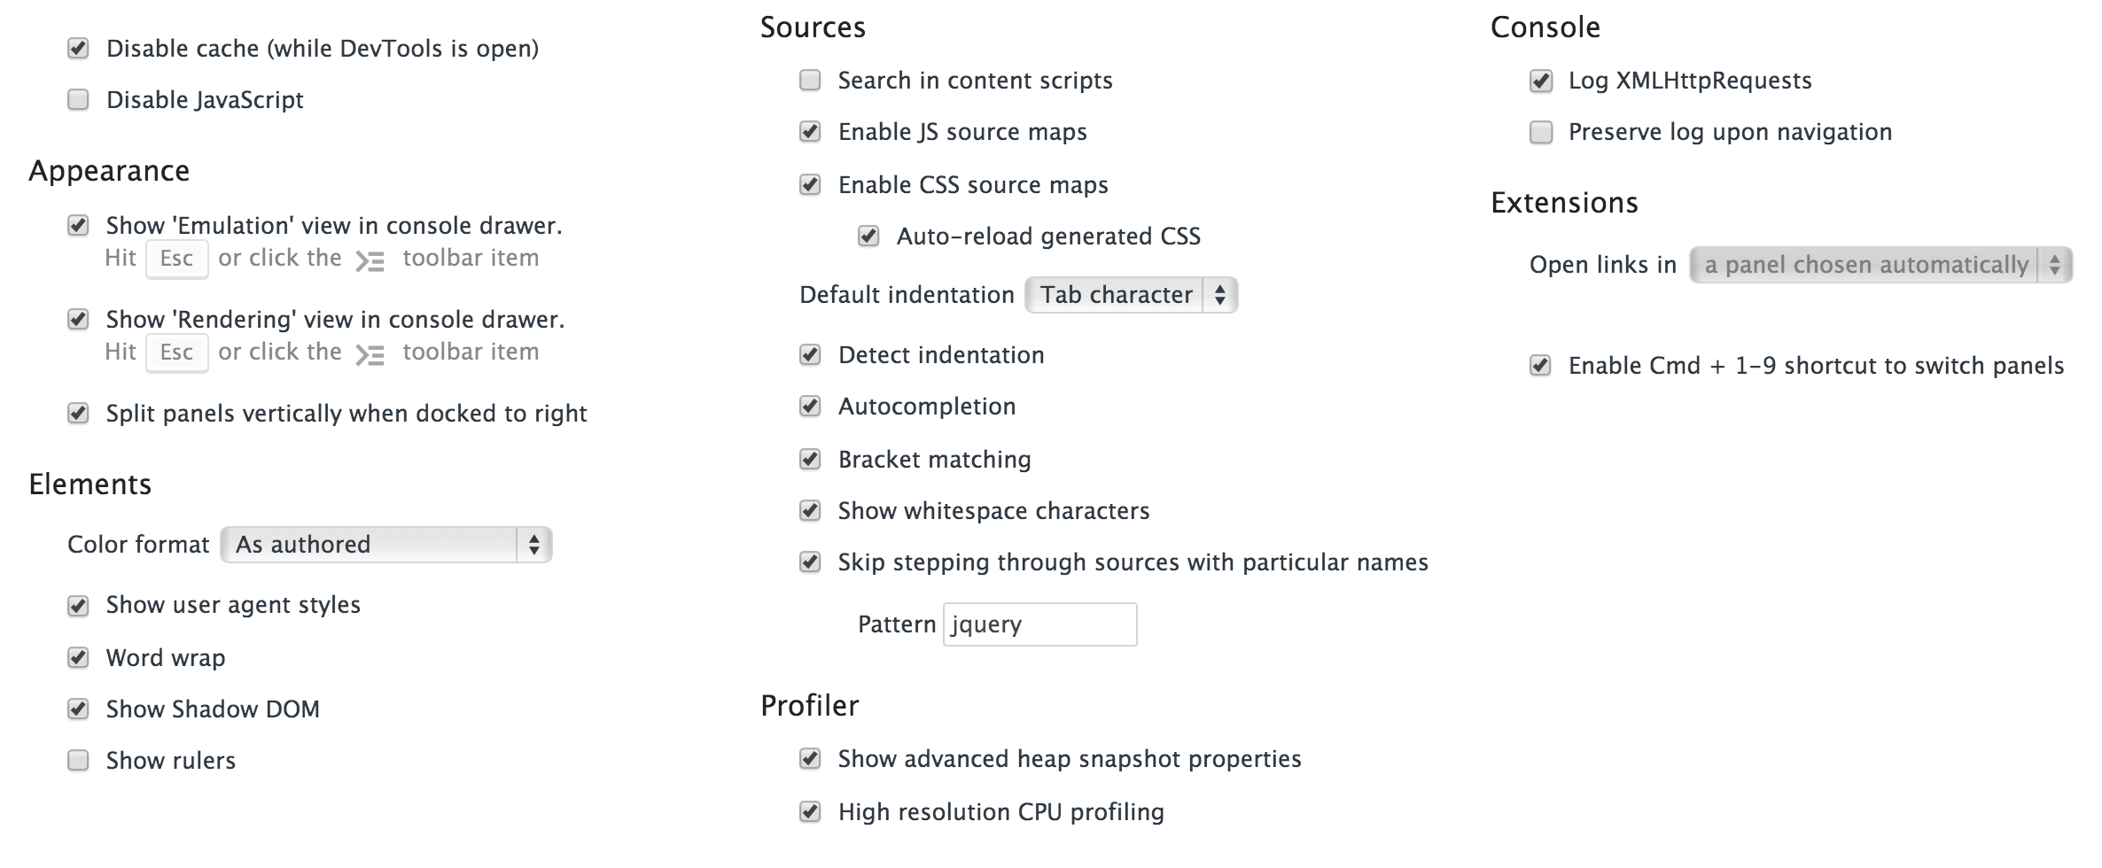
Settings
https://developer.chrome.com/devtools/docs/settings

Slide 16
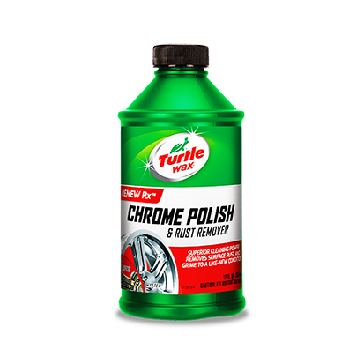
Demo

Slide 17

Stuff
DevTools Overview
https://developer.chrome.com/devtools
DevTool Videos
https://developer.chrome.com/devtools/docs/videos
Ask a question in the forums
https://groups.google.com/forum/?fromgroups#!forum/google-chrome-developer-tools
Follow @ChromiumDev on Twitter
More keyboard shortcuts
https://developer.chrome.com/devtools/docs/shortcuts

Slide 18
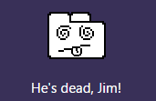
Questions?

