Slide 1
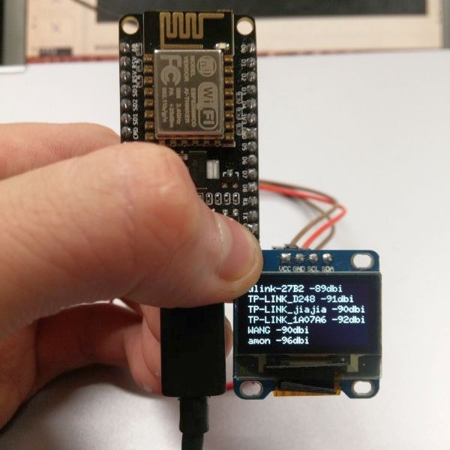
ESP8266 NodeMCU
Ardunio Killer
Or
How I learned to stop worrying and ...

Slide 2
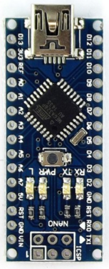
Arduino Nano
Arduino version used for our FW-Dev workshop
Atmel ATmega328 16MHz
14 Digital I/O Pins
8 Analog Input Pins
DC Current per I/O Pin 40 mA
32 KB Flash
2 KB RAM
No WiFi on-board
WiFi options were expensive
We used 433MHz radio to send data off-board

Slide 3
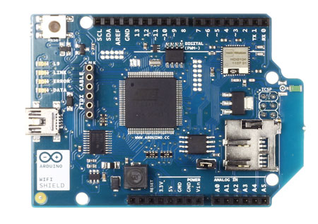
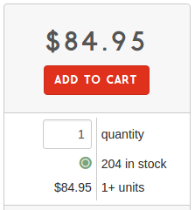
Wi-Fi Shield
Expensive. $85/each. Wow
802.11b/g
WEP and WPA2
Connection with Arduino on SPI port
Onboard micro-SD card slot

Slide 4
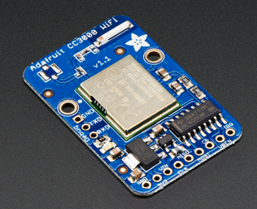
CC3000 Wi-Fi
Expensive. $35/each on breakout board with chip antenna
802.11b/g, open/WEP/WPA/WPA2 security, TKIP & AES
Built in TCP/IP stack with a "BSD socket" interface
Can connect to an access point but it cannot be an access point.
SSID scanning, connection, DHCP, DNS lookup, ping
UDP/TCP client server connections. Up to 4 concurrent sockets
SPI Interface
Buggy and ornery

Slide 5
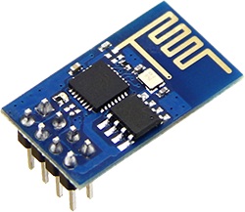
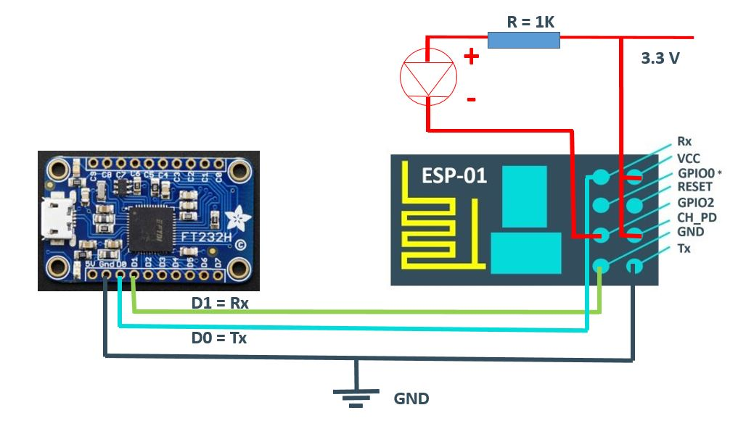
ESP8266
ESP-01
Originally was $5
Now < $2 on eBay
Simple serial interface
AT commands
Can be Client or Access Point

Slide 6


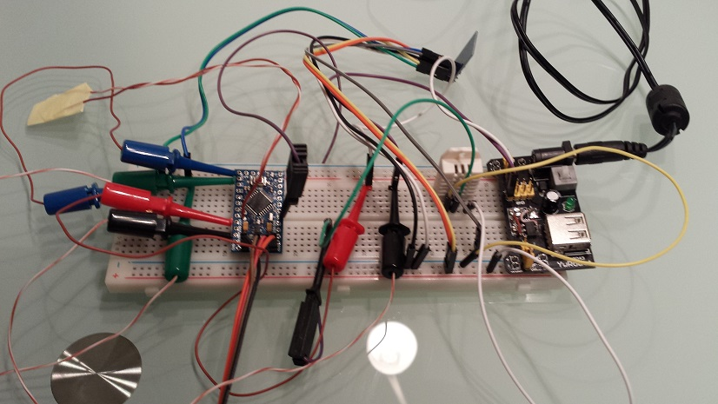

To the Cheap Cloud

Slide 7
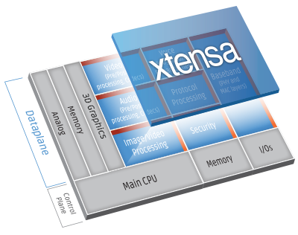
ESP8266 Wifi Module
Self contained SoC with integrated TCP/IP protocol stack
32-bit RISC CPU 80 MHz
64 KB of instruction RAM, 96 KB of data RAM
External QSPI flash - 512 KB to 4 MB (up to 16MB is supported)
IEEE 802.11 b/g/n Wi-Fi
16 GPIO pins
SPI, I²C
UART on dedicated pins
2nd transmit-only UART on GPIO2
1 10-bit AD
The ESP8266 is capable of either hosting an application or
offloading all Wi-Fi networking functions to a micro-controller
ESP-01 PITA to program

Slide 8
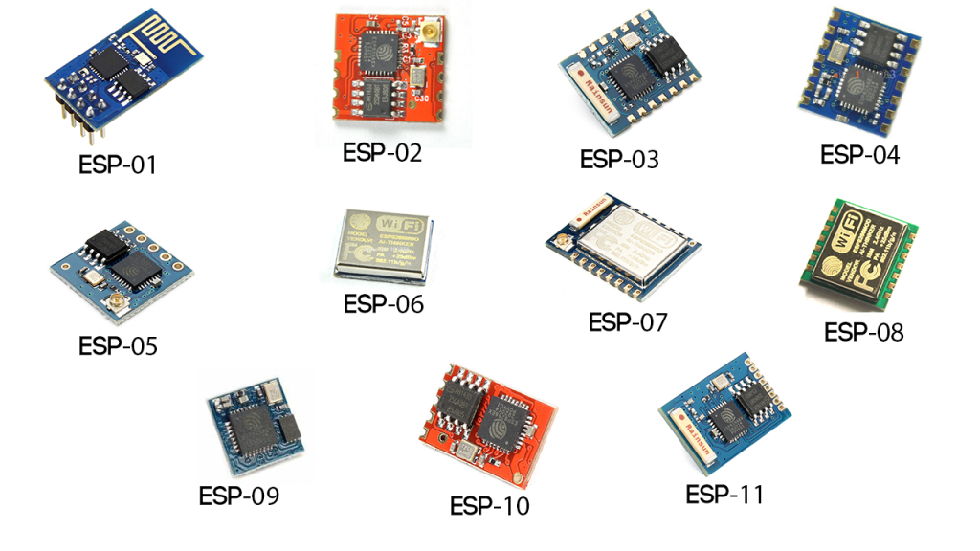

Slide 9
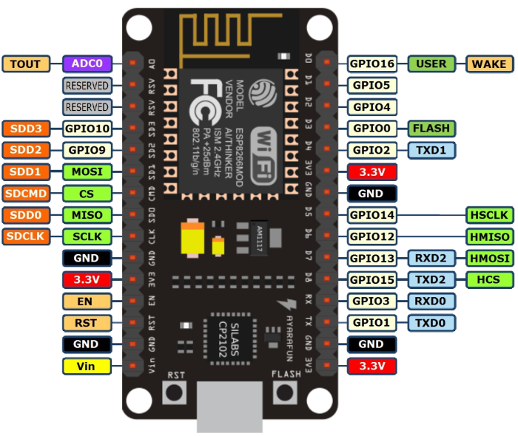
NodeMCU DEVKIT V1.0

Slide 10
NodeMCU
32-bit RISC CPU 80 MHz (OC 160MHz)
64 KB of instruction RAM, 96 KB of data RAM
4MB flash
IEEE 802.11 b/g/n Wi-Fi
13 GPIO pins
SPI, I²C
1 10-bit AD
CP2102 USB
Can be programmed with LUA, C++, Python, Basic, Arduino IDE

Slide 11
Saturday Workshop?
Similar to Arduino Workshop
For nominal fee ($20?), you'll get parts, code and ~4 hrs of instruction for projects
Parts:
NodeMCU
Sensors (Temperature/Humidity?)
Display (OLED or LCD)
Breadboard, wires
Mid to End May?

Slide 12
Example Agenda
ESP8266/NodeMCU overview
Setup development environment
Build a Wifi client and pull data
Read sensors and push data to web
Create a Web server, web page with sensor data and access from PC/Phone
Display sensor data on graphic display
Create Wifi Access Point with SSID
All code and tutorials will be put on github

