Slide 1
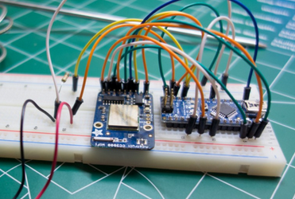
ardiuno meetup
8 Nov 2014

Slide 2
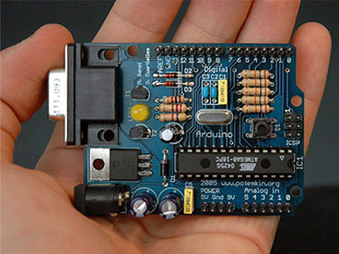

Arduino 101
Started 2005
Open-source electronics
prototyping platform
  Open-source hardware
  Open-source software
Hardware based on 8-bit Atmel AVR microcontroller or 32-bit Atmel ARM
Very popular in the maker community
http://arduino.cc/

Slide 3
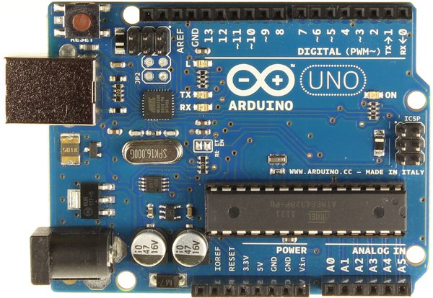
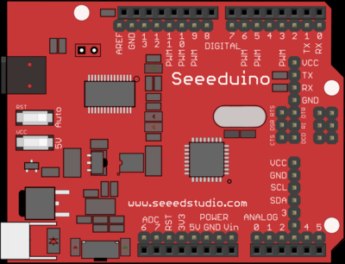
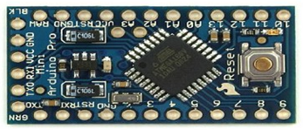
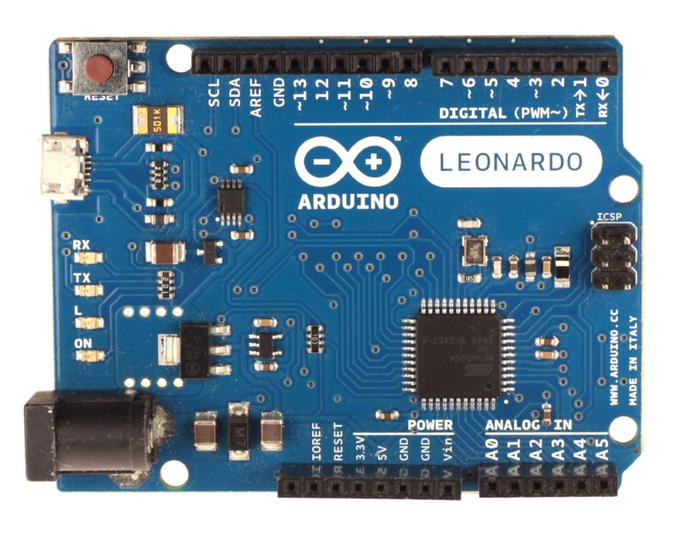
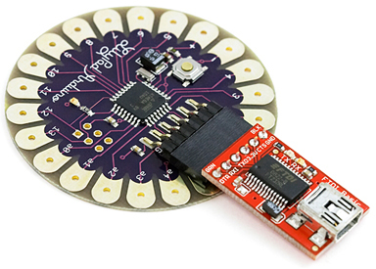
51 Flavours and counting
Uno is current “standard”, uses ATMega328 < $20
Leonardo uses ATMega32u4 < $18
Mini/Nano uses Atmega328P < $5

Slide 4
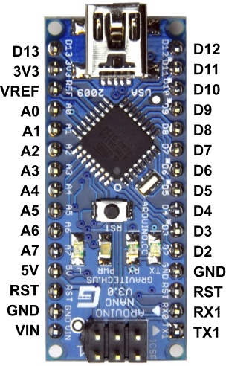
Arduino Nano
Microcontroller Atmel ATmega328
Operating Voltage (logic level) 5 V
Input Voltage 7-12 V
Input Voltage (limits) 6-20 V
Digital I/O Pins 14 (of which 6 provide PWM output)
Analog Input Pins 8
DC Current per I/O Pin 40 mA
Flash Memory 32 KB of which 2 KB used by bootloader
SRAM 2 KB
EEPROM 1 KB
Clock Speed 16 MHz
Dimensions 0.73" x 1.70"
http://arduino.cc/en/Main/ArduinoBoardNano

Slide 5
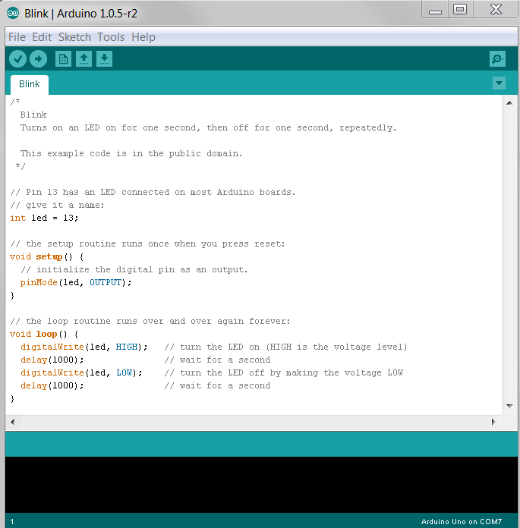
Arduino IDE
Upload
to Board
Serial
Monitor
Save
Compile
Integrated Development Environment (IDE)
All-in-one programming tool with built in compiler
Arduino language is C-like
Messages
http://arduino.cc/en/Main/Software

Slide 6
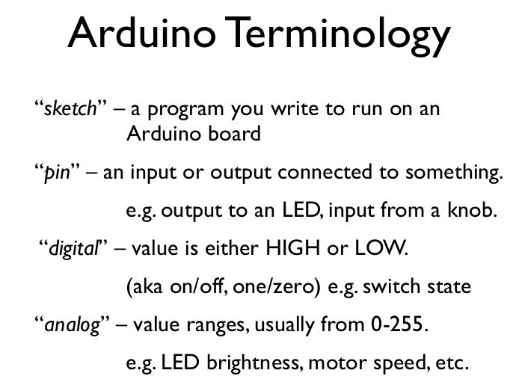

Slide 7
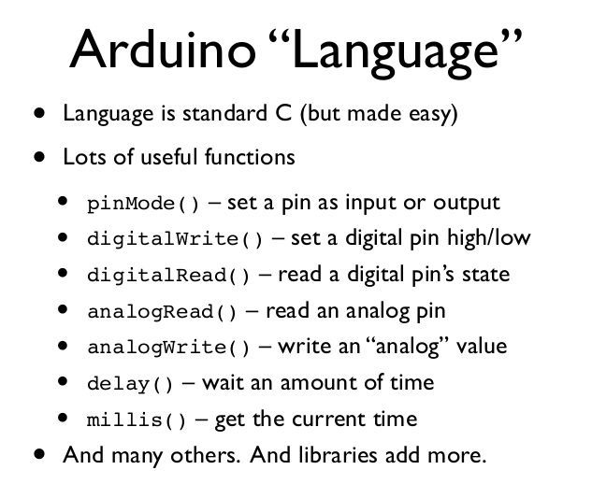

Slide 8
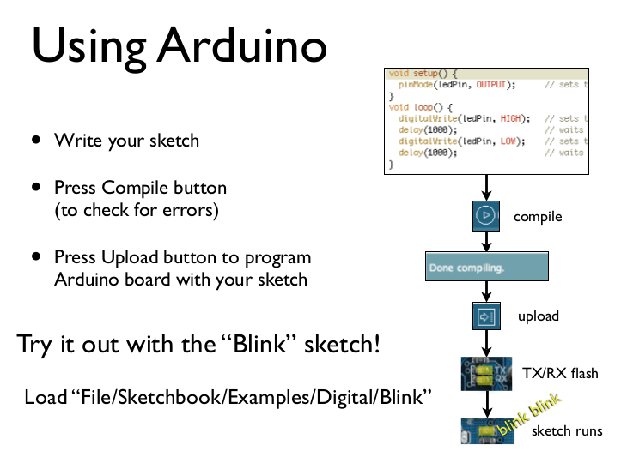

Slide 9
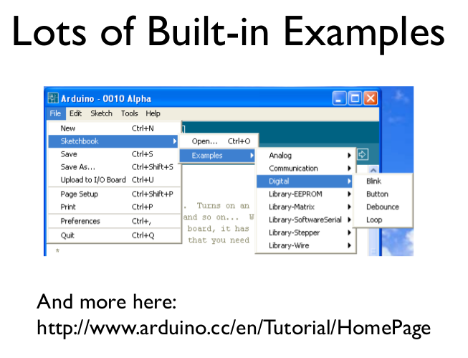

Slide 10
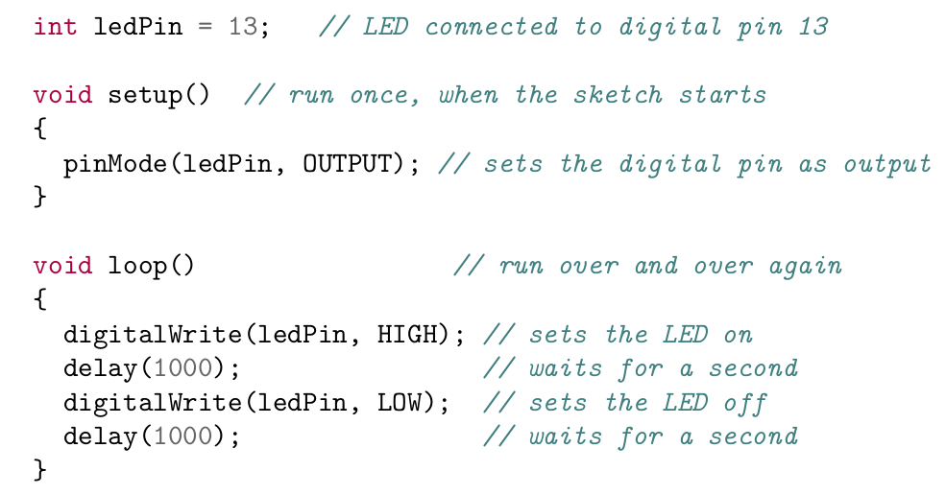
Hello Blinky World

Slide 11
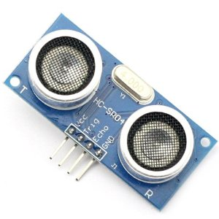
HC-SR04 Ultrasonic Sensor
2cm~500 cm resolution : 0.3 cm
Trig pin to any digital output
Echo pin to any digital input
Pulse Trig, read echo, calculate distance
Pace of Sound = 1 / Speed of Sound = 1 / 0.03435 = 29.1 ųs/cm

Slide 12
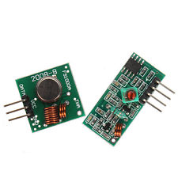
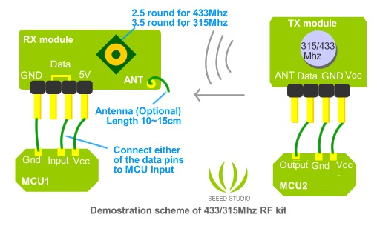
433Mhz RF Transmitter + Receiver Module
Other cheap modules are:
315/330MHz,
2.4GHz
FCC regulates 433MHz:
~no more than 10 minutes
on every hour
~20-200m LOS; 4Kbps
Noisy, interference from door bell, garage openers, cordless phone
Easy to use with VirtualWire Library

Slide 13



Slide 14
Today's Task List
Install Arduino IDE
Install CH340G Driver
Modify Blink example to print to Serial console
Breadboard HC-SR04 Ultrasonic Sensor and read distance
Breadboard 433Mhz RF Transmitter and send distance
Breadboard RF Receiver and then transmit received messages

Slide 15
Stretch Goals
Add checksum to transmission
Use additional Components and Sensors
  LEDs
  Light Sensors
  Pushbuttons
  ?

Slide 16
Install Arduino IDE
http://arduino.cc/en/Main/Software
Arduino 1.0.6

Slide 17
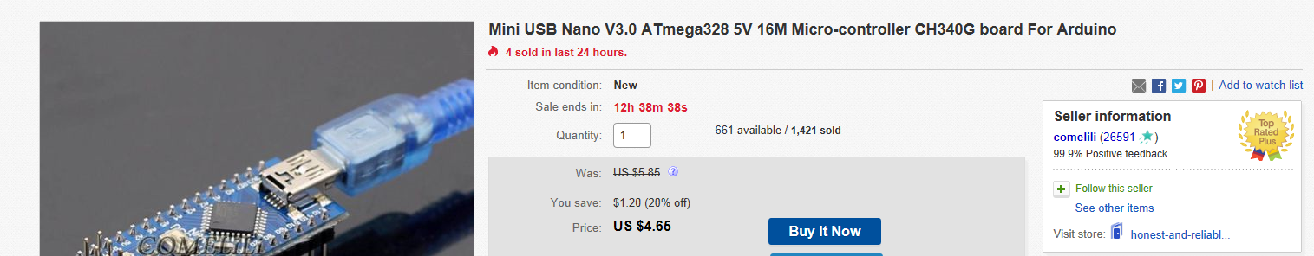
Install CH340G Driver
Some Arduino clones use a CH340G USB chip and you'll need to install a driver.
https://github.com/fwin-dev/arduino_sonar_web_api/tree/master/CH340_drivers

Slide 18
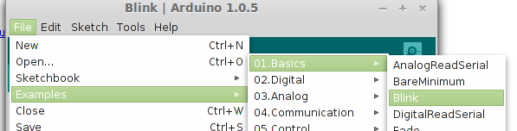
Modify Blink example
Print “on” and “off” as the LED blinks.
In setup() you will need to opens serial port and set data rate to 9600 bps
In loop() print “on” when the LED is on, “off” when LED is turned off

Slide 19
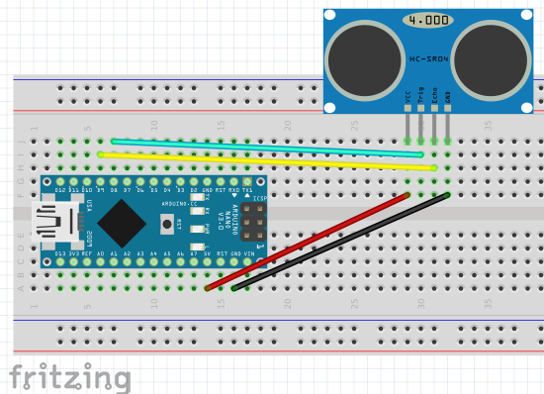
Breadboard HC-SR04
Arduino D8 => sonar trigger pin
Arduino D9 => sonar echo pin

Slide 20
Read HC-SR04 Distance -
Setup
Review the HC-SR04 slide
Define constants for the trigger and echo pins
In setup, set pins to OUTPUT or INPUT

Slide 21
Read HC-SR04 Distance -
loop
In the loop() you will want to trigger for 1 second and then read the echo.
Handy methods would include digitalWrite and pulseIn
Calculate distance in cm
distance = (duration / 2 ) / pace of sound;
Print calculated distance to the Serial console
Add short delay of at least ½ second at end of loop

Slide 22
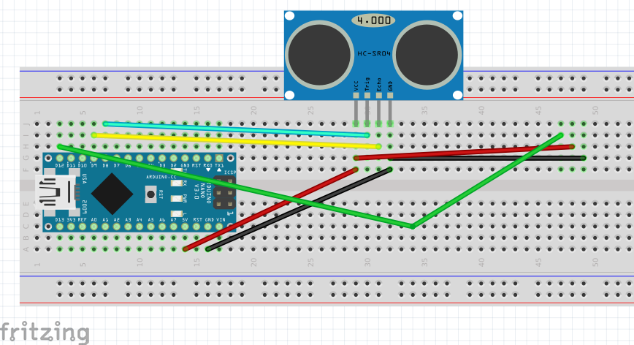
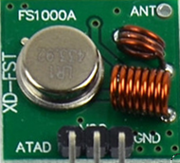
Breadboard RF Transmitter
Arduino D12 => Xmit data pin

Slide 23
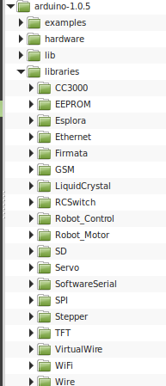
RF Transmitter
Install Virtual Wire
Virtual Wire Library
Unzip into Arduino libraries folder

Slide 24
RF Transmitter - setup
You will transmit the sonar distance using the 433MHz radio
Define constants for the on board LED and the transmit pin
Define a constant for the name of your arduino: “ralph12”
Include the Virtual Wire library
Initialize the the Virtual Wire library and bitrate
vw_set_ptt_inverted(true);
vw_setup(2000);
Calculate a random value between ½ a second and 1 ½ secs used to avoid transmit collision
Print the calculated random delay to the Serial console

Slide 25
RF Transmitter - loop
The transmitted JSON string will need to be in a format like this: {"i":"joe4", "d":97}
A useful method for formatting the JSON string is sprintf()
char msg[50];
sprintf(msg, "{\"i\":\"%s\", \"d\":%d}", NAME, distance);
Flash LED when transmitting
Send json string with virtual wire
const char* temp = msg;
vw_send((uint8_t *)temp, strlen(temp));
vw_wait_tx();
Delay a random amount at end of loop

Slide 26
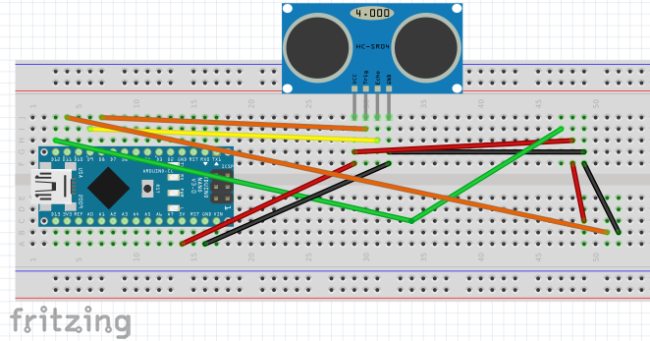
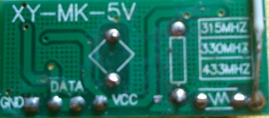
Breadboard RF Receiver
Arduino D11 => either data pin

Slide 27
RF Receiver - setup
You will enable the 433MHz receiver to hear other arduino transmissions and report them in your transmission
Define a constant for your receiver pin
Creat a buffer for receiving data
uint8_t recvbuf[VW_MAX_MESSAGE_LEN];
uint8_t recvbuflen = VW_MAX_MESSAGE_LEN;
Start the Virtual Wire receiver
vw_rx_start();

Slide 28
RF Receiver – loop
The transmitted JSON needs to be in a format like this:
{"i":"joe4", "d":97, "h":"herman789"}
Always reset the length of your buffer at the top of the loop
recvbuflen = VW_MAX_MESSAGE_LEN;
Check if any data was received
vw_get_message(recvbuf, &recvbuflen))
If you receive data, null terminate your message
recvbuf[recvbuflen] = 0;
Print received data to Serial console

Slide 29
RF Receiver – loop cont
You can extract the ID of the received data using indexOf()
String h = String((char *)recvbuf);
int idEnd = s.indexOf('"', 6);
h.toCharArray((char *)recvbuf, recvbuflen);
Use sprintf to format into a JSON string
sprintf(recvmsg, "\"h\":\"%s\"", recvbuf);
Print formatted data to Serial console
Transmit whole JSON message at once
{"i":"joe4", "d":97, "h":"herman789"}

Slide 30
Example Code
https://github.com/fwin-dev/arduino_sonar_web_api/tree/master/arduino

