Slide 1
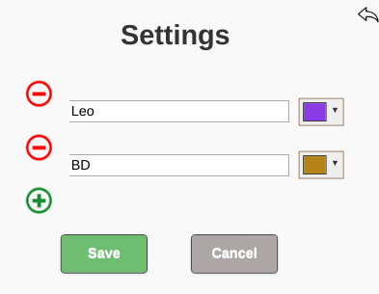
Delete team
Add a new team (Maximum 8)

