Slide 1
Communication Protocols
GraphQL

Slide 2
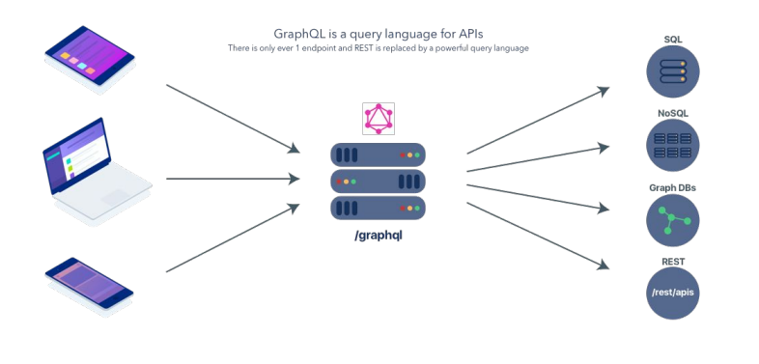
General GraphQL Structure

Slide 3
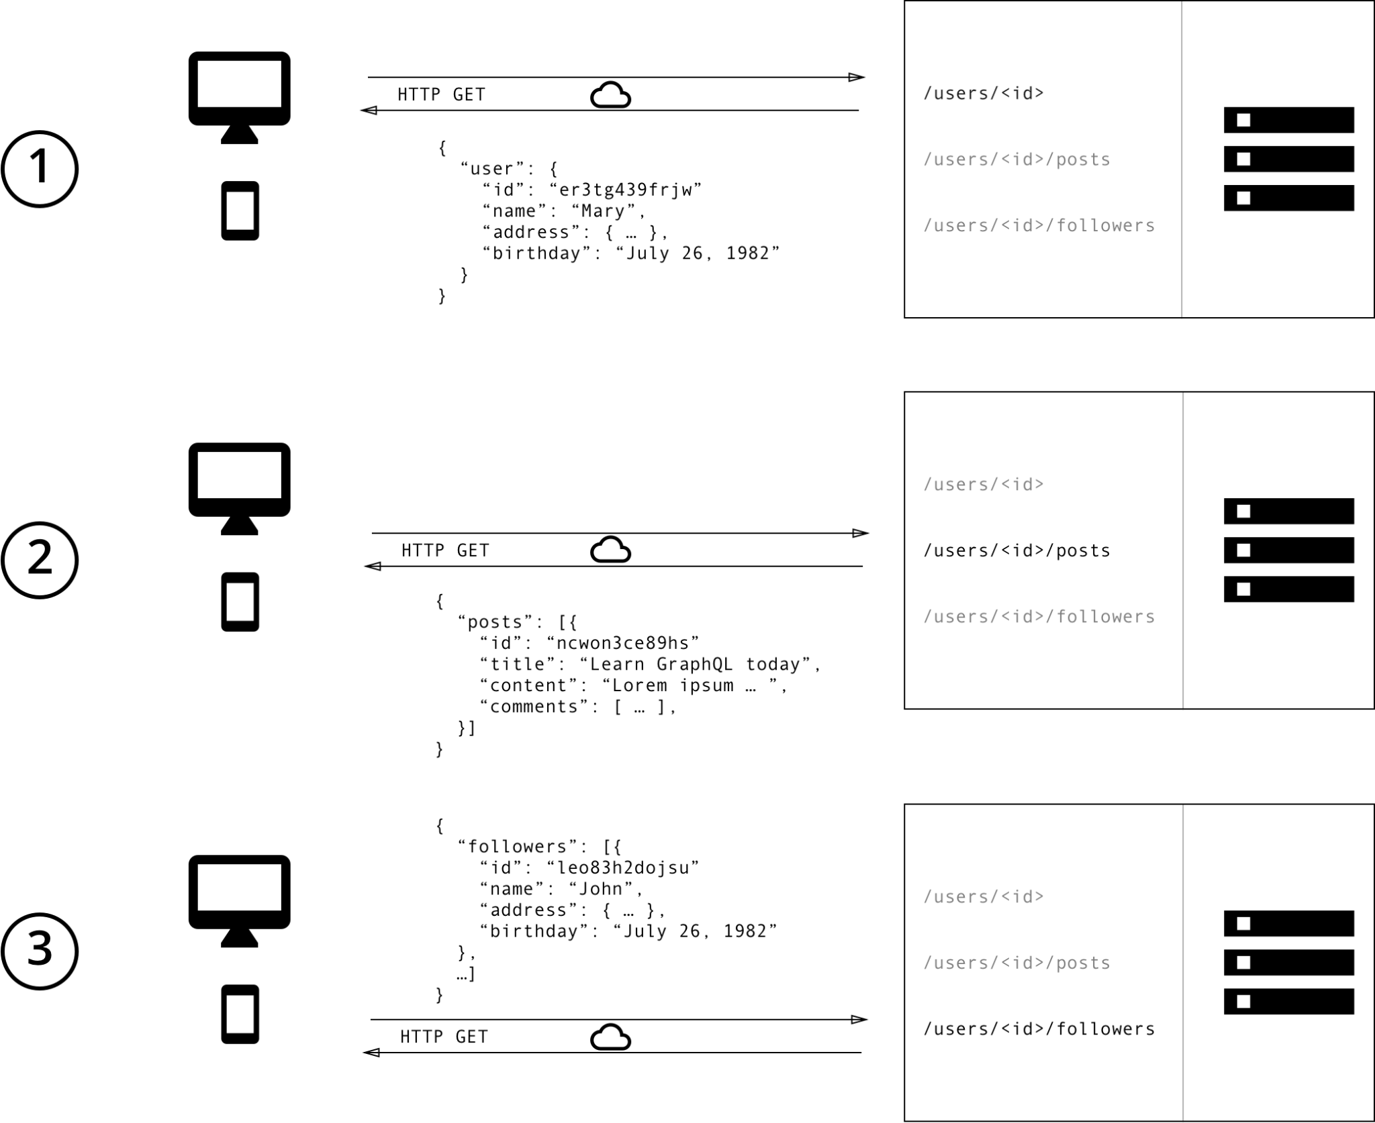

Slide 4
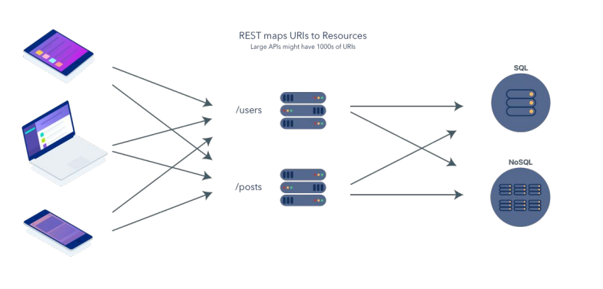
General REST Structure

Slide 5
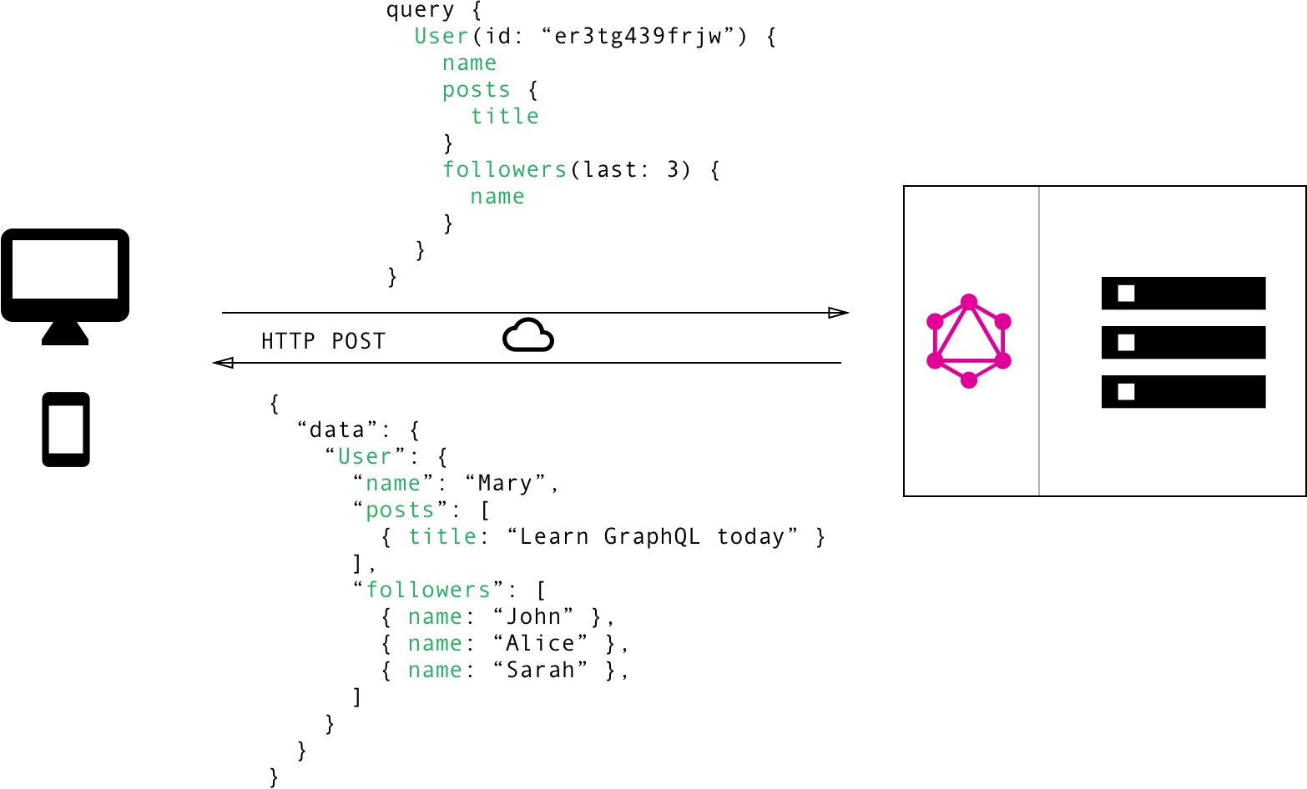

Slide 6

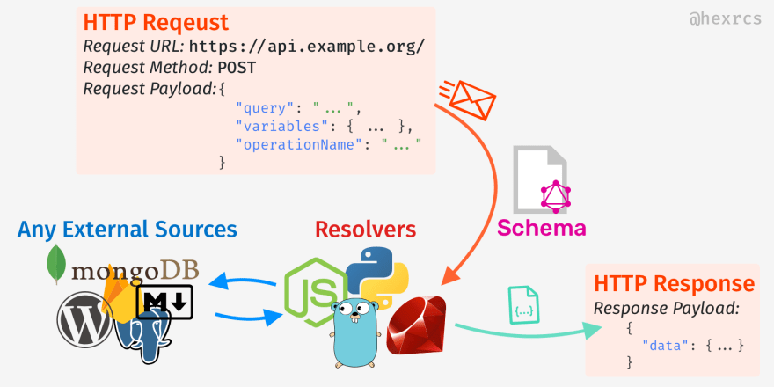
GraphQL Request Flow

Slide 7
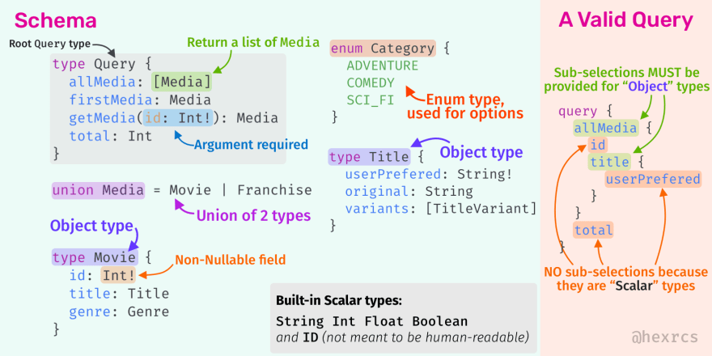
GraphQL Schema

Slide 8
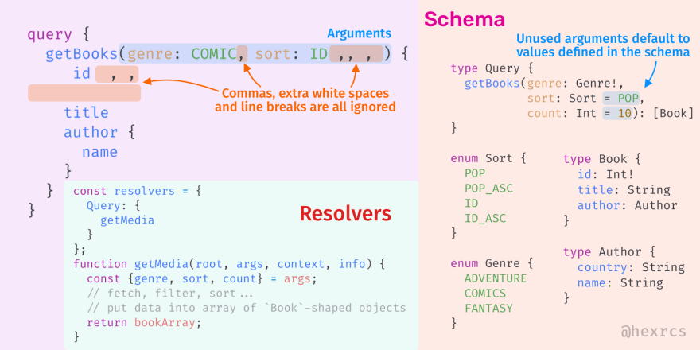
GraphQL Arguments

Slide 9
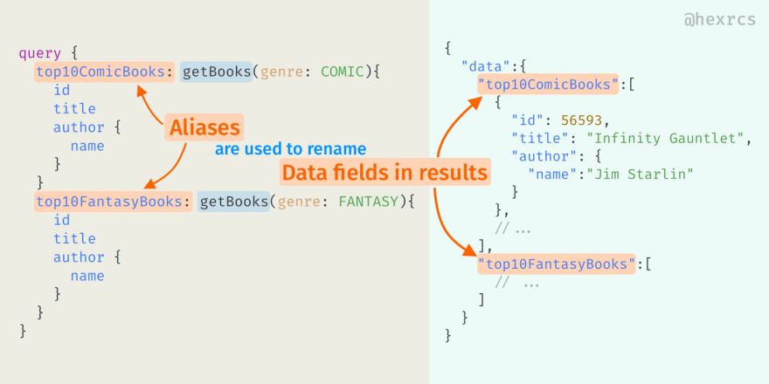
GraphQL Alias

Slide 10
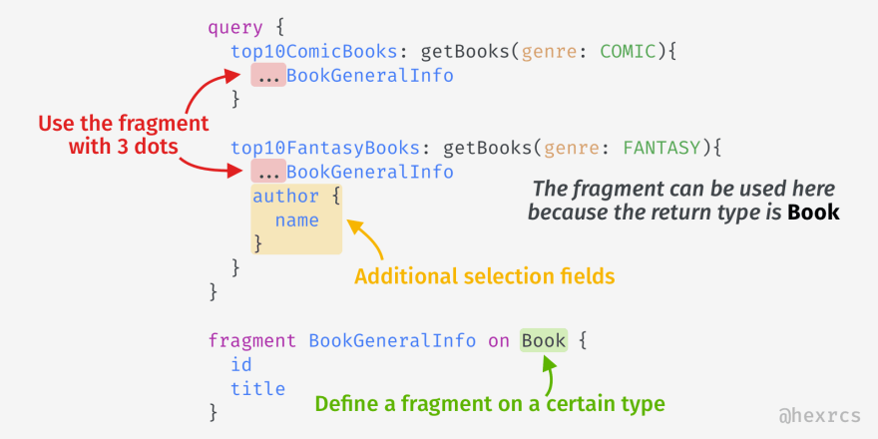
GraphQL Fragments

Slide 11
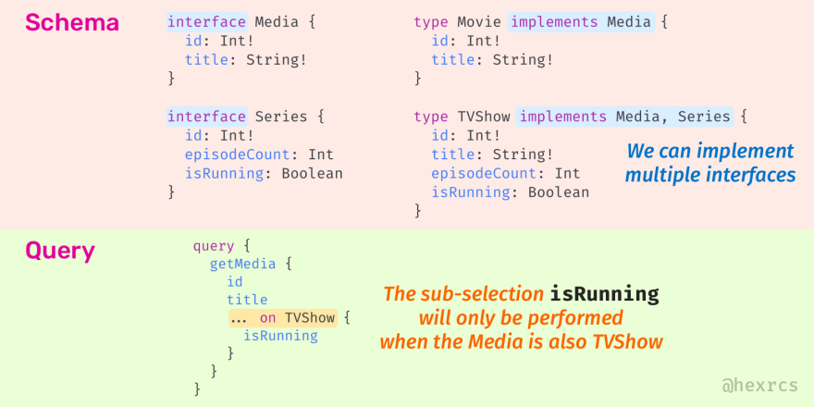
GraphQL Interface

Slide 12
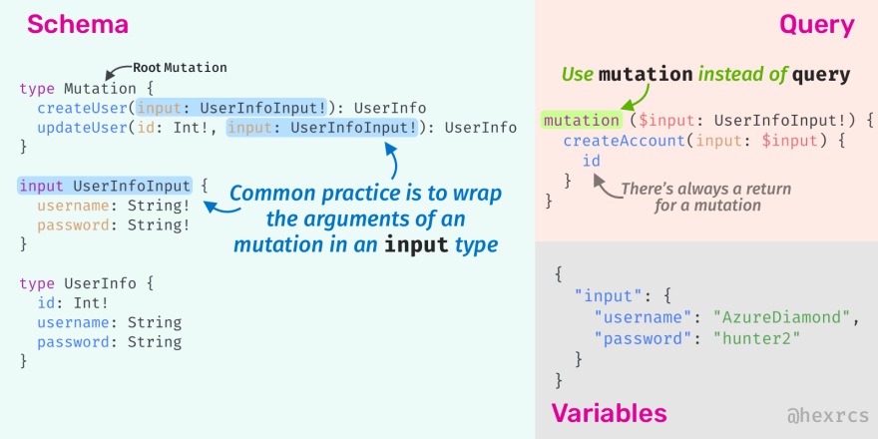
GraphQL Mutation

Slide 13
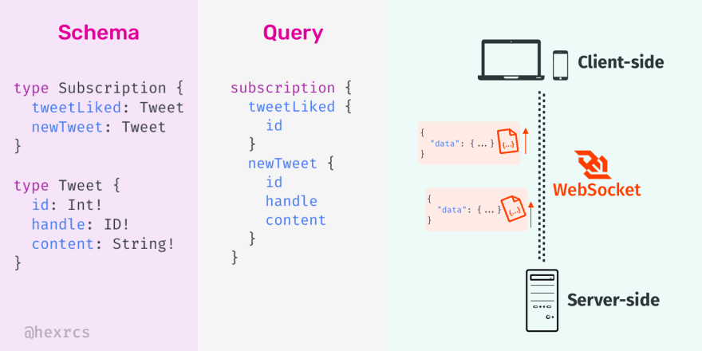
GraphQL Subscription

Slide 14
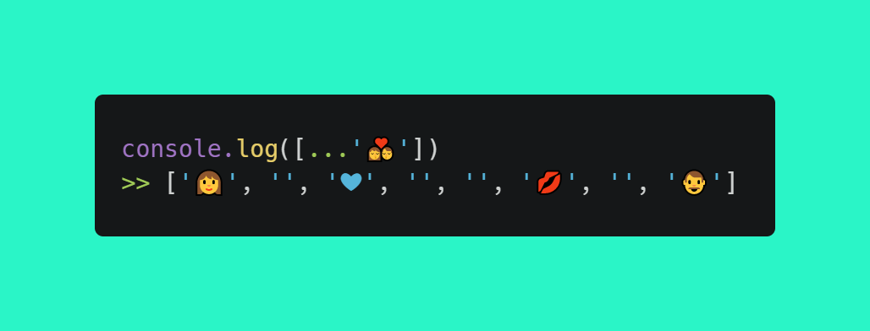
Thank you for attention
Spread the love and support

