Slide 1
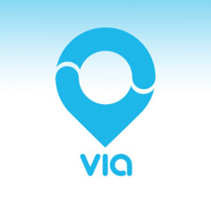

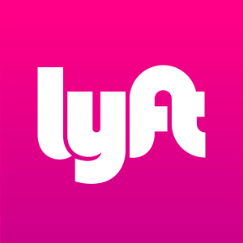

Ride Hailing Apps vs. New York City Taxis
Liza Sakhaie

Slide 2
The Topic and the Data
In this project, I will study how ride hailing apps have grown recently. I will then contrast this to the decline of the NYC Taxi Industry.
I will use data from NYC Open Data as well as the NYC Taxi and Limousine Commission
More specifically, I will analyze data from 2015 to 2018, since 2015 is when ride sharing became particularly popular.
I will also explore the decline of the NYC taxi industry in contrast to the rise of ride-hailing apps.
What are we exploring?
The data holds potential to portray a few different trends that I explored, including:
The growth in the rides for each app vs. taxis
The Y-O-Y growth rates for each ride hailing app
The growth in the number of drivers for each ride hailing app
The increase in the trend for ride-sharing and the seasonality of choosing to take a cab/car

Slide 3
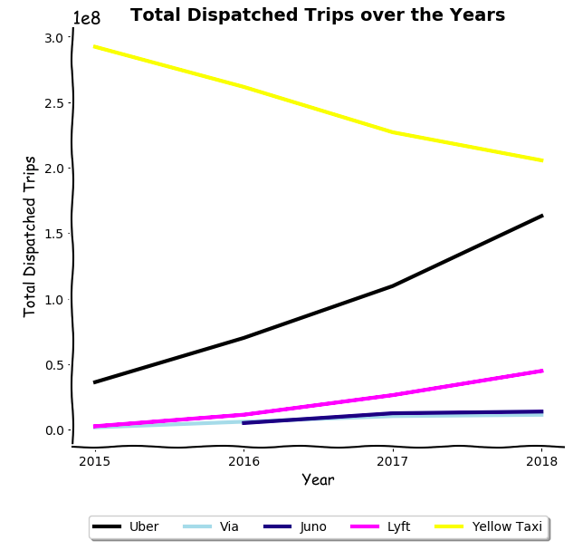
Who has the most rides?
As we can see, the more dispatched trips our ride-hailing apps have, the less for NYC taxis. This makes sense as there is a limited population in NYC so as the competition continues to enter the market and grow, cabs will definitely lose a part of their market share.
Furthermore, we see that Uber has had the strongest performance out of all the apps and is slowly catching up to NYC taxis! We would expect that within the next one or two years, their lines will cross and Uber will surpass NYC Taxis as the most popular mode of transportation out of the options.

Slide 4
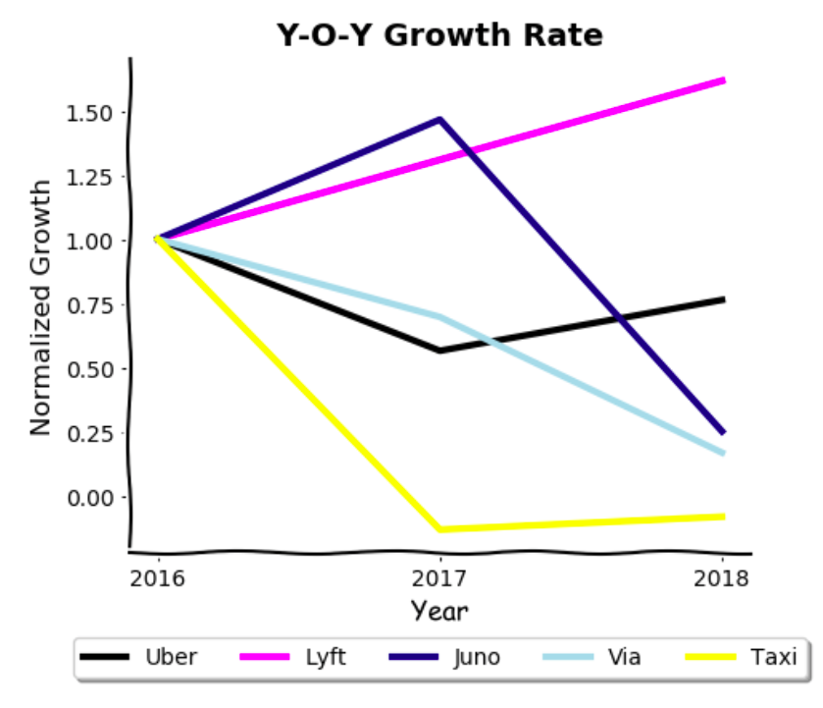
Who’s growing the fastest?
In general, we can tell that taxis have had a serious decline between 2016 and 2017 as ride-hailing apps began to really take a place in the market. The decline became less drastic between 2017 and 2018.
When comparing the ride-hailing apps to each other, we see that although initially in 2016, Juno had the most growth, Lyft is the only app that has consistently grown over the years. This could be because they branded themselves as a ride-sharing app from the very start and now ride-sharing has become extremely popular. We also see that via has been consistently declining since 2016. Lastly, we see that although Uber dropped off, it has begun to climb again. This could potentially be because they released a subscription service that motivated users to take more rides.

Slide 5
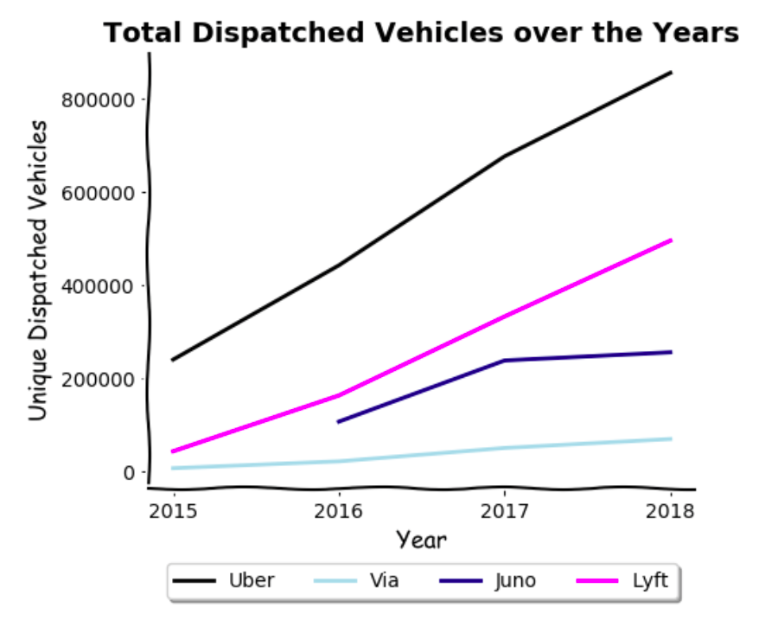
Which app is dispatching the most vehicles over time?
This graph clearly proves that these applications have been bringing on more and more drivers and therefore registering more and more vehicles. Just as we saw in the graph before, Juno's growth has definitely slowed since 2017 which has affected the number of dispatched vehicles for the brand. Similarly, we see that Lyft has consistently grown since 2016 in the previous graph, and in turn we see them dispatching more and more vehicles each year.

Slide 6
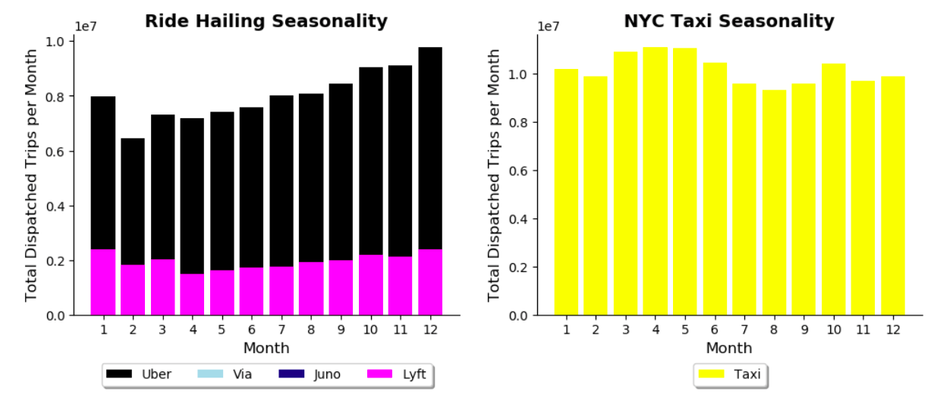
What seasons does each mode of transportation dominate?
Ride Hailing Apps: as expected, in the colder months of the year, people are more likely to use ride-hailing apps. However, we see this even more in October and November than we do in March and April, potentially because people are not yet adjusted to the cold and therefore are more likely to give in to paying for a car. We see a huge increase in December, which is probably due to the number of tourists in the city for the holidays.
Taxis: For taxis, we see that the most taxis are taken in March, April, and May. This is likely because these are the rainiest months of the year. When it starts raining, people hail a cab immediately rather than going inside somewhere and waiting to call a car from an app. Also, ride-hailing apps typically sur-charge when it is raining so people will choose to take taxis if they can since this will likely be the cheaper option as well as the quicker option.

