Slide 1
Enhancing Reinforcement Learning Using DQN with Distributed Training for Taxi and Cartpole
By Liza Trundle, Ann Li, Bailey Phillips, and Shelton Kwiterovich
Notes:
[Shelton]

Slide 2
Problem Statement:
Conduct hyperparameter tuning to find cost-effective and effective strategies to solve simple reinforcement learning games using Ray and DQN
Notes:
[Ann]

Slide 3
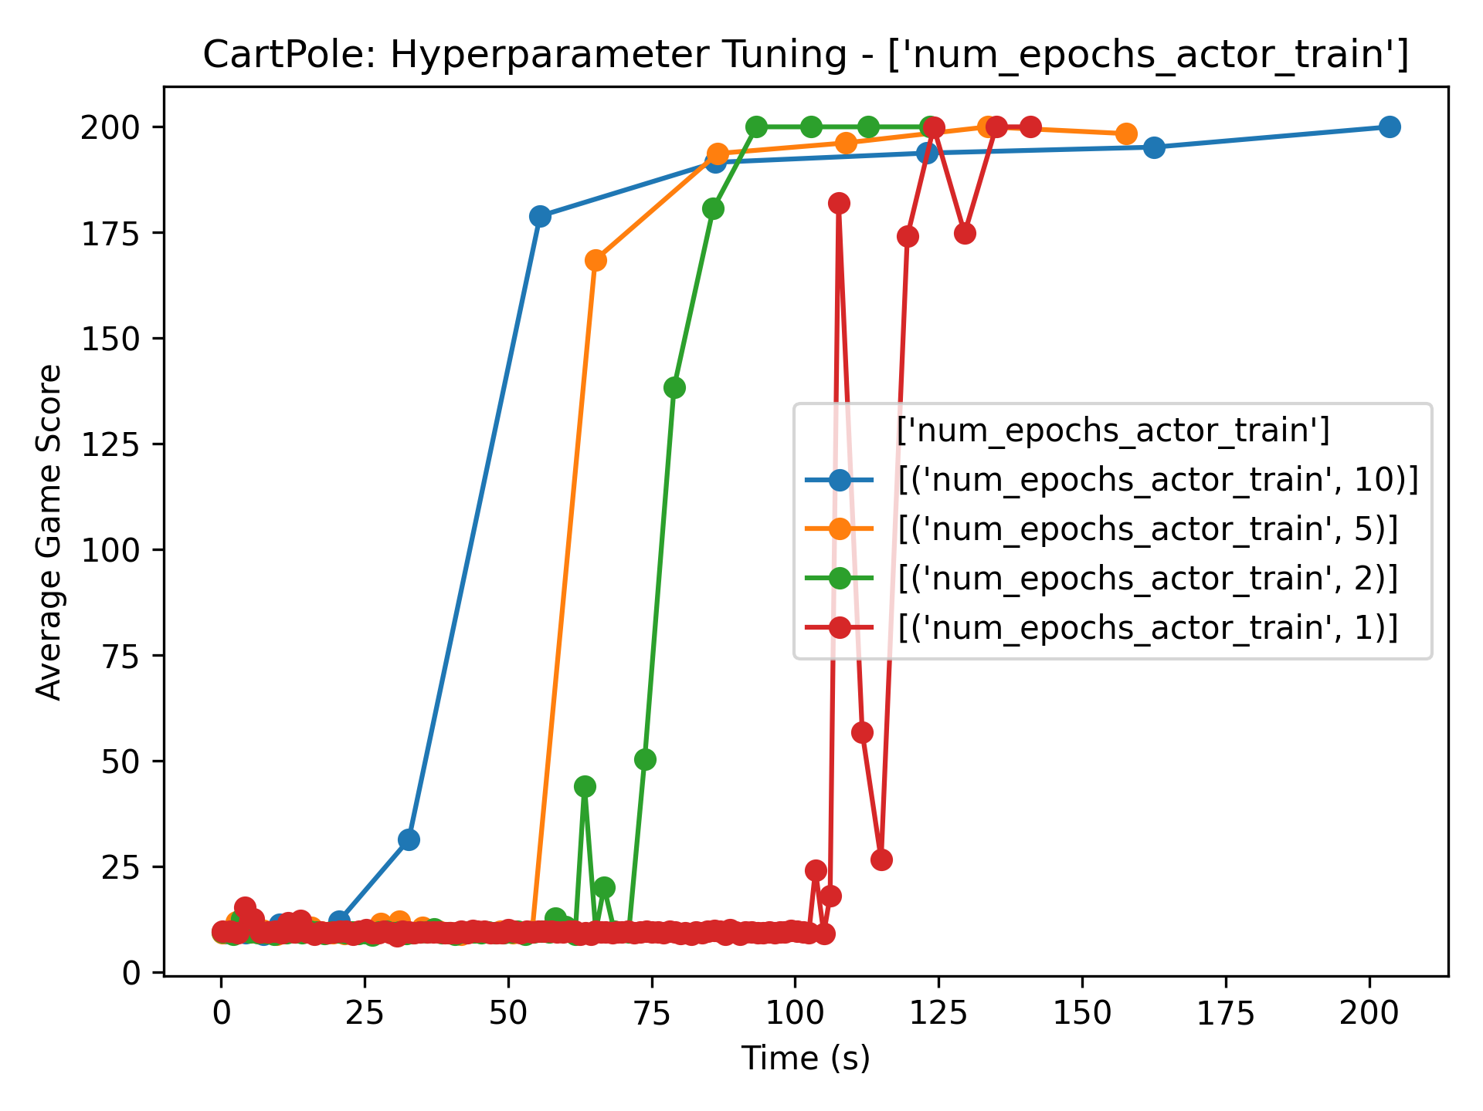
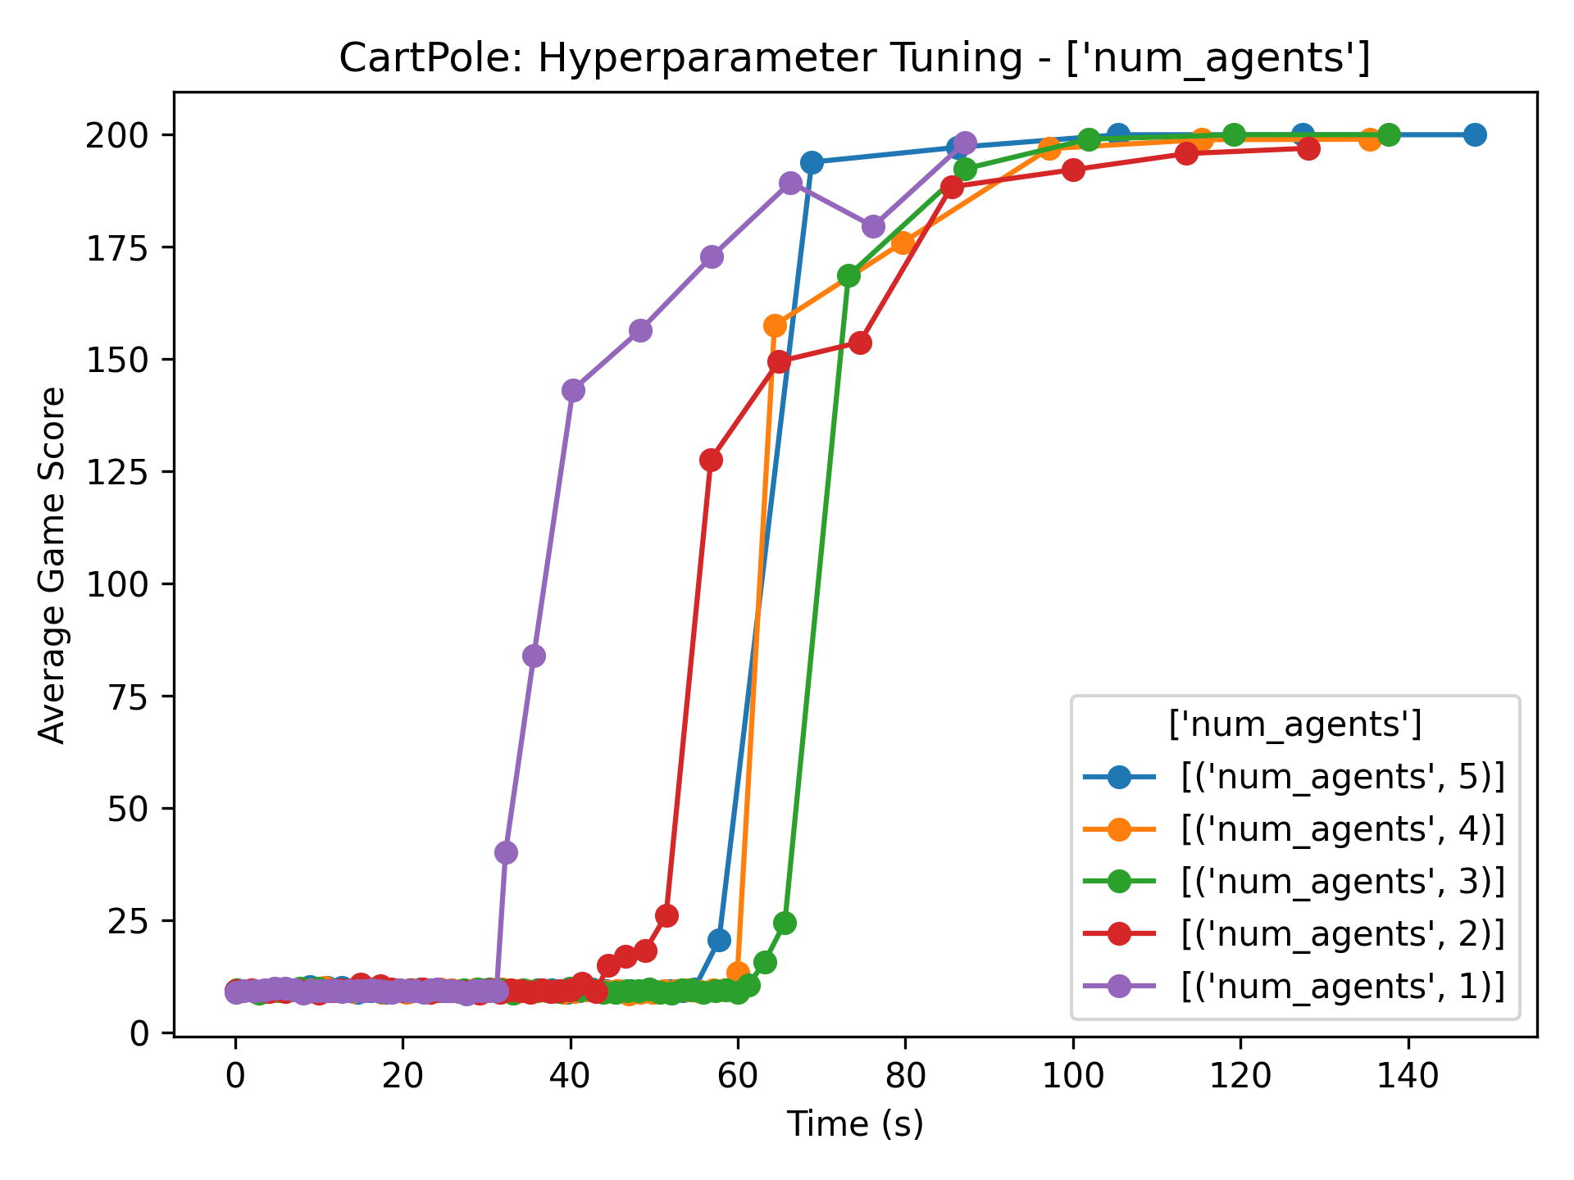
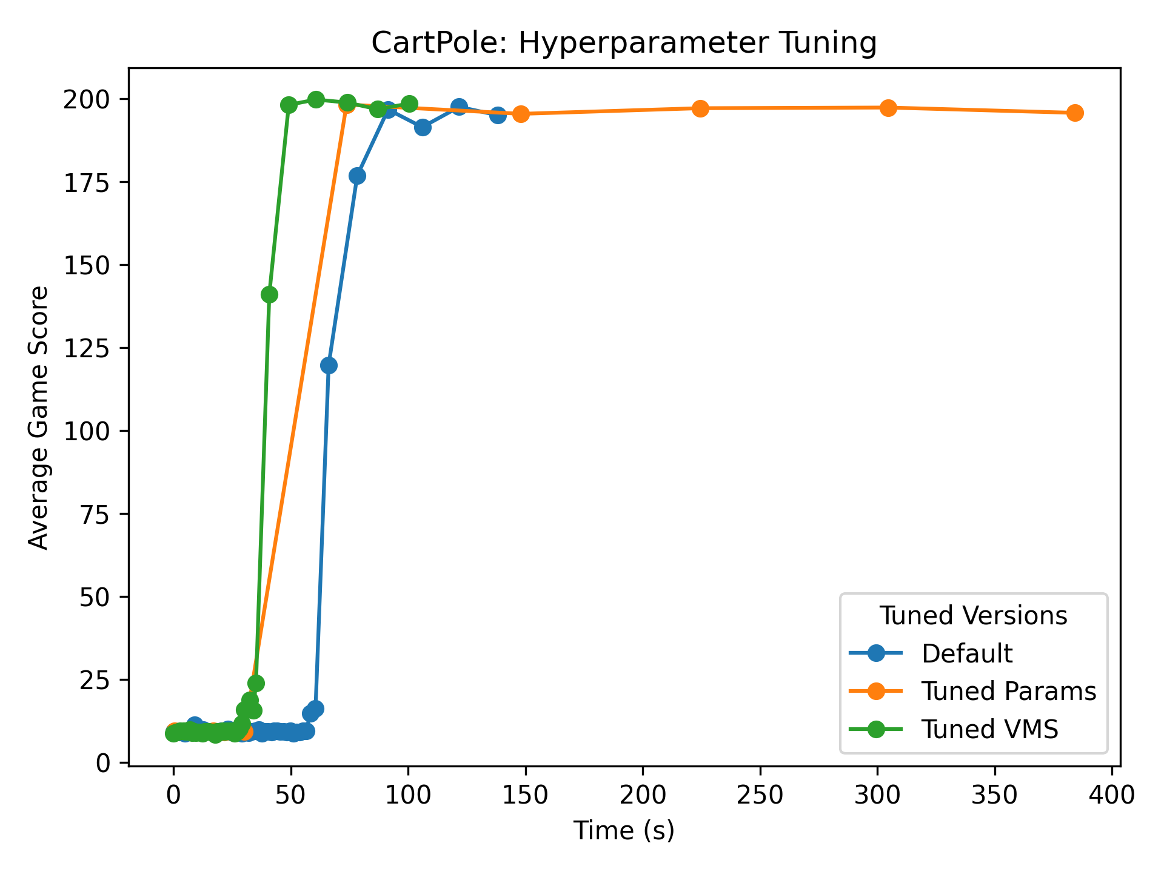
CartPole Background:
Goal: Since CartPole is a simple game, we wanted to see how efficient we can make the training time with regards to the least amount of resources/vms.
Set Up:
Adapted assignment 3 code for new environment
Altered state size to 4 and action size to 2
Added code to save each run to a json file
Added code to graph different runs
Adjusted hyperparameters: num_epochs_actor_train, batch_size, learning_rate, update_every, and num_agents
Results:
Started to fine tune hyperparameters and noticed that changing num_epochs_actor_train and batch_size had a considerable effect on training time
Most likely due to simplicity of the game
Combined fine-tuned hyperparameters with least amount of VMs proved 2 VM’s with 1 agent to be the quickest…
Notes:
Fine tuned
—-------------
[Liza]

Slide 4
Data Comparisons
Default Params
Fine Tuned Params and VMs
epochs = 10, Batch = 64, Learning rate = 5e-4, Update_every = 4, agents = 4
Environment solved in 110 episodes!
Total duration: 384.22 seconds
Average time for training: 3.40 seconds
Average time for updating: 0.02 seconds
Average time for synchronizing: 0.02 seconds
epochs = 2, Batch = 128, Learning rate = 0.0001, Update_every = 2, agents = 1
Environment solved in 410 episodes!
Total duration: 100.59 seconds
Average time for training: 0.21 seconds
Average time for updating: 0.01 seconds
Average time for synchronizing: 0.01 seconds
Fine Tuned Params
Conclusion:
epochs = 2, Batch = 128, Learning rate = 0.0001, Update_every = 2, agents = 4
Environment solved in 440 episodes!
Total duration: 135.51 seconds
Average time for training: 0.26 seconds
Average time for updating: 0.02 seconds
Average time for synchronizing: 0.02 seconds
Optimal performance with 2 VM’s and 1 agent and fine tuned parameters – fine tuning reduced training time
3.81x speed increase compared to default settings
CartPole's simplicity allowed efficient training with minimal resources
Notes:
[Bailey]
This slide goes over all the different hyper parameter combinations we analyzed with the default taking 384.22 seconds.
For fine tuning, we lowered the number of epochs to get rid of any extra updates and computational time
We then increased the batch size so more experiences were able to be sampled to diminish the effects of any outlier data points the agents were taking in.
With a larger batch size, we are able to use a smaller learning rate as each update now contained more information about the dataset.
Since CartPole is a simple and relatively stable environment, we are able to update more often without leading the any destablization of the learning process.
With these hyerparameter changes we were able to decrease training time to 135.51 seconds.
Lastly, we combined the fine tuned hyperparameters with only 1 agent and 2 VMs. By having less agents, less computational overhead was needed and the singular agent could learn about the environment more effectively and at a slower rate which gave us a total time of 100.59 seconds. In conlclusion, this combination of hyperpramters provided us with a 3.81 speed increase and allow us to train CartPole efficiently with minimal resources.

Slide 5
Visual comparison of hyperparameter tuning:
Tuned Params
Default
Notes:
[Bailey]
This slide just shows the visual comparison of the data from the slide before. As shown, the fine tuned hyperparameters with less VMs proved to be the quickest in terms of training time and quality.

Slide 6
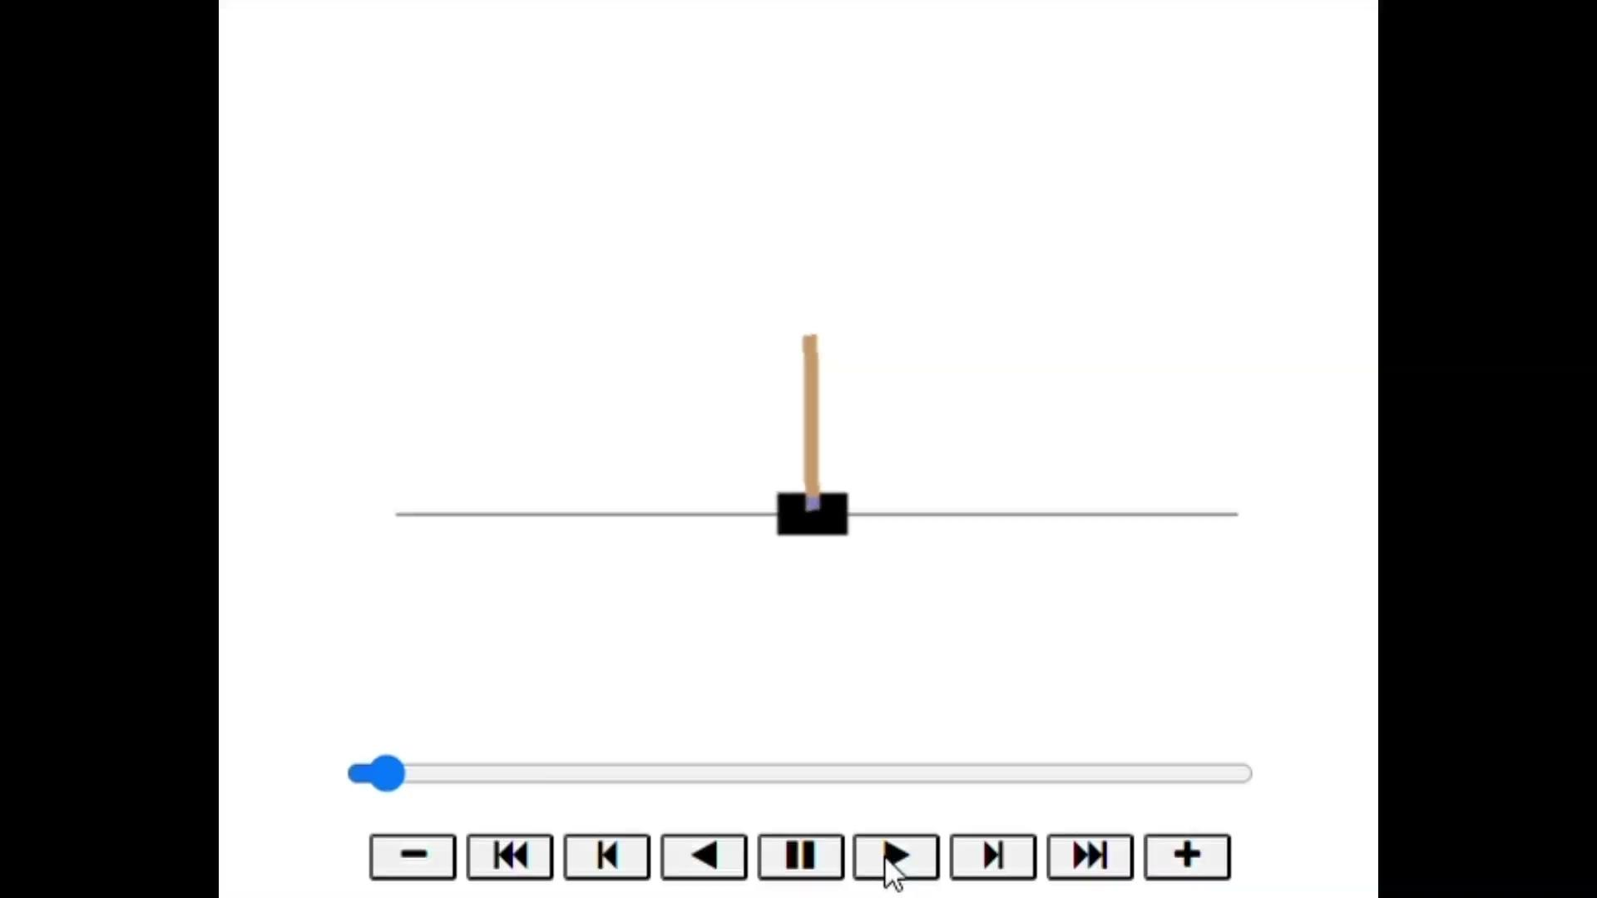
CartPole Game Visualization:
Notes:
[Bailey]

Slide 7
Limitations and Future Work
Runtime variations and consistency concerns
More complex models
Metrics v. performance (Taxi)
Increase trials for consistency
Runtime and costs
Extensive combination hyperparameter testing
Notes:
[Ann + Shelton]

Slide 8
Thank You and Questions:
Notes:
[Shelton]

