Slide 1
2: Improving Robustness of Deepfake Detectors through Gradient Regularization
Computer Vision 2025
Najeh Alhalawani (2223737), Yelizaveta Tskhe (2224260)

Slide 2
Outline
Introduction
Related Works
Proposed Methods
Datasets and Metrics
Implementation details
Results
Conclusion and Future Works

Slide 3
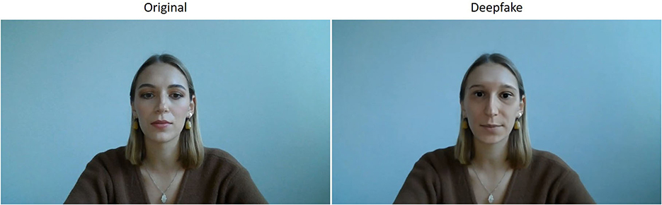
Introduction
Recent generative models can produce highly realistic fake videos and images.
Deepfakes are used in malicious contexts, posing security and trust risks.
The need for reliable deepfake detectors is high.

Slide 4
Problem
Deepfake detectors easily overfit to the specific texture artifacts of known forgery methods.
This leads to a significant drop in performance when tested against unseen or new deepfakes.
Essentially, the model memorizes the "fingerprint" of the training data's forgeries.
When a new forgery with a different texture "fingerprint" appears, the model fails to recognize it.

Slide 5
Goal
The deepfake detector must:
identify fake media generated by various methods.
be robust against adversarial attacks.
Project Goals:
Improve the adversarial robustness of deepfake detectors.
Use gradient regularization – a technique that enhances generalization by leveraging shallow feature statistics and an approximate Hessian-based gradient penalty.

Slide 6
Related Works
Gradient Regularization improves generalization by separating class features through Hessian-guided penalties [1]
EfficientNet achieves high performance with fewer parameters using compound scaling [2]
Investigation of various facial manipulation techniques (FaceSwap, Deepfakes, etc.) and proposition of benchmarks for detection [3]
The dimensions for systematic evaluation of deepfake detection models: accuracy, generalization, and adversarial robustness [4]
[1] Guan, W., Wang, W., Dong, J., & Peng, B. "Improving Generalization of Deepfake Detectors by Imposing Gradient Regularization." IEEE Transactions on Information Forensics and Security, vol. 19, pp. 5345–5356, IEEE, 2024
[2] Tan, M., & Le, Q. "EfficientNet: Rethinking model scaling for convolutional neural networks." Proceedings of the 36th International Conference on Machine Learning (ICML), Long Beach, CA, PMLR, 2019.
[3] Dang, H., Liu, F., Stehouwer, J., Liu, X., & Jain, A. "On the Detection of Digital Face Manipulation." Proceedings of the IEEE/CVF Conference on Computer Vision and Pattern Recognition (CVPR), Seattle, WA, IEEE, 2020.
[4] Abbasi, M., Váz, P., Silva, J., & Martins, P. "Comprehensive Evaluation of Deepfake Detection Models: Accuracy, Generalization, and Resilience to Adversarial Attacks." Applied Sciences, vol. 15, no. 3, article 1225, MDPI, 2025.

Slide 7
Proposed Method: Core Idea
We know that poor generalization stems from a model’s sensitivity to texture patterns in fake images.
We represent these low-level textures using the channel-wise mean μ and standard deviation σ of its early-layer (shallow) feature maps.
These early layers are known to capture edges, patterns, and other textual information.

Slide 8
Proposed Method: Core Idea
The central idea is that a model that relies heavily on these specific statistics is fragile and will not generalize well.
We propose to penalize this sensitivity. We actively discourage the model from depending on these simple, unreliable cues.
The goal is to force the model to learn more fundamental, semantic artifacts of manipulation, leading to a more robust and generalizable detector.

Slide 9
How It Works: A Two-Pass Approach
The training process for each batch is a two-step cycle designed to balance two competing goals: accuracy on known data and robustness to the unknown.
First Pass: Find the Weak Points
Calculate the standard classification loss
Compute the gradient for this loss with respect to the texture statistics
This gradient reveals the “worst-case” texture change that would fool the model
Second Pass: Regularize with Perturbed Features
Create a small, adversarial perturbation by moving along the gradient found in the first pass
Apply this perturbation to the original feature statistics
Calculate a new regularization loss on these adversarially modified features

Slide 10



Final Model Update
The final update to the model’s weights is not based on one loss alone, but on a weighted combination of the gradients from both passes.
is the Accuracy Gradient, which improves performance on the training set.
is the Robustness Gradient, which improves generalization to unseen textures.
The hyperparameter α acts as a balance coefficient.

Slide 11
Regularized Model
This combined update strategy creates a final model that is not only accurate but also fundamentally more robust against the diverse and evolving landscape of deepfake techniques.

Slide 12
Datasets
DFFD: Diverse Fake Face Dataset - strong class imbalance (fake: 83%, real: 17%).
Added frames from FaceForensics++ dataset - slightly improved class balance but still skewed.
Augmentation of Real Training Images - each real image augmented 3 times => fake: 52%, real: 48%.

Slide 13
Metrics
Accuracy - percentage of correctly classified samples (real or deepfake) over the total number of samples.
Precision - proportion of predicted deepfakes that are actually deepfakes.
Recall - proportion of actual deepfakes that were correctly identified.
F1-Score - harmonic mean of precision and recall.
Robustness Accuracy - accuracy of the model exposed to adversarial inputs.

Slide 14
Baseline Model Training and Evaluation
Used a pretrained EfficientNetB0
CrossEntropyLoss and Adam optimizer with learning rate 1e-4
5 epochs
Epoch | Train Loss | Train Accuracy | Validation Accuracy
1 | 0.0356 | 98.65% | 99.70%
2 | 0.0082 | 99.75% | 99.84%
3 | 0.0049 | 99.83% | 99.86%
4 | 0.0039 | 99.86% | 99.92%
5 | 0.0032 | 99.90% | 99.94%

Slide 15
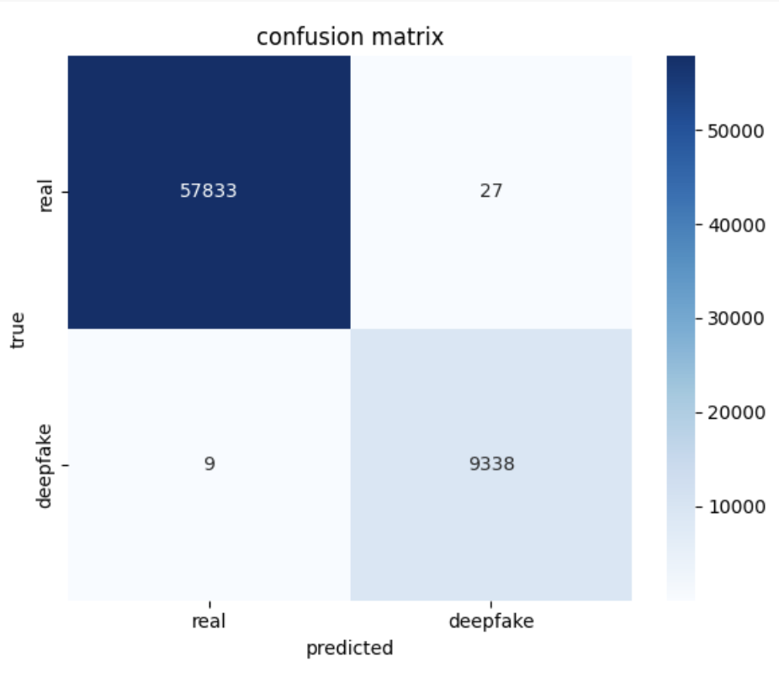
Baseline Model - Test Accuracy = 99.95%
The baseline model generalizes well to unseen images and shows strong real/fake classification performance.

Slide 16
Adversarial Attack - FGSM (Fast Gradient Sign Method)
For each image:
Calculated the loss.
Computed the gradient of that loss with respect to the input image.
Nudged each pixel slightly in the direction that increases the loss.
Clipped the pixel values so they stay valid (between 0 and 1).

Slide 17
Adversarial Attack - FGSM (Fast Gradient Sign Method)
As we increase epsilon (make the perturbations slightly stronger), the model becomes less accurate.
Even tiny changes can severely degrade performance.
=> baseline model is highly vulnerable to adversarial noise.
Epsilon | Accuracy
0.001 | 25.21%
0.005 | 9.06%
0.010 | 5.58%
0.020 | 5.53%

Slide 18
Adversarial Attack - PGD (Projected Gradient Descent)
Often used as a benchmark "strong" attack in adversarial robustness research.
For each image:
Took a small step (alpha) in the direction that increases the loss.
Made sure the image stays close to the original (no more than epsilon away).
Repeated this for several steps, gradually crafting a stronger attack.

Slide 19
Adversarial Attack - PGD (Projected Gradient Descent)
PGD is much stronger than FGSM due to iterative refinement
Accuracy drops from ~99% → ~15% with just epsilon = 0.001.
=> baseline model is highly vulnerable to adversarial noise.
Epsilon | Step | Alpha | Accuracy
0.0001 | 5 | 0.00002 | 34.09%
0.0005 | 5 | 0.00010 | 23.25%
0.0010 | 5 | 0.00020 | 15.82%

Slide 20
Model with Gradient Regularization
Perturbation applied to the first two layers
Hyperparameters:
r: 0.05 - controls the magnitude of the perturbation
alpha: 1 - balance coefficient for the two loss components
learning rate: 0.001
The model trained for 6 epochs was selected, as it resulted in the lowest loss across all training runs.
Epoch | Train Loss | Validation Loss | AUC | Log Loss | F1 Score
4 | 0.0007 | 0.0049 | 100% | 0.0049 | 99.74%
6 | 0.0003 | 0.0045 | 100% | 0.0044 | 99.74%
8 | 0.0004 | 0.0049 | 100% | 0.0048 | 99.63%

Slide 21
Results - Comparison - FGSM
Epsilon | Accuracy (baseline) | Accuracy (with gradient regularization)
0.001 | 25.21% | 33.23%
0.005 | 9.06% | 13.15%
0.010 | 5.58% | 8.69%
0.020 | 5.53% | 10.27%

Slide 22
Results - Comparison - PGD
Epsilon | Step | Alpha | Accuracy (baseline) | Accuracy (with gradient regularization)
0.0001 | 5 | 0.00002 | 34.09% | 40.86%
0.0005 | 5 | 0.00010 | 23.25% | 29.95%
0.0010 | 5 | 0.00020 | 15.82% | 19.92%

Slide 23
Ablation Study - Perturbation Layers
Perturbation Level | Train Loss | Validation Loss | AUC | Log Loss | F1 Score
First Three Layers | 0.0051 | 0.0046 | 1 | 0.0046 | 0.9559
First Two Layers | 0.0003 | 0.0045 | 1 | 0.0044 | 0.9974

Slide 24
Ablation Study - Attacked Models - FGSM
Perturbation on the first three layers
Perturbation on the first two layers
Epsilon | Accuracy | AUC | F1 Score
0.0010 | 0.3163 | 0.7480 | 0.2866
0.0050 | 0.1483 | 0.2699 | 0.1911
0.0100 | 0.0987 | 0.1246 | 0.1637
0.0200 | 0.1095 | 0.0896 | 0.1922
Epsilon | Accuracy | AUC | F1 Score
0.0010 | 0.2031 | 0.6707 | 0.2577
0.0050 | 0.1454 | 0.3936 | 0.2313
0.0100 | 0.1323 | 0.2647 | 0.2281
0.0200 | 0.1369 | 0.2421 | 0.2351

Slide 25
Ablation Study - Perturbation Magnitude and Balance Coefficient
r = 0.05 alpha = 1
r = 0.05 alpha = 0.75
Epsilon | Accuracy | AUC | F1 Score
0.0010 | 0.2031 | 0.6707 | 0.2577
Epsilon | Accuracy | AUC | F1 Score
0.0010 | 0.1391 | 0.6332 | 0.2442
r = 0.1 alpha = 0.75
Epsilon | Accuracy | AUC | F1 Score
0.0010 | 0.2031 | 0.6707 | 0.2577

Slide 26
Conclusion and Future Works
Our deepfake detection model, enhanced by gradient regularization, achieved significant robustness against adversarial attacks, with accuracy improvements to 33.23% at ε=0.001 FGSM (vs. 25.21% baseline) and 10.27% at ε=0.020 FGSM (vs. 5.53% baseline). An ablation study optimized the selection of perturbation layers and fine-tuned hyperparameters (balance coefficient α and approximation scalar r), yielding a high-performing configuration.

Slide 27
Thank you for your attention!

