Slide 1
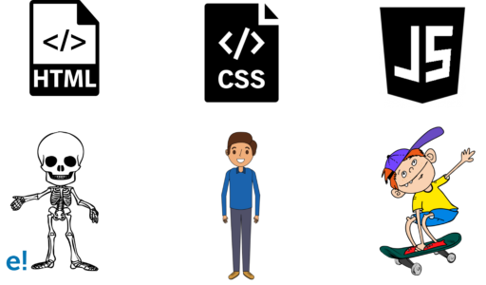
Web Development
What is HTML?
Hyper Text Mark-up Language
What is CSS?
Cascading Style Sheets

Slide 2
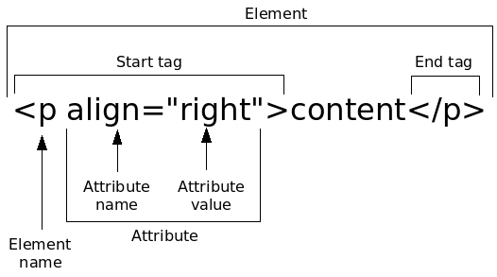
Basic HTML Element

Slide 3
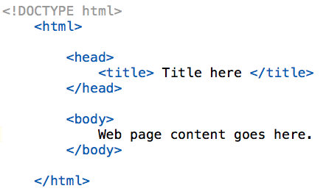
Starting HTML File
.html file extension
<!DOCTYPE html>
<html>
<head>
<title>
<body>

Slide 4
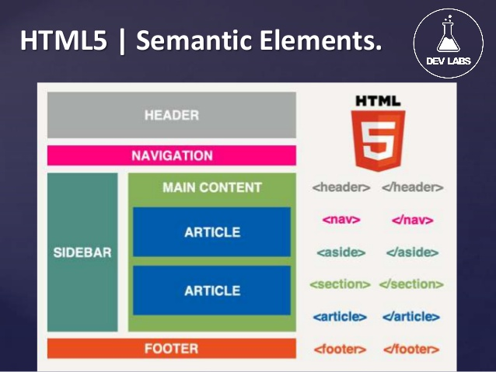
Page Structure

Slide 5


Slide 6
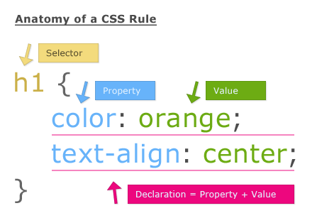
Basic CSS Element

Slide 7
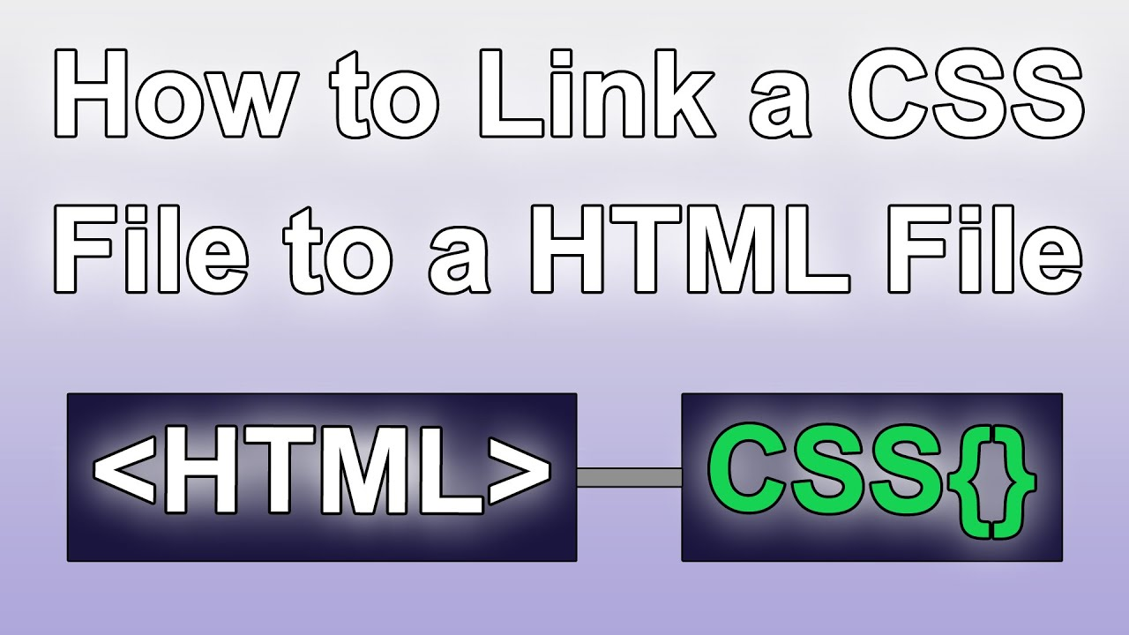
<link rel=”” type=”” href=””>

Slide 8
ID’s Classes & Specificity
Id HTML attribute (uniqueness)
Class HTML attribute (broad)
# CSS selector (id)
. CSS selector (class)
Nested Tags Nested Selectors
# > . > element (weights)

Slide 9
HTML/CSS Common
HTML
<img src=”” alt=””>
<a href=”#”>
CSS
Background-color
Width
Height
Text-decoration
Top/left/bottom/right
Display
float

Slide 10
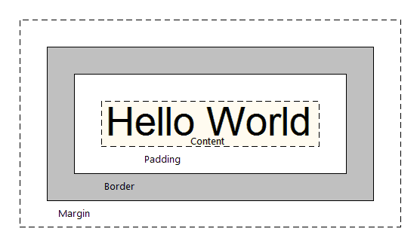
Box - Model

