Slide 1
Seurat
An R package designed for QC, analysis, and exploration of single cell RNA-seq data.
Zongcheng Li
小课堂二期-05

Slide 2
课程提纲
Basic Tools
Data Preprocessing
Analysis of Profiling Data
Biological Exploration
Linux & R
From fastq data to gene expression matrix
Seurat
HVG, DR, Clustering, DEG,
DEG and Marker gene
clusterProfiler
GSEA
`
1
2
3
4
5
6
7
8
Sequencing Data
R programming
Data Visualization
Course Project
Smartseq2 & STRT-seq
Basic grammar
ggplot2
Adobe Illustrator
Reproduce results of a research
熟悉单细胞转录组数据分析
Notes:
同学的反馈和建议
避免细枝末节，太多的个人经验分享会使得听众抓不到主题
自己动手操作能更真实的学到和学会
R的基础语法需要大家自学了

Slide 3
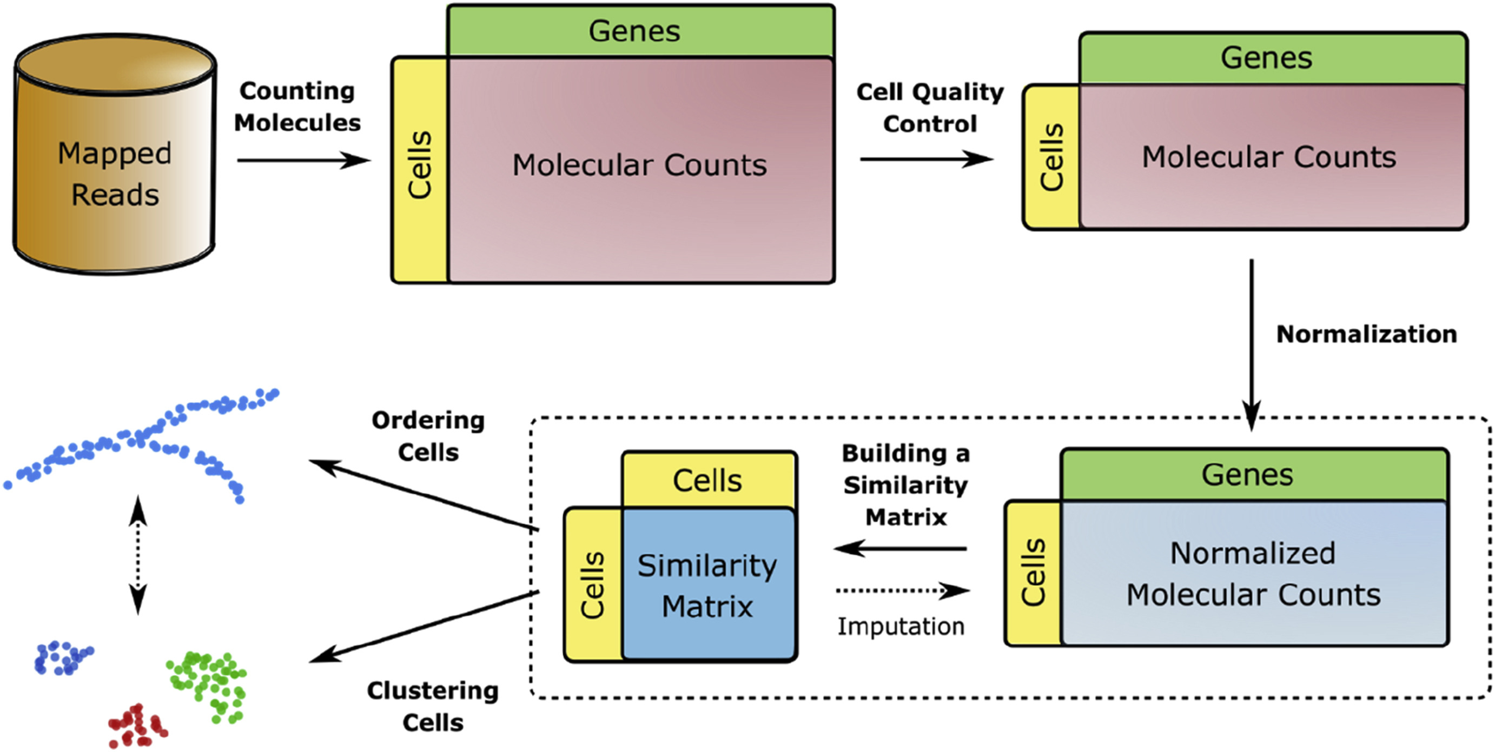
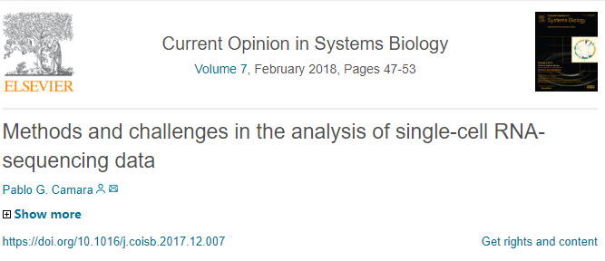
The structure of a generic pipeline for the analysis of scRNA-seq data.

Slide 4
Points of concern
Cell QC
Pseudotime
Filter low content cells
Filter house-keeping/mitochondrial/cell cycle/lowly expressed genes
Monocle/Mpath/DPT/Wishbone/SPRING/others
Cell development trajectories or bifurcation
HVGs
DEGs
Biological Variances
The basis for identifying heterogeneity
Wilcox/ROC/scde/others
Biological differences at gene expression level
Dimension Reduction
Functional analysis
PCA/tSNE/DiffusionMap/others
Visualization of cell population heterogeneity
GO/GSEA/Metascape/TF-network/Module Score
deep exploration and analyses of biological significances
Keep in mind
Single cell analysis
SUMMARY
Clustering
Confounding
HC/k-means/Graph-density/random-forest/RACEID/APcluster
Limited clusters for further analysis and exploration
Batch effect/ Technical variation/Cell cycle/individual
Try your best to minimize effects of confounding factors
4

Slide 5
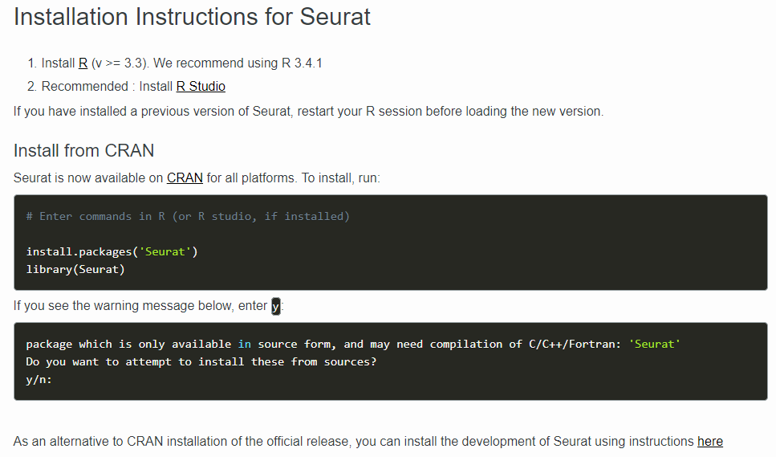
https://satijalab.org/seurat/install.html

Slide 6
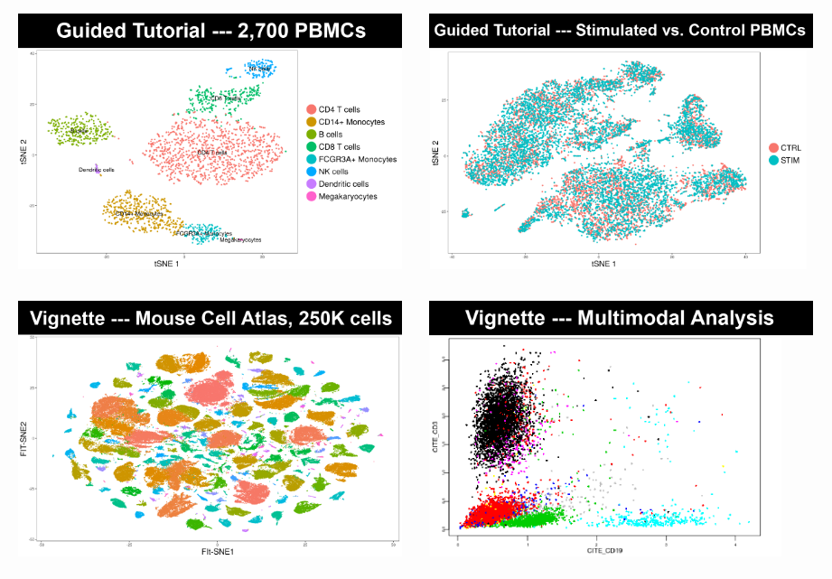
Guided Analyses
For new users of Seurat, we suggest starting with a guided walkthrough of a dataset of 2,700 Peripheral Blood Mononuclear Cells (PBMCs) made publically available by 10X Genomics (download raw data, R markdown file, and final Seurat object). This tutorial implements the major components of the Seurat clustering workflow including QC and data filtration, calculation of high-variance genes, dimensional reduction, graph-based clustering, and the identification of cluster markers.
Recently, we have developed new computational methods for integrated analysis of single cell datasets generated across different conditions, technologies, or species. As an example, we provide a guided walkthrough for integrating and comparing PBMC datasets generated under different stimulation conditions. We also provide a workflow tailored to the analysis of large datasets (250,000 cells from a recently published study of the Microwell-seq Mouse Cell Atlas), as well as an example analysis of multimodal single cell data.
https://satijalab.org/seurat/get_started.html
https://satijalab.org/seurat/pbmc3k_tutorial.html

Slide 7
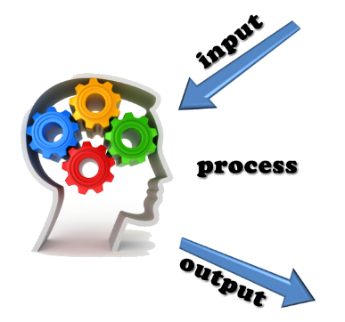
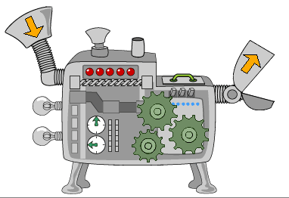
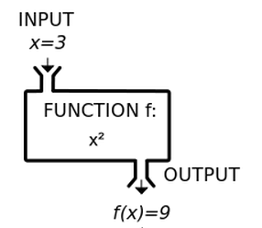

Slide 8
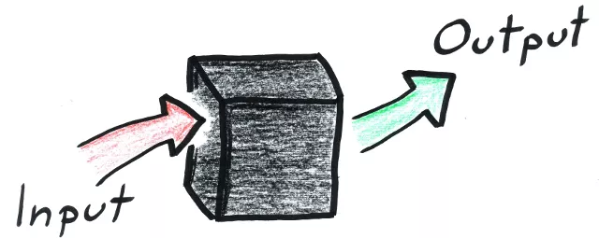
Function/Command is a blackbox

Slide 9
Case Study
By Zongcheng Li
生信小课堂二期

