Slide 1
Preprocessing scRNA-Seq data
Step by step
Zongcheng Li
LLLab
2018
第二期
生信小课堂

Slide 2

学会使用工具，是人类最重要的进化

Slide 3

取彼之长，为我所用
吾尝终日而思矣，不如须臾之所学也；吾尝跂而望矣，不如登高之博见也。登高而招，臂非加长也，而见者远；顺风而呼，声非加疾也，而闻者彰。假舆马者，非利足也，而致千里；
假舟楫者，非能水也，而绝江河。
君子生非异也，善假于物也。
《劝学》 荀子

Slide 4
Workflow
Paired to Single
Read1
@seqname
ATGC…
+
HHHH…
Read2 (with Barcode+UMI）
@seqname
GCTCATCGTGCAGTACTTTTT…
+
H+A?>@....
Clean reads
Read mapping
New single Read
@ GCTCATCGTGCAGTACTTTTT@seqname
ATGC…
+
HHHH…
Count UMI of
each gene in each cell

Slide 5
$bash Anaconda********
…
$conda config --add channels https://mirrors.tuna.tsinghua.edu.cn/anaconda/pkgs/free/
$conda config --add channels https://mirrors.tuna.tsinghua.edu.cn/anaconda/pkgs/main/
$conda config --set show_channel_urls yes
$conda config --add channels https://mirrors.tuna.tsinghua.edu.cn/anaconda/cloud/bioconda/
$conda install fastqc cutadapt hisat2 samtools htseq perl
$wget https://github.com/lizc07/bioinfoClass/raw/master/Materials/03_preprocessing.zip
$cd
$alias
$vi .profile
: alias wk=‘cd /mnt/c/Users/Hazard/Desktop’
$source .profile
$alias
$wk
$cd
$ln –s /mnt/c/Users/Hazard/Desktop desktop
$cd desktop

Slide 6
Split index if needed
Raw data
fastqc
Paired to single
Remove 5’ TSO, 3’ PolyA
Custom script
Romove 3’ Adaptor
cutadapt
Clean data
Read mapping
hisat2
Build reference
Hisat2-build
Genome
mm10
Grcm37
Transcriptome
refGene
Gencode
lncRNA
Sam to bam
samtools
Mapped reads
Count UMI
htseq
Custom script

Slide 7
https://bioconda.github.io/recipes.html#recipes
$perl paired2single.pl
$conda install perl-app-cpanminus
$cpanm JSON
$conda install make
$cpanm JSON
perl paired2single.pl test1_1.fq.gz test1_2.fq.gz AACGTGAT,AAACTAA,AGTGGTCA,ACCACTGT,ACATTGGC,CAGATCTG,CATCAAGT,CGCTGATC,ACAAGCTA,CTGTAGCC,AGTACAAG,AACAACCA,AACCGAGA,AACGCTTA,AAGACGGA,AAGGTACA,ACACAGAA,ACAGCAGA,ACCTCCAA,ACGCTCGA,ACGTATCA,ACTATGCA,AGAGTCAA,AGATCGCA,AGCAGGAA,AGTCACTA,ATCCTGTA,ATTGAGGA,CAACCACA,CAAGACTA,CAATGGAA,CACTTCGA,CAGCGTTA,CATACCAA,CCAGTTCA,CCGAAGTA,CCGTGAGA,CCTCCTGA,CGAACTTA,CGACTGGA,CGCATACA,CTCAATGA,CTGAGCCA,CTGGCATA,GAATCTGA,GACTAGTA,GAGCTGAA,GATAGACA,GCCACATA,GCGAGTAA,GCTAACGA,GCTCGGTA,GGAGAACA,GGTGCGAA,GTACGCAA,GTCGTAGA,GTCTGTCA,GTGTTCTA,TAGGATGA,TATCAGCA,TCCGTCTA,TCTTCACA,TGAAGAGA,TGGAACAA,TGGCTTCA,TGGTGGTA,TTCACGCA,AACTCACC,AAGAGATC,AAGGACAC,AATCCGTC,AATGTTGC,ACACGACC,ACAGATTC,AGATGTAC,AGCACCTC,AGCCATGC,AGGCTAAC,ATAGCGAC,ATCATTCC,ATTGGCTC,CAAGGAGC,CACCTTAC,CCATCCTC,CCGACAAC,CCTAATCC,CCTCTATC,CGACACAC,CGGATTGC,CTAAGGTC,GAACAGGC,GACAGTGC,GAGTTAGC,GATGAATC,GCCAAGAC 1 test1.single.fq.gz test1.others.fq.gz TGGTATCAACGCAGAGTACAT AAAAAAAAAAAAAAA 40 test1
cutadapt -a AGATCGGAAGAGC -a GCTCTTCCGATCT --max-n=0.1 -o test1.single.trim.fq.gz test1.single.fq.gz

Slide 8
Genome Sequences and Annotations
Important resource for many NGS data analysis routines
Example NCBI FTP site for sequence download: ftp://ftp.ncbi.nlm.nih.gov
Most genomes have their own community database
Problem: inconsistent annotations across organisms
Ensembl contains many genomes consistently organized
Batch downloads via FTP: http://uswest.ensembl.org/info/data/ftp/index.html
Significance: many NGS routines (e.g. read mapping and counting) require FASTA file for genome sequence plus GFF/GTF file for annotations
Example for NGS workflow, such a read counting step in RNA-Seq:
download.file("some_ensembl.gff.gz", "my.gff") # Download annotations from Ensembl txdb <- makeTxDbFromGFF("my.gff", ...) # Generate txdb read_counts <- summarizeOverlaps(ebyg, "bam_file.list", ...) # Read counting
http://girke.bioinformatics.ucr.edu/GEN242/mydoc_slides_02.html

Slide 9
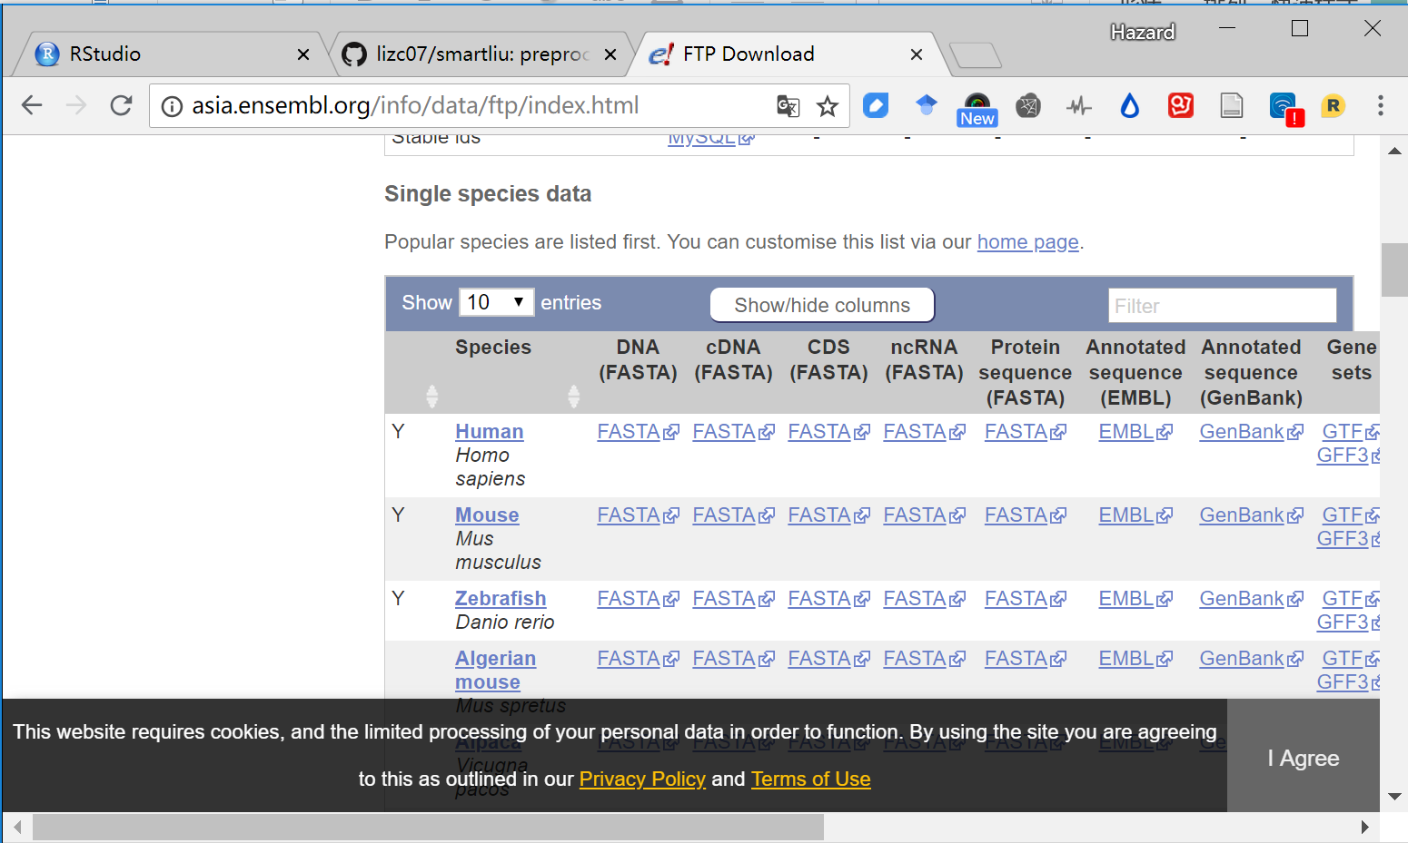

Slide 10
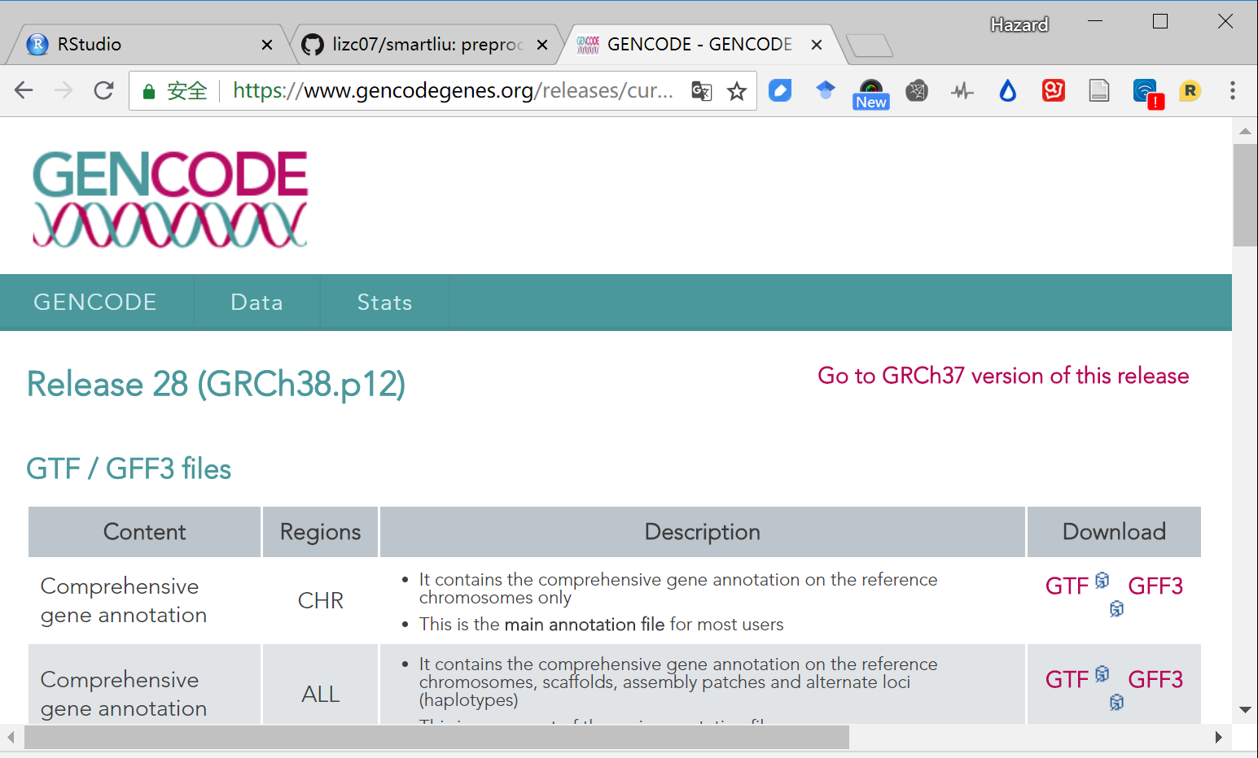

Slide 11
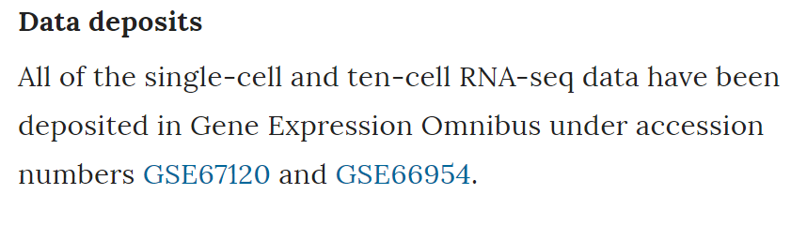
Repository for Microarray & RNA-Seq Data
Example: Gene Expression Omnibus (GEO) (Barrett et al., 2007)
Includes microarray, RNA-Seq and ChIP-Seq samples
n Series: 83,306￼
n Platforms: 17,085
n Samples: 2,037,767
http://girke.bioinformatics.ucr.edu/GEN242/mydoc_slides_02.html

Slide 12
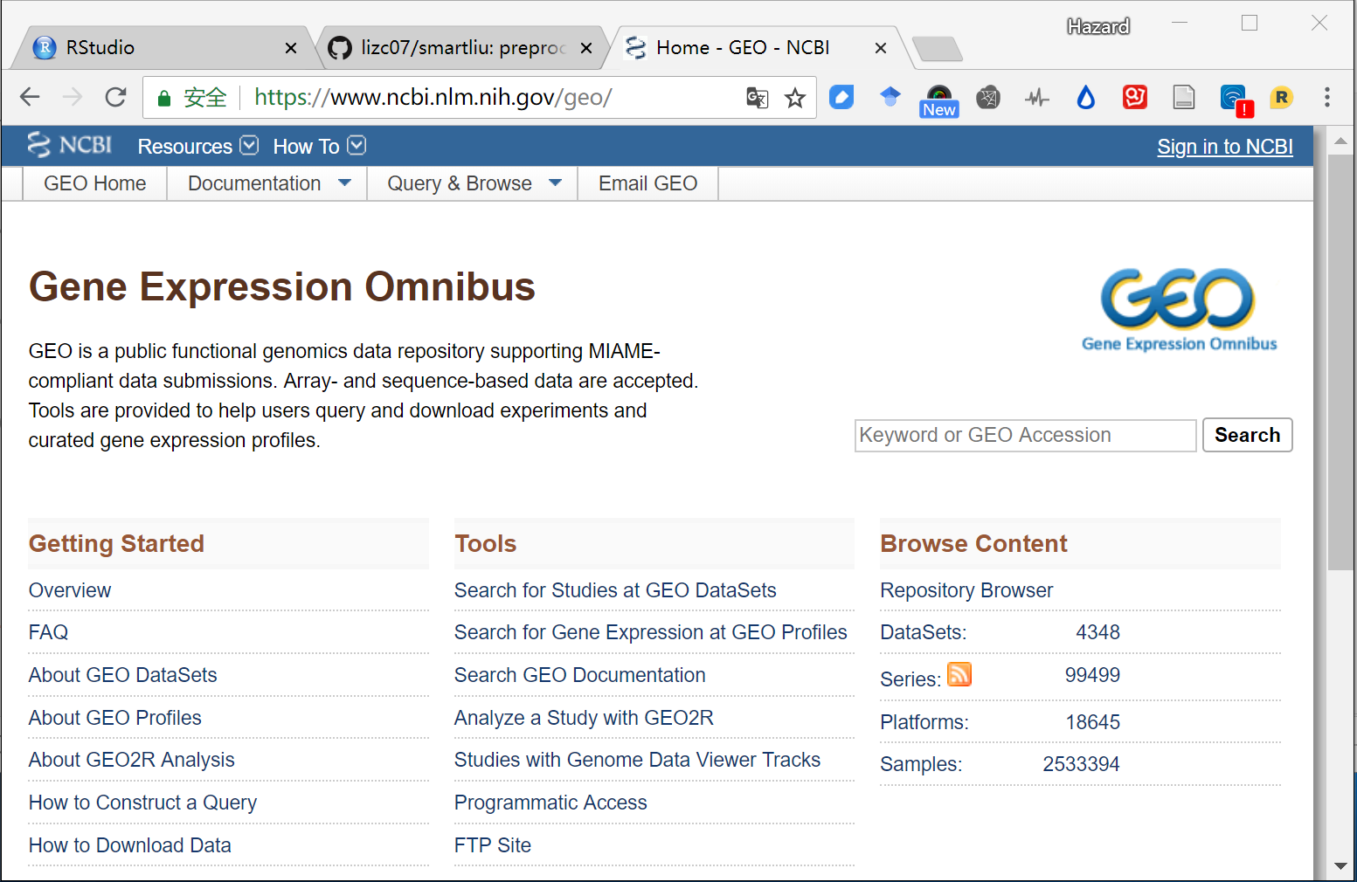

Slide 13
Hisat2-build ERCC92_RGC ERCC92_RGC
hisat2 -x ERCC92_RGC -S test1.sam -U test1.single.trim.fq.gz
samtools view -h -b -o test1.bam test1.sam
rm test1.sam
samtools sort -o test1.sorted.bam test1.bam
samtools index test1.sorted.bam
samtools sort -n -o test1.sorted.bam test1.bam
samtools view -h test1.sorted.bam | htseq-count -s no -f sam -otest1.count.sam - ERCC92_RGC.gtf > test1.count.txt

Slide 14
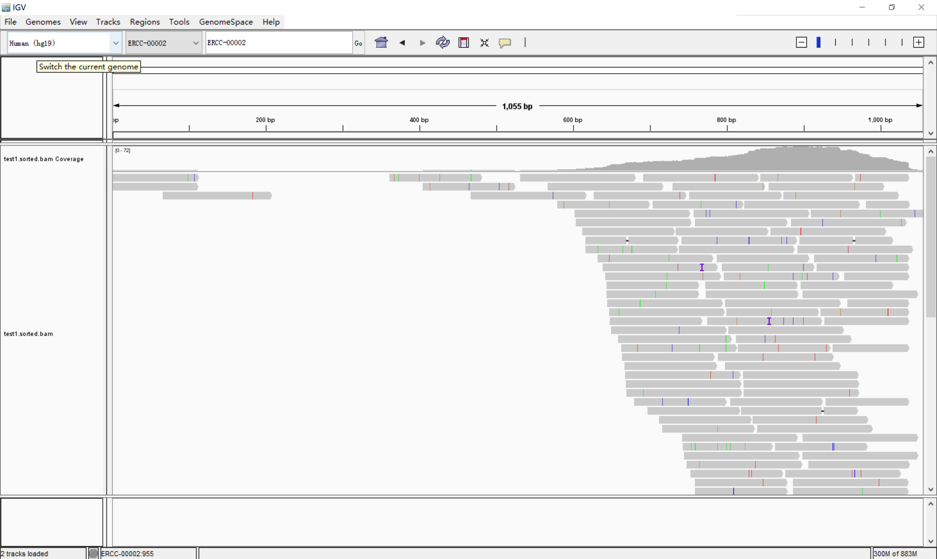

Slide 15
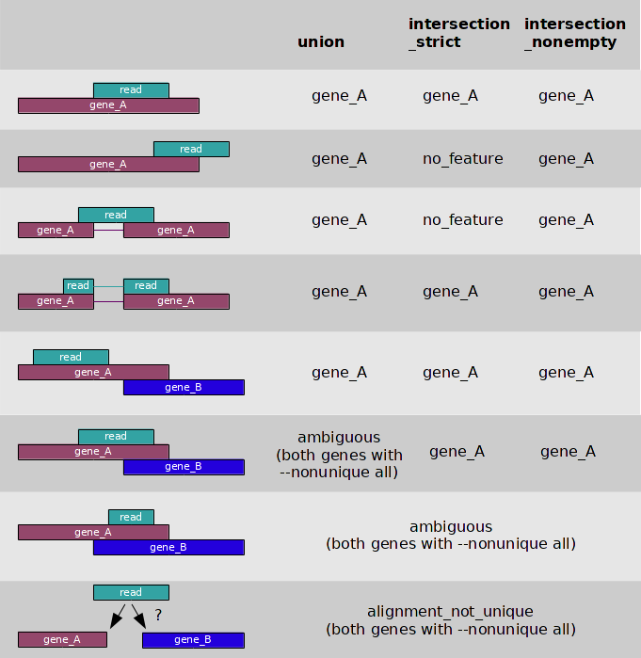

Slide 16
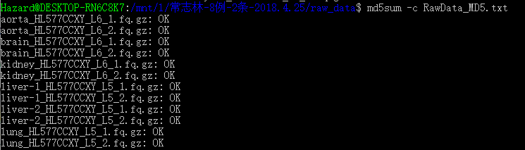
保证备份数据的有效性和一致性（重要）
处理流程：
A中数据→ 拷贝至B → B中数据上传至S → 核对B/S上fastq的md5与A中一致* → A归还公司
*如果A中没有MD5文件，自己md5sum下
1) 计算md5
$cd path_to_rawdata
$md5sum `find .` > rawdata.md5
2) 校对md5
$cd path_to_rawdata
$md5sum -c rawdata.md5
可选处理流程：
A中数据→ 拷贝至B → B中数据上传至S → S上执行smartliu/cellranger → 执行完成，确保未出错→ A归还公司
A, 公司硬盘; B, 实验室备份硬盘; S, 实验室服务器。

