Slide 1
Databases and Software for Genome Biology
Data Analysis in Genome Biology
GEN242
Thomas Girke
April 5, 2018

Slide 2
Outline
Background
Database Examples
Software Resources
Homework Assignment
References and Books

Slide 3
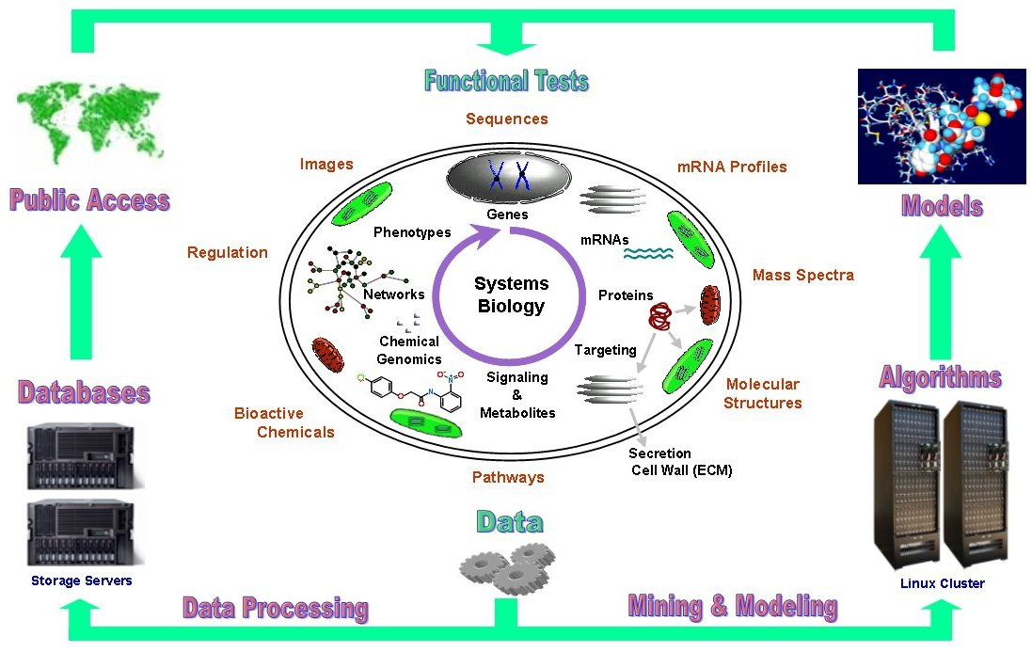
Genome Data Science = Infer Knowledge from Data

Slide 4
Data Explosion in Biosciences
Modern genome sciences has transformed biology into a data science discipline.
Philosophical and ethical question: Do living systems simply consist of information (genome) plus chemical components?
We can create viruses just by knowing their sequence
Soon the same will be possible with simple bacteria
Still, our understanding of living systems is very incomplete.
Systems biology and synthetic biology are the future. Both will be dominated by computational approaches.

Slide 5
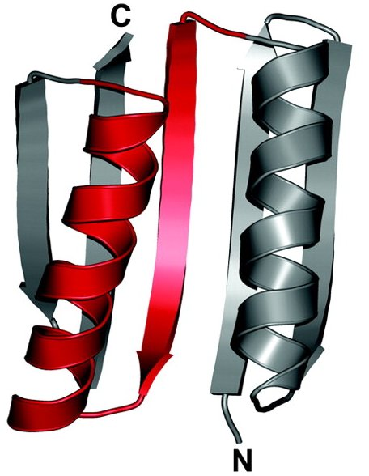
Design of Novel Protein Folds
Human engineered protein folds that do not exist in nature (Kuhlman et al 2008).

Slide 6
Computational Biology Areas
Common Bioinformatics Areas
Biostatistics
Computational biology: algorithms
Sequence analysis
Phylogenetics
Gene expression analysis
Proteomics & metabolic profiling
Network & systems analysis
Structural Bioinformatics
Cheminformatics
Drug design
Molecular modeling
Biological Databases
Data management/curation, web programming, etc.

Slide 7
Genome Annotation Requires Reference Databases
Genome/Transcriptome Assemblies
RNA-Seq and DNA-Seq
Annotation
Gene predictions
ORFs, UTRs, introns, exons, promoters
Similarity searches
BLAST, FASTA, Smith-Waterman
Pathway and gene ontology annotations
Gene/protein families
Domain databases
Multiple alignments
Structure/Function
2D/3D structure

Slide 8
Outline
Background
Database Examples
Software Resources
Homework Assignment
References and Books

Slide 9
Databases for Biological Sequences
DNA/Protein sequence data: GenBank, EMBL (ENA) and DDBJ
NCBI: http://www.ncbi.nlm.nih.gov
SRA: http://www.ncbi.nlm.nih.gov/sra
EBI: http://www.ebi.ac.uk
Ensembl: http://www.ensembl.org
BioMart: http://www.biomart.org
Swiss-Prot: http://us.expasy.org/sprot
UniProt: http://www.uniprot.org
ENCODE: https://www.encodeproject.org

Slide 10
Sequence Domain/Motif Databases
Examples
PFAM: http://pfam.xfam.org
PROSITE: http://us.expasy.org/prosite
ProDom: http://prodom.prabi.fr/prodom/current/html/home.php
InterPro: http://www.ebi.ac.uk/interpro

Slide 11
Genome Sequences and Annotations
Important resource for many NGS data analysis routines
Example NCBI FTP site for sequence download: ftp://ftp.ncbi.nlm.nih.gov
Most genomes have their own community database
Problem: inconsistent annotations across organisms
Ensembl contains many genomes consistently organized
Batch downloads via FTP: http://uswest.ensembl.org/info/data/ftp/index.html
Significance: many NGS routines (e.g. read mapping and counting) require FASTA file for genome sequence plus GFF/GTF file for annotations
Example for NGS workflow, such a read counting step in RNA-Seq:
download.file("some_ensembl.gff.gz", "my.gff") # Download annotations from Ensembl txdb <- makeTxDbFromGFF("my.gff", ...) # Generate txdb read_counts <- summarizeOverlaps(ebyg, "bam_file.list", ...) # Read counting

Slide 12
Repository for Microarray & RNA-Seq Data
Example: Gene Expression Omnibus (GEO) (Barrett et al., 2007)
Includes microarray, RNA-Seq and ChIP-Seq samples
n Series: 83,306￼
n Platforms: 17,085
n Samples: 2,037,767

Slide 13
Databases Related to Functional Processes
Pathways and process classification
KEGG: http://www.genome.jp/kegg
Reactome: http://www.reactome.org/
Gene Ontology: http://geneontology.org
Disease Ontology: https://bioportal.bioontology.org/ontologies/DOID
Functional elements in human and model organism genomes
ENCODE: http://genome.ucsc.edu/ENCODE
modENCODE: http://www.modencode.org
Process oriented databases
Many specialized resources for pathways, gene families, feature predictions, etc.

Slide 14
Molecular Structure Databases
Protein Structure
Protein Data Bank (PDB): http://www.rcsb.org/pdb
Structural Classification of Proteins (SCOP): http://scop.mrc-lmb.cam.ac.uk/scop/data/scop.b.html
Bioactive Compounds (drug-like)
DrugBank: http://www.drugbank.ca/
PubChem: http://pubchem.ncbi.nlm.nih.gov
ChEMBL: https://www.ebi.ac.uk/chembl
ChemBank: http://chembank.med.harvard.edu
NCI: http://cactus.nci.nih.gov

Slide 15
Example: NCBI
Main Page: http://www.ncbi.nlm.nih.gov/
GenBank
Literature: PubMed , Google Scholar & Paperpile
Alphabetical Link Table: http://www.ncbi.nlm.nih.gov/Sitemap/AlphaList.html
FTP Downloads:
Sequences: ftp://ftp.ncbi.nlm.nih.gov
Software: ftp.ncbi.nih.gov/blast/
Useful protein structure viewing tool: http://www.ncbi.nlm.nih.gov/Structure/CN3D/cn3d.shtml

Slide 16
Outline
Background
Database Examples
Software Resources
Homework Assignment
References and Books

Slide 17
Indispensable Skills for Genome Data Science
Requires training in three main areas: statistics, computer science and at least one application domain
Knowing just C++ or Java is not enough. Fluency of R, Python or similar environments is essential
Since big data analysis happens on HPC systems, expert knowledge of data analysis programming under Linux and compute clusters is a must.
Knowledge of reproducible analysis environments, e.g. R markdown, knitr/Latex and/or iPython Notebooks (see recent ligo example)

Slide 18
Additional Relevant Skills
Knowledge of subversion systems and social coding environments such as GitHub
Strong record of reusable software development. Being just a user of software is often not sufficient to be competitive in today's job market.
Extracting knowledge from data is the ultimate goal, but it requires domain knowledge meaning a genome data scientist needs to have a decent background in genetics and genomics.

Slide 19
Software Needs for Genome Analysis?
Sequence analysis
Feature predictions
Statistical methods
Machine learning
Supervised
Non-supervised (clustering)
Deep learning
Molecular dynamics
Databases
Big Data resources (e.g. MapReduce, Spark)

Slide 20
Collection: Mostly NGS Analysis Software
List of 1001 NGS Software Tools

Slide 21
More Important: Environments for Genome Analysis
UNIX/LINUX
Algorithms
Statistic tools
Programming languages
Bio* projects
Database engines
Open-source community projects

Slide 22
Why LINUX?
Free access to hundreds of scientific software tools (often more up-to-date)
Multiuser, multitasking & remote access
Preferred OS for developing research software
Better performance, advanced parallel computing on LINUX clusters
Access to shell, open-source projects, programming languages, database engines
Many more reasons

Slide 23
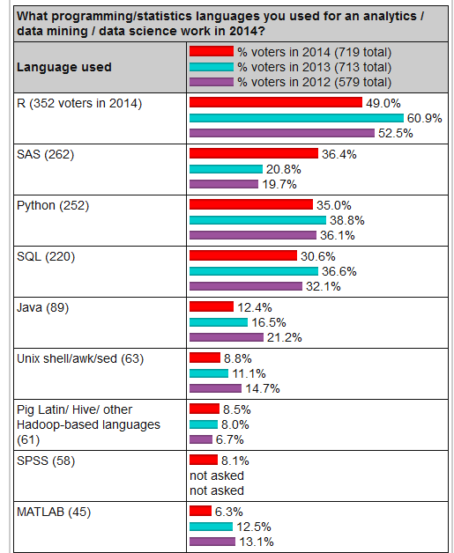
Popularity of Programming Languages for Bioinformatics
Survey from here

Slide 24
Bio* Projects
Bio* community project focusing on biological data analysis
BioPerl: http://bio.perl.org
BioPython: http://biopython.org
BioJava: http://www.biojava.org
BioRuby: http://bioruby.org
Bioconductor: http://www.bioconductor.org

Slide 25
Programming Languages
Selection of programming languages widely used in bioinformatics
C/C++
JAVA
Python
R
Perl
Ruby
Many others ...
Which one to choose depends on needs.

Slide 26
Statistical Environments
Selection of biostatistical tools
R
S-Plus
SAS
MATLAB
Others ...

Slide 27
Homework Assignment (HW1)
The homework of this lecture (go here) is designed to expose students to a wide range of online resources. The algorithms used in this assignment will be introduced later in this course. This is the only homework that does not involve any problem solving or coding tasks.
Note, all homework assignments of this class will be available under the Homework menu of the GEN242 site here.
Each homework is due one week after it was assigned.

Slide 28
References and Books
Kuhlman B, Dantas G, Ireton GC, Varani G, Stoddard BL, Baker D (2003) Design of a novel globular protein fold with atomic-level accuracy. Science 302: 1364-1368. URL http://www.hubmed.org/display.cgi?uids=14631033
Barrett, T, Troup, D B, Wilhite, S E, Ledoux, P, Rudnev, D, Evangelista, C, Kim, I F, Soboleva, A, Tomashevsky, M, Edgar, R (2007) NCBI GEO: mining tens of millions of expression profiles–database and tools update. Nucleic Acids Res, 35: 760-765.URL http://www.hubmed.org/display.cgi?uids=17099226

