Slide 1
Molecular Biology Essentials
Data Analysis in Genome Biology
GEN242
Thomas Girke
April 5, 2018

Slide 2
Outline
Molecular Biology Essentials
References and Books

Slide 3
Today’s Topics
Molecular Biology Essentials for Bioinformatics
Bioscience Database Overview
Software Resources for Bioinformatics
Introduction to GitHub and Biocluster

Slide 4
Organization and Structure of Genomes
Genomes
Chromosomes
Genes
mRNA
Noncoding RNAs, e.g. small RNAs
Proteins

Slide 5
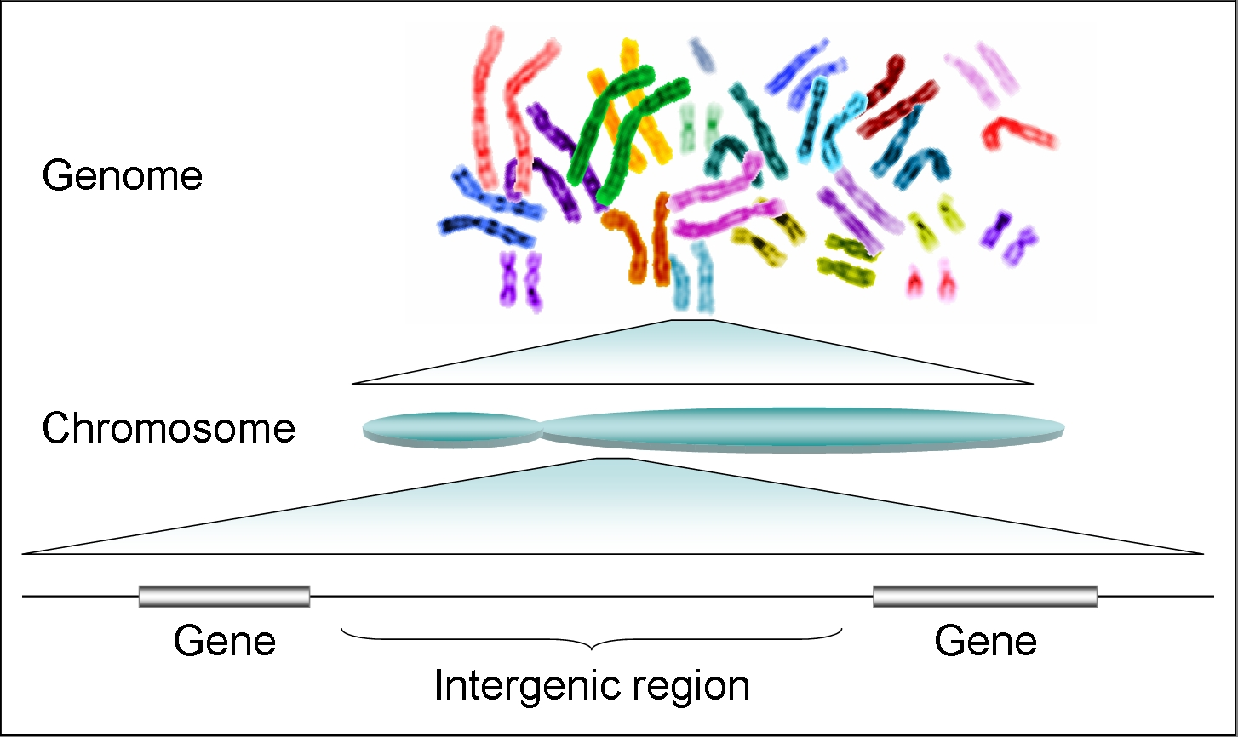
From Genomes to Genes

Slide 6
Genome Sizes
Organism | Genome Size (bp) | Genes
Phage Phi-X 174 (virus) | 5.3 ∗ 10³ | 10
Escherichia coli (bacterium) | 4.6 ∗ 10⁶ | ~4,000
Saccharomyces cerevisiae (yeast) | 12.5 ∗ 10⁶ | ~6,000
Arabidopsis thaliana (plant) | 1.3 ∗ 10⁸ | ~28,000
Fritillaria assyrica (plant) | 1.3 ∗ 10¹¹ | NA
Caenorhabditis elegans (nematode) | 1 ∗ 10⁸ | ∼19,500
Homo sapiens | 3 ∗ 10⁹ | ~30,000
Only approximate numbers are given in this table.
The numbers usually vary with the quality of a genome assembly.
The most accurate numbers can be found in genome databases (e.g. NCBI).

Slide 7
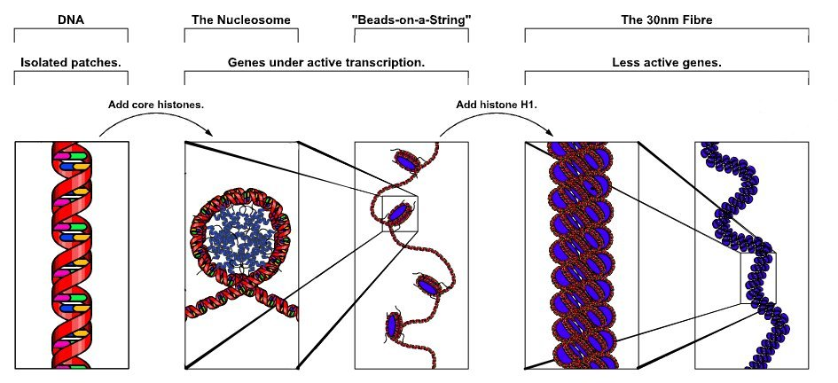
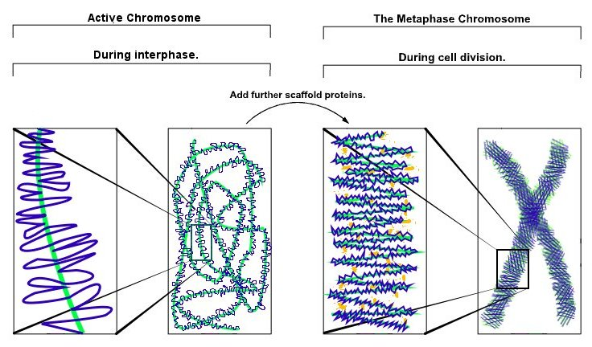
Chromatin
Chromatin: complex of DNA and protein that makes up chromosomes.
Histones are the major protein component.
Functions: DNA packaging in mitosis and meiosis, and to serve as a mechanism to control expression and DNA replication
Molecular Biology of the Cell Online [Alberts et al. 2002]

Slide 8
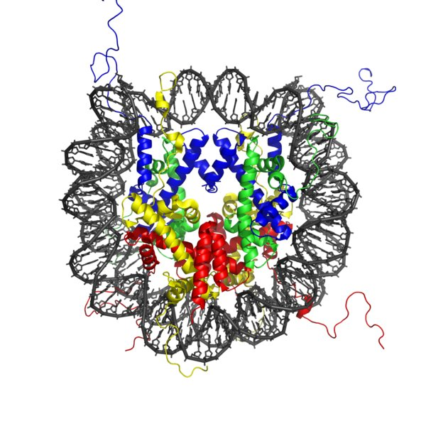
Nucleosome Structure
Nucleosome crystal structure [Luger et al. 1997]
Nucleosome core particle: ∼147 base pairs of DNA wrapped around a histone octamer consisting of two times of each histone: H2A, H2B, H3 and H4.
Histone H1 links different nucleosomes together to compact chromatin structure.

Slide 9
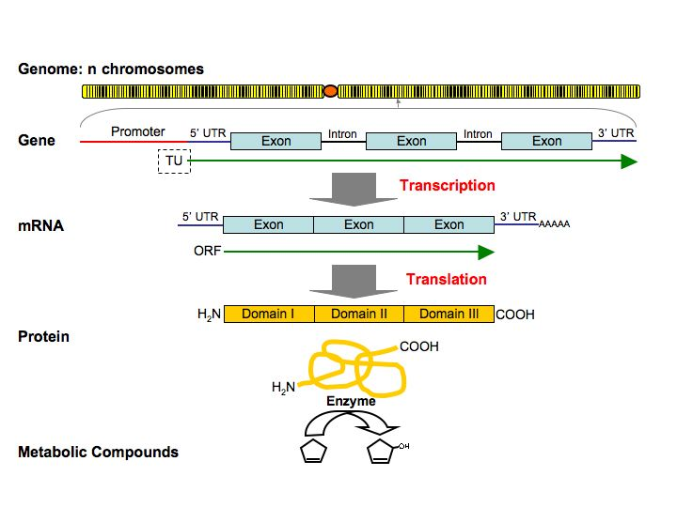
From Genes to mRNAs to Proteins to Compounds

Slide 10
Genetic Code and Amino Acids
Name | Abbreviation | Codons | Properties
Alanine | Ala A | GCT GCC GCA GCG | nonpolar
Arginine | Arg R | CGT CGC CGA CGG AGA AGG | pos charged
Asparagine | Asn N | AAT AAC | polar -CONH2
Aspartic acid | Asp D | GAT GAC | neg charged
Cysteine | Cys C | TGT TGC | polar -SH
Glutamine | Gln Q | CAA CAG | polar -CONH2
Glutamic acid | Glu E | GAA GAG | neg charged
Glycine | Gly G | GGT GGC GGA GGG | nonpolar
Histidine | His H | CAT CAC | pos charged
Isoleucine | Ile I | ATT ATC ATA | nonpolar
Leucine | Leu L | TTA TTG CTT CTC CTA CTG | nonpolar
Lysine | Lys K | AAA AAG | pos charged
Methionine | Met M | ATG (START codon) | nonpolar
Phenylalanine | Phe F | TTT TTC | nonpolar
Proline | Pro P | CCT CCC CCA CCG | nonpolar
Serine | Ser S | TCT TCC TCA TCG AGT AGC | polar -OH
Threonine | Thr T | ACT ACC ACA ACG | polar -OH
Tryptophan | Trp W | TGG | nonpolar
Tyrosine | Tyr Y | TAT TAC | polar -OH
Valine | Val V | GTT GTC GTA GTG | nonpolar
 | STOP | TAA TAG TGA

Slide 11
Gene Components and Important Processes
Genome: hereditary information of organism encoded in DNA (RNA); contains gene and intergenic regions
Gene: transcribed region; coding and non-coding genes (e.g. miRNA)
mRNA: messenger RNA
TU: transcriptional unit
UTR: untranslated region
ORF: open reading frame reaching from START to STOP codon
CDS: coding sequence
Promoter: regulatory region controlling gene expression
Transcription: formation of mRNA
Splicing: removal of introns converts pre-mRNA to mRNA
Translation: conversion of mRNA to protein

Slide 12
Important Regulatory Processes
Transcriptional control: promoter elements (DNA), regulatory RNAs,
transcription factors (proteins)
Post-transcriptional control: mRNA turnover and availability.
Translational control: translational control factors (proteins and RNAs)
Post-translational control: protein activity modulations by modifications
(e.g. phosphorylation by kinases)
Control by small RNAs: miRNAs and siRNAs controlling gene expression on transcriptional and translational levels

Slide 13
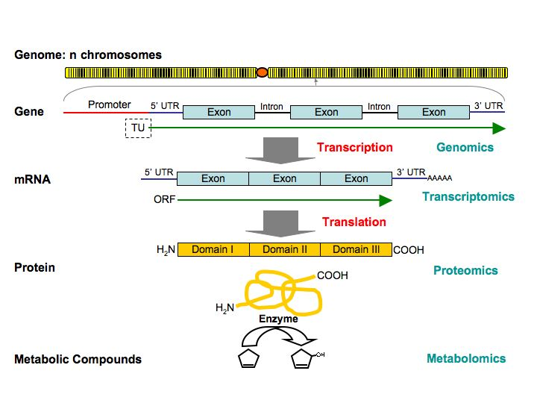
What is Measured by ’Omics’ Technologies?

Slide 14
Outline
Molecular Biology Essentials
References and Books

Slide 15
References and Books
Alberts, Bruce; Johnson, Alexander; Lewis, Julian; Raff, Martin; Roberts, Keith; Walter, Peter (2002) Molecular Biology of the Cell. Online Version from NCBI Bookshelf.
Luger K, Mader AW, Richmond RK, Sargent DF, Richmond TJ (1997) Crystal Structure of the Nucleosome Core Particle at 2.8 A. Nature 389: 251-260.

