Slide 1
DNA Sequencing Technologies
Data Analysis in Genome Biology
GEN242
Thomas Girke
April 10, 2018

Slide 2
Outline
What Are We Sequencing?
Genomic Libraries
cDNA Libraries
Traditional DNA Sequencing Technologies
Chemical Sequencing
Sanger Sequencing
Next Generation Sequencing Methods
Solexa/Illumina: Reversible Terminator Method
Helicos: Single Molecule Sequencing
454/Roche: Pyrosequencing Method
SOLiD/ABI: Supported Oligo Ligation Method
Third Generation Sequencing: PacBio and Others
Research Applications
References and Books

Slide 3
Usually We Prefer to Sequence DNA
DNA sequencing is more efficient because:
DNA cloning and amplification is easy
Availability of efficient enzymatic sequencing reactions
Protein sequencing is much harder because
No comparable cloning or amplification techniques available
Limited availability of enzymatic sequencing techniques
Chemical nature of proteins makes sequencing harder

Slide 4
DNA Libraries
A DNA library consists of cloned DNA fragments that can represent the entire genome of an organism (genomic DNA library) or its transcriptome (cDNA library).
Genomic library
Contains often entire DNA content of an organism.
Suitable for determining genomic DNA sequence.
Requires chromosomal DNA isolation.
cDNA library
Contains the mRNAs that are expressed in a tissue sample.
mRNA is used as starting material
mRNA needs to be reverse transcribed into cDNA
Requires mRNA isolation
Challenges: cDNA libraries tend to be incomplete with regard to
5’ sequences
Representation of all genes in the genome

Slide 5
Why Is it Helpful to Have Both?
Genomic library gives genome sequence
cDNA library gives information about expressed sequences in genome
For instance: cDNA sequences can be aligned to newly generated genomic sequence to
identify gene boundaries ⇒ gene prediction with physical evidence
distinguish between expressed genes and pseudo-genes
Many other reasons

Slide 6
Outline
What Are We Sequencing?
Genomic Libraries
cDNA Libraries
Traditional DNA Sequencing Technologies
Chemical Sequencing
Sanger Sequencing
Next Generation Sequencing Methods
Solexa/Illumina: Reversible Terminator Method
Helicos: Single Molecule Sequencing
454/Roche: Pyrosequencing Method
SOLiD/ABI: Supported Oligo Ligation Method
Third Generation Sequencing: PacBio and Others
Research Applications
References and Books

Slide 7
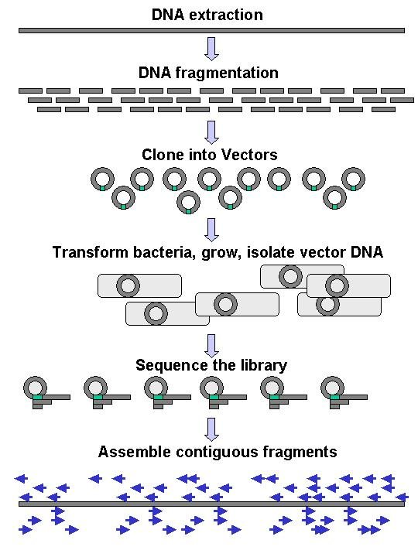
Workflow of a Genomic Sequencing Project
Annotation of Functional Features
Submit to GenBank

Slide 8
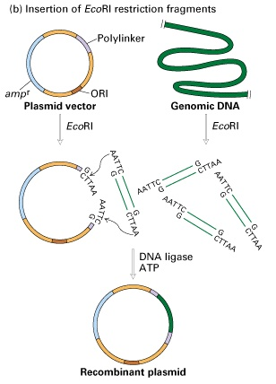
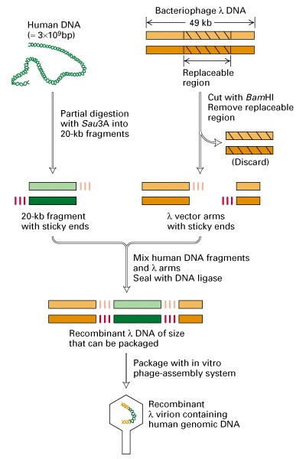
Synthesis of Common Genomic Libraries
Plasmid Library λ Phage Library

Slide 9
Outline
What Are We Sequencing?
Genomic Libraries
cDNA Libraries
Traditional DNA Sequencing Technologies
Chemical Sequencing
Sanger Sequencing
Next Generation Sequencing Methods
Solexa/Illumina: Reversible Terminator Method
Helicos: Single Molecule Sequencing
454/Roche: Pyrosequencing Method
SOLiD/ABI: Supported Oligo Ligation Method
Third Generation Sequencing: PacBio and Others
Research Applications
References and Books

Slide 10
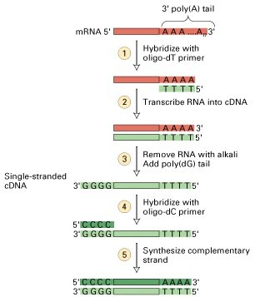
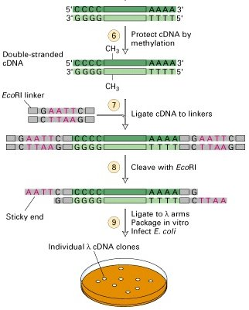
Synthesis of cDNA Library in λ Phage Vector
1. mRNA to cDNA 2. cDNA Cloning into λ

Slide 11
Cloning Vectors for Libraries
Plasmid Library [ Genomic & cDNA ]
Circular extra-chromosomal DNA molecule in bacteria
Maximum insert size for cloning: 1,000-20,000 bp
λ Phage Library [ Genomic & cDNA ]
Double-stranded linear DNA of E. coli infecting virus
Maximum insert size for cloning: 1,000-25,000 bp
Cosmid Library [ Genomic ]
λ phage-derived hybrid plasmid with cos sequences
Maximum insert size for cloning: 35,000 to 50,000 bp
BAC Library [ Genomic ]
Bacterial artificial chromosome
Maximum insert size for cloning: 150,000-350,000 bp
YAC Library [ Genomic ]
Yeast artificial chromosome
Maximum insert size for cloning: 100,000-3,000,000 bp
Many Additional Library Types
Please consult molecular biology books.

Slide 12
What are EST Sequences?
Expressed sequence tags or ESTs are short single-pass sequences from cDNA libraries (partial RNA sequences).
They are useful for:
Identification of gene boundaries in genomic sequences
Discovery of single nucleotide polymorphisms (SNPs)
Discovery of alternative splice events in transcripts
Quantitative (digital) gene expression analysis (DGE)
Currently, there are hundreds of million ESTs available in GenBank
RNA-Seq reads are the NGS version of ESTs
Many additional applications.

Slide 13
Outline
What Are We Sequencing?
Genomic Libraries
cDNA Libraries
Traditional DNA Sequencing Technologies
Chemical Sequencing
Sanger Sequencing
Next Generation Sequencing Methods
Solexa/Illumina: Reversible Terminator Method
Helicos: Single Molecule Sequencing
454/Roche: Pyrosequencing Method
SOLiD/ABI: Supported Oligo Ligation Method
Third Generation Sequencing: PacBio and Others
Research Applications
References and Books

Slide 14
History of DNA Sequencing
”DNA Sequencing by Chemical Degradation” is published by Allan Maxam and Walter Gilbert.
”DNA Sequencing by Enzymatic Synthesis” is published by Fred Sanger.
Fred Sanger and Walter Gilbert receive the Nobel Prize in Chemistry.
GenBank starts as a public repository of DNA sequences.
Leroy Hood’s laboratory at the California Institute of Technology announces the first semi-automated DNA sequencing machine.
Genome sequence of E. coli is published.
Draft sequence of the Human genome is published.
First next generation sequencing technologies become available to the public.

Slide 15
Outline
What Are We Sequencing?
Genomic Libraries
cDNA Libraries
Traditional DNA Sequencing Technologies
Chemical Sequencing
Sanger Sequencing
Next Generation Sequencing Methods
Solexa/Illumina: Reversible Terminator Method
Helicos: Single Molecule Sequencing
454/Roche: Pyrosequencing Method
SOLiD/ABI: Supported Oligo Ligation Method
Third Generation Sequencing: PacBio and Others
Research Applications
References and Books

Slide 16
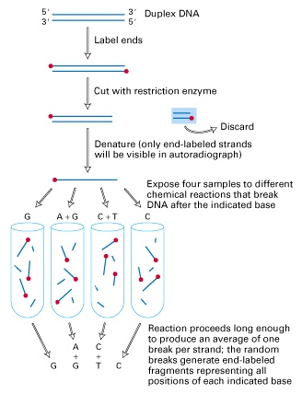
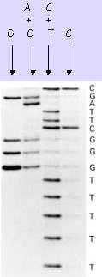
Chemical Sequencing by Maxam & Gilbert
Uses radioactive labeled DNA fragments of 500 bp.
Four separate chemical treatments generate DNA breaks at the positions: G, A+G, C, C+T.
The fragments are size-separated by gel electrophoresis in four separate lanes.
Visualization of the fragments by autoradiography on an X-ray film.
Chemical DNA Degradation Gel Electrophoresis

Slide 17
Outline
What Are We Sequencing?
Genomic Libraries
cDNA Libraries
Traditional DNA Sequencing Technologies
Chemical Sequencing
Sanger Sequencing
Next Generation Sequencing Methods
Solexa/Illumina: Reversible Terminator Method
Helicos: Single Molecule Sequencing
454/Roche: Pyrosequencing Method
SOLiD/ABI: Supported Oligo Ligation Method
Third Generation Sequencing: PacBio and Others
Research Applications
References and Books

Slide 18
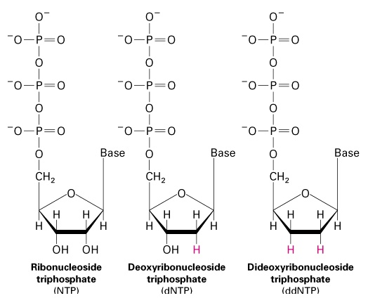
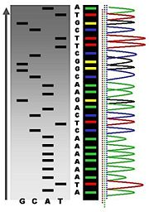
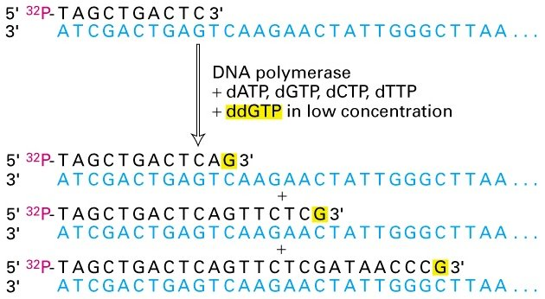
Illustration of Sanger Sequencing
Radioactive Fluorescence
Labeling
Sequencing Principle

Slide 19
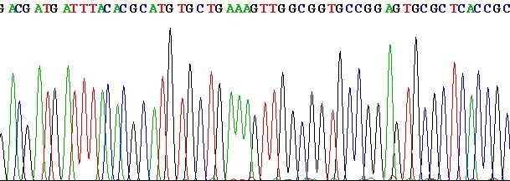
Processing of Sequencing Raw Data
Assign quality score to each peak
The frequently used Phred scores provide log(10)-transformed error probability values:
score = 20 corresponds to a 1% error rate
score = 30 corresponds to a 0.1% error rate
score = 40 corresponds to a 0.01% error rate
The base calling (A, T, G or C) is performed based on Phred scores.
Ambiguous positions with Phred scores ≤ 20 are labeled with N.

Slide 20
Outline
What Are We Sequencing?
Genomic Libraries
cDNA Libraries
Traditional DNA Sequencing Technologies
Chemical Sequencing
Sanger Sequencing
Next Generation Sequencing Methods
Solexa/Illumina: Reversible Terminator Method
Helicos: Single Molecule Sequencing
454/Roche: Pyrosequencing Method
SOLiD/ABI: Supported Oligo Ligation Method
Third Generation Sequencing: PacBio and Others
Research Applications
References and Books

Slide 21
Common Synonyms
High-throughput sequencing: HTS or HT-Seq
Flow cell sequencing (FCS)
Massively parallel sequencing (MPS)
Next generation sequencing (NGS)
Second/third generation sequencing
Deep sequencing
Sequencing by synthesis
Many other synonyms
Review article: Holt et al 2008

Slide 22
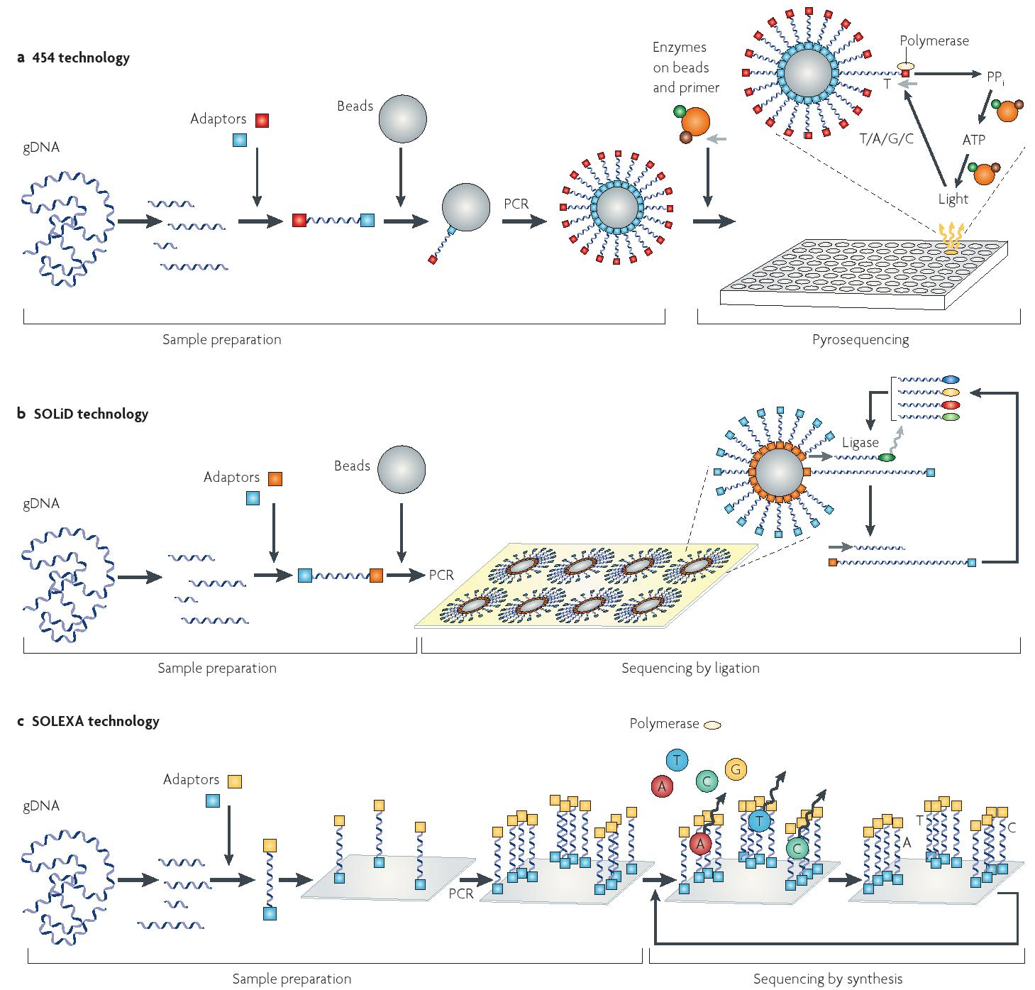
Overview: 454, SOLiD and Illumina
From review article: Medini et al 2008

Slide 23
Similarities and Differences of NGS Technologies
Common components
Flow cells as reaction chambers
Iterative sequencing process
Massive parallelization
Clonally amplified or single molecule templates
Differences
Template preparation
Sequencing chemistry
Flow cell configuration

Slide 24
NGS Sequencing Methods
Reversible Terminator Methods (e.g. Illumina/Solexa)
Use reversible versions of dye-terminator reactions.
Principle steps: adding one nucleotide at a time, detecting fluorescence corresponding to that position, then removing the blocking group to allow polymerization of another nucleotide.
Single Molecule Methods (e.g. Helicos, PacBio)
Variable strategies.
Pyrosequencing Methods (e.g. 454)
Also use DNA polymerization to add nucleotides.
Principle steps: adding one type of nucleotide at a time, then detecting and quantifying the number of nucleotides added to a given location through the light emitted by the release of attached pyrophosphates.
Supported Oligonucleotide Ligation Methods (e.g. SOLiD, Complete Genomics)
Uses ligation-based approach
Principle steps: stepwise ligation of labeled random octamers to obtain sequence of attached dinucleotides; the ligated dinucleotides of each ligation round are spaced by several nucleotides; continuous sequence information is obtained by offsetting sequencing primer.

Slide 25
Outline
What Are We Sequencing?
Genomic Libraries
cDNA Libraries
Traditional DNA Sequencing Technologies
Chemical Sequencing
Sanger Sequencing
Next Generation Sequencing Methods
Solexa/Illumina: Reversible Terminator Method
Helicos: Single Molecule Sequencing
454/Roche: Pyrosequencing Method
SOLiD/ABI: Supported Oligo Ligation Method
Third Generation Sequencing: PacBio and Others
Research Applications
References and Books

Slide 26
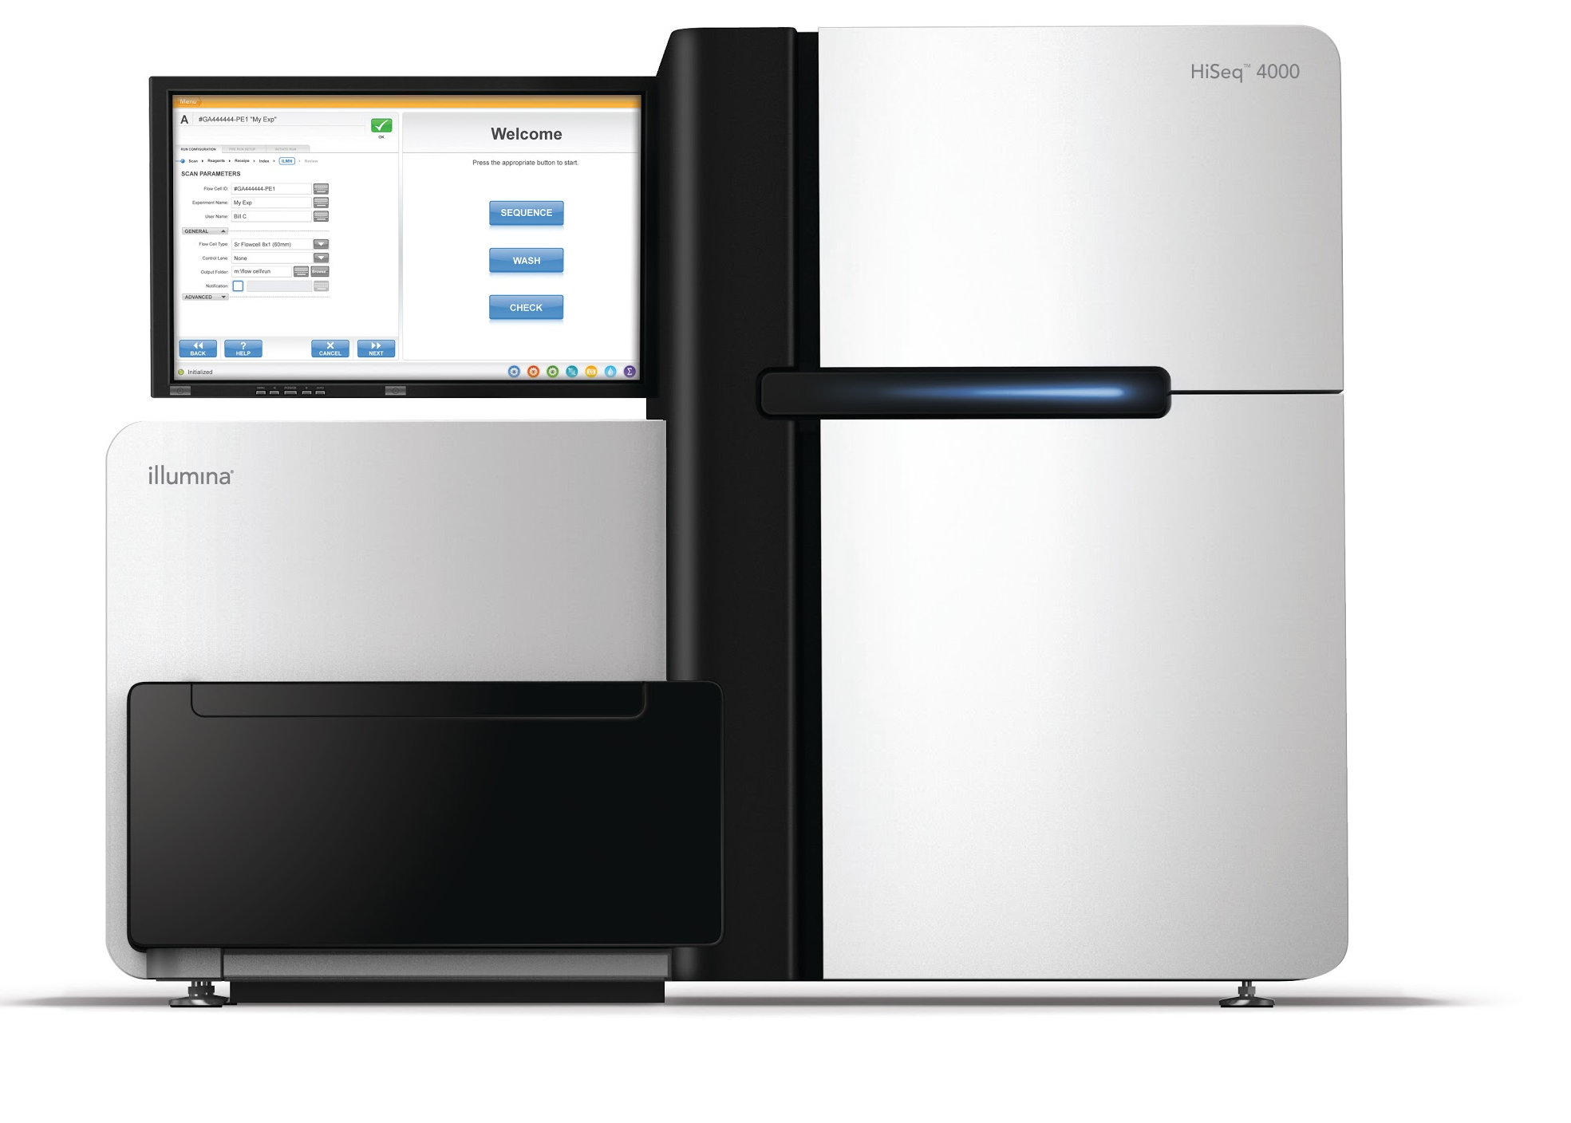
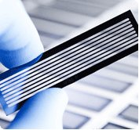
Example: Illumina/Solexa Technology
Illumina HiSeq 2500 Sequencer
Flow Cell

Slide 27
Basic Steps of Illumina Sequencing
Compare with illustration on next 3 slides!
Flow Cell Loading
Generate DNA library (genomic- or cDNA-based) with insert length of ∼200 bp.
Load library onto flow cell (nano device for liquid handling).
PCR-based bridge amplification of loaded fragments to obtain DNA clusters (serves signal amplification)
Sequencing Cycles
Start reversible dye-terminator reaction containing primer and labeled dNTPs among other components.
Image scan to detect the identity of first base of each cluster via the characteristic fluorescence signal for each labeled nucleotide.
De-protection step removes the blocking group and fluorescence group of the incorporated nucleotide.
Repeat steps 4-6 about 50-250 times.

Slide 28
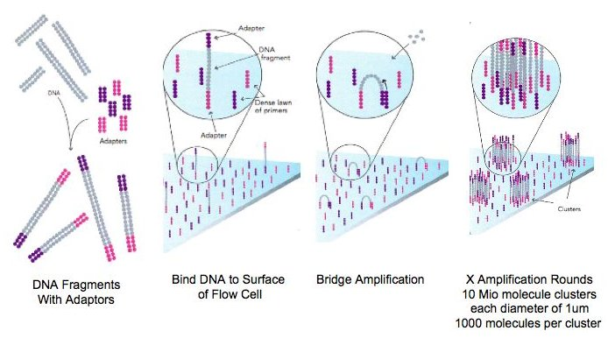
Flow Cell Loading
Illumina HiSeq 2500 Sequencer
Flow Cell

Slide 29
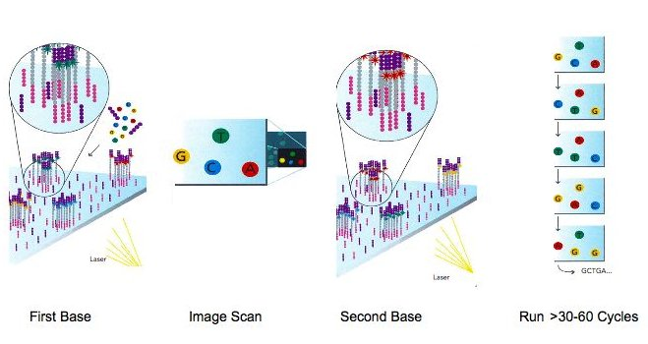
Sequencing Cycles

Slide 30
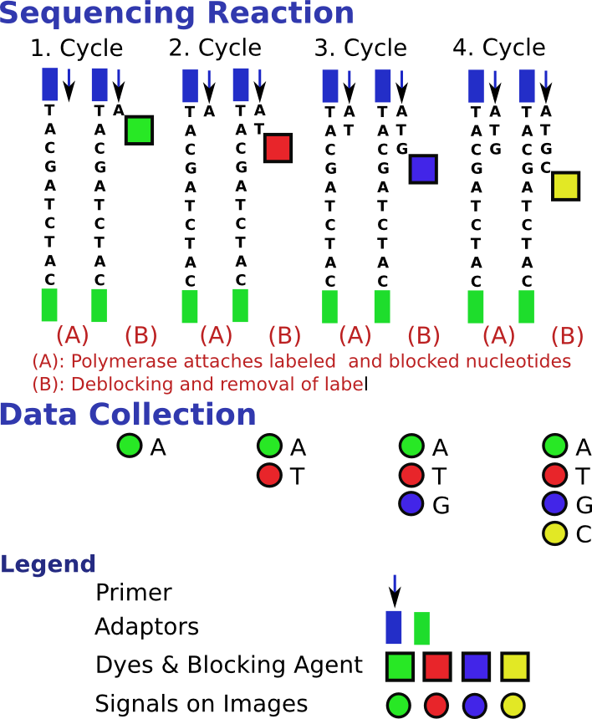
Details of Sequencing Reaction
Illustration shows the sequencing cycles for a single template molecule!

Slide 31
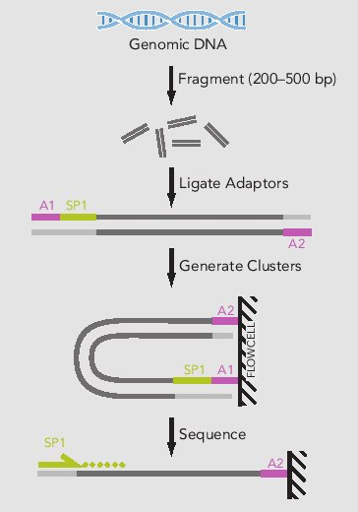
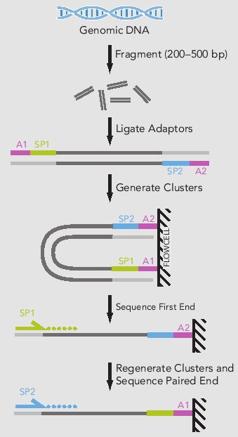
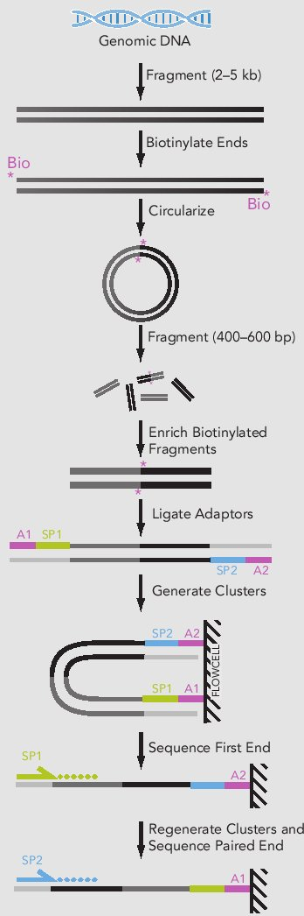
Single End, Paired End and Mate Pair Sequencing
Single End
Paired End
Mate Pair
AP1/AP2: flow cell adapators; SP1/SP2: sequencing primers

Slide 32
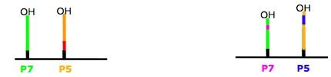
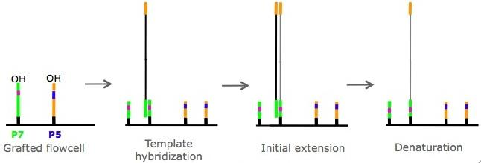
Paired End Chemistry: Step I
Grafted Flow Cell
Single End
Paired End
Linearization: periodate two different enzymes
Cluster Generation: Initial Extension

Slide 33
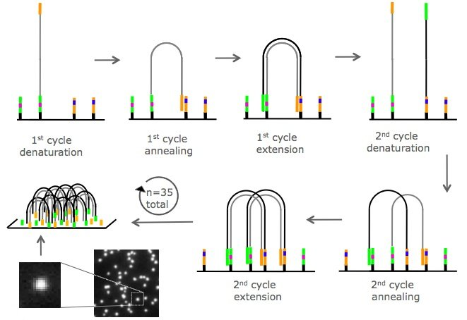
Paired End Chemistry: Step II
Cluster Generation: Amplification

Slide 34
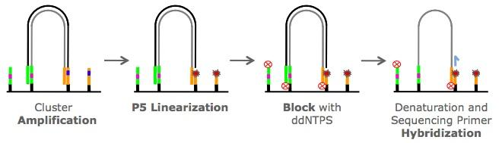
Paired End Chemistry: Step III
Cluster Generation: Linearization

Slide 35
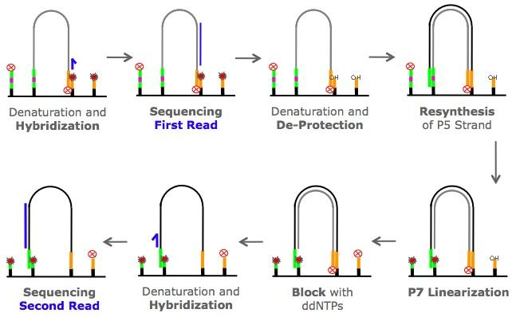
Paired End Chemistry: Step IV
Sequencing

Slide 36
Processing of Illumina Sequencing Data
Convert cluster images to intensity values.
Base calling based on intensity for each fluorescence dye.
Generates quality scores similar to Phred scores.
The length of each sequence corresponds to the number of cycles, e.g. 75 cycles → 75 bp.
Remove sequences with low quality reads.
Downstream analyses specific to application!
A single sequencing run with 2x 100 cycles can generate ∼ 3 billion sequences and 32TB of image data.

Slide 37
Sequence Format: FASTQ
FASTQ format has 4 lines per sequence
'@' character followed by a sequence identifier
Character string of sequence
'+' character optionally followed by the same sequence identifier
Quality scores in ASCII format
Example of partial FASTQ file
@SRR446037.238 length=75
TCAGCCTTGCGACCATACTCCCCCCGGAACCCAAAAACTTTGATTTCTCATAAGGTGCCAGCGGAGTCCTATAAG
+SRR446037.238 length=75
IIIIIIIIIIIGIIHIHIIIIIIIIDHDIIIIIFHDGDEFHCCGHHHHHCDDD@?6?@A@?A;??@2@BA@BBB@
... millions of entries ...

Slide 38
Outline
What Are We Sequencing?
Genomic Libraries
cDNA Libraries
Traditional DNA Sequencing Technologies
Chemical Sequencing
Sanger Sequencing
Next Generation Sequencing Methods
Solexa/Illumina: Reversible Terminator Method
Helicos: Single Molecule Sequencing
454/Roche: Pyrosequencing Method
SOLiD/ABI: Supported Oligo Ligation Method
Third Generation Sequencing: PacBio and Others
Research Applications
References and Books

Slide 39
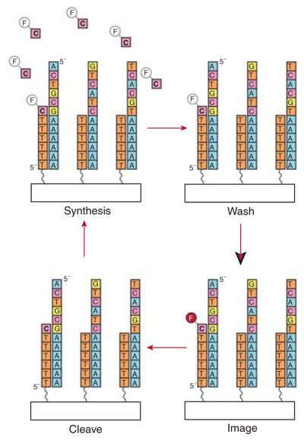
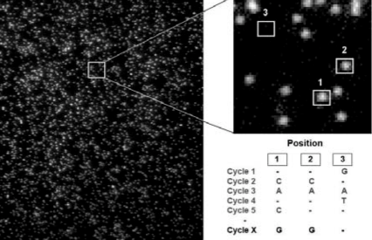
Helicos: Single Molecule Sequencing
Has similarities to Solexa/Illumina technology, but sequences single molecule templates.
Attaches one of the four nucleotides at a time using proprietary nucleotide-polymerase formulations. This prevents the incorporation of more than one nucleotide in each cycle in homopolymer regions.

Slide 40
Outline
What Are We Sequencing?
Genomic Libraries
cDNA Libraries
Traditional DNA Sequencing Technologies
Chemical Sequencing
Sanger Sequencing
Next Generation Sequencing Methods
Solexa/Illumina: Reversible Terminator Method
Helicos: Single Molecule Sequencing
454/Roche: Pyrosequencing Method
SOLiD/ABI: Supported Oligo Ligation Method
Third Generation Sequencing: PacBio and Others
Research Applications
References and Books

Slide 41
454/Roche Sequencing Steps
Pyrosequencing Methods (e.g. 454)
Also uses DNA polymerization to add nucleotides.
Principle steps: adding one type of nucleotide at a time, then detecting and quantifying the number of nucleotides added to a given location through the light emitted by the release of attached pyrophosphates.
For more details see: 454 Web Site (http://www.454.com)

Slide 42
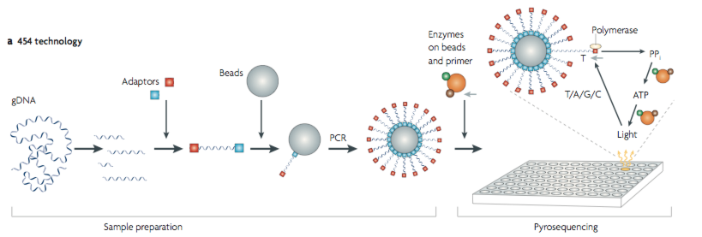
454 Pyrosequencing

Slide 43
Outline
What Are We Sequencing?
Genomic Libraries
cDNA Libraries
Traditional DNA Sequencing Technologies
Chemical Sequencing
Sanger Sequencing
Next Generation Sequencing Methods
Solexa/Illumina: Reversible Terminator Method
Helicos: Single Molecule Sequencing
454/Roche: Pyrosequencing Method
SOLiD/ABI: Supported Oligo Ligation Method
Third Generation Sequencing: PacBio and Others
Research Applications
References and Books

Slide 44
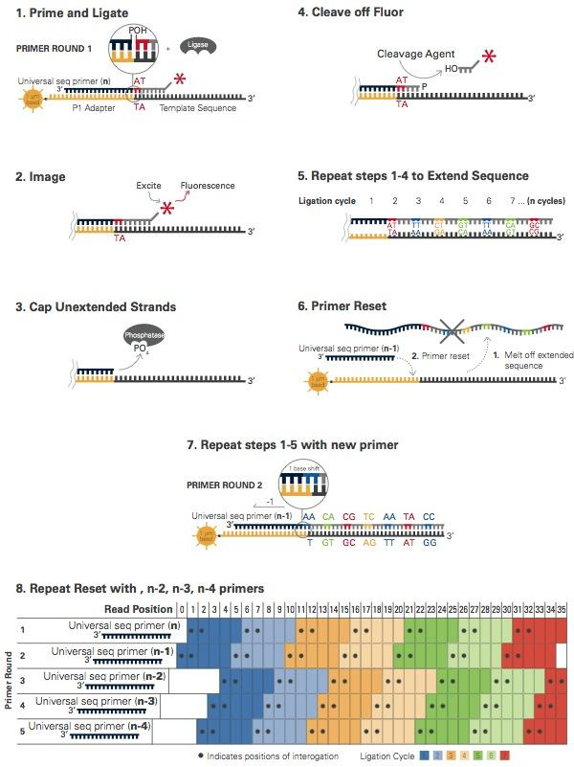
SOLiD: Sequencing by Supported Oligonucleotide
Ligation and Detection

Slide 45
Outline
What Are We Sequencing?
Genomic Libraries
cDNA Libraries
Traditional DNA Sequencing Technologies
Chemical Sequencing
Sanger Sequencing
Next Generation Sequencing Methods
Solexa/Illumina: Reversible Terminator Method
Helicos: Single Molecule Sequencing
454/Roche: Pyrosequencing Method
SOLiD/ABI: Supported Oligo Ligation Method
Third Generation Sequencing: PacBio and Others
Research Applications
References and Books

Slide 46
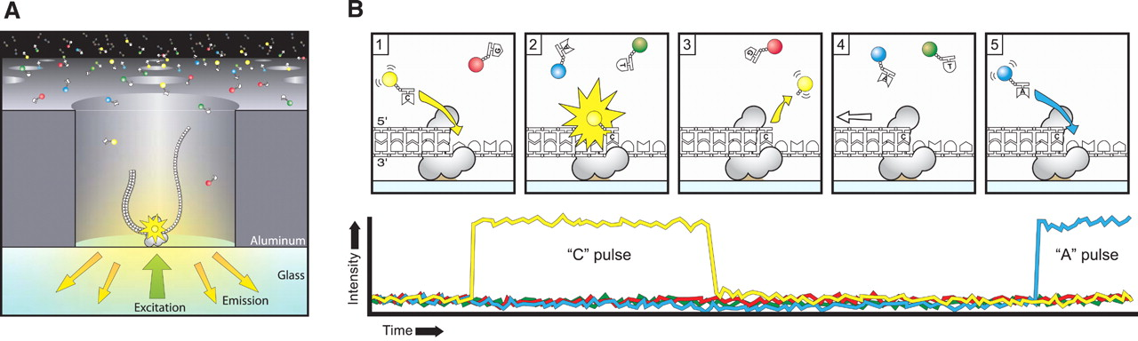
PacBio: Sequencing with Single Polymerase Molecule
Publication: Eid et al 2009
Read lengths: 0.5-20kbp!!
Much lower cost
Disadvantages: high error rate and low number of sequences

Slide 47
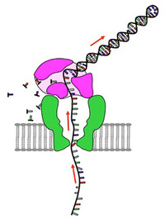
Nanopore Sequencing
Read lengths: xkbp!!
Much lower cost.
Disadvantages: currently higher error rate and low number of sequences.

Slide 48
Comparison of Methods
Method | Read Length | Sequences per Run | Utility
Sanger | 500-1500bp | 384 | de novo and low throughput
454/Roche | 300-600bp | ~2*10⁶ | de novo and medium throughput
Pacbio | 0.5-20kbp | ~1-5*10⁶ | de novo and medium throughput
Illumina | 50-150 (1-2x) | ~1.6*10⁹ | de novo and high-throughput
All numbers are estimates and apply to the situation in Dec. 2015!

Slide 49
Outline
What Are We Sequencing?
Genomic Libraries
cDNA Libraries
Traditional DNA Sequencing Technologies
Chemical Sequencing
Sanger Sequencing
Next Generation Sequencing Methods
Solexa/Illumina: Reversible Terminator Method
Helicos: Single Molecule Sequencing
454/Roche: Pyrosequencing Method
SOLiD/ABI: Supported Oligo Ligation Method
Third Generation Sequencing: PacBio and Others
Research Applications
References and Books

Slide 50
Applications of NGS Methods
NGS technologies provide vast opportunities for genomics, comparative genome biology, medical diagnostics, etc. The following list only a few of examples.
Applications
Genome-wide detection of SNPs and mutations (SNP-seq)
Methylome profiling by bisulphite sequencing (BS-seq)
DNA-protein interactions (ChIP-seq)
Transcriptome sequencing (RNA-seq)
mRNA expression profiling (RNA-seq and DGE)
Small RNA profiling and discovery
Hi-C to study three dimensional architecture of genomes
De novo genome assembly (for PacBio)

Slide 51
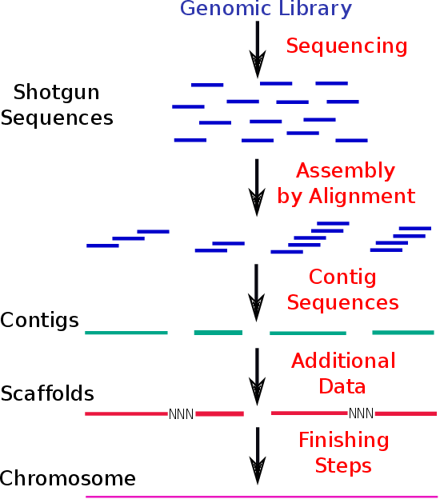
Application: De Novo Sequencing and Assembly

Slide 52
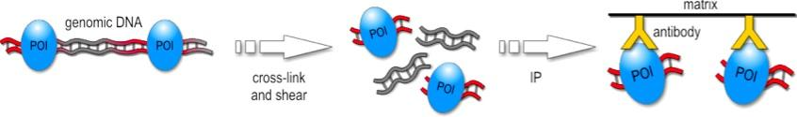
Application: DNA-Protein Interactions with ChIP-Seq
Reference for ChIP-Seq data analysis: Jothi et al 2008

Slide 53
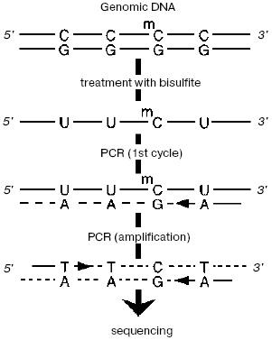
Application: Methylome Profiling with BS-Seq

Slide 54
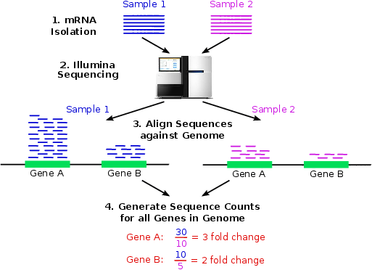
Application: RNA-Seq Gene Expression Profiling

Slide 55
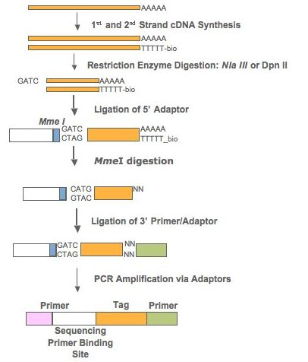
Application: Digital Gene Expression (DGE) Profiling
Sequencing

Slide 56
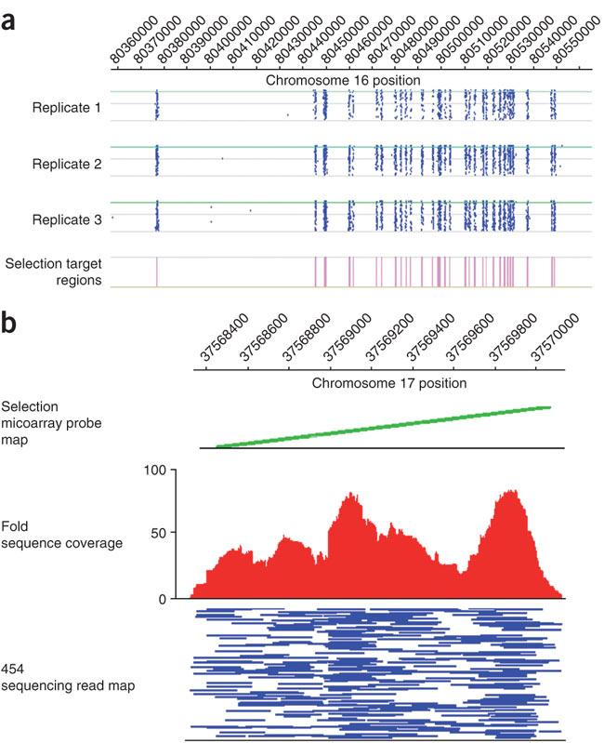
Targeted Sequencing for Large Genomes
Targeted sequencing using DNA capture microarrays or beads
Powerful approach to make NGS-Seq more economic and versatile.
Example: usage of programmable microarrays (here NimbleGen) to enrich for DNA regions of interest (Albert et al 2007).

Slide 57
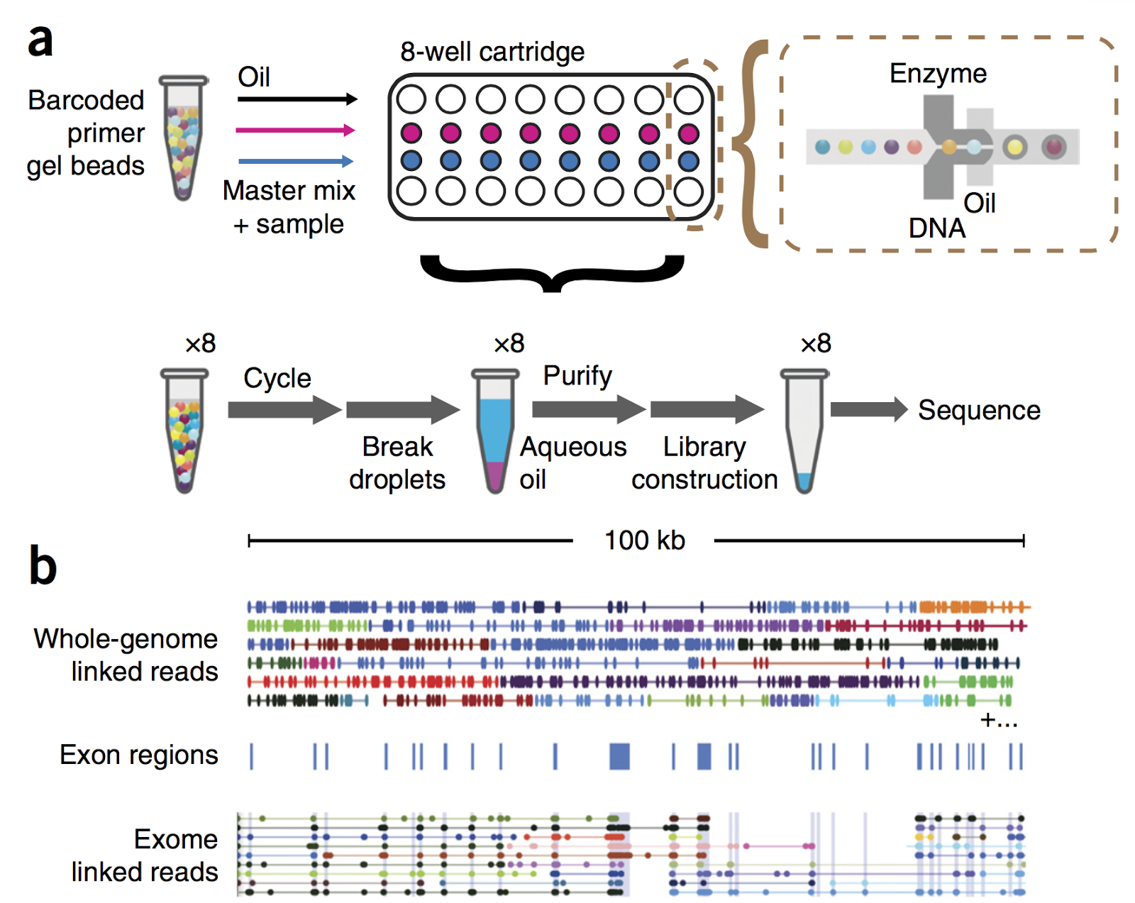
10X Genomics: Linked-Read Sequencing
Resolves many challenges inherent to short read sequencing
From Zheng et al (2016)

Slide 58
Database: Sequence Read Archive from NCBI
SRA: http://www.ncbi.nlm.nih.gov/Traces/sra
1000 Human Genomes Project: http://www.1000genomes.org
Many more 1000 genome projects

Slide 59
Outline
What Are We Sequencing?
Genomic Libraries
cDNA Libraries
Traditional DNA Sequencing Technologies
Chemical Sequencing
Sanger Sequencing
Next Generation Sequencing Methods
Solexa/Illumina: Reversible Terminator Method
Helicos: Single Molecule Sequencing
454/Roche: Pyrosequencing Method
SOLiD/ABI: Supported Oligo Ligation Method
Third Generation Sequencing: PacBio and Others
Research Applications
References and Books

Slide 60
References
Albert, T J, Molla, M N, Muzny, D M, Nazareth, L, Wheeler, D, Song, X, Richmond, T A, Middle, C M, Rodesch, M J, Packard, C J, Weinstock, G M, Gibbs, R A (2007) Direct selection of human genomic loci by microarray hybridization. Nat Methods, 4: 903-905. URL http://www.hubmed.org/display.cgi?uids=17934467
Eid, J et al. (2009) Real-time DNA sequencing from single polymerase molecules. Science, 323: 133-138. URL http://www.hubmed.org/display.cgi?uids=19023044
Holt, RA, Jones, SJ (2008) The new paradigm of flow cell sequencing. Genome Res, 18: 839-846. URL http://www.hubmed.org/display.cgi?uids=18519653
Jothi, R, Cuddapah, S, Barski, A, Cui, K, Zhao, K (2008) Genome-wide identification of in vivo protein-DNA binding sites from ChIP-Seq data. Nucleic Acids Res, 36: 5221-5231. URL http://www.hubmed.org/display.cgi?uids=18684996
Medini, D, Serruto, D, Parkhill, J, … , C, Moxon, R, Falkow, S, Rappuoli, R (2008) Microbiology in the post-genomic era. Nat Rev Microbiol, 6: 419-430. URL http://www.hubmed.org/display.cgi?uids=18475305

Slide 61
References
Zheng GXY et al (2016) Haplotyping germline and cancer genomes with high-throughput linked-read sequencing. Nat Biotechnol 34: 303–311

