Slide 1
Introduction to R
Data Analysis in Genome Biology
GEN242
Thomas Girke
April 12, 2018

Slide 2
Outline
Overview Slides
Online Tutorial

Slide 3
Why Using R?
Complete statistical package and programming language
Efficient functions and data structures for data analysis
Powerful graphics
Access to fast growing number of analysis packages
Most widely used language in bioinformatics
Is standard for data mining and biostatistical analysis
Technical advantages: free, open-source, available for all OSs
Books & Documentation
Collection of Books and online tutorials - URL
Bioinformatics and Computational Biology Solutions Using R and Bioconductor (Gentleman et al., 2005) - URL
More on this see ”Finding Help” section in UCR Manual - URL

Slide 4
R Working Environments (IDEs)
Examples of R working environments with support for syntax highlighting and utilities to send code to R console:
RStudio: excellent choice for beginners (Cheat Sheet)
Basic R code editors provided by Rguis
gedit, Rgedit, RKWard, Eclipse, Tinn-R, Notepad++, NppToR
Nvim-R-Tmux: R working environment based on vim and tmux
Emacs (ESS add-on package)

Slide 5
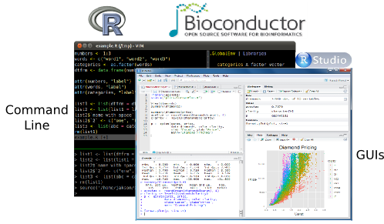
Examples: R Working Environments

Slide 6
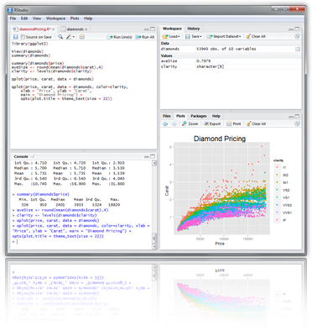
RStudio: Alternative Working Environment for R
New integrated development environment (IDE) for R that works well for beginners and developers.
Some useful shortcuts:
Ctrl+Enter: send code to R console
Ctrl+Alt+Enter: send code to terminal
Ctrl+Shift+C: comment/uncomment
Ctrl+1/2: switch window focus

Slide 7
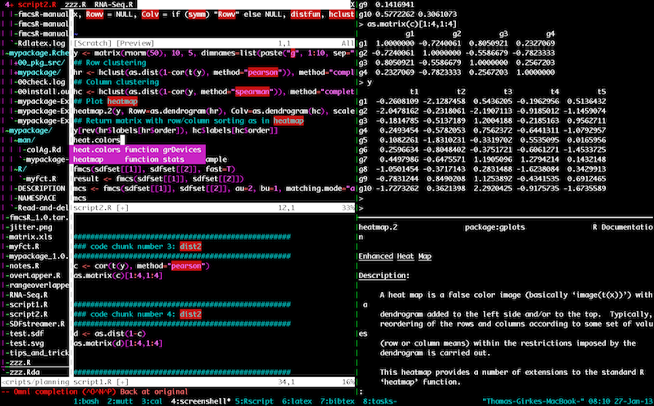
Nim-R-Tmux: Terminal-based R Environment

Slide 8
R Package Repositories
CRAN (>11,000 packages) general data analysis - URL
Bioconductor (>1,500 packages) bioscience data analysis - URL
Omegahat (>90 packages) programming interfaces - URL

Slide 9
Outline
Overview Slides
Online Tutorial

Slide 10
Online Tutorial
Continue here!

Slide 11
References and Books
Huber W, Carey VJ, Gentleman R, Anders S, Carlson M, Carvalho BS, …, et al (2015) Orchestrating high-throughput genomic analysis with Bioconductor. Nat Methods 12: 115–121

