Slide 1
Sequence Alignments and Similarity Searching
Data Analysis in Genome Biology
GEN242
Thomas Girke
April 17, 2018

Slide 2
Outline
Utilities of Sequence Alignments
Pairwise Alignment Algorithms
Pairwise Alignment
Example of Substitution Matrices
Global Alignment
Local Alignment
Other Alignments
Sequence Similarity Searching
Background
SSearch
BLAST
FASTA
Software
Homework
References

Slide 3
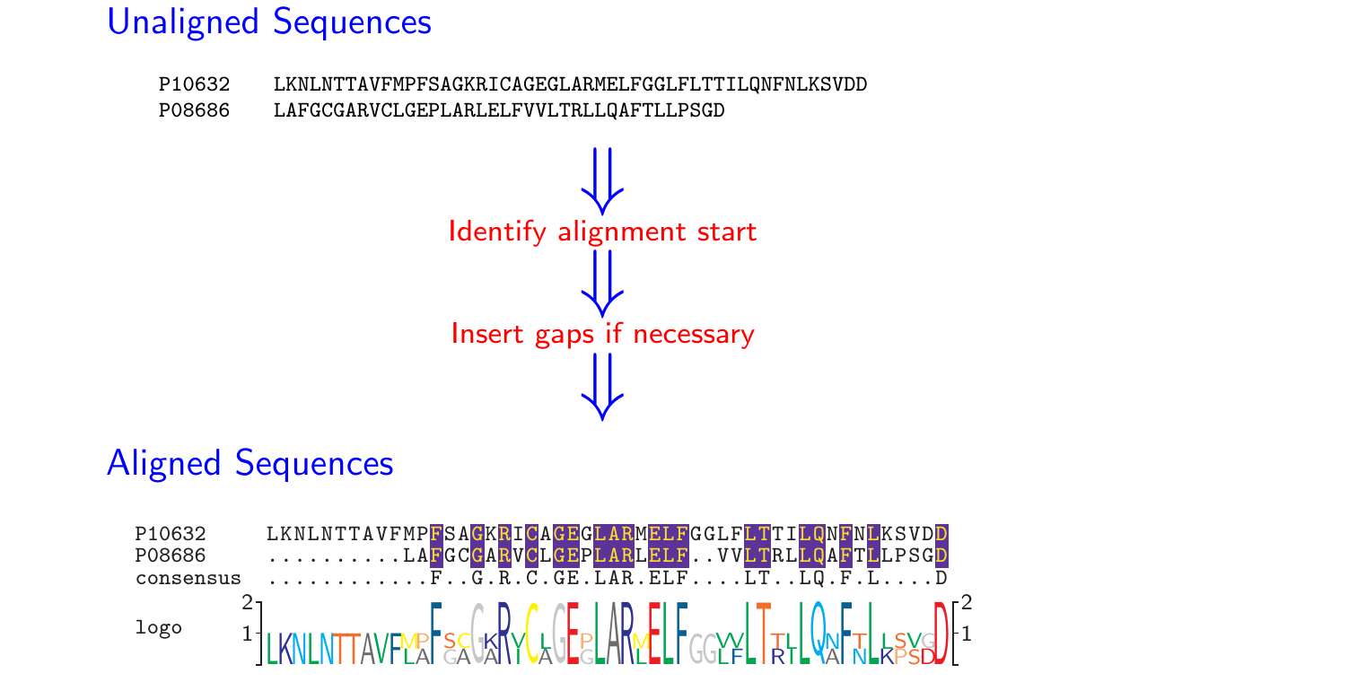
Illustration of Sequence Alignment Process
Goal: maximize number of identical and similar residues in columns of alignment.

Slide 4
Why Comparing Sequences?
Background
The evolution of biological sequences is mainly driven by gene duplications, point mutations, insertions and deletions.
Alignment algorithms are the central tool to detect these events and to perform sequence similarity analyses in general.
Utilities
Functional analyses:
Conserved sequence regions are functionally important.
Evolutionary analyses:
Sequences divergence patterns can be used to reconstruct their phylogenetic relationships.
Mutation and SNP analyses
Comparative genomics
Sequence similarity searching is based on alignment methods.
Many other utilities

Slide 5
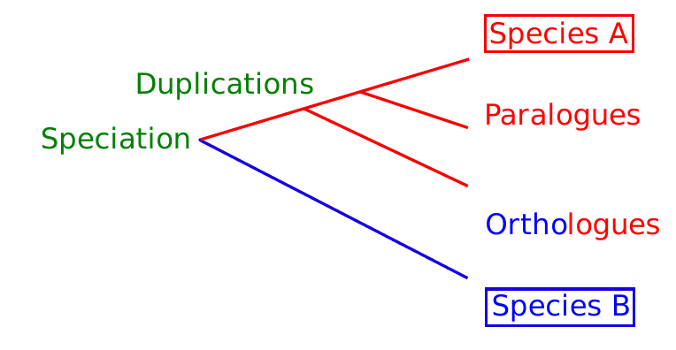
Important Terminology
Sequence Identity: often expressed in percent identical residues
Sequence Similarity: often percent of identical and similar residues
Homologous Sequences: evolved from a common ancestor sequence
Orthologous Sequences: homologous sequences from different species
Paralogous Sequences: homologous sequences within one species (gene duplications)

Slide 6
Outline
Utilities of Sequence Alignments
Pairwise Alignment Algorithms
Pairwise Alignment
Example of Substitution Matrices
Global Alignment
Local Alignment
Other Alignments
Sequence Similarity Searching
Background
SSearch
BLAST
FASTA
Software
Homework
References

Slide 7
Sequence Alignments
Matrix representation of similarities between sequences to identify functional, structural, or evolutionary relationships between them.
In an alignment the sequences are organized in rows, and their residues with identical or similar properties are arranged in columns.
Gaps are often introduced to maximize the alignment of similar residues in the same columns.
High quality alignments arrange the sequences in columns with as many high scoring pairs as possible, while minimizing the cost of unrelated residue pairs and gaps.

Slide 8
Similarity Concepts
Pairwise Sequence Alignments
Dot plots
Global alignment
Local alignment
Multiple Sequence Alignments

Slide 9
Why Gapped Alignments?
Sequences evolve by complex mutation processes
Gene duplications*
Gene deletions*
Point mutations
Substitutions
Insertions*
Deletions*
⇒ *require gaps

Slide 10
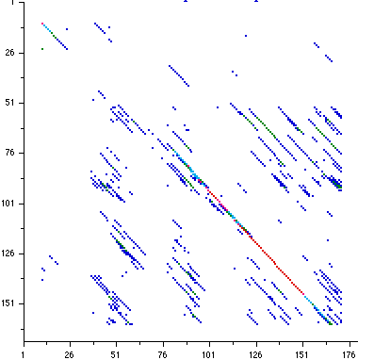
Dot Matrix: Plot of Pairwise Sequence Similarities
Dros hsp22
Useful to identify: insertions, deletions and repetitive regions.
Commonly used to compare entire chromosomes.
Dros hsp23

Slide 11
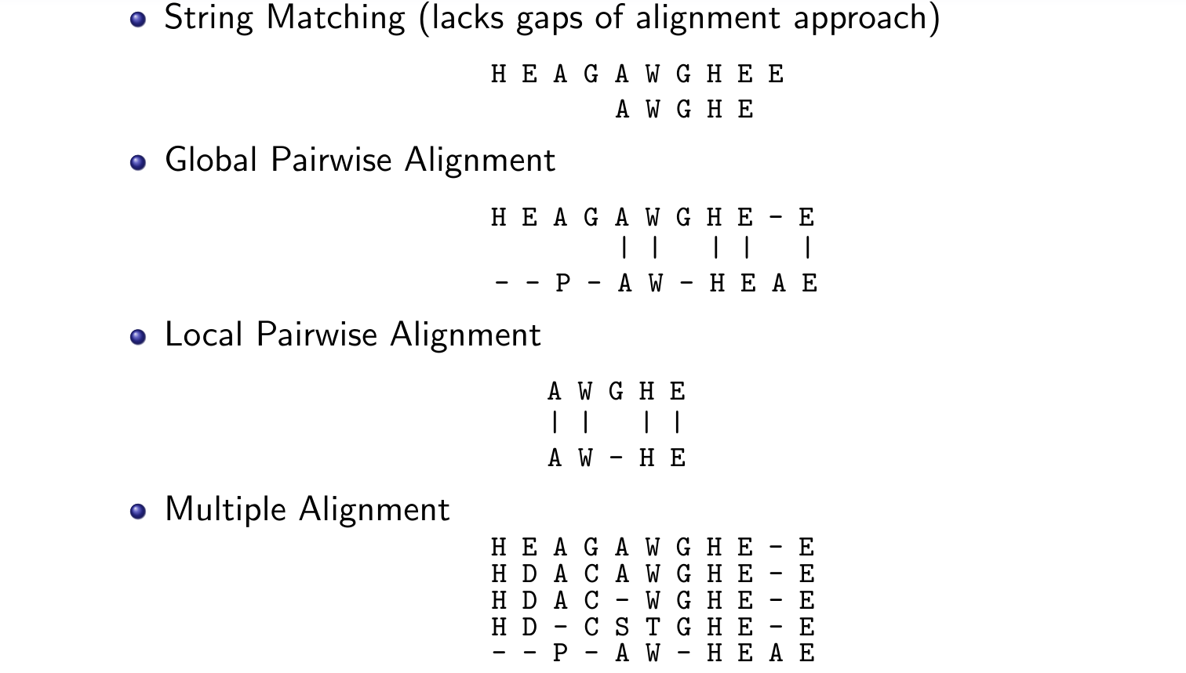
Sequence Alignment Concepts

Slide 12
Outline
Utilities of Sequence Alignments
Pairwise Alignment Algorithms
Pairwise Alignment
Example of Substitution Matrices
Global Alignment
Local Alignment
Other Alignments
Sequence Similarity Searching
Background
SSearch
BLAST
FASTA
Software
Homework
References

Slide 13
Important Steps in Pairwise Alignment Process
Type of alignment
Scoring system
Algorithm to find best scoring alignment
Statistics to evaluate significance of alignment score

Slide 14
Best Sequence Type for Alignments
Divergent Sequences
If available, use protein sequences, because of higher information content, better scoring system, reliability of alignment, functional constraints, etc.
Similar Sequences
Protein or DNA sequence depending on analysis needs.

Slide 15
Outline
Utilities of Sequence Alignments
Pairwise Alignment Algorithms
Pairwise Alignment
Example of Substitution Matrices
Global Alignment
Local Alignment
Other Alignments
Sequence Similarity Searching
Background
SSearch
BLAST
FASTA
Software
Homework
References

Slide 16
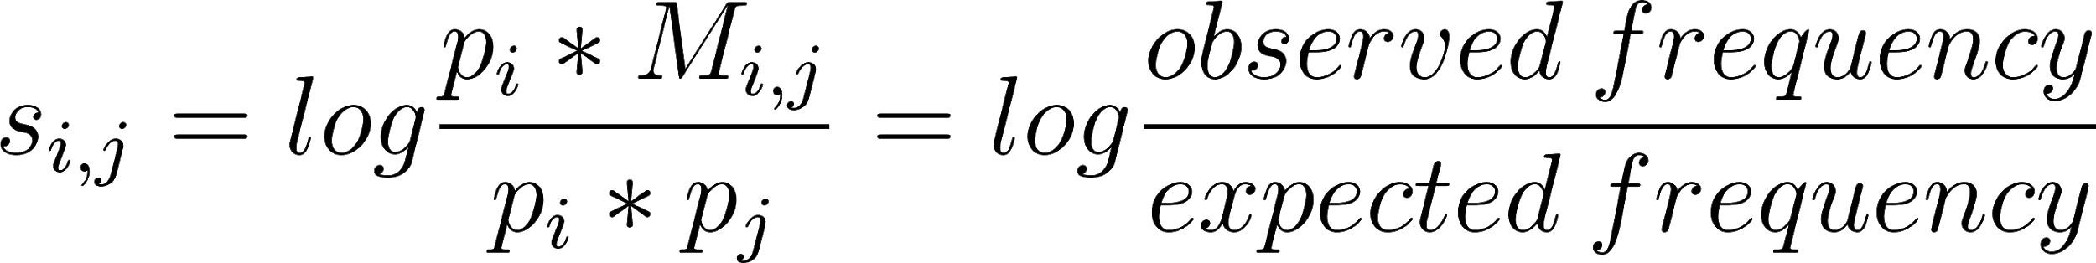
Scoring Parameters for Alignments
Substitution matrix
Empirically determined rates at which one residue in a sequence changes to another residue over time. These substitution rates are typically expressed as:
Log-Odds Scores
M_{i,j} = probability of AA_{i} transforming into AA_{j}; p_{i} =frequency of AA_{i}
Gap Opening Penalty
Penalty score for gap insertion. Often severe value to minimize the number of gaps.
Gap Extension Penalty
Penalty score for gap extension. Often severe value to minimize the length of gaps.

Slide 17
Scoring or Substitution Matrices
BLOSUM (BLOcks of Amino Acid SUbstitution Matrix)
Based on functional model for analyzing divergent protein sequences (Henikoff & Henikoff 1992). The log-odds scores were obtained from the substitution probabilities in conserved and gap-less regions of protein families in the BLOCKS database - one for each of the possible substitutions of the 20 standard amino acids. Matrices with low values (e.g. BLOSUM50) are for divergent sequences, and matrices with high values (e.g. BLOSUM80) for more related sequences.
PAM (Point Accepted Mutation Matrix)
Based on evolutionary model for analyzing protein sequences (Dayhoff et al 1978). The mutations are considered throughout the global alignment in conserved and unconserved regions of many well studied protein families. PAM matrices with higher numbers are for studying evolutionary distant sequences, while PAMs with smaller numbers are for more related sequences (opposite in BLOSUM matrices).
Matrices for DNA and RNA alignments
Often simple scoring matrices are used where matches have a positive match score, mismatches a negative mismatch score, and gaps a negative gap penalty.

Slide 18
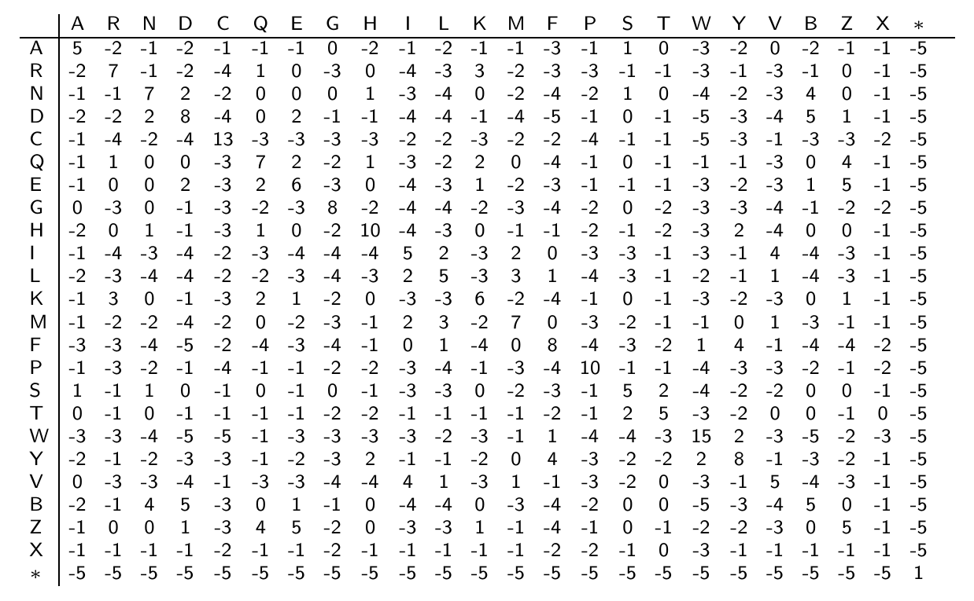
Substitution Matrix
BLOSUM50 (NCBI Matrix Download)
B (Asx): aspartic acid, asparagine; Z (Glx): glutamic acid, glutamine; X (Xaa): ’other’ amino acid

Slide 19
Gap Penalties
To build high-quality alignments, it is important to control the number and the length of the gaps that are introduced during the alignment building process. This is achieved by selecting gap penalties for the alignment scoring process which are usually negative values.
Constant gap penalty
Every gap receives the same penalty independent of its size.
Linear gap penalty
Linear gap penalties have only parameter (d) which is linear to the length of the gap.
Disadvantage: the overall penalty for one large gap is the same as for many small gaps that add up to the same length.
Affine gap open and extension penalties [most commonly used!]
Attempt to overcome the problem of the linear gap penalties by using a gap opening penalty (o) and a gap extension penalty (e). Their values are often set so that gap insertions are discouraged and longer gaps are favored over many short gaps.

Slide 20
Outline
Utilities of Sequence Alignments
Pairwise Alignment Algorithms
Pairwise Alignment
Example of Substitution Matrices
Global Alignment
Local Alignment
Other Alignments
Sequence Similarity Searching
Background
SSearch
BLAST
FASTA
Software
Homework
References

Slide 21
Global Alignment: Needleman-Wunsch Algorithm
Initial algorithm (Needleman and Wunsch 1970)
Improved version (Gotoh 1982)

Slide 22
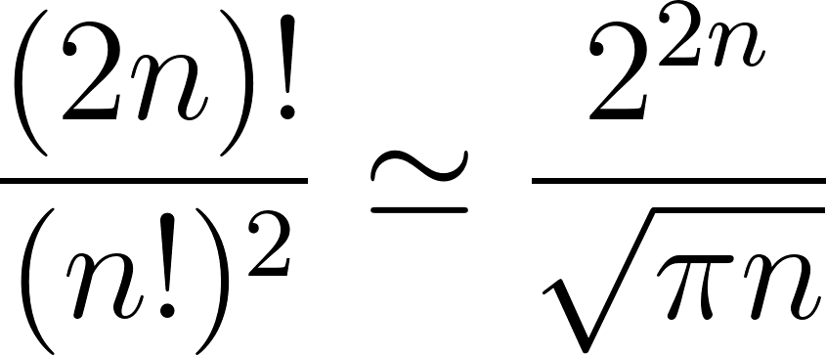
Dynamic Programming Alignment Algorithm
Impossible to calculate all possible alignments
The number of possible alignments:
n = length of both sequences
Solution: dynamic programming algorithm
Algorithm for finding an optimal alignment between two sequences with an additive scoring system.

Slide 23
Main Steps: Dynamic Programming Alignment Algorithm
Recurrence rules: dynamic programming matrix
Boundary conditions: gaps, termination and extensions
Traceback step: optimal alignment

Slide 24
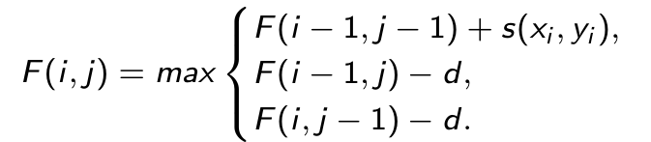
Global Sequence Alignment Algorithm
The dynamic programming approach builds an optimal alignment stepwise by adding solutions of optimal sub-alignments. This is achieved with the following steps:
Construct dynamic programming matrix F(i, j) where the rows i and columns j represent the residues of the two sequences.
Fill the boundary rows and columns with gap penalty d: F(i, 0) = -id and F(0, j) = -jd
Fill the matrix from the top left to bottom right with the largest score of three possible substitution solutions, while first cell F(0, 0) is initialized with 0:
F(i, j) = additive substitution score of each sub-solution; d = gap penalty
Apply operation repeatedly to bottom right corner of each quadrant of four cells (see next slide). In each step store a pointer for each cell back to the cell from which F(i, j) was derived.
Generate alignment by traceback method: starting from final cell move back along the stored pointers and align residues according to movement direction:
Diagonal movement: align corresponding residues
Up or left movement: insert gaps accordingly
Final score of alignment is value in bottom right cell

Slide 25
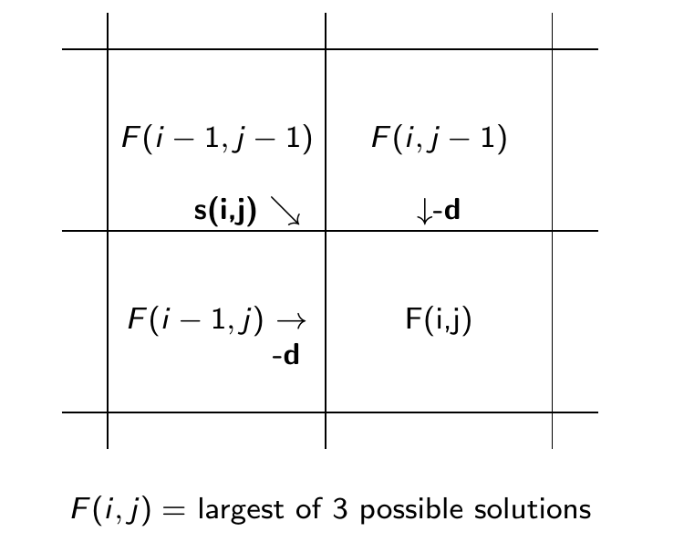
Three Possibilities : Align, Insert or Delete

Slide 26
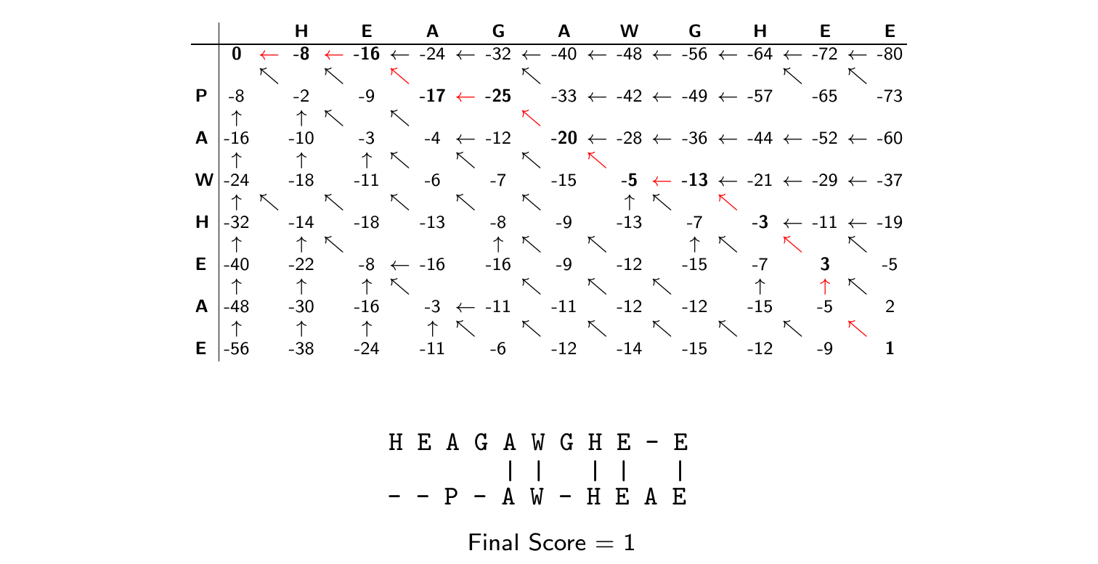
Dynamic Programming Matrix: Global Alignment
Substitution matrix: BLOSUM50
Gap opening and extension penalties: 8

Slide 27
Animation
1: Construct dynamic programming matrix
2: Fill boundary rows with gap penalty
3: Populate each quadrant with max value of three options
3: align residues (lookup value in substitution matrix)
3: gap in horizontal sequence (add gap penalty: -8)
3: gap in vertical sequence (add gap penalty: -8)
3: choose best scoring solution, here -2 → alignment of H-P
4: apply operation of step 3 to each quadrant iteratively
5: create alignment by traceback
6: final score of alignment is value in bottom right cell
 |  | H | E | A | G | A | W | G | H | E | E
 | 0 | -8 | -16 | -24 | -32 | -40 | -48 | -56 | -64 | -72 | -80
P | -8 | -2 | -9 | -17 | -25 | -33 | -42 | -49 | -57 | -65 | -73
A | -16 | -10 | -3 | -4 | -12 | -20 | -28 | -36 | -44 | -52 | -60
W | -24 | -18 | -11 | -6 | -17 | -15 | -5 | -13 | -21 | -29 | -37
H | -32 | -14 | -18 | -13 | -8 | -9 | -13 | -7 | -3 | -11 | -19
E | -40 | -22 | -8 | -16 | -16 | -9 | -12 | -15 | -7 | 3 | -5
A | -48 | -30 | -16 | -3 | -11 | -11 | -12 | -12 | -15 | -5 | 2
E | -56 | -38 | -24 | -11 | -6 | -12 | -14 | -15 | -12 | -9 | 1
H | E | A | G | A | W | G | H | E | E
0 | -8 | -16 | -24 | -32 | -40 | -48 | -56 | -64 | -72 | -80
-2
-16
P
A
W
H
E
A
E
-8
-16
-24
-32
-40
-48
-56
-9
-10
1
E
E
-E
AE
E-E
EAE
HE-E
HEAE
GHE-E
-HEAE
WGHE-E
W-HEAE
AWGHE-E
AW-HEAE
GAWGHE-E
-AW-HEAE
AGAWGHE-E
P-AW-HEAE
EAGAWGHE-E
-P-AW-HEAE
HEAGAWGHE-E
--P-AW-HEAE
Final Score: 1

Slide 28
Complexity of Algorithm
Time and memory cost: O(nm)
nm: product of length of two sequences
O: ”of order nm”

Slide 29
Outline
Utilities of Sequence Alignments
Pairwise Alignment Algorithms
Pairwise Alignment
Example of Substitution Matrices
Global Alignment
Local Alignment
Other Alignments
Sequence Similarity Searching
Background
SSearch
BLAST
FASTA
Software
Homework
References

Slide 30
Local Alignment: Smith-Waterman Algorithm
Often more important than global alignment, because related sequences show frequently only local similarities.
Initial algorithm (Smith and Waterman, 1981)
Improved version (Gotoh 1982)

Slide 31
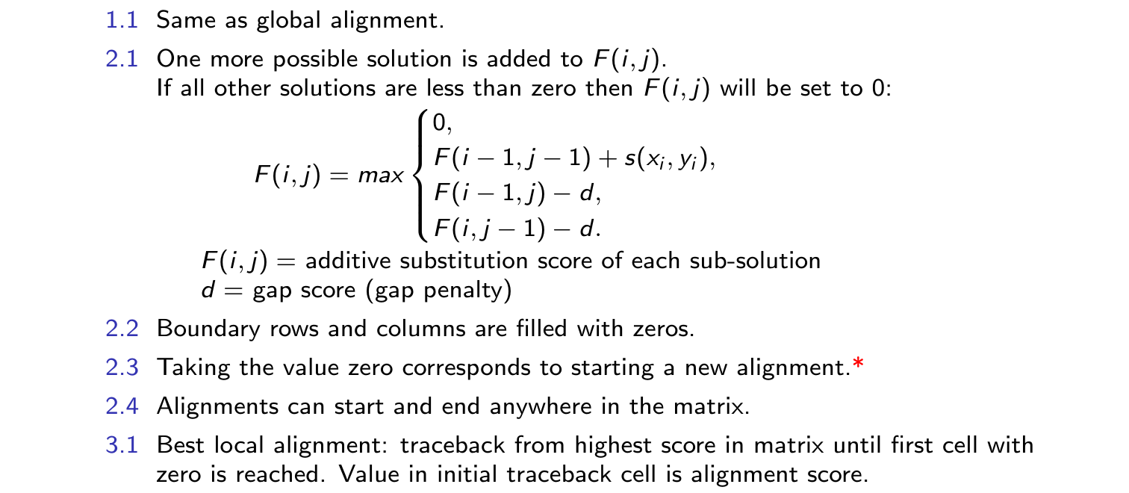
Local Sequence Alignment Algorithm
Algorithm closely related to global alignment approach, with the following modifications:
*Important requirement: random matches must receive negative values by scoring system, otherwise long unrelated matches would mask significant local matches!

Slide 32
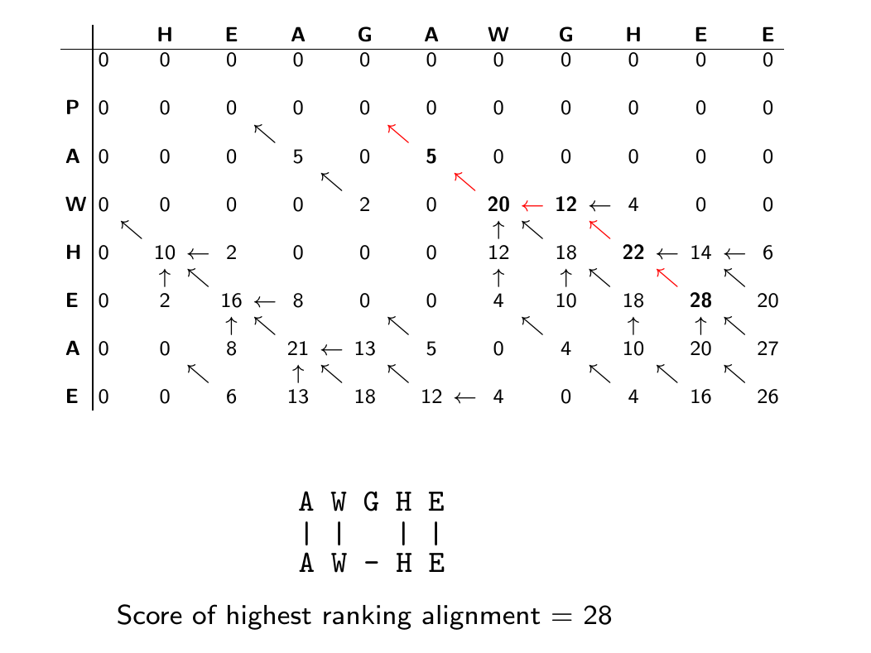
Dynamic Programming Matrix: Local Alignment
Substitution matrix: BLOSUM50
Gap opening and extension penalties: 8

Slide 33
Outline
Utilities of Sequence Alignments
Pairwise Alignment Algorithms
Pairwise Alignment
Example of Substitution Matrices
Global Alignment
Local Alignment
Other Alignments
Sequence Similarity Searching
Background
SSearch
BLAST
FASTA
Software
Homework
References

Slide 34
Additional Algorithms for Pairwise Alignments
Repeat alignment algorithm
Algorithm for obtaining all non-overlapping local alignments with significant scores.
Maximum overlap match algorithm
Global alignment algorithm without penalizing overhanging ends like in sequence assembly problem.
Algorithms tolerating long gaps
Aligning cDNA (no introns) to genomic DNA (introns).
Many more algorithms for specific alignment problems

Slide 35
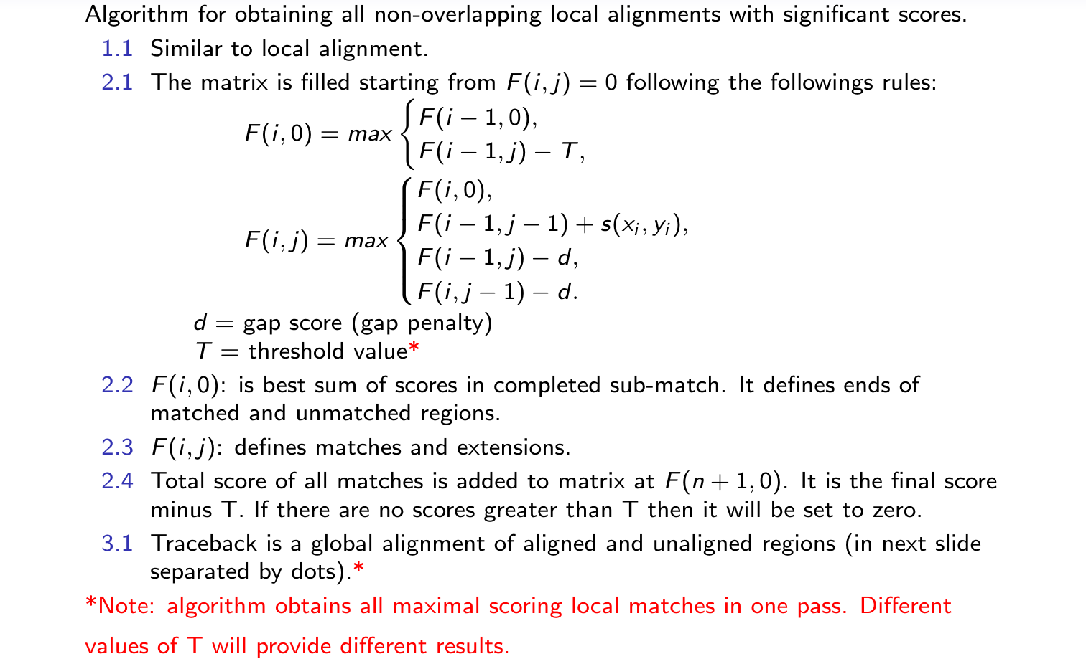
Repeat Alignment Algorithm

Slide 36
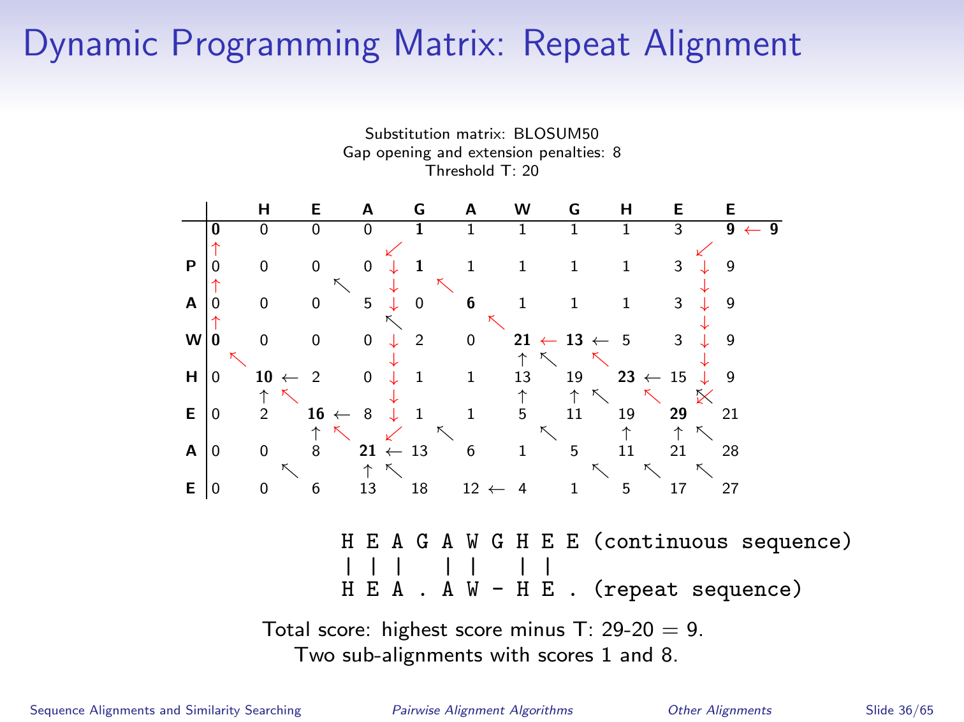
Dynamic Programming Matrix: Repeat Alignment

Slide 37
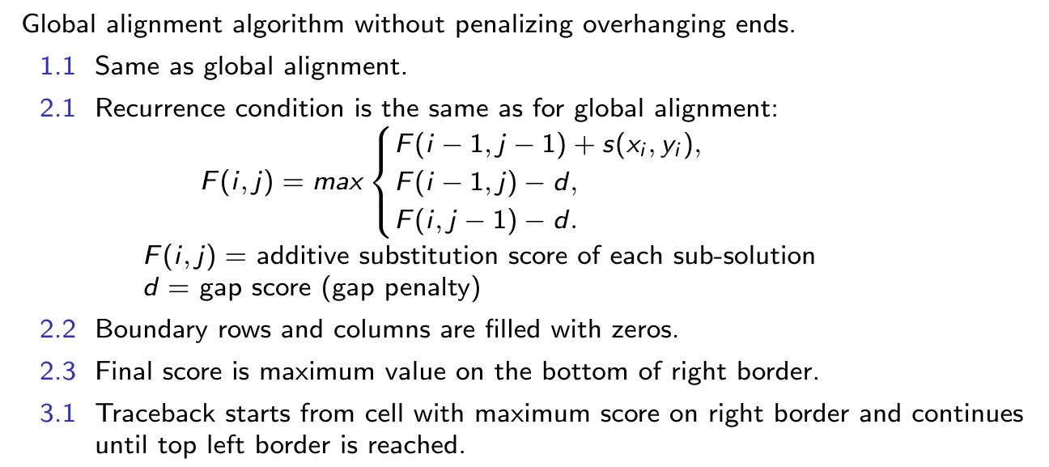
Maximum Overlap Match Algorithm

Slide 38
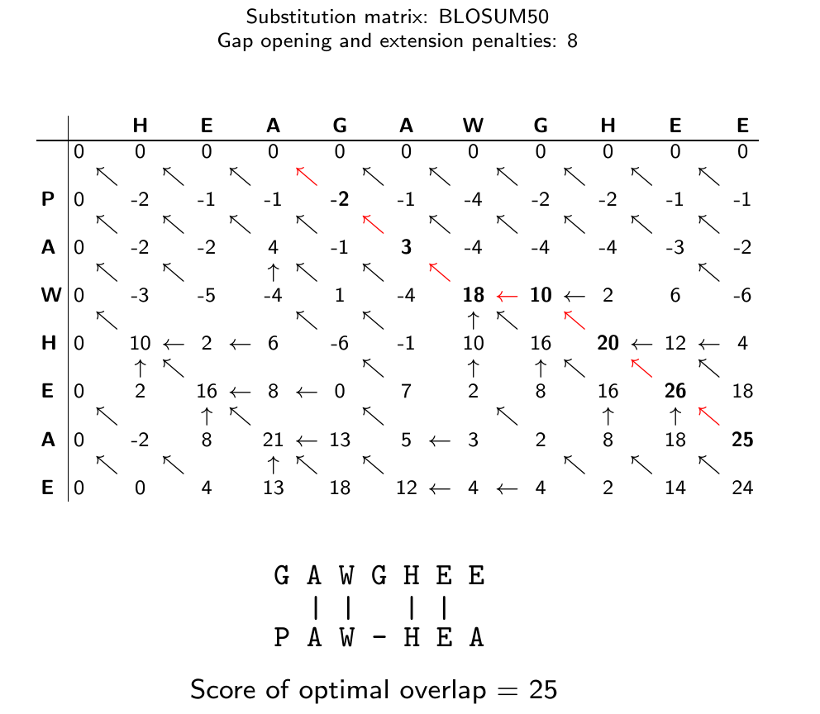
Dynamic Programming Matrix: Overlap Match

Slide 39
Summary
Many variants of dynamic programming algorithms exist. They mainly differ in their:
Boundary conditions
Recurrence rules
They are all necessary to solve the wide variety of alignment problems.
An all-purpose alignment algorithm does not exist.

Slide 40
Outline
Utilities of Sequence Alignments
Pairwise Alignment Algorithms
Pairwise Alignment
Example of Substitution Matrices
Global Alignment
Local Alignment
Other Alignments
Sequence Similarity Searching
Background
SSearch
BLAST
FASTA
Software
Homework
References

Slide 41
Why Sequence Similarity Searching?
Essential tool for retrieving related sequences from databases by providing protein or DNA sequences as queries.
Applications
Similarity-function principle to predict gene functions
If the function of a query sequence is unknown, and a sequence similarity search retrieves highly similar sequences of known function, then it is likely that the query sequence has a similar function.
Principle of relatedness for evolutionary analyses
Sequence similarities can be used to reconstruct their phylogenetic relationships.
For example: identification of sequences with a common ancestors, such as orthologs and paralogs
Discovery of new genes or proteins.
Exploring gene and protein structures.
...

Slide 42
Outline
Utilities of Sequence Alignments
Pairwise Alignment Algorithms
Pairwise Alignment
Example of Substitution Matrices
Global Alignment
Local Alignment
Other Alignments
Sequence Similarity Searching
Background
SSearch
BLAST
FASTA
Software
Homework
References

Slide 43
SSearch for Searching Sequence Databases
http://fasta.bioch.virginia.edu/fasta/fasta_list.html
SSearch performs a rigorous Smith-Waterman sequence similarity search of a query sequence against a sequence database.
It is the iterative version of Smith-Waterman algorithm for pairwise alignments by performing the following computations:
Align and score a query sequence against all members in a database using Smith-Waterman algorithm.
Rank search results by score.
It is one of the most sensitive methods available for sequence similarity searching.
It is much slower than the BLAST and FASTA search methods.
Hardware solution: Smith-Waterman searches on FPGAs (field-programmable gate arrays), 1000-2000 acceleration compared to CPUs.

Slide 44
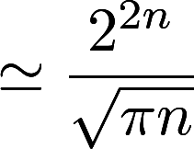
Speed Acceleration by Heuristic Approaches
Optimal (exhaustive) approaches
Can guarantee optimal solution to a problem.
Often impossible to compute because of extreme computation time. For example, impossibility of computing all possible pairwise alignments between two sequences, due to following relationship:
Number of possible alignments
n = length of both sequences
Heuristic (approximate) approaches
Overcome computation time limitations by providing approximate rather than complete solutions.
Optimal solution is not guaranteed.
Approximate solutions are often of acceptable accuracy.

Slide 45
Outline
Utilities of Sequence Alignments
Pairwise Alignment Algorithms
Pairwise Alignment
Example of Substitution Matrices
Global Alignment
Local Alignment
Other Alignments
Sequence Similarity Searching
Background
SSearch
BLAST
FASTA
Software
Homework
References

Slide 46
BLAST: Basic Local Alignment Search Tool
Developed by Altschul et al. (1990)
Most widely used similarity search tool
Heuristic approach based on Smith-Waterman algorithm
Finds best local alignments
Provides statistical significance
Online, command-line, and network clients

Slide 47
How BLAST Works?
Generate lookup hash table of query words
Scan database for hits
Ungapped extensions of hits
Gapped extensions of hits with traceback
Rank hits by scoring system

Slide 48
Step 1: Generate Lookup Table for Query
Create lookup word table of query sequence by a moving window of size w.
Example of lookup word table of query sequence with w = 3:
Query: GTQITVEDLFY
GTQ
TQI
QIT
ITV
TVE
VED
EDL
DLF
LFY
Word size w for proteins (BLASTP): 2 or 3 (3 is default).
Word size w for BLASTN: min 7 (11 is default).

Slide 49
Step 2: Scan Database for Hits
Match query lookup table against similar lookup table in database:
Query: ITV MSV
Database: LTV, ITV, MTV, LSV, MSV, IAV, ...

Slide 50
Step 3: Ungapped Extensions of Hits
Once a hit of a query word is found in the database, extend the hit in the sequences in either direction:
Query:........ GTQITVEDLFY
|||
Database: WHKLCGTQITVEDLAQFY
⇐⇒
Query:........ GTQITVEDLFY
|||||||||
Database: WHKLCGTQITVEDLAQFY

Slide 51
Step 4: Gapped Extensions of Hits
Further extend alignment by gapped alignment with traceback method (dynamic programming):
Query: GTQITVEDL--FY
||||||||| ||
Database: WHKLCGTQITVEDLAQFY
Keep track of the score by using substitution matrix (e.g. BLOSUM50).
Stop when the score drops below some cutoff.

Slide 52
Step 5: Rank Hits by Scoring System
BLAST search results in local alignments: HSPs (High Similarity Pairs).
Their scores follow an extreme value distribution (EVD).
E values are the most relevant scores of a BLAST search result. They are derived from the analysis of the distribution of alignment scores.
Equation for calculating E values for an HSP:
E = Kmne^{−λS}
E = number of hits expected from search with scores greater than S
K = scale for search space (constant)
m = size of query sequence
n = size of database
S = score
λ = scale for the specific scoring matrix
Searches against larger databases give less significant E values than against smaller databases because of n dependency in above formula!

Slide 53
Meaning of E Value in BLAST Searches
The E value (expectation value) expresses the number of different alignments with scores equivalent to or better than S that are expected to occur in a database search by chance.
The lower the E value, the more significant the score (alignment).
Low E values are similar to P values:
E value | P value (1 − e^{−E value})
10 | 0.99995460
5 | 0.99326205
1 | 0.63212056
0.1 | 0.09516258
0.001 | 0.00099950
0.0001 | 0.0001000

Slide 54
Some More Details
Nucleotide BLAST looks for exact matches
CGTAGCTACGTAGCTACTACTACGTAC
TACGTAGCTAC
Protein BLAST requires two neighborhood matches
GTQITVEDLFYNI
QIT FYN
SEQ and DUST programs are used to mask low complexity regions in query sequences

Slide 55
Word Size Limitation of BLAST
Alignments that BLAST cannot find because of word size limitation of 7 nucleotides for DNA sequences:
Query: ATCTACTACTACTTAGATCGAGCGTACGTGTTGACACACTATCTAC
|||||| |||||| |||||| |||||| |||||| |||||| ||||
Subject: ATCTACCACTACTGAGATCGTGCGTACATGTTGAAACACTAGCTAC

Slide 56
Untranslated and Translated BLAST Tools
Untranslated BLAST Tools
BLASTN: query DNA vs DNA database
BLASTP: query protein vs protein database
Translated BLAST Tools
BLASTX: translated query DNA vs protein database
TBLASTN: query protein vs translated DNA database
TBLASTX: translated query DNA vs translated DNA database

Slide 57
BLAST Flavors
Different BLAST Programs: http://www.ncbi.nlm.nih.gov/BLAST
blastall: command-line collection of BLAST tools
BLAST: BLASTN, BLASTP, BLASTX, TBLASTN, TBLASTX
Psi-BLAST: Position-Specific Iterated BLAST
RPS-BLAST: Reverse Position-Specific BLAST
Phi-BLAST: Pattern Hit Initiated BLAST
Mega-BLAST: 10 faster than BLASTN
BLAST2: pairwise comparisons
WU-BLAST: Washington University BLAST

Slide 58
Outline
Utilities of Sequence Alignments
Pairwise Alignment Algorithms
Pairwise Alignment
Example of Substitution Matrices
Global Alignment
Local Alignment
Other Alignments
Sequence Similarity Searching
Background
SSearch
BLAST
FASTA
Software
Homework
References

Slide 59
FASTA Database Search Algorithm
http://fasta.bioch.virginia.edu/fasta/fasta_list.html
Heuristic sequence similarity search approach developed by
Pearson and Lipman, 1988.
Identifies in first step all identical words of given length between query and database sequences.
Identifies diagonals for best word matches.
Extends word matches to identify best scoring ungapped matches.
Tries to join ungapped matches by insertion of gaps.
Highest scoring candidates are aligned with full dynamic programming algorithm

Slide 60
Outline
Utilities of Sequence Alignments
Pairwise Alignment Algorithms
Pairwise Alignment
Example of Substitution Matrices
Global Alignment
Local Alignment
Other Alignments
Sequence Similarity Searching
Background
SSearch
BLAST
FASTA
Software
Homework
References

Slide 61
Selected Software
Pairwise Alignment Programs
Smith-Waterman local alignment: WATER (EMBOSS)
BLAST-like local alignments: BLAST2
Global alignments: NEEDLE (EMBOSS)
...
Sequence Similarity Search Programs
BLAST and its variants: online and download
SSearch
FASTA
Short read alignment tools (various websites)
...

Slide 62
Outline
Utilities of Sequence Alignments
Pairwise Alignment Algorithms
Pairwise Alignment
Example of Substitution Matrices
Global Alignment
Local Alignment
Other Alignments
Sequence Similarity Searching
Background
SSearch
BLAST
FASTA
Software
Homework
References

Slide 63
Homework
See HW4 here

Slide 64
Outline
Utilities of Sequence Alignments
Pairwise Alignment Algorithms
Pairwise Alignment
Example of Substitution Matrices
Global Alignment
Local Alignment
Other Alignments
Sequence Similarity Searching
Background
SSearch
BLAST
FASTA
Software
Homework
References

Slide 65
References
Altschul, S F, Gish, W, Miller, W, Myers, E W, Lipman, D J (1990) Basic local alignment search tool. J Mol Biol, 215: 403-410. URL http://www.hubmed.org/display.cgi?uids=2231712
Dayhoff, MO, Schwartz, RM, Orcutt, BC (1978) A model of evolutionary change in proteins. Atlas of Protein Sequence and Structure: Vol 5, 345-352.
Durbin, R, Eddy, S, Krogh, A, Mitchison, G. (1998) Probabilistic Models of Proteins and Nucleic Acids. Cambridge University Press, UK, 356 pages.
Gotoh O (1982) An improved algorithm for matching biological sequences. J Mol Biol 162, 705-708. URL http://www.hubmed.org/display.cgi?uids=7166760
Henikoff, S, Henikoff, JG (1992) Amino Acid Substitution Matrices from Protein Blocks. PNAS 89: 10915-10919. URL http://www.hubmed.org/display.cgi?uids=1438297

Slide 66
References
Needleman SB, Wunsch CD (1970) A general method applicable to the search for similarities in the amino acid sequence of two proteins. J Mol Biol 48, 443-453. URL http://www.hubmed.org/display.cgi?uids=5420325
Smith TF, Waterman MS (1981) Identification of common molecular subsequences. J Mol Biol 147, 195-197. URL http://www.hubmed.org/display.cgi?uids=7265238

