Slide 1
Multiple Sequence Alignments
Data Analysis in Genome Biology
GEN242
Thomas Girke
April 24, 2018

Slide 2
Outline
Multiple Sequence Alignments
Introduction
Utilities
Algorithms
Alignment Programs
Challenges
References

Slide 3
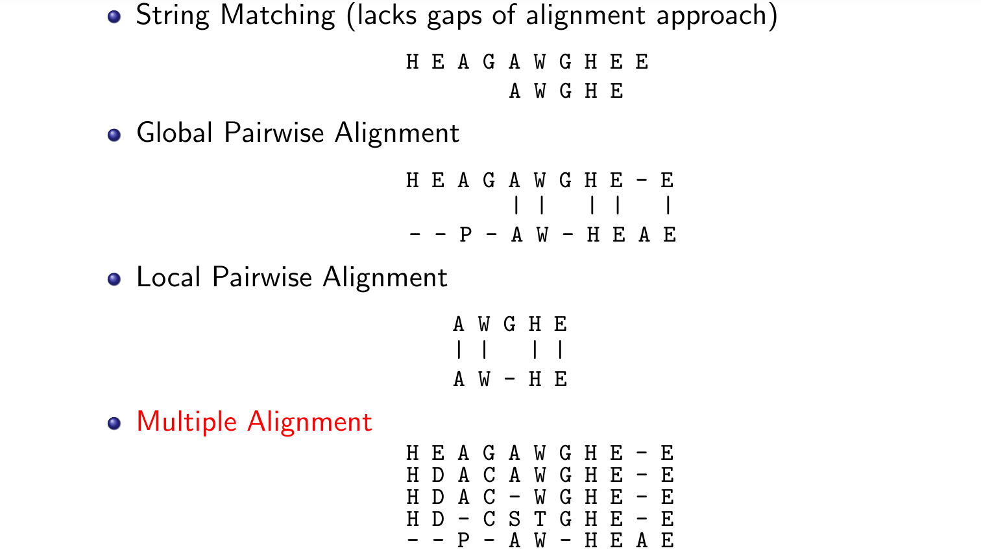
Basic Alignment Concepts

Slide 4
What Are Multiple Sequence Alignments
Problem
Simultaneous alignment of more than two sequences.
Representation
Matrix representation of similarities between sequences.
Gaps are inserted to maximize the alignment of similar residues in the same columns.
High quality alignments arrange the sequences in columns with as many conserved residues as possible, while minimizing columns with unrelated residues and gaps.

Slide 5
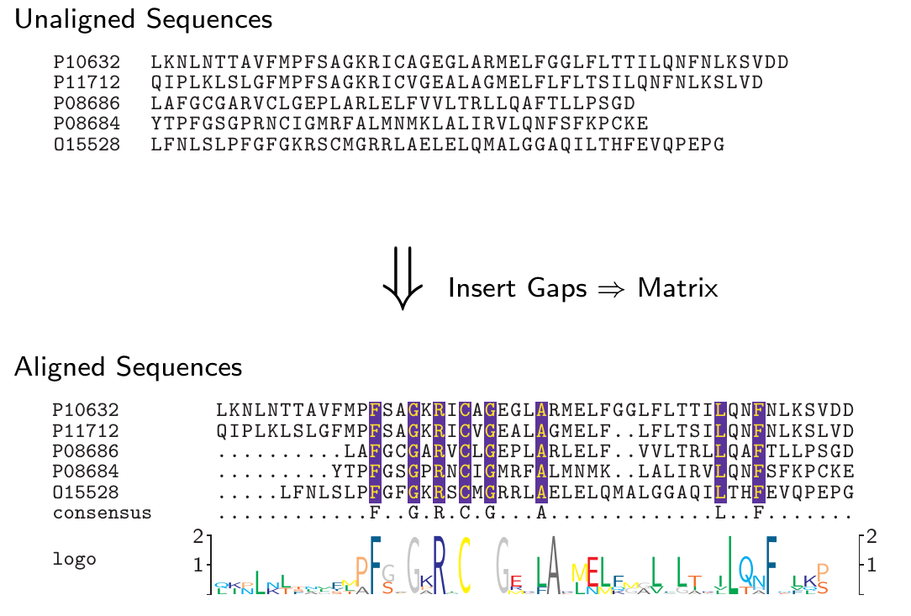
Example: From Unaligned to Aligned Sequences

Slide 6
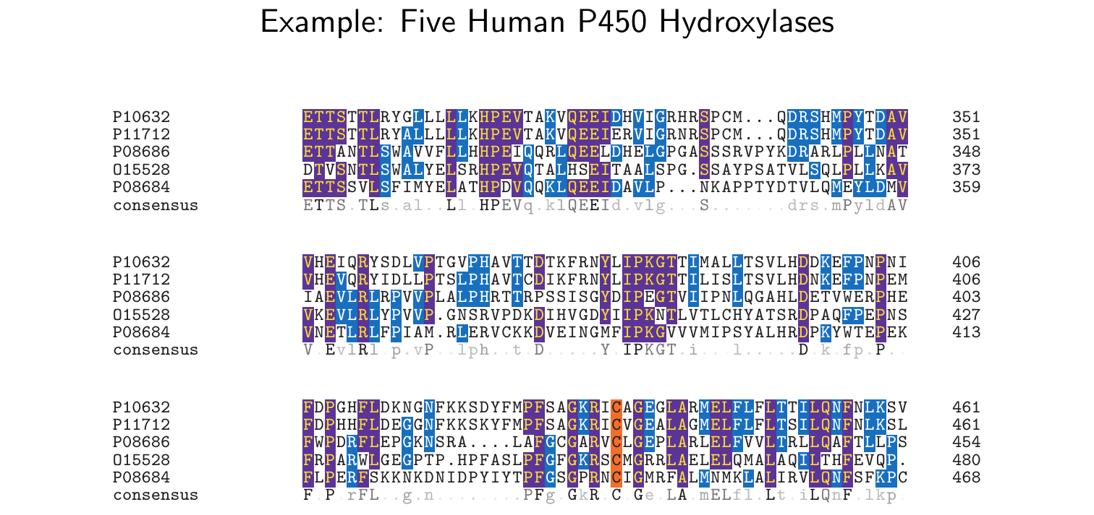
Multiple Sequence Alignments

Slide 7
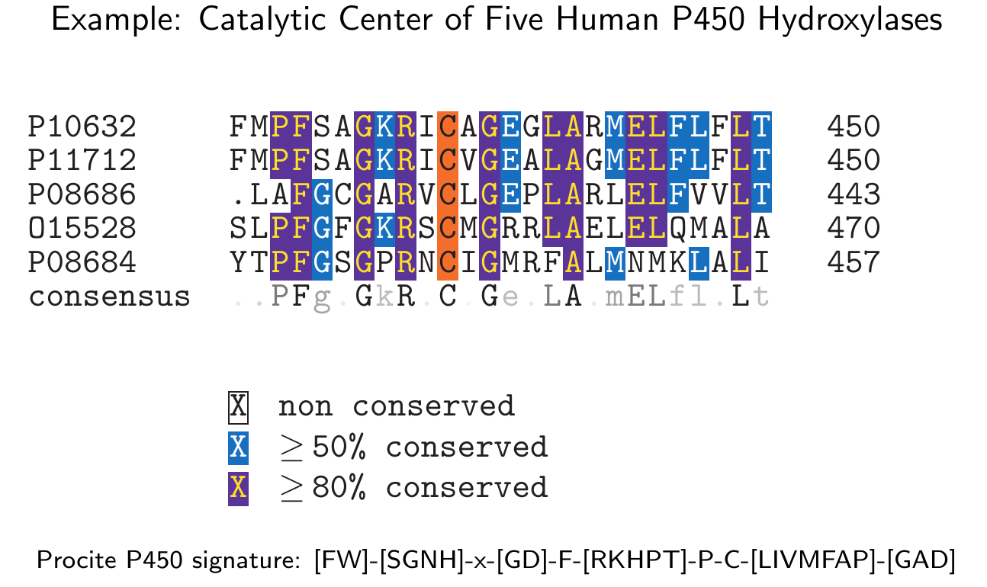
Multiple Sequence Alignments

Slide 8
Outline
Multiple Sequence Alignments
Introduction
Utilities
Algorithms
Alignment Programs
Challenges
References

Slide 9
Why Multiple Sequence Alignments
Conserved residues can only be identified in context of many sequences
Identification of functional residues, motifs and domains
Often final proof that sequences belong into one family
Analysis of evolutionary relationships
Phylogenetic analyses
Threading and homology modeling
Functional mapping of mutations
Many more utilities

Slide 10
Typical Sequence Analysis Routine
Sequence candidate
⇓
Sequence & Domain Database Searches
⇓
Multiple Sequence Alignments
⇓
Phylogenetic Tree
⇓
Homology Modeling

Slide 11
Outline
Multiple Sequence Alignments
Introduction
Utilities
Algorithms
Alignment Programs
Challenges
References

Slide 12
Multiple Sequence Alignment Algorithms
Here: ab initio multiple alignment computation
Later: HMM model-based multiple alignments

Slide 13
Important Steps in Multiple Alignment Process
Sequence selection
Scoring system
Alignment algorithm
Refinement: remove, add and re-align

Slide 14
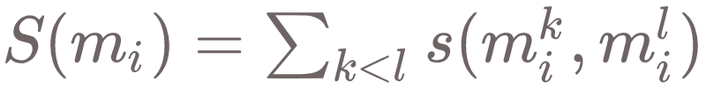
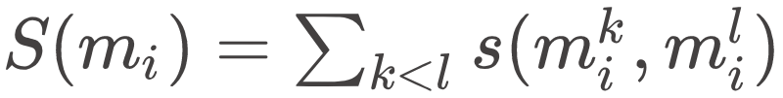
Scoring Multiple Alignments
Example: Sum of Pairs (SP) Method
Each column in an alignment is scored by summing the substitution scores s (e.g. BLOSOM) of all pairs in each column. The score of the entire alignment is then summed over all columns.
Example for single column i in multiple sequence alignment m where l is the number of sequences:

Slide 15
Multiple Sequence Alignment Algorithms
Multidimensional dynamic programming
Modification: MSA
Profile approaches

Slide 16
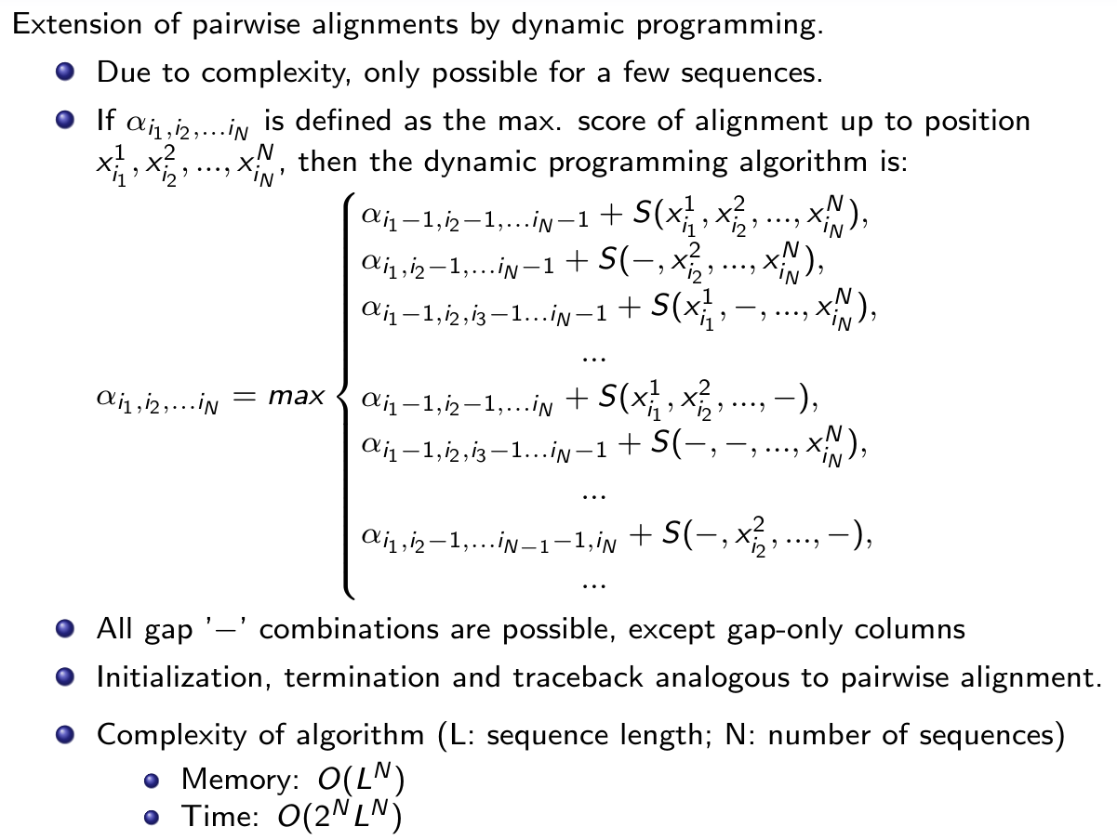
Multidimensional Dynamic Programming

Slide 17
MSA
Method for reducing multidimensional dynamic programming matrix developed by Carrillo & Lipman 1988.
Achieved by identifying upper and lower score bounds to reduce matrix volume.
Implemented in multiple sequence alignment program MSA by Lipman et al 1989.
Download: MSA from NCBI.
Can generate multiple alignment for 7-8 sequences with 200-300 residues.
Uses SP scoring system for residues and gaps.
Does not guarantee optimal multiple alignment.

Slide 18
Progressive Multiple Alignment Methods
Heuristic approach proposed by Feng & Doolittle (1987).
Most commonly used approach in modern alignment programs.
Iteratively merges most similar sequences into alignments.
Once a gap always a gap.
Time complexity in the order of computing all-against-all pairwise alignments: O(N²L²).
Multiple alignments are constructed by succession of all pairwise alignments.

Slide 19
Feng-Doolittle Progressive Multiple Alignment
Compute all pairwise alignments.
Use scores to calculate pairwise distance matrix.
Construct guide tree based on distances using fast clustering algorithm.
Align sequences in order defined by tree moving from leaves to root.
Alignments are constructed by pairwise dynamic programming algorithm.
When sequences or alignments are aligned to existing alignments the highest scoring pairwise alignment defines the global alignment. Existing gaps will never be removed: ’once a gap always a gap’.

Slide 20
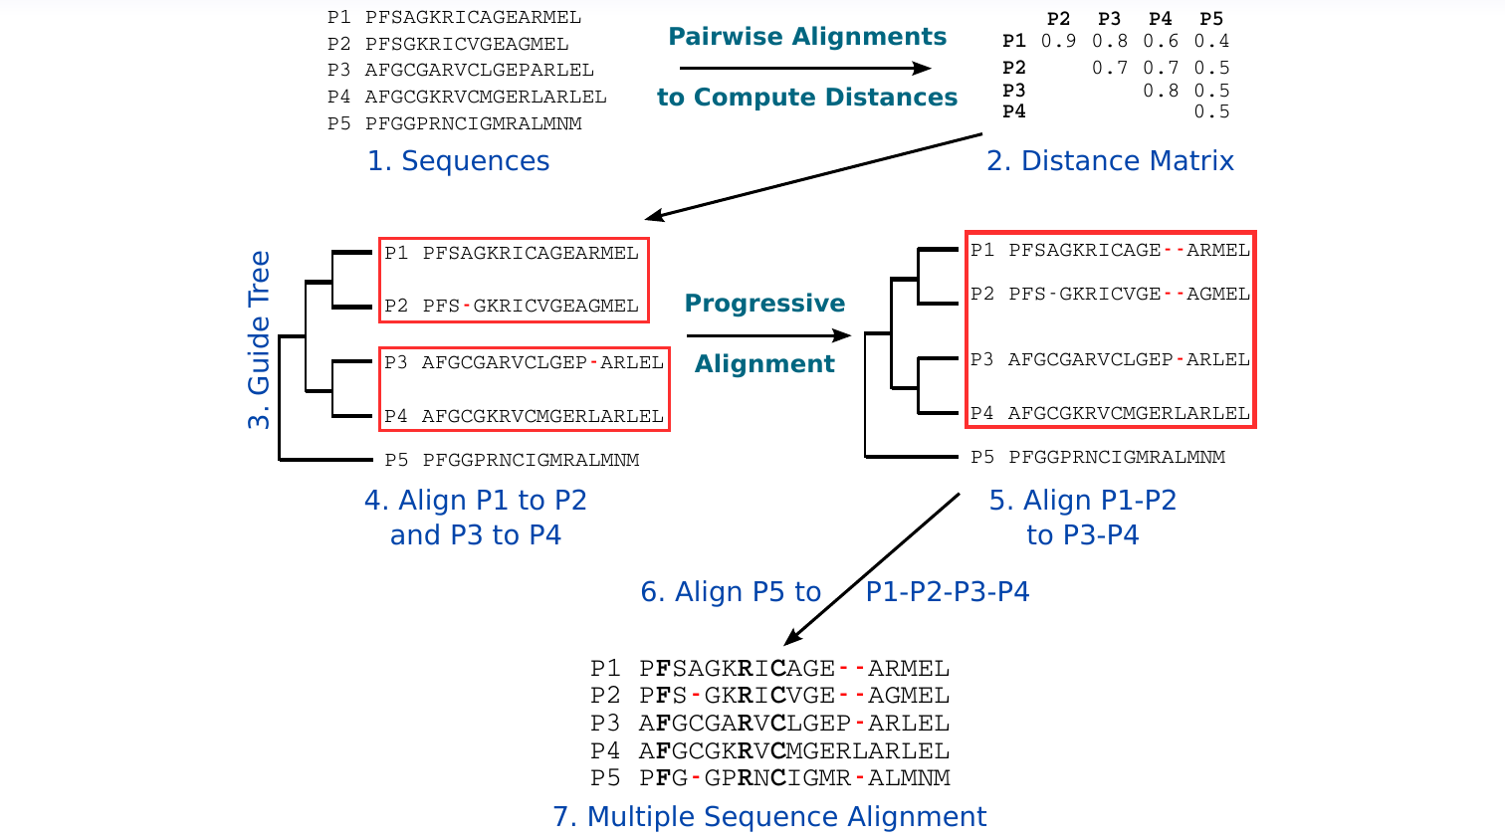
Illustration of Progressive MSA Algorithm

Slide 21
Profile Alignments
Feng-Doolittle approach ignores conservation of residues (position specific information).
Profile alignment methods: incorporate position-specific information in alignment construction process.
When new sequences or alignments are added to existing alignment then the profile information will be used.
There are many variations of this approach that mainly vary in their handling of gaps, profile-sequence and profile-profile scoring.

Slide 22
Outline
Multiple Sequence Alignments
Introduction
Utilities
Algorithms
Alignment Programs
Challenges
References

Slide 23
CLUSTALW
Widely used multiple alignment program developed by Thompson et al, 1994
Algorithm is combination of Feng-Doolittle and profile approaches:
Calculate all-against-all distance matrix by pairwise dynamic programming algorithm.
Construct guide tree.
Progressively align at tree nodes in order of decreasing similarity, using sequence-sequence, sequence-profile and profile-profile alignments.
Many detailed refinements in algorithm resulted in very robust approach. These include modifications to the scoring system, weighting of sequence compositions, gap handling and profile improvements.

Slide 24
Additional Examples
Multalin: uses iterative hierarchical clustering for guide tree formation (Corpet 1988).
T-Coffee: reevaluates sequence alignments in each iteration of progressive alignment approach (Notredame et al, 2000).
Dialign: no gap penalty to identify sequence similarities with long gaps (Morgenstern et al, 1998).

Slide 25
Multiple Sequence Alignment Programs
Multiple Alignment Programs
Hierarchical clustering: MultAlin
For diverse sequences: MSA from NCBI
For diverse sequences: T-Coffee
For diverse sequences: MUSCLE
For diverse sequences: HMMER (hmmalign)
For local similarities (long gaps): DIALIGN

Slide 26
Outline
Multiple Sequence Alignments
Introduction
Utilities
Algorithms
Alignment Programs
Challenges
References

Slide 27
Challenges
Only very similar sequences can be aligned unambiguously.
Very difficult to create unambiguous multiple alignments for diverse sequences.
Typically only the conserved regions are ’alignable’, while the quality of unconserved regions remains questionable.
Often impossible to compute reliable multiple alignments for extremely diverse sequences (≤25% identity) or sequences with many repetitive domains.
Solution for very diverse sequences: all-against-all pairwise alignments - no multiple alignment!

Slide 28
Comparisons of Diverse Sequences
Multiple Alignments
Challenging with multiple domain proteins or sequence identities below 25%
Pairwise all-against-all comparisons
Build phylogenetic tree from pairwise scores
Descriptor-based approach
Use numeric property values as similarity measure: AA composition, physical properties, etc.

Slide 29
Summary
Pure dynamic programming for multiple alignments not practical.
Many algorithms available to solve the wide variety of alignment problems.

Slide 30
Outline
Multiple Sequence Alignments
Introduction
Utilities
Algorithms
Alignment Programs
Challenges
References

Slide 31
References
Corpet F (1988) Multiple sequence alignment with hierarchical clustering. Nucleic Acids Res 16, 10881-90. URL http://www.hubmed.org/display.cgi?uids=2849754
Dayhoff, MO, Schwartz, RM, Orcutt, BC (1978) A model of evolutionary change in proteins. Atlas of Protein Sequence and Structure: Vol 5, 345-352.
Gotoh O (1982) An improved algorithm for matching biological sequences. J Mol Biol 162, 705-708. URL http://www.hubmed.org/display.cgi?uids=7166760
Henikoff, S, Henikoff, JG (1992) Amino Acid Substitution Matrices from Protein Blocks. PNAS 89: 10915-10919. URL http://www.hubmed.org/display.cgi?uids=1438297
Koonin, E and Galperin, M (2003) Sequence - Evolution - Function. NCBI Bookshelf, Kluwer Academic. URL http://www.ncbi.nlm.nih.gov/books/NBK20260/.

Slide 32
References
Morgenstern B, Frech K, Dress A, Werner T. (1998) DIALIGN: finding local similarities by multiple sequence alignment. Bioinformatics 14, 290-4. URL http://www.hubmed.org/display.cgi?uids=9614273
Notredame, Higgins, Heringa (2000) T-Coffee: A novel method for multiple sequence alignments. Journal of Molecular Biology 302, 205-217 URL http://www.hubmed.org/display.cgi?uids=2231712
Thompson JD, Higgins DG, Gibson TJ (1994) CLUSTAL W: improving the sensitivity of progressive multiple sequence alignment through sequence weighting, position-specific gap penalties and weight matrix choice. Nucleic Acids Res 22, 4673-80. URL http://www.hubmed.org/display.cgi?uids=7984417

