Slide 1
Short Read Alignments
Data Analysis in Genome Biology
GEN242
Thomas Girke
April 24, 2018

Slide 2
Outline
Overview: Short Read Alignment Needs
Selected Algorithms
Indexing with Hash Tables
FM-Index (Burrows Wheeler Transform)
Applications
Variant Tolerance: VAR-Seq
Splice Junction Awareness: RNA-Seq
Pseudo-alignments for RNA-Seq
References

Slide 3
Requirements for Short Read Aligners
In NGS analysis we usually want to find the true origin of reads (NG sequences) in a reference genome or transcriptome. Thus, we are mostly interested in finding the best scoring or multiple best scoring locations for each read, but not lower scoring alternative solutions as in search applications for finding related sequences.
If possible ambiguous/multiple mappings should be removed, because there is no evidence of their true origin. However, for certain applications one may need to include them, e.g. when mapping RNA-Seq reads against transcript sequences instead of genome or in miRNA-Seq experiments.

Slide 4
Mapping Modes
Alignment with Near Perfect Matching
ChIP-Seq
RNA-Seq (if mapping against transcriptome or intron-less genome)
Bis-Seq (with injected reference)
...
Variant Tolerant Alignments
VAR-Seq
Bis-Seq (without injected reference)
...
Splice Junction Aware Alignments
RNA-Seq

Slide 5
Performance Requirements
Aligning tens of millions of sequences requires:
Ultra fast search algorithms (100-1000x faster than BLAST)
Small memory footprint
Efficient data structures and file formats
Alignment requirements
The requirements for short-read mapping applications are very different from traditional sequence database search approaches for ortholog identification.
Many short-read alignment algorithms will not work with longer sequences!
Most of them are more sensitive in aligning short-reads with mismatches than BLAST, because they lack its word size limitation
Only best hits with almost perfect alignments are required. Lower scoring alternative hits (more mismatches) are less interesting.
Often only perfect matching required, but with the possibility to allow some mismatches and short gaps.

Slide 6
Common Features of Many NGS Aligners
Usage of auxiliary data structures, called indices, for read sequences or the reference sequence, or both.
Based on the indexing strategy, they can be grouped into three major categories:
Algorithms based on hash tables
Algorithms based on suffix trees
Algorithms based on merge sorting

Slide 7
Seeding and Filtering Strategies
Like BLAST, most NGS alignment algorithms are based on the seed-and-extend paradigm
BLAST seeds alignments with consecutive matches (e.g. 1111111), while many short read aligners seed with non-consecutive matches (e.g. 1100110011). The latter has been shown to be more sensitive.
A seed allowing internal mismatches is called spaced seed; the number of matches in the seed is its weight.
Problem with both consecutive seed and spaced seed algorithms is that they do not allow gaps within the seed sequence.
The q-gram overcomes this limitation by requiring several seed matches within each read sequence. It is based on the assumption that sequences with a small number of mismatches and gaps must share a minimum number of substrings of a given length.

Slide 8
Extension Stage
After seeding the extension of the alignment can be divided into a two-step process:
Extension without gaps: apply this relatively fast step to all reads
Extension with gaps: perform this more time consuming step only on remaining reads
Gapped alignments are generated with accelerated versions of Smith-Waterman algorithm. Acceleration is achieved by taking advantage of seed alignments to reduce complexity of dynamic programming matrix (banded versions), and/or parallelization via CPU SIMD instructions.

Slide 9
Examples of Short-Read Alignment Tools of Over 50
Indexing Reads with Hash Tables
ZOOM: uses spaced seeds algorithm (Lin et al 2008)
RMAP: simpler spaced seeds algorithm (Smith et al 2008)
SHRiMP: employs a combination of spaced seeds and the Smith-Waterman
MAQ (Li et al 2008b)
Eland (commercial)
Indexing Reference with Hash Tables
SOAPv1 (Li et al 2008)
Indexing Reference with Suffix Array, FM-Index, Burrows-Wheeler Transform
Bowtie (Langmead et al 2009)
BWA (Li et al 2009)
SOAPv2
Merge Sorting
Slider (Malhis et al 2009)
For a more complete list see here.

Slide 10
Sequence Alignment/Map (SAM/BAM) Format
SAM is a tab-delimited alignment format consisting of a header section (lines starting with @) and an alignment section with 12 columns. BAM is the compressed, indexed and binary version of this format.
The below sample alignment contains the following features: (1) bases in lower cases are clipped from the alignment; (2) read r001/1 and r001/2 constitute a read pair; (3) r003 is a chimeric read; (4) r004 represents a split alignment.
Coor 12345678901234 5678901234567890123456789012345
ref AGCATGTTAGATAA**GATAGCTGTGCTAGTAGGCAGTCAGCGCCAT
+r001/1 TTAGATAAAGGATA*CTG
+r002 aaaAGATAA*GGATA
+r003 gcctaAGCTAA
+r004 ATAGCT..............TCAGC
-r003 ttagctTAGGC
-r001/2 CAGCGGCAT
SAM Format
r001 163 ref 7 30 8M2I4M1D3M = 37 39 TTAGATAAAGGATACTG *
r002 0 ref 9 30 3S6M1P1I4M * 0 0 AAAAGATAAGGATA *
r003 0 ref 9 30 5S6M * 0 0 GCCTAAGCTAA * SA:Z:ref,29,-,6H5M,17,0;
r004 0 ref 16 30 6M14N5M * 0 0 ATAGCTTCAGC *
r003 2064 ref 29 17 6H5M * 0 0 TAGGC * SA:Z:ref,9,+,5S6M,30,1;
r001 83 ref 37 30 9M = 7 -39 CAGCGGCAT * NM:i:1
For details see the SAM Format Specification here.

Slide 11
Outline
Overview: Short Read Alignment Needs
Selected Algorithms
Indexing with Hash Tables
FM-Index (Burrows Wheeler Transform)
Applications
Variant Tolerance: VAR-Seq
Splice Junction Awareness: RNA-Seq
Pseudo-alignments for RNA-Seq
References

Slide 12
Hash Table Illustration
Phone book example
Keys
Hash
function
Buckets
00
First1 Last1
01
827-3829
02
827-2342
First2 Last2
03
...
...
First3 Last3
50
51
827-4421
52
For read mapping applications
Hash function maps keys to unique buckets, e.g. reads to genome
Buckets are the indexed genome with location (or indexed reads)

Slide 13
Example: MAQ (Mapping Quality)
Algorithm Li et al. (2008b)
Hashing technique guaranteed to find alignments with up to two mismatches in the first 28 bp of the reads; many similarities with Eland algorithm
Indexes the reads in six hash tables and scans the reference genome for seed hits that are subsequently extended and scored
Performance
Slower than Bowtie and SOAP. Intermediate rank with regard to memory footprint
Features
Versatile pipeline for SNP detection
Can report all hits for queries with multiple mappings
Allows at most two mismatches in seed region
Gaps only possible for PE reads by applying Smith-Waterman algorithm (slow)
Limitations
Read length limit 128bp, no gapped alignment for single-end reads
All sequences in one run need to to have the same length

Slide 14
MAQ - Step 1: Indexing
Builds six hash tables to index the reads and scans the reference sequence against the hash tables to find the hits. This ensures that sequences with up to two mismatches will be found.
The six hash tables correspond to six noncontiguous seed templates. For example, the six templates for 8bp seeds are 11110000, 00001111, 11000011, 00111100, 11001100 and 00110011.
Only the nucleotides at 1’s will be indexed, but not those at 0’s using a 24-bit integer for hashing.
When all the reads are processed, the 24-bit integers are sorted, such that reads with the same hashing integer are grouped together. Each integer and its corresponding region are then recorded in a hash table with the integer as the key.
Indices are built for only the first 28bp of the reads, which are typically the most accurate part of the read.

Slide 15
MAQ - Step 2: Searching
Each 28-bp subsequence of the reference will be hashed with the first two templates (TMPA in Fig. 1) used for indexing and will be looked up in the corresponding two hash tables.
It maps the reads to a position that minimizes the sum of quality values of mismatched bases.
When the scan of the reference is complete, the next two templates (TMPB in Fig. 1) are applied and the reference will be scanned once again (TMPC in Fig. 1) until no more templates are left.
Using six templates guarantees to find seed hits with no more than two mismatches.
If a hit is found to a read, MAQ will calculate the sum of qualities of mismatched bases q over the whole length of the read, extending out from the 28bp seed without gaps.

Slide 16
MAQ Algorithm - Illustration
Ref4 | TACGCGAT | 2 continuous mismatches
Ref3 | AACGGGAT | 2 spaced mismatches
Ref2 | AACGCGAT | 1 mismatch
Ref1 | ATCGCGAT | perfect match
Read | ATCGCGAT | Ref1 | Ref2 | Ref3 | Ref4
TMPA | 11110000 | Y | N | N | N
TMPA | 00001111 | Y | Y | N | Y
TMPB | 11000011 | Y | N | N | N
TMPB | 00111100 | Y | Y | N | Y
TMPC | 11001100 | Y | N | N | N
TMPC | 00110011 | Y | Y | Y | Y
Fig. 1: Indexing and search strategy of MAQ algorithm

Slide 17
MAQ - Error Statistics for Genotype Modeling
Error probabilities are computed for the final genotype calls
It uses a Bayesian statistical model
Model incorporates:
Mapping qualities
Error probabilities from the raw sequence quality scores
Sampling of the two haplotypes
Empirical model for correlated errors at a site

Slide 18
Outline
Overview: Short Read Alignment Needs
Selected Algorithms
Indexing with Hash Tables
FM-Index (Burrows Wheeler Transform)
Applications
Variant Tolerance: VAR-Seq
Splice Junction Awareness: RNA-Seq
Pseudo-alignments for RNA-Seq
References

Slide 19
Finding Short Exact Matches Fast with Suffix/Prefix Tries
Reduce inexact matching problem to the exact matching problem:
Identifying exact matches first and really fast
Build inexact alignments supported by exact matches
Exact matches are found via representations of suffix/prefix tries, such as suffix tree, enhanced suffix array and FM-index
The FM-index is a data structure based on the Burrows-Wheeler Transform
The advantage of tries is that substrings mapping to multiple locations in reference needs to be evaluated only once because identical copies collapse on a single path in the trie.
In contrast to this, mappings via hash tables need to be identified for each copy separately.

Slide 20
Bowtie 1 Aligner
Algorithm (Langmead et al 2009)
Burrows-Wheeler index based on the full-text minute-space (FM) index
Performance
Aligns sequences of 4-1,024 bases and variable length in a single run
Index requires only 1.3GB memory for the human genome
Used to be fastest aligner: maps 25 million 35bp reads per CPU-hour
Limitations
Requires BWT index, which takes several hours to compute
Not suitable for indel discovery, however newer Bowtie2 version is
It reports inexact matches, but does not guarantee to find the match with the highest quality alignment
Increased accuracy options can overcome some of these limitation at the cost of speed performance

Slide 21
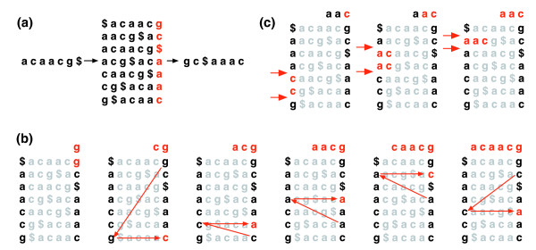
Bowtie 1: Burrows-Wheeler Transform (BWT)
The Burrows-Wheeler matrix and transformation for acaacg. Data compression is facilitated by forming stretches of the same characters.
An unpermute step repeatedly applies the last first (LF) mapping to recover the original text (in red on the top line) from the Burrows-Wheeler transform (in black in the rightmost column).
Steps taken by an exact search to identify the range of rows, and thus the set of reference suffixes, prefixed by aac.

Slide 22
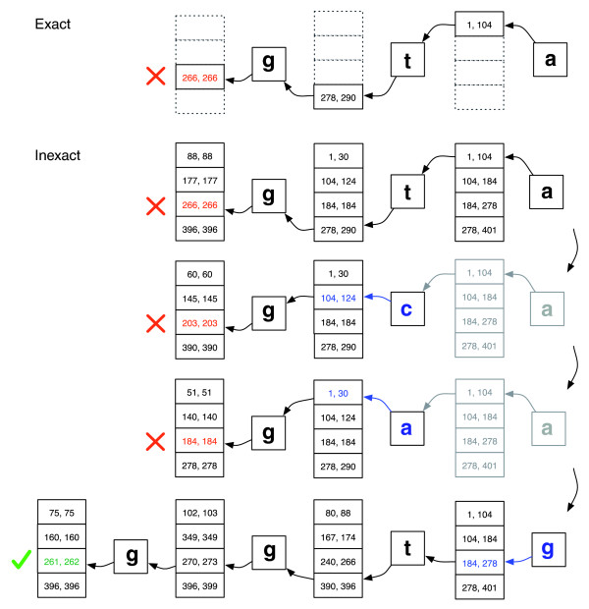
Bowtie 1: Searching for Inexact Matches
Main steps
If the range of an exact search becomes empty, then the algorithm selects an already-matched query position and substitutes its base by different ones (mismatch). Next, the exact search resumes from the substituted position.
If there are multiple candidate substitution positions, then the algorithm greedily selects a position with a minimal quality value.
Fig. 2: Inexact match for query GGTA

Slide 23
Outline
Overview: Short Read Alignment Needs
Selected Algorithms
Indexing with Hash Tables
FM-Index (Burrows Wheeler Transform)
Applications
Variant Tolerance: VAR-Seq
Splice Junction Awareness: RNA-Seq
Pseudo-alignments for RNA-Seq
References

Slide 24
Software Examples
BWA
BWA-MEM
Bowtie 2 (used as example)
Novoalign
SRMA
…

Slide 25
Bowtie 2: Fast Alignments with Gap Support
Basic Steps of Bowtie 2 Algorithm (Langmead et al 2012)
Extract seed substrings from the reads in sense and antisense
Ungapped alignment of substrings using the FM Index, yielding Burrows-Wheeler (BW) ranges
Prioritize BW ranges (rows) by range size and FM Index walk-left procedure.
Performs Single Instruction Multiple Data (SIMD)-accelerated dynamic programming alignment in the vicinity of each seed alignment.

Slide 26
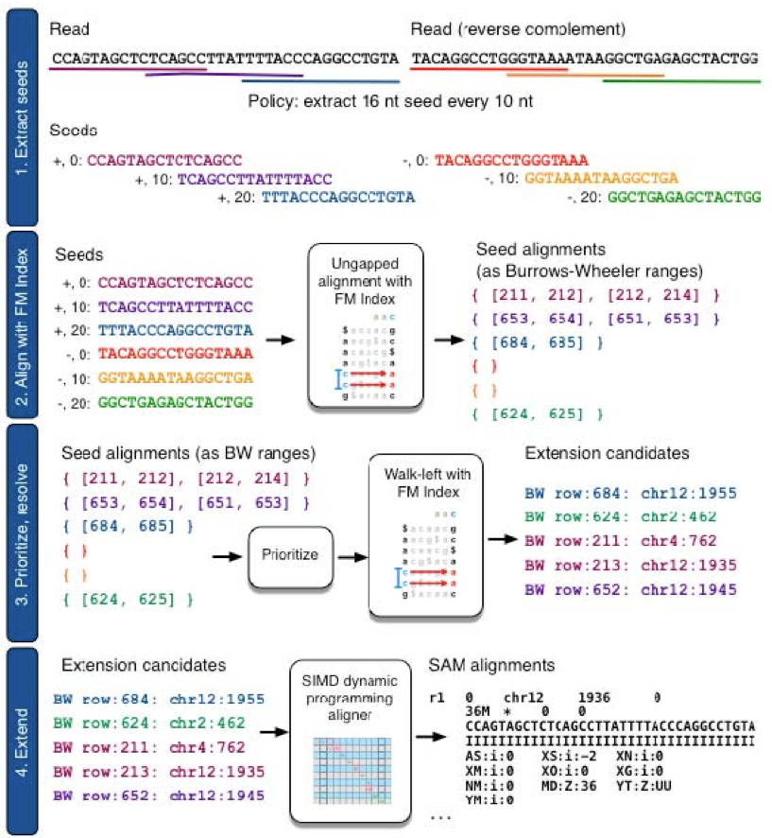
Bowtie 2: Seed Alignment Plus Dynamic Programming
Steps 1-2

Slide 27
Bowtie 2: Seed Alignment Plus Dynamic Programming
Steps 3-4

Slide 28
Outline
Overview: Short Read Alignment Needs
Selected Algorithms
Indexing with Hash Tables
FM-Index (Burrows Wheeler Transform)
Applications
Variant Tolerance: VAR-Seq
Splice Junction Awareness: RNA-Seq
Pseudo-alignments for RNA-Seq
References

Slide 29
Splice Junction Aware RNA-Seq Alignments
Read mapping strategy required when aligning RNA-Seq reads against genome
Align reads first against transcriptome (extracted via GFF from genome) and scale mappings, including splice junction mappings, back to genome location
Align remaining unmapped reads against genome
Align segmented reads (split or half reads) against genome and extend to complete reads. Alignment is accepted if extension of read ends recovers entire read sequence interrupted by gap that is framed by the typical intron donor/acceptor sites
RNA-Seq mapping software implementing some or all of these steps (Lindner et al 2012): HISAT, Tophat2/Bowtie2 (Tophat/Bowtie), PALMA, Star, MapSplice, SpliceMap, ERANGE, RUM, RNASEQR, Rsubread, ...

Slide 30
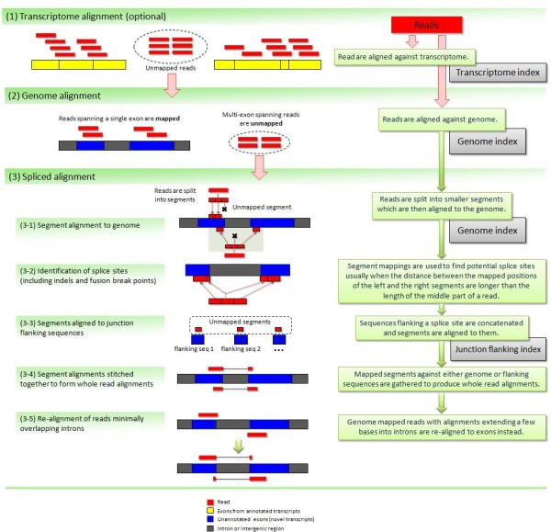
Tophat 2: RNA-Seq Alignment Pipeline
(1) Alignment of RNA-Seq reads against transcriptome
(2) Alignment of reads without transcriptome mappings against genome
Figure 6 from Kim et al., 2013

Slide 31
Tophat 2: RNA-Seq Alignment Pipeline
(3) Split read alignments against genome. Uses only reads without mappings in steps (1)-(2)
Figure 6 from Kim et al., 2013

Slide 32
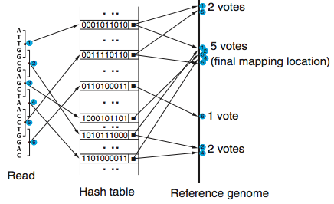
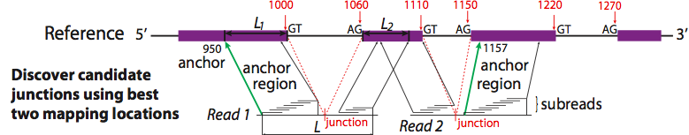
Subread: Seed-and-Vote RNA-Seq Aligner
Subread/Rsubread uses seed and vote strategy. It is currently one of the fastest and most accurate RNA-Seq aligners (Liao et al 2013).

Slide 33
Outline
Overview: Short Read Alignment Needs
Selected Algorithms
Indexing with Hash Tables
FM-Index (Burrows Wheeler Transform)
Applications
Variant Tolerance: VAR-Seq
Splice Junction Awareness: RNA-Seq
Pseudo-alignments for RNA-Seq
References

Slide 34
Avoiding Alignment Step in RNA-Seq
In RNA-Seq experiments alignments are used for quantifying expression levels, typically by counting reads overlapping features of interest (e.g. transcripts or genes).
How can we quantify the abundance of transcripts directly from the reads, while avoiding the time consuming alignment step?
Answer
Count k-mers occurring in reads rather than reads aligned to reference
Transcript abundance estimated with EM algorithm(s)
Implementations
Sailfish: 20x faster than alignment based methods with comparable accuracy
Kallisto: uses de Bruijn graph to maintain k-mer connectivity (avoids information loss) resulting in higher accuracy, while also outperforming Sailfish in speed

Slide 35
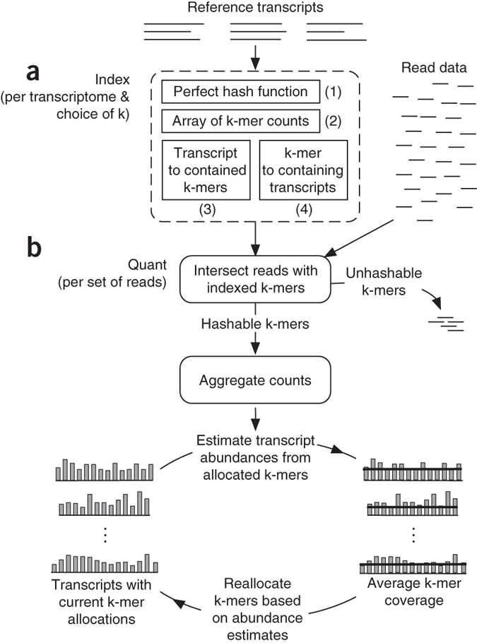
Sailfish: Alignment-free Transcript Quantification
Indexing of k-mers in transcripts involving index components (1)-(4)
Quantification by counting the indexed k-mers in reads and then estimating relative transcript abundance with EM procedure
K-mer count assignments are illustrated by bars along known transcripts.
Figure 1 from Patro et al., 2014

Slide 36
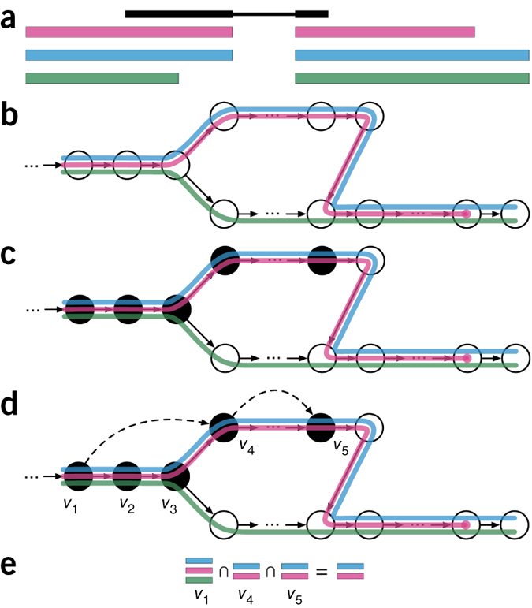
Kallisto: Pseudo-alignments via de Bruijn Graph
Read(s) in black with transcripts colored
Construct index by creating transcriptome de Bruijn Graph where nodes are k-mers, each transcript corresponds to a colored path
k-mers of a read are hashed (black nodes) to find the k-compatibility class of a read
k-mers with same k-compatibility class are collapsed
k-compatibility class of read is determined by taking the intersection
Figure 1 from Bray et al 2016

Slide 37
Outline
Overview: Short Read Alignment Needs
Selected Algorithms
Indexing with Hash Tables
FM-Index (Burrows Wheeler Transform)
Applications
Variant Tolerance: VAR-Seq
Splice Junction Awareness: RNA-Seq
Pseudo-alignments for RNA-Seq
References

Slide 38
References
Bray NL, Pimentel H, Melsted P, Pachter L (2016) Near-optimal probabilistic RNA-seq quantification. Nat Biotechnol. doi: 10.1038/nbt.3519
Kim D, Pertea G, Trapnell C, Pimentel H, Kelley R, Salzberg SL (2013) TopHat2: accurate alignment of transcriptomes in the presence of insertions, deletions and gene fusions. Genome Biol 14: R36
Langmead, B, Trapnell, C, Pop, M, Salzberg, S L (2009) Ultrafast and memory-efficient alignment of short DNA sequences to the human genome Genome Biol, 10:. URL http://www.hubmed.org/display.cgi?uids=19261174
Langmead B, Salzberg SL (2012) Ultrafast and memory-efficient alignment of short DNA sequences to the human genome Nat Methods, 9: 357-359 URL http://www.hubmed.org/display.cgi?uids=22388286
Liao, Y, Smyth, GK, Shi, W (2013) The Subread aligner: fast, accurate and scalable read mapping by seed-and-vote Nucleic Acids Res 41, e108. URL http://www.ncbi.nlm.nih.gov/pubmed/23558742

Slide 39
References
Li, R, Li, Y, Kristiansen, K, Wang, J (2008) SOAP: short oligonucleotide alignment program. Bioinformatics, 24: 713-714. URL http://www.hubmed.org/display.cgi?uids=18227114
Li, H, Ruan, J, Durbin, R (2008b) Mapping short DNA sequencing reads and calling variants using mapping quality scores. Genome Res, 18: 1851-1858. URL http://www.hubmed.org/display.cgi?uids=18714091
Lin, H, Zhang, Z, Zhang, M Q, Ma, B, Li, M (2008) ZOOM! Zillions of oligos mapped. Bioinformatics, 24: 2431-2437. URL http://www.hubmed.org/display.cgi?uids=18684737
Lindner R, Friedel CC (2012) A Comprehensive Evaluation of Alignment Algorithms in the Context of RNA-Seq PLoS One, 7: e52403. URL http://www.hubmed.org/display.cgi?uids=23300661
Li, H, Durbin, R (2009) Fast and accurate short read alignment with Burrows-Wheeler transform. Bioinformatics, 25: 1754-1760. URL http://www.hubmed.org/display.cgi?uids=19451168

Slide 40
References
Malhis, N, Butterfield, Y S, Ester, M, Jones, S J (2009) Slider–maximum use of probability information for alignment of short sequence reads and SNP detection. Bioinformatics, 25: 6-13. URL http://www.hubmed.org/display.cgi?uids=18974170
Patro R, Mount SM, Kingsford C (2014) Sailfish enables alignment-free isoform quantification from RNA-seq reads using lightweight algorithms. Nat Biotechnol 32: 462–464
Smith, A D, Xuan, Z, Zhang, M Q (2008) Using quality scores and longer reads improves accuracy of Solexa read mapping. BMC Bioinformatics, 9: 128-128. URL http://www.hubmed.org/display.cgi?uids=18307793

