Slide 1
Analysis of Gene Expression Data from Microarray and RNA-Seq Experiments
Data Analysis in Genome Biology
GEN242
Thomas Girke
May 1, 2018

Slide 2
Outline
Technology Overview
Microarrays
RNA-Seq
Common Challenges
Data Analysis
Microarray Data
RNA-Seq Data
References

Slide 3
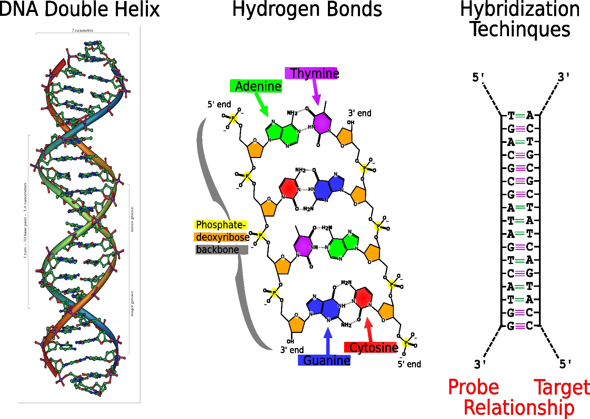
Microarrays: DNA Hybridization Technique
Definition
Hybridization-based technique that allows the simultaneous detection of thousands of DNA sequences on a solid substrate.
Mechanism
Hydrogen bond formations of DNA/DNA or DNA/RNA double helices provide the highly selective forces of the technology.

Slide 4
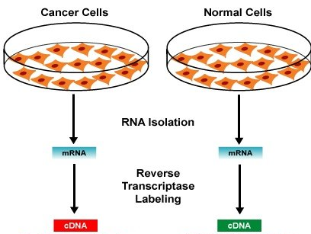
Microarrays and RNA-Seq Are Comparative Techniques
Microarrays
or
RNA-Seq

Slide 5
Technical Components of Microarray Experiments
A. Microarray Features
A multiplex technology that consists of an arrayed series of thousands of DNA features (probes), each representing a specific DNA sequence. They are attached to a solid surface, the microarray, which can be glass, a silicon chip, beads, membranes, etc.
B. Multiplexed Probe-Target Hybridization
The microarray probes are used to hybridize to their specific cDNA or cRNA targets in the hybridization solution under high-stringency conditions.
C. Target Quantification
The amount of probe-target hybridization is usually detected and quantified by fluorescence-based detection. The obtained intensities are used to determine the relative abundance of nucleic acid sequences in the target sample.
D. Microarray Experiment
Important components of microarray hybridizations are the experimental design and the methods of analyzing the data.

Slide 6
Application Spectrum of Microarray Technology
Main Applications
mRNA profiling (focus of this presentation)
Detection of gene copy numbers
Genotyping and SNP (single-nucleotide polymorphism) detection
DNA-protein interaction (e.g.: ChIP-on-chip)
Alternative splicing (e.g.: Tiling arrays)
Identification of new cell lines
...
Related technologies
Protein arrays
Small molecule arrays (e.g. drugs)

Slide 7
Different Types of Microarrays
Single channel approaches
Affymetrix GeneChipsⓇ
Agilent
Nimblegen
Macroarrays
Multiple channel approaches
Dual color microarrays
Printed cDNA microarrays
Oligo microarrays
Agilent
Nimblegen
Specialty approaches
Bead arrays: Illumina
PCR-based approaches

Slide 8
Components of Dual Color Microarray Experiments
Microarray Features
Oligo microarrays: single stranded oligonucleotide probes (20-100 NT long) immobilized on glass slides.
cDNA microarrays: double stranded cDNA probes, usually PCR amplified (300-2000bp long) and immobilized on glass slides.
Multiplexed Probe-Target Hybridization
Co-hybridization of two (or more) targets to one microarray.
The targets are labeled with different fluorescent dyes, e.g. Cy3 and Cy5.
Target Quantification
The differently labeled targets are detected by a laser at two different wavelengths.
Two intensity sets are obtained from each array: one for the Cy3 sample and one for the Cy5 sample.
Microarray Experiment
Desired sample comparisons are defined by co-hybridization of two samples. Comparisons across dual color arrays should be avoided.

Slide 9
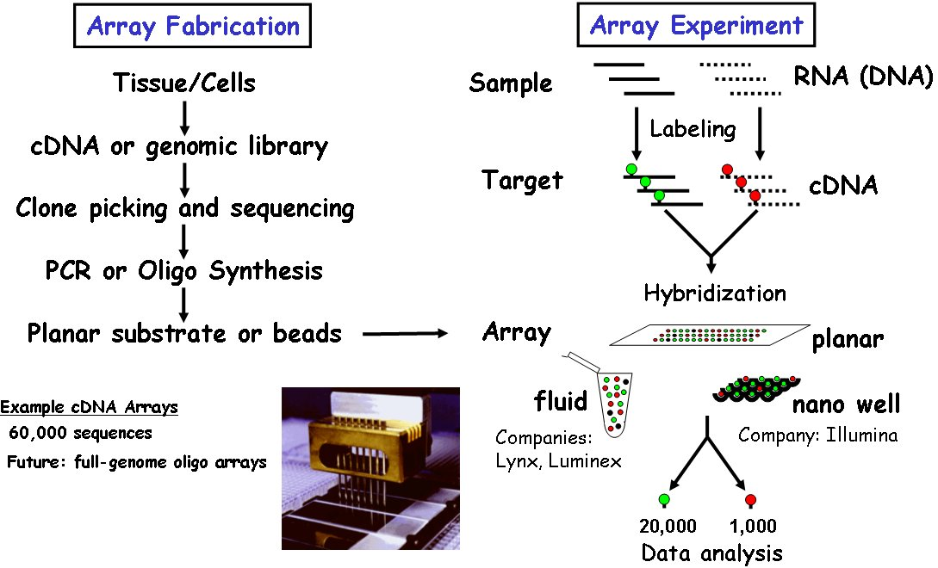
Dual Color Microarrays

Slide 10
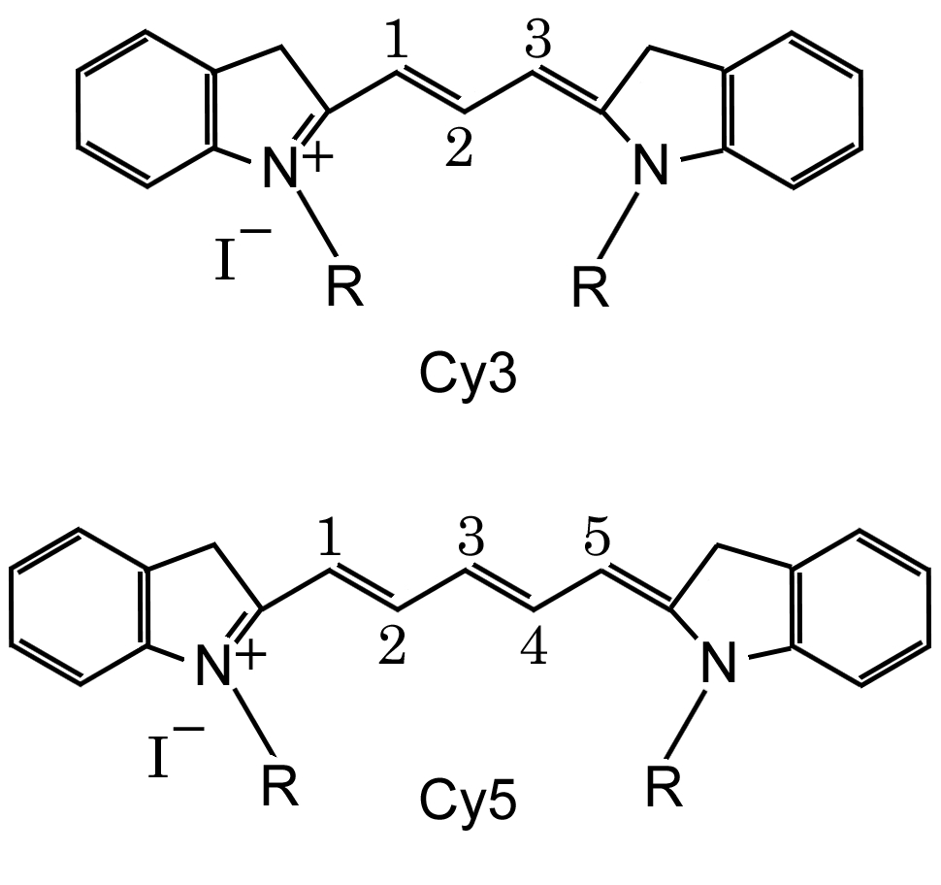
Structure of Common Fluorescent Dyes
Cy3 excitation wavelength is ∼550 nm and emission ∼570 nm
Cy5 excitation wavelength is ∼649 nm and emission ∼670 nm
The dyes are linked to nucleic acids via their R groups

Slide 11
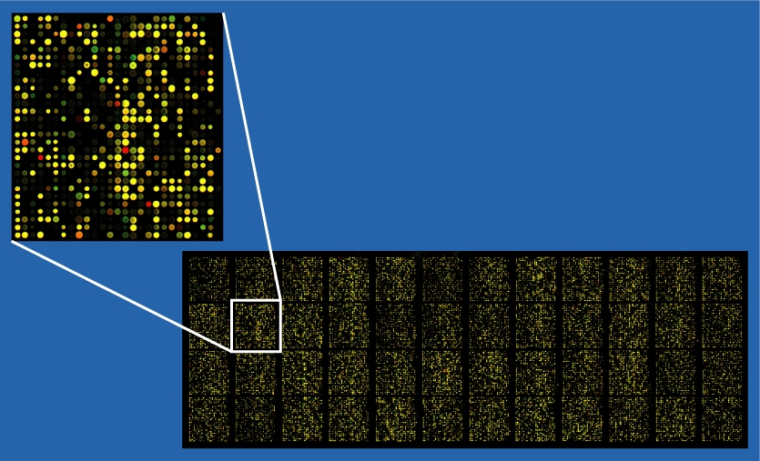
False Color Image of a Dual Color Microarray

Slide 12
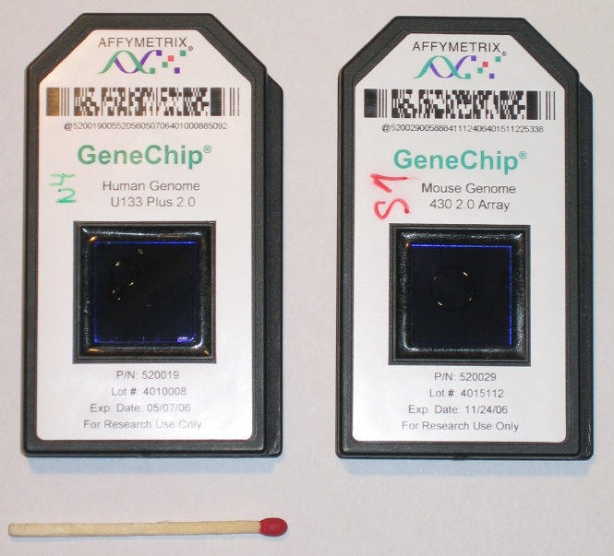
Single Color Affymetrix GeneChipsⓇ

Slide 13
Components of Affymetrix GeneChipsⓇ Experiments
Microarray Features
Single stranded oligonucleotide probes are synthesized by a photolithographic technique (21 NT long) directly onto the GeneChipsⓇ.
Each gene is represented by a probe set consisting of 11-20 perfect matchprobes (PM) and 11-20 mismatch probes (PM). The latter are used for background correction. The mismatch probes have the same sequence as the perfect match probes, except for one mismatch in their central position.
Multiplexed Probe-Target Hybridization
Hybridization of a single target sample to each GeneChipsⓇ.
Target sample is labeled with biotin detectable with a streptavidin-phycoerythrin conjugate.
Target Quantification
The labeled target is detected by a laser at a single wavelength.
Only one intensity set is obtained from each array.
Microarray Experiment
Sample comparisons are performed by comparing the intensity data from different arrays.

Slide 14
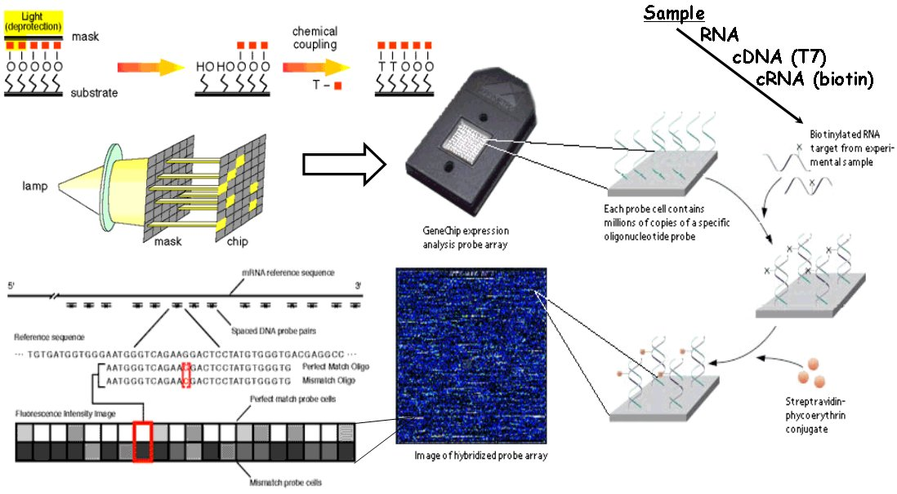
Affymetrix GeneChipsⓇ Technology

Slide 15
Outline
Technology Overview
Microarrays
RNA-Seq
Common Challenges
Data Analysis
Microarray Data
RNA-Seq Data
References

Slide 16
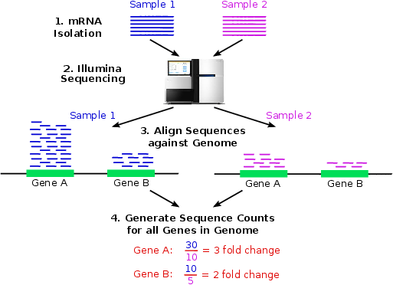
RNA-Seq: Gene Expression Profiling by Sequencing

Slide 17
Advantages of RNA-Seq Over Microarrays
Useful for both sequenced and unsequenced organisms
Much more detailed information output:
Identification of all transcribed regions in genome (complete transcriptome)
More comparable among organisms than hybridization events across differently designed chips
Identification of new genes
Alternative splicing
SNP/variant analysis focused on expressed regions
Allele specific gene expression profiling
Strand specific profiling (e.g. antisense expression)
Ribosome footprinting
CLIP-Seq (e.g. small RNA targets, RNA-binding proteins)
...

Slide 18
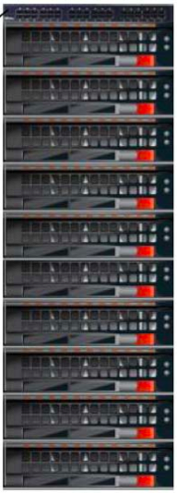
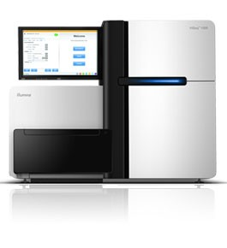

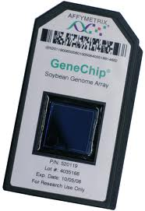
Big Data Challenge
2002-2007 2008-present
Affymetrix HiSeq 2500
Laptop Storage Cluster

Slide 19
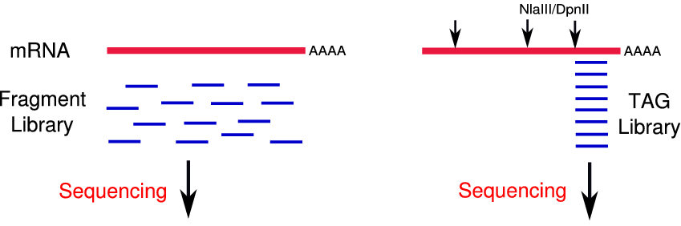
RNA-Seq versus DGE
Expression profiling
Alternative splicing
Exon variant detection
Many other applications
Expression profiling

Slide 20
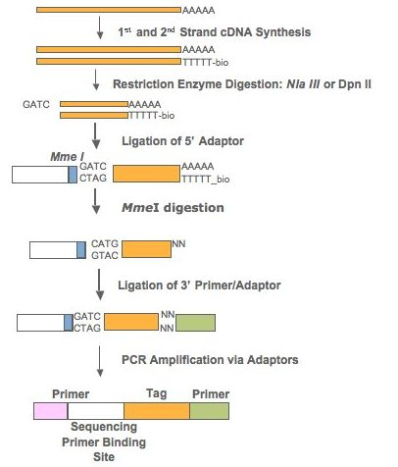
Illumina’s Digital Gene Expression (DGE) Profiling

Slide 21
Outline
Technology Overview
Microarrays
RNA-Seq
Common Challenges
Data Analysis
Microarray Data
RNA-Seq Data
References

Slide 22
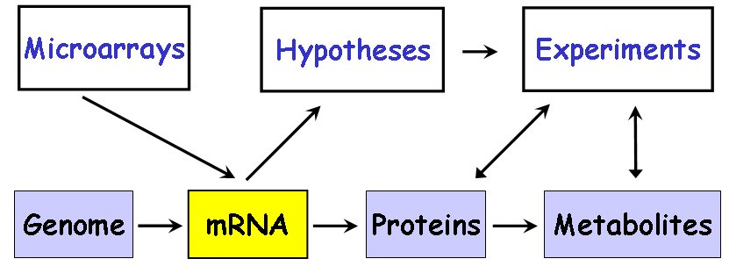
What We Measure Are Differences of mRNA Levels
Efficient strategy for downstream follow-up experiments important!

Slide 23
Microarray and RNA-Seq Data Are Noisy
Sources of Variation in Transcriptional Profiling Experiments
Every step in transcriptional profiling experiments can contribute to the inherent ’noise’ of gene expression data.
Variations in biosamples, RNA quality, target labeling or library construction are normally the biggest noise introducing steps in mRNA profiling experiments.
Careful experimental design and initial calibration experiments can minimize this noise.

Slide 24
Factors to Consider for Planning Expression Experiments
Motivation of experiment driven by biological questions
Which genes are expressed in a sample?
Which genes are differentially expressed (DE) in a treatment, mutant, etc.?
Which genes are co-regulated in a series of treatments?
Selection of best biological samples and reference
Comparisons with minimum number of variables
Sample selection: maximum number of expressed genes
Alternative reference: pooled RNA of all time points (mainly dual color arrays)
Biological replicates are essential
Biological replicates: utilize independently collected biosamples
Technical replicates: utilize often the same biosample or RNA pool
Develop validation strategy for expression hits
For example, real-time PCR and analysis of mutants or transgenics.

Slide 25
Considerations Specific to Dual Color Microarrays
In a dual color microarray experiment the appropriate sample comparisons need to be defined prior to the hybridization experiment, because it is a co-hybridization technique.
Comparisons across dual color microarrays should be avoided for identifying differentially expressed genes.
This is less an issue with single color arrays, because the comparisons are always performed between arrays (not a co-hybridization technique).

Slide 26
Common Experimental Designs
Common reference design
Reference A vs. Treatment A
Reference A vs. Treatment B
Paired reference design
Reference A vs. Treatment A
Reference B vs. Treatment B
Loop & pooling designs
Often used when RNA samples are limited
Many other designs

Slide 27
Outline
Technology Overview
Microarrays
RNA-Seq
Common Challenges
Data Analysis
Microarray Data
RNA-Seq Data
References

Slide 28
Analysis Workflow of Microarray Gene Expression Data
Image Processing
Extract intensity values from feature and background pixels
Background Correction
Removal of nonspecific hybridization and background fluorescence
Normalization
Adjustment for global signal variations of entire microarrays
Identification of Differentially Expressed Genes (DEGs)
Identification of genes with significant expression differences
Identification of expressed genes possible for strongly expressed ones
Cluster Analysis
Identification of genes with similar expression profiles across many samples
Enrichment Analysis of Functional Annotations
Gene ontology/pathway analysis of obtained gene sets from steps 4 and 5

Slide 29
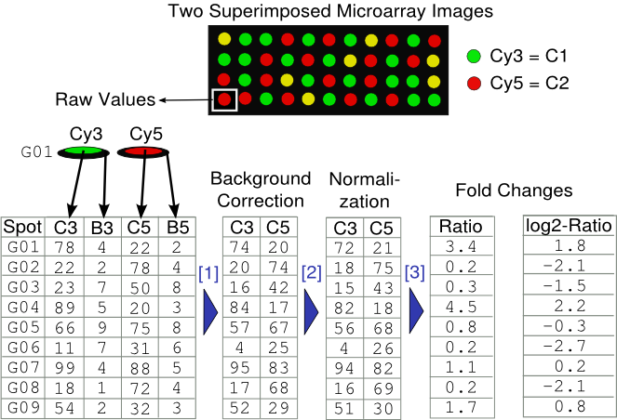
Analysis of Dual Color Microarrays
Background correction. Many approaches are available. Most commonly the intensity of the local background is subtracted from the signal intensity: C1 − B1 and C2 − B2
(2) Normalization step to adjust for global differences between channels. Many methods, e.g. Loess.
(3) Fold changes to obtain relative fold-changes between samples. Often this is performed in log2 scale: log₂(C3/C5) or log₂(C3) − log₂(C5)

Slide 30
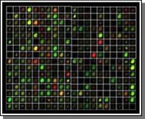
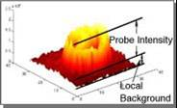
Image Analysis
Overall slide quality
Grid alignment (linkage between spots and feature IDs)
Signal quantification: mean, median, threshold, etc.
Local background
Manual spot flagging
Export signals to tabular file
Image analysis software (selection)
ScanAlyze
TIGR SpotFinder

Slide 31
Background Correction
Filtering (optional)
Intensities below detection limit
Negative intensities
Spacial quality issues
Background (BG) correction
BG consists of non-specific hybridization and background fluorescence
If BG is higher than signal: (1) remove values, (2) set signal to lowest measured intensity, (3) many other approaches
BG subtraction
Local background
Global background
No background subtraction
Background subtraction can cause ratio inflation, therefore background corrected intensities below threshold are often set to threshold or similar value.

Slide 32
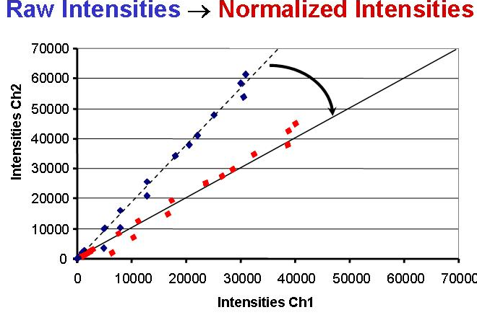
Normalization
Normalization is the process of balancing the intensities of the channels to account for variations in labeling and hybridization efficiencies. To achieve this, various adjustment strategies are used to force the distribution of all ratios to have a median (mean) of 1 or the log₂-ratios to have a median (mean) of 0.

Slide 33
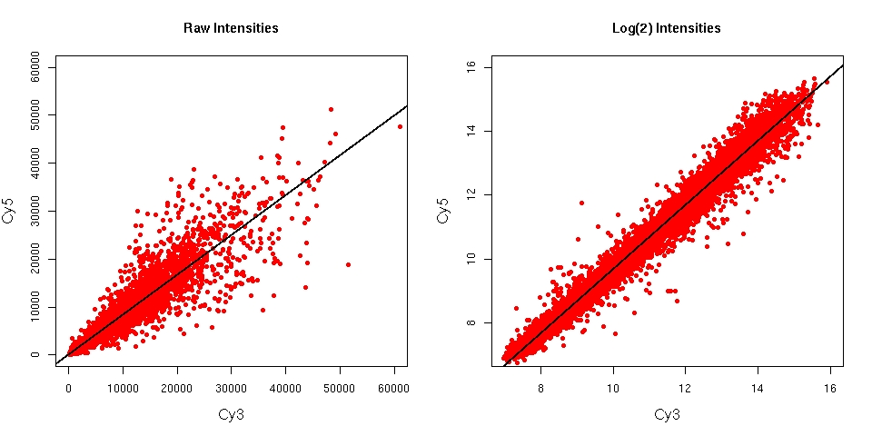
Log Transformation
Reasons for working with log-transformed intensities and ratios
spreads features more evenly across intensity range
makes variability more constant across intensity range
results close to normal distribution of intensities and experimental errors

Slide 34
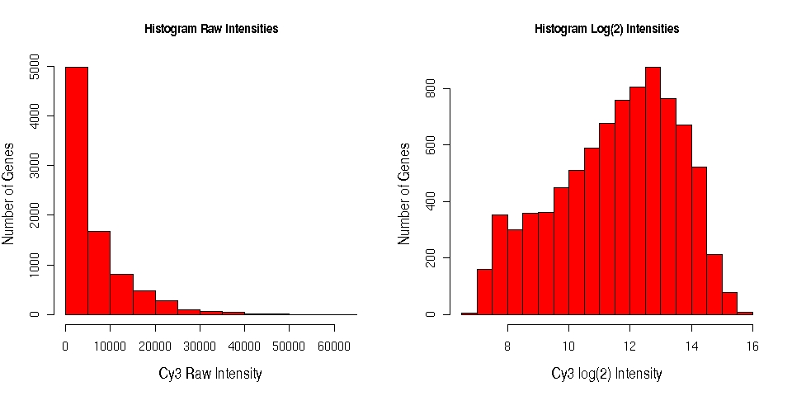
Log Transformation: Histograms

Slide 35
Normalization If Large Fraction of Genes IS DE
Minimize normalization requirements (dynamic range limits)
Pre-scanning: hybridize equal amounts of label
During scanning: balance average intensities through laser power and PMP adjustments
Normalization if large fraction of genes is differentially expressed (DE)
Spike-in controls
Housekeeping controls
Determine constant feature set
Note: for the following (more common) normalization methods the assumption is that most genes are not DE!

Slide 36
Global Within-Array Normalization of Dual Color Arrays
Normalization Factor (simplest approach)
Ch1 normalized = Ch1 ∗ mean(Ch2)/mean(Ch1)→ treats channels differently
Linear Regression
Fit of log2(Ch2) against log2(Ch1)
⇒ adjust Ch1 with fitted values. →treats channels differently
Fit of log2(ratios) against averaged log2(int)
⇒ subtract fitted value from raw log ratios. → treats channels equally
Loess Regression (locally weighted polynomial regression)
Most commonly used method for dual color microarrays.
A non-linear regression fit of log2(ratios) against averaged log2(int) is performed, which joins local regressions with overlapping windows to a smooth curve.
⇒ subtract fitted Loess values from raw log2(ratios). → treats channels equally
Spatial Within-Array Normalization
All of the above methods can be used to correct for spatial bias on the microarray, such as print tip blocks.

Slide 37
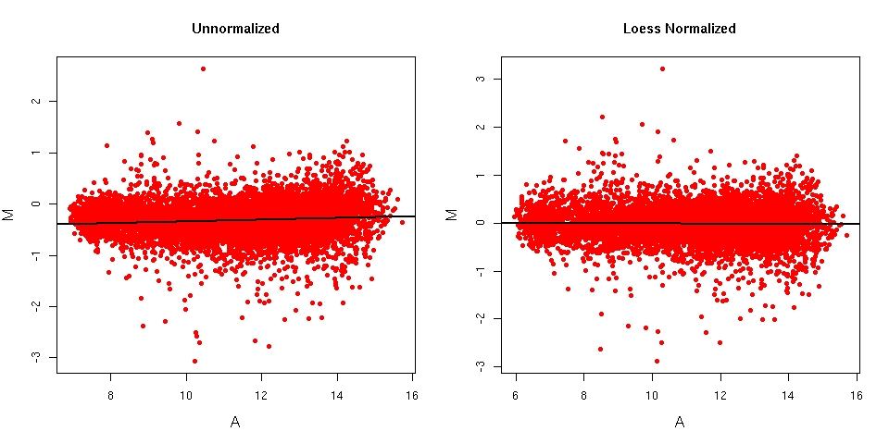
MA Plots

Slide 38
Between-Array Normalization for Single Color Arrays
Scaling
Operation: log2(int)− mean log2(int)
Result: mean = 0
Centering
Operation: Scaled values divided by standard deviation (STD).
Result: mean = 0, STD = 1
Quantile (Distribution) Normalization
Operations
Generate centered data.
Sort each array by intensities.
Calculate row mean for sorted values across arrays.
Replace sorted array intensities by corresponding row mean.
Sort data back to original order.
Result: mean = 0, STD = 1, identical distribution between arrays
Note: used by many normalization methods for Affymetrix GeneChips

Slide 39
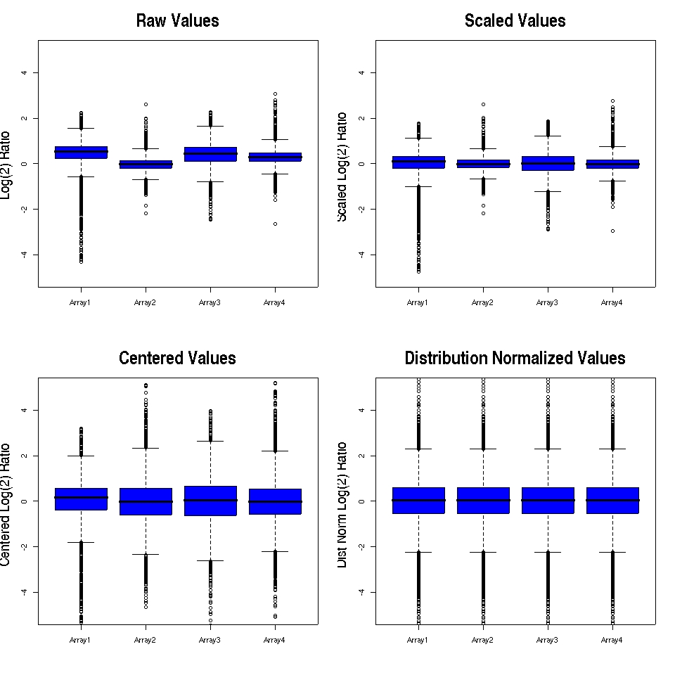
Box Plots for Between-Array Normalization Steps

Slide 40
Analysis Methods for Affymetrix GeneChipsⓇ
Method | BG Adjustment | Normalization | MM Correction | Probeset Summary
MAS5 | regional adjustment | scaling by constant | subtract idealized MM | Turkey biweight average
gcRMA | by GC content | quantile normalization | / | robust fit of linear model
RMA | array background | quantile normalization | / | robust fit of linear model
VSN | / | varianze stabilizing TF | / | robust fit of linear model
dChip | / | by invariant set | / | multiplicative model
dChip.mm | / | by invariant set | subtract MM | multiplicative model
References
Qin et al. (2006), BMC Bioinfo, 7:23.
MAS 5.0: Affymetrix Documentation: MAS5
PLIER: Affymetrix Documentation: PLIER, not included here
gcRMA: Wu et al. (2004), JASA, 99, 909-917.
RMA: Irizarry et al. (2003), Nuc Acids Res, 31, e15.
VSN: Huber et al. (2002), Bioinformatics, 18, Suppl I S96-104.
dChip & dChip.mm: Li & Wong (2001), PNAS, 98, 31-36.

Slide 41
Analysis of Differentially Expressed Genes (DEGs)
Approaches
Parametric test: t-test variants
Non-parametric tests: Wilcoxon sign-rank/rank-sum tests
Bootstrap analysis (boot package)
Significance Analysis of Microarrays (SAM)
Linear Models of Microarrays (LIMMA)
Rank Product
ANOVA and MANOVA (R/maanova)
Advantages of statistical testing for selecting DEGs
Incorporates variation between measurements
Estimate of false discovery rates (FDR)
Detection of minor changes (if enough replicates)
Ranking of DE genes
Multiple testing adjustment of p-values
Methods: Benjamini-Hochberg (FDR), Bonferroni, many more.

Slide 42
Outline
Technology Overview
Microarrays
RNA-Seq
Common Challenges
Data Analysis
Microarray Data
RNA-Seq Data
References

Slide 43
Analysis Workflow of RNA-Seq Gene Expression Data
Alignment of RNA reads to reference
Reference can be genome or transcriptome
Count reads overlapping with annotation features of interest
Most common: counts for exonic gene regions, but many viable alternatives exist here
Normalization
Main adjustment for sequencing depth and compositional bias.
Identification of Differentially Expressed Genes (DEGs)
Identification of genes with significant expression differences
Identification of expressed genes possible
Specialty applications
Splice variant discovery (semi-quantitative), gene discovery, antisense expressions, etc
Cluster Analysis
Identification of genes with similar expression profiles across many samples
Enrichment Analysis of Functional Annotations
Gene ontology analysis of obtained gene sets from steps 5-6

Slide 44
Important Aspects in RNA-Seq Analysis
Best reference for alignments
Genome
Transcript models
Both
How to quantify expression?
Read count per range - most common
Coverage summary per range - rare
k-mer counts - newer methods
What features?
Genes, transcript models, exons
Alternative splicing
Often restricted to splice junction analysis
Objective: discovery vs. quantification

Slide 45
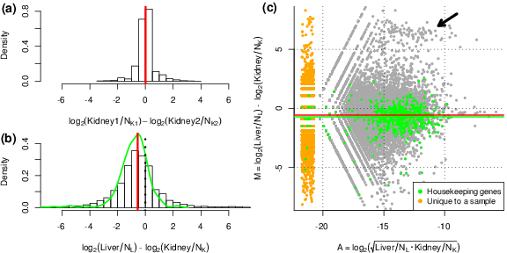
Normalization Required
Log ratio distributions (a and b) and MA plot (c) for two tissue samples (Robinson and Oshlack, 2010).

Slide 46
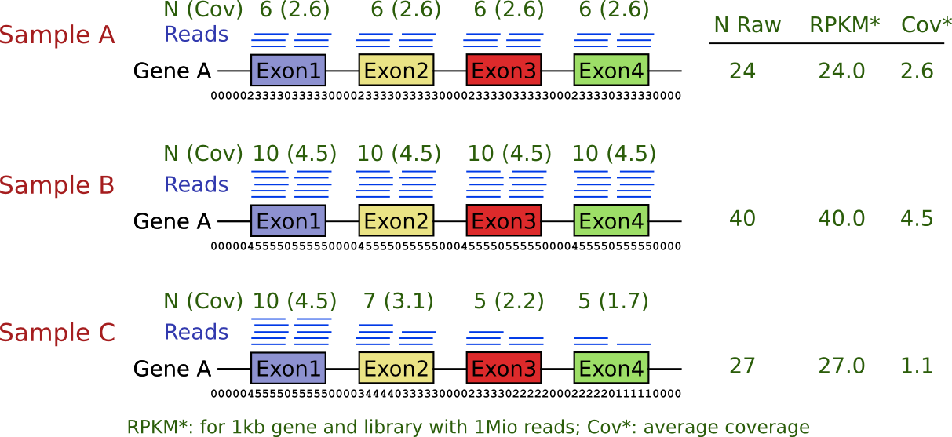
RNA-Seq Artifacts
Often inhomogeneous read coverage across genes/transcripts. Thus, comparison of identical ranges important.

Slide 47
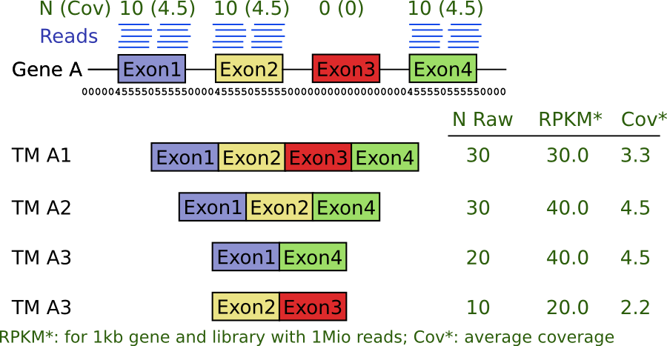
Alternative Splicing
Abundance estimates of alternative splice variants is limited to unique segments in mRNAs.

Slide 48
Normalization Methods
Necessary due to variable sequencing depth of RNA-Seq samples
Normalization for library size more important than gene length
Normalization for gene length only relevant for comparing expression across different genes/features
Simple size normalization can be skewed by highly overrepresented RNAs
Examples of common normalization methods:
RPKM (reads per kb per million mapped reads) - not for statistical testing
CPM (counts per million reads)
TMM (trimmed mean of M values)
log and rlog transformation
Median ratio method (size factor)
Quantile normalization methods
Many more

Slide 49
Be Careful with RPKM/FPKM Values
RPKM Concept (FPKM is paired-end version of it)
RPKM (FPKM): reads (fragments) per kp per million mapped reads
The more we sequence, the more reads we expect from each gene. Adjustment for library size difference is the most relevant correction of this method.
Longer transcript are expected to generate more reads. The latter is only relevant for comparisons among different genes which we rarely perform.
RPKM/FPKM are not suitable for statistical testing. Why? Consider the following example: in two libraries, each with one million reads, gene X may have 10 reads for treatment A and 5 reads for treatment B, while it is 100x as many after sequencing 100 millions reads from each library. In the latter case we can be much more confident that there is a true difference between the two treatments than in the first one. However, the RPKM values would be the same for both scenarios (information loss).
Thus, RPKM/FPKM may be useful for reporting expression values, but not for statistical testing!

Slide 50
TMM Method Corrects for RNA Composition Bias
Trimmed Mean of M Values (TMM) by Robinson and Oshlack (2010)
Many RNA-Seq normalization methods perform poorly on samples with extreme composition bias. For instance, in one sample a large number of reads comes from rRNAs while in another they have been removed more efficiently. Most scaling based methods, including RPKM and CPM, will underestimate the expression of weaker expressed genes in the presence of extremely abundant mRNAs (less sequencing real estate available for them). The TMM methods tries to correct this bias.
Method implemented in edgeR library (Robinson et al., 2010).

Slide 51
Aspects of RNA-Seq Count Data
Data is discrete, positively skewed
no (log-)normal model
Small numbers of replicates
no permutation methods
Sequencing depth (coverage) varies among samples
normalization critical

Slide 52
DEG Analysis Methods
Requirements
One would like to perform for each gene a test similar to a two sample t-test
t-test assumes normal distribution and no mean-variance dependence. Both are not appropriate assumptions for RNA-Seq data.
Variance estimation and rank-order statistics is difficult on small sample numbers.
Statistical Testing
Poisson distribution (initially used but not very common anymore)
Most statistical methods for RNA-Seq DEG analysis use negative binomial distribution along with modified statistical tests based on that.
The multiple testing issue is very similar as in microarray data analysis. Thus, most tools provide False Discovery Rates (FDRs), which are derived from p-values corrected for multiple testing using the Benjamini-Hochberg method.
For variance estimation most methods borrow information across genes

Slide 53
Statistical Testing for Differential Expression
RNA-Seq Count Data
Non-negative integers following Poisson or Negative Binomial distributions
Poisson
Distribution for modeling count data with large number of trials. Has single parameter mean. Variance/dispersion and the mean are the same.
Negative binomial
Distribution for modeling count data with overdispersion. Has two parameters (e.g. mean and overdispersion). Variance/dispersion and mean can be distinct (generalization of Poisson). More appropriate for low counts.
Testing for DE (examples)
DESeq2: NB with raw counts; Wald test, generalized linear model
edgeR: NB with raw counts; empirical Bayes for estimating dispersion; generalized linear model with likelihood ratio tests or quasi-likelihood F-tests

Slide 54
Steps in DEG Analysis
Estimate variability - (common and genewise dispersion)
Determine fold change between samples (e.g. treatment and control)
Determine significance (p-value)
Correct for multiple testing (corrected p-value, false discovery rate)
Selection of DEG sets based on FDR (and possibly minimum fold-change)

Slide 55
Complex Experimental Designs
Facilitated by generalized linear models (GLMs). Examples:
Interaction effects
Blocking
Paired samples
Batch effects
ANOVA-like tests

Slide 56
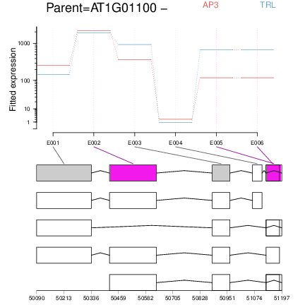
Differential Exon Usage Analysis
Motivation: differential analysis of entire isoform analysis unreliable with short reads, thus focus on differential exon usage (Anders et al., 2012).

Slide 57
Software for RNA-Seq DEG Analysis
edgeR (Robinson et al., 2010)
DESeq/DESeq2 (Anders and Huber, 2010)
DEXSeq (Anders et al., 2012)
limmaVoom
Cuffdiff/Cuffdiff2 (Trapnell et al., 2013)
PoissonSeq
baySeq (Hardcastle & Kelly, 2010)
EBSeq (Leng et al., 2013)
NBPSeq (Di et al., 2011)
TSPM
...

Slide 58
Microarray and RNA-Seq Depositories
NCBI GEO: http://www.ncbi.nlm.nih.gov/geo
ArrayExpress: http://www.ebi.ac.uk/arrayexpress/
Many Others

Slide 59
Outline
Technology Overview
Microarrays
RNA-Seq
Common Challenges
Data Analysis
Microarray Data
RNA-Seq Data
References

Slide 60
References
Anders, S., Huber, W., 2010. Differential expression analysis for sequence count data. Genome Biol 11 (10). URL http://www.hubmed.org/display.cgi?uids=20979621
Anders, S., Reyes, A., Huber, W., Oct 2012. Detecting differential usage of exons from RNA-seq data. Genome Res 22 (10), 2008–2017. URL http://www.hubmed.org/display.cgi?uids=22722343
Di Y, W SD, S CJ, H CJ (2011) The NBP Negative Binomial Model for Assessing Differential Gene Expression from RNA-Seq. Stat Appl Genet Mol Biol 10: 1–28
Hardcastle TJ, Kelly KA (2010) baySeq: empirical Bayesian methods for identifying differential expression in sequence count data. BMC Bioinformatics 11: 422
Leng N, Dawson JA, Thomson JA, Ruotti V, Rissman AI, Smits BMG, Haag JD, Gould MN, Stewart RM, Kendziorski C (2013) EBSeq: an empirical Bayes hierarchical model for inference in RNA-seq experiments. Bioinformatics 29: 1035–1043

Slide 61
References
Robinson, M. D., McCarthy, D. J., Smyth, G. K., Jan 2010. edgeR: a Bioconductor package for differential expression analysis of digital gene expression data. Bioinformatics 26 (1), 139–140. URL http://www.hubmed.org/display.cgi?uids=19910308
Robinson, M. D., Oshlack, A., Mar 2010. A scaling normalization method for differential expression analysis of RNA-seq data. Genome Biol 11 (3). URL http://www.hubmed.org/display.cgi?uids=20196867
Trapnell, C., Hendrickson, D. G., Sauvageau, M., Goff, L., Rinn, J. L., Pachter, L., Jan 2013. Differential analysis of gene regulation at transcript resolution with RNA-seq. Nat Biotechnol 31 (1), 46–53. URL http://www.hubmed.org/display.cgi?uids=23222703

