Slide 1
NGS Workflows with systemPipeR
Data Analysis in Genome Biology
GEN242
Thomas Girke
May 3, 2018

Slide 2
Outline
Motivation
Design
Templates
Getting started

Slide 3
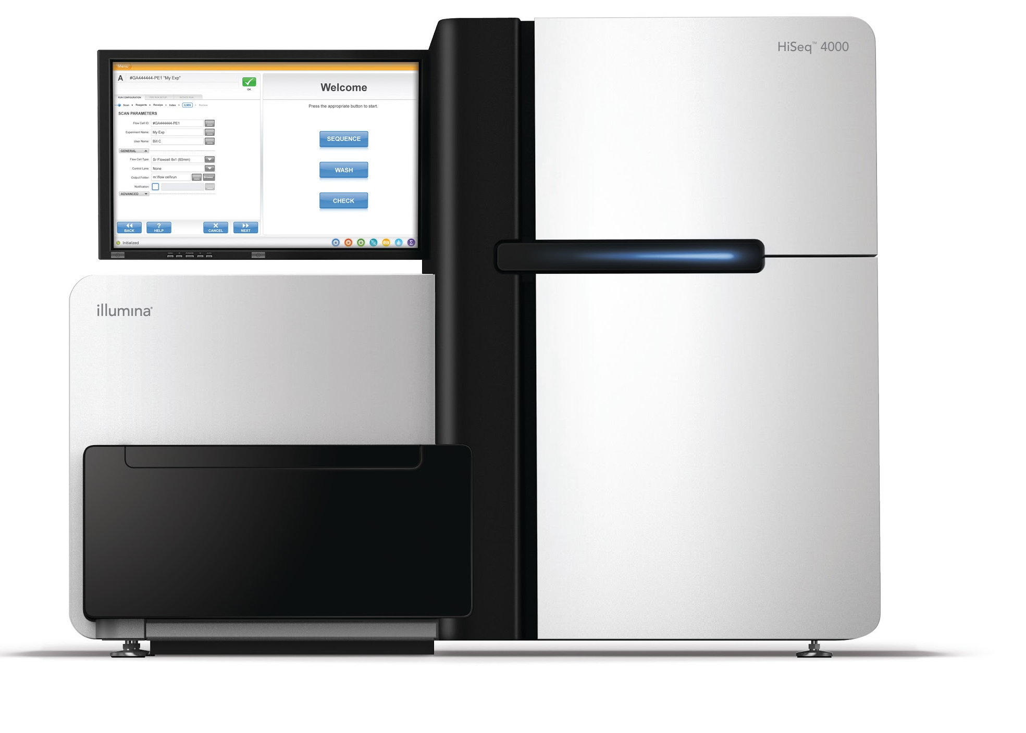
Many NGS Applications
Profiling
mRNA, miRNA
etc.
Genome Resequencing
Methylome
Profiling
De Novo Sequencing
Chromosome Structure
Hi-C
Functional
Elements
ChIP-Seq
Metagenome
Splice Variants
HPC
Research Projects
Teaching

Slide 4
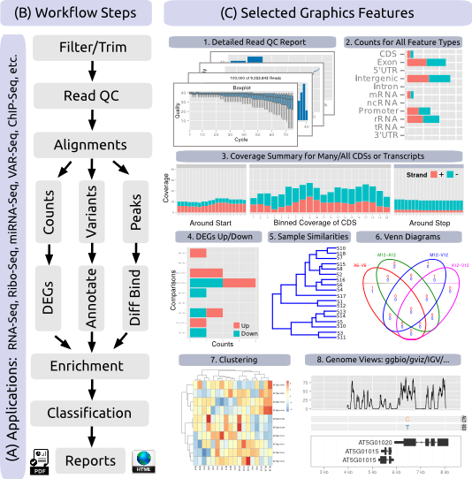
Overlapping Needs Among NGS Applications
Many NGS applications share several analysis routines, such as:
Read QC and preprocessing
Alignments
Quantification
Feature annotations
Enrichment analysis
Thus, a common workflow environment has many advantages for improving efficiency, standardization and reproducibility

Slide 5
Requirements for Workflow Environment
Design and execution of end-to-end analysis pipelines
Support for both single computers and computer clusters
Support for any type of command-line and R-based software
Automated report generation supporting Latex (PDF) and Markdown (HTML)
Uniform sample handling and annotation with minimum human intervention to run many workflows with hundreds of samples
Flexibility to support custom changes and new software without reengineering environment

Slide 6
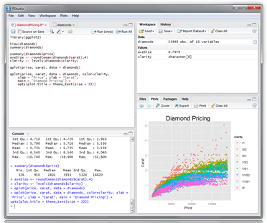
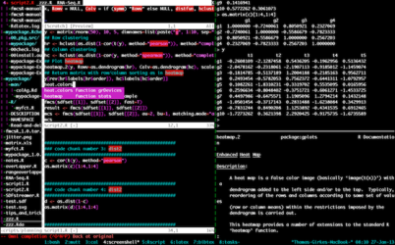
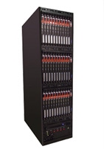
Run Environments
RStudio Server SSH Terminal
Computer Cluster, Cloud or Local Machines

Slide 7
Outline
Motivation
Design
Templates
Getting started

Slide 8
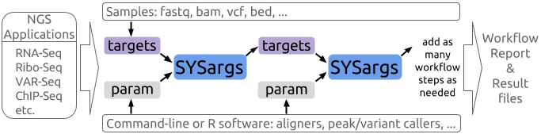
Workflow Design of systemPipeR
Workflow steps with input/output file operations are controlled by workflow control modules called SYSargs objects.
Each SYSargs instance is constructed from a targets file and a param file.
Only user input is initial targets file. Subsequent targets instances are created automatically.
Any number of predefined or custom workflow steps are supported.

Slide 9
Template Workflows: systemPipeRdata
Helper package to generate with a single command NGS workflow templates for systemPipeR.
Includes sample data for testing.
User can create new workflows, or change and extend existing ones.

Slide 10
Browse Vignettes and Load *.Rmd Files
Browse and open vignettes
vignette("systemPipeR", package="systemPipeR")
List all files in a package’s vignette (doc) directory
list.files(system.file("doc", package="systemPipeR"), pattern="",
full.names=TRUE)
Choose specific source file and copy it into your R working directory
myRmd <- system.file("doc", "systemPipeR.Rmd", package="systemPipeR") file.copy(myRmd, "systemPipeR.Rmd")
Copy from GitHub repos (choose URL to raw file)
download.file("https://raw.githubusercontent.com/tgirke/systemPipeRdata/master
/vignettes/systemPipeR.Rmd", "systemPipeR.Rmd")

Slide 11
Workflow Templates
Generate workflow template, e.g. "rnaseq", "varseq", "chipseq" or “riboseq”
genWorkenvir(workflow="rnaseq", mydirname=NULL, bam=FALSE) setwd("rnaseq")
Command-line alternative for generating workflow environments
$ Rscript -e "systemPipeRdata::genWorkenvir(workflow='rnaseq')"

Slide 12
Install and Load Packages
Install required packages
source("http://bioconductor.org/biocLite.R") biocLite(c("systemPipeR", "systemPipeRdata"))
Load packages
library("systemPipeR") library("systemPipeRdata")
Accessing help
library(help="systemPipeR") vignette("systemPipeR")

Slide 13
Samples Are Defined in targets File
Structure of targets file for single-end (SE) library
read.delim("targets.txt", comment.char = "#")[1:3,1:5]
FileName SampleName Factor SampleLong Experiment
1 ./data/SRR446027_1.fastq M1A M1 Mock.1h.A 1
2 ./data/SRR446028_1.fastq M1B M1 Mock.1h.B 1
3 ./data/SRR446029_1.fastq A1A A1 Avr.1h.A 1
Structure of targets file for paired-end (PE) library
read.delim("targetsPE.txt", comment.char = "#")[1:3,1:4]
FileName1 FileName2 SampleName Factor
1 ./data/SRR446027_1.fastq ./data/SRR446027_2.fastq M1A M1
2 ./data/SRR446028_1.fastq ./data/SRR446028_2.fastq M1B M1
3 ./data/SRR446029_1.fastq ./data/SRR446029_2.fastq A1A A1

Slide 14
Targets File
A sample targets file is available here in Google Sheets format
It can be imported as
tab delimited text file (preferred)
Google Sheets:
Import targets file using googlesheets package from Jenny Bryan
library("googlesheets"); library("dplyr"); library("knitr")
gs_auth() # Generates/checks authorization token sheetid <- "1U-32UcwZP1k3saKeaH1mbvEAOfZRdNHNkWK2GI1rpPM"
gap <- gs_key(sheetid)
mysheet <- gs_read(gap, skip=4)
(df <- as.data.frame(mysheet))

Slide 15
SYSargs: targets & param
SYSargs instances are constructed from a targets file and a param file. The param file contains the settings for running command-line software.
args <- systemArgs(sysma="hisat2.param", mytargets="targets.txt")
An instance of 'SYSargs' for running 'hisat2' on 18 samples
Slots and accessor functions have the same names
names(args)[c(5,8,13)]
[1] "software" "reference" "sysargs"
Return command-line arguments for given software, here HISAT2 for 1st sample
sysargs(args)[1]
hisat2 -p 4 -o SRR446027_1.fastq.hisat.sam tair10.fasta -U SRR446027_1.fastq

Slide 16
Structure of Workflow Templates
The workflow templates generated by genWorkenvir contain the following preconfigured directory structure:
workflow_name/ # *.Rnw/*.Rmd scripts, targets file, etc. param/ # parameter files for command-line software data/ # inputs e.g. FASTQ, reference, annotations results/ # analysis result files
The above structure can be customized as needed, but for first-time users it is easier to keep changes to a minimum.

Slide 17
Run on Single Machines or Clusters
Run command-line tool, here HISAT2, on single machine. Command-line tool needs to be installed for this.
runCommandline(args)
Submit command-line or R processes to a computer cluster with a queueing system.
clusterRun(args, ...)
The last step requires additional resource allocation arguments. For details see the main manual here.

Slide 18
Run workflows
Next, run from within R the chosen sample workflow by executing interactively the code provided in the corresponding *.Rmd template file (or *.Rnw or *.R versions).
Alternatively, one can run an entire workflow from start to finish with a single command by executing from the command-line:
$ Rscript -e "rmarkdown::render('systemPipeRNAseq.Rmd')"
or
$ make -B # Requires Makefile
Analysis reports in PDF or HTML format are autogenerated when running a workflow using standard R resources for scientific report generation including knitr and rmarkdown, respectively.
Integration of ReportingTools is also straightforward.

Slide 19
Outline
Motivation
Design
Templates
Getting started

Slide 20
RNA-Seq Workflow Template
Read preprocessing
Quality filtering (trimming)
FASTQ quality report
Alignments: rsubread, Bowtie2/Tophat2, HISAT2
Available soon: alignment free approaches, e.g. Kallisto (tximport)
Alignment statistics
Read counting per annotation
Sample-wise correlation analysis
DEG analysis with edgeR or DESeq2
Enrichment analysis of GO terms or other annotation types
Gene-wise cluster analysis

Slide 21
VAR-Seq Workflow Template
Read preprocessing
Quality filtering (trimming)
FASTQ quality report
Alignments: gsnap, bwa
Alignment statistics
Variant calling: VariantTools, GATK, BCFtools
Variant filtering: VariantTools and VariantAnnotation
Variant annotation: VariantAnnotation
Combine results from many samples
Summary statistics of samples

Slide 22
ChIP-Seq Workflow Template
Read preprocessing
Quality filtering and/or trimming
FASTQ quality report
Alignments: rsubread, Bowtie2
Alignment statistics
Genome-wide coverage statistics
Peak calling: MACS2, BayesPeak
Peak annotation with genomic context
Differential binding analysis
Enrichment analysis of GO terms or other annotation types
Motif analysis

Slide 23
Ribo-Seq Workflow Template
Read preprocessing
Adaptor trimming and quality filtering
FASTQ quality report
Alignments: Bowtie2/Tophat2, HISAT2 (or any other RNA-Seq aligner)
Alignment stats
Compute read distribution across genomic features
Adding custom features to workflow such as predictions of uORFs
Genomic read coverage along transcripts
Read counting
Sample-wise correlation analysis
Analysis of differentially expressed genes (DEGs)
GO term enrichment analysis
Gene-wise clustering
Differential ribosome binding (translational efficiency)

Slide 24
RNA-Seq Step 1: Read Preprocessing
Largely based on utilities provided by ShortRead
Demultiplexing
Adaptor trimming
Quality filtering
Duplicate removal: e.g. PCR, other

Slide 25
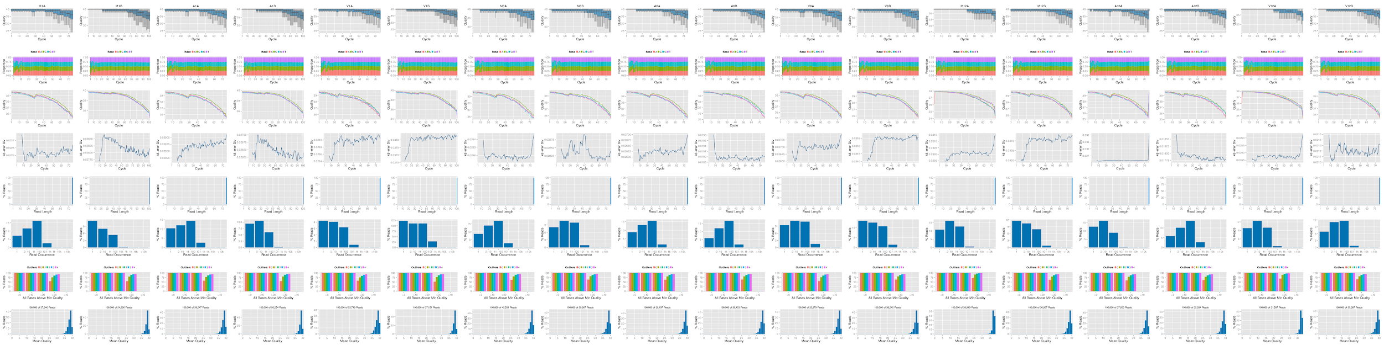
RNA-Seq Step 2: Read Quality Report

Slide 26
RNA-Seq Step 3: Alignments
Most aligners: Bowtie2/Tophat2, HISAT2, Rsubread, STAR, etc
After setting parameters, aligners run with single command:
runCommandline single computer
clusterRun computer cluster
Alignment stats generated with alignStats
FileName Nreads2x Nalign Perc_Aligned Nalign_Primary Perc_Aligned_Primary
1 M1A 192918 177961 92.24697 177961 92.24697
2 M1B 197484 159378 80.70426 159378 80.70426
3 A1A 189870 176055 92.72397 176055 92.72397
4 A1B 188854 147768 78.24457 147768 78.24457

Slide 27
RNA-Seq Step 4: Read Counting
For any annotation feature (typical RNA-Seq uses exonic gene ranges)
Many counting policies, including strand sensitive/insensitive modes
Parallelizable
Example count table generated by summarizeOverlaps:
M1A M1B A1A A1B V1A V1B M6A M6B A6A A6B V6A V6B M12A M12B A12A A12B V12A V12B
AT1G01010 28 254 203 183 371 233 45 42 156 46 295 412 126 144 135 66 235 124
AT1G01020 16 104 74 130 111 90 22 30 23 6 93 156 44 87 37 20 44 35
AT1G01030 20 108 74 60 99 159 9 14 9 7 36 157 32 33 14 10 73 91
AT1G01040 109 728 541 714 628 707 172 186 264 78 724 1098 359 671 385 89 220 187
AT1G01046 2 4 10 10 11 8 3 1 9 0 8 21 7 6 4 1 2 8
AT1G01050 39 133 112 188 142 323 128 194 148 45 248 703 365 839 205 53 216 192
AT1G01060 15 278 63 72 10 27 5 2 0 0 0 4 92 211 129 27 63 34
AT1G01070 0 0 2 1 8 8 2 4 6 4 5 15 9 46 8 0 12 2
AT1G01073 0 0 0 0 0 0 0 0 0 0 0 0 0 0 0 0 0 0
AT1G01080 49 403 182 478 300 551 115 216 82 42 153 565 264 641 80 29 81 62
AT1G01090 173 1086 803 1420 681 1860 363 552 334 143 621 1736 815 1736 287 124 402 284

Slide 28
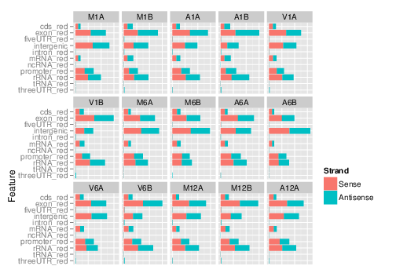
RNA-Seq Step 5: Feature Count Plots

Slide 29
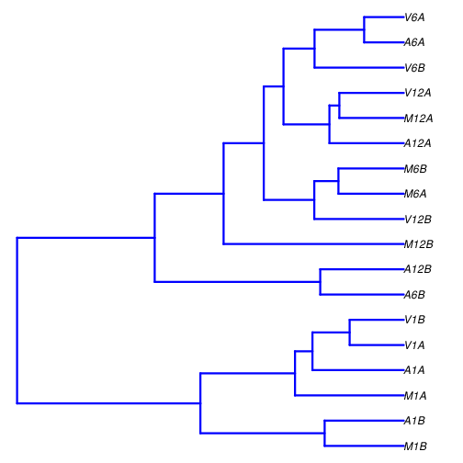
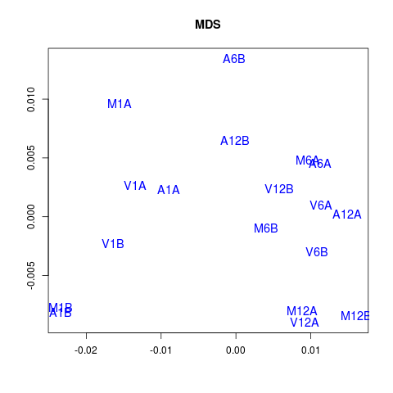
RNA-Seq Step 6: Sample Tree or MDS Plot
Sample Tree Sample MDS

Slide 30
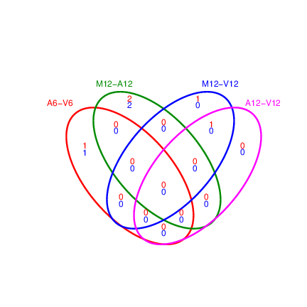
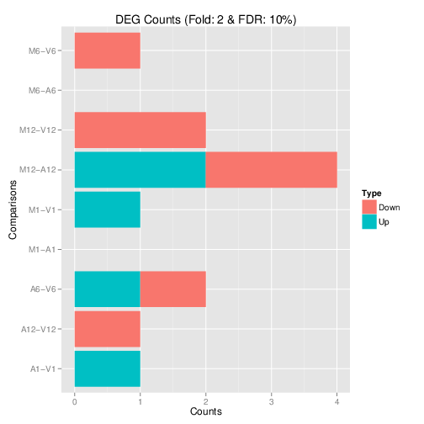
RNA-Seq Step 7: DEG Analysis
Fully automated for simple pairwise designs
Supports edgeR and DESeq2

Slide 31
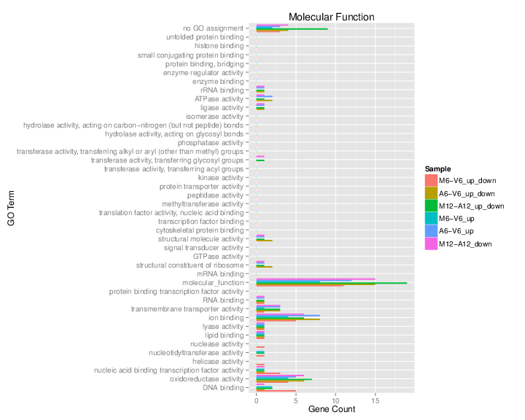
RNA-Seq Step 8: Enrichment Analysis
Automated for large numbers of clusters or DEG sets.
Full or slim GO analysis

Slide 32
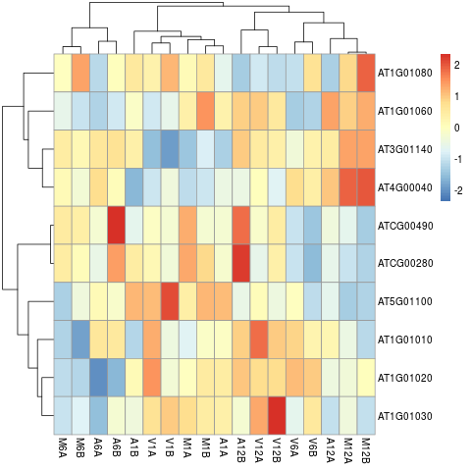
RNA-Seq Step 9: Cluster Analysis

Slide 33
RNA-Seq Step 10: Analysis Report
Based on knitr/Latex and/or R Markdown
Human generated text with citations and reference list
In text evaluation of variables
Can include all code with syntax highlighting
Images and tables generated in real time
Supported formats: PDF, HTML, etc
All functionalities are essential for reproducible research

Slide 34
RNA-Seq: Demonstration
Populate targets file: here (usually performed by person who generated sequencing libraries)
Execute workflow on cluster interactively or with single command
$ Rscript -e "rmarkdown::render('systemPipeRNAseq.Rmd')
Monitor cluster queue with squeue or online here
$ squeue # or jobMonitor
View final report in web browser: HTML version & PDF version
View some alignment results in IGV: here (region: Chr1:49,457-51,457)

Slide 35
Coming Soon
Workflow templates for:
miRNA-Seq
Methyl-Seq
Community contributions

Slide 36
Future development
Workflow templates for additional NGS applications
Support for multiple reference genomes
Automated generation of param files (will make use of docopt)
Technical parameter report and workflow graph in separate HTML file
Additional visualization functions
Streamlined support of very complex experimental designs

Slide 37
References
Huber W, Carey VJ, Gentleman R, Anders S, Carlson M, Carvalho BS, …, et al (2015) Orchestrating high-throughput genomic analysis with Bioconductor. Nat Methods 12: 115–121
Backman T and Girke T (2016) systemPipeR: NGS workflow and report generation environment. BMC Bioinformatics: 17, 1-8

