Slide 1
ChIP-Seq Technology and Data Analysis
Data Analysis in Genome Biology
GEN242
Thomas Girke
May 8, 2018

Slide 2
Outline
ChIP-Seq Technology
Experimental Design
Software
General
R/Bioconductor
Tutorial
References

Slide 3
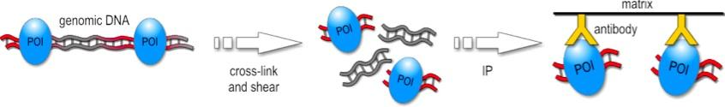
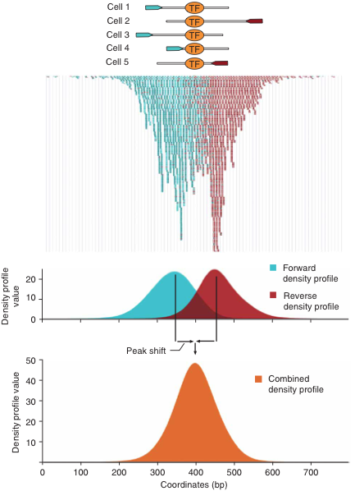
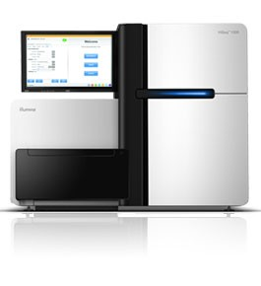
ChIP-Seq Technology
Definition: NGS-based profiling of protein-DNA interactions by chromatin immunoprecipitation (ChIP).
1. ChIP experiment (pull down)
2. NGS sequencing
3. Alignment
4. Peak Calling

Slide 4
ChIP-Seq Workflow
Align reads to reference genome
Peak calling
Differential binding analysis
Filter peaks
Annotate peaks
Gene set enrichment analysis
Motif prediction to identify putative TF binding sites

Slide 5
Outline
ChIP-Seq Technology
Experimental Design
Software
General
R/Bioconductor
Tutorial
References

Slide 6
Experimental Design
Target DNA binding protein
Can be any DNA binding protein:
Transcription factors
Histones
DNA modification enzymes
Many alternatives
Control sample (reference or input sample)
Serves as background reference during peak calling step
Optional for some peak callers, but usually improves sensitivity
Often called input sample that has been cross-linked and sonicated but not immunoprecipitated. Alternatively, one can use here immunoprecipitations of other or unspecific DNA binding proteins

Slide 7
Experimental Design
Replicates
Biological replicates are most important
Technical replicates can be useful for calibrating/optimizing larger ChIP-Seq studies
Sources of noise
Poor selectivity of the antibody used for the immunoprecipitation (pull down) step is one of the main sources of noise. This step needs to be optimized to obtain biologically meaningful results.
Insufficient read depth can be a problem especially for less selective DNA binding proteins
Variable peak width can be challenging for peak caller
Reference Experiments
To identify unique binding sites, compare the binding sites (peaks) of your DNA binding protein with published ones, e.g. in ENCODE database.

Slide 8
Outline
ChIP-Seq Technology
Experimental Design
Software
General
R/Bioconductor
Tutorial
References

Slide 9
Peak Callers (Command-line Tools)
CisGenome
ERANGE
FindPeaks
F-Seq
GLITR
MACS
PeakSeq
QuEST
SICER
SiSSRs
spp
USeq
...

Slide 10
Outline
ChIP-Seq Technology
Experimental Design
Software
General
R/Bioconductor
Tutorial
References

Slide 11
General Purpose Resources for ChIP-Seq Analysis in R
GenomicRanges: high-level infrastructure for range data
Rsamtools: BAM support
DiffBind: Differential binding analysis of ChIP-Seq peak data
rtracklayer: Annotation imports, interface to online genome browsers
edgeR and DESeq2: useful for differential binding analysis
chipseq: Utilities for ChIP-Seq analysis
ChIPpeakAnno and ChIPseeker: Annotating peaks with genome context
MotifDb: Collection of motif databases
motifStack: Stacked logo plots
PWMEnrich: PWM enrichment analysis
Bioc Workflow Link : Overview of resources ...

Slide 12
Peak Calling in R
BayesPeak: hidden Markov models (HMM) and Bayesian statistics
PICS: probabilistic inference
MOSAiCS: model-based analysis of ChIP-Seq
iSeq: Hidden Ising Models
ChIPseqR
CSAR: tests based on Poisson distribution
csaw: ChIP-seq analysis with windows
ChIP-Seq
SPP
NarrowPeaks
...

Slide 13
Outline
ChIP-Seq Technology
Experimental Design
Software
General
R/Bioconductor
Tutorial
References

Slide 14
Online Tutorial
Continue here!

Slide 15
Outline
ChIP-Seq Technology
Experimental Design
Software
General
R/Bioconductor
Tutorial
References

Slide 16
References
Bailey T, Krajewski P, Ladunga I, Lefebvre C, Li Q, Liu T, Madrigal P, Taslim C, Zhang J (2013) Practical guidelines for the comprehensive analysis of ChIP-seq data. PLoS Comput Biol 9: e1003326
Jothi R, Cuddapah S, Barski A, Cui K, Zhao K (2008) Genome-wide identification of in vivo protein-DNA binding sites from ChIP-Seq data. Nucleic Acids Res 36: 5221–5231
Kharchenko PV, Tolstorukov MY, Park PJ (2008) Design and analysis of ChIP-seq experiments for DNA-binding proteins. Nat Biotechnol 26: 1351–1359
Lun ATL, Smyth GK (2014) De novo detection of differentially bound regions for ChIP-seq data using peaks and windows: controlling error rates correctly. Nucleic Acids Res 42: e95
Pepke S, Wold B, Mortazavi A (2009) Computation for ChIP-seq and RNA-seq studies. Nat Methods 6: 22–32

Slide 17
References
Wilbanks EG, Facciotti MT (2010) Evaluation of algorithm performance in ChIP-seq peak detection. PLoS One. doi: 10.1371/journal.pone.0011471
Zhang Y, Liu T, Meyer CA, Eeckhoute J, Johnson DS, Bernstein BE, Nussbaum C, Myers RM, Brown M, Li W, et al (2008) Model-based analysis of ChIP-Seq (MACS). Genome Biol. doi: 10.1186/gb-2008-9-9-r137

