Slide 1
Analysis of VAR-Seq Data with R/Bioconductor
Data Analysis in Genome Biology
GEN242
Thomas Girke
May 10, 2018

Slide 2
Outline
Concept
Software
Data Formats
Tutorial
References

Slide 3
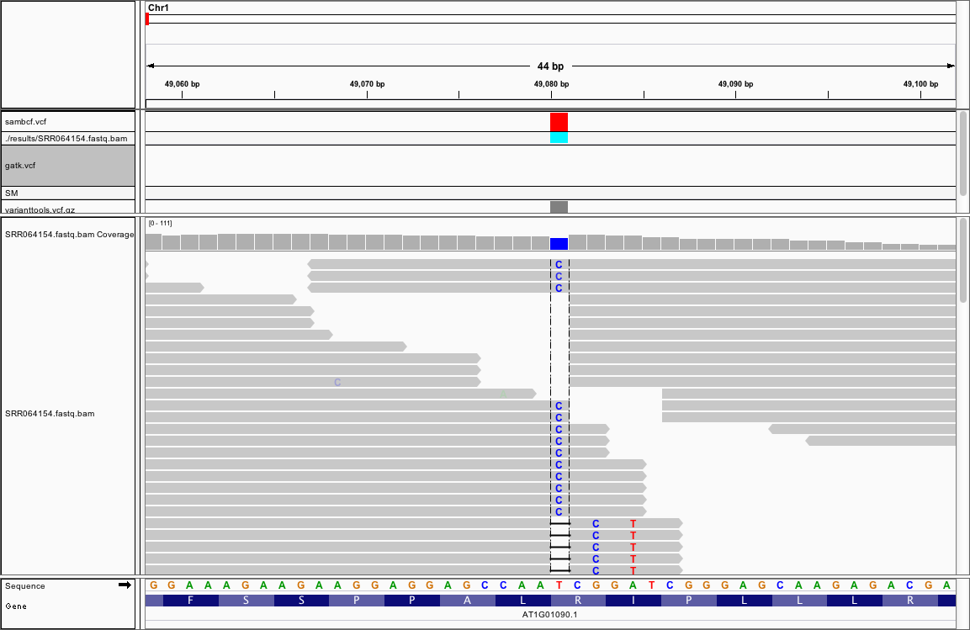
Objective and Requirements
Determine sequence differences (e.g. SNPs) of a sample in comparison to a reference genome
Usually, sample and reference need to share high sequence similarity

Slide 4
Variant Calling Principles
Simple methods using fixed cutoffs and filtering
Count alleles with high quality base calls at each site
Use frequency cutoff for calling final variants
Disadvantage:
Works only well for positions with high read coverage
Does not provide measures of uncertainty
Probabilistic methods
Provide statistical measures of uncertainty when calling variants and genotypes
Precision of variant calling can be improved by jointly analyzing multiple samples rather than single ones separately
Often built-in support for incorporating knowledge from other sources such as known variants (e.g. dbSNP)
Note: prior removal of PCR products and base quality and alignment calibration often recommended

Slide 5
VAR-Seq Workflow
Read preprocessing: quality filtering
Read mapping with variant tolerant aligner
Postprocess alignments: mark/remove PCR duplicates, indel refinement, quality score recalibration, etc.
Variant calling
Variant filtering
Variant annotation
Summary statistics of samples

Slide 6
Most Common Sources of Error
False positive variant calls
PCR errors/duplicates inflate read support
Variants from low coverage areas
Sequencing errors
False read placements
False negative variant calls
Low/no coverage
Complex rearrangements prevent read mapping

Slide 7
Outline
Concept
Software
Data Formats
Tutorial
References

Slide 8
Tools for Variant Calling
Variant Tolerant Aligners
Bowtie2, SOAPsnp, MAQ, BWA, gsnap/gmapR, ...
Alignment Processing
SAMtools, Rsamtools, Picard, …
Variant Calling
SAMtools/BCFtools, VariantTools, Rsubread (exactSNP), VarScan, SOAPsnp, MAFsnp, seqEM, QCALL, GATK, ...
Variant Annotation
VariantAnnotation, SnpEff, ANNOVAR, VariantAnnotator, …
Variant Visualization
IGV, ggbio, Gviz, ...

Slide 9
Additional Bioconductor Tools for Variant Analysis
deepSNV: Sub-clonal SNVs in deep sequencing experiments
cn.mops: Mixture of Poissons copy number variation estimates
exomeCopy: Hidden Markov copy number variation estimates
ensemblVEP: Interface to the Ensembl Variant Effect Predictor
snpStats: SnpMatrix and XSnpMatrix classes and methods
GWAStools: Tools for Genome Wide Association Studies
GGtools: eQTL identification

Slide 10
Outline
Concept
Software
Data Formats
Tutorial
References

Slide 11
Variant Call Format (VCF)
The Variant Call Format (VCF) is a standard for storing variant data. BCF is the binary version of VCF.
VCF consists of 3 main components: (i) meta-information (ii) one header line and (iii) data component
The data component is a tab-delimited table containing the following columns:
CROM: Chromosome name
POS: 1-based position. For an indel, this is the position preceding the indel.
ID: Variant identifier. Usually the dbSNP rsID.
REF: Reference sequence at POS involved in the variant. Is single base for a SNP.
ALT: Comma delimited list of alternative sequence(s).
QUAL: Phred-scaled probability of all samples being homozygous reference.
FILTER: Semicolon delimited list of filters that the variant fails to pass.
INFO: Semicolon delimited list of variant information.
FORMAT: Colon delimited list of the format of individual genotypes in the following fields.
Sample(s): Individual genotype information defined by FORMAT.
For details see here: SAMtools and 1000 Genomes

Slide 12
Online Tutorial
Continue here!

Slide 13
References
Nielsen R, Paul JS, Albrechtsen A, Song YS (2011) Genotype and SNP calling from next-generation sequencing data. Nat Rev Genet 12: 443–451
Shihab HA, Rogers MF, Gough J, Mort M, Cooper DN, Day INM, Gaunt TR, Campbell C (2015) An integrative approach to predicting the functional effects of non-coding and coding sequence variation. Bioinformatics 31: 1536–1543 PubMed
Kumar P, Henikoff S, Ng PC (2009) Predicting the effects of coding non-synonymous variants on protein function using the SIFT algorithm. Nat Protoc 4: 1073–1081 PubMed
Adzhubei I, Jordan DM, Sunyaev SR (2013) Predicting functional effect of human missense mutations using PolyPhen-2. Curr Protoc Hum Genet Chapter 7: Unit7.20 PubMed

Slide 14
References
Kumar RD, Chang L-W, Ellis MJ, Bose R (2013) Prioritizing Potentially Druggable Mutations with dGene: An Annotation Tool for Cancer Genome Sequencing Data. PLoS One 8: e67980 PubMed
DePristo MA, Banks E, Poplin R, Garimella KV, Maguire JR, Hartl C, Philippakis AA, del Angel G, Rivas MA, Hanna M, et al (2011) A framework for variation discovery and genotyping using next-generation DNA sequencing data. Nat Genet 43: 491–498 PubMed
Li H (2011) A statistical framework for SNP calling, mutation discovery, association mapping and population genetical parameter estimation from sequencing data. Bioinformatics 27: 2987–2993 PubMed
McKenna A, Hanna M, Banks E, Sivachenko A, Cibulskis K, Kernytsky A, Garimella K, Altshuler D, Gabriel S, Daly M, et al (2010) The Genome Analysis Toolkit: a MapReduce framework for analyzing next-generation DNA sequencing data. Genome Res 20: 1297–1303 PubMed

