Slide 1
Genome Annotation, Ontologies and Gene Set Enrichment
Data Analysis in Genome Biology
GEN242
Thomas Girke
May 22, 2018

Slide 2
Outline
Genome Annotation Overview
Gene Finding
Concepts
Computational Gene Prediction
Evidence-Based Gene Finding
Functional Gene Annotation
Similarity-Based Gene Annotations
Gene Ontologies
Pathway Annotation Systems
Enrichment Analysis of Gene Categories
References

Slide 3
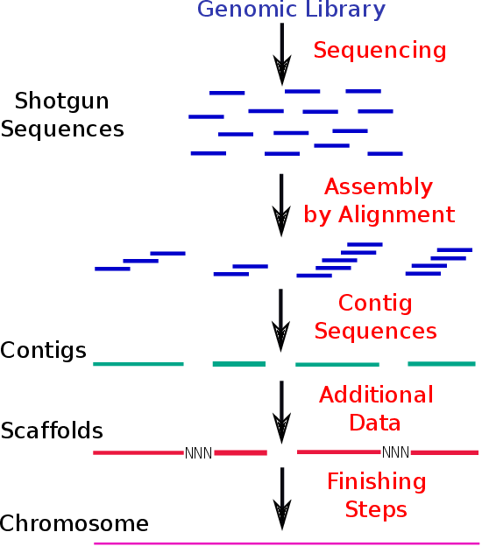
Overview of Genome Annotation Process
Sequence Assembly
Genome Annotation
Assembled Genome
Gene Finding
Functional Gene Annotation

Slide 4
Manual vs. Computational Genome Annotation
Manual annotation by human expertise
pros: accurate
cons: very slow and labor intensive
Computational annotation approaches try to perform all annotation steps by computer programs.
pros: fast
cons: sometimes inaccurate
Ideally, both manual and computational annotation approaches are used and complement each other in the same annotation pipeline.

Slide 5
Outline
Genome Annotation Overview
Gene Finding
Concepts
Computational Gene Prediction
Evidence-Based Gene Finding
Functional Gene Annotation
Similarity-Based Gene Annotations
Gene Ontologies
Pathway Annotation Systems
Enrichment Analysis of Gene Categories
References

Slide 6
Gene Finding
Gene finding is the process of identifying coding and non-coding genes in genomes.
It is often the first and most important step in analyzing and understanding a new genome.
Two main gene finding approaches exist:
Computational gene prediction
Ab initio methods
Homology-based methods
Evidence-based gene finding
Usually genome annotation projects combine all of the above approaches to a pipeline that aims to maximize the accuracy of the gene finding process by using the most reliable method for each gene prediction.

Slide 7
Genome Annotations Are Never Final
Gene finding effort results in gene models and not in final gene annotations.
The term gene model stresses the fact that the gene annotations are usually never final, because they are subject to a continuous revision process which keeps improving their quality.
For instance, the identification of a new full-length cDNA may provide evidence for a longer 5’ UTR region of an already well-supported gene model.

Slide 8
What Are We Looking For?
Chromosomes
...AGTCATCTAATTACCATCTAATTACCTAGTCATTACT...
Thousands of genes
Gene
*
Promoter
5’ UTR
Exon
Intron
Exon
Intron
Exon
3’ UTR
Transcribed sequence
TU
5’ UTR
Exon
Intron
Exon
Intron
Exon
3’ UTR
ORF (CDS)
Exon
Exon
Exon
Translation
Protein
NH2
Protein
COOH
*Note: UTRs can be composed of exons and introns

Slide 9
What Can We Predict?
Complete gene structure: entire gene model rarely available
Promoter
5’ UTR
Exon
Intron
Exon
Intron
Exon
3’ UTR
⇒ In eukaryotic organisms only available for well studied genes.
Computational prediction of gene structures ⇒ ORF/CDS with Introns
Exon
Intron
Exon
Intron
Exon
⇒ Can provide complete protein model by translating combined exon sequences.
⇒ Promoter and UTR sequences cannot be predicted reliably.
Evidence-based gene finding ⇒ TU
5’ UTR
Exon
Intron
Exon
Intron
Exon
3’ UTR
⇒ Can provide complete protein model by translating combined exon sequences.
⇒ Can provide complete TUs including 5’ and 3’ UTR sequences.
⇒ Annotations of promoter regions require much more experimental evidence.

Slide 10
Computational Gene Prediction by Ab Initio Methods
Ab Initio Gene Prediction in Prokaryotes
Is relatively easy and reliable in prokaryotes.
Can be accomplished by identifying all open reading frames above a certain length.
Ab Initio Gene Prediction in Eukaryotes
Is often difficult and not so reliable in eukaryotes.
Main challenge: open reading frames are disrupted by introns.
Identify rough coding region by typical compositional nucleotide bias. This bias varies among organism groups.
Once a gene region is identified, one can build a gene model from a variety of signals, such as:
Coding sequence signals, e.g. start and stop codons.
Intron signals, e.g. intron boundaries:
Promoter signals, e.g. TATA boxes or CpG islands. The latter are characteristic stretches of CG dinucleotide that often occur in or near mammalian promoters.
Exon
GT…AG
Exon

Slide 11
Computational Gene Prediction by Homology
Homology approaches are based on the assumption that many genes of newly sequenced organisms should have homologs available in existing sequence databases.
If the gene annotations of these homologs are of high-quality, then they can be used for annotating the genes of a newly sequenced organism by sequence similarity searches, such as BLAST.
The choice of the best database is most critical for this approach.
As a rule of thumb, one can select the database based on the following criteria:
Use the annotated gene sequences of a closely related organism with a well annotated genome.
If such a well annotated genome is not available, then one can use a multipurpose protein sequence database, such as SwissProt or UniProt. These databases contain the annotated protein sequences for organisms from all kingdoms with sequence information.

Slide 12
Evidence-Based Gene Prediction
The most reliable models of gene structures can be obtained by aligning EST/RNA-Seq and full-length cDNA sequences to the target genome.
These mRNA-to-genome alignments usually provide the most accurate and complete models of the transcriptional units (TU) of a gene.
Generate gene models from mRNA to genome alignments:
Genomic DNA
mRNA
Alignment
ATG
Gene or TU Model
STOP
5’ UTR
Exon
Intron
Exon
Intron
Exon
3’ UTR
Translation of coding exons
NH2
Protein
COOH

Slide 13
Some Important Conclusions
Gene finding approaches provide only positional information about genes (start and end on chromosome), but nothing about their functional role in an organism (e.g. biological role of gene product).
Protein sequences are almost exclusively derived from the translation of their gene models. Thus, most protein sequences are working models!
The boundaries of promoter sequences are not well defined in genome annotations. Often the sequence upstream of the TU is considered to be the promoter area.
5’ and 3’ UTR sequence are only available for gene models with mRNA (cDNA or EST/RNA-Seq) support.

Slide 14
Genome Annotations Are Stored in GFF/GTF Files
GFF/GTF format definitions see Ensembl and SO sites.
Note: in R read/write functionality for GFF/GTF files is provided by the rtracklayer package. The makeTxDbFromGFF function from the GenomicFeatures package is used to store transcript annotations from GFF files as TxDb object (SQLite database).
Sample code for converting a GFF file (downloaded from Ensembl’s FTP site) to a TxDb object, e.g. for RNA-Seq read counting with summarizeOverlaps:
download.file("some_ensembl.gff.gz", "my.gff") # Download annotations from Ensembl txdb <- makeTxDbFromGFF("my.gff", ...) # Generate txdb read_counts <- summarizeOverlaps(ebyg, "bam_file.list", ...) # Read counting

Slide 15
Software Tools
Gene Finding
GENSCAN
FGENESH
GeneMark
GLIMMER
...
mRNA to Gene Alignments
Spidey (NCBI)
BLAT
est2genome (EMBOSS)
...

Slide 16
Outline
Genome Annotation Overview
Gene Finding
Concepts
Computational Gene Prediction
Evidence-Based Gene Finding
Functional Gene Annotation
Similarity-Based Gene Annotations
Gene Ontologies
Pathway Annotation Systems
Enrichment Analysis of Gene Categories
References

Slide 17
Functional Gene Annotations
One of the most important questions in the annotation process of genomes is the functional characterization of all identified genes.
The function of genes can be identified by experiments (e.g. knockout lines). However, experimental verification of gene functions takes a lot of time.
Much faster solution: the similarity-based annotation approach allows to provide putative functions for genes by sequence similarity searches. This way one can functionally annotate new genomes very quickly.
Similarity-based annotation approaches aim to identify in well annotated databases closely related genes that are functionally characterized. Their functional annotations are then used as putative functions for the genes of the newly sequenced genome.
Subsequently, manual curation steps by humans are necessary to improve the quality of the computational annotations.

Slide 18
Functional Gene Annotation by BLAST Searches
The identified protein sequences of a newly sequenced genome are used for BLASTP searches against reference databases that contain functionally well characterized proteins.
Choice of reference database:
Reference Genome
If a well annotated genome sequence of a closely related organism is available, use the protein database of this organism.
Universal Protein Databases
If a well annotated reference genome is not available, then one can use one of the universal protein databases that contain highly annotated sequences from all organism kingdoms. The most commonly used databases for this purpose are:
SwissProt
UniProt
Non-redundant protein database from NCBI

Slide 19
Functional Annotation Using Conserved Domains
Usually related genes and proteins share only a high degree of similarity in functional important regions, which are called protein domains.
These conserved domains often co-align with characteristic segments of their 3D structure, which are known as protein folds.
Often proteins contain several distinct domains, e.g. receptor kinase has a receptor domain and a kinase domain.
These domains - rather than entire genes or proteins - are the functional building blocks of evolution.
One of the most widely used domain databases is the Pfam database.
Pfam URL: http://pfam.xfam.org/

Slide 20
Functional Annotation Using Conserved Domains
To annotate new genomes, one can identify the presence of Pfam domains in their protein sequences.
The resulting domain structure provides important information about their functional features.
Example of a protein encoded in a newly sequenced genome:
New protein
Pfam domains
Domain Functions Receptor Kinase
Conserved domains are usually represented as profile hidden Markov models (profile HMMs). The current version of the Pfam database contains over 16,000 domain models.
HMM domain searches are used for identifying conserved domains in a query protein.
NH2
New Protein
COOH
Domain 1
Domain 2

Slide 21
Functional Annotation Using Conserved Motifs
Protein motifs represent the most highly conserved residues in related protein sequences, which are usually much shorter than protein domains.
Often they are located within conserved domain regions of protein sequences.
Often they represent the functionally most important residues of a protein, such as the residues that interact directly with the substrates and cofactors of an enzyme.
Example Cytochrome P450 Pfam domain with PROSITE motif:
New protein
Pfam domains
PROSITE Motif
NH2
New Protein
COOH
P450 Domain
[FW]-[SGNH]-x-[GD]-{F}-[RKHPT]-{P}-C-[LIVMFAP]-[GAD]

Slide 22
Functional Annotation Using Conserved Motifs
To annotate new genomes, one can identify the presence of conserved motifs in their protein sequences.
The resulting motif matches provide important information about their functional features.
The PROSITE database contains a large collection of conserved protein motifs that are well annotated.
PROSITE URL: http://expasy.org/prosite/

Slide 23
Some Important Conclusions
Remember: BLAST, domain and motif searches utilize very different algorithms and databases.
BLASTP: protein sequence database (e.g. SwissProt)
Domain search: domain (HMM) database (e.g. Pfam)
Motif search: motif database (e.g. PROSITE)
Although the results from these three search types provide overlapping information, all three are useful for annotating new protein sequences functionally.

Slide 24
Outline
Genome Annotation Overview
Gene Finding
Concepts
Computational Gene Prediction
Evidence-Based Gene Finding
Functional Gene Annotation
Similarity-Based Gene Annotations
Gene Ontologies
Pathway Annotation Systems
Enrichment Analysis of Gene Categories
References

Slide 25
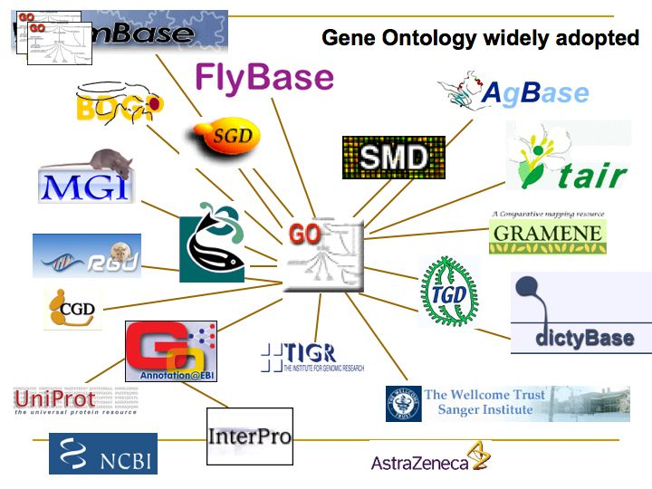
Community Network

Slide 26
Gene Ontology (GO) Consortium
Formed to develop a shared language describing the functional components of genomes.
Adequate for the annotation of molecular characteristics across organisms.
Seeks to achieve a mutual understanding of the definition and meaning of any word used.
Supports cross-database queries
Members provide gene product annotations to GO database.
Facilitates data analysis and semantic interoperability

Slide 27
What Are Ontologies?
A machine interpretable representation of the different components and features of a system (e.g. organism).
What components exist? Example:
Nucleus
Genome
What are their relationships?
Genome is part of nucleus
Nucleus is a cell compartment
Solution: controlled vocabulary system developed and maintained by Gene Ontology Consortium
Relationships of components (terms): represented in a graph

Slide 28
Gene Ontologies?
Gene Ontologies (GO) are an annotation system that describes functions of genes and their products.
GO consists of three ontologies:
Molecular Function (MF): molecular activity/task of genes
Examples: carbohydrate binding and ATPase activity
Biological Process (BP): broader biological function
Examples: involved in mitosis or purine metabolism, accomplished by ordered assemblies of molecular functions
Cellular Component (CC): subcellular location or component of complex
Examples: nucleus, mitochondria or part of RNA polymerase II holoenzyme

Slide 29
GO Term Relationships Are Organized in DAG
GO terms can be linked by two relationships:
is_a: class-subclass relationship, for example, nuclear chromosome is_a chromosome.
part_of: C part of D means that when C is present, it is a part of D, but C does not always have to be present. For example, nucleus is part_of cell.
The ontologies are structured as DAGs (directed acyclic graphs).
DAGs are similar to hierarchies but a child term can have multiple parent terms. For example, the biological process term hexose biosynthesis has two parents: hexose metabolism and monosaccharide biosynthesis.

Slide 30
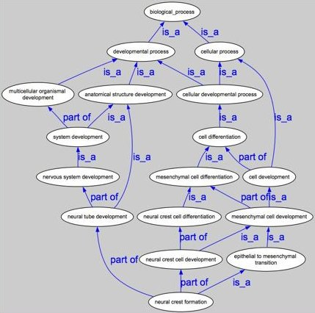
DAG Example

Slide 31
Evidence Codes
The supporting data type for GO annotations can be tracked by their evidence codes. The current set of evidence codes are:
IDA: Inferred from direct assay
IPI: Inferred from physical interaction
IMP: Inferred from mutant phenotype
IGI: Inferred from genetic interaction
IEP: Inferred from expression pattern
IEA: Inferred from electronic annotation
ISS: Inferred from sequence or structural similarity
TAS: Traceable author statement
NAS: Non-traceable author statement
IC: Inferred by curator
RCA: Reviewed Computational Analysis
ND: no data available

Slide 32
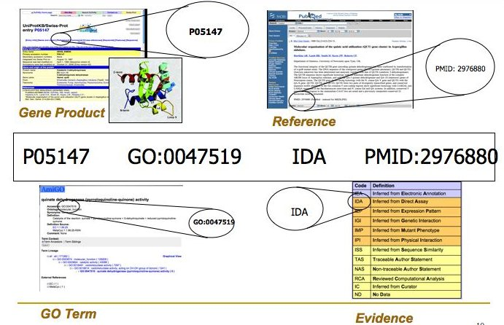
Annotating Genes with GO

Slide 33
Dynamics of GO Annotations
Everything is under a dynamic change:
GO Term Inventory: frequently new terms are created, others discontinued and new relationships are established.
Gene-to-GO Mappings: updated by genome annotation projects on a weekly basis.
Consequence: it is important to use always the most up-to-date annotations.

Slide 34
Challenges with GO
Complex data structure
Nothing is unique:
Genes have mappings to many GO terms within each ontology.
Quality of the Gene-to-GO term mappings high for model organisms (manually curated).
In-silico Gene-to-GO term mappings often of low quality.
Despite these challenges, GO is the best and most complete annotation system!!

Slide 35
What is GO Slim Analysis?
GO slims are cut-down versions of the GO ontologies containing a subset of the terms in the whole GO.
They give a broad overview of the ontology content.
GO slims are particularly useful for giving a summary of the GO annotations of a genome, microarray, or cDNA collection when broad classification of gene product function is required.
GO slims are created by users according to their needs, and may be specific to species or to particular areas of the ontologies.
Any type of enrichment test can be applied to the GO slim categories.

Slide 36
How to Work with GO?
Most important online site: geneonotology.org
Working with GO in R:
## Load GOstats library
library(GOstats); library(GO.db)
## Print complete GO term information for "GO:0003700"
GOTERM$"GO:0003700"
## Print parent and children terms for a GO ID
GOMFPARENTS$"GO:0003700"; GOMFCHILDREN$"GO:0003700"
## Print complete lineages of parents and children for a GO ID
GOMFANCESTOR$"GO:0003700"; GOMFOFFSPRING$"GO:0003700"
## Print number of GO terms in each of the 3 ontologies
zz <- eapply(GOTERM, function(x) x@Ontology); table(unlist(zz))
## Gene to GO mappings for an organism (here Arabidopsis)
library(org.At.tair.db) # For human use org.Hs.eg.db
xx <- as.list(org.At.tairGO2ALLTAIRS)
More on this in the GO Section of the R and BioConductor Manual

Slide 37
Alternative Annotation Systems
Pathway annotation systems assign gene products to pathway maps.
REACTOME: pathway database
KEGG (Kyoto Encyclopedia of Genes and Genomes): pathway database
WIT: pathway database for bacteria
EcoCyc: pathway database for bacteria
AraCyc: pathway database for Arabidopsis
DO: disease ontology
Many more...
Advantages over GO: simpler data structure, less duplications
Disadvantages: low genome coverage (∼30%), contains only molecular information content.

Slide 38
Outline
Genome Annotation Overview
Gene Finding
Concepts
Computational Gene Prediction
Evidence-Based Gene Finding
Functional Gene Annotation
Similarity-Based Gene Annotations
Gene Ontologies
Pathway Annotation Systems
Enrichment Analysis of Gene Categories
References

Slide 39
Enrichment Analysis of Functional Annotations
Most high-throughput data analysis projects result in large sets of candidate genes, such as lists of DEGs or genes in clusters.
The challenge is to understand what functions the genes in a given list have in common.
Statistical enrichment analysis of functional annotations provide here a powerful solution.
They help to identify which functional annotations are overrepresented in a set of genes.
The following functional annotations are often used:
Gene Ontologies - GO (most common)
Pathway annotations (e.g. KEGG, DO)
Pfam domains
The statistical enrichment tests used for this purpose include:
Tests based on the hypergeometric distribution
Fisher’s exact test (one-tailed)
Gene set enrichment analysis (GSEA)
Many others

Slide 40
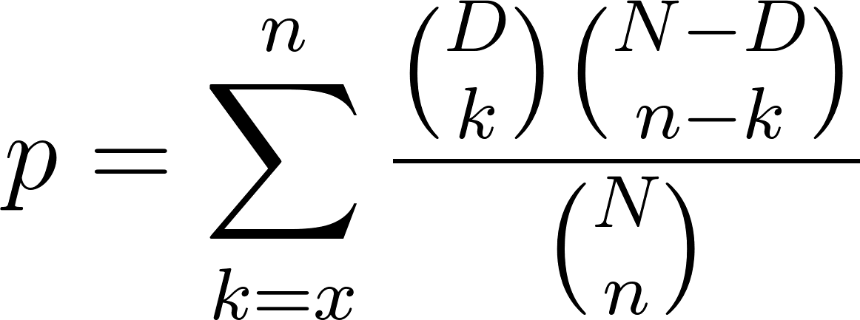
Hypergeometric Distribution
Describes the probability that exactly k objects are identical in a sample of n distinct objects drawn from an object pool without replacement. Its cumulative probability (p-value: the chance of encountering a specific observation for a given background distribution) can be calculated by the following equation:
N: total number of objects
for GO: total number of annotated genes
D: number of specific objects
for GO: number of genes annotated at specific node
n: total number of drawn objects
for GO: total number of genes in test sample
k: number of specific objects in drawn sample
for GO: number of genes in sample annotated at specific node
Very similar to the corresponding one-tailed version of Fisher’s exact test.
GO DAG

Slide 41
Applications of Hypergeometric Distribution
Motif/pattern enrichment (e.g. promoter motifs)
Enrichment of functional terms (GO, KEGG, Pfam, etc.)
Many other applications

Slide 42
Enrichment of GO Terms in Gene Sets
GO Term Enrichment Analysis with GOstats Package
## Load required packages
# module load R/3.3.0
library(GOstats); library(GO.db); library(org.At.tair.db)
## Define universe and test sample set
geneUniverse <- keys(org.At.tairGENENAME)
geneSample <- c("AT2G46210", "AT2G19880", "AT2G38910", "AT5G25140", "AT2G44525")
## Generate params object
params <- new("GOHyperGParams", geneIds = geneSample,
universeGeneIds = geneUniverse,
annotation="org.At.tair", ontology = "MF", pvalueCutoff = 0.5,
conditional = FALSE, testDirection = "over")
## Run enrichment test
hgOver <- hyperGTest(params)
## Viewing of results
summary(hgOver)[1:4,]
htmlReport(hgOver, file = "MyhyperGresult.html")

Slide 43
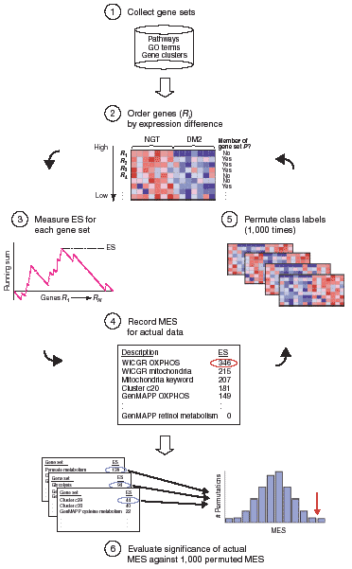
Gene Set Enrichment Analysis (GSEA)
Question: is a gene category/set S enriched on top of a ranked gene list?
Rank list based on expression differences.
Test if gene category/set is enriched on top of list using K-S (Kolmogorov-Smirnov) running sum statistic:
Begin with top-ranking gene
Running sum increases if gene is part of S
ES is greatest pos deviation of the running sum for all genes
If many members of S appear at the top of the list, then ES is high
The MES (max ES) is computed for all gene categories/sets
To determine enrichment in different classes, perform permutations of gene category assignments: repeat steps 2-4 ∼1000 times.
The permutation data is used to build a histogram of the maximum ESs. The MES achieved using the actual data (red arrow) is used to provide a global p-value for a given histogram.

Slide 44
GO and GSEA Software (Selection)
Bioconductor Packages
GOstats
clusterProfiler
limma
GOseq
SPIA
GO.db
GSEAlm
SeqGSEA
…
Online Resources
DAVID
GSEA Online at Broad Institute
...

Slide 45
Outline
Genome Annotation Overview
Gene Finding
Concepts
Computational Gene Prediction
Evidence-Based Gene Finding
Functional Gene Annotation
Similarity-Based Gene Annotations
Gene Ontologies
Pathway Annotation Systems
Enrichment Analysis of Gene Categories
References

Slide 46
References
Falcon, S, Gentleman, R (2007) Using GOstats to test gene lists for GO term association Bioinformatics, 23: 257-258 URL http://www.hubmed.org/display.cgi?uids=17098774
Mootha, VK, Lindgren, CM, Eriksson, KF, Subramanian, A, Sihag, S, Lehar, J, Puigserver, P, Carlsson, E, Ridderstrle, M, Laurila, E, Houstis, N, Daly, MJ, Patterson, N, Mesirov, JP, Golub, TR, Tamayo, P, Spiegelman, B, Lander, ES, Hirschhorn, JN, Altshuler, D, Groop, LC (2003) PGC-1alpha-responsive genes involved in oxidative phosphorylation are coordinately downregulated in human diabetes. Nat Genet, 34: 267-273 URL http://www.hubmed.org/display.cgi?uids=12808457
Subramanian, A, Tamayo, P, Mootha, V K, Mukherjee, S, Ebert, B L, Gillette, M A, Paulovich, A, Pomeroy, S L, Golub, T R, Lander, E S, Mesirov, J P (2005) Gene set enrichment analysis: a knowledge-based approach for interpreting genome-wide expression profiles. Proc Natl Acad Sci U S A, 102: 15545-15550 URL http://www.hubmed.org/display.cgi?uids=16199517

