Slide 1
Introduction to De Novo Assemblies of Genomes and Transcriptomes
Data Analysis in Genome Biology
GEN242
Thomas Girke
May 22, 2018

Slide 2
Outline
Sequencing Strategies
Assembly Algorithms
Transcriptome Assembly
References

Slide 3
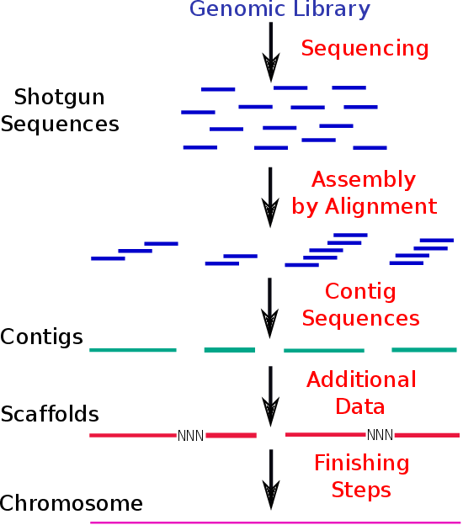
Overview of Genome Assembly and Annotation Process
Sequence Assembly
Genome Annotation
Assembled Genome
Gene Finding
Functional Gene Annotation

Slide 4
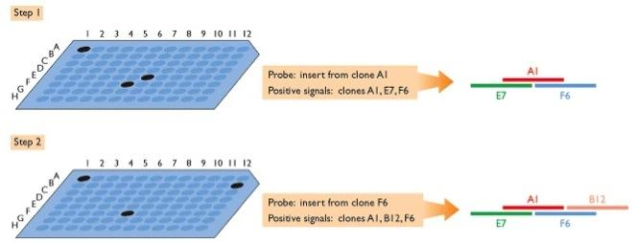
BAC Sequencing
E.g. sequence and assemble BACs, find overlapping ones via hybridization approach, and then sequence those.
More reliable than shotgun sequencing, but also much slower.

Slide 5
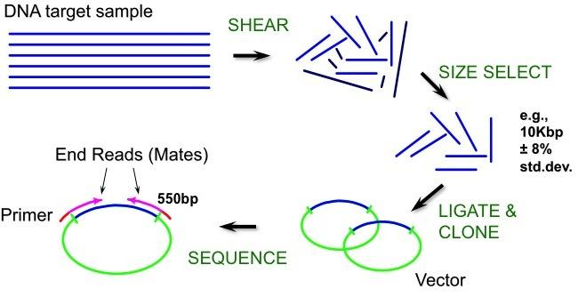
Shotgun Sequencing

Slide 6
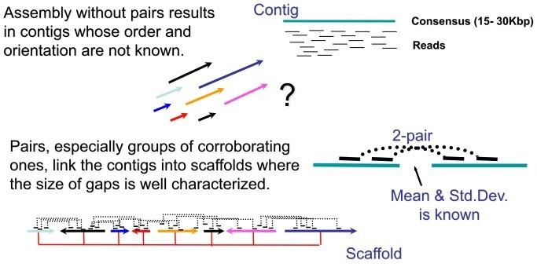
Paired-end Reads Order and Connect Contigs to Scaffolds

Slide 7
Sequencing Technologies for Assemblies
Sanger sequencing (not common for assemblies anymore)
Short Read NGS (Next Generation Sequencing)
Illumina HiSeq, MiSeq, other
Roche/454
Ion Torrent
Many other
Long Read NGS
Single molecule, long read sequencing, e.g. PacBio
Illumina reduced complexity sequencing (many local assemblies)
Many other
Combinatorial approaches
Short read NGS preassembly
Improvement (hybrid assembly) with error corrected long reads
Targeted approaches
10x Genomics Sequencing

Slide 8
Outline
Sequencing Strategies
Assembly Algorithms
Transcriptome Assembly
References

Slide 9
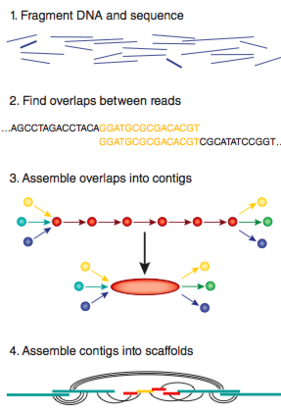
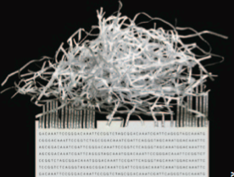
NGS Assemblies: Challenging Application

Slide 10
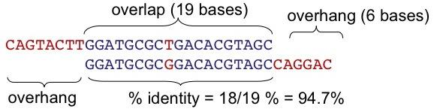
All We Have Are Overlaps Among Sequences
overlap: region of similarity between regions
overhang: unaligned ends of the sequences
The assembler can screen merges based on:
length of overlap
% identity in overlap region
maximum overhang size

Slide 11
Assembly Algorithms
Overlap-Then-Extend (OTE) Algorithm
Long reads
Software: TIGR Assembler, PHRAP, CAP3, ...
Overlap-Layout-Consensus (OLC) Algorithm
Long reads
Software: Celera Assembler, Arachne, ...
String Graph-Based Algorithm
Short reads
Software: Edena, SGA, ...
de Bruijn Graph (DBG) Algorithm
Short reads
Software: Velvet, ABySS, SOAPdenovo, ALLPATHS-LG, Platanus, and Euler-SR, ...

Slide 12
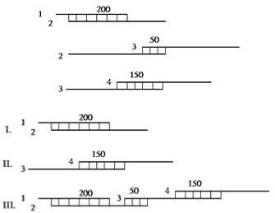
A. Overlap-Then-Extend (OTE) Algorithm
Steps
Build map of fragment overlaps
Pick best scoring overlap
Merge the two fragments
Repeat until no more merges possible

Slide 13
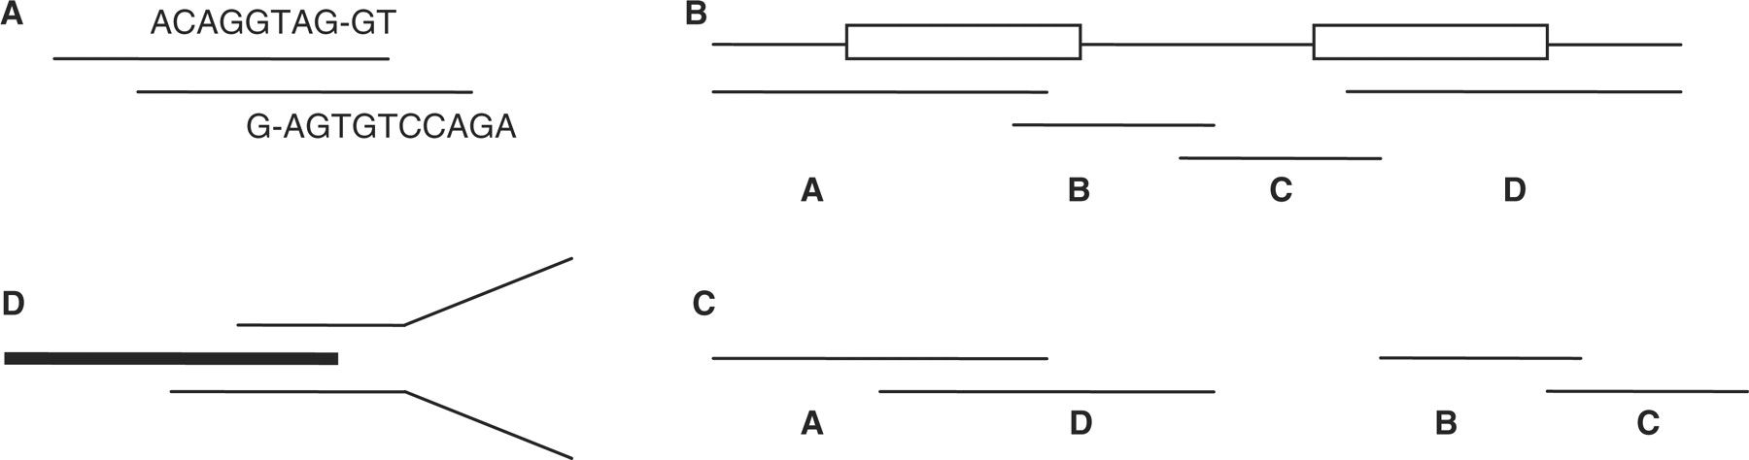
Typical Error of Greedy OTE Approach
Overlap between two reads; agreement within overlapping region need not be perfect
Correct assembly of genome with 2 repeats (boxes) using 4 reads A-D
Assembly produced by the greedy approach. Reads A and D are assembled first incorrectly, because they overlap best.
Disagreement between two reads (thin lines) that could extend a contig (thick line), indicating a potential repeat boundary. Contig extension must be terminated in order to avoid misassemblies.

Slide 14
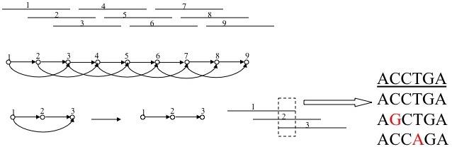
B. Overlap-Layout-Consensus (OLC) Algorithm
Main entity: read
Relationship between reads: overlap

Slide 15
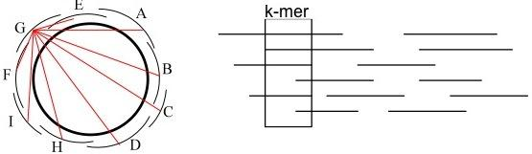
All Pairs Alignment
Needed by the assembler
If we try all pairs, we must consider ∼ n²
Smarter solution: only n x coverage (e.g. 8) pairs
Build a table of k-mers contained in sequences (single pass through data)
Generate the pairs from k-mer table (single pass through k-mer table)

Slide 16
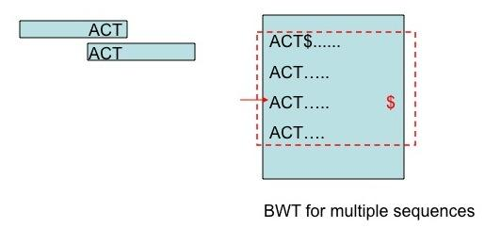
C. String Graph-based Algorithm
BWT-based overlap detection
Efficient construction of an assembly string graph using the FM-index (Simpson and Durbin, 2010)

Slide 17
D. de Bruijn Graph (DBG) Algorithm
Break each read into k-mers (typically k ≥ 19)
Construct a de Bruijn graph using the k-mers from all reads
Each k-mer is a node
k-mer v1 has a directed edge to v2 if v1 can be expressed by removing the last char from v2 and adding a new char at the beginning of v2, e.g.:
v1 = acgtctgact
v2 = cgtctgactg
Find an Eulerian path in the graph
Method visits each edge exactly once
Contigs are constructed according to graph traversal

Slide 18
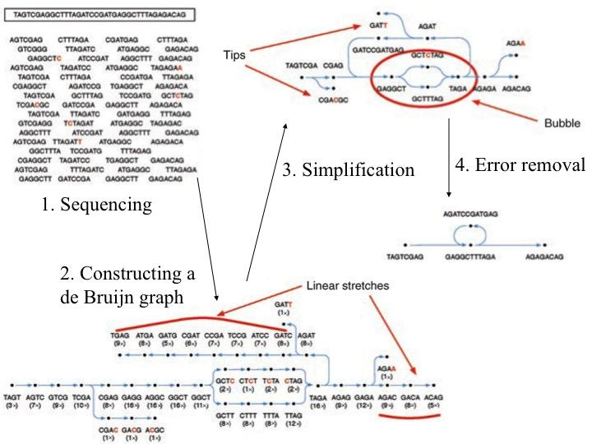
Constructing and Visualizing a de Bruijn Graph
From Flicek and Birney (2009)

Slide 19
Constructing and Visualizing a de Bruijn Graph
7-bp reads sequenced from genome above. Read errors are in red.
k-mers (here 4-mers) are extracted; assigned to nodes and connected with edges if they are adjacent in reads; the k-mer coverage at each node is recorded. There are continuous linear stretches within the graph, and the sequencing errors create distinctive, low-coverage features throughout the graph.
Graph is simplified by collapsing nodes which effectively results in longer sequences assigned to nodes.
Error correction removes tips and bubbles resulting from sequencing errors and creates a final graph structure that accurately and completely describes in the original genome

Slide 20
Advantages: Eulerian Path-based Assembly
No need to compute pairwise overlaps - important for NGS data
Eulerian paths are much easier to find than Hamiltonian path
Disadvantage: multiple Eulerian paths may exist
Loss of information
Repeats appear as cycles in the graph
Less likely to cause mis-assembly in Eulerian path-based assemblies
More suitable for short read assembly

Slide 21
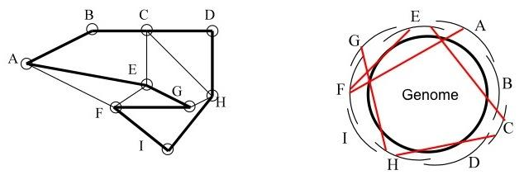
Paths Through Graphs and Assembly
Hamiltonian circuit: visit each node (city) exactly once, and return to the start
Hamiltonian path: visit each node (city) exactly once

Slide 22
Unitig Reduction and Scaffolds
Unitig concept introduced by Celera assembler (Venter et al., 2001; Miller et al., 2010)
Complexity of graph can be greatly reduced by removing transitively inferable overlaps.
Unitigs are uniquely assembled contigs
Unitigs can be connected by paired-end reads to scaffolds
Close reference genomes and physical maps can provide additional evidence for scaffolding

Slide 23
Repeat Handling
Repeat detection
Pre-assembly: find fragments that belong to repeats
Statistically (most existing assemblers)
Repeat database (RepeatMasker)
During assembly: detect ”tangles” indicative of repeats (Pevzner et al., 2001)
Post-assembly: find repetitive regions and potential mis-assemblies.
Reputer, RepeatMasker
Unhappy mate-pairs (too close, too far, mis-oriented)
Repeat resolution
Find DNA fragments belonging to the repeat
Determine correct tiling across the repeat

Slide 24
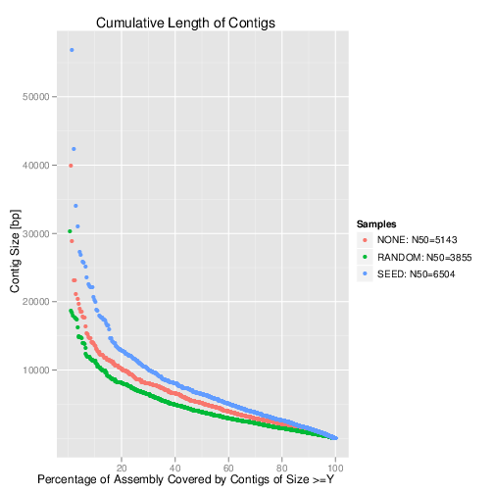
Quality Assessment of Assemblies
N50: 50% of the entire assembly is contained in contigs equal to or larger than this value, usually given in base pairs.
Note: there are many other metrics to evaluate the quality of assembly results, e.g. coverage of close reference, mis-assembly frequency, etc.
One should always assess a large number of them. For more details see: Vezzi et al. (2012); Magoc et al. (2013); Salzberg et al. (2012); Earl et al. (2011); Bradnam et al. (2013)

Slide 25
NGS Assembly Software
Genome Assembly
IDBA, SSAKE, SHARCGS, MIRA, VCAKE, Newbler, Celera Assembler, Euler, Velvet, ABySS, ALLPATHS2, ALLPATHS-LG, SOAPdenovo, Ray, ...
Transcriptome Assembly
Velvet/Oases, Trinity, Trans-ABySS, SOAPdenovo-Trans, T-IDBA, ...
Performance of assemblers vary from genome to genome
Optimization: different assemblers, parameters, etc.
Quality assessment essential, e.g. length coverage of related genome/transcriptome
Main improvements will come from increased read length.

Slide 26
Outline
Sequencing Strategies
Assembly Algorithms
Transcriptome Assembly
References

Slide 27
Workflow: RNA-Seq Assembly/Profiling
Applies to organism without genome sequence!
Assembly Stage
RNA-Seq libraries from broad tissue range
Illumina ∼100-150bp paired-end sequencing (directional if possible)
Preprocessing: QC Filtering, error correction, clustering
de novo assembly (e.g. Velvet/Oases, Trinity)
Cluster transcripts into unigene set
Annotation of transcripts
⇒ typically 60-80% of genes with full-length transcripts
Profiling Stage
RNA-Seq libraries from tissues of interest
Illumina ∼50bp paired-end sequencing
RNA profiling by aligning reads against transcripts
Comparative analyses, splice variant analysis
⇒ typically 80-90% of genes from assembled transcripts are expressed

Slide 28
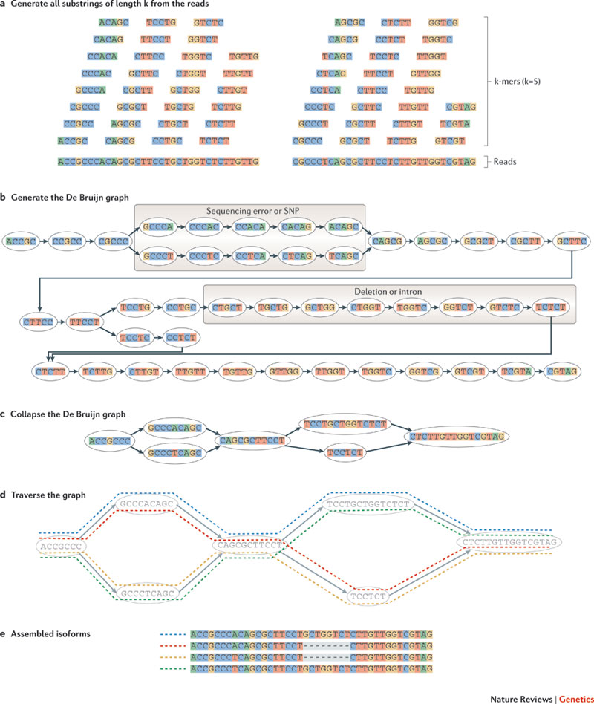
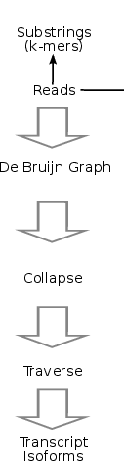
de novo Transcriptome Assembly
From Martin and Wang (2011)

Slide 29
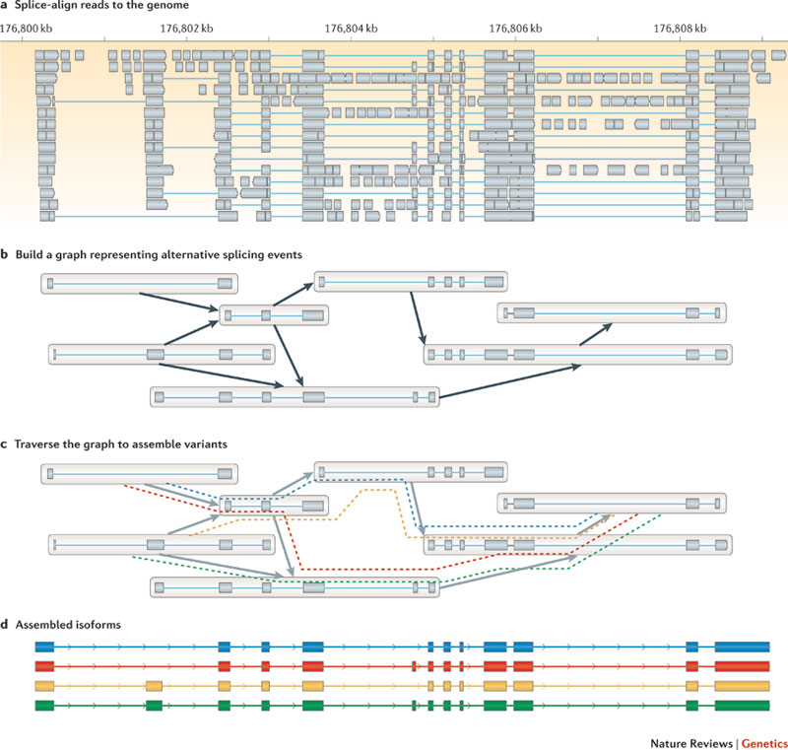
Reference-based (ab initio) Transcriptome Assembly

Slide 30
Challenges: Transcriptome Assemblies
Challenges Specific to Transcriptome Assemblies
Highly variable abundance of mRNA species
Secondary structures can result in fragmented transfrags
Many genes are too low expressed to be assembled
Transcriptome assemblies unlikely to reflect entire gene inventory of an organism
Alternative/incomplete splicing causes many complications
Overestimation of true set of alternatively spliced transcripts
Assessment of functionally relevant splice variants difficult
Some Improvements
Sample RNA from wide spectrum of tissues
Include normalized libraries in assembly
PE libraries with variable insert length

Slide 31
Conclusions
Modern assembly algorithms perform extremely well with synthetic sequences, but much less effective with real biological sequences mainly due to sequence repeats and sequencing errors
Main challenges
Impossible to resolve repeats or highly similar gene family members with short NGS
Uneven coverage (e.g. RNA-Seq)
Base call errors
Difficult to sequence areas (e.g. secondary structures)
Contaminations
As a result, even the best curated reference sequence contains assembly mistakes!
Common assembly errors: truncated contigs, chimeric sequences and base call errors enriched in low coverage regions

Slide 32
Outline
Sequencing Strategies
Assembly Algorithms
Transcriptome Assembly
References

Slide 33
References
Bradnam KR, Fass JN, Alexandrov A, Baranay P, Bechner M, Birol I, Boisvert S, Chapman JA, Chapuis G, Chikhi R, et al (2013) Assemblathon 2: evaluating de novo methods of genome assembly in three vertebrate species. Gigascience 2: 10
Earl D, Bradnam K, St John J, Darling A, Lin D, Fass J, Yu HOK, Buffalo V, Zerbino DR, Diekhans M, et al (2011) Assemblathon 1: a competitive assessment of de novo short read assembly methods. Genome Res 21: 2224–2241
Flicek P, Birney E (2009) Sense from sequence reads: methods for alignment and assembly. Nat Methods 6: 6–6
Magoc T, Pabinger S, Canzar S, Liu X, Su Q, Puiu D, Tallon LJ, Salzberg SL (2013) GAGE-B: an evaluation of genome assemblers for bacterial organisms. Bioinformatics 29: 1718–1725

Slide 34
References
Martin JA, Wang Z (2011) Next-generation transcriptome assembly. Nat Rev Genet 12: 671–682
Miller JR, Koren S, Sutton G (2010) Assembly algorithms for next-generation sequencing data. Genomics 95: 315–327
Pevzner P, Tang H, Waterman M (2001) An Eulerian path approach to DNA fragment assembly. Proceedings of the National Academy of Sciences 98: 9748
Salzberg SL, Phillippy AM, Zimin A, Puiu D, Magoc T, Koren S, Treangen TJ, Schatz MC, Delcher AL, Roberts M, et al (2012) GAGE: A critical evaluation of genome assemblies and assembly algorithms. Genome Res 22: 557–567
Simpson JT, Durbin R (2010) Efficient construction of an assembly string graph using the FM-index. Bioinformatics 26: i367–73

Slide 35
References
Venter JC, Adams MD, Myers EW, Li PW, Mural RJ, Sutton GG, Smith HO, Yandell M, Evans CA, Holt RA, et al (2001) The sequence of the human genome. Science 291: 1304–1351
Vezzi F, Narzisi G, Mishra B (2012) Reevaluating assembly evaluations with feature response curves: GAGE and assemblathons. PLoS One 7: e52210

