Slide 1
Cluster Analysis
Data Analysis in Genome Biology
GEN242
Thomas Girke
May 24, 2018

Slide 2
Outline
Introduction
Data Preprocessing
Widely Used Clustering Methods
Hierarchical Clustering
K-Means
Principal Component Analysis
Multidimensional Scaling
Biclustering
Similarity Measures for Clustering Results
Clustering Exercises
References

Slide 3
What is Clustering?
Clustering is the classification of data objects into similarity groups (clusters) according to a defined distance measure.
It is used in many fields, such as machine learning, data mining, pattern recognition, image analysis, genomics, systems biology, etc.
Machine learning typically regards data clustering as a form of unsupervised learning.

Slide 4
Outline
Introduction
Data Preprocessing
Widely Used Clustering Methods
Hierarchical Clustering
K-Means
Principal Component Analysis
Multidimensional Scaling
Biclustering
Similarity Measures for Clustering Results
Clustering Exercises
References

Slide 5
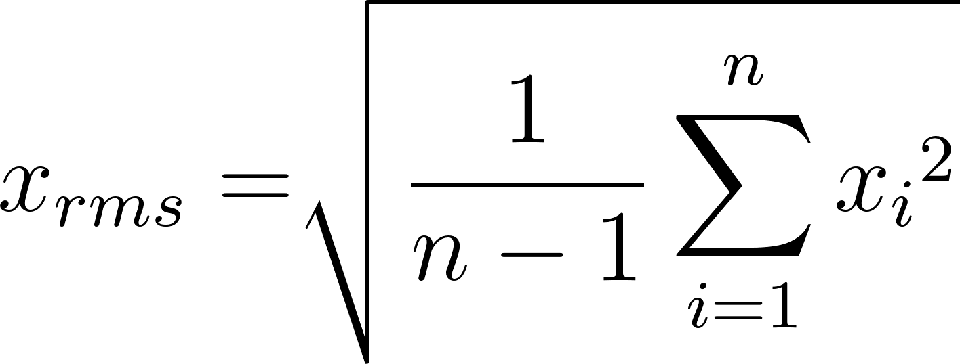
Data Transformations Choice depends on data set!
Center & standardize
Center: subtract from each value the mean of the corresponding vector
Standardize: divide by standard deviation
Mean = 0 and STDEV = 1
Center & scale with the scale() function
Center: subtract from each value the mean of the corresponding vector
Scale: divide centered vector by their root mean square (rms):
Mean = 0 and STDEV = 1
Log transformation
Rank transformation: replace measured values by ranks
No transformation

Slide 6
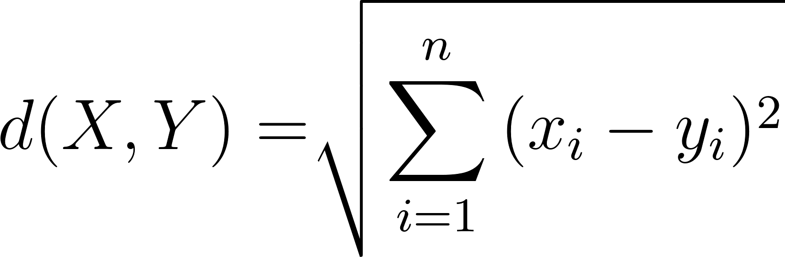
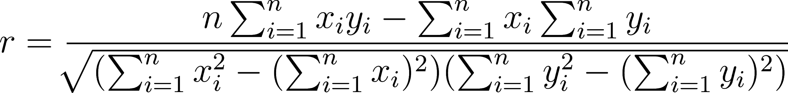
Distance Methods Lists only most common ones!
Euclidean distance for two profiles X and Y
Disadvantages: not scale invariant, not for negative correlations
Maximum, Manhattan, Canberra, binary, Minowski, ...
Correlation-based distance: 1 - r
Pearson correlation coefficient (PCC)
Disadvantage: outlier sensitive
Spearman correlation coefficient (SCC)
Similar to PCC but with ranked values!

Slide 7
There Are Many More Distance Measures
If the distances among items are quantifiable, then clustering is possible.
Choose the most accurate and meaningful distance measure for a given application.
If uncertain then choose several distance measures and compare the results.

Slide 8
Outline
Introduction
Data Preprocessing
Widely Used Clustering Methods
Hierarchical Clustering
K-Means
Principal Component Analysis
Multidimensional Scaling
Biclustering
Similarity Measures for Clustering Results
Clustering Exercises
References

Slide 9
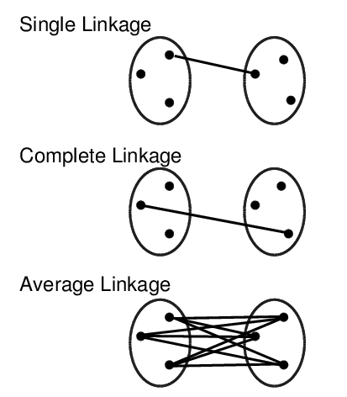
Cluster Linkage

Slide 10
Hierarchical Clustering Algorithm
Example: Hierarchical Clustering [Similar to UPGMA Tree Building!]
Initialization
Assign each item (gene) to its own cluster.
Iteration
Determine the clusters with the smallest distance. If there are several equidistant choices then pick one randomly.
Join these closest clusters to a new (larger) cluster.
Place a node for new cluster at the height corresponding to a predefined distance rule between the joined clusters.
Update distances by computing the distance of the new cluster to all other clusters.
Termination
When only two clusters remain place the root at the height according to the predefined distance rule.

Slide 11
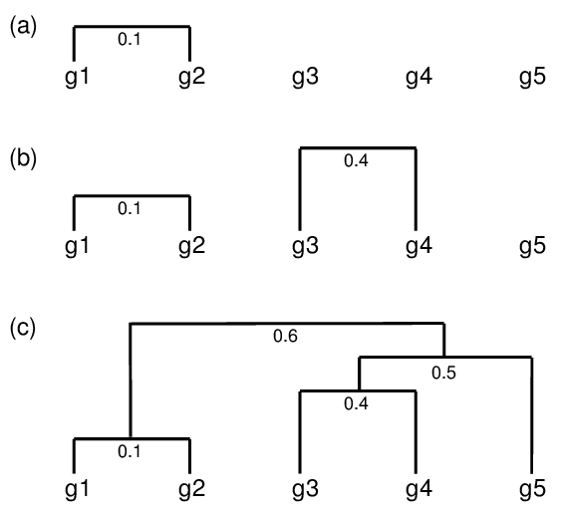
Hierarchical Clustering Agglomerative Approach

Slide 12
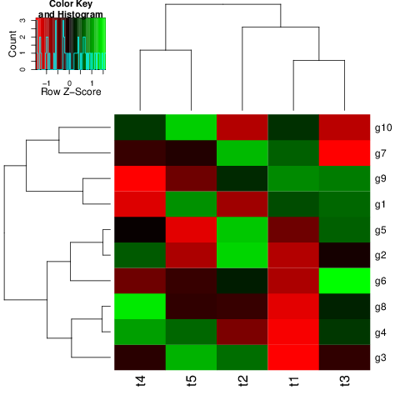
Hierarchical Clustering with Heatmap
A heatmap is a color coded table. To visually identify patterns, the rows and columns of a heatmap are often sorted by hierarchical clustering trees.
In case of gene expression data, the row tree usually represents the genes, the column tree the samples/treatments, while the colors in the heat table represent the gene expression values.

Slide 13
Hierarchical Clustering Approaches
Agglomerative approach (bottom-up)
hclust() and agnes()
Divisive approach (top-down)
diana()

Slide 14
Tree Cutting to Obtain Discrete Clusters
Cut tree by:
Node height in tree
Number of clusters
Search tree nodes by distance cutoff

Slide 15
K-Means Clustering
Choose the number of k clusters
Randomly assign items to the k clusters
Calculate new centroid for each of the k clusters
Calculate the distance of all items to the k centroids
Assign items to closest centroid
Repeat until clusters assignments are stable

Slide 16
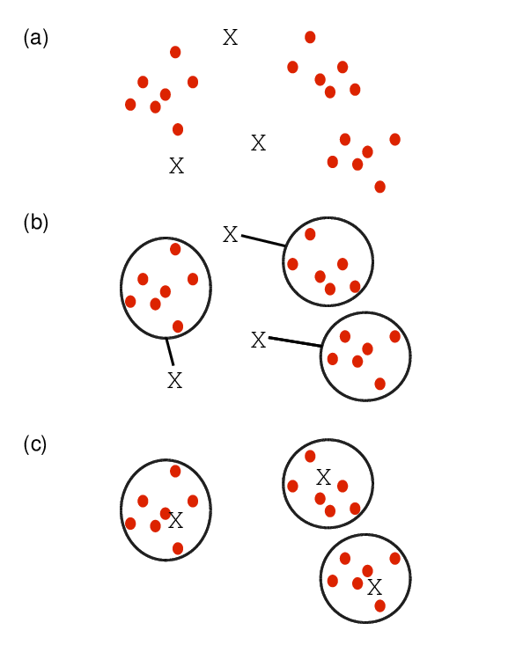
K-Means Clustering

Slide 17
Fuzzy C-Means Clustering
In contrast to strict (hard) clustering approaches, fuzzy (soft) clustering methods allow multiple cluster memberships of the clustered items.
This is commonly achieved by assigning to each item a weight of belonging to each cluster.
Thus, items at the edge of a cluster, may be in a cluster to a lesser degree than items at the center of a cluster.
Typically, each item has as many coefficients (weights) as there are clusters that sum up for each item to one.

Slide 18
Principal Component Analysis (PCA)
Principal components analysis (PCA) is a data reduction technique that allows to reduce multidimensional data sets to 2 or 3 dimensions for plotting purposes and visual variance analysis.

Slide 19
Basic PCA Steps
Center (and standardize) data
First principal component axis
Across centroid of data cloud
Distance of each point to that line is minimized, so that it crosses the maximum variation of the data cloud
Second principal component axis
Orthogonal to first principal component
Along maximum variation in the data
1st PCA axis becomes x-axis and 2nd PCA axis y-axis
Continue process until the necessary number of principal components is obtained

Slide 20
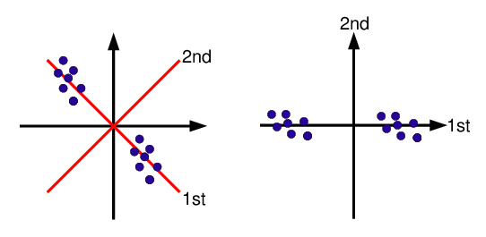
PCA: Two-Dimensional Representation

Slide 21
Identifies the Amount of Variance of Components
Example
Also see FactorMineR package that implements many methods related to PCA
Principal Component | 1st | 2nd | 3rd | Other
Proportion of Variance | 62% | 34% | 3% | rest
1st and 2nd principal components explain 96% of variance.

Slide 22
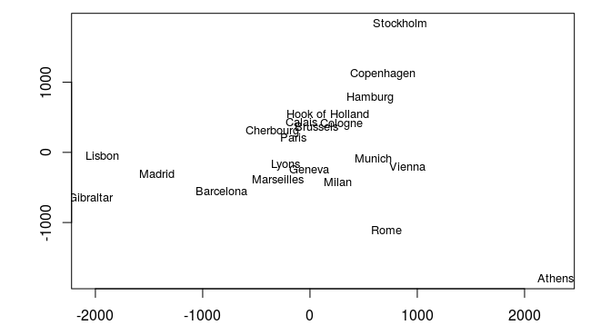
Multidimensional Scaling (MDS)
Alternative dimensionality reduction approach
Represents distances in 2D or 3D space
Starts from distance matrix (PCA uses data points)
Example: cmdscale()

Slide 23
tSNE: t-Distributed Stochastic Neighbor Embedding
Alternative dimensionality reduction approach to PCA and MDS
tSNE is a non-linear dimensionality reduction algorithm used for exploring high-dimensional data. It maps multi-dimensional data to two or more dimensions suitable for human observation.
tSNE often achieves better resolution than PCA
See tsne package on CRAN

Slide 24
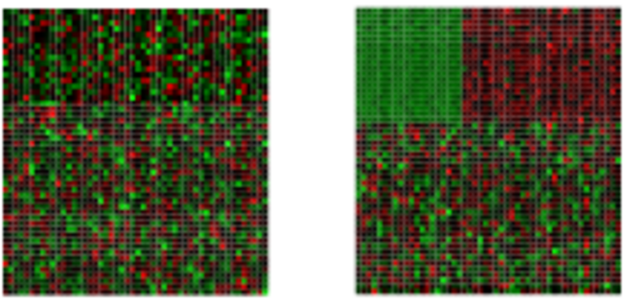
Biclustering
Finds in matrix subgroups of rows and columns which are as similar as possible to each other and as different as possible to the remaining data points.
Unclustered Clustered

Slide 25
Similarity Measures Among Clustering Results
Example: Jaccard Index
Compare the numbers of identical and unique item pairs appearing in cluster sets
Achieved by counting the number of item pairs found in both clustering sets (a) as well as the pairs appearing only in the first (b) or the second (c) set.
With this a similarity coefficient, such as the Jaccard index, can be computed. The latter is defined as the size of the intersect divided by the size of the union of two sample sets: a/(a+b+c).
In case of partitioning results, the Jaccard Index measures how frequently pairs of items are joined together in two clustering data sets and how often pairs are observed only in one set.
Related coefficients are the Rand Index and the Adjusted Rand Index. These indices also consider the number of pairs (d) that are not joined together in any of the clusters in both sets.

Slide 26
Outline
Introduction
Data Preprocessing
Widely Used Clustering Methods
Hierarchical Clustering
K-Means
Principal Component Analysis
Multidimensional Scaling
Biclustering
Similarity Measures for Clustering Results
Clustering Exercises
References

Slide 27
Why Clustering and Data Mining in R?
Efficient data structures and functions for clustering
Reproducible and programmable
Comprehensive set of hundreds of clustering and machine learning packages
Integration with many other data analysis tools
Useful Links
Cluster Task Views
Machine Learning Task Views
UCR Cluster Manual

Slide 28
Online Tutorial
Continue here!

Slide 29
References
Krishnapuram R, Joshi A, Nasraoui O, Yi L (2001) Low-complexity fuzzy relational clustering algorithms for Web mining. IEEE-FS 9: 595–607
Hathaway RJ, Bezdek JC, Pal NR (1996) Sequential Competitive Learning and the Fuzzy c-Means Clustering Algorithms. Neural Netw 9: 787–796
Prelić A, Bleuler S, Zimmermann P, Wille A, Bühlmann P, Gruissem W, Hennig L, Thiele L, Zitzler E (2006) A systematic comparison and evaluation of biclustering methods for gene expression data. Bioinformatics 22: 1122–1129

