Slide 1
Biological Functional Annotation of a set of genes
Gene Set Enrichment Analysis & Over-Representation Analysis
Zongcheng Li @LLLab
生信小课堂II期-08
2018/08/14
Notes:
探索性分析中最常用的方法

Slide 2
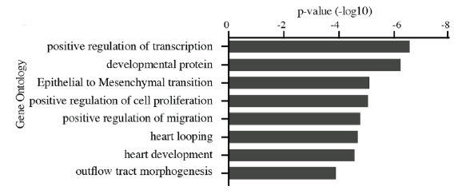
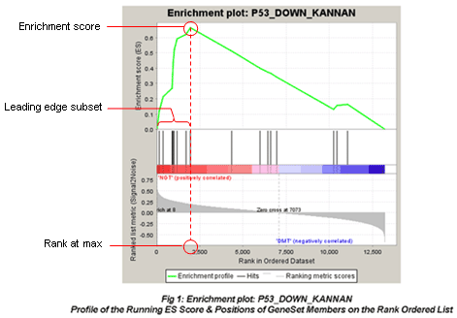
Assign biological significance to the cell populations/clusters
Marker genes (Signature genes, Specific genes)
Over-Representation Analysis (eg. GO analysis)
A group of genes (eg. Differentially Expressed Genes, DEGs)
Gene Ontology, etc.
clusterProfiler, metascape.org, etc.
GSEA (PNAS, 2005)
Comparison between two clusters
all genes, ordered and scored by Signal2Noise (default)
KEGG, MSigDB (Molecular Signatures Database), etc.
算法细节：http://www.gsea-msigdb.org/gsea/doc/subramanian_tamayo_gsea_pnas.pdf
GSEA参考手册：http://www.gsea-msigdb.org/gsea/doc/GSEAUserGuideFrame.html
GSEAjava, clusterProfiler, etc.
Notes:
统计算法进行简单介绍，细节不详述，重点放在工具的使用。

Slide 3
Use the tools
David (https://david.ncifcrf.gov)
Metascape (http://metascape.org/gp/index.html)
GSEAjava
clusterProfiler
topgo

Slide 4
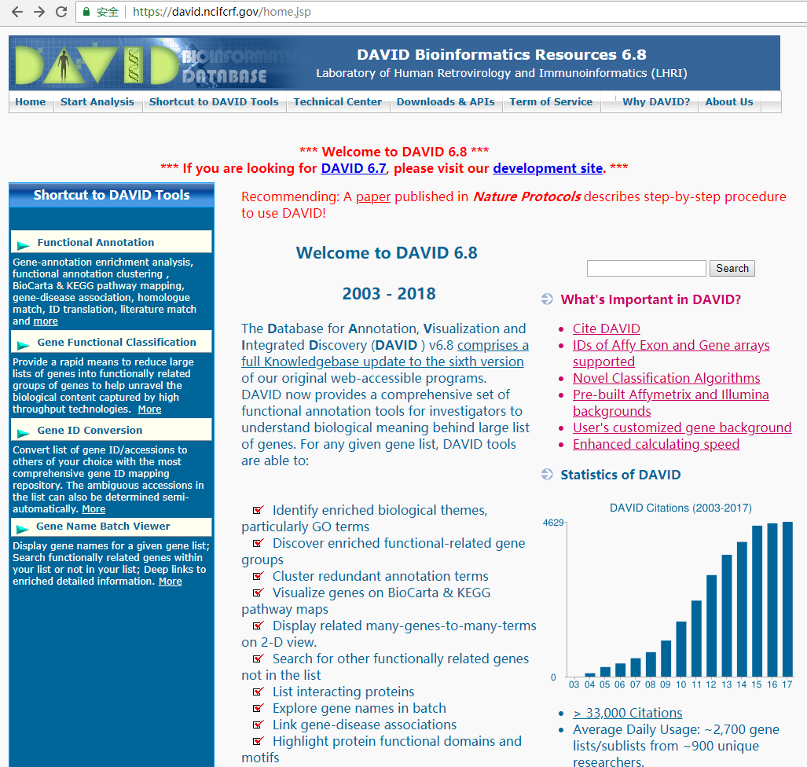
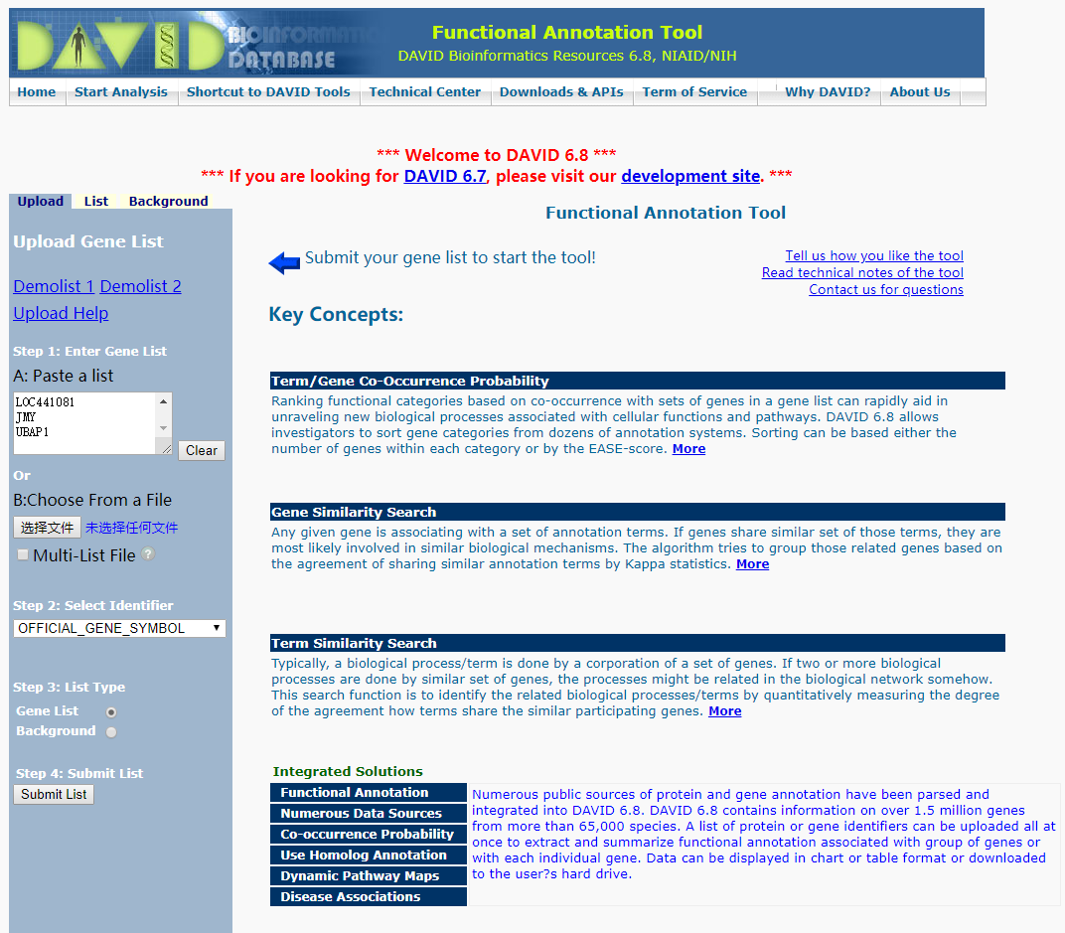
David

Slide 5
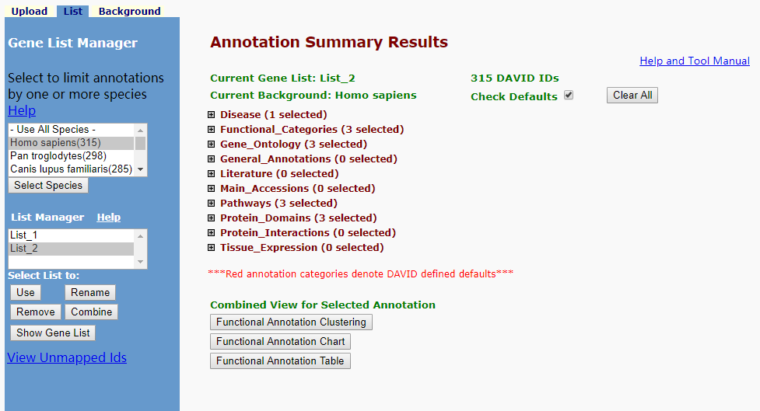
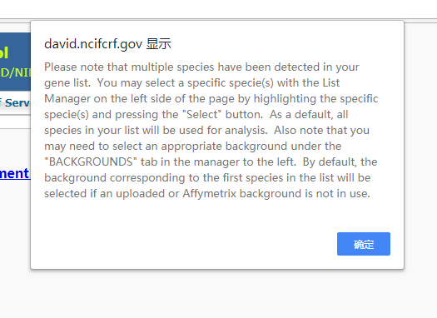
David: 319 DEGs of C5_Lymphatic

Slide 6
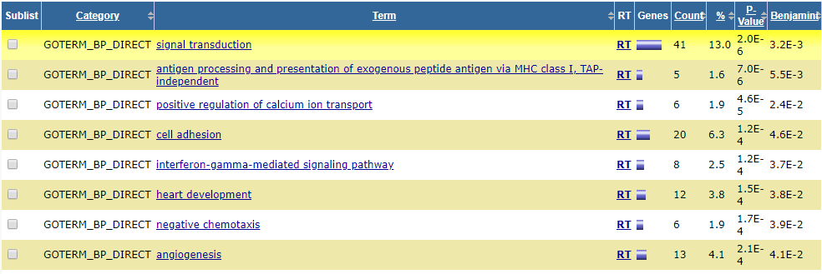
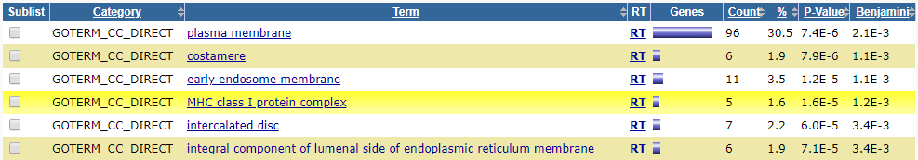
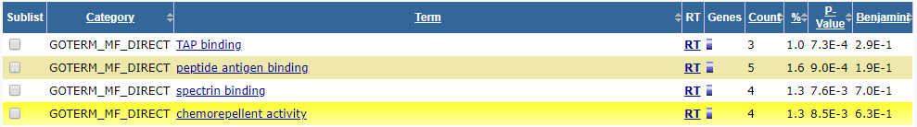
Biological
Process
Cellular
Component
Molecular
Function

Slide 7
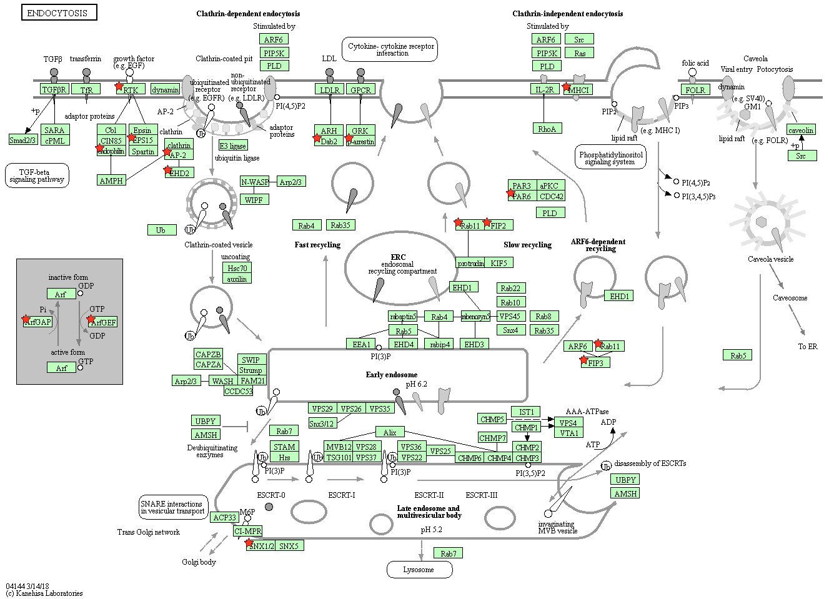

Slide 8
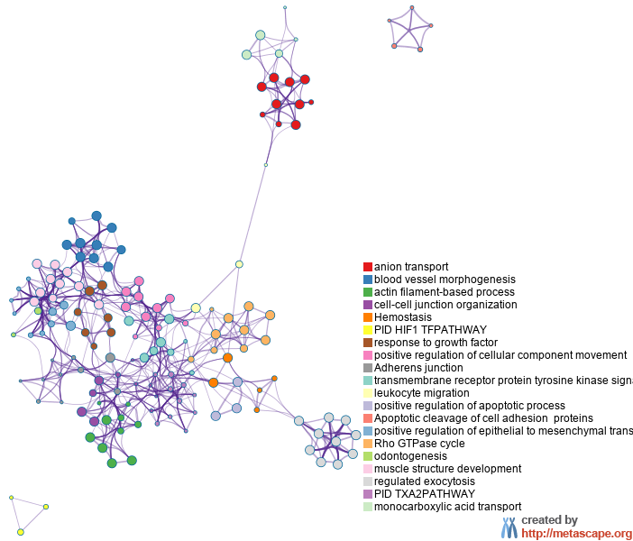
metascape.org

Slide 9
GSEAjava
write.gsea <- function(expr, annot, filename.prefix = "gsea", add.sys.time = T){
suffix <- ifelse(add.sys.time, Sys.time(), "")
filename.dataset <- paste(filename.prefix, suffix, "txt",sep = ".")
expr <- expr[,rownames(annot)]
dataset <- cbind(rownames(expr), NA, expr)
colnames(dataset)[1:2] <- c("Name", "Description")
write.table(dataset, file = filename.dataset, quote = F, sep = "\t", row.names = F)
sapply(colnames(annot), function(x){
label <- unique(annot[,x])
filename.pheno <- paste(filename.prefix, x, suffix, "cls",sep = ".")
write(paste(length(annot[,x]), length(label), 1, sep = " "), file = filename.pheno)
write(paste("#", paste(label, collapse = " "), sep = " "), file = filename.pheno, append = T)
write(paste(annot[,x], collapse = " "), file = filename.pheno,append = T)
#unlink(filename.pheno)
return()
})
return()
}

Slide 10
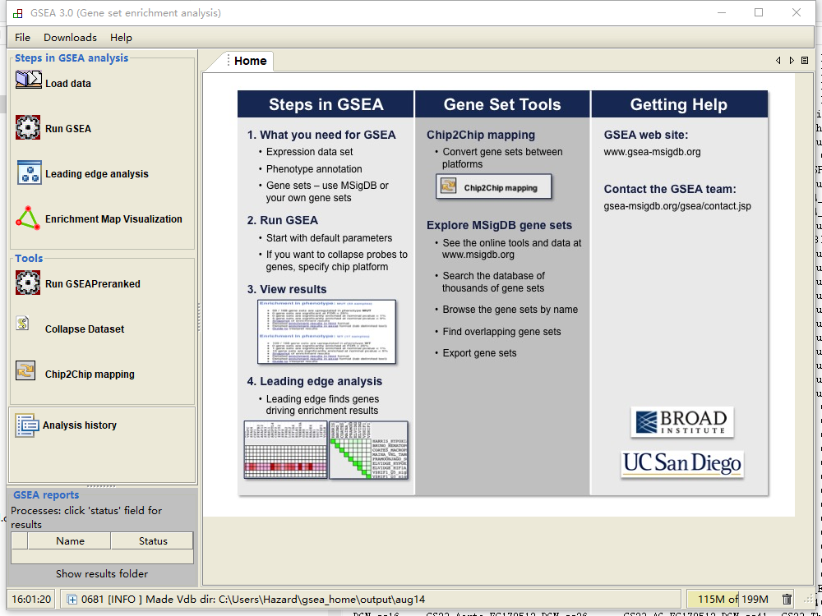
Notes:
http://www.gsea-msigdb.org/gsea/doc/GSEAUserGuideFrame.html

Slide 11
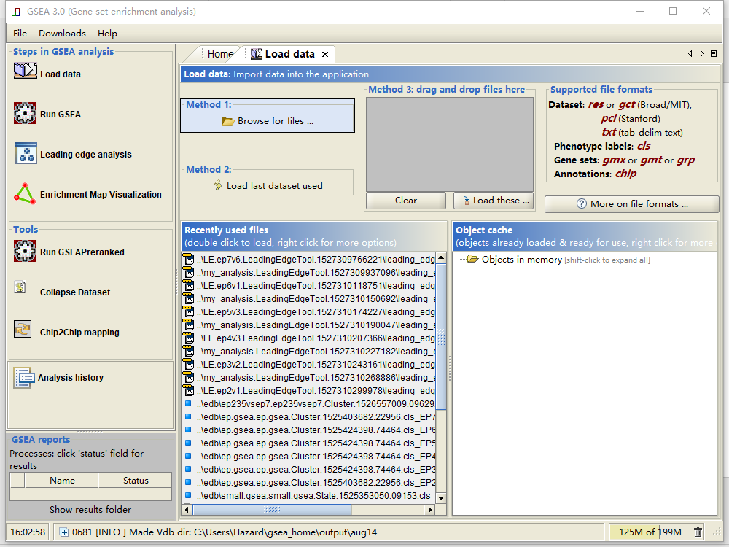
Notes:
http://www.gsea-msigdb.org/gsea/doc/GSEAUserGuideFrame.html

Slide 12
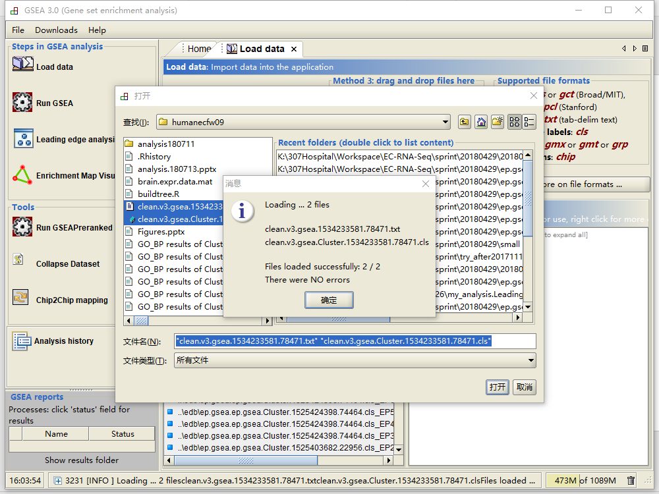
Notes:
http://www.gsea-msigdb.org/gsea/doc/GSEAUserGuideFrame.html

Slide 13
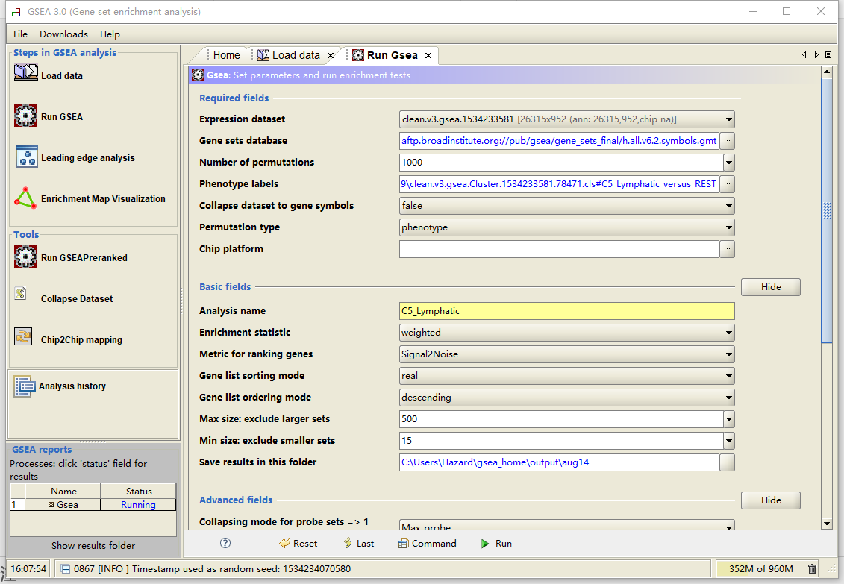
Results
Notes:
http://www.gsea-msigdb.org/gsea/doc/GSEAUserGuideFrame.html

Slide 14
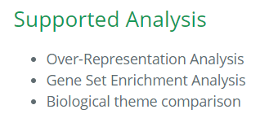
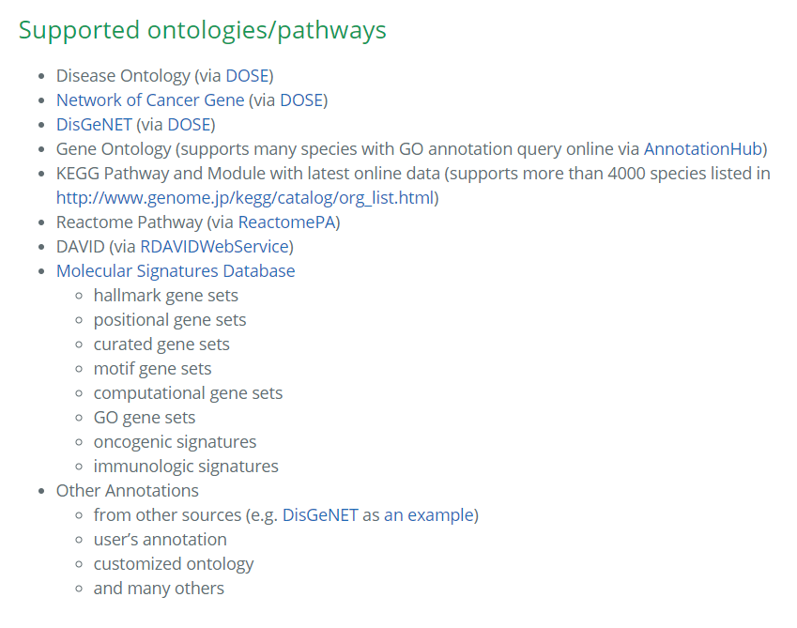
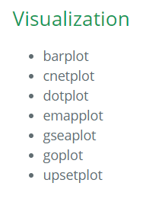
clusterProfiler analyze and visualize functional profiles of genomic coordinates (supported by ChIPseeker), gene and gene clusters.

Slide 15
clusterProfiler
To Rstudio

Slide 16
Thanks. Learn Something.
Zongcheng Li
2018/08/14

