Slide 1
Capstone Project
Part 1: Pitch & Problem Statement

Slide 2
Idea 1:
Predicting competence in a foreign language
Problem Statement:
Applications for degree courses linked to European languages have fallen by almost a quarter in the past five years, and applications to other language courses have dropped by almost a fifth (source, Press Association analysis).
Q: Would it make a difference if we could predict competence in a foreign language?

Slide 3

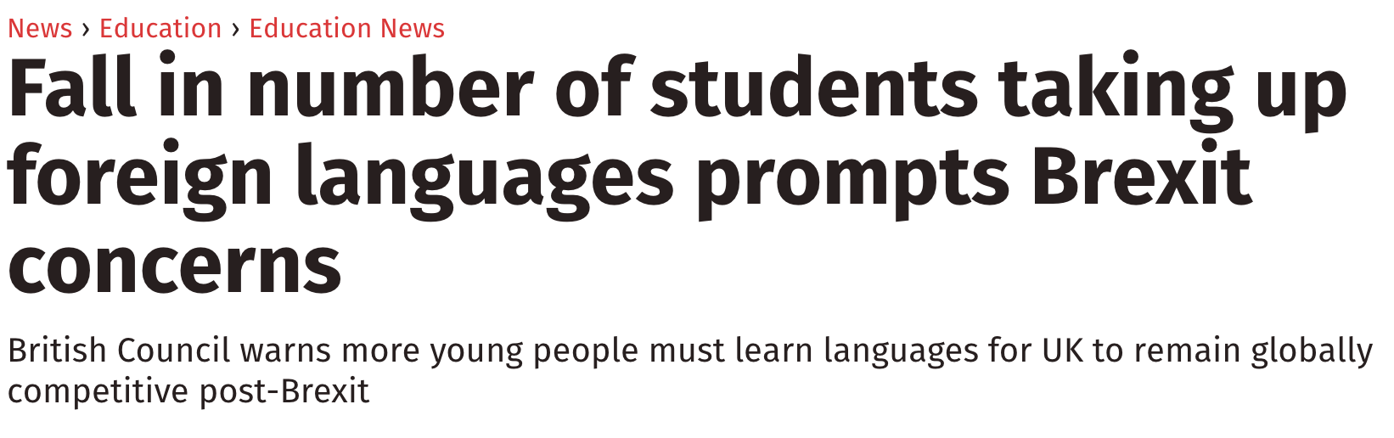
What’s the point when everyone speaks English anyway?
And one thing Baroness Coussins didn’t mention:
- goodwill*
* (because after Brexit, we are going to need all the goodwill we can get)

Slide 4

Idea 1:
Audience & Goals
Target Audience:
Schools/boards of education who need justification for funding in targeted areas
Students who need justification of the factors leading to success in order to continue studying languages
Goal:
A model that can predict the achievement of competence in a foreign language on the basis of variable factors (ie. not moving to the country in question or being adopted by bilingual parents)

Slide 5
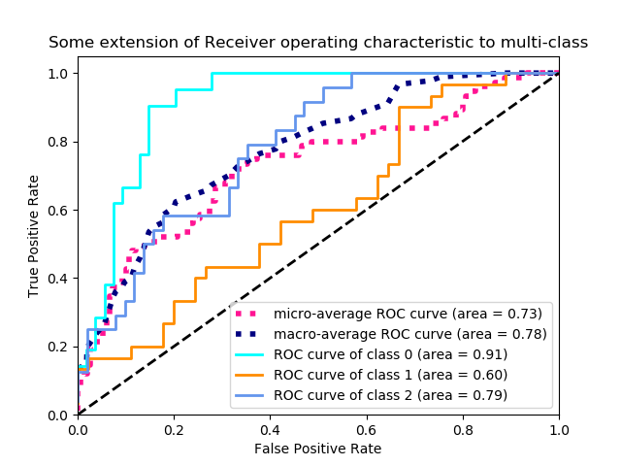
Idea 1:
Success Metrics & Data
Success Metrics:
Accuracy
Recall
ROC Curve
Data Source:
European Survey on Language Competences (ESLC) conducted by the Centre for Research on Education and Lifelong Learning

Slide 6
Idea 2:
Predicting YouTube video content from comments
Before anyone says anything...

Slide 7
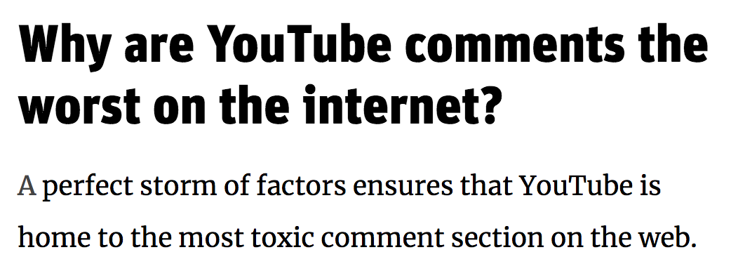
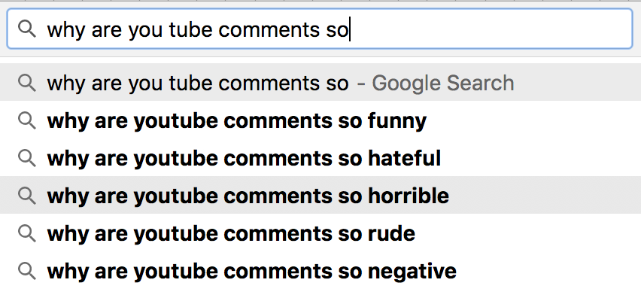
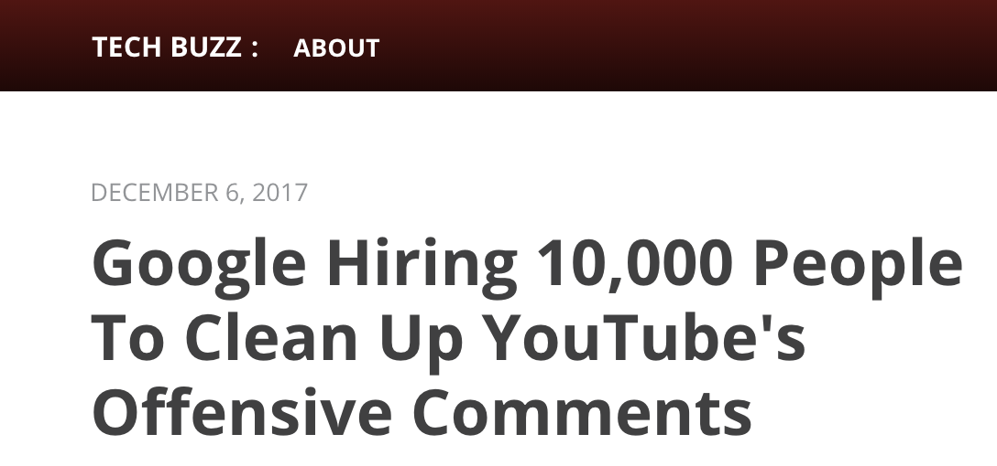
We all know the YouTube comment section is a dark place...
… but could there be a way to minimise negative feedback?

Slide 8
Idea 2:
Predicting YouTube video content from comments
Problem Statement:
YouTube comments are notoriously negative BUT I consistently find one category of vids with little to no negative commentary - dance.
Rather than removing negative videos/comments, can you promote the positive?
Q: Is there a key to avoiding negative commentary on YouTube?

Slide 9
Idea 2:
Audience & Goals
Target Audience:
Social media platforms who could promote content with a positive message
Socialmedialites who need guidance on avoiding the dark side of social media presence
Goal:
A model that can predict the (particularly positive) content of YouTube videos on the basis of comments/interaction with the site

Slide 10
Idea 2:
Success Metrics & Data
Success Metrics:
Accuracy
Recall
ROC Curve
Data Source:
YouTube API
YouTube Analytics API

Slide 11
Risks & Challenges
Language Investigation:
The best predictors may turn out to be non-variable features
Built on the assumption that a higher level of competence leads to continued study
The model should predict performance in languages other than English
YouTube Investigation:
I could be completely wrong and there is no positive content anywhere on YouTube

Slide 12
Thank you
Liz Spiking
DSI5

