Slide 1

Butterfly-Wasp Model Saturday, November 9, 2019
Designed by Huisheng Zhu, Ran Tao, and Zeman Li
Coach: Christina Lee

Slide 2
Overview
Restatement of the Problem
Assumptions
Model Design
Models
Simulation, Results & Analysis
Conclusion

Slide 3
Restatement of Our Problem
Female butterfly's pheromone release attracts many males (P. Brassicae)
Male butterfly release a chemical signal called “anti-aphrodisiacs " to disrupt other males
Wasps, the butterfly egg parasitoid, could detect the A.A.
When a female butterfly has a higher level of A.A., Wasps are more likely to find and eat their eggs

Slide 4
Our assumptions
1. This is an idealized ecosystem focusing solely on wasps and butterflies.
2. All wasps possess the same parasitic strategy
3. Ratio of female P. brassicae to male P. brassicae is 1:1 and probability of giving birth to a male progeny is 50%.

Slide 5
Model Design
What is Best for the system? What is likely to happen in the long run?
Goal: find α (the amount of a.a. secreted by one male butterfly) to maximize B (butterfly population) in the long run

Slide 6

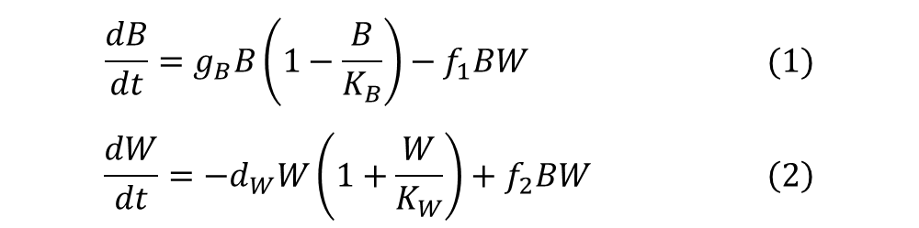

Model Design
$$\frac{dB}{dt}=g_{B}B\left(1−\frac{B}{K_{B}}\right)−f_{1}BW (1)$$
$$\frac{dW}{dt}=−d_{W}W\left(1+\frac{W}{K_{W}}\right)+f_{2}BW \left(2\right)$$
The established Lotka-Volterra Model fits well into our simulated situation of the competition between butterflies and wasps
Based on the classic LV Model, we introduce the influence of anti-aphrodisiacs
$d_{W}$ = 0.57 (Southon et al., 2015)

Slide 7

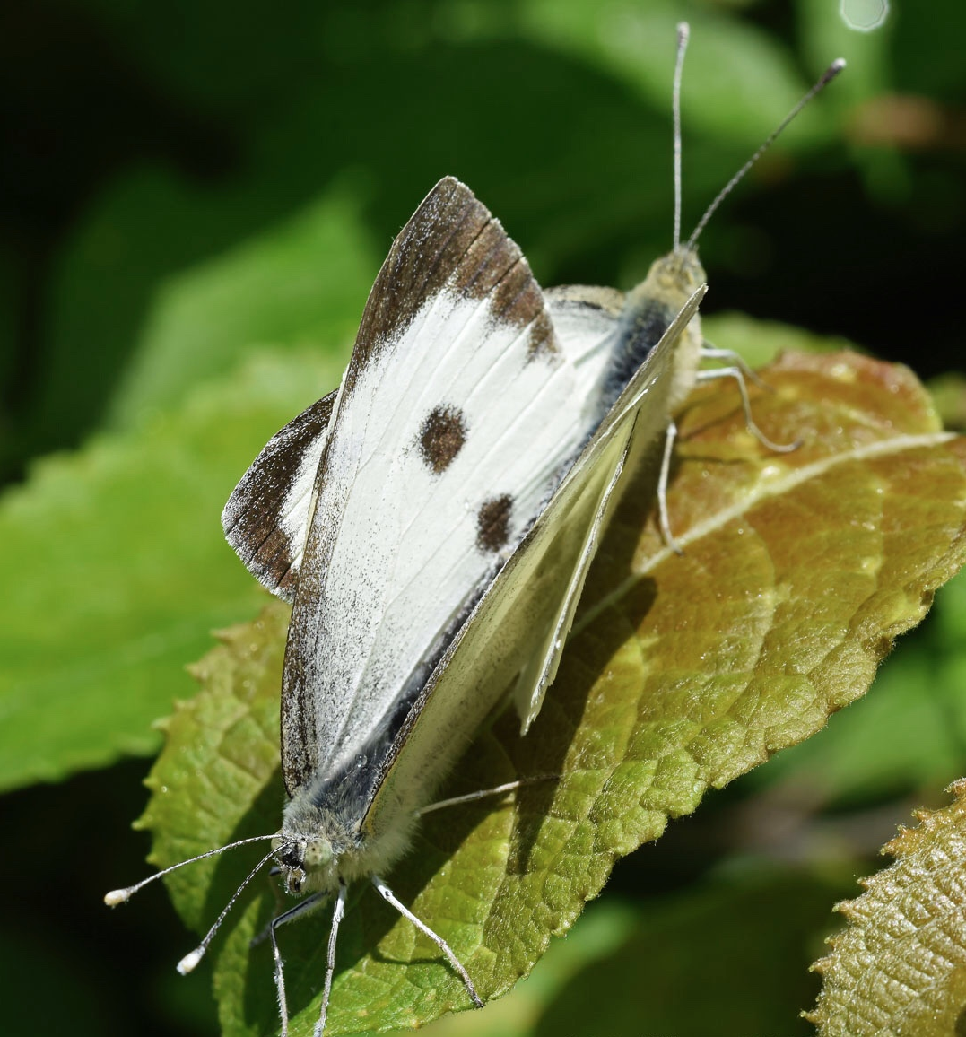

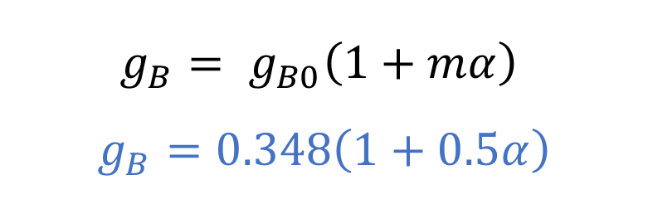
Interactions of Male & Female P. brassicae
$$g_{B}= g_{B0}\left(1+mα\right)$$
$$g_{B}=0.348\left(1+0.5α\right)$$
$g_{B0}$: the natural growth rate of butterflies without a.a. =
0.348 (Southon et al., 2015)
$m$: the effectiveness of a.a. in helping female butterflies lay their eggs
α: the amount of a.a. secreted by one male butterfly ($μg$)
$g_{B}:t$he growth rate of butterflies with a.a.

Slide 8
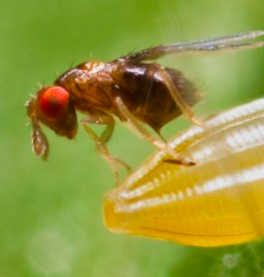



Interactions of Butterflies & Parasitic Wasps
$$f_{1}= f_{10}\left(1+hα\right)$$
$$f_{2}= f_{20}\left(1+hα\right)$$
$$f_{1}=0.01\left(1+0.5α\right)$$
$$f_{2}=0.005\left(1+0.5α\right)$$
$f_{10}$: butterflies’ natural mortality factor without a.a.
h: the effectiveness of a.a. in helping wasps eat the eggs = 0.5 (Fatouros et al., 2005)
α: the amount of a.a. secreted by one male butterfly ($μg$)
$f_{1}$: butterflies’ mortality factor by supplying eggs to wasps
$f_{20}$: wasps’ natural growth factor without a.a.
$f_{2}$: wasps’ growth factor by consuming host butterfly eggs

Slide 9
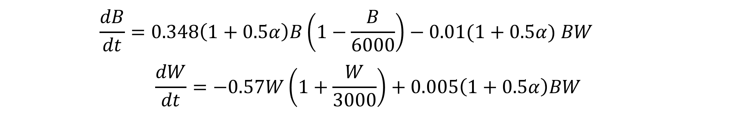

The Model
$$\frac{dB}{dt}=0.348\left(1+0.5α\right)B\left(1−\frac{B}{6000}\right)−0.01(1+0.5α) BW$$
$$\frac{dW}{dt}=−0.57W\left(1+\frac{W}{3000}\right)+0.005\left(1+0.5α\right)BW$$
Initial conditions
$$B\left(0\right)=2000$$
$$W\left(0\right)=500$$

Slide 10
Simulation, Results & Analysis
Alpha = 0

Slide 11
Simulation, Results & Analysis
Characteristics of Our Simulation (h = 0.5, alpha = 0)
Butterfly reaches its minimum around Day 5
As the wasp population remains at a high level, butterfly population starts to recover
A cyclical repeat
Equilibrium population or fixed point

Slide 12
Simulation, Results & Analysis
Alpha = 0.78

Slide 13
Simulation, Results & Analysis
Alpha = 0
Explanation
When h change from from 0.5 to 0.05, the alpha of maximum equilibrium population change from 0 to 0.78
Possible explanation from the viewpoint of evolution
"Interestingly, this behavior is innate in T. brassicae, whereas T. evanescens learns it after one successful ride on a mated female butterfly" (Huigens et al., 2010).
Alpha = 0.78

Slide 14
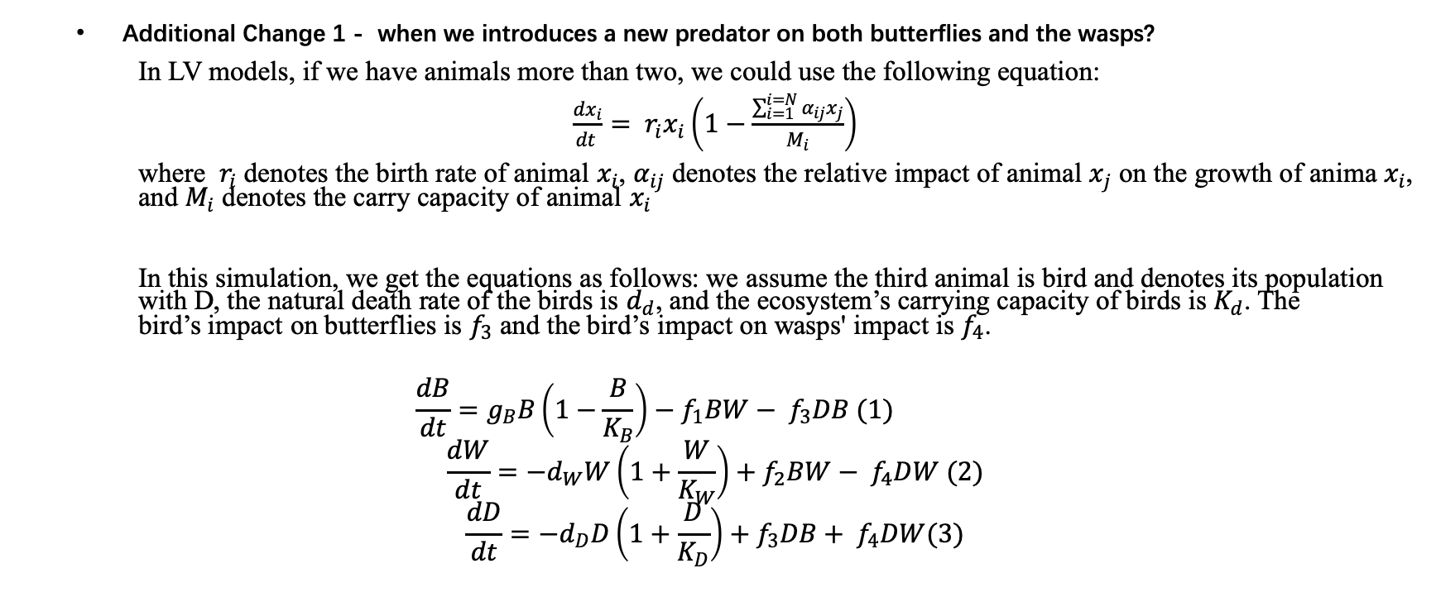
Additional Issues
Additional Change 1 - when we introduces a new predator on both butterflies and the wasps?
In LV models, if we have animals more than two, we could use the following equation:
$\frac{dx_{i}}{dt }= r_{i}x_{i}\left(1−\frac{\sum_{i=1}^{i=N}{α_{ij}x_{j}}}{M_{i}}\right)$
where $r_{i}$ denotes the birth rate of animal $x_{i}$, $α_{ij}$ denotes the relative impact of animal $x_{j}$ on the growth of anima $x_{i}$, and $M_{i}$ denotes the carry capacity of animal $x_{i}$
In this simulation, we get the equations as follows: we assume the third animal is bird and denotes its population with D, the natural death rate of the birds is $d_{d}$, and the ecosystem’s carrying capacity of birds is $K_{d}$. The bird’s impact on butterflies is $f_{3}$ and the bird’s impact on wasps' impact is $f_{4}$.
$$\frac{dB}{dt}=g_{B}B\left(1−\frac{B}{K_{B}}\right)−f_{1}BW− f_{3}DB (1)$$
$$\frac{dW}{dt}=−d_{W}W\left(1+\frac{W}{K_{W}}\right)+f_{2}BW− f_{4}DW (2)$$
$$\frac{dD}{dt}=−d_{D}D\left(1+\frac{D}{K_{D}}\right)+f_{3}DB+ f_{4}DW(3)$$

Slide 15
Additional Issues
Alpha = 0
Additional Change 2 - when we introduces a new predator on both butterflies and the wasps?
Female butterfly’s strategy depends on the trade-offs of releasing anti-aphrodisiac.
Under condition that h = 0.5, female prefers to mate with males that have low propensity to releasing a.a.
Under condition that h = 0.05, when alpha range from 0 to 0.78, female prefers to mate with the male that higher propensity to release a.a.
Alpha range from 0 to 0.78

Slide 16
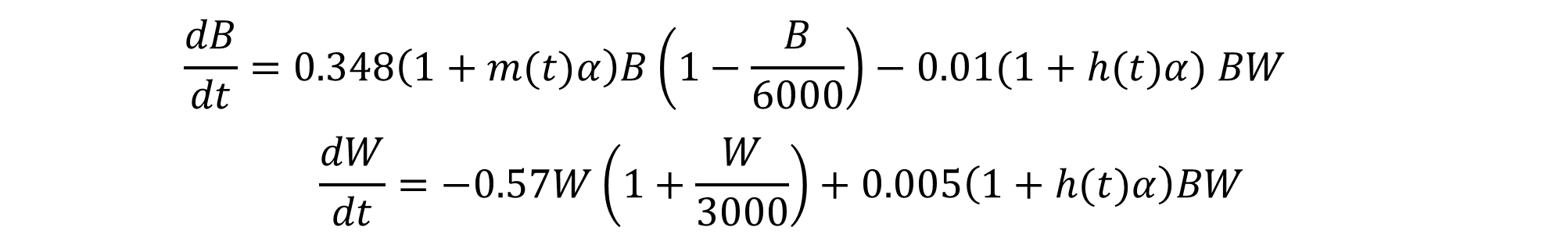
Additional Issues
Additional Change 3 – what if effectiveness of a.a. depends on time of day?
$$\frac{dB}{dt}=0.348\left(1+m(t)α\right)B\left(1−\frac{B}{6000}\right)−0.01(1+h(t)α) BW$$
$$\frac{dW}{dt}=−0.57W\left(1+\frac{W}{3000}\right)+0.005\left(1+h(t)α\right)BW$$
Initial conditions
$$B\left(0\right)=2000$$
$$W\left(0\right)=500$$

Slide 17
Reference
Huigens, M. E., Woelke, J. B., Pashalidou, F. G., Bukovinszky, T., Smid, H. M., & Fatouros, N. E. (2010). Chemical espionage on species-specific butterfly anti-aphrodisiacs by hitchhiking Trichogramma wasps. Behavioral Ecology, 21(3), 470-478.
Southon, R. J., Bell, E. F., Graystock, P., & Sumner, S. (2015). Long live the wasp: adult longevity in captive colonies of the eusocial paper waspPolistes canadensis(L.). PeerJ, 3. doi: 10.7717/peerj.848
Fatouros, N. E., Huigens, M. E., Loon, J. J. A. V., Dicke, M., & Hilker, M. (2005). Butterfly anti-aphrodisiac lures parasitic wasps. Nature, 433(7027), 704–704. doi: 10.1038/433704a

Slide 18
THE END

