Slide 1
Static Routing Implementation
Cisco Confidential

Slide 2
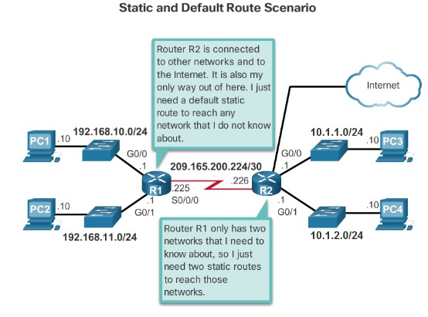
Reach Remote Networks
Static Routing
A router can learn about remote networks in one of two ways:
Manually - Remote networks are manually entered into the route table using static routes.
Dynamically - Remote routes are automatically learned using a dynamic routing protocol.
RIP v2
EIGRP
OSPF
Cisco Confidential

Slide 3
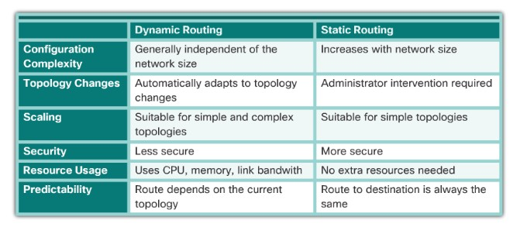
Why Use Static Routing?
Static Routing
Static routing provides some advantages over dynamic routing, including:
Static routes are not advertised over the network, resulting in better security.
Static routes use less bandwidth than dynamic routing protocols, no
CPU cycles are used to calculate and communicate routes.
The path a static route uses to send data is known.
Cisco Confidential

Slide 4
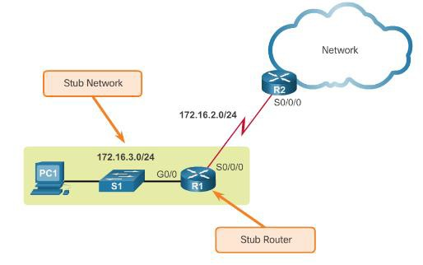
When to Use Static Routes
Static Routing
Static routing has three primary uses:
Providing ease of routing table maintenance in smaller networks.
Routing to and from stub networks. A stub network is a network
accessed by a single route, and the router has no other neighbors.
Using a single default route to represent a path to any network that does not have a more specific match with another route in the routing table.
Cisco Confidential

Slide 5
Static Route Applications
Types of Static Routes
Static Routes are often used to:
Connect to a specific network.
Provide a Gateway of Last Resort for a stub network.
Reduce the number of routes advertised by summarizing several contiguous networks as one static route.
Create a backup route in case a primary route link fails.
Cisco Confidential

Slide 6
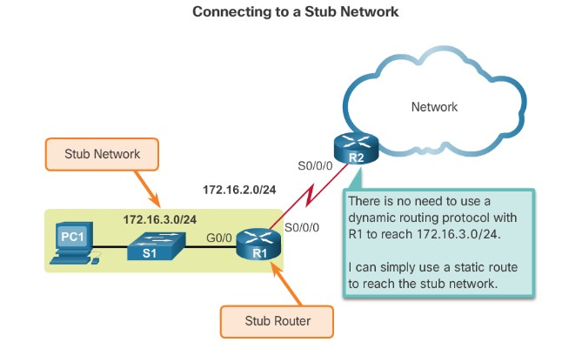
Types of Static Routes
Standard Static Route
Cisco Confidential

Slide 7
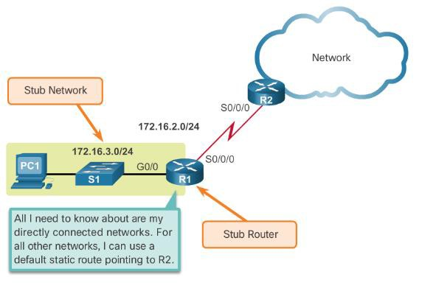
Default Static Route
Types of Static Routes
A default static route is a route that matches all packets.
A default route identifies the gateway IP address to which the router
sends all IP packets that it does not have a learned or static route.
A default static route is simply a static route with 0.0.0.0/0 as the destination IPv4 address.
© 2008 Cisco Systems, Inc. All rights reserved. Cisco Confide
ntial

Slide 8
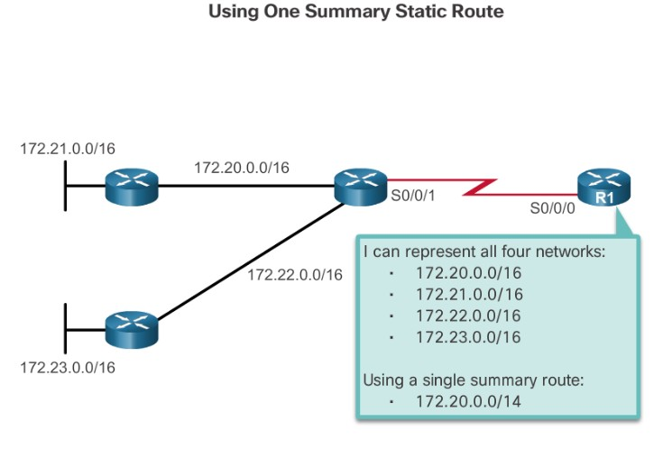
Types of Static Routes
Summary Static Route
Cisco Confidential

Slide 9
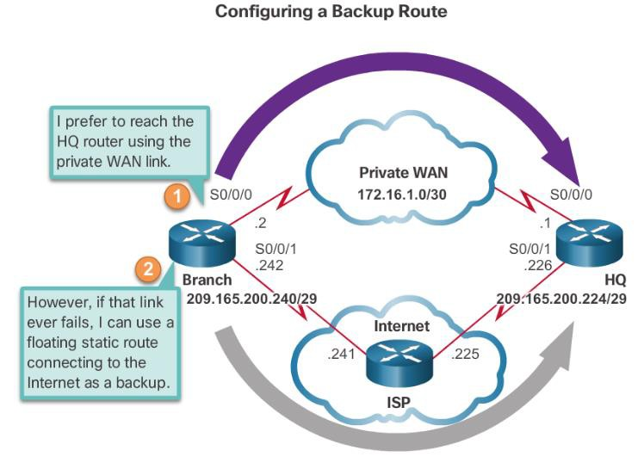
Types of Static Routes
Floating Static Route
Cisco Confidential

Slide 10
6.2 Configure Static and Default Routes
Cisco Confidential

Slide 11
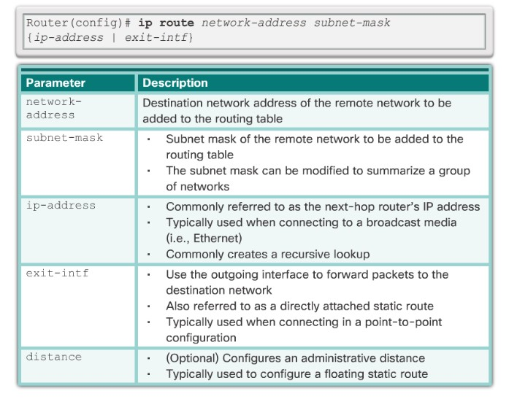
Configure IPv4 Static Routes
ip route Command
Cisco Confidential

Slide 12
Next-Hop Options
Configure IPv4 Static Routes
The next hop can be identified by an IP address, exit interface, or both. How the destination is specified creates one of the three following route types:
Next-hop route - Only the next-hop IP address is specified.
Directly connected static route - Only the router exit interface is specified.
Fully specified static route - The next-hop IP address and exit interface are specified.
Cisco Confidential

Slide 13
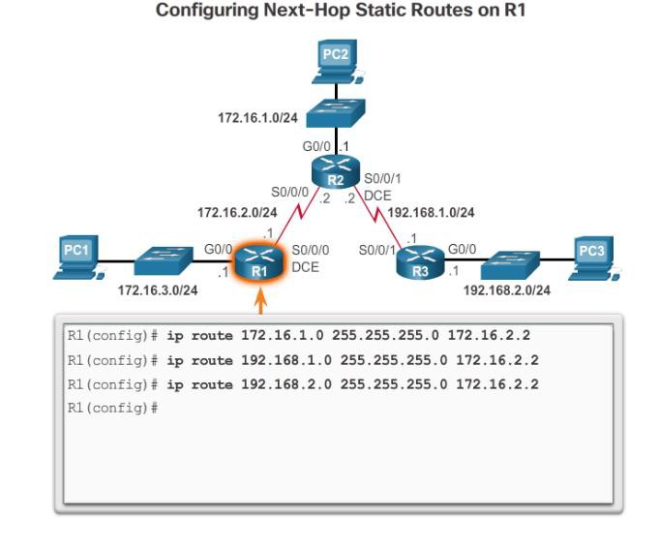
Configure IPv4 Static Routes
Configure a Next-Hop Static Route
Cisco Confidential

Slide 14
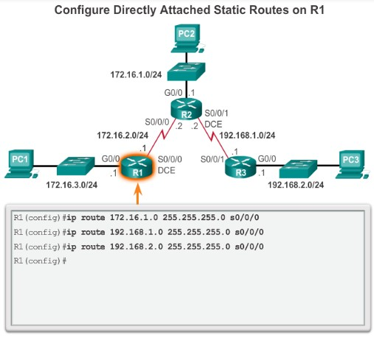
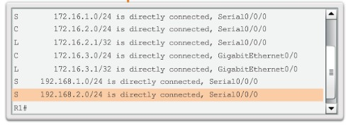
Configure IPv4 Static Routes
Configure Directly Connected Static Route
Cisco Confidential

Slide 15
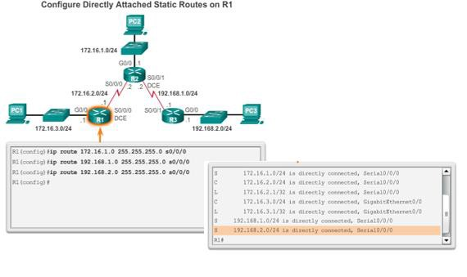
Configure IPv4 Static Routes
Configure a Fully Specified Static Route
Cisco Confidential

Slide 16
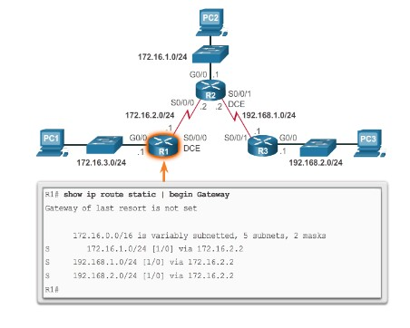
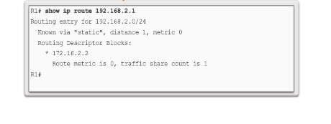

Configure IPv4 Static Routes
Verify a Static Route
Cisco Confidential

Slide 17
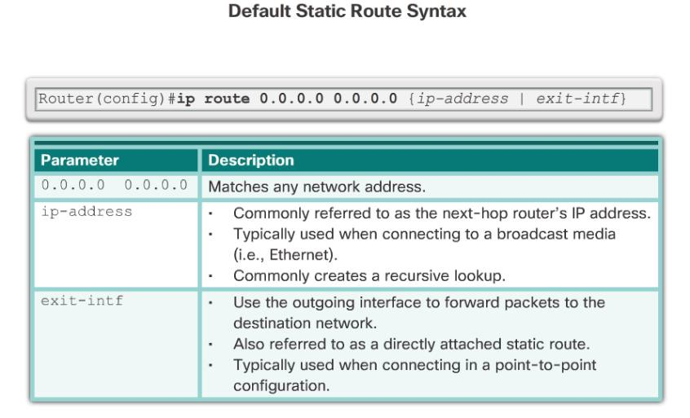
Configure IPv4 Static Routes
Default Static Route
Cisco Confidential

Slide 18
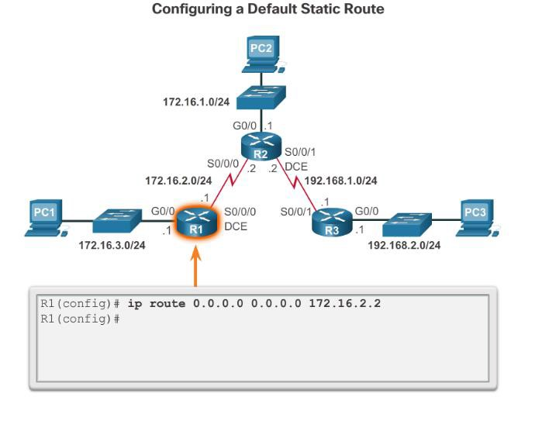
Configure IPv4 Static Routes
Configure a Default Static Route
© 2008 Cisco Systems, Inc. All rights reserved. Cisco Confidential

Slide 19
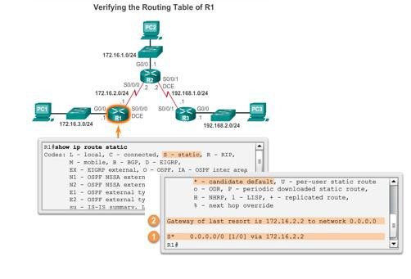
Configure IPv4 Static Routes
Verify a Default Static Route
Verify a Default Static Route Verify a Default Static Route
Cisco Confidential

