Slide 1
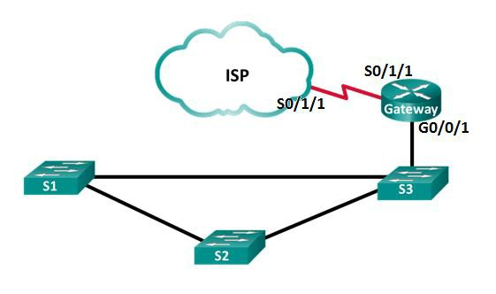
Lab 10.1.2.5 - Configure CDP and LLDP

